Slide 1
Team name
Name of the team: RAP Team
Names of team members | Fractal ID
1 Prateek Jain | F02519
2 Ragul Bhagwanth | F02073
3 Ashish Cherian | F01171

Slide 2
Problem statement
Goal of the study is to create a model that predicts if a client will default on credit card payment in next month.
To find the predictability of a defaulter our main objective is to find what features can play an important role to predict a credit card defaulter? Therefore we may need to find answers to some questions like:
1. Is the % of defaulters significantly different between male & female ?
2. How does Marital Status effect the proportion of defaulters ?
3. Does the Level of Education play a role in the % of defaulters ?
4. Which age group constitutes for higher proportion of defaulters ?
5. Is the number of defaulters correlated with credit limit ?
6. Is there a pattern in past repayment statuses which can help predict probability of a defaulter ?
7. Does the history of credit card bill amount has a correlation with the % of defaulters ?
The Analysis is divided into 3 main sections namely:
1. Initialize Libraries, Load Data & Preprocess
2. Exploratory Data Analysis and Visualization
3. Predictive Modelling

Slide 3
Data description
Data Set Information: The training data contains 22500 observations with the predictor variables as well as the response variable. The test set contains 7500 observations with the response variable removed.
Variable descriptions:
This research employed a binary variable, default payment (Yes = 1, No = 0), as the response variable. This study reviewed the literature and used the following 23 variables as explanatory variables:
- X1: Amount of the given credit (NT dollar): it includes both the individual consumer credit and his/her family (supplementary) credit.
- X2: Gender (1 = male; 2 = female).
- X3: Education (1 = graduate school; 2 = university; 3 = high school; 4 = others).
- X4: Marital status (1 = married; 2 = single; 3 = others).
- X5: Age (year).
- X6 - X11: History of past payment. We tracked the past monthly payment records (from April to September, 2005) as follows:
- X6 = the repayment status in September, 2005;
- X7 = the repayment status in August, 2005; . . .;
- X11 = the repayment status in April, 2005. The measurement scale for the repayment status is:
-1 = pay duly;
1 = payment delay for one month;
2 = payment delay for two months; . . .;
8 = payment delay for eight months;
9 = payment delay for nine months and above.
-2 indicates no consumption in the month, and a value of
0 indicates the use of revolving credit (equivalent to prepayment)
- X12-X17: Amount of bill statement (NT dollar).
- X12 = amount of bill statement in September, 2005;
- X13 = amount of bill statement in August, 2005; . . .;
- X17 = amount of bill statement in April, 2005.
- X18-X23: Amount of previous payment (NT dollar).
- X18 = amount paid in September, 2005;
- X19 = amount paid in August, 2005; . . .;
- X23 = amount paid in April, 2005.

Slide 4
Data cleaning and preprocessing steps
The Data is loaded into Pandas DataFrames.
The Data did not have a meaningful header & the actual Header was part of Data, fix_header function fixes the header.
The Education column had extra values like 5,6,0 which were not classified , Converted these values to 4 i.e. Others
The Marriage column had extra values 0 which were not classified Converted these values to 3 i.e. Others.
Renamed Target value column to a shorter name DEFAULTER.
Create 6 more features as part of Feature Engineering.
Tools used
Stage | Tool(s)
Data cleaning and preprocessing | Python
EDA and insight generation | Python pandas, numpy
Data visualization | Python matplotloib,searborn
Predictive modelling | Python sklearn
Model delivery | Python

Slide 5
EDA and insights
(use additional slides if necessary)
Data Set does not have any null values hence it is fairly clean
Education column had extra categories unaccounted for since they were small in number changed them to Others
Marriage Column also had extra values changed them to Others as well
Data set does not have any negative AGE values.
From the Train data set we can see 22.61% denote defaulters this data set can be termed as fairly unbalanced, which might not result in a very accurate prediction model.
The distribution of data we cross check with t-SNE visualisation also which shows fairly mixed dataset.
From the correlation matrix we see that PAY_0,PAY_2…columns have high positive correlation to DEFAULTER Column and LIMIT_BAL has high negative correlation to the target ‘DEFAULTER’ variable.
Below are few questions we found needed to be answered to get more in-depth insights into the data.
1. Is the % of defaulters significantly different between male & female ?
Data shows Males are slightly more likely to default.
2. How does Marital Status effect the proportion of defaulters ?
There were more married defaulters compared to singles.
3. Does the Level of Education play a role in the % of defaulters ?
Higher the education level less likely is the person to default
4. Which age group constitutes for higher proportion of defaulters ?
Age group 25-35 has more density of defaulters
5. Is the number of defaulters correlated with credit limit ?
We can see that people with lower credit balance tend to default more
6. Is there a pattern in past repayment statuses which can help predict probability of a defaulter ?
The ratio of defaulters in delinquency bucket 2 or more i.e. with payment delay for 2 or more months are higher.
7. Does the history of credit card bill amount has a correlation with the % of defaulters ?
Higher the Bill amount in most recent months higher is the defaulter rate

Slide 6
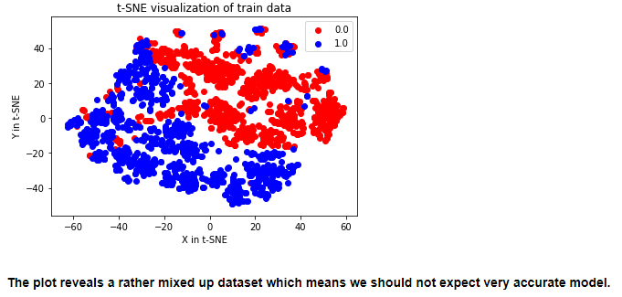
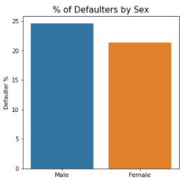

Data visualization
(use additional slides if necessary)

Slide 7
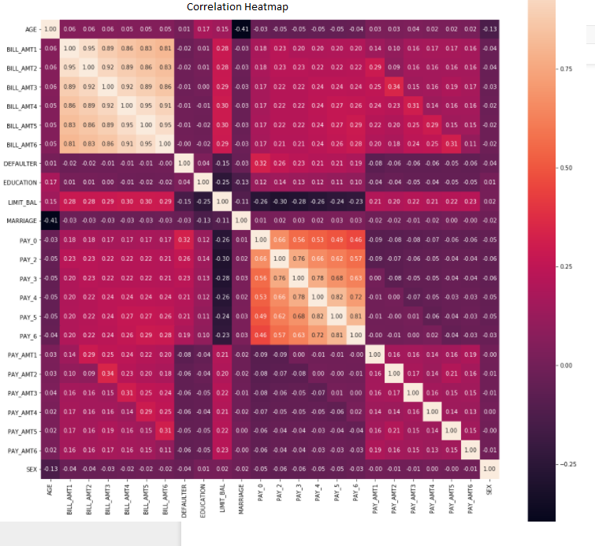
Data visualization
(use additional slides if necessary)

Slide 8
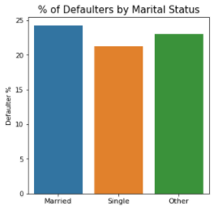
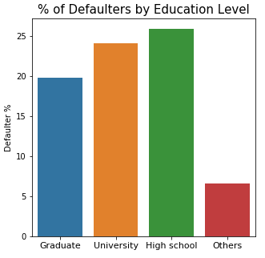

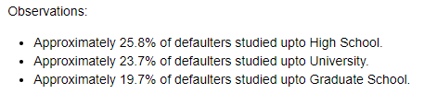
Data visualization
(use additional slides if necessary)

Slide 9
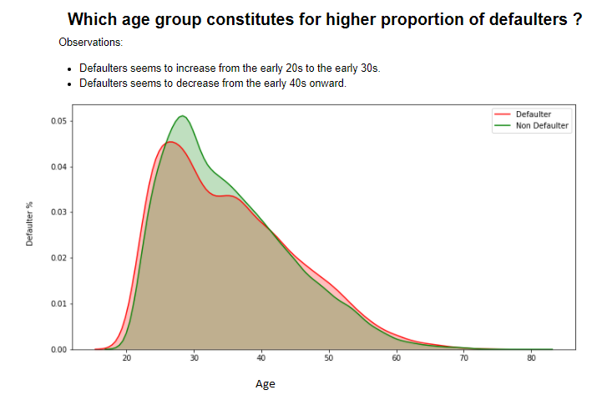
Data visualization
(use additional slides if necessary)

Slide 10
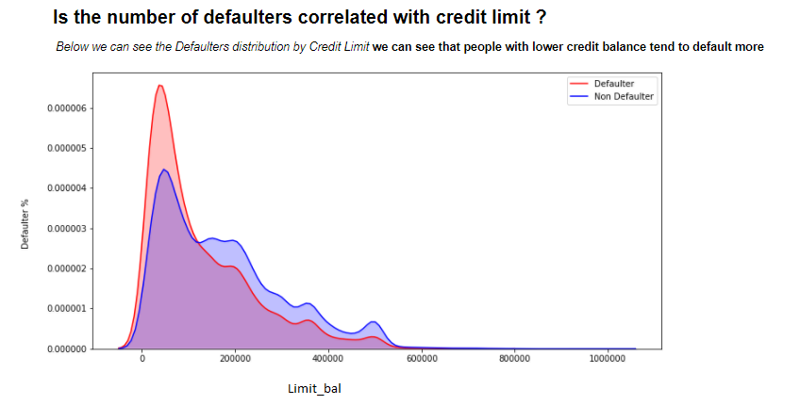
Data visualization
(use additional slides if necessary)

Slide 11
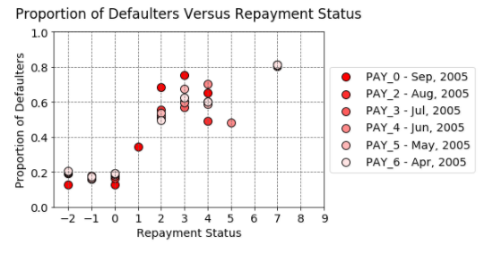
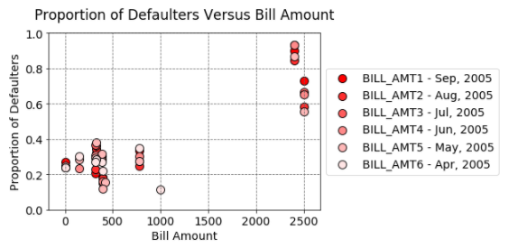
Data visualization
(use additional slides if necessary)

Slide 12
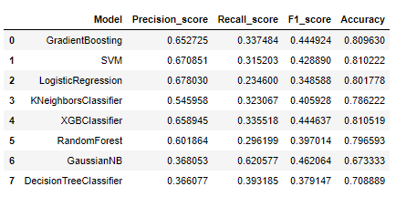
Modelling approaches
Performance metrics
Final model selected
(use additional slides if necessary)
This is a Supervised binary classification problem. Where Defaulter Yes(1) or No(0) is the dependant variable
therefore we can use the classification models
Initially more for the learning purposes we checked the basic model of the below listed classification algorithms.
here is a report of all algorithms we tested with corresponding accuracy, precision, recall, F1 scores
Based on fairly higher accuracy & f1 score we shortlist XGBoost & GradientBoosting models to experiment with.

Slide 13
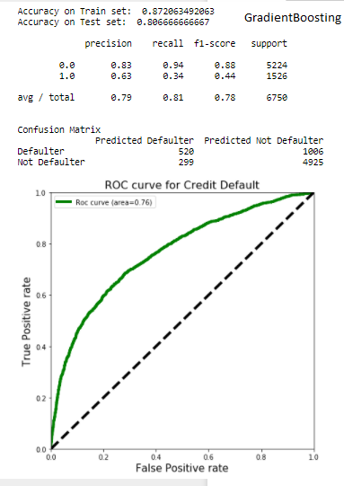
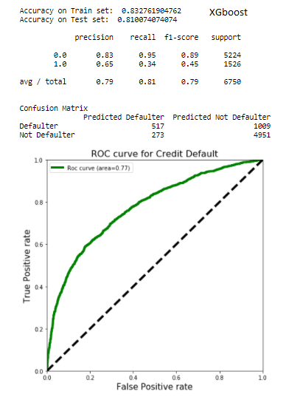
Modelling approaches Performance metrics Final model selected
For Training the models we used gridsearch to tune the model parameters to optimize the training process & get best results.
Based on slightly higher precision, f-score & accuracy we chose XGBoost as the final model for our study.

Slide 14
Model predictions (embed file - .csv)

Slide 15
Code (embed file - .R, .py,. .ipynb,. .txt, etc.)

Slide 16
Interpretation and business implications
Key findings
A history of delayed payment can be a stronger indicator.
Given this data set, personal data alone is insufficient to reliably predict a default. There are significant differences in risk with age and credit limit, but few strong indicators.
Parameter tuning helps a lot for training the models.
Business Implications:
The dataset denotes that the bank has fairly high defaulter rate of 22.61% close to ¼ th roughly. To assess if deploying a model such as this provides any benefits to the bank, we need to compare how much defaults the bank could have prevented versus the cost of effort needed to prevent the defaults. From bank's operation's point of view it creates additional work and associated cost (e.g., slower approvals, unhappy customers, more manpower needed for checking). But looking at the defaulter rate it appears the bank should invest in the approach and be more diligent.

