Slide 1





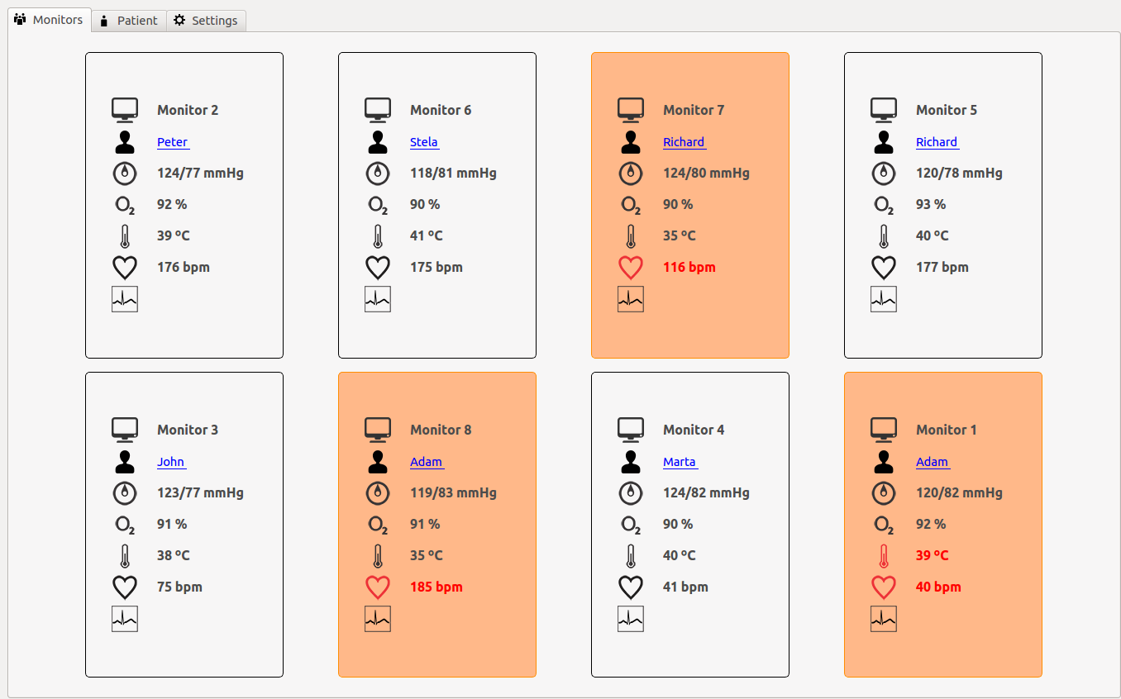
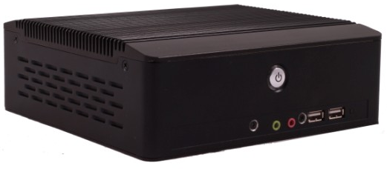
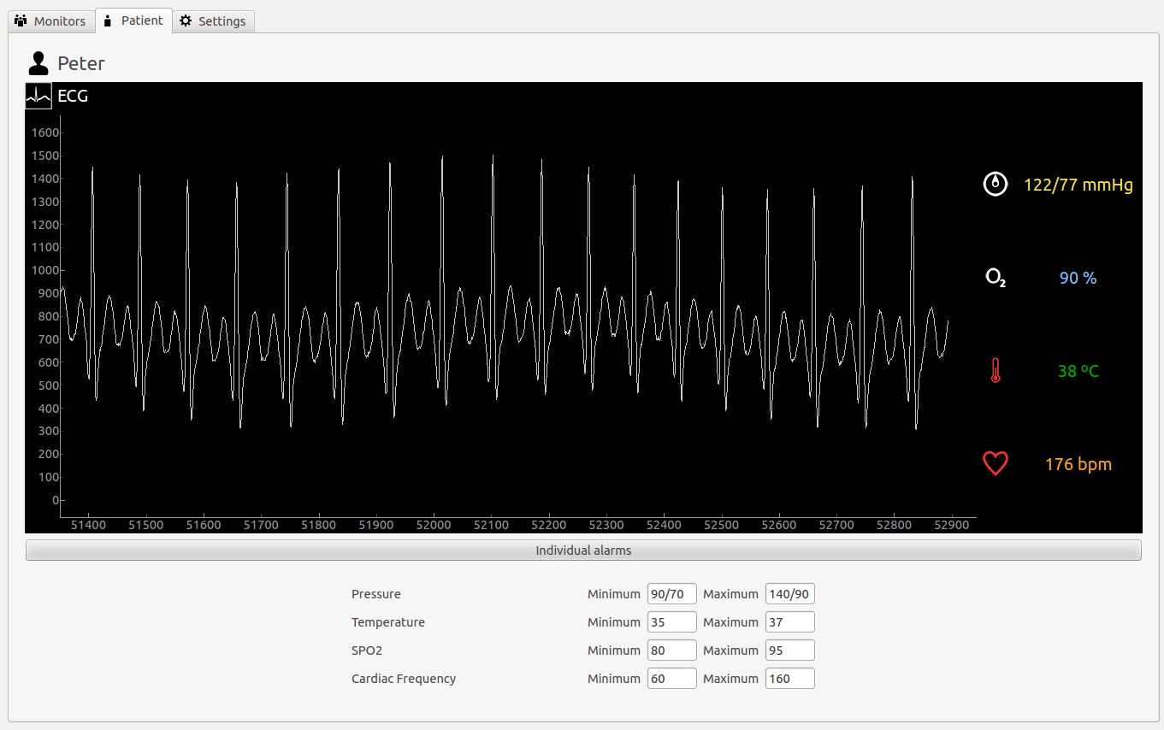
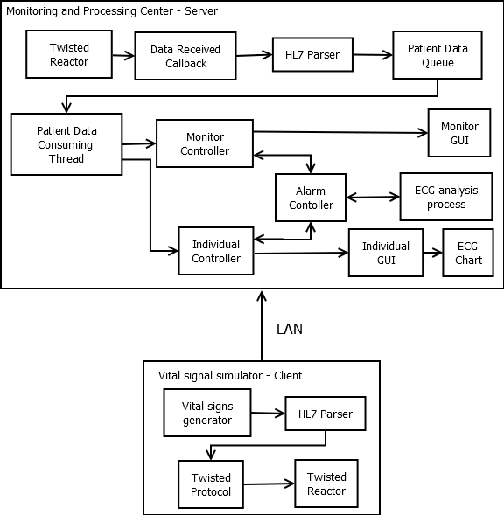


MULTI-PATIENT VITAL SIGNS MONITORING CENTER FOR INTENSIVE CARE UNITS A.N. Silva*, D. T. G. Mariano*, N. D. Linhares*, E. A. Lamounier** *Biomedical Engineering Laboratory **Computer Graphics Laboratory Faculty of Electrical Engineering / Federal University of Uberlândia, Uberlândia, Brazil andrei.ufu@gmail.com, dtgmariano@gmail.com.br, nicolailinhares@gmail.com,
INTRODUCTION
RESULTS
Technology is increasingly present in the medical field, aiming to improve healthcare quality in both diagnosis and treatment. On this scenario, modern Intensive Care Units (ICU) has many devices to support the patient such as multiparameter monitors, mechanical ventilators and infusion pumps, for instance. Thus, it is a rather complex task to analyze all the data that is available at na ICU which monitoring centers tries to solve.
This work aims to develop an embedded ICU monitoring center application that receives data from different monitors via network and processes them to improve patient care.
METHODOLGY
It was chosen the BIS-6630 Cedar-Trail as the motherboard to the develop the embedded application. It has a dual-core Intel Atom N2800 2.13 GHz processor, 2 GB RAM and other important features that met the requirements of the project [2]. Figure 1 shows an image of the motherboard.
Figure 3: Monitoring center main window.
Figure 1: Norco BIS 6630 Cedar Trail.
Python was chosen as programming language, because of syntax simplicity and robustness, taking advantage of the numberous frameworks that is available that could make the development faster and easier. It were used Twisted to handle network communication, SciPy and NumPy for signal processing and PyQt to design the graphical user interfaces (GUI) [3]. Besides these frameworks, API’s were designed to provide the additional functionalities needed.
The project consists of several vital sign simulators that act as clients that can be connected to the monitoring center, who is the server, via network communication. The later is a multithreaded application which receives the incoming data and passes it to a data queue that is consumed by another thread that handles the data and passes events to the GUI to print the information. Additionaly, alarms can be configured and all the medical information has been parsed to HL7 standards [4].
Figure 2 presents the block diagram of the developed system.
Figure 4: Individual patient monitoring.
DISCUSSION AND CONCLUSION
The presented results demonstrated that it was possible to develop an embedded vital sign monitoring application and run it with the BIS 6630. In terms of performance, the application didn’t run smoothly but it had regular performance overall. It was possible to connect up to 8 monitors simultanesouly to the center and all the data transported had its integrity preserved. Several trials were conducted and the system had the expected response most of the time.
Furthermore, it was verified the possibility of developing an ICU monitoring center by using network communication and the use of the HL7 standards to deliver medical information gave a professional approach to this project.
The authors believe that this work has contributed significantly to their technical expertise and knowledgment, being crucial to provide insightful for engineers who are interested into developing new medical devices that are, above all, embedded systems with crital requirements.
ACKNOWLEDGEMENTS
REFERENCES
[1] Marino, P. L., “The ICU book”, 3 ed, 2006.
[2] BIS-6630 reference manual, accessed on: http://www.intel.com.br/content/www/br/pt/intelligent-systems/evaluation-platforms/norco-bis-6630-atom-n2800-development-kit.html.
[3] Lutz, M., “Programming Python”, O’Reilly, 4 ed, 2011.
[4] HL7 manuals, accessed on: http://www.hl7.org/
Figura 2: Block diagram
Notes:
Assuntos:
Region based
Análise estatística
Posicionamento da máscara
Implementação
Testes

