Slide 1
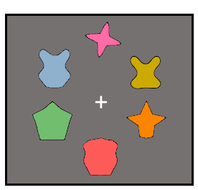





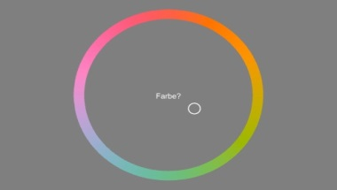




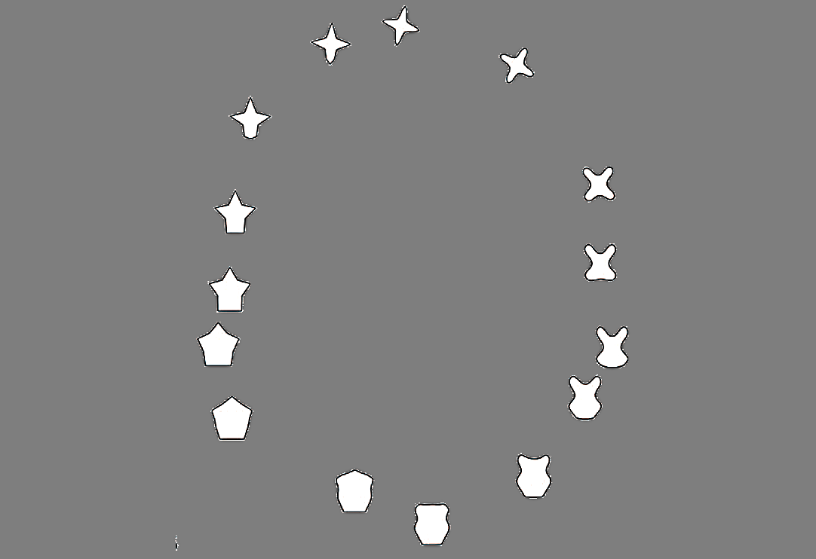

Encoding
Retention interval (2000 ms in total)
Retrieval (unspeeded)
Intrinsic-Intrinsic
Extrinsic-Intrinsic
Intrinsic-Extrinsic
Shape-Color
Location-Color
Color-Location
+
+
+
No disruption
+
500 ms
1000 ms
500 ms
Peripheral
+
+
+
Color-Shape
Location-Shape
Shape-Location
100 ms
Central
+
+
+
+
75 ms
75 ms

