Slide 1
PowerShell Classification
An ML Threat Detection Use Case

Slide 2
Who am I
Derek Thomas
Applied Research Engineer at eSentire
Security Data enthusiast
Twitter: @dth0m
Linkedin: https://www.linkedin.com/in/derthoma/

Slide 3
Agenda
Goal
Why is monitoring PowerShell important?
How the Journey began
Why is a better approach needed?
PowerShell classification approach
Pitfalls
Possible Solutions
Conclusion

Slide 4
Goal
Understand why PowerShell logging is important
Learn from my struggles
Describe the basic process for developing a use case that utilizes machine learning
Start thinking about other tools in your threat detection tool box

Slide 5
Why is it important to monitor PowerShell
PowerShell is everywhere
Can be used in every stage of the attack lifecycle
Utilized significantly in the wild
I am definitely not a PowerShell Expert…
And I can identify malicious code
You can too
Covered the “Why” in depth during my 2017 MiSec Southfield presentation

Slide 6
The Journey Begins
My journey into PowerShell started early 2017 and I presented on the general concepts for MiSec in April
Began with a “simple” request to monitor and alert on malicious PowerShell activity
Created and tested a suite a rules based on suggestions from:
https://malwarearchaeology.squarespace.com/cheat-sheets/
Absolutely awesome resource for ramping up
Rules worked great… at first

Slide 7
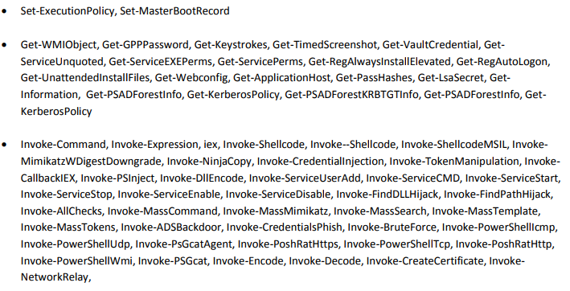
The Journey Begins
I basically created a large list of static rules that match text like:

Slide 8
The Journey Begins
This worked OK but can be noisy
Alerts were tuned to the point the noise was manageable
Initial red team testing triggered the rules
Attempts to obfuscate the code and bypass the rules were very successful
New bypass techniques seemed to pop up daily

Slide 9
The Journey Begins
Second stage of testing involved bypassing rules
Rules were pretty easily bypassed using various strategies
Obscure PowerShell shorthand (everything below does the same thing)
-e
-ec
-enc
-enco
-encod
-encode
-encoded
Obfuscating parameters with .value.toString() and [char]45
Obfuscation frameworks exist like ISESteroids and Invoke-obfuscation to bypass string matching
As I learned more about PowerShell it appeared there was a never ending cycle of creating rules for detecting bad behavior which was then followed by creating rules that detected attempted bypasses

Slide 10
Back to the Drawing Board
While string matching is easily bypassed it is often easy to spot malicious code by eye
& ( $enV:pUBLiC[13]+$eNv:pUBLIC[5]+'X')(""$( SET-ITEm 'VARIAbLE:Ofs' '' )"" + [strINg][cHAr[]](36 ,80,83, 86, 101, 114 , 115, 105,111, 110,84,97 , 98,108 , 101 , 46,80, 83, 86, 101 , 114, 115 , 105,111 , 110)+""$(sET-vARIAbLe 'OFs' ' ')"")
Normal activity does not look like this!
But it is hard to create rules for this type of event

Slide 11
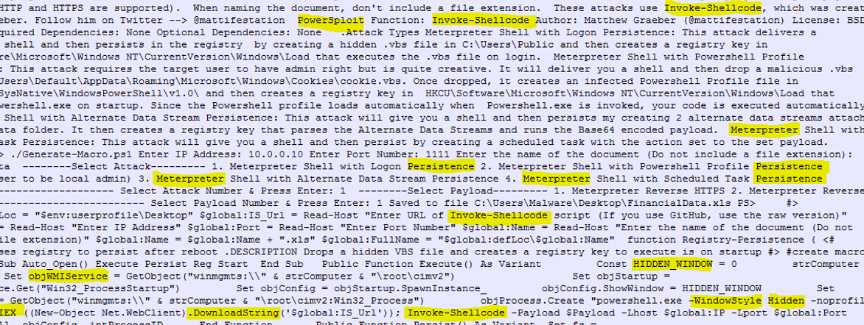
Quantities of Known Suspicious/Malicious Modules
Malicious scripts tend to have a lot of suspicious and or malicious modules

Slide 12
Strange Capitalization
Random capitalization is often used to avoid literal text based matching
Always use case insensitivity whenever possible
Ratio of upper to lower case characters is one possible indicator.
An equal quantity of capital letters and lowercase letters is not normal

Slide 13
Obfuscation
Slightly different than encoding
Obfuscation rearranges, uses find and replace, odd concatenations, and other means to avoid detection
High quantity of concatenation can be an indicator
Known methods of replacement and reordering is an indicator

Slide 14
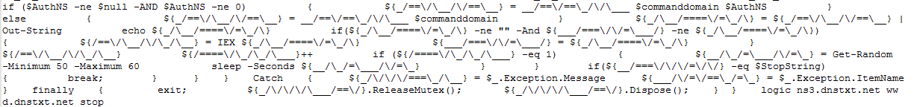
Ratio of Special Characters
Some malware uses complex obfuscation, filtering, reordering, and replacing
High ratio of special characters can be an indicator

Slide 15
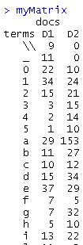
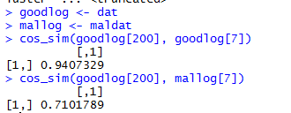
Cosine Similarity
Detects the similarity in two document-term matrices------>
Detailed discussion at http://www.leeholmes.com/blog/2016/10/22/more-detecting-obfuscated-powershell/
Several tests corroborate the findings in the blog.
Similarity value to a known good sample under .80 is suspicious

Slide 16
A Better Approach
Started enumerating high level properties of malicious code
Quantities of known suspicious/malicious modules
Strange Capitalization
Encoding
Obfuscation
Quantity of special characters
Cosine similarity
My co-worker had the idea that this would make a good classification problem
At this point I started treating PowerShell threat detection like an ML classification problem

Slide 17
Machine Learning Classification
What is a classification problem?
Process of taking observations of events like:
Quantities of known suspicious/malicious modules
Strange Capitalization
Encoding
Obfuscation
Quantity of special characters
Cosine similarity
And assigning a label like:
Benign
Suspicious
Using that set of labeled data to develop a model of what is suspicious and what is not
Feeding new events into this model to classify new events as benign or suspicious

Slide 18

ML Classification-Getting Started
I used “SciKit Learn” from http://scikit-learn.org as my main tool for prototyping a proof of concept and developing my initial models

Slide 19
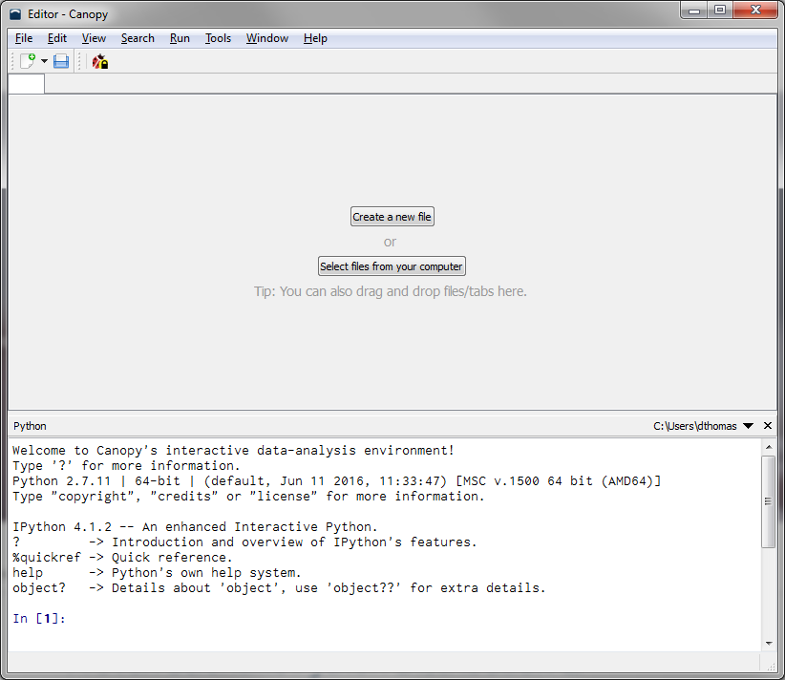
ML Classification-Getting Started
Canopy (https://www.enthought.com/product/canopy/) is an easy to install scientific and analytic package for Windows.
Some packages are difficult to install on Windows.
Now I use Jupyter notebooks since they are better for sharing analysis and are more flexible since many Kernals can be used (python, R, etc.)

Slide 20

ML Classification-Getting Started
I learned the basics of ML from Coursera courses
Numerous out there for Python, R, Scala and more
I learned the basics in R which transferred easily to Python

Slide 21
ML Classification-Getting Started
If you want a great resource for learning the basics of ML then take a look at https://machinelearningmastery.com
Preparing the data is harder than any of the coding that we go through.
Once the data is prepared, the process is basically the “Hello World” of ML
https://machinelearningmastery.com/machine-learning-in-python-step-by-step/

Slide 22
ML Classification-Process
Define the problem
Getting and cleaning data
Evaluate algorithms
Present the results
Tune and update models as necessary

Slide 23
ML Classification-Define the problem
Covered the specifics earlier:
“Classify PowerShell events (suspicious/not suspicious) using high level properties of the event in a manner that generalizes across organizations”

Slide 24
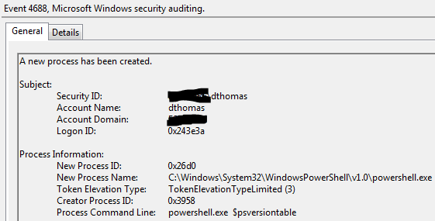
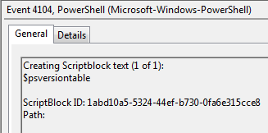
ML Classification-Getting and Cleaning Data
My primary set of data comes from command line logs and Windows PowerShell script block logs

Slide 25
ML Classification-Getting and Cleaning Data
Key step of any classification problem is getting the data in a form that is suitable for learning.
I started by reviewing a large quantity of PowerShell events and splitting them into a file for malicious events and file for benign events
For each event I calculated a vector of values using the properties that I believe could be used for identifying malicious events:
Ratio of uppercase characters to lowercase case characters
Ratio of special characters to total characters
Ratio of alpha characters to total characters
Cosine similarity score as defined by http://www.leeholmes.com/blog/2016/10/22/more-detecting-obfuscated-powershell/
Count of suspicious modules
Count of malicious modules

Slide 26
ML Classification-Getting and Cleaning Data
Sample malicious event:
& ( $enV:pUBLiC[13]+$eNv:pUBLIC[5]+'X')(""$( SET-ITEm 'VARIAbLE:Ofs' '' )"" + [strINg][cHAr[]](36 ,80,83, 86, 101, 114 , 115, 105,111, 110,84,97 , 98,108 , 101 , 46,80, 83, 86, 101 , 114, 115 , 105,111 , 110)+""$(sET-vARIAbLe 'OFs' ' ')"")
Derive values for different properties:
U/L Ratio | Spec Ratio | Alpha Ratio | Cos Score | Susp Mod | Mal Mod | Label
1.77272727273, | 0.173553719008, | 0.252066115702, | 0.360638728938, | 0, | 0, | 1

Slide 27
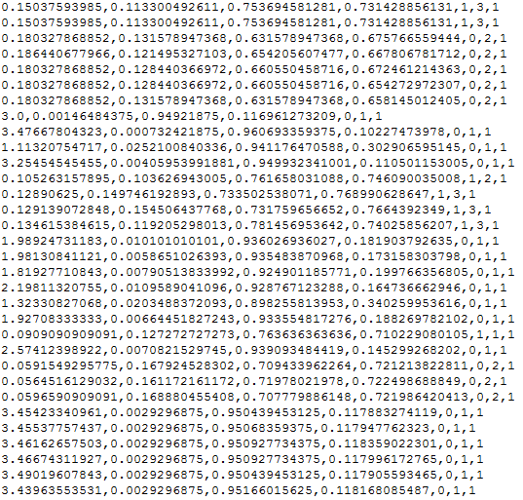
ML Classification-Getting and Cleaning Data
Convert all of the raw data (PowerShell events) into these predictors and labels:

Slide 28
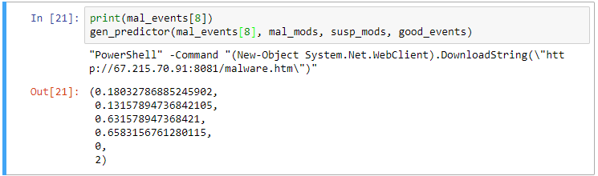
ML Classification-Getting and Cleaning Data
Sample malicious event with calculated predictors

Slide 29
ML Classification-Getting and Cleaning Data
Calculate the predictors, append a label, and save the data
Process a file of known good samples followed by a file of known bad samples to make labeling easy and save in text file predictors.txt
Load the data from predictors.txt and store in a numpy array once the data is processed

Slide 30
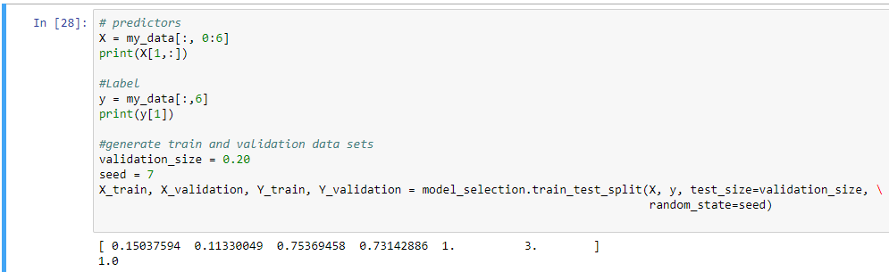
ML Classification-Getting and Cleaning Data
Now we are almost ready to start experimenting with ML models
Separate the calculated predictors from the labels into X predictors and y labels
Divide the predictors and labels into a training/test set and a validation sets

Slide 31
ML Classification-Evaluate Algorithm
It is time to start evaluating algorithms once your data is generated
There are many different classification algorithms in the python SciKit-Learn library
I didn’t have a clue which one would work best so I did an initial evaluation on many of them:
RandomForestClassifier()
LogisticRegression()
LinearDiscriminantAnalysis()
KneighborsClassifier()
DecisionTreeClassifier()
GaussianNB()
SVC()

Slide 32
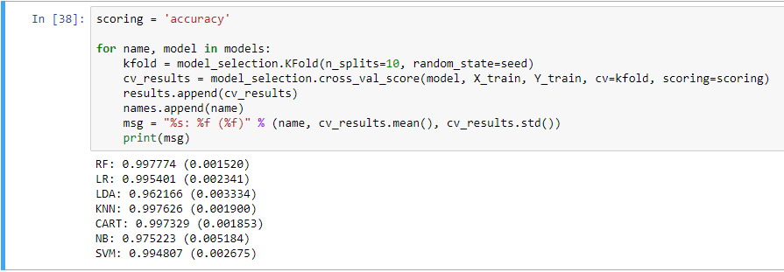
ML Classification-Evaluate Algorithm
Evaluate the accuracy of each of the defined models to determine which is the most accurate on our training data

Slide 33
ML Classification-Evaluate Algorithm
Evaluate the accuracy of each of the defined models to determine which is the most accurate on our training data

Slide 34
ML Classification-Evaluate Algorithm
Each model is evaluated using 10 fold validation
The training data is divided into 10 parts
The model is trained on 9 of the parts using the predictors and the labels
The model predicts values on the 10 part
Compares the accuracy of predictions vs the known label
Average is taken for the overall accuracy number
Accuracy is the quantity of true positives (correct malicious predictions) plus true negatives (correct benign predictions) divided by the total samples

Slide 35
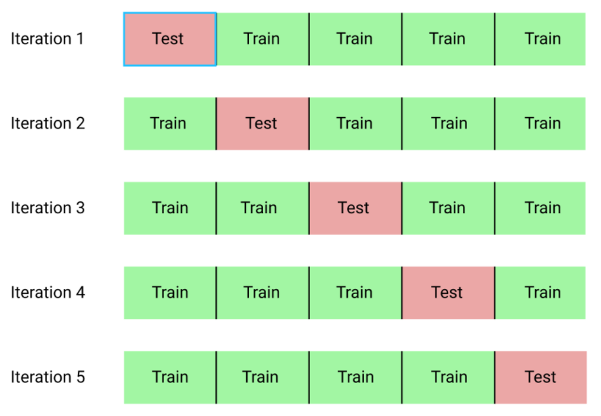
ML Classification-K Fold Validation

Slide 36
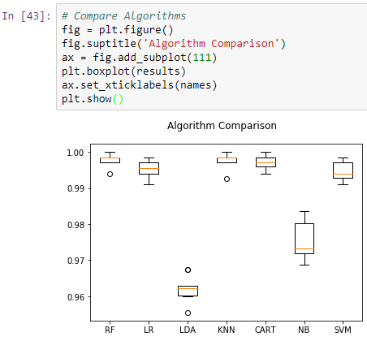
ML Classification-K Fold Validation

Slide 37
ML Classification-Evaluate Algorithm
Accuracy
Not always the best measurement
Can be deceiving in data that is heavily biased towards one label like we have
If we made a “benign” prediction for every event we would be 93% accurate
Depending on your use case you will want to review other scoring metrics like precision or recall.

Slide 38
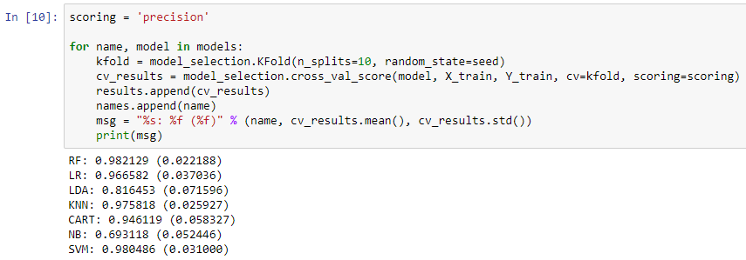
ML Classification-Evaluate Algorithm
Precision
Shows what percentage of positive (suspicious events) predictions were truly suspicious out of all the positive predictions.
This metric answers the question: What percentage of suspicious classifications are truly suspicious?

Slide 39
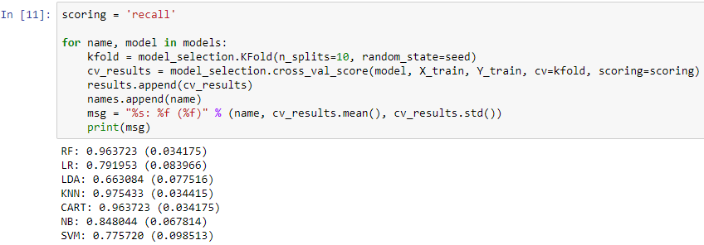
ML Classification-Evaluate Algorithm
Recall
Helps determine how much we can trust the algorithm to catch all suspicious events.
This metric answers the questions: What percentage of truly suspicious events were classified as suspicious?

Slide 40
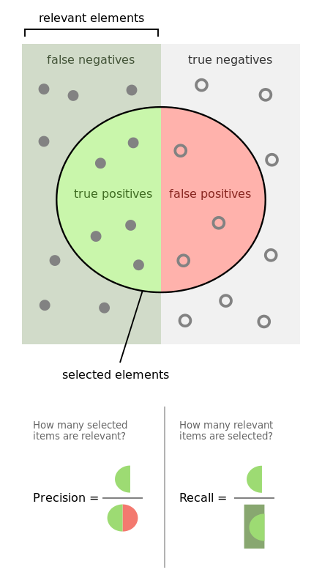
ML Classification-Evaluate Algorithm
Which metric would we favor in the PowerShell use case?
Precision-What percentage of suspicious classifications are truly suspicious?
Recall- What percentage of truly suspicious events were classified as suspicious?
By Walber - Own work, CC BY-SA 4.0, https://commons.wikimedia.org/w/index.php?curid=36926283

Slide 41
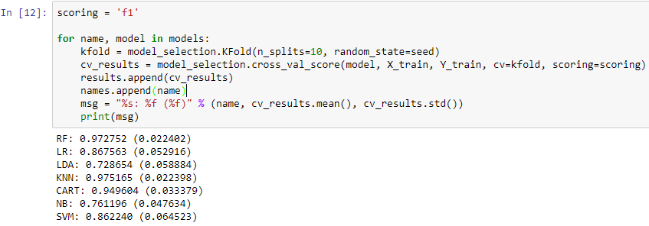
ML Classification-Evaluate Algorithm
F1
Metric that considers both recall and precision.

Slide 42
ML Classification-Evaluate Algorithm
The Random Forest algorithm is the most accurate of the tested algorithms
The validation set of data has to be used to determine if the model will be accurate when supplied with previously unseen data
Very important that the model is not trained on the validation set
Similar to memorizing the answers to Version 1 of a test and failing because you take Version 2.
Train the model on the training data and test the accuracy on the validation data

Slide 43
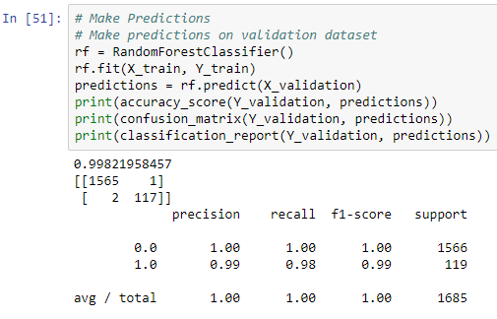
ML Classification-Evaluate Algorithm
 | Predicted Benign | Predicted Suspicious
True Benign | True Positive | False Positive
True Malicious | False Negaitve | True Negaitve

Slide 44
ML Classification-Evaluate Algorithm
RandomForest had the highest accuracy of the tested algorithms
This was the algorithm that we used for a while and with a little tuning the algorithm generalized pretty well
The algorithm was very successful
Reduced false positives significantly
Increased true positives
Decreased false negatives
We could detect this because we were running in parallel with existing rules
Also test on VirusTotal samples in real time

Slide 45

ML Classification-Make Predictions
Now make predictions on previously unseen data by passing an event to the model:

Slide 46
ML Classification-Pitfalls
Overfitting
Testing on your training data
Creating a model using all of your labeled data will most likely give good accuracy in test and poor accuracy in production
Not enough data/lack of diverse data
If training data is not truly representative of new data then production results can be poor
Bad data
Certain algorithms require data in certain formats
Labeling mistakes are common

Slide 47
ML Classification-Pitfalls
Overfitting
Data was pretty good and testing was fairly thorough with K fold validation and validation data
One of the issues we encountered was the hand engineered predictors
Malicious/suspicious modules requires human judgement to populate a list of modules and text which are then counted
The suspicious/malicious modules list needs to be updated with every new pieces of malicious PowerShell and then the data set needs to be recalculated and model retrained
Apparently this is often frowned upon in ML

Slide 48
ML Classification-Pitfalls
Not enough data/lack of diverse data
The data available was pretty good but even with large quantities of logs there were still some new types of events
This shows up in reduced production accuracy but may be unavoidable
I do believe that we have a reasonable maximum quantity of data

Slide 49

ML Classification-Pitfalls
Bad Data
Later I found that certain algorithms prefer normalized event data rather than the raw numbers I provided
This essentially means converting the data for each predictor into a value between zero and 1
This may be the reason that some of the algorithms originally scored less than others in algorithm evaluation

Slide 50
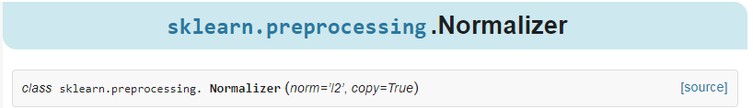
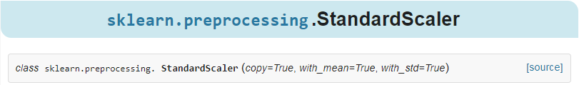
ML Classification-Possible Solutions
Not enough data/lack of diverse data
Not much we can do here
Bad Data
Easy fix by normalizing the values of all our predictors.
Scikit-learn has built in scalers and normalizers that easily processes the data set
http://scikit-learn.org/stable/modules/generated/sklearn.preprocessing.Normalizer.html
http://scikit-learn.org/stable/modules/generated/sklearn.preprocessing.StandardScaler.html

Slide 51
ML Classification-Possible Solutions
Overfitting
This was our primary concern
Didn’t want to constantly comb the Internet for updated malicious PowerShell modules, update our hand engineered features, re-calculate all of the training predictors, and retrain the model
This concerned was addressed by changing the algorithm and predictors by letting the tool generate the term list that helps identify known good and bad events
We generate a vocabulary from the events that is made up of keywords and count how many times each keyword is present
Train the model with this new output

Slide 52
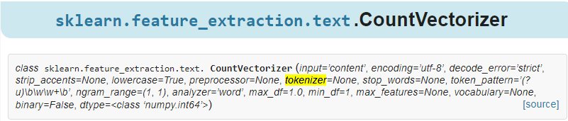
ML Classification-Possible Solutions
The text processing technique is called Vectorization

Slide 53
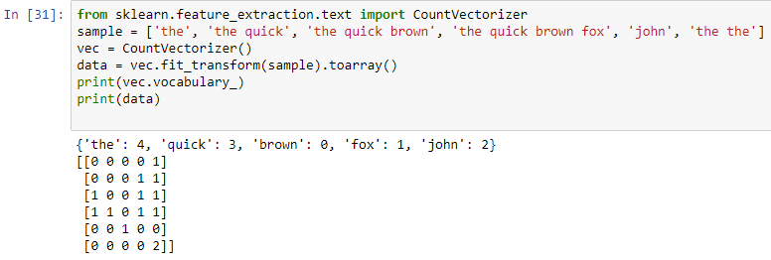
ML Classification-Possible Solutions
Vectorization Example

Slide 54
ML Classification-Possible Solutions
Now it is possible to automatically generate the vocabulary and training data very quickly when new data is added to the training set
In addition to vectorization we started using a neural net classifier
The neural net classifier had high but similar performance when compared to other algorithms
Neural Net models seem to be more portable and flexible when compared to other algorithms
Overall the changes seem to provide more stable and resilient results in production with less overhead

Slide 55
ML Classification-Conclusion
In the end it was possible to:
Generate a highly successful model with only a basic level of ML knowledge
It was possible to quickly iterate and generate a more robust model as we learned more
The solution is easily updated with new samples
The solution is constantly monitored for false positives and false negatives

Slide 56
Resources
https://github.com/dth0m/MiSec-Presentation-January
Dataset and Jupyter notebook
https://malwarearchaeology.squarespace.com/s/Windows-PowerShell-Logging-Cheat-Sheet-ver-Sept-2017-v21.pdf
General overview of security related PowerShell info
https://github.com/danielbohannon/Invoke-Obfuscation
Generate obfuscated PowerShell samples
https://github.com/danielbohannon/Revoke-Obfuscation
Utility for identifying obfuscated PowerShell events
https://github.com/pan-unit42/iocs/tree/master/psencmds
Huge set of malicious PowerShell event samples

