Slide 1
Estimating the Undiagnosed Fraction:
The “Testing History” Method of Backcalculation
Martina Morris, PhD
Jeanette Birnbaum, PhD
Matt Golden, MD
Ian Fellows, PhD
Notes:
Update on this project about …
Notes: just 4 slides on backcalculation

Slide 2
Overview
The Method
Summary and key assumptions
Applications to date
Dissemination plans
Prototype “Rshiny” web app
Your Feedback
Priorities for refining the methods
Seattle/King County, WA
Existing R code
WA state
Notes:
Methodology development with explaining TID + our assumptions (3 slides total: TID – with assumptions (graphically show), then backcalculation. 4 panel plot of how assumption of time of infection relates to TID; add another 2 panels to ) -> Propotype web access -> Working with stakeholders

Slide 3
A brief description of backcalculation based on testing history data

Slide 4
Backcalculation: basic idea
10 diagnoses observed
New diagnoses in 2014…
2014
2013
2012
2011
2010
Time
3 infection
3 infection
2 infections
1 infections
1 infections
…are based on infections that occurred in the past

Slide 5
Time from Infection to Diagnosis (TID)
10 diagnoses observed
Each case has a time from infection to diagnosis
2014
2013
2012
2011
2010
Time
3 infection
3 infection
2 infections
1 infections
1 infections
TID = 0 yrs
TID = 1 yrs
TID = 2 yrs
TID = 3 yr
TID = 4 yrs

Slide 6
TID probability distribution
This gives the probability of diagnosis by year
Percent of cases
Years from infection to diagnosis
30% 30% 20% 10% 10%
3 infections
3 infections
2 infections
1 infection
1 infection
TID = 0 yrs
TID = 1 yrs
TID = 2 yrs
TID = 3 yr
TID = 4 yrs

Slide 7
Backcalculation’s 3 Components
OBSERVE
BACKCALCULATE
ESTIMATE
Sum ( * )
Cases diagnosed at T
Incidence X yrs ago
TID
probability for X yrs ago
=

Slide 8
TID from Testing History
Infection window = [Start date, Date of diagnosis]
1) Get date of last negative test
“When was your last negative HIV test?”
Previous test exists
No previous test
Missing
Start date = date provided
Start date = age 16 or age-18 yrs
2 data inclusion options
First key assumption
Second key assumption
Third key assumption
2) Assign time of infection within the infection window

Slide 9
First key assumption: If no previous test
We set the start date of the possible infection window to a maximum value
Either:
18 years ago OR
Age 16, as the earliest age of infection
IMPACT: This gives a conservative (longer) estimate of the time spent undiagnosed

Slide 10
Second key assumption: If missing test data
Two options:
Exclude these when estimating the TID distribution
They are still included in the backcalculation
IMPACT: Assumes these cases are “missing at random”
Include these when estimating the TID distribution
Assuming the maximum possible infection window of age-18 or 16 yrs old.
IMPACT: Assumes “worst case”, so a conservative (longer) estimate of the time spent undiagnosed.

Slide 11
Third key assumption: Time of infection
Uniform:
Distributes the probability of infection uniformly across the possible interval
UNIFORM
# infections
Diagnosis
Last neg test
At last neg test (ALNT):
Probability=1 that infection occurred on the day after the last negative test
AT LAST NEG TEST
# infections
Diagnosis
Last neg test

Slide 12
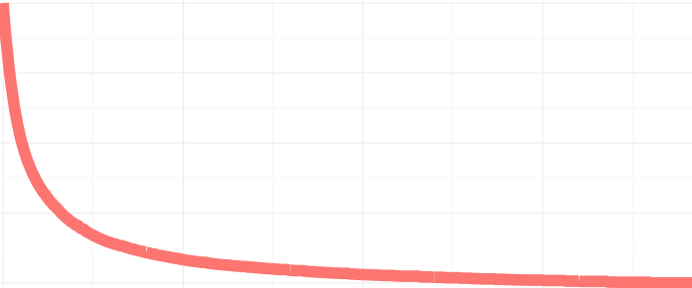
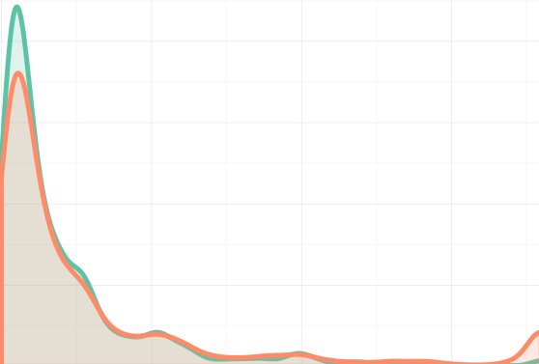

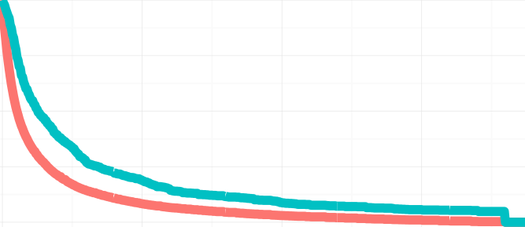
Impact of TID Assumptions on TID
OBSERVED ONLY
UNIFORM
“BASE CASE”
# infections
% undiagnosed
Density of last negative tests
Diagnosis
Last neg test
18 years
AT LAST NEG TEST
“WORST CASE (OBS)”
0 years
18 years
# infections
% undiagnosed
We use this for the KC analysis
Diagnosis
Last neg test
18 years

Slide 13
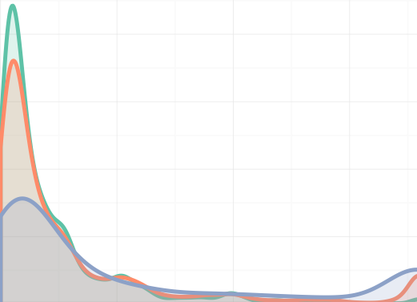

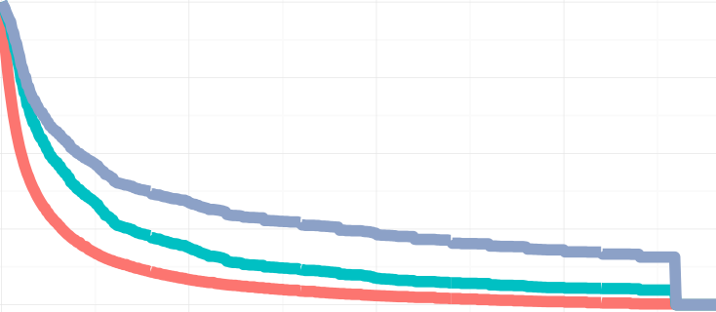
OBSERVED ONLY
UNIFORM
“BASE CASE”
# infections
% undiagnosed
Density of last negative tests
Diagnosis
Last neg test
18 years
AT LAST NEG TEST
“WORST CASE (OBS)”
# infections
% undiagnosed
0 years
18 years
We use this for the WA state analysis
Diagnosis
Last neg test
18 years
INCLUDING MISSING
AT LAST NEG TEST
“WORST CASE (MISS)”
Density of last negative tests
# infections
% undiagnosed
Diagnosis
Last neg test
18 years
0 years
18 years

Slide 14
Applications: 1. MSM in Seattle/King County 2006-12 2. WA state, 2005-13

Slide 15
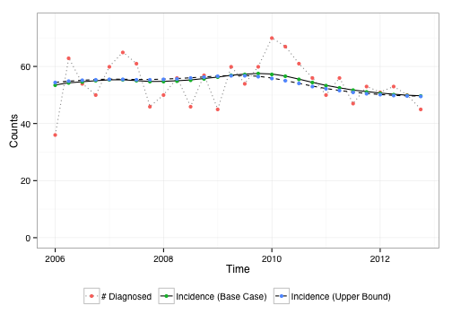
KC MSM: Incidence ~ Constant
15% missing testing history
Uniform TID
ALNT TID
Notes:
Fairly constant incidence…precede by % missing by race

Slide 16


KC MSM: Undiagnosed % Varies by Race
ALNT TID
Uniform TID

Slide 17
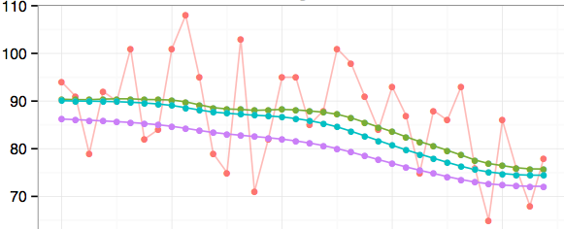



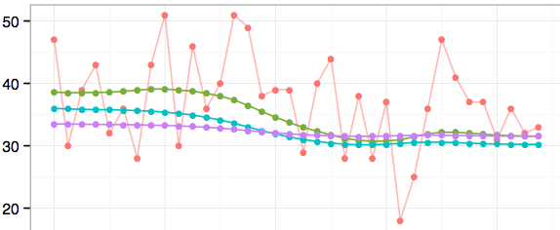

WA: Incidence is declining, esp. for MSM
MSM
35% missing
Number of cases
Uniform TID
ALNT TID, excl miss
Hetero
ALNT TID, inc miss
60% missing

Slide 18
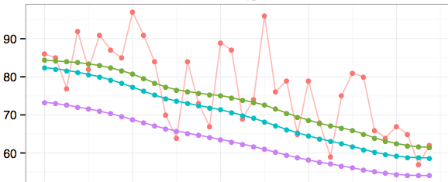
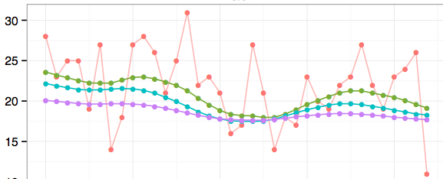
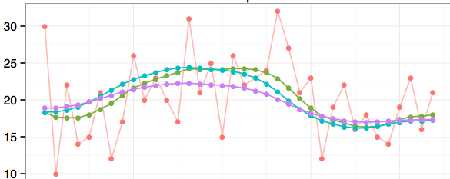

White
40% missing
Black
49% missing
Uniform TID
ALNT TID, excl miss
ALNT TID, inc miss
Hispanic
48% missing

Slide 19
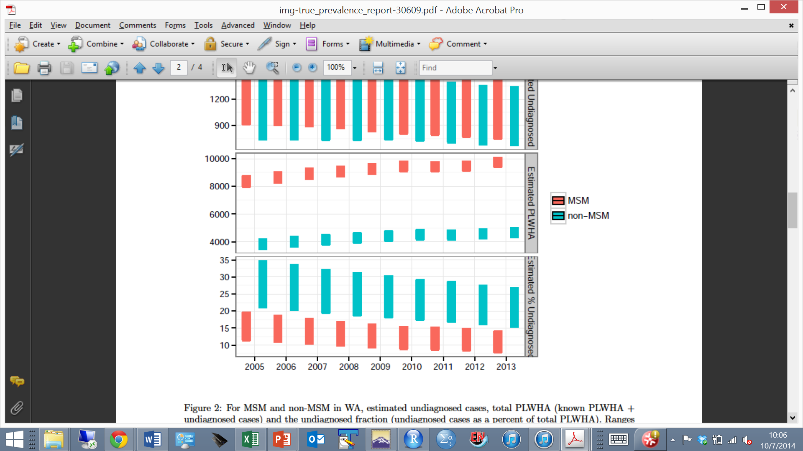
WA state undiagnosed fraction
ALNT TID
Uniform TID
2013: MSM: 8 - 14%
Non-MSM: 16 - 27%

Slide 20
Dissemination to Public Health Departments 1. R package 2. Rshiny web application

Slide 21
Code for R users
Format
Standardize variable names and units
Apply assumptions to testing history question
Describe
Sample characteristics
TID under various assumptions
Run
R package “HIVBackCalc”
Summarize results

Slide 22
R package “HIVBackCalc”
Backcalculation functions
estimateProbDist
estimateIncidence
meanEMUpdate
estimateUndiagnosed
Formatting and descriptive functions
Author: Dr. Ian Fellows (Fellows Statistics, CA)
Notes:
estimateProbDist: Estimates the discrete time probability distribution function for the time between infection and diagnosis (using the uniform assumption or incidence=at time of last negative test assumption)
estimateIncidence: the backcalculation
estimateUndiagnosed: uses the incidence estimates and the TID again to estimate how many were undiagnosed in each (quarter)

Slide 23
Web Portal: Rshiny Application
Goals:
Provide self-guided access to model for local use
Minimal learning curve
Minimal pre-processing of data
Outputs presented in most policy-relevant form
Mechanism
“Rshiny” interface

Slide 24
Protoype Rshiny App
https://hivbackcalc.shinyapps.io/HIVBackCalc_App/

Slide 25
We Need Your Feedback

Slide 26
Specific Issues
Data privacy requirements
Local, protected upload, unprotected upload
Detail in outputs
Race, mode, sex subgroup results?
Impact of missing data (suggestions for better assumptions?)
Training for users

Slide 27
Timing: Your interest and our availability
Your timeline for trying this?
Data/personnel ready now, or further in the future?
Our availability
Jan to mid Feb
Some code development and R support
Mar – May
Limited to existing code
June
Further development of Rshiny web portal
Support for interpreting results

Slide 28
Thank you!

