Slide 1

ALGOFORGE HACKATHON
PROJECT TITLE: Server Request Load Distributor
ONE LINE IDEA: A load distributor shares the workload with different servers to increase efficiency on request handling.
TEAM MEMEBERS: Shikar Thakur, Muzzamil Baig, D.Sai Teja, D.Rajesh
1

Slide 2
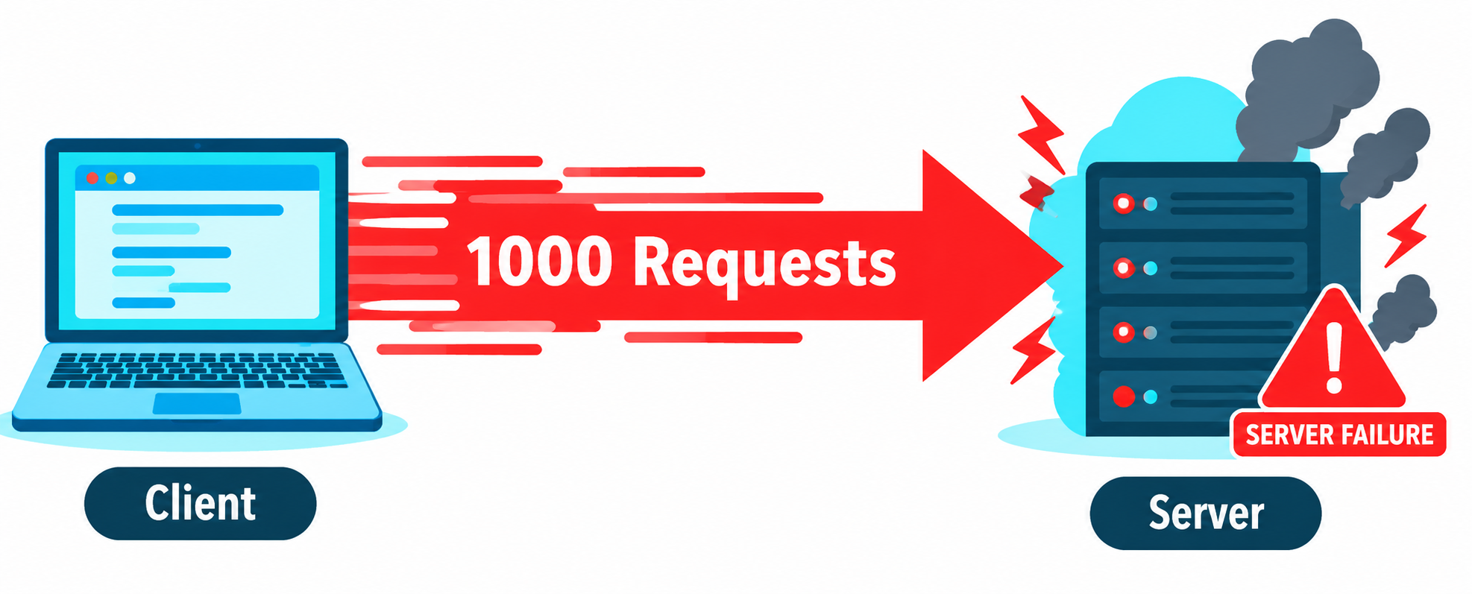
Problem Statement: Server Request Load Distributor
Many requests, few servers. Modern applications receive thousands of requests at the same moment from users all over the world.
Uneven distribution. Without a routing strategy, a few servers get flooded while others sit idle.
Real consequences. Overloaded servers build long queues, respond slowly and can crash; idle servers waste money.
Blind routing fails. Random or round-robin choice ignores queue length, capacity and cost.
Our problem: decide, for every incoming request, which server should handle it so that load stays balanced and response time and cost stay low.
1

Slide 3
Our Solution: Smart Request Routing
Whenever a request arrives, our system evaluates every server and places the request on the one that is best for it. If no server can take it safely, the system creates a new server automatically.
LOAD
COST
RUNTIME
How busy is the server?
How expensive is it?
How fast will it finish?
Queue length and used capacity. A server with a short queue and spare capacity scores better.
Estimated cost of processing the request on that server. Cheaper servers are preferred.
Estimated response time for this request on that server. Faster servers are preferred.
Estimated Time = Setup Time + (Current Backlog + Incoming Workload) / Processing speed
The server with the lowest score wins (greedy choice). All servers full? A new server is created.
2

Slide 4
How the Solution Works
1. Request arrives. Each request has an ID, size and priority.
2. Priority queue. Requests wait in a priority queue; the most urgent is always taken first.
3. Score servers. For every server we compute load, cost and runtime, then combine them into one score.
4. Capacity check. If some server still has spare capacity, we continue; otherwise a new server is created.
5. Greedy assignment. The request goes to the server with the lowest score.
6. Update and log. Queue lengths and loads are updated, and the decision is recorded so the user can see why it was chosen.
Incoming Request
Main Server
(Load Balancer)
Best score selected
Server 1
Server 2
processing
Server 3
result sent back
Response / Output
3

Slide 5
Technologies Used
Backend
Algorithms
Tools
Python
Flask
Greedy strategy
Priority queue (heapq)
VS Code
Git & GitHub
Frontend
HTML & CSS
JavaScript
4

Slide 6
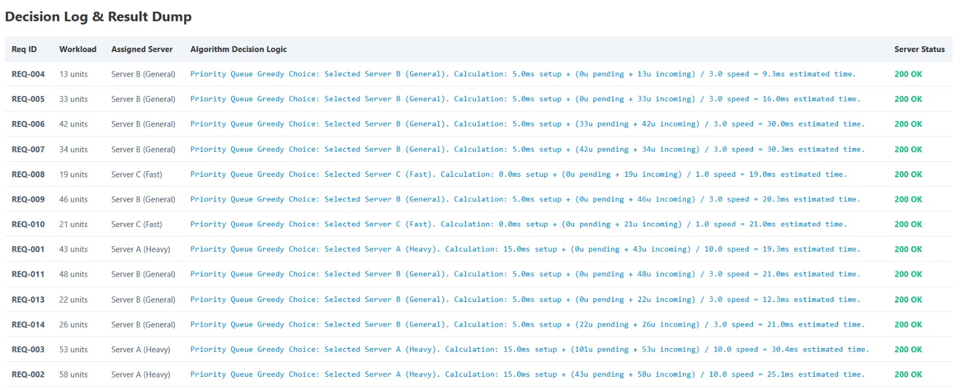
Demo & Impact
4

Slide 7
Thank You
Server Request Load Distributor

