Slide 1
Introduction to IPSO Smart Objects
Jaime Jiménez, Ericsson Research, IPSO Smart Objects co-chair.
jaime.jimenez@ericsson.com
Some slides are from Michael Koster ARM, IPSO Smart Objects Chair.
michael.koster@arm.com
June 15th, 2015

Slide 2
Problems to solve in IoT
Interoperability
Software’s interaction with physical resources.
Device independence from software management and vendors.
Discovery, Management, Reporting, Security, Authorization.
Scalability
Billions of devices, users, connections…
Billions of interactions.
Reusability and modularity
Software, networks, protocols, data models.
In a vertical segment, across vendors.
Across diverse vertical segments.
Permissionless Innovation
Enable anyone to participate and innovate.

Slide 3
IPSO Smart Objects
Developed by IP for Smart Objects (IPSO) Alliance in the Smart Objects Working Group.
Work exclusively on semantic Interoperability across IoT devices and applications.
Based on LWM2M Object Model.
Reusable Object IDs and Resource IDs.
Transport Protocol Independent (CoAP, LWM2M, MQTT, HTTP…) if support addressing, content formats and data types.
Encoding Independent (JSON, TLV, SenML…)
Basic Objects represent simple sensors and actuators.
Basic Starter Pack published on 2014 (Expansion Pack upcoming).
Tested over CoAP and LWM2M during IPSO Interoperability test on May 2015 (ARM, Ericsson, Intel, SICS, Yanzi, TUT …) .

Slide 4
The Web
HTTP and REST
Defines a client/server model and a request/response communication model.
Support of extensive representation formats (e.g. HTML, JSON, XML etc.)
Web content can be anything (HTML files, images, video…) each piece of information is a resource.
Defines some methods to indicate the server what to do. (GET, POST, PUT, HEAD, DELETE, TRACE).
Statelessness, requests are performed with the information provided only in that request
Resources are identified with identifiers (URI), either by location or by name.
Resources are accessible via an uniform locator (URL)
PROTOCOL://HOST_NAME:PORT /RESOURCE_PATH?RESOURCE_INPUT
Resources can be identified with an unique identity (URN)
urn:NAMESPACE_IDENTIFIER:SPECIFIC_STRING
Notes:
Conceptually speaking, a lot of what is being standardized nowadays in IETF, OMA or IPSO is inspired on the web. And it is only natural since the goal is something like a web of devices.
First thing that HTTP made is to define a client and server and request-response scheme i.e. request from the client is sent to the server and the server replies with a respond to the client.
HTTP supports many different representation formats that are also used in IoT without much modification.
The content in the web is defined as a resource and has an identity on the web server.
Resources on the web server are accessible via uniform resource locator (URL) that indicates a reference to the unique resource on the web server and follows a specific format.
So in summary from the web we get the REST type of communication, some methods to operate on the content, on resources that is.
Uniform Resource Identifier (URI) is a string of characters used to identify a name or a resource on the Internet
A URI identifies a resource either by location, or a name, or both. A URI has two specializations known as URL and URN.
A Uniform Resource Locator (URL) is a subset of the Uniform Resource Identifier (URI) that specifies where an identified resource is available and the mechanism for retrieving it.URL defines how the resource can be obtained. It does not have to be HTTP URL (http://), a URL can also be (ftp://) or (smb://)
A Uniform Resource Name (URN) is a Uniform Resource Identifier (URI) that uses the URN scheme, and does not imply availability of the identified resource. Both URNs (names) and URLs (locators) are URIs, and a particular URI may be both a name and a locator at the same time.
The URNs are part of a larger Internet information architecture which is composed of URNs, URCs and URLs.
bar.html is not a URN. A URN is similar to a person's name, while a URL is like a street address. The URN defines something's identity, while the URL provides a location. Essentially, "what" vs. "where". A URN has to be of this form <URN> ::= "urn:" <NID> ":" <NSS> where <NID> is the Namespace Identifier, and <NSS> is the Namespace Specific String.

Slide 5
Constrained Application Protocol (CoAP)
It is a RESTful protocol for constrained devices and networks. Similar to HTTP:
Client/server (although now tending more to P2P model) & Request/Response
GET, POST, PUT and DELETE Methods
Same key concepts (Media types, URL, URN…)
Resource discovery via the Resource Directory (RD)
Request coap://HOST_ADDRESS:PORT_NUMBER/PATH?QUERY
Response coap://ericsson.com:5683/rd/jorvas/room/541/temperature/
The well-known URI
coap://[2001:db8::2:1]/.well-known/core
IPv6 oriented (using 6LowPAN)
UDP preferred instead of TCP, SMS also possible
Reliability is ensured by using with different message types:
Confirmable (CON), non-confirmable (NON), acknowledgement (ACK) and reset (RST).
Observe/Notify, adding an “observe” flag in the CoAP GET Request
Introduces a Publish/Subscribe model for constrained devices.
Notes:
Moving into CoAP.
CoAP is the equivalent of HTTP but for constrained devices. It is also client/server type, although endpoints will often be both, so it’d be more of a P2P scenario. But that is the versatility that it has, often one server in the sensor and a client would be enough if the scenario is simple. It also uses a smaller subset of methods to operate on resources and also uses URL, URN….
The new things is that it provides Resource Discovery via the RD. A node that can also be running on devices or be more of a server entity, to which you can request with a formatted URL and it should answer with the location of the devices matching the request.
It also has the .well-known URI, that CoAP devices should implement, so that you can see which resources they have underneath.
Instead of using TCP mainly, it uses UDP or SMS bindings. Therefore to fix the problem of reliability it uses some fields in the application protocol (CoAP).
And last it also has a simple but very versatil publish subscribe mechanism with the Observe flag. This last point actually is now being extended for instance with the PubSb draft that Michael Ari and I have been working on.

Slide 6
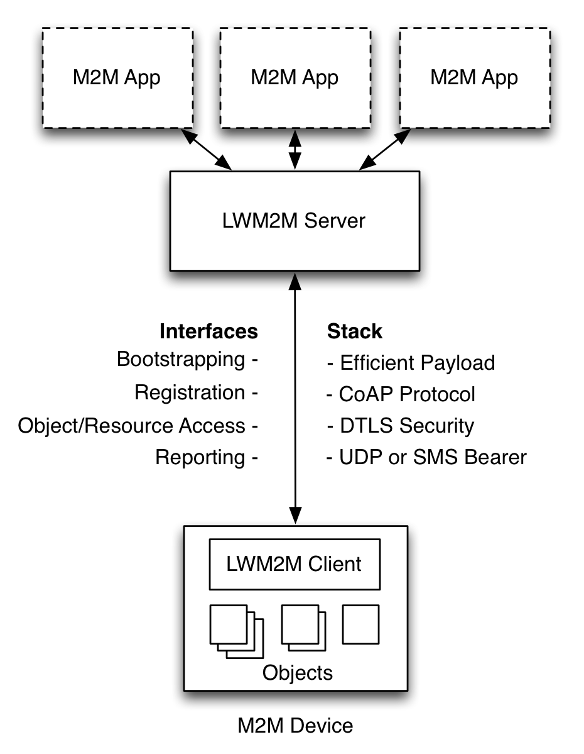
OMA Lightweight M2M (LWM2M)
Based on CoAP (runs on top) and used for management and control of constrained devices
Provides a set of interfaces for managing of constrained devices.
Bootstrap
Registration
Information Reporting
Device Management
Service Enablement
Swaps “server” and “client” roles. A Constrained device would then run at least a CoAP Server and LWM2M Client.
Also allows for operations on objects (RWX, Access Control, Observation, Notification)
Offers a simple and reusable object based model.
Notes:
A third protocol that appears in the picture is OMA LWM2M
LWM2M is relatively recent when compared with CoAP and it tries to give management support for constrained devices.
In a way it extends CoAP with few interfaces that provide bootstrap, registration…. For the constrained device.
It also kinda swaps the client-server roles but, as I was saying before, EPs capabilities vary and they will most likely have client and server roles.
LWM2M also ads the posibility to operate on the device’s resources, adding read write, execute options, access control , …)
More importantly, those resources adquire a new dimension since they have a structure that allows for extensibility and interoperability. LWM2M introduces the use of a simple and resusable object mode.
This object model is the one that IPSO has taken and extended to support new object types, new devices and new sensor types.

Slide 7


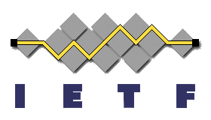
The Web in constrained devices
Applications
Application
IPSO Objects
Data Models
LWM2M
Web Server
API / Services
CoAP
HTTP
Application Protocol
6LowPAN
IPv4 / IPv6
Routing
802.15.4
Wifi, Ethernet, LTE, …
HW Network
MCU
MPU
Hardware

Slide 8
IPSO Smart Object Structure
Reusable resource and object IDs
Common definitions for concepts
Map to semantic terms e.g. temperature, currentValue
IDs are registered with the OMNA
Usable in different transport protocols that support
URI Addressing
(…/home/weather/3303/0/5700)
Data Types
Content Formats
RWX Operations
3303/0/5700
Object ID, defines object type
Object Instance, one or more
Resource ID, defines resource type

Slide 9
Example: IPSO Humidity Sensor
Object | Object ID | Object URN | Multiple Instances? | Description
IPSO Humidity | 3304 | urn:oma:lwm2m:ext:3304 | Yes | Relative humidity sensor, example units = %
Resource Name | Resource ID | Access Type | Multiple Instances? | Mandatory | Type | Range or Enumeration | Units | Descriptions
Sensor Value | 5700 | R | No | Mandatory | Float |  |  | Last or Current Measured Value from the Sensor
Units | 5701 | R | No | Optional | String |  |  | Measurement Units Definition e.g. “Cel” for Temperature in Celsius.
Min Measured Value | 5601 | R | No | Optional | Float | Same as Measured Value | Same as Measured Value | The minimum value measured by the sensor since power ON or reset
Max Measured Value | 5602 | R | No | Optional | Float | Same as Measured Value | Same as Measured Value | The maximum value measured by the sensor since power ON or reset
Min Range Value | 5603 | R | No | Optional | Float | Same as Measured Value | Same as Measured Value | The minimum value that can be measured by the sensor
Max Range Value | 5604 | R | No | Optional | Float | Same as Measured Value | Same as Measured Value | The maximum value that can be measured by the sensor
Reset Min and Max Measured Values | 5605 | E | No | Optional | Opaque |  |  | Reset the Min and Max Measured Values to Current Value

Slide 10
IPSO Object Linking

Slide 11
IPSO Composite Objects

Slide 12
Communication Patterns: REST
Endpoint
RD
Application
CoAP (POST /rd?ep=urn ")
CoAP (2.01 Created Location: /rd/xb72hj)
CoAP (Create /NetInfObject, empty)
LWM2M (2.01 Created “/8/1”)
LWM2M (Observe, “/8/1”)
LWM2M (Notify, “/8/1” changed, [ipv6address1])

Slide 13
Communication Patterns: PubSub
Endpoint
RD
Application
CoAP (POST /rd?ep=urn ")
CoAP (2.01 Created Location: /rd/xb72hj)
CoAP (Create /NetInfObject, empty)
LWM2M (2.01 Created “/8/1”)
LWM2M (Observe, “/8/1”)
LWM2M (Notify, “/8/1” changed, [ipv6address1])

Slide 14
Roadmap
☐ UPnP harmonization – from SOAP to REST.
☐ BLE/ZigBee harmonization.
✔ Draft Smart Object Data Model Design Guide @done (15-03-30)
✔ Draft Smart Object Expansion Pack for Basic Objects @done (15-04-30)
✔ Set up test servers for IPSO objects (LWM2M + TLV payload) @done (15-06-15)
☐ Draft Domain Specific Objects reference designs @due (mid 2015)
☐ Publish Smart Object Data Model Design Guided @due(15-07-31)
☐ Publish Smart Object Expansion Pack for Basic objects @due(15-07-31)
☐ Publish Smart Object Expansion Pack for Composite Objects @due(15-07-31)
☐ Publish Smart Object Expansion Pack for Reference Devices @due(15-07-31)
☐ IETF 93 – Bits and Bites @due(15-09-1)

Slide 15
Next Steps
Activities
Working with Smart Objects: Expansion Pack, Composite Objects, Linked Objects.
Collaboration with other IoT Interest Groups like UPnP, IIC, OIC.
Work on related Standards organizations: IETF CoRE - CoAP, OMA DM - LWM2M.
Prototyping and testing (IETF 93, Bits and Bites, 2nd IPSO Interop, …)
Focus Area
IPSO Smart Objects are meant to be very generic.
Any vendor can use them for their specific area by creating their own Objects by reusing generic resources and add their own.
Absolutely necessary for IoT
Harmonization and mapping between different data models & standards.
Use of standards for Application Level interoperability btw devices and applications vs propietary solutions.

Slide 16


