Slide 1
An Introduction to IPSO Smart Objects
Jaime Jiménez, Ericsson Research, IPSO Smart Objects co-chair.
May 13th, 2015

Slide 2
Table of Contents
IoT History
From M2M to IoT
Mainstream IoT
IoT Protocols
The Web
CoAP
LWM2M
IPSO Objects
IPSO Smart Objects
Relationship with other standards
Protocol Stack
Example
Deployment

Slide 3
1. IoT history

Slide 4
Moving into Iot
Machine-to-Machine
Internet of Things
Point problem driven
Connected device centric
Complex problems
Remote operations
Internal bus objectives
B2B
Consultancy & SI
In-house deployment
Marketplaces and Value Networks
B2B2C
Open web and innovation
Cloud and aaS
Vertical silos
Single-app devices
Proprietary industry tech
Specialized s/w dev’t
Horizontal integration
Generic devices
Standards & open source
Open APIs & dev’t
Notes:
What will characterize the future of M2M moving into IoT?
That’s has been in very broad strokes the evolution that has occurred.
M2M you had one problem and you try to deploy an specific device as a solution. From an application perspective it is pretty much focused on the connectivity. A sample story in Finland is that each of the public buses often had 5 to 10 SIM cards to provide connectivity to different systems installed in them, each of those systems was not aware of the existence of the others, and they were done often by different contractors that needed to fit their solution on the bus.
M2M solutions focus on the internal business of the companies (for example replacing people with smart meters so that you don’t have to send people out basically or in the case of the buses having connectivity for the passenger counting systems). The business is build around consultancy and system integration with in house deployments (just putting the server farm in the basement).
They are vertical solutions, this kind of silo type of solutions and with a lot of proprietary industry technologies, there is complete fragmentation. Even within building automation there is ten types of protocols that you can use…
Finally we will be looking at IoT. There is much more complex operations. Think about automated docks that do the load and unload of containers completely unmanned with the control site sitting many kilometers away and controlling it remotely. The complexity of these systems is much larger. Businesswise is still about internal value but across the supply chain and technologically you look into the data and service integration. These is also driven by the type of devices that are more complex than in the M2M stage.
The approach is much more innovation driven, having open interfaces, creating communities of users and developers. Businesswise it is more about creating marketplaces and linking your business to other businesses. They also have much more horizontal integration, specially when compared with the vertical silos in M2M. They are not about deploying devices for a single purpose but often they do not have a single application in mind.

Slide 5







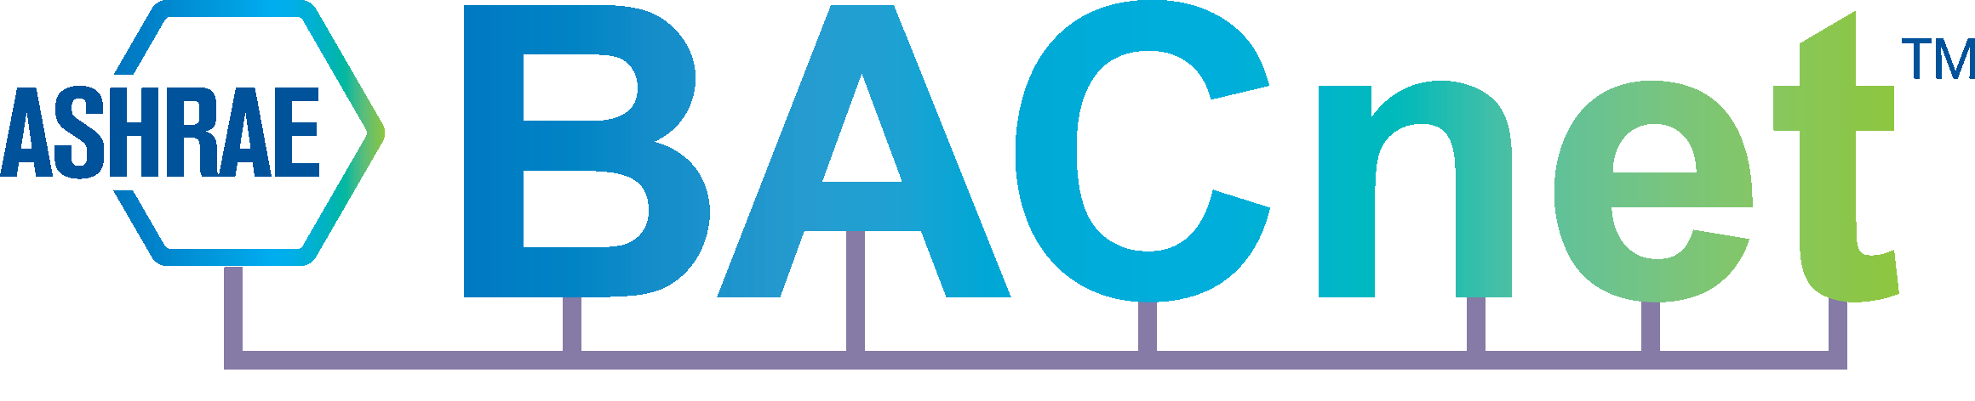



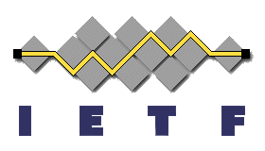
Make devices go mainstream
Go IP
Reduce technology fragmentation
Drive IP to the “tiniest of devices”
Go Web
Use standard web technologies
Ease enterprise SOA integration
Attract the global developer community
Go Simple
Make devices application generic
Drive value from devices to cloud enablement
Break device silos
48 kB of Flash
8 kB of RAM
Resource View
/temp
/light
/switch
REST (CoAP, HTTP)
TCP/UDP
IPv6
6LoWPAN
WiFi
3G LTE
IEEE 802.15.4
BTLE
Notes:
Even though we have seen devices like sensors and actuators move from the research lab to become consumer products in about 10 years, we are still some way from making it possible to really embed them in the environment. So, we would still like to drive device costs further down.
What we see today in M2M is a huge fragmentation in the technology domain. Each industry vertical develops their own technology and solution without any real reuse of off-the-shelf technologies. Even within a segment there are a range of proprietary and de facto standards. For instance in building automation, there is KNX, LON,X.10, BACnet, ZigBee,....
We believe that we should start by putting IP into even the smallest devices. As we have heard already, this is fully possible today thanks to work done by people like Adam at SICS with the Contiki operating system. We also see the industrial momentum around this not only in standardization but also in the IP for Smart Objects Alliance.
Furthermore, we should turn to standard development tools. Today, development is very much done in proprietary and closed systems mastered by a few trained developers. Going mainstream means that we can make use of the 100s of thousands of developers out there.
We should also invite for open innovation but providing open APIs. What if we were to do what Apple has done with AppStore, or Google with Android market?

Slide 6
2. IoT Protocols
Notes:
From the protocol point of view there has also been many developments

Slide 7
the web
HTTP and REST
Defines a client/server model and a request/response communication model.
Support of extensive representation formats (e.g. HTML, JSON, XML etc.)
Web content can be anything (HTML files, images, video…) each piece of information is a resource.
Defines some methods to indicate the server what to do. (GET, POST, PUT, HEAD, DELETE, TRACE).
Statelessness, requests are performed with the information provided only in that request
Resources are identified with identifiers (URI), either by location or by name.
Resources are accessible via an uniform locator (URL)
PROTOCOL://HOST_NAME:PORT /RESOURCE_PATH?RESOURCE_INPUT
Resources can be identified with an unique identity (URN)
urn:NAMESPACE_IDENTIFIER:SPECIFIC_STRING
Notes:
Conceptually speaking, a lot of what is being standardized nowadays in IETF, OMA or IPSO is inspired on the web. And it is only natural since the goal is something like a web of devices.
First thing that HTTP made is to define a client and server and request-response scheme i.e. request from the client is sent to the server and the server replies with a respond to the client.
HTTP supports many different representation formats that are also used in IoT without much modification.
The content in the web is defined as a resource and has an identity on the web server.
Resources on the web server are accessible via uniform resource locator (URL) that indicates a reference to the unique resource on the web server and follows a specific format.
So in summary from the web we get the REST type of communication, some methods to operate on the content, on resources that is.
Uniform Resource Identifier (URI) is a string of characters used to identify a name or a resource on the Internet
A URI identifies a resource either by location, or a name, or both. A URI has two specializations known as URL and URN.
A Uniform Resource Locator (URL) is a subset of the Uniform Resource Identifier (URI) that specifies where an identified resource is available and the mechanism for retrieving it.URL defines how the resource can be obtained. It does not have to be HTTP URL (http://), a URL can also be (ftp://) or (smb://)
A Uniform Resource Name (URN) is a Uniform Resource Identifier (URI) that uses the URN scheme, and does not imply availability of the identified resource. Both URNs (names) and URLs (locators) are URIs, and a particular URI may be both a name and a locator at the same time.
The URNs are part of a larger Internet information architecture which is composed of URNs, URCs and URLs.
bar.html is not a URN. A URN is similar to a person's name, while a URL is like a street address. The URN defines something's identity, while the URL provides a location. Essentially, "what" vs. "where". A URN has to be of this form <URN> ::= "urn:" <NID> ":" <NSS> where <NID> is the Namespace Identifier, and <NSS> is the Namespace Specific String.

Slide 8
coap
It is a RESTful protocol for constrained devices and networks. Similar to HTTP:
Client/server (although now tending more to P2P model) & Request/Response
GET, POST, PUT and DELETE Methods
Same key concepts (Media types, URL, URN…)
Resource discovery via the Resource Directory (RD)
Request coap://HOST_ADDRESS:PORT_NUMBER/PATH?QUERY
Response coap://ericsson.com:5683/rd/jorvas/room/541/temperature/
The well-known URI
coap://[2001:db8::2:1]/.well-known/core
IPv6 oriented (using 6LowPAN)
UDP preferred instead of TCP, SMS also possible
Reliability is ensured by using with different message types:
Confirmable (CON), non-confirmable (NON), acknowledgement (ACK) and reset (RST).
Observe/Notify, adding an “observe” flag in the CoAP GET Request
Introduces a Publish/Subscribe model for constrained devices.
Notes:
Moving into CoAP.
CoAP is the equivalent of HTTP but for constrained devices. It is also client/server type, although endpoints will often be both, so it’d be more of a P2P scenario. But that is the versatility that it has, often one server in the sensor and a client would be enough if the scenario is simple. It also uses a smaller subset of methods to operate on resources and also uses URL, URN….
The new things is that it provides Resource Discovery via the RD. A node that can also be running on devices or be more of a server entity, to which you can request with a formatted URL and it should answer with the location of the devices matching the request.
It also has the .well-known URI, that CoAP devices should implement, so that you can see which resources they have underneath.
Instead of using TCP mainly, it uses UDP or SMS bindings. Therefore to fix the problem of reliability it uses some fields in the application protocol (CoAP).
And last it also has a simple but very versatil publish subscribe mechanism with the Observe flag. This last point actually is now being extended for instance with the PubSb draft that Michael Ari and I have been working on.

Slide 9
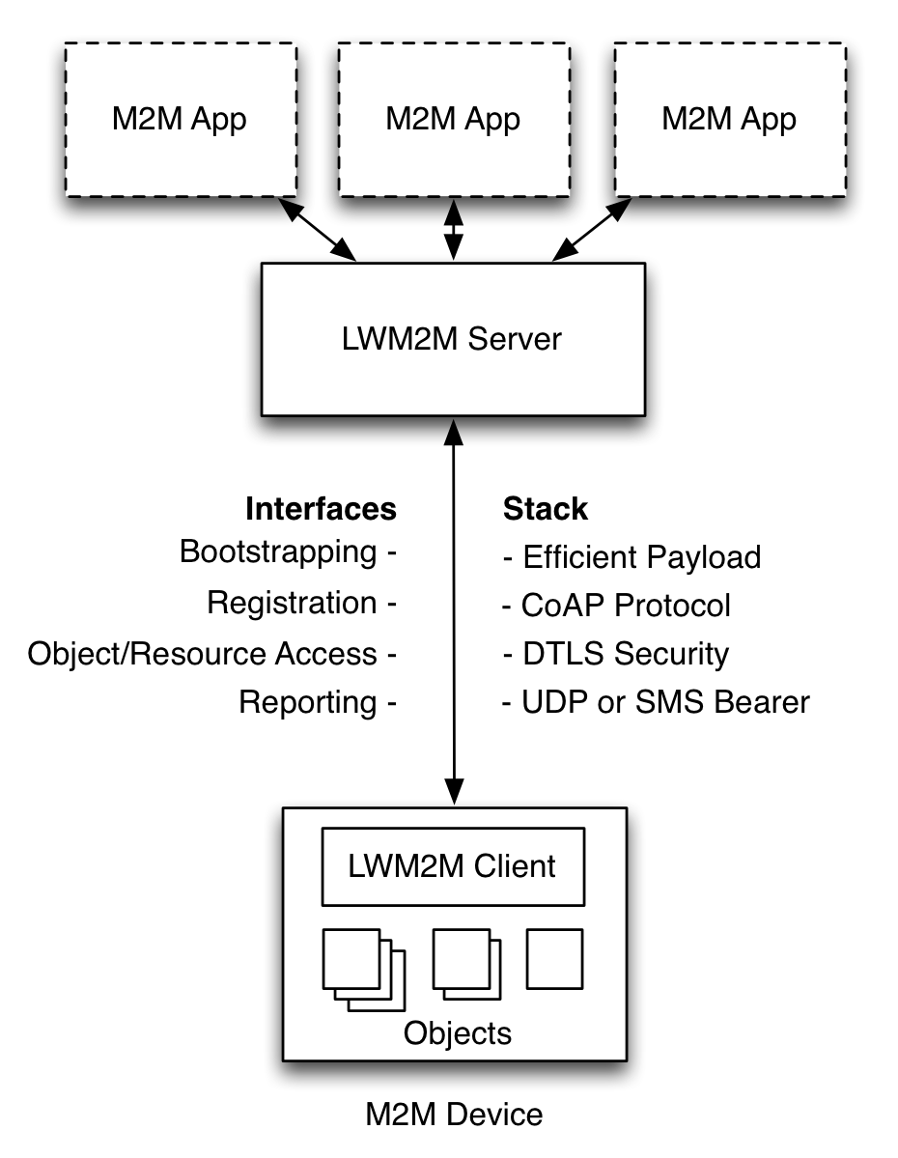
OMA lwm2m
Based on CoAP (runs on top) and used for management and control of constrained devices
Provides a set of interfaces for managing of constrained devices.
Bootstrap
Registration
Information Reporting
Device Management
Service Enablement
Swaps “server” and “client” roles. A Constrained device would then run at least a CoAP Server and LWM2M Client.
Also allows for operations on objects (RWX, Access Control, Observation, Notification)
Offers a simple and reusable object based model.
Notes:
A third protocol that appears in the picture is OMA LWM2M
LWM2M is relatively recent when compared with CoAP and it tries to give management support for constrained devices.
In a way it extends CoAP with few interfaces that provide bootstrap, registration…. For the constrained device.
It also kinda swaps the client-server roles but, as I was saying before, EPs capabilities vary and they will most likely have client and server roles.
LWM2M also ads the posibility to operate on the device’s resources, adding read write, execute options, access control , …)
More importantly, those resources adquire a new dimension since they have a structure that allows for extensibility and interoperability. LWM2M introduces the use of a simple and resusable object mode.
This object model is the one that IPSO has taken and extended to support new object types, new devices and new sensor types.

Slide 10
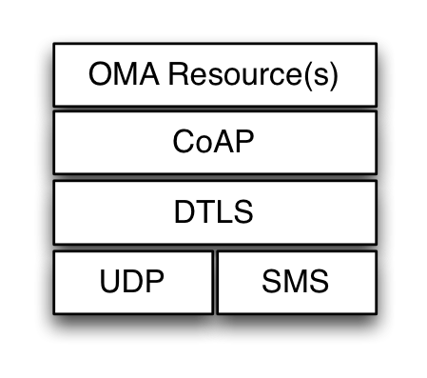
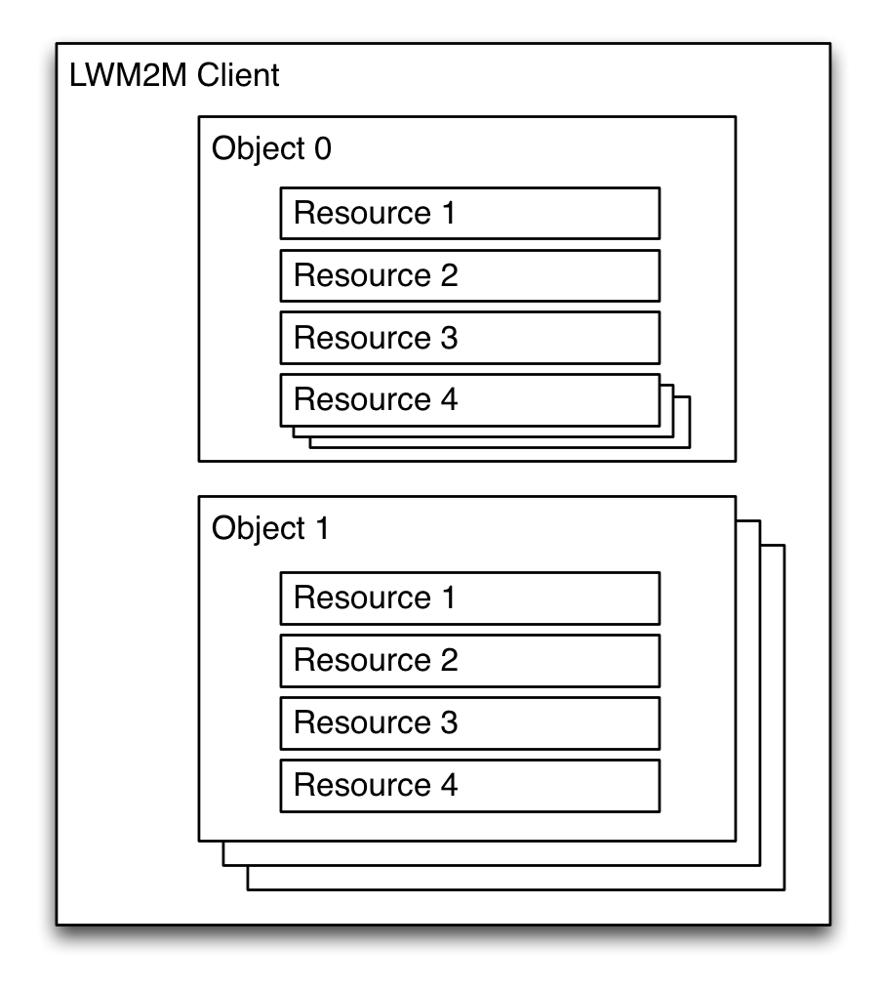
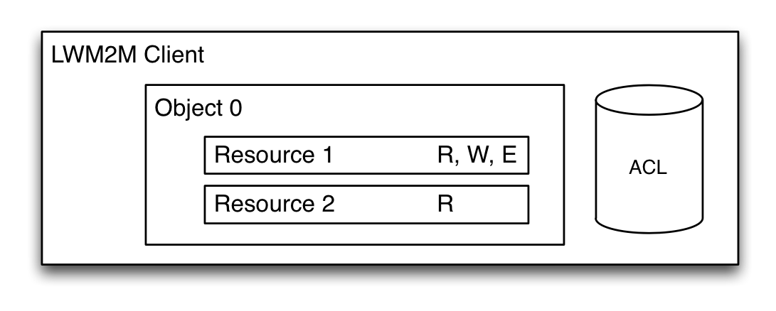
IPSO objects
First introduced in LWM2M
To ensure application interoperability
Make it simple to add new resources.
Common design pattern that is independent of the protocol used (CoAP, HTTP, MQTT, SNMP, TR69,…)
To provide the building blocks to semantically define more complex devices
Washing Machine = sensors for humidity, temperature, water level, water-valves (for the hoses going to to/from it), a pump, a timer, electricity sockets, a capacitor…
Notes:
And now we arrive to the IPSO Objects.
They are kinda the next step required to ensure this horizontalization we were talking about.
First it happened with the use of IP for constrained devices. Then with CoAP at the Application layer.
And now with the set of common design patterns that in essence are independent of the protocol (in the wire, objects can be encapsulated in whichever protocol you want).
Their main purpose is to provide a simple way to add new resources and reuse similar resources so that you don’t have to reinvent the wheel every time you have a new device.

Slide 11
3. IPSO Smart Objects

Slide 12
Relationship with other Standards

Slide 13

After IP – The Web in constrained devices
RESTful web services to embedded devices
Eases enterprise SOA integration
Eases application development – Web programming∂
HTTP or CoAP possible
CoAP (and EXI) for constrained environments, including Observe
HTTP-CoAP interworking
Resource view
Web resources – web linking
Semantic annotations and simple profiles preferred
XML - EXI, JSON
“Open” means discovery
publication and look-up
Wrapping of Legacy devices
IPSO Objects
OMA LWM2M
CoAP
HTTP
TCP/UDP
IPv6
6LoWPAN
3G LTE
IEEE 802.15.4
BTLE
LLN
Notes:
SO here you have on the right side how the current standard stack would look like.

Slide 14
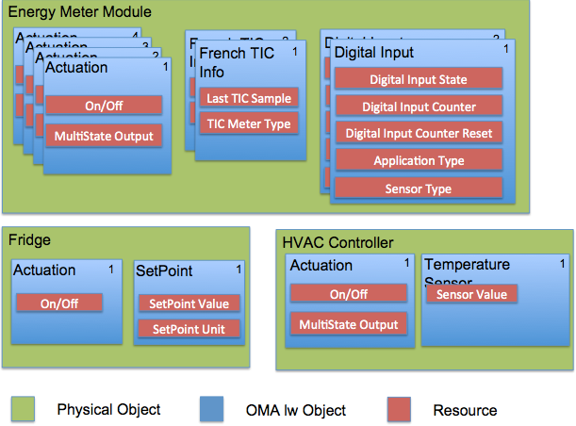
IPSO Smart Object Structure I
Notes:
A Client has one or more Object Instances
An Object is a collection of Resources
A Resource is an atomic piece of information that can be
Read, Written or Executed
Objects can have multiple instances
Objects and Resources are identified by a 16-bit Integer, Instances by an 8-bit Integer
Objects/Resources are accessed with simple URIs:
/{Object ID}/{Object Instance}/{Resource ID}
Ex: /3/0/1 (Object Type=Device, Instance=0, Resource=Device Mfg.)

Slide 15
IPSO Smart Object Structure II
REST API with a URI template
Objects
Object Instances
Resources
(Resource Instances)
Reusable resource and object IDs
Common definitions for concepts
Map to semantic terms e.g. temperature, currentValue
IDs are registered with the OMNA
Can be embedded in a path hierarchy on the server
/home/weather/3303/0/5700
3303/0/5700
Object ID, defines object type
Object Instance, one or more
Resource ID, defines resource type

Slide 16

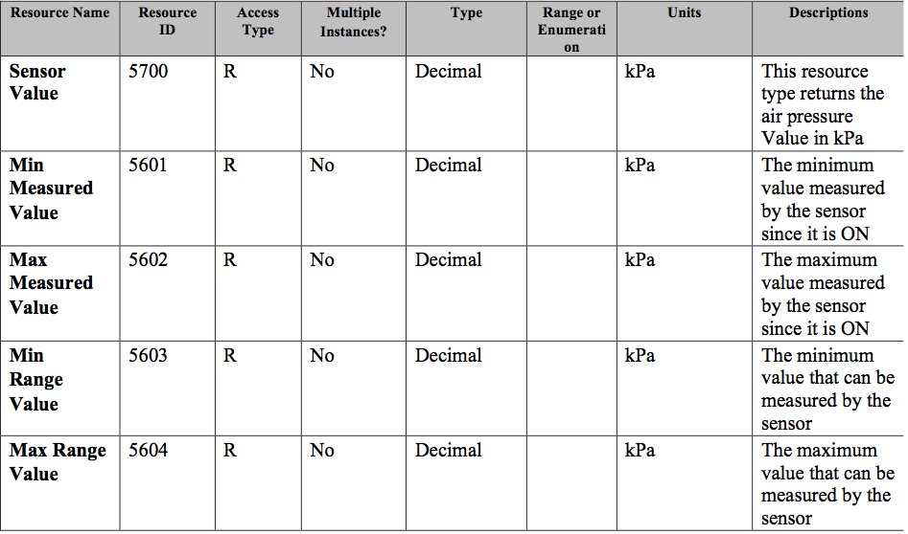
IPSO BAROMETER OBJECT

Slide 17
Washing machine example I
Washing Machine
Water Valve Actuator
Temperature Sensor
Water Valve Actuator
Sensor Value
On / Of
Min Meas Value
On / Of
Max Meas Value
Dimmer
Min Range Value
Dimmer
Max Range Value

Slide 18
Washing machine example II
CoAP S
REGISTRATION (EP Name, Lifetime SMS,)
CoAP C
LWM2M C
LWM2M S
</3303/0/5700></3303/0/5701></3303/0/5702></3303/0/5703><3303/0/5704>;rt=“oma.lwm2m”;ct=50;obs=1
Success 2.05
Get (Observe) /3303/0 Observe Token: 2222
Success 2.05
{“e”:[{
"n":"0", "v":"32",
"n":"1", "v":"30",
"n":"2", "v":"60",
"n":"3", "v":"0",
"n":"4", "v":"100"}]}
2.04 (Notify)
Message ID: 34
Token: 2222
Notes:
Device is already Bootstrapped and is performing the registration registered on the LWM2M Client.
The LWM2M Server is already aware of the location of the devices since they have registered on its RD.
On our washing machine we would have one LWM2M client taking care of controlling its sensors. We could send a request for an IPSO Temperature Object on it (Req: GET /3303/0), the client would then return the following small JSON payload in the response (Res: 2.04 Content).
{“e”:[{
"n":"0", "v":"32",
"n":"1", "v":"30",
"n":"2", "v":"60",
"n":"3", "v":"0",
"n":"4", "v":"100"}]}
We could probably do something smarter with this technology though, like automatically ending the washing process, since knowing the temperature would not prevent the washing machine from ruining the parquet once the lock breaks.

Slide 19


