Slide 1
Introduction to IPSO Smart Objects
Jaime Jiménez, Ericsson Research, IPSO Smart Objects co-chair.
jaime.jimenez@ericsson.com
Some slides are from Michael Koster ARM, IPSO Smart Objects Chair.
michael.koster@arm.com
June 15th, 2015

Slide 2
Problems to solve in IoT
Interoperability
Software’s interaction with physical resources.
Device independence from software management and vendors.
Discovery, Management, Reporting, Security, Authorization.
Scalability
Billions of devices, users, connections…
Billions of interactions.
Reusability and modularity
Software, networks, protocols, data models.
In a vertical segment, across vendors.
Across diverse vertical segments.
Permissionless Innovation
Enable anyone to participate and innovate.

Slide 3
IPSO Smart Objects
Developed by IP for Smart Objects (IPSO) Alliance in the Smart Objects Working Group.
Work exclusively on semantic Interoperability across IoT devices and applications.
Based on LWM2M Object Model.
Reusable Object IDs and Resource IDs.
Transport Protocol Independent (CoAP, LWM2M, MQTT, HTTP…) if support addressing, content formats and data types.
Encoding Independent (JSON, TLV, SenML…)
Basic Objects represent simple sensors and actuators.
Basic Starter Pack published on 2014 (Expansion Pack upcoming).
Tested over CoAP and LWM2M during IPSO Interoperability test on May 2015 (ARM, Ericsson, Intel, SICS, Yanzi, TUT …) .
Notes:
Since we have only few slides and little time, I will focus on being pragmatic and on the content and message of this presentation.
IP for Smart Objects is an Alliance of several companies, you can find that information on the IPSO Alliance Website. IPSO has few committees, among those the IPSO Smart Objects Committee where we define Smart Objects.
The overall goal is for semantic interoperability btw devices (sensors and actuators) and the applications that use them. We are creating a standard set of semantics that can be used to provide plug and play interoperability btw devices and applications.
We have taken the LWM2M Object model almost as it is. LWM2M Objects are used for management of devices, they provide a clear URI format for addressing those management objects, as well as access control, instantiation and resources.
In IPSO we extend that model with the concept of reusable resources. The goal is that if you have some specific sensor, you can take one of the existing IPSO Objects and use it as it is or take its resources and extend it to suit your particular device characteristics.
We have designed IPSO Objects to be transport protocol independent. It obviously supports CoAP as it is based on LWM2M objects, but people have used them with MQTT or HTTP as well. So you can basically send the object data over as long as you support the basic data types and content formats.
Also for serialization it will depend on the protocol, can be TLV, JSON, plain text . For example we have successfully done interop tests with TLV and plaintext.
We have already released a basic set of smart objects last year, with some very common sensors and actuator templates, you can go and have a look at the website or you can let us know if you are interested on using them or give feedback and so on.
We also have tested it between the partners in IPSO few weeks ago. Each brought their own implementation of IPSO objects, we used CoAP LWM2M for the application layer and tested it over an IPv6 network

Slide 4
The Web
HTTP and REST
Defines a client/server model and a request/response communication model.
Support of extensive representation formats (e.g. HTML, JSON, XML etc.)
Web content can be anything (HTML files, images, video…) each piece of information is a resource.
Defines some methods to indicate the server what to do. (GET, POST, PUT, HEAD, DELETE, TRACE).
Statelessness, requests are performed with the information provided only in that request
Resources are identified with identifiers (URI), either by location or by name.
Resources are accessible via an uniform locator (URL)
PROTOCOL://HOST_NAME:PORT /RESOURCE_PATH?RESOURCE_INPUT
Resources can be identified with an unique identity (URN)
urn:NAMESPACE_IDENTIFIER:SPECIFIC_STRING
Notes:
Conceptually speaking, a lot of what is being standardized nowadays in IETF, OMA or IPSO is inspired on the web. And it is only natural since the goal is something like a web of devices.
First thing that HTTP made is to define a client and server and request-response scheme i.e. request from the client is sent to the server and the server replies with a respond to the client.
HTTP supports many different representation formats that are also used in IoT without much modification.
The content in the web is defined as a resource and has an identity on the web server.
Resources on the web server are accessible via uniform resource locator (URL) that indicates a reference to the unique resource on the web server and follows a specific format.
So in summary from the web we get the REST type of communication, some methods to operate on the content, on resources that is.
Uniform Resource Identifier (URI) is a string of characters used to identify a name or a resource on the Internet
A URI identifies a resource either by location, or a name, or both. A URI has two specializations known as URL and URN.
A Uniform Resource Locator (URL) is a subset of the Uniform Resource Identifier (URI) that specifies where an identified resource is available and the mechanism for retrieving it.URL defines how the resource can be obtained. It does not have to be HTTP URL (http://), a URL can also be (ftp://) or (smb://)
A Uniform Resource Name (URN) is a Uniform Resource Identifier (URI) that uses the URN scheme, and does not imply availability of the identified resource. Both URNs (names) and URLs (locators) are URIs, and a particular URI may be both a name and a locator at the same time.
The URNs are part of a larger Internet information architecture which is composed of URNs, URCs and URLs.
bar.html is not a URN. A URN is similar to a person's name, while a URL is like a street address. The URN defines something's identity, while the URL provides a location. Essentially, "what" vs. "where". A URN has to be of this form <URN> ::= "urn:" <NID> ":" <NSS> where <NID> is the Namespace Identifier, and <NSS> is the Namespace Specific String.

Slide 5
Constrained Application Protocol (CoAP)
It is a RESTful protocol for constrained devices and networks. Similar to HTTP:
Client/server (although now tending more to P2P model) & Request/Response
GET, POST, PUT and DELETE Methods
Same key concepts (Media types, URL, URN…)
Resource discovery via the Resource Directory (RD)
Request coap://HOST_ADDRESS:PORT_NUMBER/PATH?QUERY
Response coap://ericsson.com:5683/rd/jorvas/room/541/temperature/
The well-known URI
coap://[2001:db8::2:1]/.well-known/core
IPv6 oriented (using 6LowPAN)
UDP preferred instead of TCP, SMS also possible
Reliability is ensured by using with different message types:
Confirmable (CON), non-confirmable (NON), acknowledgement (ACK) and reset (RST).
Observe/Notify, adding an “observe” flag in the CoAP GET Request
Introduces a Publish/Subscribe model for constrained devices.
Notes:
Moving into CoAP.
CoAP is the equivalent of HTTP but for constrained devices. It is also client/server type, although endpoints will often be both, so it’d be more of a P2P scenario. But that is the versatility that it has, often one server in the sensor and a client would be enough if the scenario is simple. It also uses a smaller subset of methods to operate on resources and also uses URL, URN….
The new things is that it provides Resource Discovery via the RD. A node that can also be running on devices or be more of a server entity, to which you can request with a formatted URL and it should answer with the location of the devices matching the request.
It also has the .well-known URI, that CoAP devices should implement, so that you can see which resources they have underneath.
Instead of using TCP mainly, it uses UDP or SMS bindings. Therefore to fix the problem of reliability it uses some fields in the application protocol (CoAP).
And last it also has a simple but very versatil publish subscribe mechanism with the Observe flag. This last point actually is now being extended for instance with the PubSb draft that Michael Ari and I have been working on.

Slide 6
Web Linking for Constrained Devices
RFC6690 Constrained RESTful Environments (CoRE) Link Format.
Follows the Web Linking RFC5988.
Defines semantic link serialization and M2M content types.
Defines a well-known resource where links are stored.
Enables query string parameters for discovery by attribute and relation.
<3303/0/5507>;rt=“ipso”;ct=50;obs=1
Links are discovered using GET with content type “application/link-format”
JSON representation using GET with content type “application/link-format+json”
Resource Type
Content Type
Observable

Slide 7
Discovery for Constrained Devices
Core Link defines
Link format
Device to device discovery.
Resource Directory draft adds
Sleepy node support.
No multicast needed.
Remote lookup, hierarchical and federated distribution.
Core Link is also used in RD
EP POST (register) resource links to RD.
EP PUT (refresh) to RD.
EP DELETE (remove) their RD entry.
EP RD
| |
| ----- GET /.well-known/core?rt=core.rd* ------> |
| |
| |
| <---- 2.05 Content "</rd>; rt="core.rd" ------ |
| |
Req: GET coap://[ff02::1]/.well-known/core?rt=core.rd*
Res: 2.05 Content
</rd>;rt="core.rd",
</rd-lookup>;rt="core.rd-lookup",
</rd-group>;rt="core.rd-group"

Slide 8
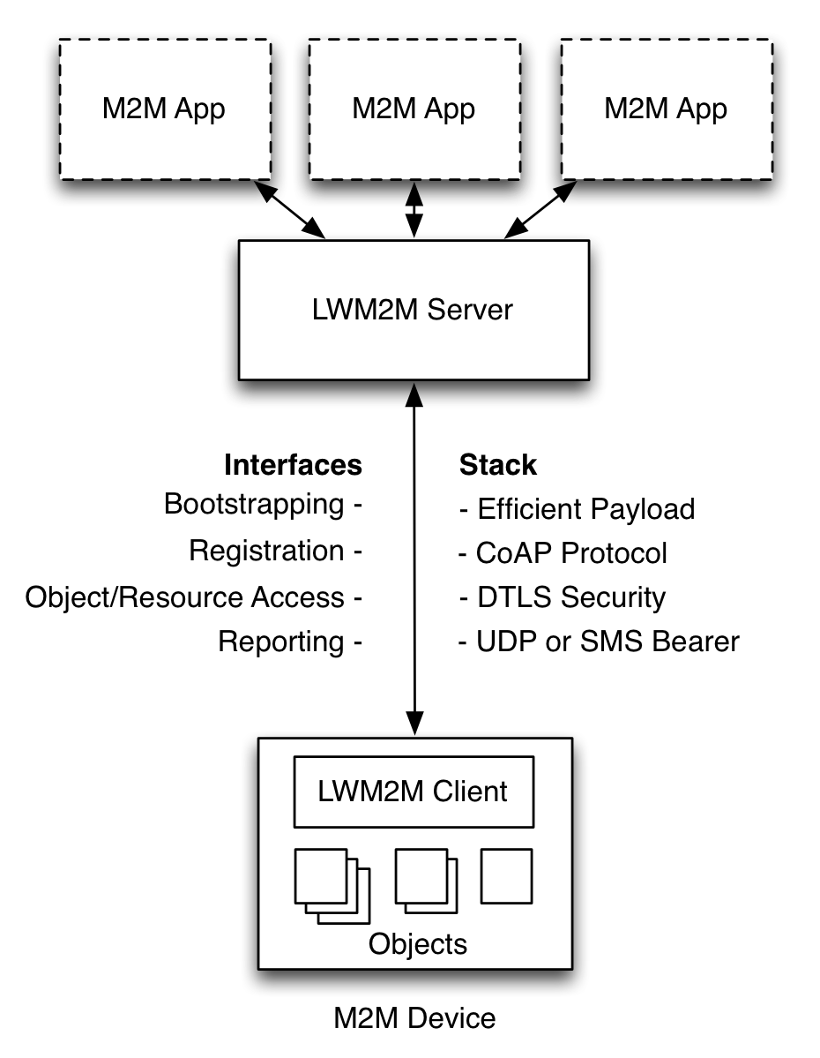
OMA Lightweight M2M (LWM2M)
Based on CoAP (runs on top) and used for management and control of constrained devices
Provides a set of interfaces for managing of constrained devices.
Bootstrap
Registration
Information Reporting
Device Management
Service Enablement
Swaps “server” and “client” roles. A Constrained device would then run at least a CoAP Server and LWM2M Client.
Also allows for operations on objects (RWX, Access Control, Observation, Notification)
Offers a simple and reusable object based model.
Notes:
A third protocol that appears in the picture is OMA LWM2M
LWM2M is relatively recent when compared with CoAP and it tries to give management support for constrained devices.
In a way it extends CoAP with few interfaces that provide bootstrap, registration…. For the constrained device.
It also kinda swaps the client-server roles but, as I was saying before, EPs capabilities vary and they will most likely have client and server roles.
LWM2M also ads the posibility to operate on the device’s resources, adding read write, execute options, access control , …)
More importantly, those resources adquire a new dimension since they have a structure that allows for extensibility and interoperability. LWM2M introduces the use of a simple and resusable object mode.
This object model is the one that IPSO has taken and extended to support new object types, new devices and new sensor types.

Slide 9



The Web in constrained devices
Applications
Application
IPSO Objects
Data Models
LWM2M
Web Server
API / Services
CoAP
HTTP
Application Protocol
6LowPAN
IPv4 / IPv6
Routing
802.15.4
Wifi, Ethernet, LTE, …
HW Network
MCU
MPU
Hardware

Slide 10
IPSO Smart Object Structure
Reusable Data Model for Constrained Devices
Across domains
Reusable resource and object IDs
Common definitions for concepts
Map to semantic terms e.g. temperature, currentValue
IDs are registered with the OMNA
Usable in different transport protocols that support
URI Addressing
(…/home/weather/3303/0/5700)
Data Types
Content Formats
RWX Operations
3303/0/5700
Object ID, defines object type
Object Instance, one or more
Resource ID, defines resource type
Notes:
IPSO Smart Objects

Slide 11
Example 1: IPSO Humidity Sensor
Object | Object ID | Object URN | Multiple Instances? | Description
IPSO Humidity | 3304 | urn:oma:lwm2m:ext:3304 | Yes | Relative humidity sensor, example units = %
Resource Name | Resource ID | Access Type | Multiple Instances? | Mandatory | Type | Range or Enumeration | Units | Descriptions
Sensor Value | 5700 | R | No | Mandatory | Float |  |  | Last or Current Measured Value from the Sensor
Units | 5701 | R | No | Optional | String |  |  | Measurement Units Definition e.g. “Cel” for Temperature in Celsius.
Min Measured Value | 5601 | R | No | Optional | Float | Same as Measured Value | Same as Measured Value | The minimum value measured by the sensor since power ON or reset
Max Measured Value | 5602 | R | No | Optional | Float | Same as Measured Value | Same as Measured Value | The maximum value measured by the sensor since power ON or reset
Min Range Value | 5603 | R | No | Optional | Float | Same as Measured Value | Same as Measured Value | The minimum value that can be measured by the sensor
Max Range Value | 5604 | R | No | Optional | Float | Same as Measured Value | Same as Measured Value | The maximum value that can be measured by the sensor
Reset Min and Max Measured Values | 5605 | E | No | Optional | Opaque |  |  | Reset the Min and Max Measured Values to Current Value

Slide 12
Example 2: New Reusable Object
Object | Object ID | Object URN | Multiple Instances? | Description
Company Humidity | n | urn:company:ext:1 | Yes | Relative humidity sensor, example units = %
Resource Name | Resource ID | Access Type | Multiple Instances? | Mandatory | Type | Range or Enumeration | Units | Descriptions
Sensor Value | 5700 | R | No | Mandatory | Float |  |  | Last or Current Measured Value from the Sensor
Units | 5701 | RW | No | Optional | String |  |  | Measurement Units Definition e.g. “Cel” for Temperature in Celsius.
Reset Units | 12000 | E | No | Optional | Opaque |  |  | Reset the Min and Max Measured Values to Current Value
On/Off | 5850 | R, W |  |  | Boolean |  |  | This resource represents an on/off actuator, which can be controlled, the setting of which is a Boolean value (1,0) where 1 is on and 0 is off.

Slide 13
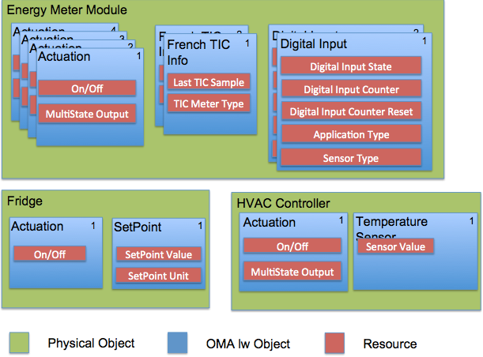
Example 3: Composite Object

Slide 14
IPSO Object Linking
 | 8300 – IPSO Thermostat
Input Link (7100) | 3303/0
Setpoint Link (7101) | 3308/0
Output Link (7102) | 3306/0
Application Type (5750) | Thermostat
New LWM2M data type: Object Link
Composite objects can be built using by referring to other objects instead of explicitly adding resources.
Similar to the web-like pattern, following links.
Linked objects are serialized inline using SenML.
3303/0– IPSO Temperature
3303/0– IPSO Setpoint
3303/0– IPSO Actuation

Slide 15
Roadmap
☐ UPnP harmonization – from SOAP to REST.
☐ Schema.org for registration of instances and schemas
☐ BLE/ZigBee harmonization.
✔ Draft Smart Object Data Model Design Guide @done (15-03-30)
✔ Draft Smart Object Expansion Pack for Basic Objects @done (15-04-30)
✔ Set up test servers for IPSO objects (LWM2M + TLV payload) @done (15-06-15)
☐ Draft Domain Specific Objects reference designs @due (mid 2015)
☐ Publish Smart Object Data Model Design Guided @due(15-07-31)
☐ Publish Smart Object Expansion Pack for Basic objects @due(15-07-31)
☐ Publish Smart Object Expansion Pack for Composite Objects @due(15-07-31)
☐ Publish Smart Object Expansion Pack for Reference Devices @due(15-07-31)
☐ IETF 93 – Bits and Bites @due(15-09-1)
Notes:
At the moment we are working with other standards in order to come together to a common data model. For example with UPnP we are currently trying to harmonize the large amount of resuorce descriptions in UPnP with the IPSO Objects. Some of the challenges here is that UPnP uses more of a SOAP approach with its Message Exchange Pattenrs than a REST-based one.
Interworking with TR69, ZigBee, BLE and how to harmonize them so that there is one set.
We have also some deadlines, this list is taken from our item activity document. So basically we are setting up some test servers for continuous testing of Smart Objects, in this case over IPv6 and LWM2M.
We are also working on various expansion packs, like the domain specific objects (GW Objects, Home Appliances, etc)
We have to produce a standalone schema on how to construct the objects and how clients and servers are supposed to use them.
We are also working on Composite objects, by using a new data type that represents a link. So that we will have resources that do not only map to a specific resource, rather it will be more like the web and we will use linking instead.
Also we will have a session in November in the IETF bits and bites. There we will show how objects work, some examples, how to create them and so on.

Slide 16


