Slide 1
Introduction to IPSO Smart Objects
Jaime Jiménez, Ericsson Research, IPSO Smart Objects co-chair.
jaime.jimenez@ericsson.com
Some slides are from Michael Koster ARM, IPSO Smart Objects Chair.
michael.koster@arm.com
June 17th, 2015

Slide 2
The Web
Narrow Waist
Innovation happening on endpoints.
Stateless Interaction
REST APIs
HTTP client/server model and a request/response communication model.
HTTP stateless methods to indicate the server what to do. (GET, POST, PUT, HEAD, DELETE, TRACE).
Focus on Resources and Content
Support of extensive representation formats (e.g. HTML, JSON, XML etc.)
Web content can be anything (HTML files, images, video…) each piece of information is a resource.
Uniform Addressing
Resources are identified URIs, either by location or by name.
Hyperlinks pointing to resources.
IP addressing and global DNS.
Notes:
A lot of the problems that we have today for IoT, have already been already solved by the web. Some of the web properties can be very useful for IoT.
First of all, the narrow waist, which means that the value is created at the endpoints and everything in between is communication infrastructure.
Those endpoints communicate using REST APIs that do not require to keep a state. It also defines different roles for the endpoints as clients and servers and defines a set of stateless methods to interact between them.
The web focuses on resources and on the content hosted by the endpoints. It supports multiple representation formats (HTML, JSON…) and identifies each piece of information as a resource. Basically a resource can be anything.
It also brings Uniform Addressing, regardless of the resource it can be found via a URI and a Hyperlink can point to it. IP addresses and DNS are unique which makes the web global and easily scalable.

Slide 3
Constrained Application Protocol (CoAP)
It is a RESTful protocol for constrained devices and networks. Similar to HTTP:
Client/server & Request/Response
GET, POST, PUT and DELETE Methods
Same key concepts (Media types, URL, URN…)
The well-known URI
coap://[2001:db8::2:1]/.well-known/core
Resource discovery via the Resource Directory (RD)
Request coap://HOST_ADDRESS:PORT_NUMBER/PATH?QUERY
Response coap://ericsson.com:5683/rd/jorvas/room/541/temperature/
IPv6 oriented (using 6LowPAN)
UDP preferred instead of TCP, SMS also possible
Reliability is ensured by using with different message types:
Confirmable (CON), non-confirmable (NON), acknowledgement (ACK) and reset (RST).
Observe/Notify, adding an “observe” flag in the CoAP GET Request
Introduces a Publish/Subscribe model for constrained devices.
Notes:
CoAP is the Constrained Application Protocol by the IETF for constrained devices and networks. CoAP is the equivalent of HTTP but for constrained devices. From HTTP it takes multiple characteristics:
It is also client/server type, although endpoints will often be both, so it’d be more of a P2P scenario.
It also uses a smaller subset of methods to operate on resources.
Same key concepts like media types, Url, URN, etc.
Some of the new things is that it provides some resource discovery mechanisms via the well-known ur that CoAP devices should implement, so that other endpoints can get the list of resources hosted on that endpoint.
It also provides Resource Discovery via the RD, The new things is that it provides Resource Discovery via the RD.
Oriented to be used over IPv6 by means of a translation layer for constrained devices (6LowPAN).
Instead of using TCP mainly, it uses UDP or SMS bindings. Therefore to fix the problem of reliability it uses some fields in the application protocol (CoAP) to request a confirmation if needed.
And last it also has a simple but very versatile publish subscribe mechanism with the Observe flag.

Slide 4
Web Linking for Constrained Devices
RFC6690 Constrained RESTful Environments (CoRE) Link Format.
Reuses Web Linking RFC5988 for IoT.
Defines semantic link serialization and M2M content types.
GET ./well-known/core?optional_query_string.
Enables query string parameters for discovery by attribute and relation (rt, if, sz). The response looks like:
<3303/0/5700>;rt=“ipso:temp”;ct=“0”;obs=1
Links are discovered using GET with content type “application/link-format”
JSON representation using GET with content type “application/link-format+json”
Resource Type
ContentType
Observable
Notes:
CoAP Core_Link RFC6690 expands the definitions on the web linking RFC and expands it for IoT.
RFC6690 defines the serialization of links in a formal way as well as defining specific M2M content types.
It also defines a well-known resource which is the well-known/core which is globally reserved. Also can be used with HTTP since it is also reserved there.
This well-known resource can accept optional query string parameters. So we could use this new content types and resources types to find resources on the device based on attribute and relation. You can see that we are requesting an IPSO temperature resource, with content type 0 (plaintext) and that it has to be observable.
In order to find them and see the links, we can use GET message with content type and the representation that we want (for example JSON)

Slide 5
Discovery for Constrained Devices
CoRE Link defines
Link format
Device to device discovery.
Resource Directory draft adds
Sleepy node support.
No multicast needed.
Remote lookup, hierarchical and federated distribution.
Core Link is also used in RD
EP POST (register) resource links to RD.
EP PUT (refresh) to RD.
EP DELETE (remove) their RD entry.
EP RD
| |
| ----- GET /.well-known/core?rt=core.rd* ------> |
| |
| |
| <---- 2.05 Content "</rd>; rt="core.rd" ------ |
| |
Req: GET coap://[ff02::1]/.well-known/core?rt=core.rd*
Res: 2.05 Content
</rd>;rt="core.rd",
</rd-lookup>;rt="core.rd-lookup",
</rd-group>;rt="core.rd-group"
Notes:
So, CoRE links defines the link format and how to discover resources from one device to another and that is useful if they are on the same network.
For cases of multiple subnets or over the internet, it makes sense to use a directory of resources.
Clients can discover resources by querying the RD and getting the URIs to those resources. Similarly like a reverse search engine.
Sleepy endpoints can register their resources with POST messages.
They can also update resources or delete them.
Lookups can be made with CoAP from the EP or via normal HTTP.

Slide 6
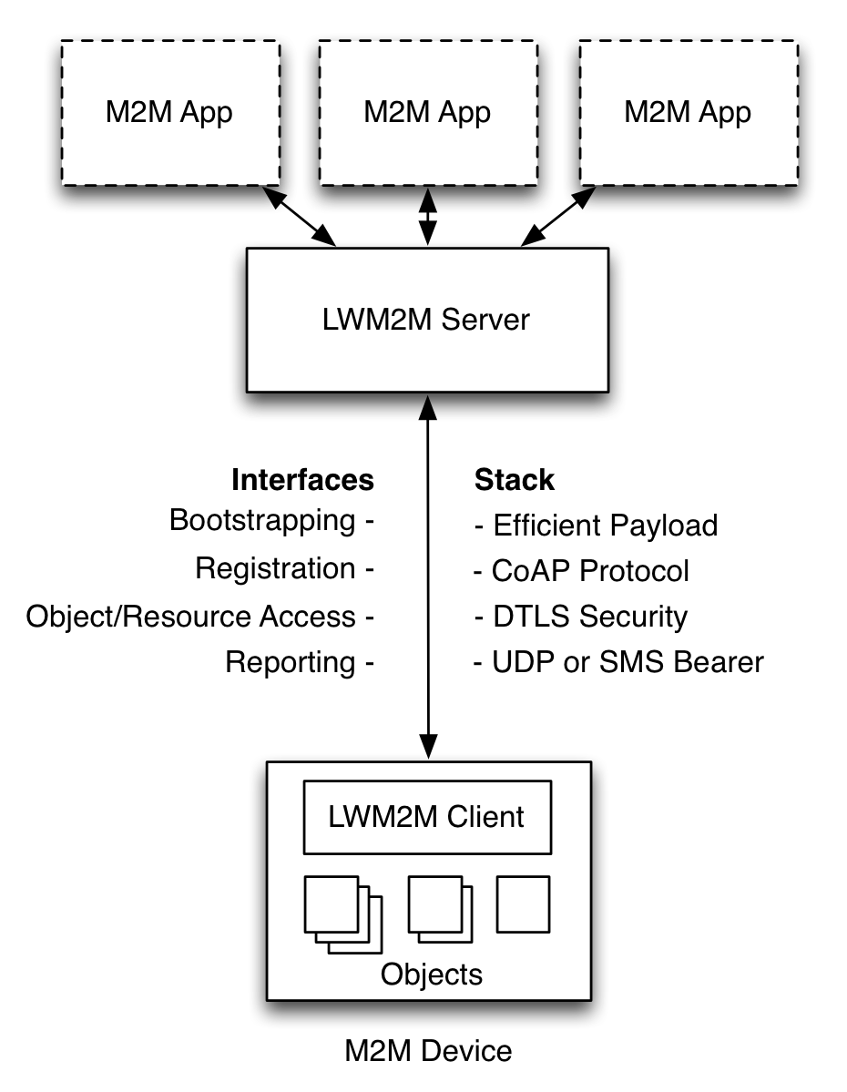
OMA Lightweight M2M (LWM2M)
Based on CoAP (runs on top) and used for management and control of constrained devices
Provides a set of interfaces for managing of constrained devices.
Bootstrap
Registration
Information Reporting
Device Management
Service Enablement
Also allows for operations on objects (RWX, Access Control, Observation, Notification)
Offers a simple and reusable object based model.
Notes:
A third protocol that appears in the picture is OMA LWM2M
In a way it extends CoAP with few interfaces that provide bootstrap, registration…. For the constrained device.
LWM2M also ads the possibility to operate on the device’s resources, adding read write, execute options, access control , …)
More importantly, those resources acquire a new dimension since they have a structure that allows for extensibility and interoperability. LWM2M introduces the use of a simple and resusable object mode.
This object model is the one that IPSO has taken and extended to support new object types, new devices and new sensor types.

Slide 7


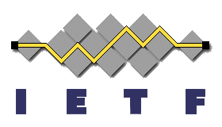
The Web in constrained devices
Applications
Application
IPSO Objects
Data Models
LWM2M
Web Server
API / Services
CoAP
HTTP
Application Protocol
6LowPAN
IPv4 / IPv6
Routing
802.15.4
Wifi, Ethernet, LTE, …
HW Network
MCU
MPU
Hardware

Slide 8
IPSO Smart Objects
Developed by IP for Smart Objects (IPSO) Alliance in the Smart Objects Working Group.
Work exclusively on semantic Interoperability across IoT devices and applications.
Based on LWM2M Object Model.
Reusable Object IDs and Resource IDs.
Transport Protocol Independent (CoAP, LWM2M, MQTT, HTTP…) if support addressing, content formats and data types.
Encoding Independent (JSON, TLV, SenML…)
Basic Objects represent simple sensors and actuators.
Basic Starter Pack published on 2014 (Expansion Pack upcoming).
Tested over CoAP and LWM2M during IPSO Interoperability test on May 2015 (ARM, Ericsson, Intel, SICS, Yanzi, TUT …) .
Notes:
IP for Smart Objects is an Alliance of several companies, you can find that information on the IPSO Alliance Website. IPSO has few committees, among those the IPSO Smart Objects Committee where we define Smart Objects.
The overall goal is for semantic interoperability btw devices (sensors and actuators) and the applications that use them. We are creating a standard set of semantics that can be used to provide plug and play interoperability btw devices and applications.
We have taken the LWM2M Object model almost as it is. LWM2M Objects are used for management of devices, they provide a clear URI format for addressing those management objects, as well as access control, instantiation and resources.
In IPSO we extend that model with the concept of reusable resources. The goal is that if you have some specific sensor, you can take one of the existing IPSO Objects and use it as it is or take its resources and extend it to suit your particular device characteristics.
We have designed IPSO Objects to be transport protocol independent. It obviously supports CoAP as it is based on LWM2M objects, but people have used them with MQTT or HTTP as well. So you can basically send the object data over as long as you support the basic data types and content formats.
Also for serialization it will depend on the protocol, can be TLV, JSON, plain text . For example we have successfully done interop tests with TLV and plaintext.
We have already released a basic set of smart objects last year, with some very common sensors and actuator templates, you can go and have a look at the website or you can let us know if you are interested on using them or give feedback and so on.
We also have tested it between the partners in IPSO few weeks ago. Each brought their own implementation of IPSO objects, we used CoAP LWM2M for the application layer and tested it over an IPv6 network

Slide 9
IPSO Smart Object Structure
Reusable Data Model for Constrained Devices
Across domains
Reusable resource and object IDs
Common definitions for concepts
Map to semantic terms e.g. temperature, currentValue
IDs are registered with the OMNA
Usable in different transport protocols that support
URI Addressing
(…/home/weather/3303/0/5700)
Data Types
Content Formats
RWX Operations
3303/0/5700
Object ID, defines object type
Object Instance, one or more
Resource ID, defines resource type
Notes:
IPSO Smart Objects tries to bring to the picture a set of reusable resources that can be used across domains.
We take the OMA LWM2M Object model and define a new set of Objects

Slide 10
Example 1: IPSO Humidity Sensor
Object | Object ID | Object URN | Multiple Instances? | Description
IPSO Humidity | 3304 | urn:oma:lwm2m:ext:3304 | Yes | Relative humidity sensor, example units = %
Resource Name | Resource ID | Access Type | Multiple Instances? | Mandatory | Type | Range or Enumeration | Units | Descriptions
Sensor Value | 5700 | R | No | Mandatory | Float |  |  | Last or Current Measured Value from the Sensor
Units | 5701 | R | No | Optional | String |  |  | Measurement Units Definition e.g. “Cel” for Temperature in Celsius.
Min Measured Value | 5601 | R | No | Optional | Float | Same as Measured Value | Same as Measured Value | The minimum value measured by the sensor since power ON or reset
Max Measured Value | 5602 | R | No | Optional | Float | Same as Measured Value | Same as Measured Value | The maximum value measured by the sensor since power ON or reset
Min Range Value | 5603 | R | No | Optional | Float | Same as Measured Value | Same as Measured Value | The minimum value that can be measured by the sensor
Max Range Value | 5604 | R | No | Optional | Float | Same as Measured Value | Same as Measured Value | The maximum value that can be measured by the sensor
Reset Min and Max Measured Values | 5605 | E | No | Optional | Opaque |  |  | Reset the Min and Max Measured Values to Current Value

Slide 11
Example 2: New Reusable Object
Object | Object ID | Object URN | Multiple Instances? | Description
Company Humidity | n | urn:company:ext:1 | Yes | Relative humidity sensor, example units = %
Resource Name | Resource ID | Access Type | Multiple Instances? | Mandatory | Type | Range or Enumeration | Units | Descriptions
Sensor Value | 5700 | R | No | Mandatory | Float |  |  | Last or Current Measured Value from the Sensor
Units | 5701 | RW | No | Optional | String |  |  | Measurement Units Definition e.g. “Cel” for Temperature in Celsius.
Reset Units | 12000 | E | No | Optional | Opaque |  |  | Reset the Min and Max Measured Values to Current Value
On/Off | 5850 | R, W |  | Mandatory | Boolean |  |  | This resource represents an on/off actuator, which can be controlled, the setting of which is a Boolean value (1,0) where 1 is on and 0 is off.
Notes:
For example you can create a new object for your specific device by reusing the humidity object but adapting it to your own.

Slide 12
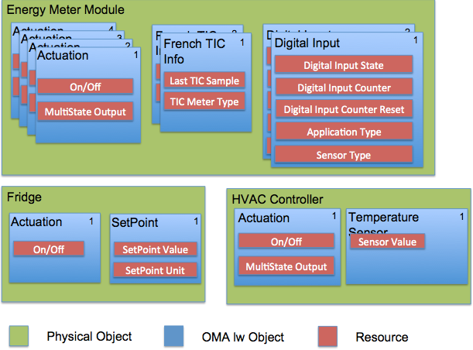
Example 3: Composite Object

Slide 13
IPSO Object Linking
 | 8300 – IPSO Thermostat
Input Link (7100) | 3303/0
Setpoint Link (7101) | 3308/0
Output Link (7102) | 3306/0
Application Type (5750) | Thermostat
New LWM2M data type: Object Link
Composite objects can be built using by referring to other objects instead of explicitly adding resources.
Similar to the web-like pattern, following links.
Linked objects are serialized inline using SenML.
3303/0– IPSO Temperature
3303/0– IPSO Setpoint
3303/0– IPSO Actuation
Notes:
Another way of creating composite objects is by using Object Links.
So instead of nesting JSON we have one level plus linking, more like in the web.
It would look the same once serialized with SenML but is actually links.
This kind of pattern could be use also for controllers since the links are typed, so you could substitute the links for something else like the data coming from a dial, or some other device that has an user interface.

Slide 14
Roadmap
☐ UPnP harmonization – from SOAP to REST.
☐ Schema.org for registration of instances and schemas
☐ BLE/ZigBee harmonization.
✔ Draft Smart Object Data Model Design Guide @done (15-03-30)
✔ Draft Smart Object Expansion Pack for Basic Objects @done (15-04-30)
✔ Set up test servers for IPSO objects (LWM2M + TLV payload) @done (15-06-15)
☐ Draft Domain Specific Objects reference designs @due (mid 2015)
☐ Publish Smart Object Data Model Design Guided @due(15-07-31)
☐ Publish Smart Object Expansion Pack for Basic objects @due(15-07-31)
☐ Publish Smart Object Expansion Pack for Composite Objects @due(15-07-31)
☐ Publish Smart Object Expansion Pack for Reference Devices @due(15-07-31)
☐ IETF 93 – Bits and Bites @due(15-09-1)
Notes:
At the moment we are working with other standards in order to come together to a common data model. For example with UPnP we are currently trying to harmonize the large amount of resuorce descriptions in UPnP with the IPSO Objects. Some of the challenges here is that UPnP uses more of a SOAP approach with its Message Exchange Pattenrs than a REST-based one.
Interworking with TR69, ZigBee, BLE and how to harmonize them so that there is one set.
We have also some deadlines, this list is taken from our item activity document. So basically we are setting up some test servers for continuous testing of Smart Objects, in this case over IPv6 and LWM2M.
We are also working on various expansion packs, like the domain specific objects (GW Objects, Home Appliances, etc)
We have to produce a standalone schema on how to construct the objects and how clients and servers are supposed to use them.
We are also working on Composite objects, by using a new data type that represents a link. So that we will have resources that do not only map to a specific resource, rather it will be more like the web and we will use linking instead.
Also we will have a session in November in the IETF bits and bites. There we will show how objects work, some examples, how to create them and so on.

Slide 15
References
IPSO Smart Object Guidelines
http://www.ipso-alliance.org/smart-object-guidelines
https://github.com/IPSO-Alliance (requires access)
OMA LWM2M Specification
http://technical.openmobilealliance.org/Technical/technical-information/release-program/current-releases/oma-lightweightm2m-v1-0
IETF CoAP References
CoAP (RFC 7252)
https://tools.ietf.org/html/rfc7252
CoRE Link-Format (RFC 6690)
https://tools.ietf.org/html/rfc6690
CoRE Resource Directory
https://tools.ietf.org/html/draft-ietf-core-resource-directory-02
CoRE CoAP PubSub Broker
https://tools.ietf.org/html/draft-koster-core-coap-pubsub
Notes:
At the moment we are working with other standards in order to come together to a common data model. For example with UPnP we are currently trying to harmonize the large amount of resuorce descriptions in UPnP with the IPSO Objects. Some of the challenges here is that UPnP uses more of a SOAP approach with its Message Exchange Pattenrs than a REST-based one.
Interworking with TR69, ZigBee, BLE and how to harmonize them so that there is one set.
We have also some deadlines, this list is taken from our item activity document. So basically we are setting up some test servers for continuous testing of Smart Objects, in this case over IPv6 and LWM2M.
We are also working on various expansion packs, like the domain specific objects (GW Objects, Home Appliances, etc)
We have to produce a standalone schema on how to construct the objects and how clients and servers are supposed to use them.
We are also working on Composite objects, by using a new data type that represents a link. So that we will have resources that do not only map to a specific resource, rather it will be more like the web and we will use linking instead.
Also we will have a session in November in the IETF bits and bites. There we will show how objects work, some examples, how to create them and so on.

Slide 16


