Slide 1

GROUP 2T:
Nguyễn Thành Đức Trí (leader)
Bùi Duy Thanh

Slide 2
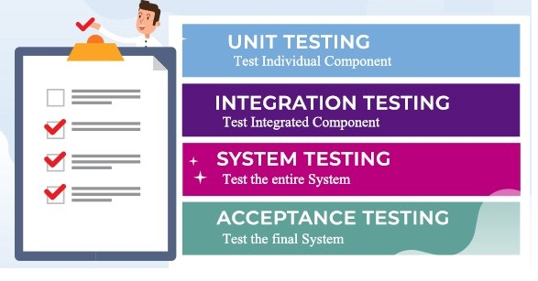
TEST LEVELS

Slide 3

CONTENTS.
1
COMPONENT TESTING.
2
INTEGRATION TESTING.
3
SYSTEM TESTING.
4
ACCEPTANCE TESTING.

Slide 4
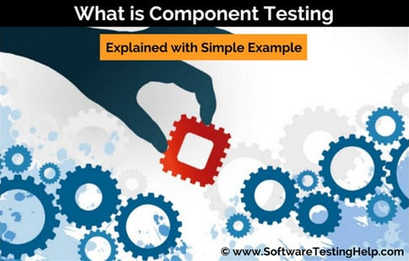
1
COMPONENT TESTING

Slide 5
1
COMPONENT TESTING
Component testing (also known as unit, module or program testing) searches for defects in, and verifies the functioning of, software modules, programs, objects, classes, etc.,
Stubs, drivers and simulators may be used.
In practice, component testing usually involves the programmer who wrote the code

Slide 6
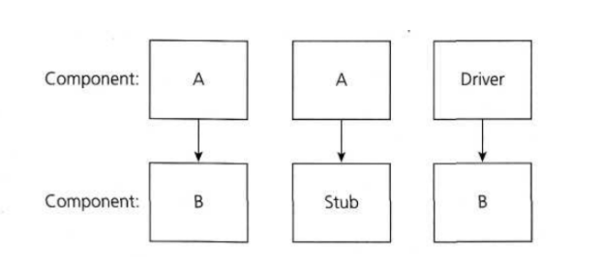
1
COMPONENT TESTING

Slide 7

2
INTEGRATION TESTING

Slide 8
2
INTEGRATION TESTING
Integration testing tests interfaces between components, interactions with different parts of a system, such as the operating system
Approach: Big-Bang Top-down method Bottom-up method Funtional incremental
Tester is responsible for the unit test

Slide 9

3
SYSTEM TESTING

Slide 10

3
SYSTEM TESTING
System testing is concerned with the behavior of a whole system/product.
In system testing, the test environment should correspond to the final target.
System testing should investigate both functional and non-functional requirements
Black box testing techniques

Slide 11
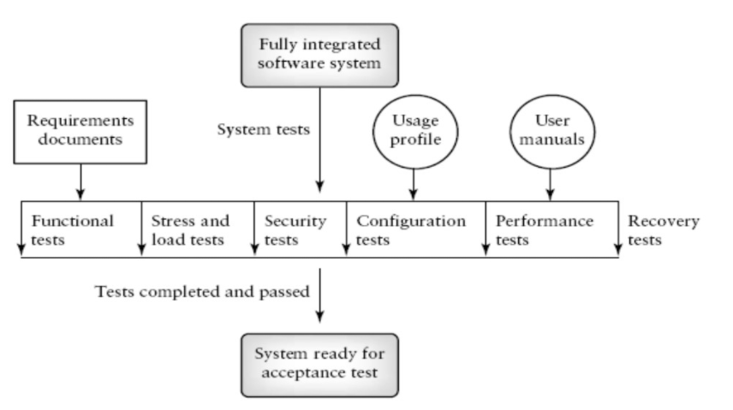
3
SYSTEM TESTING

Slide 12

4
ACCEPTANCE TESTING

Slide 13

4
ACCEPTANCE TESTING
Acceptance testing is often the responsibility of the customers or users of a system.
Finding defects should not be the main focus in acceptance testing

Slide 14

4
ACCEPTANCE TESTING
Some acceptance testing types
Testing of backup/restore;
Disaster recovery;
User management;
Maintenance tasks;
Periodic checks of security vulnerabilities.

Slide 15

THANK YOU

