Slide 1

GROUP 2T:
Nguyễn Thành Đức Trí (leader)
Bùi Duy Thanh

Slide 2

TEST TYPES

Slide 3

CONTENTS.
1
FUNCTIONAL TESTING
2
NON-FUNCTIONAL TESTING
3
STRUCTURAL TESTING
4
TESTING RELATE TO CHANGES

Slide 4
1
FUNCTIONAL TESTING
Functional testing is a type of testing that seeks to establish whether each application feature works as per the software requirements
Functional tests are based on functions and features (described in documents or understood by the testers) and their interoperability with specific systems, and may be performed at all test levels

Slide 5
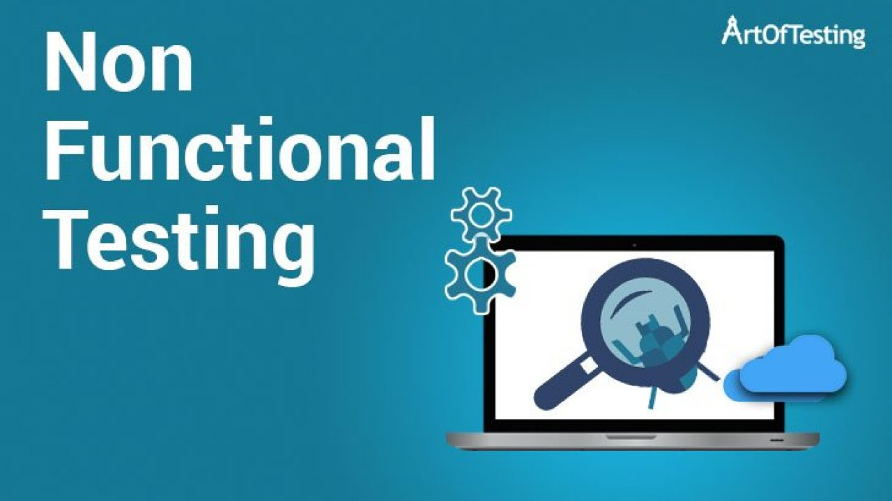
2
NON-FUNCTIONAL TESTING
Non-functional testing is done to verify the non-functional requirement of the application like Performance, Usability, etc

Slide 6
2
NON-FUNCTIONAL TESTING
Performance testing
Load testing
Stress testing
Usability testing
Maintainability testing
Reliability testing
Portability testing

Slide 7
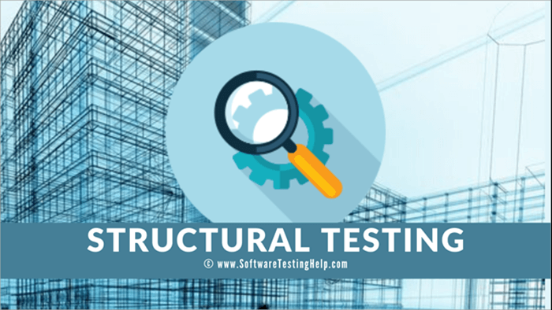
3
STRUCTURAL TESTING

Slide 8
3
STRUCTURAL TESTING
Structural testing, also known as glass box testing or white box testing is an approach where the tests are derived from the knowledge of the software's structure or internal implementation
Mostly applied at component & integration testing

Slide 9
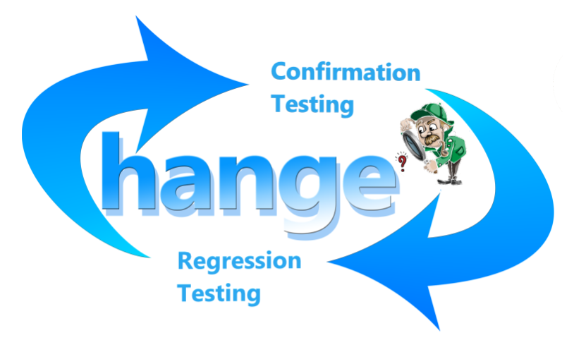
4
TESTING RELATE TO CHANGES

Slide 10

4
TESTING RELATE TO CHANGES
After a defect is detected and fixed, the software should be re-tested to confirm that the original defect has been successfully removed.
Confirmation testing
Regression Testing

Slide 11
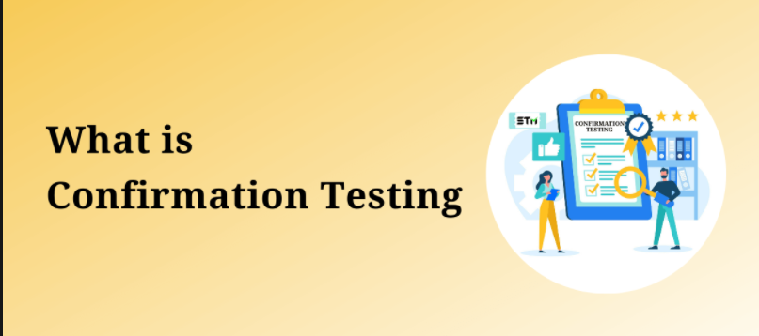
4
TESTING RELATE TO CHANGES
CONFIRMATION TESTING

Slide 12
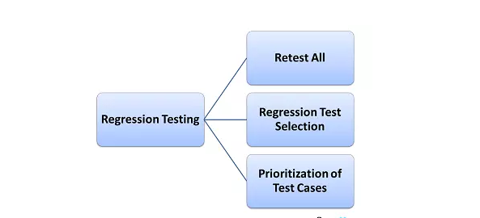
4
TESTING RELATE TO CHANGES
REGRESSION TESTING
What is regression testing?
When we do Regression Testing?
Need a complete plan
Method for Regression Testing

Slide 13

THANK YOU

