Slide 1
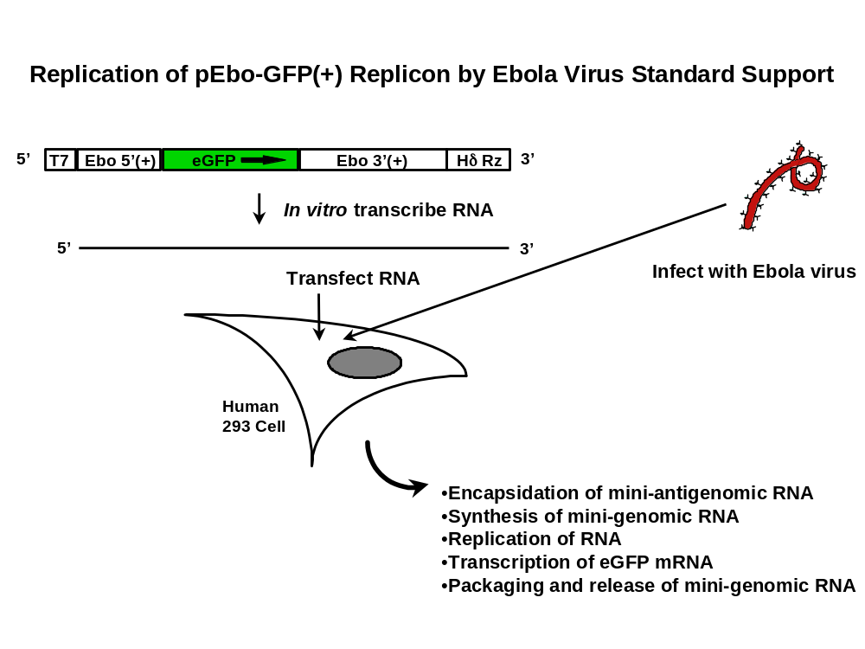
Title Here – centered across top of page
Authors Here
Institution Here
Start over on this side with your abstract: Make the font a big enough size that people can actually read it from a few feet away – when standing at a poster session interpreting your work.
Note: that this font is 32 point, Arial
In vivo replication assay: To monitor for efficiency of replication a viral mini-genome system is employed. Cells are infected with standard support Ebola virus and then transfected with RNA that represents a mini-antigenomic version of the viral RNA. This RNA contains the open reading frame for enhanced green fluorescent protein (eGFP) surrounded by the non-coding sequences from the termini of the Ebola viral antigenome. In the cell, these terminal sequences are recognized by the support viral proteins such that replication and transcription occur, and the cell can be visualized as green. To assay for packaging, the supernatant from these cells is passaged onto fresh cells and these are again analyzed for the ability to produce GFP.
NOTE: Figure captions in a poster may include text that, in a paper, would be in the narrative. It is okay to move some procedural details into figure captions.
End over here with a list of references (or other notes or acknowledgements) that you feel need to be included).

