Slide 1
Using R to Introduce Students to Principal Component Analysis, Cluster Analysis, and Multiple Linear Regression
David Harvey
Pittcon 2018
http://bit.ly/2j10Hai

Slide 2
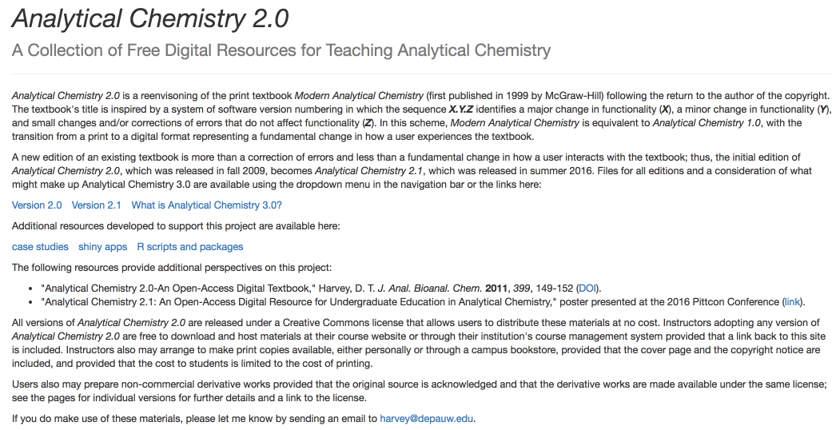
http://bit.ly/2j10Hai

Slide 3
Context
http://bit.ly/2j10Hai

Slide 4
Chem 351: Chemometrics
This course, Chem 351: Chemometrics, provides an introduction to how chemists and biochemists can extract useful information from the data they collect in lab, including, among other topics, how to summarize data, how to visualize data, how to test data, how to build quantitative models to explain data, how to design experiments, and how to separate a useful signal from noise.
Two 60 minute class periods per week for 14 weeks. Course is divided into 12 units.
Unit 1: Introduction
Unit 2: Basic Statistics
Unit 3: Distribution of Data
Unit 4: Confidence Intervals
Unit 5: Analysis of Variance
Unit 6: Linear Regression
Unit 7: 3D Visualizations
Unit 8: Experimental Design
Unit 9: Signal Processing
Unit 10: Principal Component Analysis
Unit 11: Cluster Analysis
Unit 12: Multiple Linear Regression
http://bit.ly/2j10Hai

Slide 5
R as a Tool for Teaching Chemometrics
data-centric programming language and environment for statistical computing
large number of users ensures longevity of software
base installation provides access to a wide variety of computational methods for processing data and tools for visualizing data
highly extensible through user-written scripts and packages of functions
available via Free Software Foundation’s GNU General Public License
versions for UNIX, Linux, Windows, and MacOS platforms
easy to interweave text, tables, and figures
base packages are very stable so code is resilient
for further details regarding R, see https://www.r-project.org/
Make R a tool, not a barrier. Emphasis is on adapting coding examples, using coding templates, using available packages, and using functions provided by instructor
http://bit.ly/2j10Hai

Slide 6
The Analytical System: Beer’s Law
stock standards
0.0500 M Cu²⁺
0.1000 M Co²⁺
0.0375 M Cr³⁺
0.1300 M Ni²⁺
all in 0.10 M HNO₃
samples prepared from stocks
single metal ions
binary mixtures of metal ions
ternary mixtures of metal ions
quaternary mixtures of metal ions
Spectra collected with a Vernier SpectroVis Plus spectrometer using Logger Pro 3 for data acquisition. Individual spectra exported as separate.csv files, combined into a single file, cleaned up, and saved as a single .csv file.
File has 80 rows (one per sample) and 642 columns (seven with information on composition of samples and absorbance values at 635 wavelengths).
This data set is brought into R using the readr package’s read_csv( ) function and then further subsetted within R to create individual data files.
R functions: readr::read_csv( )
http://bit.ly/2j10Hai

Slide 7
Prelude
http://bit.ly/2j10Hai

Slide 8
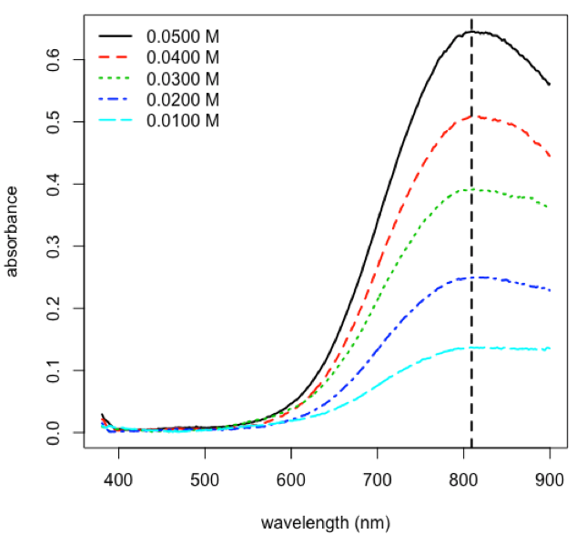
External Standardization for Copper
A_{λ,Cu} = ε_{λ,Cu}bC_{Cu}
plot spectra for set of standards and identify the wavelength of maximum absorbance
λ = 809.1 nm
R functions: matplot( ), legend( ), which.max( ), abline( )
http://bit.ly/2j10Hai

Slide 9
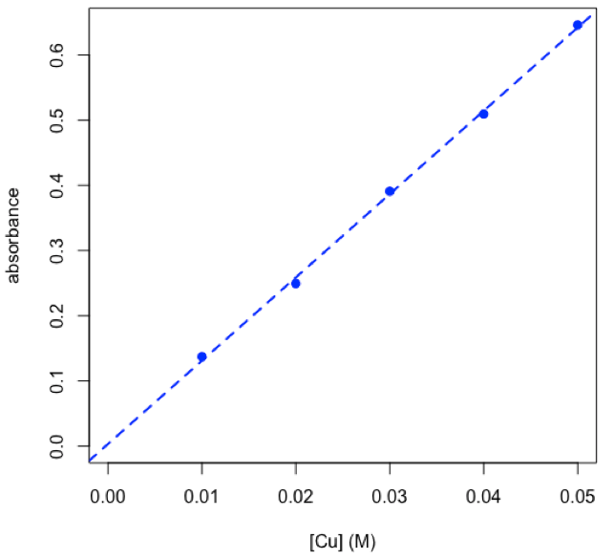
External Standardization for Copper
A_{λ,Cu} = ε_{λ,Cu}bC_{Cu}
plot spectra for set of standards and identify the wavelength of maximum absorbance
plot calibration data and determine equation for calibration curve
Coefficients: Estimate Std. Error t value Pr(>|t|)
(Intercept) 0.003202 0.008222 0.389 0.723
cuStd_conc 12.778883 0.247900 51.548 1.61e-05 ***
---Signif. codes: 0 ‘***’ 0.001 ‘**’ 0.01 ‘*’ 0.05 ‘.’ 0.1 ‘ ’ 1
Residual standard error: 0.007839 on 3 degrees of freedom
Multiple R-squared: 0.9989, Adjusted R-squared: 0.9985
F-statistic: 2657 on 1 and 3 DF, p-value: 1.608e-05
A = 12.78 M^{–1} × C + 0.0032
R functions: plot( ), lm( ), abline( ), summary( )
http://bit.ly/2j10Hai

Slide 10
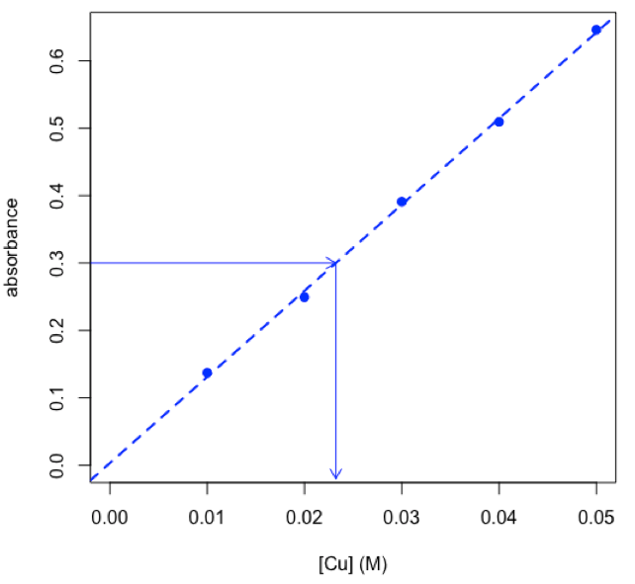
External Standardization for Copper
A_{λ,Cu} = ε_{λ,Cu}bC_{Cu}
plot spectra for set of standards and identify the wavelength of maximum absorbance
plot calibration data and determine equation for calibration curve
determine concentration of copper in an unknown using the chemCal package
$Prediction[1] 0.02322567
$`Standard Error`[1] 0.0006847376
$Confidence[1] 0.002179141
$`Confidence Limits`[1] 0.02104653 0.02540481
C_{cu} = 0.0232 M ± 0.0022 M
R functions: chemCal::inverse.predict( ), arrows( )
http://bit.ly/2j10Hai

Slide 11
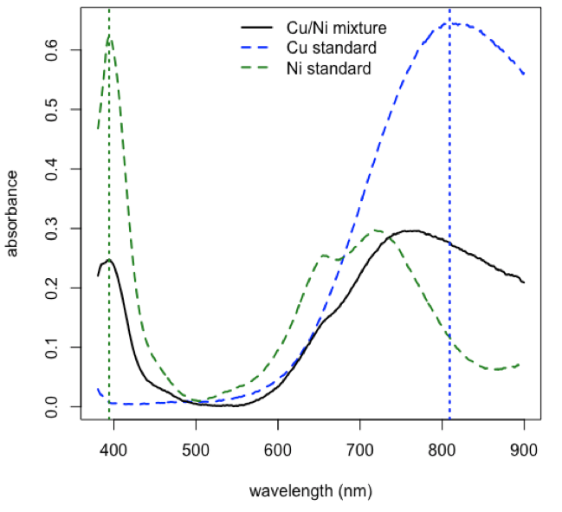
Analysis of Binary Mixture: Cu and Ni
A_{λ1,mix} = ε_{λ1,Cu}bC_{Cu} + ε_{λ1,Ni}bC_{Ni}
A_{λ2,mix} = ε_{λ2,Cu}bC_{Cu} + ε_{λ2,Ni}bC_{Ni}
plot spectra for a Cu standard, for a Ni standard, and for a mixture, and identify the wavelengths to use for the analysis
λ1 = 809.1 nm
λ2 = 394.2 nm
R functions: plot( ), lines( ), legend( ), which.max( ), abline( )
http://bit.ly/2j10Hai

Slide 12
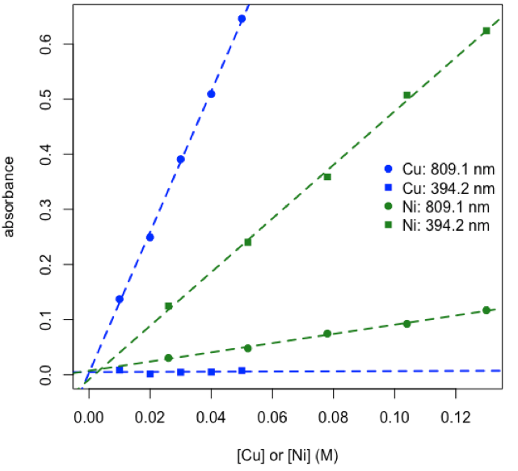
Analysis of Binary Mixture: Cu and Ni
A_{λ1,mix} = ε_{λ1,Cu}bC_{Cu} + ε_{λ1,Ni}bC_{Ni}
A_{λ2,mix} = ε_{λ2,Cu}bC_{Cu} + ε_{λ2,Ni}bC_{Ni}
plot spectra for a Cu standard, for a Ni standard, and for a mixture, and identify the wavelengths to use for the analysis
plot calibration data and determine values for εb for each metal at each wavelength
ε_{809.1,Ni}b = 0.837 M^{–1} and ε_{394.2,Νι}b = 4.870 M^{–1}
ε_{809.1,Cu}b = 12.78 M^{–1} and ε_{394.2,Cu}b = 0.017 M^{–1}
R functions: plot( ), legend( ), lm( ), abline( )
http://bit.ly/2j10Hai

Slide 13
Analysis of Binary Mixture: Cu and Ni
A_{λ1,mix} = ε_{λ1,Cu}bC_{Cu} + ε_{λ1,Ni}bC_{Ni}
A_{λ2,mix} = ε_{λ2,Cu}bC_{Cu} + ε_{λ2,Ni}bC_{Ni}
plot spectra for a Cu standard, for a Ni standard, and for a mixture, and identify the wavelengths to use for the analysis
plot calibration data and determine values for εb for each metal at each wavelength
use R’s solve function to calculate concentrations of copper and nickel in mixture
2×2 matrix of εb values
Cu Ni
809.1 nm 12.77888326 0.8369356
394.2 nm 0.01747073 4.8700205
2×1 matrix of absorbance values
mixture
809.1 nm 0.2789825
394.2 nm 0.2415476
calculate 2×1 matrix of concentrations where [eb] × [conc] = [abs]
mixture
Cu 0.01858748
Ni 0.04953220
C_{Cu} = 0.0182 M and C_{Ni} = 0.0506 M
R functions: matrix( ), colnames( ), rownames( ), solve( )
http://bit.ly/2j10Hai

Slide 14
Main Event
http://bit.ly/2j10Hai

Slide 15
Matrix Notation for Beer’s Law (A = εbC)
one analyte: one sample with absorbance measured at one wavelength
[A]₁ _{sample × 1 wavelength} = [C]₁ _{sample × 1 analyte} × [εb]₁ _{analyte × 1 wavelength}
two analytes: two samples with absorbance measured at two wavelengths
[A]₂ _{samples × 2 wavelengths} = [C]₂ _{samples × 2 analytes} × [εb]₂ _{analytes × 2 wavelengths}
overdetermined system: more samples and wavelengths than analytes
[A]₈ _{samples × 5 wavelengths} = [C]₈ _{samples × 2 analytes} × [εb]₂ _{analytes × 5 wavelengths} + [RE] _{8 samples × 5 wavelengths}
generalize: n analytes, s samples, and w wavelengths where n ≤ smaller of s or w
[A]_{s} _{× w} = [C]_{s} _{× n} × [εb]_{n} _{× w} + [RE] _{s × w}
http://bit.ly/2j10Hai

Slide 16
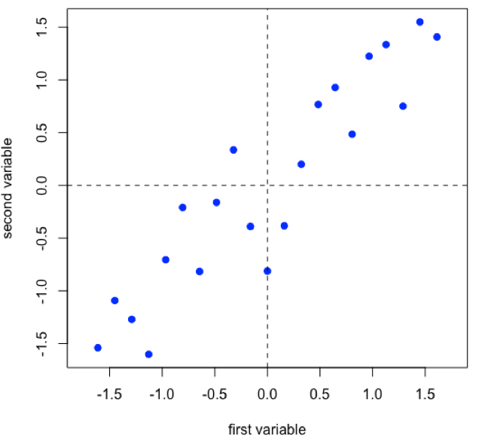
How Does PCA Work?
Suppose we have 21 samples and that we measure two properties—first variable and second variable—for each sample giving a matrix of data, [D], that has 21 rows and 2 columns.
[D]_{21 x 2}
R functions: seq( ), rnorm( ), scale( ), plot( ), abline( )
http://bit.ly/2j10Hai

Slide 17
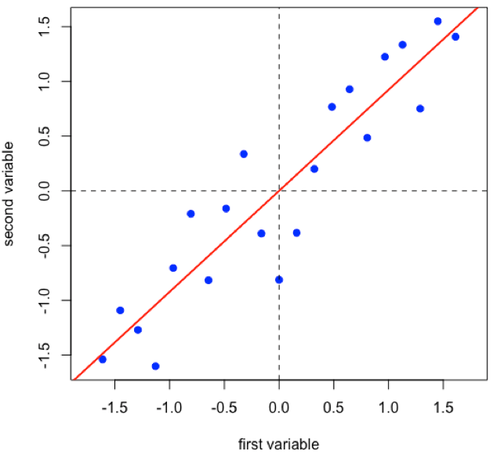
How Does PCA Work?
Linear regression provides the line of best fit to the data and explains more of the data’s overall variance than either of the two individual variables; we call this the first principal component.
R functions: lm( ), abline( )
http://bit.ly/2j10Hai

Slide 18
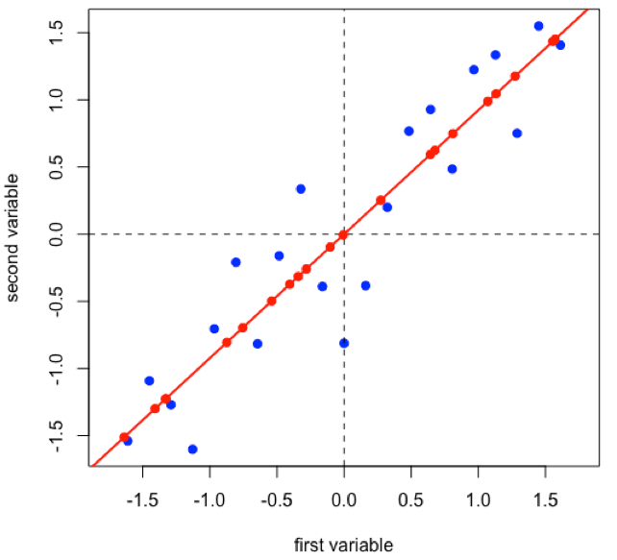
How Does PCA Work?
Projecting the data onto the regression line gives the location of the data on the first principal component; these are called scores, (S). The cosines of the angles between the first principal component and each of the original axes are called loadings, (L).
[D]_{21 x 2} = [S]_{21 x 1} × [L]_{1 x 2}
each sample has a score
each variable has a loading
R functions: points( )
http://bit.ly/2j10Hai

Slide 19
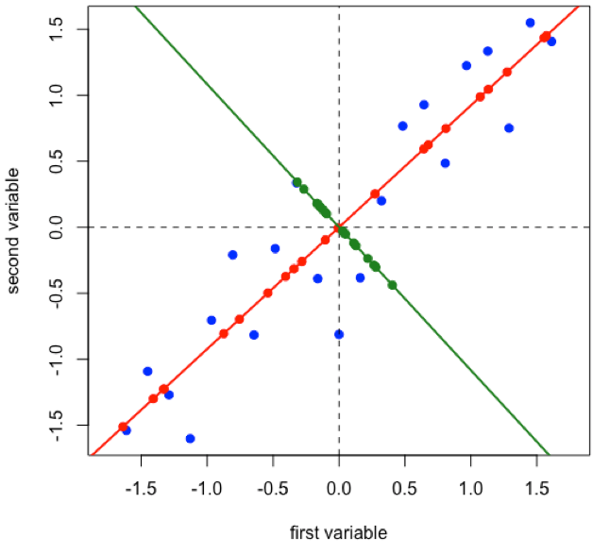
How Does PCA Work?
Projecting the original data onto a line that is perpendicular to the first principal component gives the second principal component and adds in a second set of scores and loadings.
[D]_{21 x 2} = [S]_{21 x 2} × [L]_{2 x 2}
R functions: abline( ), points( )
http://bit.ly/2j10Hai

Slide 20
How Does PCA Work?
Projecting the original data onto a line that is perpendicular to the first principal component gives the second principal component and adds in a second set of scores and loadings.
[D]_{21 x 2} = [S]_{21 x 2} × [L]_{2 x 2}
[A]_{s} _{× w} = [C]_{s} _{× n} × [εb]_{n} _{× w} + [RE] _{s × w}
R functions: abline( ), points( )
http://bit.ly/2j10Hai

Slide 21
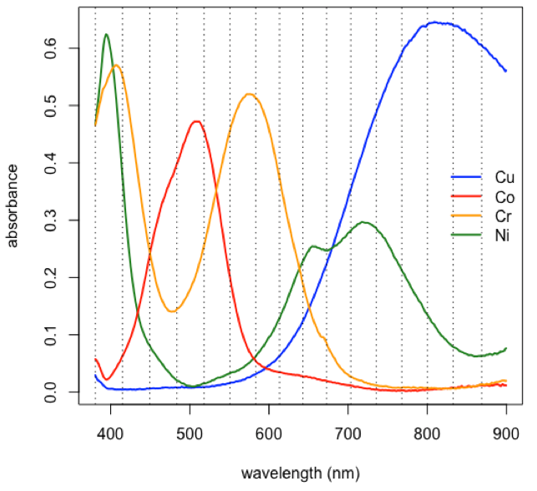
PCA: Worked Example
[A]_{s} _{× w} = [C]_{s} _{× n} × [εb]_{n} _{× w} + [RE] _{s × w}
Subset of data consisting of 24 of the 80 samples: stock Cu, stock Co, stock Cr, five Cu/Co binary mixtures, five Cu/Cr binary mixtures, five Co/Cr binary mixtures, six Cu/Co/Cr ternary mixtures.
choose a subset of the original 635 wavelengths
[1] 380.5 414.9 449.3 483.7 517.9 550.6 583.2 613.3
[9] 642.9 672.7 703.3 735.5 767.8 800.2 832.6 868.7
R functions: plot( ), lines( ), abline( ), legend( ), as.numeric( ), colnames( )
http://bit.ly/2j10Hai

Slide 22
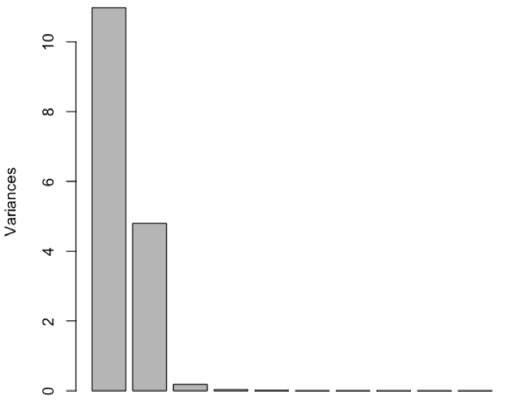
PCA: Worked Example
[A]_{s} _{× w} = [C]_{s} _{× n} × [εb]_{n} _{× w} + [RE] _{s × w}
Subset of data consisting of 24 of the 80 samples: stock Cu, stock Co, stock Cr, five Cu/Co binary mixtures, five Cu/Cr binary mixtures, five Co/Cr binary mixtures, six Cu/Co/Cr ternary mixtures.
choose a subset of the original 635 wavelengths
perform PCA and determine relative importance of the 16 principal components
PC1 PC2 PC3 PC4
Standard deviation 3.3134 2.1901 0.42561 0.17585
Proportion of Variance 0.6862 0.2998 0.01132 0.00193
Cumulative Proportion 0.6862 0.9859 0.99725 0.99919
R functions: prcomp( ), plot( ), summary( )
http://bit.ly/2j10Hai

Slide 23
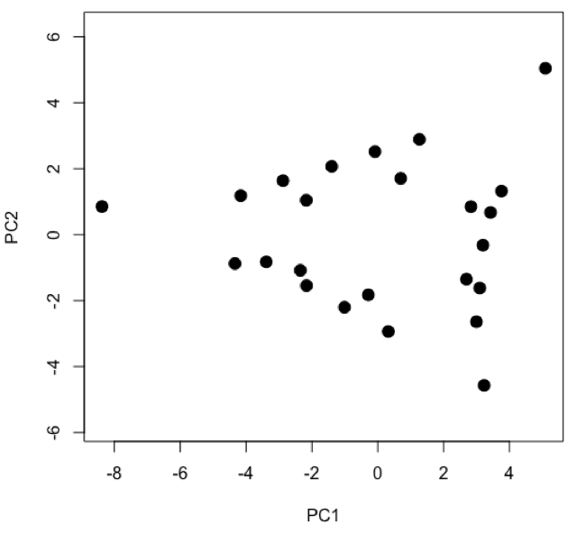
PCA: Worked Example
[A]_{s} _{× w} = [C]_{s} _{× n} × [εb]_{n} _{× w} + [RE] _{s × w}
Subset of data consisting of 24 of the 80 samples: stock Cu, stock Co, stock Cr, five Cu/Co binary mixtures, five Cu/Cr binary mixtures, five Co/Cr binary mixtures, six Cu/Co/Cr ternary mixtures.
choose a subset of the original 635 wavelengths
perform PCA and determine relative importance of the 16 principal components
examine and interpret scores for first two principal components
R functions: plot( )
http://bit.ly/2j10Hai

Slide 24
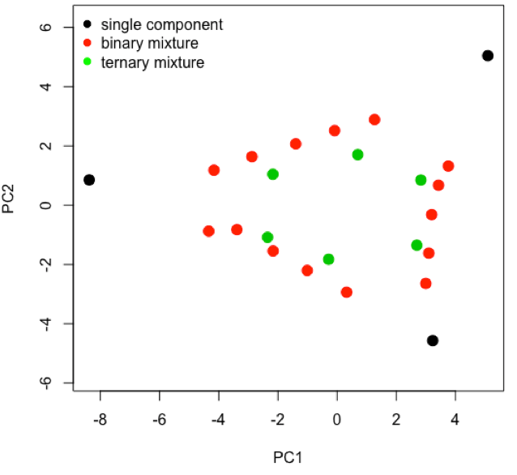
PCA: Worked Example
[A]_{s} _{× w} = [C]_{s} _{× n} × [εb]_{n} _{× w} + [RE] _{s × w}
Subset of data consisting of 24 of the 80 samples: stock Cu, stock Co, stock Cr, five Cu/Co binary mixtures, five Cu/Cr binary mixtures, five Co/Cr binary mixtures, six Cu/Co/Cr ternary mixtures.
choose a subset of the original 635 wavelengths
perform PCA and determine relative importance of the 16 principal components
examine and interpret scores for first two principal components
R functions: plot( ), factor( ), legend( )
http://bit.ly/2j10Hai

Slide 25
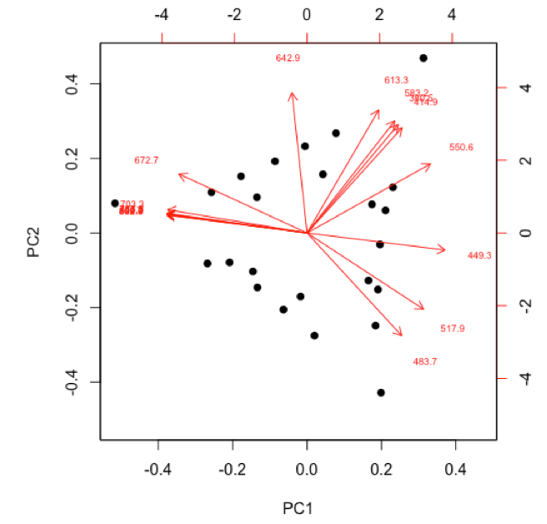
PCA: Worked Example
[A]_{s} _{× w} = [C]_{s} _{× n} × [εb]_{n} _{× w} + [RE] _{s × w}
Subset of data consisting of 24 of the 80 samples: stock Cu, stock Co, stock Cr, five Cu/Co binary mixtures, five Cu/Cr binary mixtures, five Co/Cr binary mixtures, six Cu/Co/Cr ternary mixtures.
choose a subset of the original 635 wavelengths
perform PCA and determine relative importance of the 16 principal components
examine and interpret scores for first two principal components
examine and interpret biplot of loadings and scores for the first two principal components
R functions: biplot( )
http://bit.ly/2j10Hai

Slide 26
PCA: Worked Example
http://bit.ly/2j10Hai

Slide 27
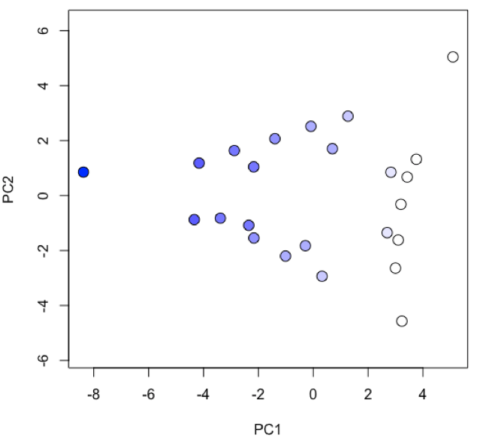
PCA: Worked Example
[A]_{s} _{× w} = [C]_{s} _{× n} × [εb]_{n} _{× w} + [RE] _{s × w}
Subset of data consisting of 24 of the 80 samples: stock Cu, stock Co, stock Cr, five Cu/Co binary mixtures, five Cu/Cr binary mixtures, five Co/Cr binary mixtures, six Cu/Co/Cr ternary mixtures.
choose a subset of the original 635 wavelengths
perform PCA and determine relative importance of the 16 principal components
examine and interpret scores for first two principal components
examine and interpret biplot of loadings and scores for the first two principal components
R functions: plot( ), colorRampPalatte( ), as.numeric( ), cut( )
http://bit.ly/2j10Hai

Slide 28
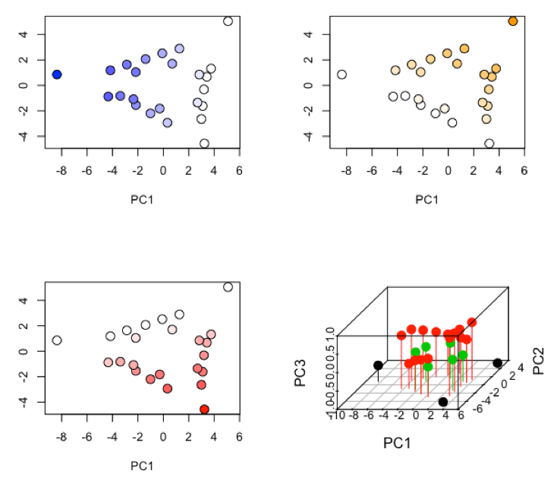
PCA: Worked Example
[A]_{s} _{× w} = [C]_{s} _{× n} × [εb]_{n} _{× w} + [RE] _{s × w}
Subset of data consisting of 24 of the 80 samples: stock Cu, stock Co, stock Cr, five Cu/Co binary mixtures, five Cu/Cr binary mixtures, five Co/Cr binary mixtures, six Cu/Co/Cr ternary mixtures.
choose a subset of the original 635 wavelengths
perform PCA and determine relative importance of the 16 principal components
examine and interpret scores for first two principal components
examine and interpret biplot of loadings and scores for the first two principal components
R functions: par( ), plot( ), scatterplot3d::scatterplot3d
http://bit.ly/2j10Hai

Slide 29
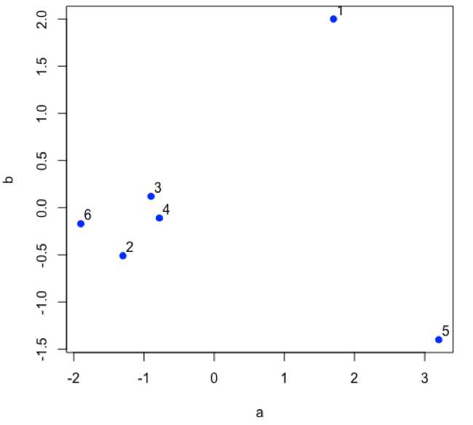
How Does Cluster Analysis Work?
Suppose we have six samples and that we measure two properties—a and b—for each sample and create a scatterplot of the data.
R functions: plot( )
http://bit.ly/2j10Hai

Slide 30
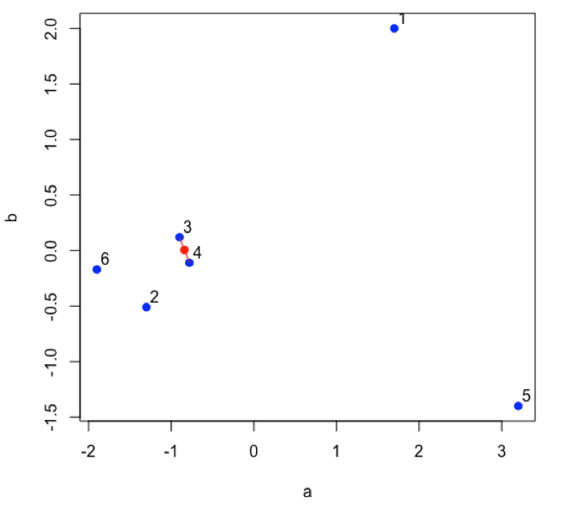
How Does Cluster Analysis Work?
Find the two points that are closest to each other; this is the first cluster. Find the midpoint between the two points and define it as the position of the first cluster.
R functions: plot( ), segments( ), points( )
http://bit.ly/2j10Hai

Slide 31
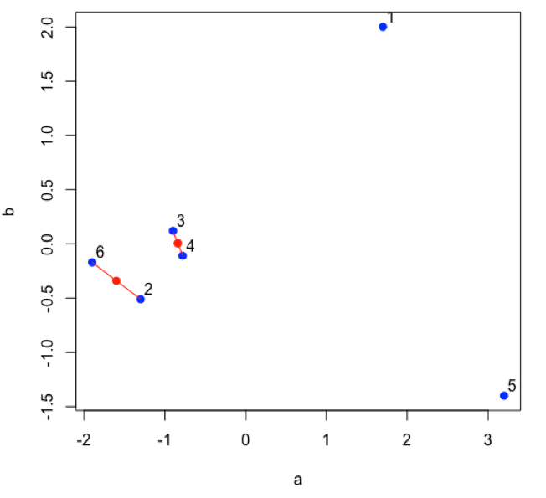
How Does Cluster Analysis Work?
Find the next two points that are closest to each other; this is the second cluster. Find the midpoint between the two points and define it as the position of the second cluster.
R functions: plot( ), segments( ), points( )
http://bit.ly/2j10Hai

Slide 32
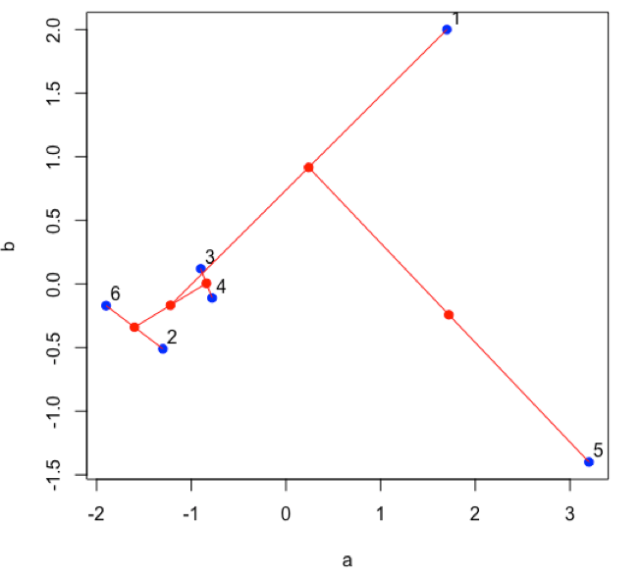
How Does Cluster Analysis Work?
Continue until all of the original data points are included in a cluster.
R functions: plot( ), segments( ), points( )
http://bit.ly/2j10Hai

Slide 33
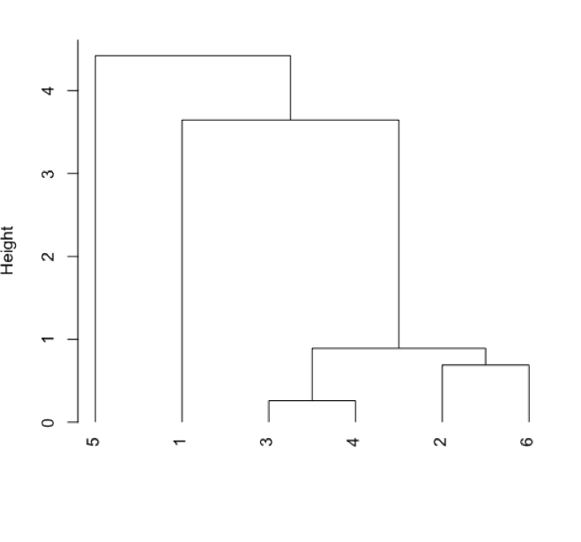
How Does Cluster Analysis Work?
Plot a dendrogram, which shows the connectivity between points and clusters of points in terms of the distance (heights) separating them.
R functions: dist( ), hclust( ), plot( )
http://bit.ly/2j10Hai

Slide 34
Cluster Analysis: Worked Example
Subset of data consisting of 24 of the 80 samples: stock Cu, stock Co, stock Cr, five Cu/Co binary mixtures, five Cu/Cr binary mixtures, five Co/Cr binary mixtures, six Cu/Co/Cr ternary mixtures.
calculate the distance between the individual data points using one of the available methods
1 2 3 4 5
2 1.53328104
3 1.73128979 0.96493008
4 1.48359716 0.24997370 0.77766228
5 1.49208058 0.32863786 0.68852029 0.09664215
6 1.49457333 0.42903074 0.57495499 0.21089686 0.11755129
R functions: dist( )
http://bit.ly/2j10Hai

Slide 35
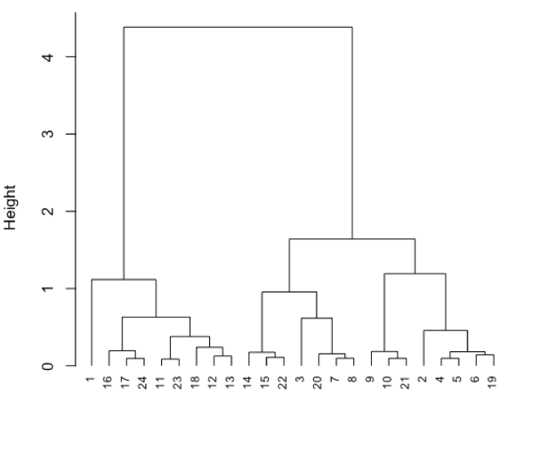
Cluster Analysis: Worked Example
Subset of data consisting of 24 of the 80 samples: stock Cu, stock Co, stock Cr, five Cu/Co binary mixtures, five Cu/Cr binary mixtures, five Co/Cr binary mixtures, six Cu/Co/Cr ternary mixtures.
calculate the distance between the individual data points using one of the available methods
identify clusters and calculate and plot the heights between them using one of the available methods
R functions: hclust( ), plot( )
http://bit.ly/2j10Hai

Slide 36
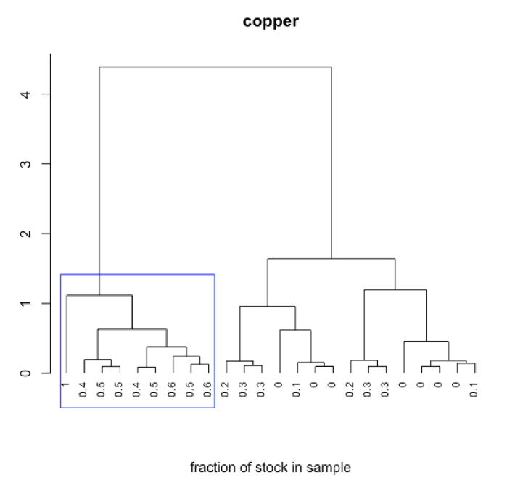
Cluster Analysis: Worked Example
Subset of data consisting of 24 of the 80 samples: stock Cu, stock Co, stock Cr, five Cu/Co binary mixtures, five Cu/Cr binary mixtures, five Co/Cr binary mixtures, six Cu/Co/Cr ternary mixtures.
calculate the distance between the individual data points using one of the available methods
identify clusters and calculate and plot the heights between them using one of the available methods
interpret dendrogram
R functions: plot( ), rect.hclust( )
http://bit.ly/2j10Hai

Slide 37
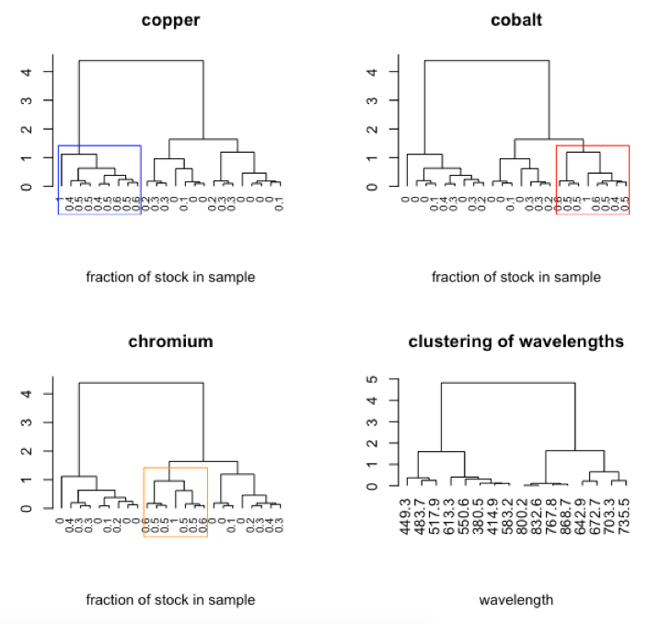
Cluster Analysis: Worked Example
Subset of data consisting of 24 of the 80 samples: stock Cu, stock Co, stock Cr, five Cu/Co binary mixtures, five Cu/Cr binary mixtures, five Co/Cr binary mixtures, six Cu/Co/Cr ternary mixtures.
calculate the distance between the individual data points using one of the available methods
identify clusters and calculate and plot the heights between them using one of the available methods
interpret dendrogram
R functions: par( ), plot( ), rect.hclust( ), t( )
http://bit.ly/2j10Hai

Slide 38
How Does MLR Work?
[A]_{s} _{× w} = [C]_{s} _{× n} × [εb]_{n} _{× w}
Suppose we measure the absorbance at W wavelengths for S individual standard solutions with known concentrations for each of the N analytes. We can use these to determine amatrix of εb values for each analyte at each wavelength.
[C]^{T}_{n} _{× s} × [A]_{s} _{× w} = [C]^{T}_{n} _{× s} × [C]_{s} _{× n} × [εb]_{n} _{× w}
([C]^{T}_{n} _{× s} × [C]_{s} _{× n})^{–1} ×[C]^{T}_{n} _{× c}×[A]_{s} _{× w} = ([C]^{T}_{n} _{× n}×[C]_{s} _{× n})^{–1} ×[C]^{T}_{n} _{× s}×[C]_{s} _{× n}×[εb]_{n} _{× w}
([C]^{T}_{s} _{× n} × [C]_{s} _{× n})^{–1} ×[C]^{T}_{s} _{× n}×[A]_{s} _{× w} = [εb]_{n} _{× w}
http://bit.ly/2j10Hai

Slide 39
How Does MLR Work?
[A]_{s} _{× w} = [C]_{s} _{× n} × [εb]_{n} _{× w}
Having found the εb matrix, we can use it to calculate the concentrations for each of the N analytes in S samples given the absorbance for each sample at each wavelength.
[A]_{s×w}×[εb]^{T}_{w×n} = [C]_{s×n}×[εb]_{n×w}×[εb]^{T}_{w×n}
[A]_{s×w}×[εb]^{T}_{w×n}× ([εb]_{n×w}×[εb]^{T}_{w×n})^{–1} = [C]_{s×n}×[εb]_{n×w}×[εb]^{T}_{w×n}× ([εb]_{n×w}×[εb]^{T}_{w×n})^{–1}
[A]_{s×w}×[εb]^{T}_{w×n}× ([εb]_{n×w}×[εb]^{T}_{w×n})^{–1} = [C]_{s×n}
http://bit.ly/2j10Hai

Slide 40
MLR: Worked Example
Standards are subset of data consisting of 15 of the 80 samples: five each prepared from stock Cu, stock Co, and stock Cr. Samples are subset of data consisting of 21 of the 80 samples: five Cu/Co binary mixtures, five Cu/Cr binary mixtures, five Co/Cr binary mixtures, six Cu/Co/Cr ternary mixtures.
use absorbance values for a set of standards to calculate the εb values
380.5 414.9 449.3 483.7 517.9 550.6 583.2 613.3
concCu 0.5484511 0.1086153 0.1340763 0.1556545 0.1947192 0.3612272 0.6875421 1.3197158
concCo 0.7117778 0.7918523 2.5371205 4.0549583 4.5779242 2.0489508 0.5975168 0.3914665
concCr 13.2668054 15.1576056 6.9958232 4.0685312 6.7662738 12.0692592 13.6134665 9.8289364
R functions: findeb( )*
* script written for this purpose
http://bit.ly/2j10Hai

Slide 41
MLR: Worked Example
Standards are subset of data consisting of 15 of the 80 samples: five each prepared from stock Cu, stock Co, and stock Cr. Samples are subset of data consisting of 21 of the 80 samples: five Cu/Co binary mixtures, five Cu/Cr binary mixtures, five Co/Cr binary mixtures, six Cu/Co/Cr ternary mixtures.
use absorbance values for a set of standards to calculate the εb values
use absorbance values for the samples and the calculated εb values to give the predicted concentrations of the analytes
predicted concentrations of analytes
concCu concCo concCr
[1,] -0.00024 0.05991 0.00696
[2,] -0.00037 0.04939 0.01050
[3,] 0.00036 0.03926 0.01488
[4,] 0.00075 0.03088 0.01879
[5,] -0.00031 0.01947 0.02227
[6,] 0.01040 0.06076 0.00079
R functions: findconc( )*
* script written for this purpose
http://bit.ly/2j10Hai

Slide 42
MLR: Worked Example
Standards are subset of data consisting of 15 of the 80 samples: five each prepared from stock Cu, stock Co, and stock Cr. Samples are subset of data consisting of 21 of the 80 samples: five Cu/Co binary mixtures, five Cu/Cr binary mixtures, five Co/Cr binary mixtures, six Cu/Co/Cr ternary mixtures.
use absorbance values for a set of standards to calculate the εb values
use absorbance values for the samples and the calculated εb values to give the predicted concentrations of the analytes
compare predicted and actual concentrations
predicted concentrations of analytes
concCu concCo concCr
[1,] -0.00024 0.05991 0.00696
[2,] -0.00037 0.04939 0.01050
[3,] 0.00036 0.03926 0.01488
[4,] 0.00075 0.03088 0.01879
[5,] -0.00031 0.01947 0.02227
[6,] 0.01040 0.06076 0.00079
actual concentrations of analytes
concCu concCo concCr
[1,] 0.000 0.06 0.00750
[2,] 0.000 0.05 0.01125
[3,] 0.000 0.04 0.01500
[4,] 0.000 0.03 0.01875
[5,] 0.000 0.02 0.02250
[6,] 0.010 0.06 0.00000
R functions: as.matrix( ), data.frame( )
http://bit.ly/2j10Hai

Slide 43
MLR: Worked Example
Standards are subset of data consisting of 15 of the 80 samples: five each prepared from stock Cu, stock Co, and stock Cr. Samples are subset of data consisting of 21 of the 80 samples: five Cu/Co binary mixtures, five Cu/Cr binary mixtures, five Co/Cr binary mixtures, six Cu/Co/Cr ternary mixtures.
use absorbance values for a set of standards to calculate the εb values
use absorbance values for the samples and the calculated εb values to give the predicted concentrations of the analytes
compare predicted and actual concentrations
report mean errors, standard deviations for errors, confidence intervals for errors, and identify maximum error for each analyte
concCu concCo concCr
-0.000304 -0.000199 -0.000315
concCu concCo concCr
0.001102 0.000857 0.000662
concCu concCo concCr
±0.002298 ±0.001787 ±0.001381
Cu: 0.00219 (0.02719 vs. 0.0250)
Co: 0.00176 (0.05176 vs. 0.0500)
Cr: 0.00173 (0.00173 vs. 0)*
* exceeds 95% confidence interval
R functions: as.matrix( ), data.frame( ), apply( ), which.max( ), abs( ), round( )
http://bit.ly/2j10Hai

Slide 44
Acknowledgments
students in Chem 351
Brian Saulnier
DePauw University’s Faculty Development Committee
stackoverflow
http://bit.ly/2j10Hai

Slide 45
http://bit.ly/2j10Hai

Slide 46
Preparation of Standards & Mixtures
stock standard solutions
0.0500 M Cu²⁺ (row 1)
0.1000 M Co²⁺ (row 6)
0.0375 M Cr³⁺ (row 11)
0.1300 M Ni²⁺ (row 16)
all in 0.10 M HNO₃
additional single metal standards
rows 2-5, 7-10, 12-15, 17-20
10, 20, 30, 40 mLs of stock solutions
diluted to 50 mL with 0.10 M HNO₃
binary mixtures
rows 21-25, 38-47, 60-64, 71-80
30:10, 25:15, 20:20, 15:25, 10:30 mLs of stock solutions
diluted to 50 mL with 0.10 M HNO₃
ternary mixtures
rows 32-37, 48-59, 65-70
15:5:25, 25:5:15, 5:15:25, 25:15:5, 5:25:15, 15:25:5 mLs of stock solutions
diluted to 50 mL with 0.10 M HNO₃
quarternary mixtures
rows 26-31
3:3:7:7, 3:7:3:7, 3:7:7:3, 7:3:3:7, 7:3:7:3, 7:7:3:3 mLs of stock solutions
diluted to 50 mL with 0.10 M HNO₃

Slide 47
Spectra for Copper Standards
allSpec = read.csv("allSpec.csv")
wavelengths = as.numeric(colnames(allSpec[8:642]))
matplot(wavelengths, t(allSpec[1:5, 8:642]), type = "l", lwd = 2, xlab = "wavelength (nm)", ylab = "absorbance)
legend("topleft", legend = c("0.0500 M", "0.0400 M", "0.0300 M", "0.0200 M", "0.0100 M"),
lty = 1:5, lwd =2, col = 1:5, bty = "n")
id = which.max(allSpec[1,8:642])
abline(v = wavelength[id], lwd = 2, lty = 2)

Slide 48
Calibration Curve for Copper Standards
plot(x = allSpec[1:5, 4], y = allSpec[1:5, id+7], xlab = "concentration (M)", ylab = "absorbance", pch = 19, col = "blue", xlim = c(0, allSpec[1,4]), ylim = c(0, allSpec[1,id+7]))
cu.lm = lm(allSpec[1:5,id+7] ~ allSpec[1:5,4])
abline(cu.lm, lwd = 2, col = "blue", lty = 2)
grid( )
summary(cu.lm)
Coefficients: Estimate Std. Error t value Pr(>|t|)
(Intercept) 0.003202 0.008222 0.389 0.723
allSpec[1:5, 4] 12.778883 0.247900 51.548 1.61e-05 ***
---Signif. codes: 0 ‘***’ 0.001 ‘**’ 0.01 ‘*’ 0.05 ‘.’ 0.1 ‘ ’ 1
Residual standard error: 0.007839 on 3 degrees of freedom
Multiple R-squared: 0.9989, Adjusted R-squared: 0.9985
F-statistic: 2657 on 1 and 3 DF, p-value: 1.608e-05
A = 12.78 M^{–1} × C + 0.0032

Slide 49
What is PCA? How Does it Work?
Suppose we have 21 samples and that we measure two properties for each sample giving a matrix of data that has 21 rows and 2 columns.
[data]_{21 x 2}
Linear regression provides the line of best fit and explains more of the variance than either of the individual variables; we call this the first principal component.
Projecting the data onto the regression line gives the location of the data on the first principal component; these are called scores. The cosine of the angles between the first principal component and each of the original axes are called loadings.
[data]_{21 x 2} = [scores] _{21 x 1} × [loadings] _{1 x 2} + [re] _{21 x 2}
Projecting the original data onto a line perpindicular to pc1 gives pc 2 and
[data]_{21 x 2} = [scores] _{21 x 2} × [loadings] _{2 x 2} + [re] _{21 x 2}

Slide 50
What is PCA? How Does it Work?
[A]_{s} _{× w} = [C]_{s} _{× n} × [εb]_{n} _{× w} + [RE] _{s × w}

Slide 51
Preparation of Standards & Mixtures
stock standard solutions
0.0500 M Cu²⁺
0.1000 M Co²⁺
0.0375 M Cr³⁺
0.1300 M Ni²⁺
all in 0.10 M HNO₃
additional single metal standards
10, 20, 30, 40 mLs of stock solutions
diluted to 50 mL with 0.10 M HNO₃
binary mixtures
30:10, 25:15, 20:20, 15:25, 10:30 mLs of stock solutions
diluted to 50 mL with 0.10 M HNO₃
ternary mixtures
15:5:25, 25:5:15, 5:15:25, 25:15:5, 5:25:15, 15:25:5 mLs of stock solutions
diluted to 50 mL with 0.10 M HNO₃
quaternary mixtures
3:3:7:7, 3:7:3:7, 3:7:7:3, 7:3:3:7, 7:3:7:3, 7:7:3:3 mLs of stock solutions
diluted to 50 mL with 0.10 M HNO₃
Spectra collected using a Vernier SpectroVis Plus spectrometer and Logger Pro 3 for data acquisition. Individual spectra exported as .csv files, combined, and cleaned up in Excel prior to reading into R. This data set was further subsetted within R to create individual data files.

Slide 52
Structure of Master Data File
filename: allSpec.csv
dimensions: 80 rows by 642 columns
columns
1: sample id
2: analyte id
3: dimension (no. analytes; 1, 2, 3, or 4)
4: concentration of Cu
5: concentration of Co
6: concentration of Cr
7: concentration of Ni
8–642: wavelengths (635 values from 380.5 nm to 899.5 nm)
rows
1–5: Cu solutions
6–10: Co solutions
11–15: Cr solutions
16–20: Ni solutions
21–25: Cr/Co mixtures
26–31: Cr/Cu/Ni/Co mixtures
32–37: Cr/Ni/Co mixtures
38–42: Cu/Co mixtures
43–47: Cu/Cr mixtures
48–53: Cu/Cr/Co mixtures
54–59: Cu/Cr/Ni mixtures
60–64: Cu/Ni mixtures
65–70: Cu/Ni/Co mixtures
71–75: Ni/Co mixtures
76–80: Ni/Cr mixtures

Slide 53
PCA: Examining the Loadings
plot(ex_one.pca$rotation, type = "o")
text(x = ex_one.pca$rotation[,1]+0.02, y = ex_one.pca$rotation[,2]+0.02, labels = wavelengths[wavelength_ids - 7], cex = 0.75)

Slide 54
Analysis of Binary Mixture: Cu and Ni
# create 2x2 matrix of eb values with rows defined by wavelengths and column by analytes
eb = matrix(data = c(eb_cu1 = cu.lm1$coefficients[2], eb_cu2 = cu.lm2$coefficients[2], eb_ni1 = ni.lm1$coefficients[2], eb_ni2 = ni.lm2$coefficients[2]), nrow = 2, ncol = 2, byrow = FALSE)
colnames(eb) = c("Cu", "Ni")
rownames(eb) = c("809.1 nm", "394.2 nm")
# create 2x1 matrix of absorbance values with rows defined by wavelengths and column by samples
abs = matrix(data = c(allSpec[62, cu.id], allSpec[62, ni.id]), nrow = 2, ncol = 1, byrow = FALSE)
colnames(abs) = "mixture”
rownames(abs) = c("809.1 nm", "394.2 nm")
# calculate 2x1 matrix of concentrations using the solve function where [eb] x [conc] = [abs]
solve(eb, abs)
# create 2x1 matrix of absorbance values with rows defined by wavelengths and column by samples
abs = matrix(data = c(mixture[idcu], mixture[idni]), nrow = 2, ncol = 1, byrow = FALSE)
colnames(abs) = "mixture”
rownames(abs) = c("809.1 nm", "394.2 nm")
abs
mixture
809.1 nm 0.2749761
394.2 nm 0.2465907
# calculate 2x1 matrix of concentrations using the solve function where [eb] x [conc] = [abs]
solve(eb, abs)
[,1]
Cu 0.01820605
Ni 0.05056911
C_{Cu} = 0.0182 M
C_{Ni} = 0.0506 M

Slide 55
PCA for a Ternary Mixture
[A]_{s} _{× w} = [C]_{s} _{× n} × [εb]_{n} _{× w} + [RE] _{s × w}
choose a subset of the original 635 wavelengths
perform PCA and determine relative importance of the 16 principal components
examine scores for first two principal components
examine biplot of loadings and scores for the first two principal components
R functions: biplot( )

Slide 56
Chem 351: Chemometrics
This course, Chem 351: Chemometrics, provides an introduction to how chemists and biochemists can extract useful information from the data they collect in lab, including, among other topics, how to summarize data, how to visualize data, how to test data, how to build quantitative models to explain data, how to design experiments, and how to separate a useful signal from noise.
Two 60 minute class periods per week for 14 weeks. Course is divided into 12 units.
Unit 1: Introduction
Unit 2: Basic Statistics
Unit 3: Distribution of Data
Unit 4: Confidence Intervals
Unit 5: Analysis of Variance
Unit 6: Linear Regression
Unit 7: 3D Visualizations
Unit 8: Experimental Design
Unit 9: Signal Processing
Unit 10: Principal Component Analysis
Unit 11: Cluster Analysis
Unit 12: Multiple Linear Regression
http://bit.ly/2j10Hai

Slide 57
R as a Tool for Teaching Chemometrics
data-centric programming language and environment for statistical computing
large number of users ensures longevity of software
base installation provides access to a wide variety of computational methods for processing data and tools for visualizing data
highly extensible through user-written scripts and packages of functions
available via Free Software Foundation’s GNU General Public License
versions for UNIX, Linux, Windows, and MacOS platforms
easy to interweave text, tables, and figures
base packages are very stable so code is resilient
for further details regarding R, see https://www.r-project.org/
http://bit.ly/2j10Hai

Slide 58
The Analytical Context
Qualitative and Quantitative Analysis
of Multicomponent Mixtures Using Beer’s Law

Slide 59
Analysis of Binary Mixture: Cu and Ni
# create 2x2 matrix of eb values with rows defined by wavelengths and column by analytes
eb = matrix(data = c(eb_cu1 = cu.lm1$coefficients[2], eb_cu2 = cu.lm2$coefficients[2], eb_ni1 = ni.lm1$coefficients[2], eb_ni2 = ni.lm2$coefficients[2]), nrow = 2, ncol = 2, byrow = FALSE)
colnames(eb) = c("Cu", "Ni")
rownames(eb) = c("809.1 nm", "394.2 nm")
# create 2x1 matrix of absorbance values with rows defined by wavelengths and column by samples
abs = matrix(data = c(allSpec[62, cu.id], allSpec[62, ni.id]), nrow = 2, ncol = 1, byrow = FALSE)
colnames(abs) = "mixture"
rownames(abs) = c("809.1 nm", "394.2 nm")
# calculate 2x1 matrix of concentrations using the solve function where [eb] x [conc] = [abs]
solve(eb, abs)
A_{λ1,mix} = ε_{λ1,Cu}bC_{Cu} + ε_{λ1,Ni}bC_{Ni}
A_{λ2,mix} = ε_{λ2,Cu}bC_{Cu} + ε_{λ2,Ni}bC_{Ni}
plot spectra for a Cu standard, for a Ni standard, and for a mixture, and identify the wavelengths to use for the analysis
plot calibration data and determine values for εb for each metal at each wavelength
use R’s solve function to calculate concentrations of copper and nickel in mixture
C_{Cu} = 0.0182 M and C_{Ni} = 0.0506 M
R functions: matrix( ), colnames( ), rownames( ), solve( )
http://bit.ly/2j10Hai

