Slide 1
Whole-Protein Docking with AutoDock Vina, DiffDock and EquiBind
Physical validity and near-nativeness across ranking depth
Dominik Mann | MSc Artificial Intelligence Engineering | FH Technikum Wien | September 2026
Notes:
Master's thesis defence deck, 15 slides. Framing for an examiner from computer
science rather than structural biology: docking is treated throughout as a
retrieval-and-ranking problem over 3-D poses, with a physics-based search on one
side and two learned generative or regression models on the other.
Thesis title: Whole-Protein Docking with AutoDock Vina, DiffDock and EquiBind.

Slide 2
Motivation and Research Questions
Docking predicts where and how a small molecule binds a protein
It is the cheap triage step before any laboratory work
AI docking claims large gains in speed and accuracy
Published comparisons judge a single nominated pose
Search budgets are rarely matched across the competing tools
Physical plausibility of the pose is often not checked at all
No published comparison covers the Orai1 calcium channel
RQ1 Physical validity, near-nativeness and ranking depth
RQ2 What post-docking optimisation actually changes
RQ3 Computational cost per usable result
RQ4 Opportunities and limits of blind whole-protein docking
Scope
Each question is asked of three configured pipelines, not of “AI versus physics” as method classes. Every workflow couples a search or a model to a preparation, a refiner and a ranking rule.
Notes:
Likely examiner challenge: "isn't this just AI versus physics?" No. Each arm is a
pipeline, and the pipeline cannot be decomposed. The AutoDock arm is Vina search
at exhaustiveness 128 followed by a gnina CNN re-ranking pass, so it already
contains a learned component. The honest claim is a ranking of three configured
workflows on this benchmark.
Second challenge: why these three tools? Vina is the established baseline,
DiffDock is the leading diffusion model and EquiBind the reference one-shot
regression model. Newer co-folding systems were out of scope and are named in
the outlook.

Slide 3
Tools, Pipeline and Metrics
Ligand + receptor
whole protein, no pocket given
Pose generation
Vina / DiffDock / EquiBind
Local optimisation
smina or gnina
PoseBusters filter
22 physics checks
Ranking + metrics
rank-1 and top-k
AutoDock Vina, stochastic search over an empirical score
DiffDock, diffusion model with a learned confidence rank
EquiBind, one forward pass, produces no score of its own
smina and gnina relax every pose, gnina also re-ranks it
None of the three receives a binding site, the box is the whole protein
* in every figure marks the carried-forward variant: Vina exh128 + gnina, DiffDock + smina, EquiBind + gnina.
Near-native, RMSD ≤ 2 Å from the crystal ligand, placement and shape
Form, best-fit (Kabsch) RMSD ≤ 1 Å, shape only
PB-valid, passes all 22 reference-free physics and chemistry checks
Headline endpoint, PB-valid and ≤ 2 Å together
Ranking depth, rank-1 against best-of-top-k, precision@1 against recall@k
Cost, one charged basis, CPU-core-seconds / 32 threads + GPU-seconds
Notes:
The CS translation to offer out loud: a docking tool is a candidate generator plus
a ranker. RMSD is the distance to the labelled answer, PoseBusters is a hard
feasibility constraint, and rank-1 versus best-of-top-k is exactly precision@1
versus recall@k. Everything downstream is that distinction.
Anticipated question: why refine the AI outputs at all, does that not change what
is being measured? It does, and that is RQ2. Both raw and refined numbers are
reported, and the refined arm is the fair one because Vina minimises its poses
during its own search, so the raw comparison would be the unfair one.
Anticipated question about parity: the EquiBind arm generated its input conformers
with a different generator than the other two arms. This is disclosed in the
appendix and is a genuine residual non-parity.

Slide 4
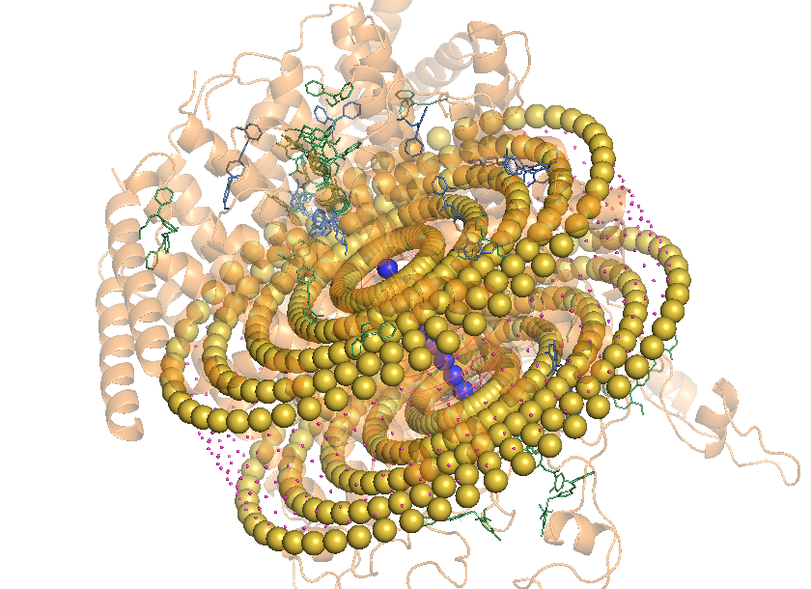
Two Datasets: Calibrate, Then Apply
308 high-quality crystal complexes released after 2021
303 analysed, DiffDock produced nothing for 5
Every complex carries a ground-truth ligand pose
Median ligand: 24 heavy atoms, 359 Da, 5 rotatable bonds
Answers RQ1 to RQ3, because accuracy is measurable here
  Post-2021 release reduces temporal overlap with training data but does not exclude homologous pockets
Calcium channel, no ligand-bound structure exists
4 molecular-dynamics snapshots × 3 known modulators
Control panel: the 308 benchmark ligands × 4 frames
No RMSD is possible without a reference pose
Endpoint is operational: valid, on the receptor, outside the pore slab
  Effective independent observations: three ligands
Orai1 hexamer viewed down the pore. Yellow spheres mark the transmembrane exclusion slab.
Notes:
The two datasets do different jobs. The benchmark has labels and therefore
supports accuracy claims. Orai1 has no label and therefore supports only an
operational claim about admissibility and placement.
Anticipated question: is the Orai1 arm underpowered? Yes, and it is reported that
way. Three ligands and four correlated frames of one trajectory. Every cross-panel
contrast is re-tested at ligand level, and almost none survives.
Anticipated question: is cognate re-docking on the benchmark harder or easier than
Orai1? Easier. Each benchmark complex is docked back into its own crystal
receptor, whereas Orai1 uses non-cognate snapshots of a homology model. The
benchmark numbers bound the Orai1 expectation from above.

Slide 5
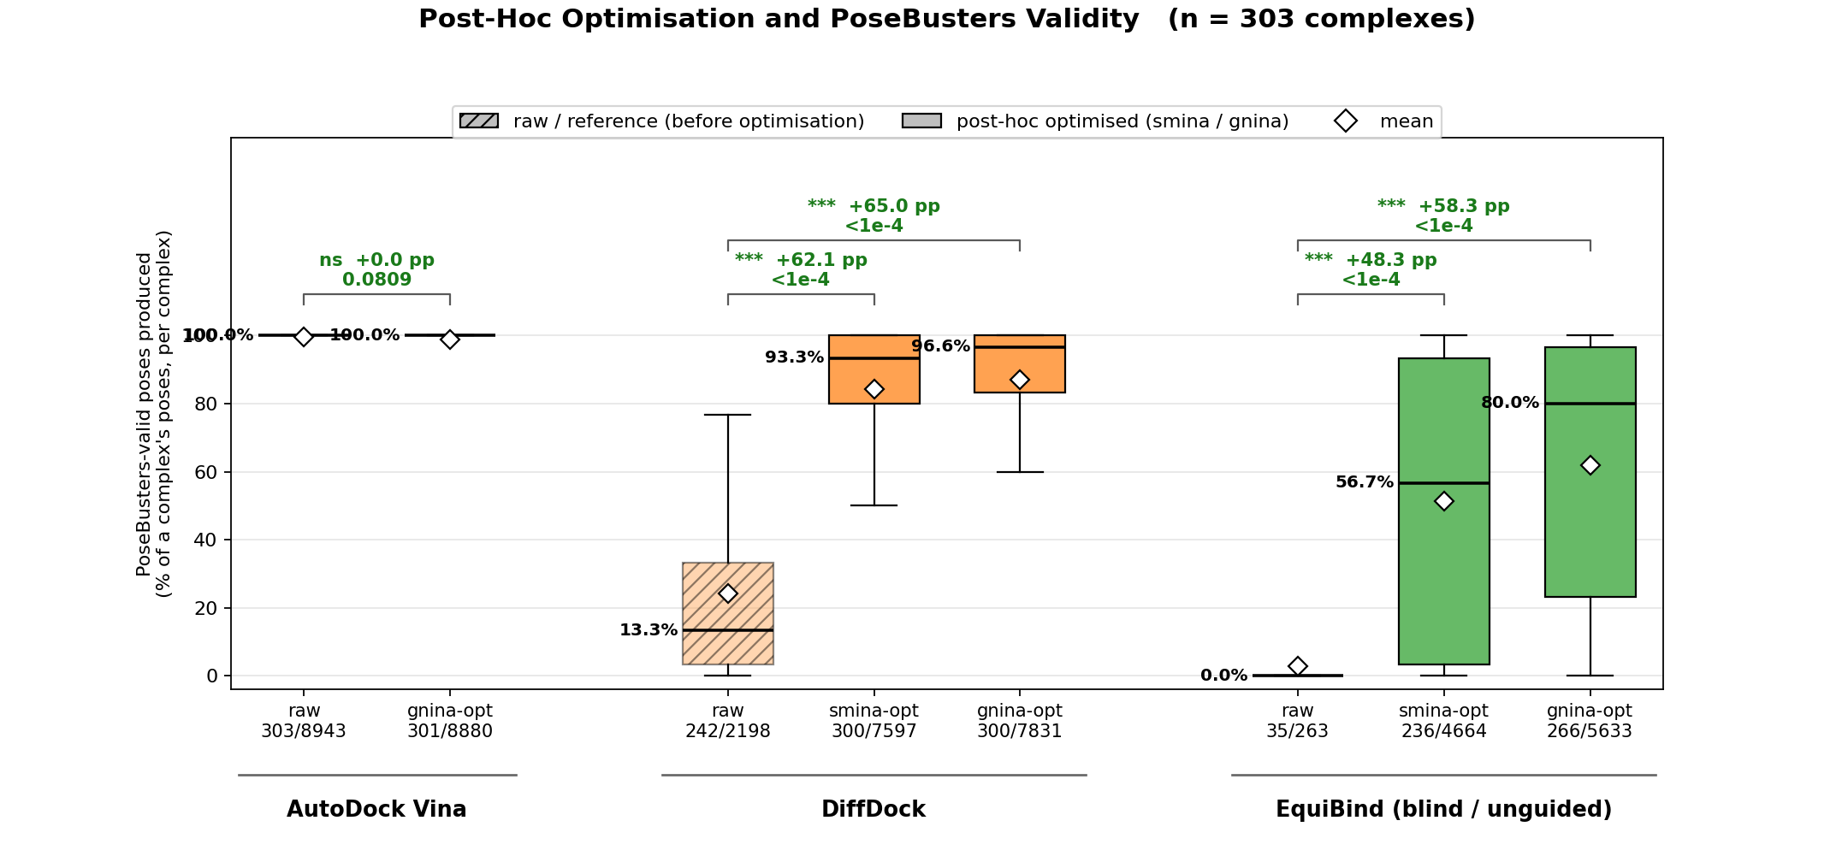
One Optimisation Pass Makes Learned Poses Legal
Raw output fails the physics checks almost everywhere, DiffDock at a 13% median and EquiBind at 0%
A single local minimisation lifts them to 93% and 80%, gains of +62 and +58 percentage points
AutoDock Vina has no headroom, it already minimises every pose during its own search
Geometry is repaired, placement is not. Accuracy at a fixed rank moves by at most a few points, so optimisation cannot supply a binding mode that was never generated.
Notes:
This is the answer to RQ2 and the single largest effect in the thesis, over 70
percentage points of pooled validity between Vina and the raw learned output.
Anticipated and important challenge: is this comparison circular? Partly, and the
thesis says so. The discriminating PoseBusters checks are intermolecular distance
checks, and they inspect coordinates that Vina has already minimised against a
closely related objective. The margin is therefore partly constitutive. The
mitigation is that requiring validity removes at most four of 303 complexes from
the headline endpoint, so it changes the ranking hardly at all.
Second challenge: raw versus rescored hydrogen handling. Both arms are rebuilt
from a bond-order template and PoseBusters adds the hydrogen shell itself, so the
two sides are measured on the same footing.

Slide 6
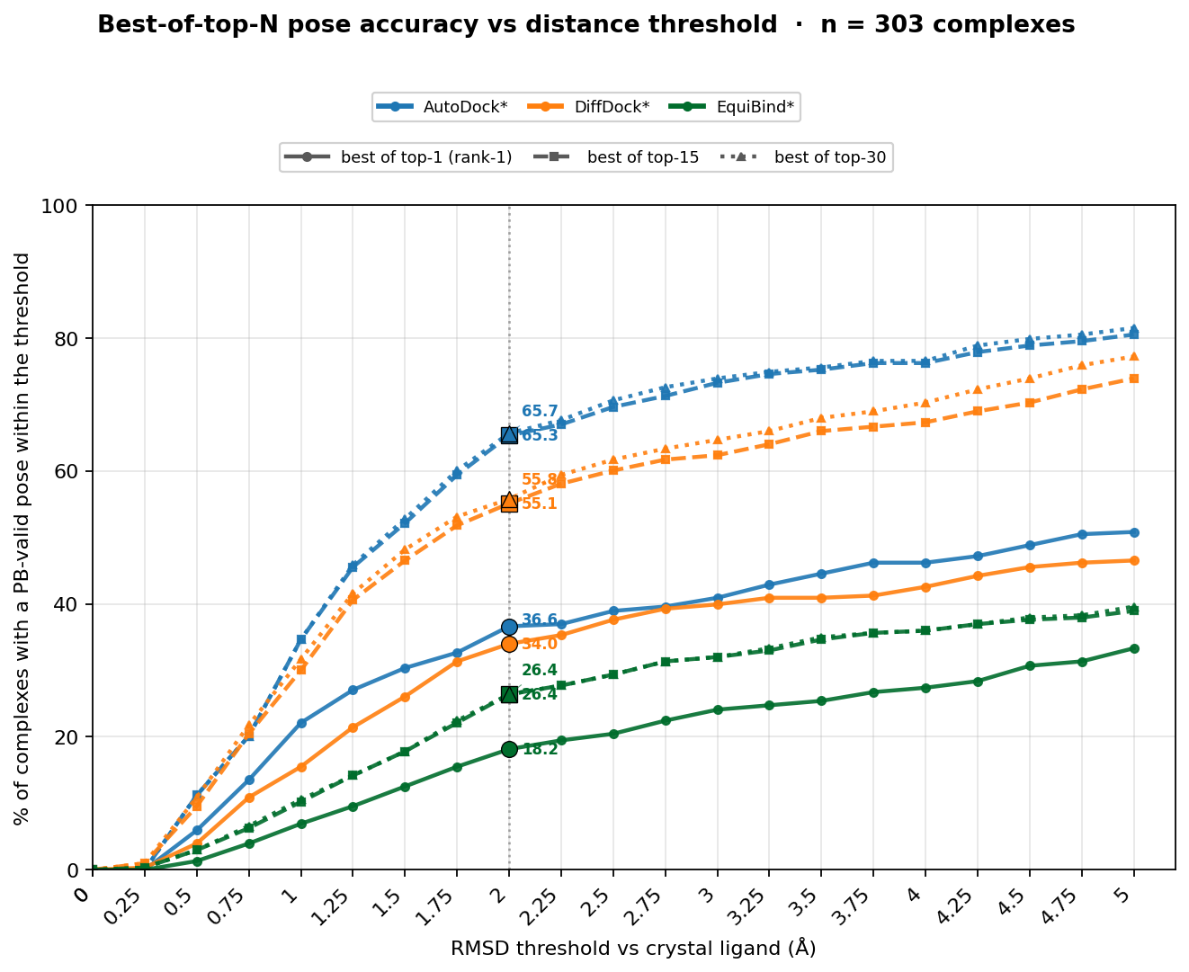
Accuracy Depends on How Deep You Look
Rank-1: AutoDock 36.6%, DiffDock 34.0%, EquiBind 18.2%
Best-of-top-15: 65.3%, 55.1% and 26.4%
The rank-1 gap between the two leaders is not resolved, 95% interval −4.2 to +9.4 points
AutoDock separates from top-5 onwards, +13.2 points, p = 7.6e-4
Depth buys 87 extra complexes for AutoDock and 64 for DiffDock
The top-k lift is recall, not precision. Realising it needs a selector the pipeline does not have.
Fairness caveat: AutoDock was tuned over five search budgets, the two learned arms only over a choice of refiner.
Notes:
Core RQ1 slide. Two messages: the leaders are not separable on the pose they
actually nominate, and everyone has a large reservoir of good poses that ranking
fails to surface.
Anticipated challenge, and it is a fair one: AutoDock was tuned. It ran a ladder
of five exhaustiveness values and the top rung was carried forward, while the two
learned arms were only given a choice of refiner. So a tuned pipeline is being set
against two untuned ones, and the AutoDock rank-1 figure carries a selection
optimism the others do not. The thesis quantifies this: the winner's-curse
correction is between 0.4 and 0.8 percentage points per family, and the largest
selection margin is 3.0 points.
Anticipated challenge: no held-out split. Correct. Variant selection and
evaluation use the same 303 complexes. That is stated in the limitations.
Anticipated challenge: is the non-significant rank-1 result equivalence? No. The
study is underpowered there, the minimum detectable difference is 9.8 points at
80% power, and no equivalence margin was prespecified.

Slide 7
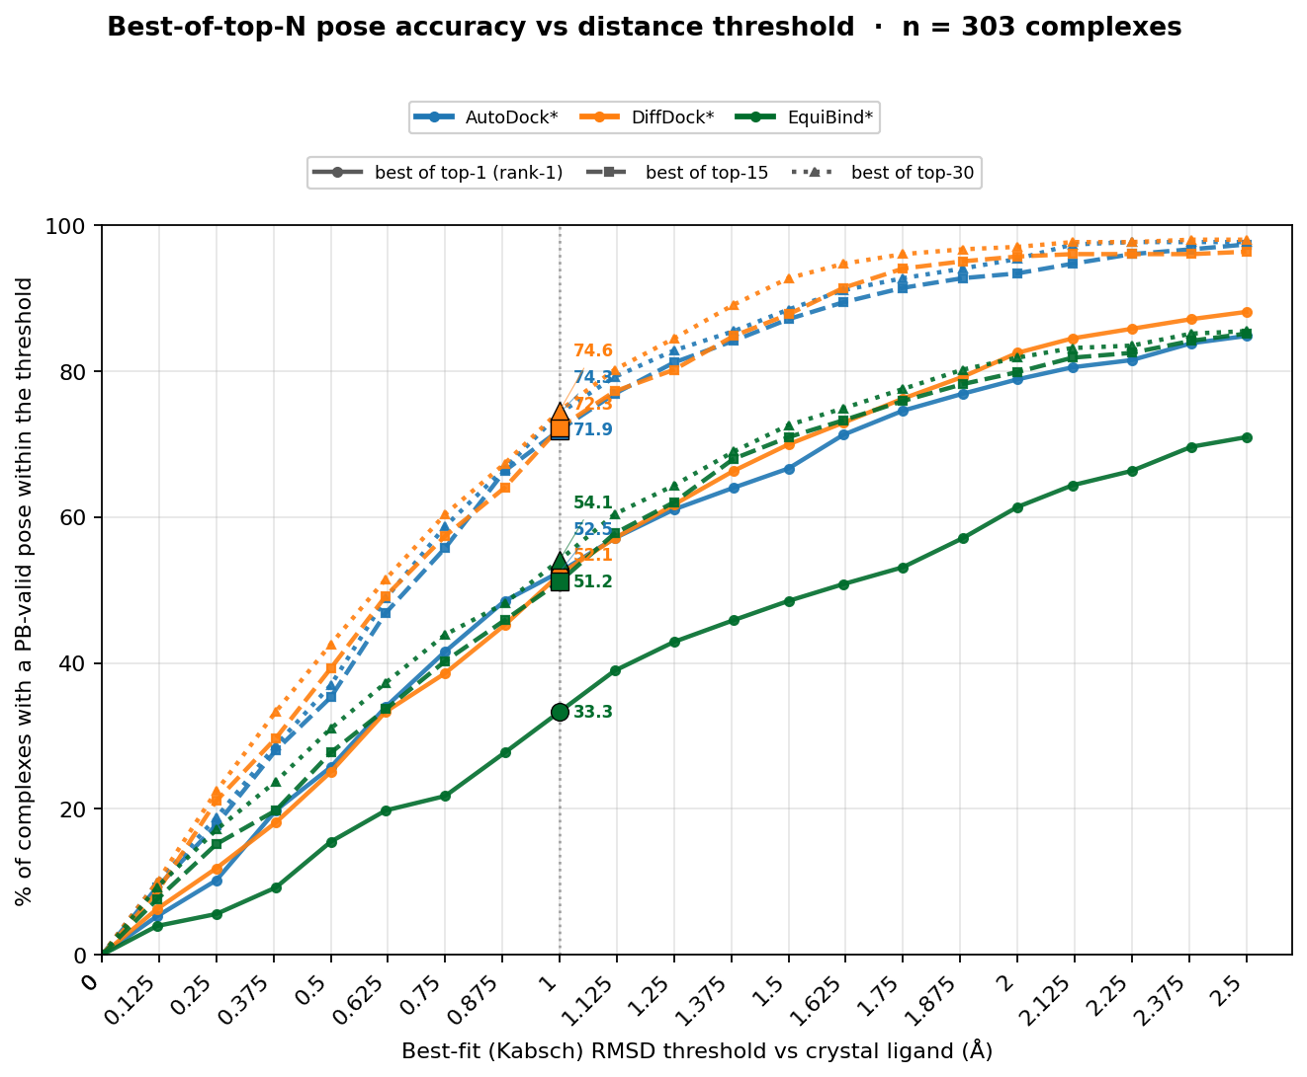
Right Shape, Wrong Place
Rank-1 form: AutoDock 52.5%, DiffDock 52.1%, EquiBind 33.3%
On form the two leaders are indistinguishable at every depth, p = 1.000
So the placement gap on the previous slide is localisation, not conformer quality
DiffDock builds the right shape and seats it less well
EquiBind is weak on both axes, its rank-1 median already exceeds 2 Å
About six in ten rank-1 failures of the two leaders contain no qualifying pose at any depth. Generation, not ranking, is the binding constraint.
Notes:
Why the decomposition matters: in-place RMSD mixes two different failures. Kabsch
superposition removes the translation and rotation, so what is left is purely the
internal conformation. A tool can be perfect on form and useless in practice.
Anticipated challenge: is the decomposition exact? No, and the thesis flags it.
The in-place and best-fit values each minimise over symmetry-equivalent atom
mappings independently and can pick different mappings for the same pose, so
placement is reported as a residual diagnostic rather than a measured component.
Anticipated challenge: the 1 Angstrom form threshold is not a published
convention. Correct, it was fixed before analysis as half the 2 Angstrom in-place
threshold, and the appendix resolves form over ten thresholds so the sensitivity
can be read directly.

Slide 8
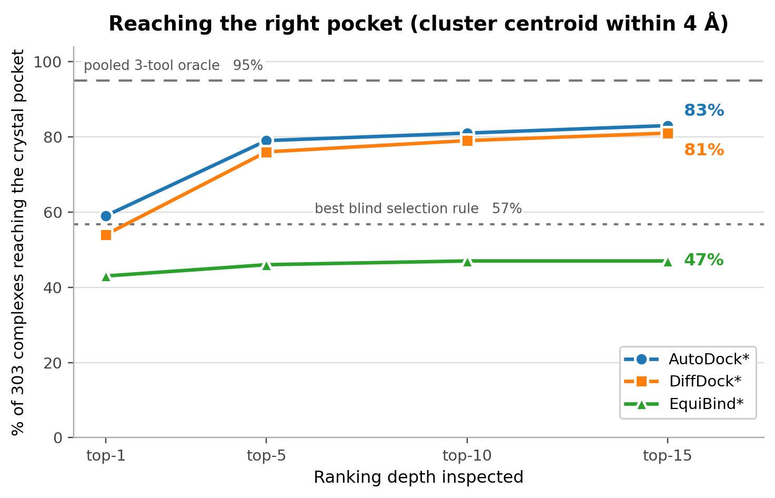
Finding the Pocket Is the Easy Part
Retrospectively, the pooled cloud of all three tools contains the crystal pocket for 95% of complexes
The best cheap blind rule ranks that pocket first in only 57%
A 38-point gap in selection, not in accuracy
Contact fidelity
Interaction-fingerprint overlap with the crystal, top-5 union: DiffDock 0.45, AutoDock 0.42, EquiBind 0.38
The two leaders resemble each other more (0.46) than either resembles the crystal
Different contact hypotheses, so agreement between tools is not evidence of correctness.
Notes:
The retrieval framing lands well here. Pooling every candidate from every tool
almost always contains the right pocket. The unsolved problem is ranking that
pocket first without a reference, which is a re-ranking problem, not a sampling
problem.
Note on the 95% number: it is a cluster-level oracle at a 4 Angstrom centroid
threshold, which is much coarser than a valid pose within 2 Angstrom. It must not
be quoted as 95% pose accuracy, and the slide deliberately labels it as an oracle.
On Jaccard: it counts shared and non-shared contacts, so it is a similarity, not a
recall. At rank-1 the two leaders are not separable on contact F1 either, and
DiffDock's lead exists only for the union of its top five.

Slide 9
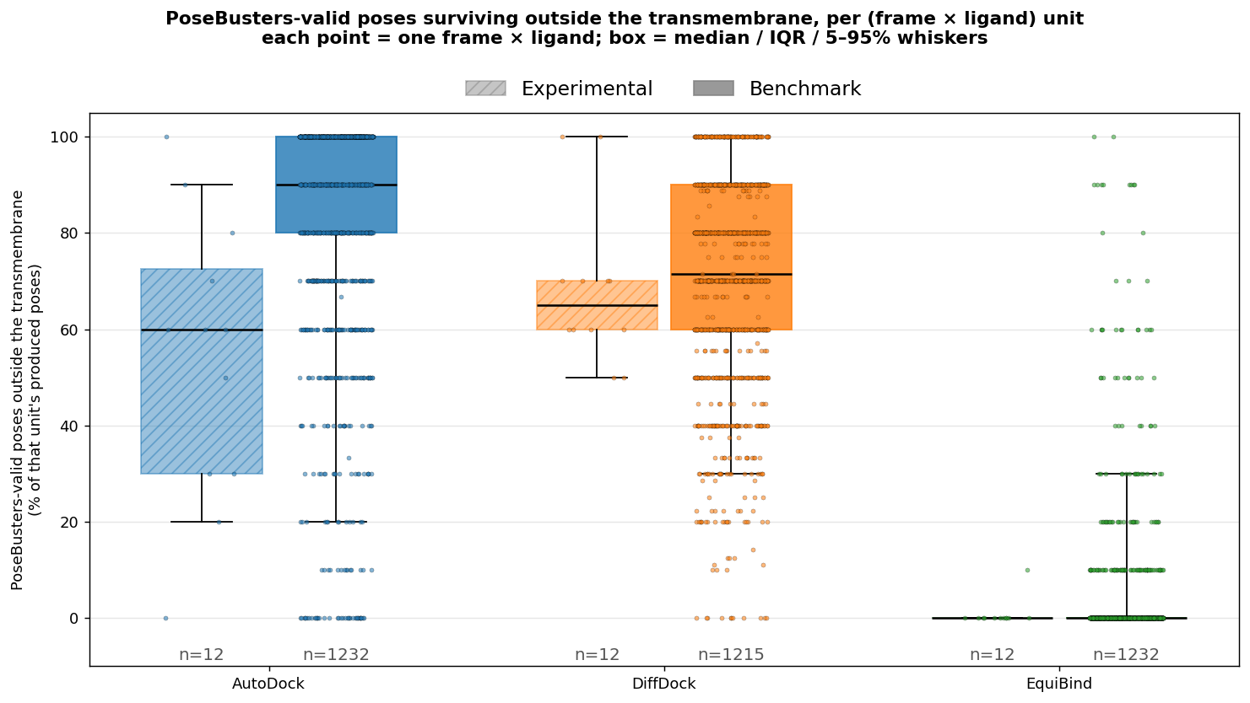
On Orai1, Physical Validity Overstates Usefulness
All 120 AutoDock poses pass the physics checks, yet only 54% are usable
DiffDock is less valid at 93% and more usable at 68%, EquiBind keeps 1 of 120
The failure is placement, not chemistry, the rejected poses sit in the pore
The reversal is a property of the secondary ranker, not of the search. Capping AutoDock on its raw Vina order instead of the gnina re-ranking returns it to 75% and removes the reversal.
Notes:
This is the most quotable Orai1 result and also the most attackable, so present
the caveat yourself before the examiner does.
Three separate caveats. First, the exclusion slab is a modelling hypothesis. It
encodes an outer-pore binding hypothesis and may well reject valid GSK-7975A or
Synta-66 poses, since both act at or near the pore mouth. Second, the two panels
were capped by different selection rules. The experimental ten poses are the
gnina-best of thirty searched modes, the control ten are all that were written.
Matching that moves the AutoDock loss from 28.7 to 17.0 points and its adjusted
p from 5.6e-4 to above 0.2. Third, the between-tool reversal disappears entirely
on the Vina prefix, so it is an artefact of the gnina ranker.
If asked whether the recovered residues validate the published Synta-66 site: no.
A decoy control contacts the same residues at the same rate, so the concordance
is not specific.

Slide 10
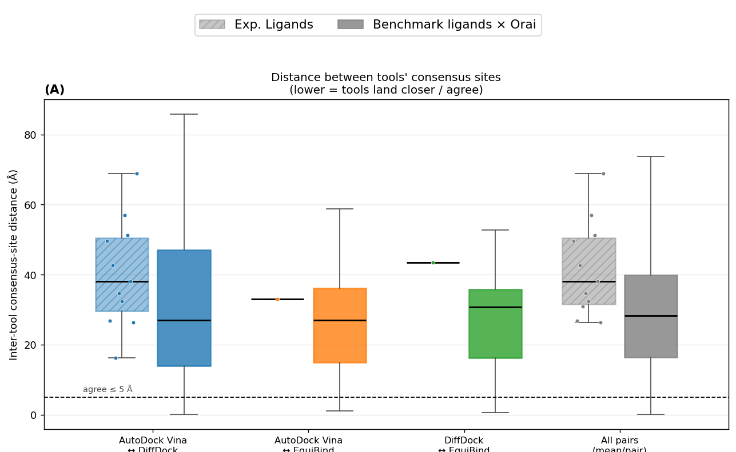
The Tools Do Not Agree on Where the Ligand Binds
Median distance between two tools' consensus sites is about 30 Å on the controls and 33 to 44 Å on the modulators
AutoDock and DiffDock land within 5 Å in 14% of control pairs and none of 11
Six-fold channel symmetry does not explain it, folding onto the nearest copy moves the median only to 27.3 Å
Consensus between independent tools is therefore not usable as a confidence signal on this target.
Notes:
A negative result, and a useful one. The intuitive safeguard, trusting a pose
because two independent methods agree on it, does not survive contact with a large
elongated membrane protein.
Anticipated question: could this be a coordinate-frame or symmetry artefact? Both
were tested. All three tools dock into the same receptor file per frame, so
within-frame comparisons share one coordinate system with no folding applied, and
the six-fold symmetry fold changes the median by two Angstroms.
Anticipated question: does filtering to valid, outside-slab poses tighten the
clouds? No, not detectably. Filtering improves bootstrap reproducibility but not
spread. Note that no equivalence test was run, so this bounds the filtering effect
rather than proving the scatter is intrinsic.
Statistical honesty point: eleven evaluable experimental pairs. This is
descriptive, not a corrected finding.

Slide 11
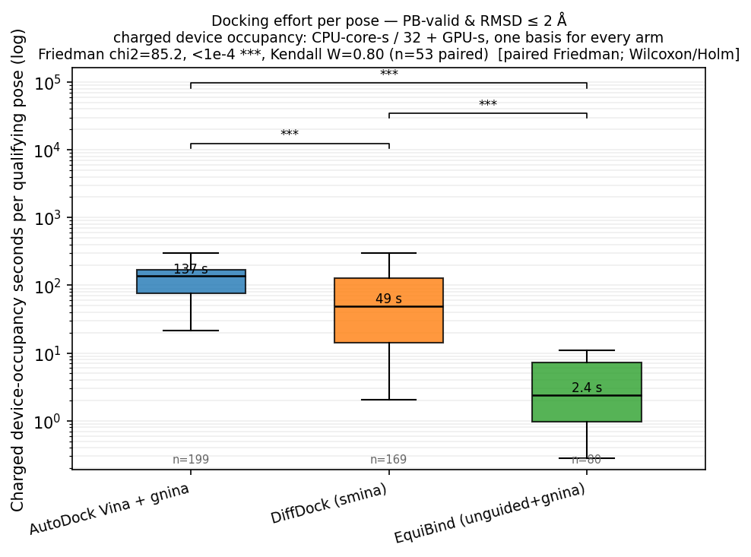
Cost per Usable Pose Spans Two Orders of Magnitude
EquiBind 2.4 s, DiffDock 49.4 s, AutoDock 137.2 s
One basis for all three, CPU-core-seconds / 32 threads + GPU-seconds
Success rates differ, 80, 169 and 199 complexes out of 303
68.5% of the AutoDock cost is the gnina rescoring pass, not the search
Vina alone needs 21.7 s and no GPU, cheaper than DiffDock
AutoDock buys coverage and admissibility, not economy. EquiBind's figure is a floor, conditional on succeeding a quarter of the time.
Notes:
The accounting basis is the part an examiner will press on, so state it first.
Charging device occupancy rather than wall clock stops work that merely ran with
more concurrency from looking cheaper. The gnina pass ran sixteen ways in
parallel and finished in 0.74 wall-hours, and charging it that way would have
flattered AutoDock to 5.47 total hours instead of 15.00.
Anticipated challenge: cost conditional on success favours whoever fails most.
True, and it is stated. EquiBind's 2.4 s describes only its 80 successful
complexes and it fails on the other 223. The alternative denominators are also
reported and none of them changes the ordering.
Anticipated challenge: the rescorer was invoked once per pose, so each call paid
process start-up on a mostly idle GPU. That is an implementation artefact.
Batching would reduce it by an amount this run does not determine.

Slide 12
Answering RQ1 and RQ2
Rank-1 valid near-native: 36.6%, 34.0% and 18.2%
Best-of-top-15: 65.3%, 55.1% and 26.4%
The leaders separate only from top-5 onwards
Pooled physical validity: 98.9%, 84.5% and 62.0%
Both leaders are decisively ahead of EquiBind everywhere
  Rank-1 is unresolved, not shown to be equivalent
  The ordering is conditional on search effort, AutoDock ran the top rung of a five-value ladder
DiffDock validity rises from 24.4% raw to 84.5%
EquiBind rises from 2.9% to 62.0%
Accuracy at a fixed rank moves by only 0.1 to 4.6 points
gnina re-ranking lifts AutoDock rank-1 from 31.0% to 36.6%
Optimisation repairs geometry and re-orders a pool
  It cannot create a binding mode that was never sampled
  Refiner choice, smina against gnina, was not statistically separable within either family
Notes:
Keep the two answers separable. RQ1 is a ranking of pipelines with an explicit
unresolved case. RQ2 is a mechanism claim, and the mechanism is repair plus
re-ordering, never generation.
The single most likely examiner question on this slide: "so is AutoDock better?"
The defensible answer is that on this benchmark, under blind whole-protein search,
with the variants carried forward, AutoDock has the higher point estimate
everywhere and a statistically separable lead only from top-5 onwards. It is not
a claim about physics-based docking in general, and the AutoDock arm is itself
CNN-rescored, so it is not even a pure physics arm.

Slide 13
Answering RQ3 and RQ4
2.4 s, 49.4 s and 137.2 s per qualifying pose
Configured AutoDock is dearest on every currency
Learned rescoring is 68.5% of that total
Removing gnina puts Vina below DiffDock on charged time
Vina still has by far the highest CPU cost
  Describes these implementations and this hardware, not method classes
The three tools fail in different ways, which favours a staged workflow
Generate, optimise, screen validity and placement, then rank for the endpoint you care about
Generation and localisation dominate failure, not ranking
Blind whole-protein search is harder than published site-centred re-docking
Refined DiffDock and AutoDock Vina are complementary
  EquiBind gives too little coverage for routine use in this configuration
Notes:
RQ3 depends entirely on the denominator, so name it before quoting the numbers.
RQ4 is deliberately a workflow answer rather than a winner, because the failure
modes are not the same failure mode. AutoDock fails by mis-ranking a pool that
contains the answer, DiffDock fails by not localising, EquiBind fails by not
generating anything usable.
If pressed on why blind whole-protein search was chosen when Vina normally gets a
box: because DiffDock and EquiBind localise the ligand themselves, so giving Vina
a pocket would have handed it information the others earn. This is stricter than
blind benchmarks that supply a predicted pocket, and a predicted-pocket Vina arm
would be the right intermediate comparison. It was not run.

Slide 14
Conclusions: What the Study Establishes
Under blind whole-protein search a tuned classical pipeline still matches or beats two learned ones
Post-hoc physical optimisation is what makes learned poses admissible, and it is cheap
Rank-1 and best-of-top-k tell different stories, so report both
Physical validity is an admissibility filter, never evidence of binding
Without a reference structure, validity has to be paired with an explicit placement rule
Agreement between independent tools is not a confidence signal
The contribution is a separation of sampling, ranking, validity and localisation failures
Recommended workflow
generate → optimise → screen validity and placement → rank for the endpoint
AutoDock Vina and refined DiffDock as complementary hypothesis generators
EquiBind not in this configuration
Retain uncertainty wherever the two disagree
Notes:
Close on the workflow, not on a winner. The examiner should leave with the four
separated failure modes, since that is the transferable contribution and it
survives the arrival of the next generation of models.
If asked for the single most useful practical finding: one cheap local
minimisation pass converts most learned output from physically impossible to
admissible, at a cost that is negligible next to the generation step itself.

Slide 15
Conclusions: Limits and Outlook
Not AI against physics, three configured pipelines at single settings
Variant selection and evaluation share the same 303 complexes, with no held-out split
The benchmark DiffDock run is one unseeded draw, no arm was run across multiple seeds
Post-2021 release does not exclude training-set leakage
Orai1 rests on three ligands and four correlated frames of one trajectory
No endpoint tests binding free energy, protonation or stability
Match information and compute against current hybrid and co-folding models
Split by protein, pocket and ligand novelty rather than by release date
Add a predicted-pocket Vina arm as the missing intermediate comparison
Batch the learned rescorer, the GPU was idle on a per-pose invocation
Treat the Orai1 poses as testable hypotheses for mutagenesis, competition assays and ligand-bound simulation
The experimental follow-up continues at JKU Linz
Notes:
Lead with the limitations rather than waiting to be asked. The strongest examiner
criticisms are already on this slide, which converts them from attacks into
evidence of judgement.
Two further limits worth having ready but not on the slide. Receptor preparation
stripped waters, ions, metals and cofactors for the AutoDock and DiffDock arms,
and a metal sits within 5 Angstroms of the crystal ligand in 78 of the 303
complexes, so a quarter of the set is scored without a coordinating partner the
native pose depends on. The AutoDock lead at top-15 is +6.7 points on the 225
metal-free complexes against +20.5 on the 78 metal-adjacent ones, so the pooled
contrast averages a narrow gap with a much wider one.
Second, the interaction profiler is blind to chlorine and bromine in its halogen
test, so any halogen-bond result is discounted.

