Slide 1


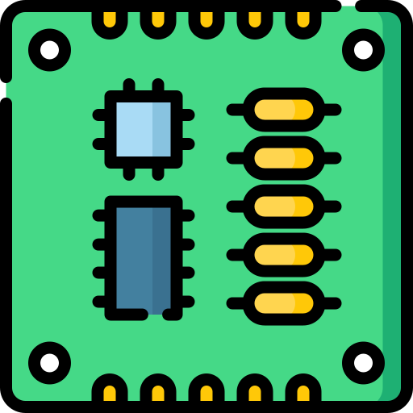
8520A
(Even CIA)
A500 MB
sel0 (13)
sel0
switch
firmware
sel1 (14)
sel1
ESP32

