Slide 1


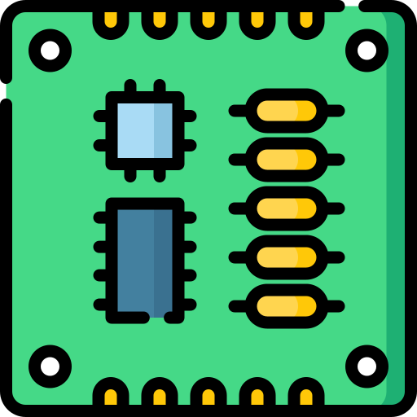
A500 MB
8520A
(Even CIA)
sel0 (13)
MCU
sel0
switch
firmware
sel1 (14)
sel1

