Slide 1
Protective Rig Covers
Making custom dust covers for your rigs
by
KI7LXI
Sheila Theriault

Slide 2
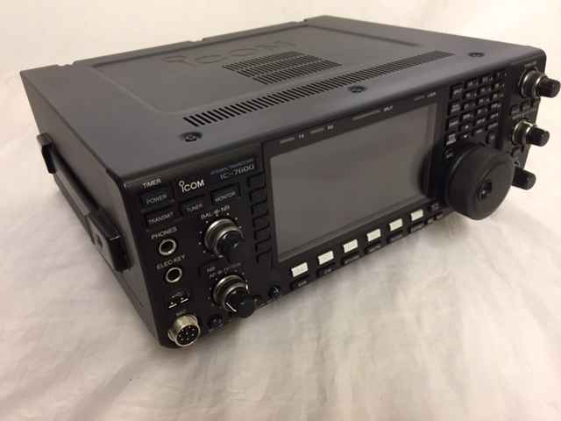
Measure the Rig
Measure Top of Rig front to back and side to side
  Width and Depth
  Include space for Knobs/Controls
Measure height of each side.
  Add 1/2” to height for a hem.
To size fabric
  Add left side, top width and right side; 7” + 11” + 7” = 25”
  Add front, top depth, rear; 7” + 13” + 7” = 27”
  Total fabric required is: 25” x 27”
IC7600 | Width | Depth | Height
 | 11” | 13” | 6.5”
hem |  |  | .5
Total | 11” | 13” | 7”

Slide 3
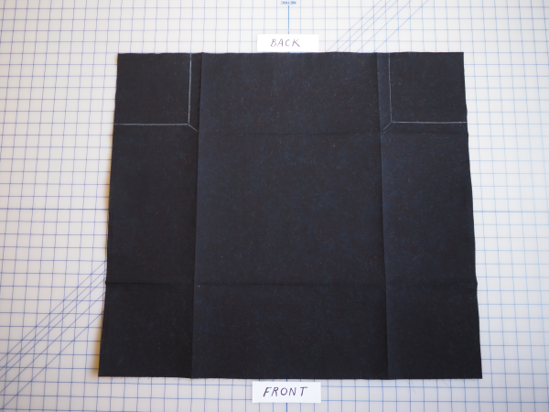
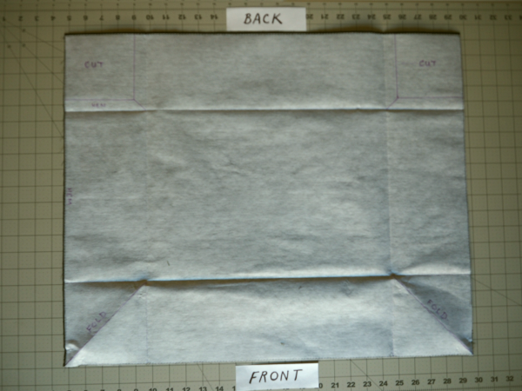
Cutting & Stabilizer
For the IC-7600 we need piece of fabric that is 25”W x 27”L
Use of stabilizer will add some stiffness to finished cover.
Stabilizer used for this project: Pellon 808 Craft-Fuse
Cut stabilizer to same size as fabric
Adhere stabilizer to fabric as per manufactures instructions.
  Can be tricky with multiple pieces
  Use plenty of heat and steam
  Sometimes a moist towel sandwich helps process

Slide 4
Measure and Mark Alignments
Draw a line 7” inside from each edge (for this example)
Fold fabric along this line using your iron
Draw 1/2” hem lines inside the 2 corners for the back side flap.

Slide 5
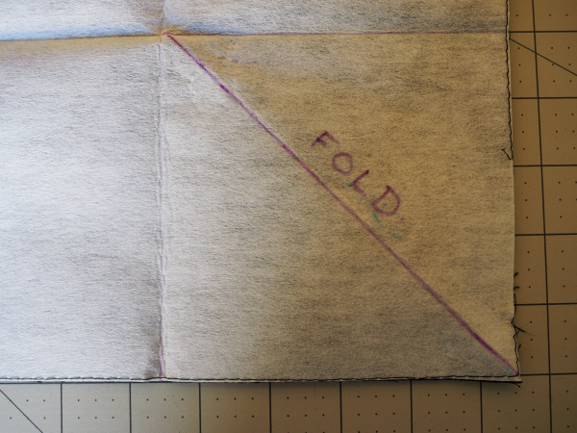
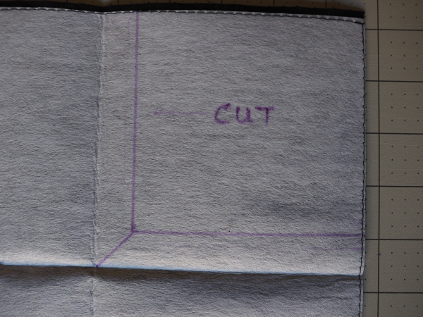
Adding Cut &
Fold Lines
Front Corner
On the front side, draw a 45° line diagonally for each of the two front corners
Rear Corner
On the rear side, draw a 1/2” line, to make a corner cut out, from the fold line made in the previous step.
The cut lines will be for the two rear corners which build a flap.

Slide 6
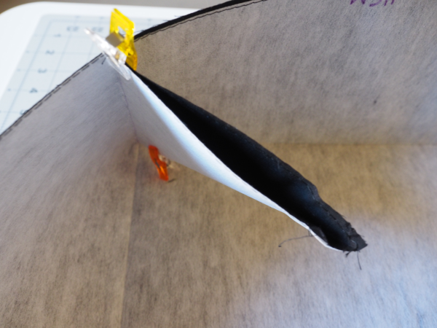
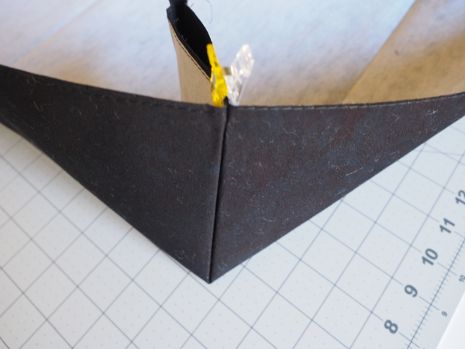
Pin or use Clips
Press with iron along each fold line to form a corner.
Secure using pins or clips along each fold line
Clips are fast and save your fingers !

Slide 7
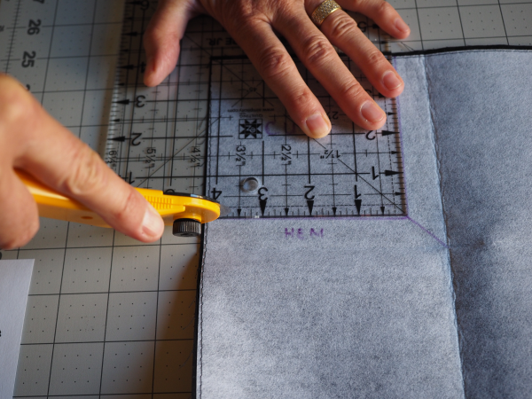
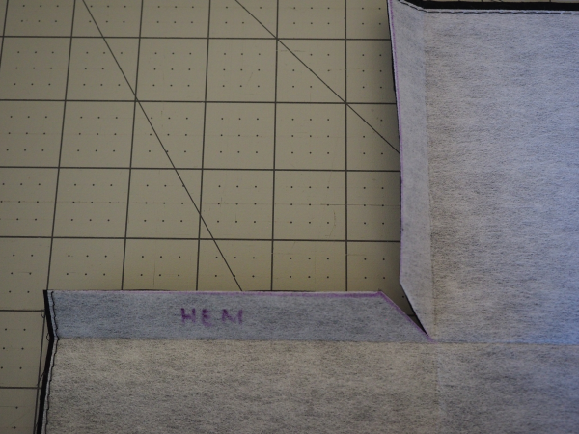
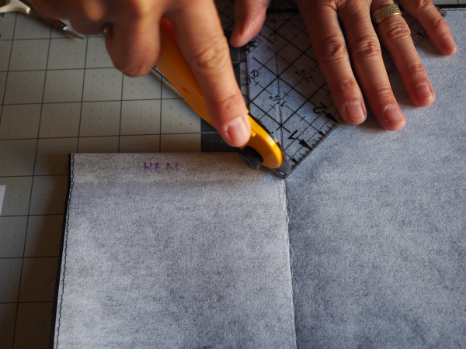
Cutting out the corners
Cut along each cut line
Then make a small diagonal 45° cut for folding
A small square ruler is helpful on this step.

Slide 8
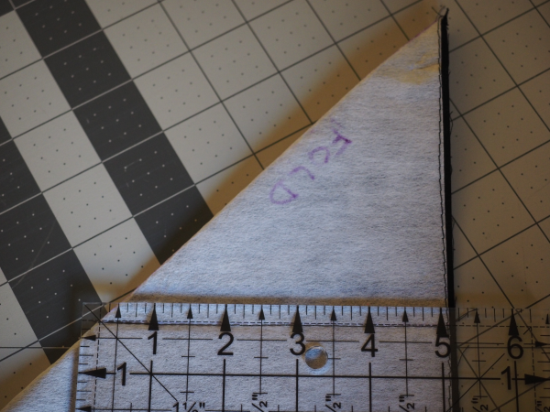
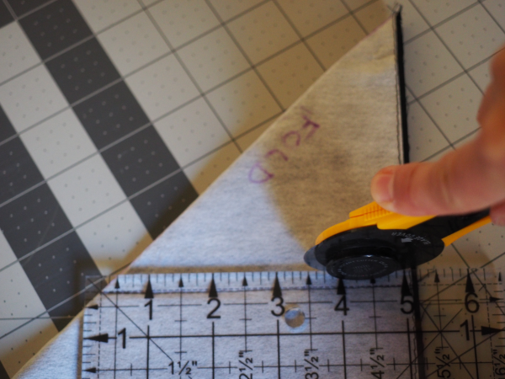
Removing excess on folded corners
1/4” out from fold line, trim off front corners
This excess is not required.

Slide 9
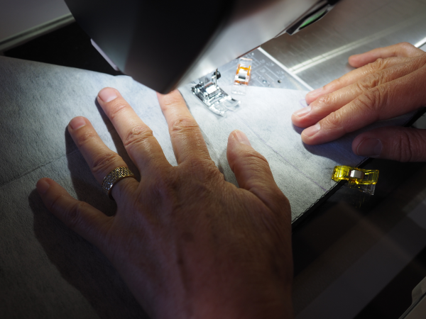
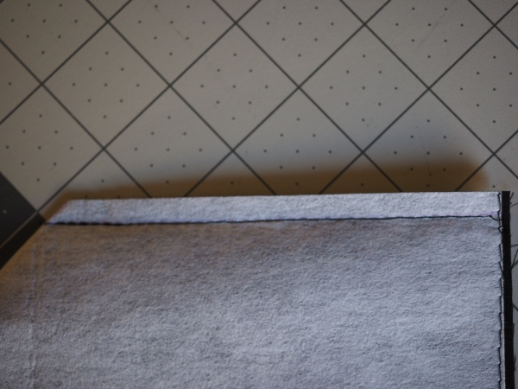
Stitch Fold Line and Trim
Reverse your corners inside out
Then stitch along fold line
Trim excess leaving 1/4” along stitch line

Slide 10
Sewing it up !
Fold all edges 1/4” and then 1/4” again
Hold edges with clips or pesky pins
Sew all edges
Your done !
Flip right side out

Slide 11
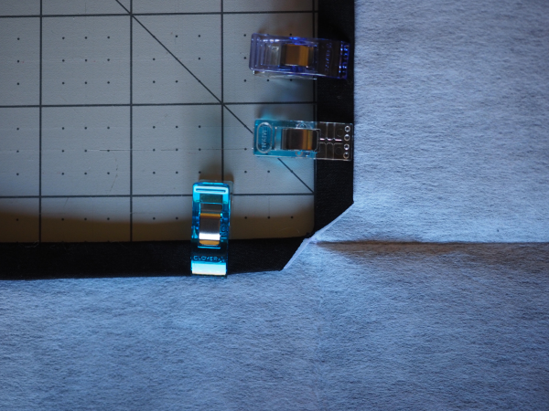
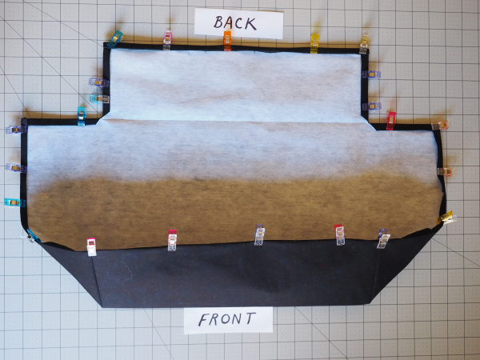
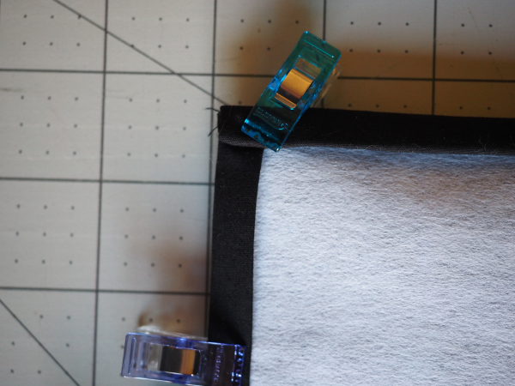
Use Clips

Slide 12
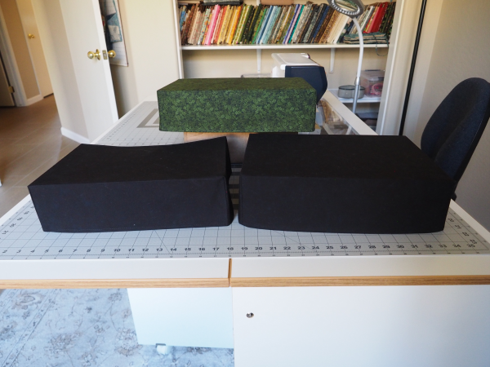
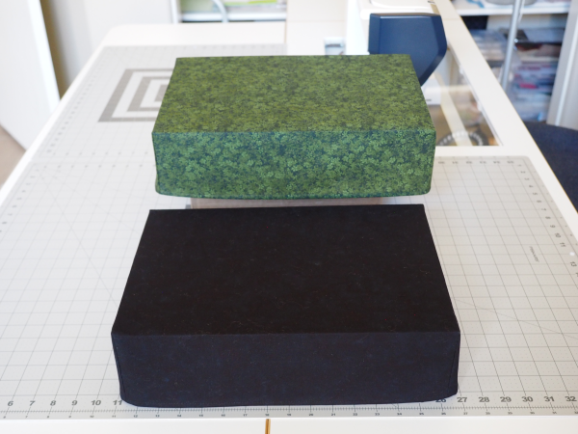
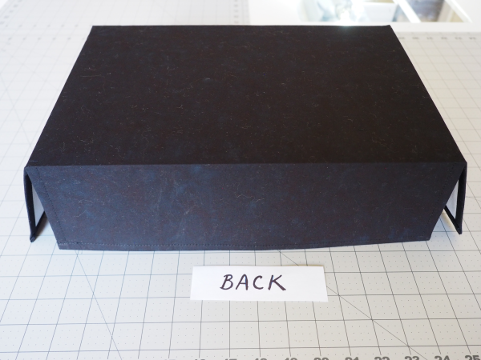
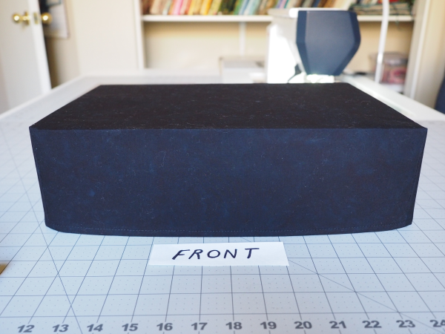
A few finished rig covers

