Slide 1

Data Visualization
For Business
~Pallav Nadhani

Slide 2

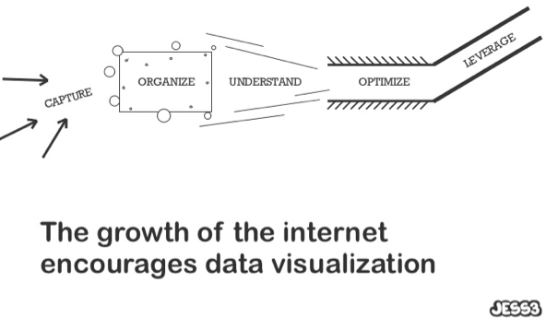
Every day, we create 2.5 quintillion bytes of data — so much that 90% of the data in the world today has been created in the last two years alone.
"The ability to take data - to be able to understand it, to process it, to extract value from it, to visualize it, to communicate it - that's going to be a hugely important skill in the next decades“ ~ Hal Varian, Google's chief economist

Slide 3
Data visualization is a multi-disciplinary recipe of art, science, math and technology.

Slide 4
Data Visualization is the visual display of measurable quantities using
Points, Lines & Curves
A co-ordinate system
Numbers
Shading
Color
Symbols
to serve a clear purpose
to understand data
to substantiate a hypothesis
to discover from data

Slide 5
Types of data visualization
Explanatory: Based around a specific and focused narrative
Exploratory: Aim to create a tool for user to discover
An exhibition of self expression. Ornamentation of data as art

Slide 6
Steps for effective business data visualization
Know your audience and their need for visualization
Choose the right visualization type and style
Explore ways of enhancing it

Slide 7
Know your audience
What role is this information for? C-level, Analysts, Operational guys
What department does he belong to? Sales, marketing etc.
What metric will help him achieve his goals?

Slide 8
Abstraction of data by role
C-level: Use information to keep track of health of business. Need strategic and high level view with focus on long term and macro data. Simple summary and indicators suffice, and they do not need real-time data.
Analyst: Focus on getting value out of data. Need query driven analysis, detailed data with precision, and focus on trends and co-relations.
Operational guys: To complete task in hand. Need information to focus on current status, issue & event driven (alerts, spikes, trouble). Real-time data here is useful.

Slide 9
Data required by department
Sales: Leads, conversions, Average value per sale, Closure time
Marketing: Visits, Acquisitions, CPC, CPM, Awareness
Network & IT: Issues, tickets, lead time, open cases, downtime
HR: Attrition rate, interview closure rates and time
Customer Support: Number of tickets, turnaround time, satisfaction rating

Slide 10
Role + department + goal derives metric
In each department, the data to be viewed changes by role
In customer support:
Support Executive sees his number of tickets, his turnaround time etc.
Head of customer support sees total tickets by department or by issue type, and turnaround time
CEO sees customer satisfaction index
In sales:
Sales associate see their number of leads, target allotted, and target covered
Sales Team Heads see number of leads for team, conversion ratio, closure rates, turnaround time, leaderboard
VP, Sales sees pipeline of all team members, revenue by teams, geographical distribution of revenue, channel distribution
CEO sees projected revenue vs actual revenue

Slide 11
When deciding what metric to visualize…
Ensure that metric helps drive a business goal. Avoid vanity metrics
Use simple metrics that everyone can understand, and act on
Just because you've some data doesn't mean you've to use it all

Slide 12
7-step framework for business metrics
Define company goals – short term (6-12 months) & long term (36 months)
What are the measures to determine if you have met your goals? (Financial and Non-financial key result indicators)
What activities should you undertake to reach the goals?
From all the activities that you could undertake, now select the 20% of activities that have the biggest impact on your goals.
Who is responsible for seeing that top 20% activities are carried out?
How are you going to measure if your most important activities are being carried out correctly?
Of all your indicators (Key result and Key performance) that are listed above determine which ones:
Are already being measured / reported
Can be measured (data is available)
Can not yet be measured (data not available)

Slide 13
Now that you know your audience, data and goals,
let’s visualize…

Slide 14
A good visualization would…
Harness the powerful visual function of the human brain
Be tailored to the medium of delivery and skill-set of audience
Use a design choice supports the comprehension of the data, and increases data-ink ratio

Slide 15
Our visual function in the brain is extremely fast compared to the cognitive function.
80% of the brain is dedicated to visual processing.

Slide 16
Maximizing pre-attentive processing
Visualizations are rendered in 3 dimensions – x, y and z
Use the z-axis to maximize pre-attentive processing by changing the color, size, shape or shading of the object

Slide 17
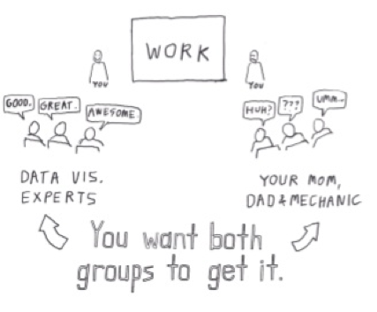
The world is not full of statisticians. Many of us would like a quick glance just to get a good idea of something.

Slide 18
Types of data representation - basic
$123,344
(This week)
$123,344
(This week)
18% up
Single figure
Single figure with historical context
Comparison of data
Transition of data
Composition of data

Slide 19
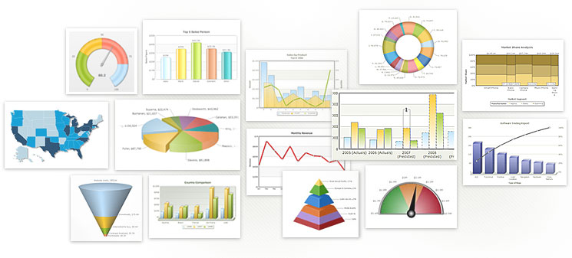
Innumerable types of visualizations are possible. As simple or as complex as you want them.

Slide 20
Communicate more than data to user.
Do not leave the processing to user.
The worst visualizations make you think more than looking at a raw data table itself.

Slide 21
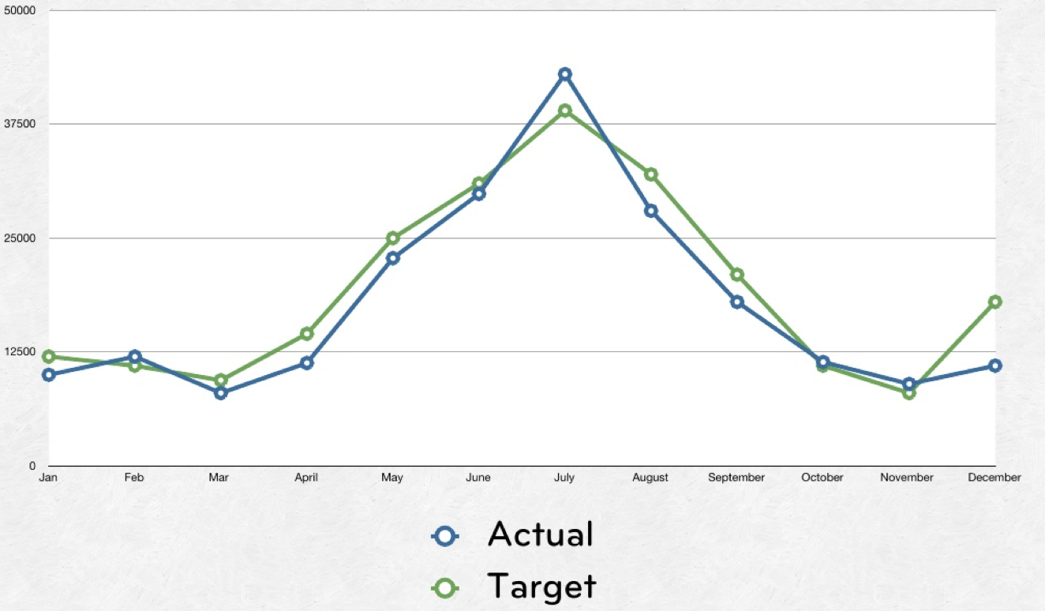
Credit: http://www.slideshare.net/destraynor/designing-data-visualisations-dashboard-in-web-applications

Slide 22
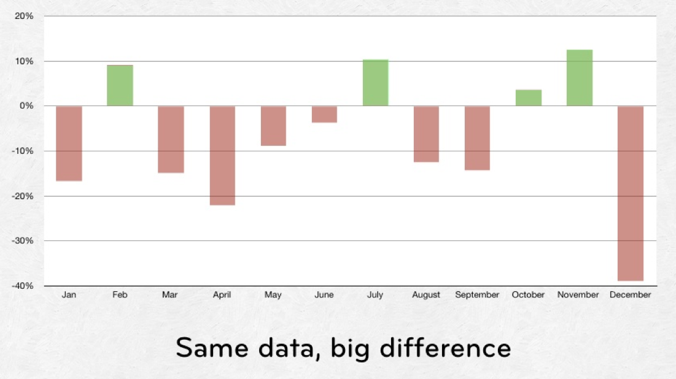
Credit: http://www.slideshare.net/destraynor/designing-data-visualisations-dashboard-in-web-applications

Slide 23
Always use labels & legends on pie chart

Slide 24
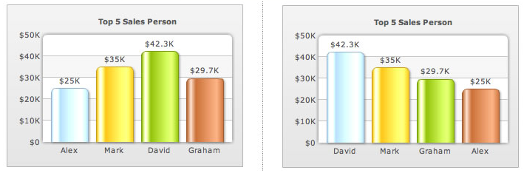
Arranging data in order makes it easy

Slide 25
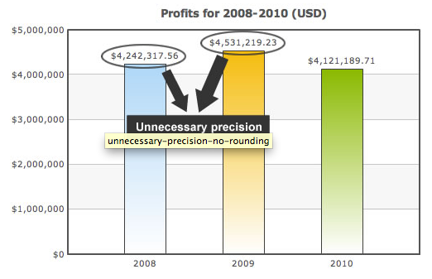
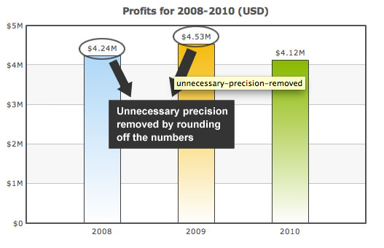
Cut down distractions

Slide 26
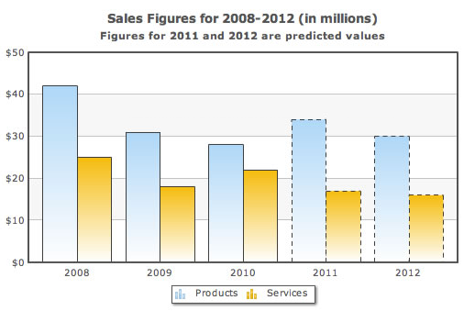
Use dotted lines for projections

Slide 27
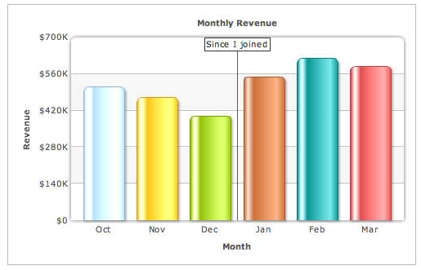
And effective annotations to highlight/segregate

Slide 28
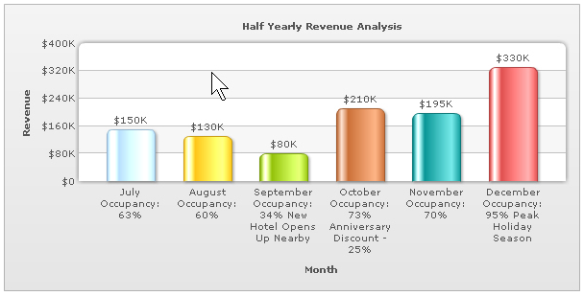
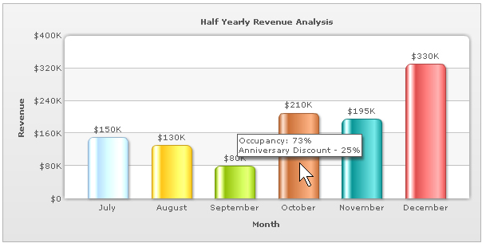
Use interactive features to increase data-ink ratio

Slide 29
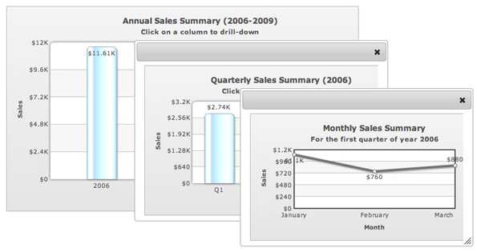
Use drill-downs for detailed data, and communicate such interactivity to user

Slide 30
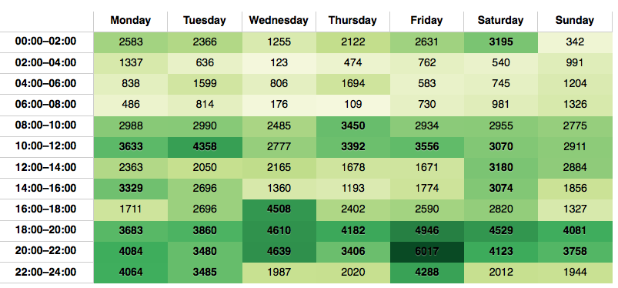
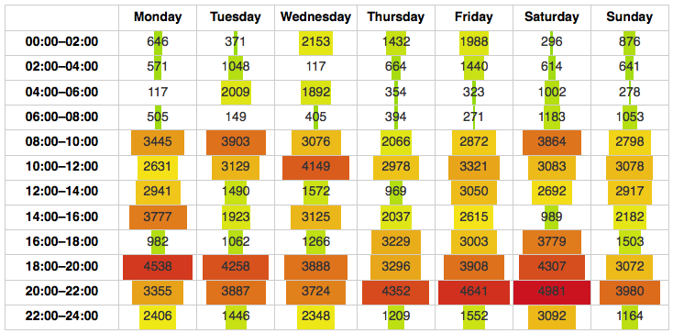
Enhance tabular data with colors and shapes

Slide 31
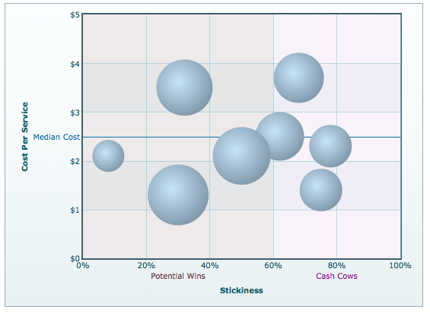
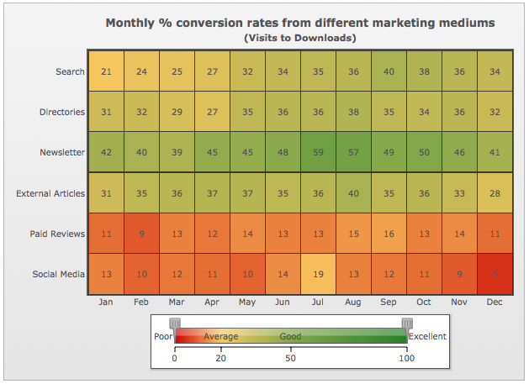
For data with 3 related dimensions, use bubble or heatmap charts

Slide 32
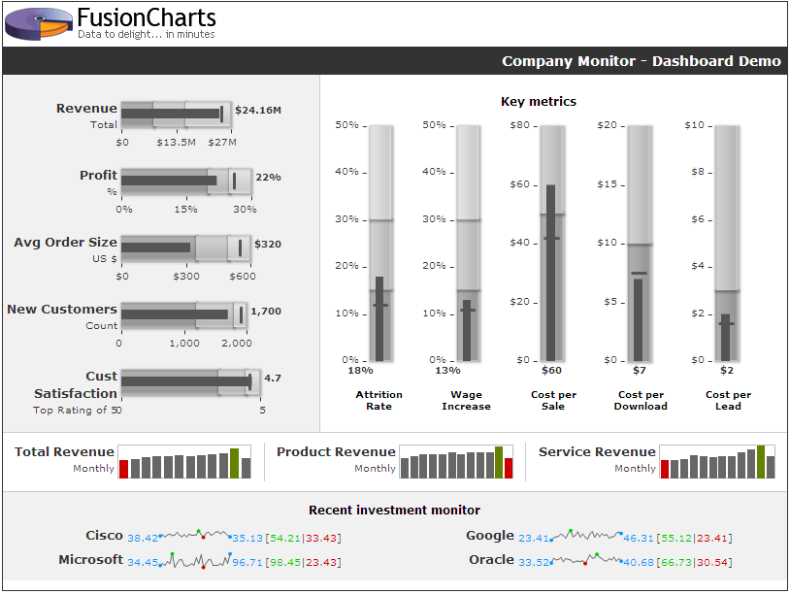
Compact charts can condense a lot of info

Slide 33
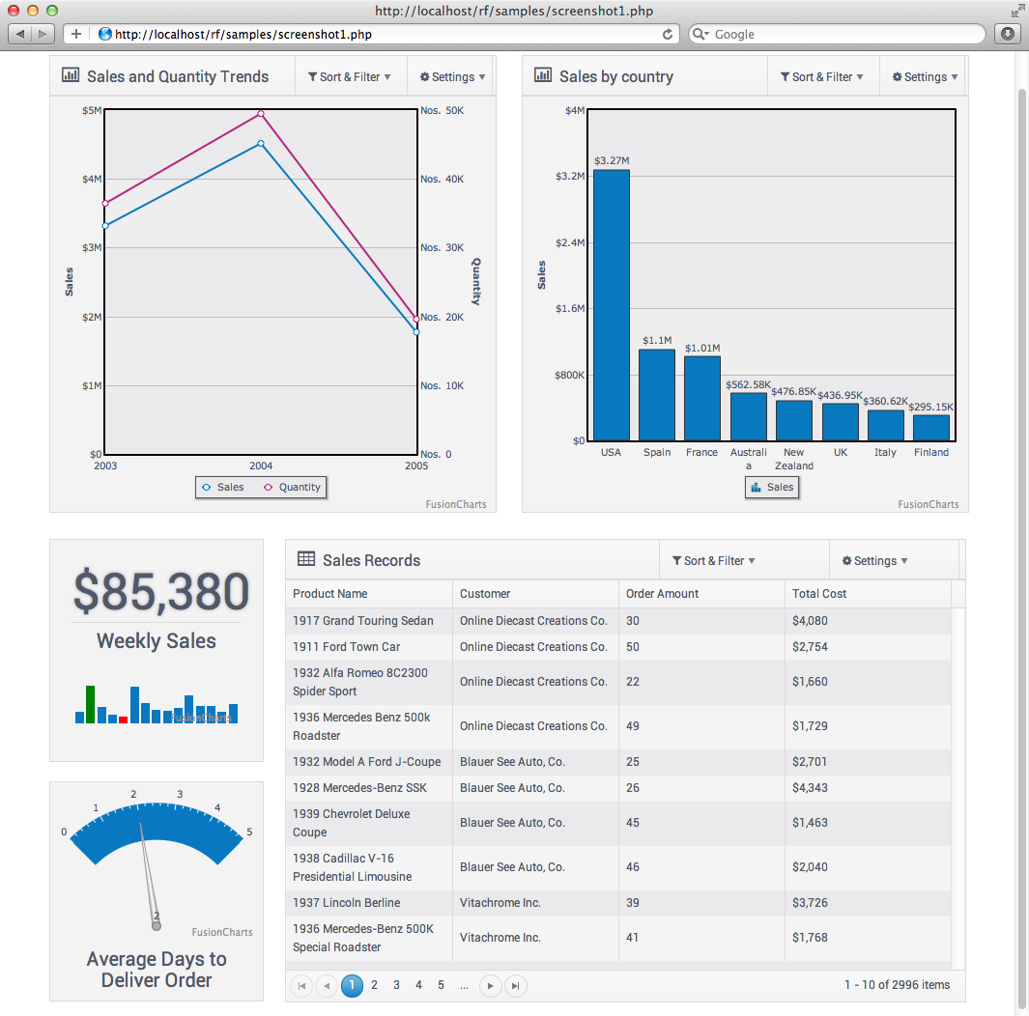
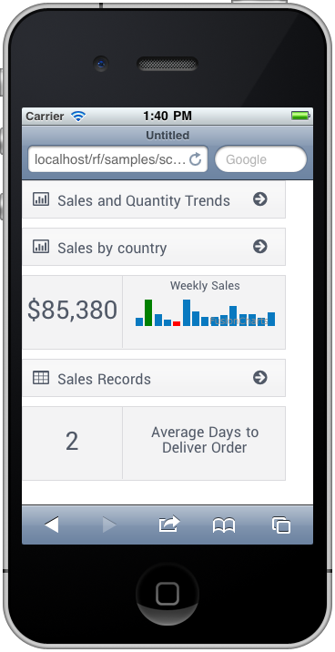
Aim to provide unified experience across devices
On a PC/Mac
On iPhone

Slide 34
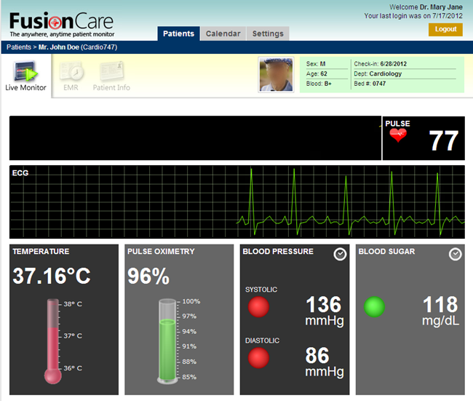
Can use symbolic representations for real-life objects

Slide 35

06

Slide 36
Credits
http://www.slideshare.net/jess3/data-visualization-meets-visual-storytelling
http://www.slideshare.net/trisnadi/infographics-data-visualisation
http://www.slideshare.net/GeneralAssembly_SF/data-visualization-16265937
http://www.slideshare.net/destraynor/designing-data-visualisations-dashboard-in-web-applications
06

Slide 37
Thank you
06

