Slide 1


Slide 2
Drools
David THIBAU – 2019
david.thibau@gmail.com

Slide 3
Agenda
Introduction
  BRMS
  Use cases
  Drools Rule’s engine
  IDE Installation
Getting started
  Session stateless
  Session stateful
  Agenda and conflicts
DRL syntax
  Main structural elements
  Rules and attributes
  LHS / RHS
  Queries, Agregation
  Complex Event Processing
Other ways to express rules
  Creating a DSL
  Decision tables
  Rule’s template
Rules and Processes
  Jbpm and Drools interaction
  Rule nodes

Slide 4
Introduction
BRMS
Use cases
Drools Rule’s engine
IDE Installation

Slide 5
The problem
Today, the main challenge for business applications is agility
Applications must be able to adapt quickly and react to:
  Functional evolutions
  Changes in legislation
  Changes in organisation
  …
Changes in business rules

Slide 6
Where to implement business rules?
Stored as configuration properties in files or database ?
=> Not suited for such a rule
If the customer lives in Paris, is over 55 years old and has been a customer for more than 2 years, give a 10% discount
Implemented in source code
  Low maintenability
  Code spaghetti which may be unefficient

Slide 7
BRMS
A business rule management system (BRMS) identifies the notion of business rule as a resource that can be managed independently of the application code
  Rules can be edited, versionned monitored by a business expert
  Independently tested
  Independently documented, audited
  Independently deployed

Slide 8
Rule’s engine
A BRMS include a rule’s engine
Which evaluates IF-THEN instructions based upon the business rules
Lorsque les conditions des règles sont satisfaites (IF), il exécute les actions associées (THEN) qui généralement modifient le modèle
=> La programmation devient alors déclarative
=> La logique métier n'est plus dispersée dans le code mais centralisée dans le repository de règles

Slide 9
Usage
Rule’s engine :
– Parses and compile the set of rules. (Once at the startup of the application for instance)
Client (code applicatif) :
– Get a reference to the rule’s engine
– Insert objects (facts) in the working memory
– Ask the engine to trigger rules
– Retreive the objetcs updated by the rule’s engine

Slide 10
Setup
Adopting a rule-based solution requires:
  Business Rules Identification: Business Expert
  Their organization and their implementation in a rule language: Business / technical expert
  Integrating the Rules Service into the Application (Build / Deploy): Technical
  The provision of a rules management interface (BRMS Tool): Business / Technical
  The implementation of update procedure (Automation of tests / Deployment): Technical

Slide 11
Considerations
A rule engine is based on complex technologies
It's hard to rely on a black box
How the rules are triggered is not very intuitive
Rules extraction is not always easy

Slide 12
Use cases

Slide 13
Benefits
Declarative programmation : Rule engines allow you to specify "What to do" and not "How to do it". They are able to solve difficult problems and in addition to providing explanations!
Separation of concern : The data is in domain objects, the logic centralized in a rules file (different from the OO approach that encapsulates attributes and methods). The business logic is no longer dispersed
Centralization of knowledge : Everything is centralized in the knowledge base, relatively readable and can be used as documentation
Understandable rules : By defining language specific to the domain or the trade, the rules are expressed in quasi-natural language and become accessible to the business experts

Slide 14
When to use a rules engine ?
The problem is too complex for the classical code (optimization problems for example, expert system)
The problem is not complex but no robust solution is needed.
The logic often changes, in this case the rules can be changed quickly without too much risk.
The business experts exist but are not technical. The rules then make it possible to express the business logic in their own terms.

Slide 15
When not to use rules engine?
A rule engine is just a part of a complex application, you do not have to implement everything as rules
A good indicator is the degree of coupling between the rules.
  If triggering a rule invariably triggers a rule chain, then the implementation of this rule-based logic may not be appropriate, a decision tree may be sufficient

Slide 16
Domains and use cases
Domains
  Finance and Insurance
  Regulation, government rules
  Ecommerce
  Risk management
Use cases
  Authorization of access based on several criteria (role, ownership of the entity, organization, location, etc.)
  Application customization (eg management of a personalized homepage of an e-commerce site)
  Diagnostic
  Complex validation
  Workflow / Orchestration
  Problem of routing, Optimization of planning, storage, ...

Slide 17
The rule’s engine Drools

Slide 18
Rule’s engine
A rule’s engine is composed of a knowledge base, an inference engine and a working memory
  The knowledge base groups the compiled rules
  The client application inserts facts (objects of the domain model) in the working memory
  The inference engine, able to handle large volume of rules and facts, has the role of comparing the facts to the conditions of the rules,
  if the conditions of the rules are satisfied the corresponding actions are performed.
  => actions modify the facts of the working memory, which can trigger the activation of other rules.

Slide 19
Agenda
When matching the rules, it is possible that several rules are active simultaneously, it is said that they are in conflict.
The Agenda component is responsible for managing the execution order of the conflicting rules by using a conflict resolution strategy. (priority or other)

Slide 20
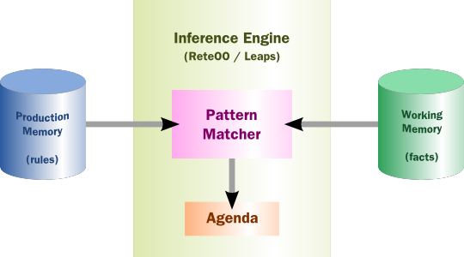
Rule’s engine architecture

Slide 21
Pattern matching, ReteOO and PHREAK
The treatment of comparing the facts to the rules is called the Pattern Matching. There are many pattern matching algorithms: Linear, Rete, Treat, Leaps.
Drools starts to implement and optimize the Rete algorithm in an object technology. (ReteOO)
  This algorithm is particularly effective when the dataset (the facts) changes regularly but in small proportions because the rule engine remembers the rules that have already matched
  It consumes lots of memory
In latest versions, Drools implements a new version of the algorithm called PHREAK
  Mainly, ReteOO memory optimization

Slide 22
Rete’s principles
The algorithm is performed in 2 steps
  The compilation of rules creates a discriminant network composed of different nodes :
    TypeNode : Relative to fact Type
    Alpha : Constraint on a fact
    Beta : Comparaison between a tuple of objects .
    Rule : Activation of a specific rule
  The pattern matching. Executed whenever the working memory changes. Facts are introduced into the network and crosses the nodes if the conditions are satisfied. Some nodes (Beta) have an associated memory which stores the facts that have reached the node.

Slide 23
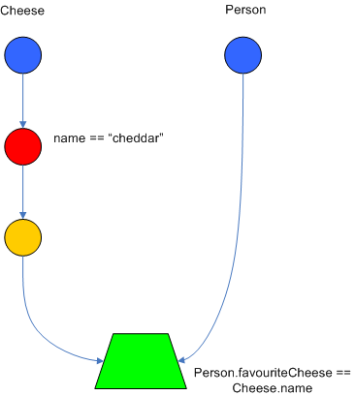
Example

Slide 24
Forward or backward chaining
We can distinguish 2 kinds of rule’s engine
  Forward chaining . The engine is driven by data: from a fact, rules apply, propagate and end with a conclusion.
  Backward chaining . The engine start from the rules to go back to the rules
Drools 5 was a forward chaining .
Drools 6 is hybrid but default to backward chaining

Slide 25
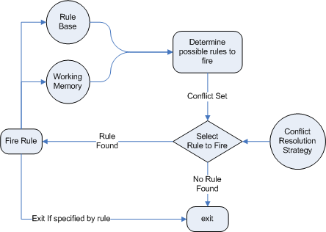
Forward chaining

Slide 26
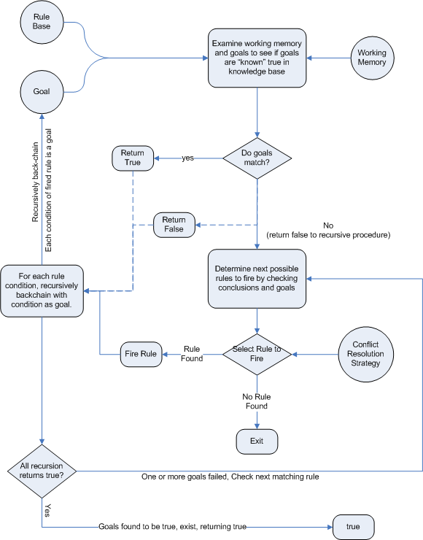
Backward chaining

Slide 27
ReteOO optimizations
ReteOO is the algorithm of versions 3, 4 and 5 of Drools.
The job of pattern matching is done every time the facts in memory changes (insert, update, delete)
=> This can cause a lot of unnecessary work (inserting fact not causing, executing rules)

Slide 28
PHREAK algorithm
Drools6 introduces the new PHREAK algorithm that improves ReteOO
  PHREAK is equivalent to ReteOO when the number of rules remains moderate but avoids performance losses when the number of rules grows
  PHREAK also allows performance gains when using calendar groups and priority attributes (salience) rules

Slide 29
Phreak’s principles
The main differences with ReteOO are:
  Phreak is lazy, the pattern matching work is only done when an explicit rule is triggered (fireAllRules() method)
  It is chained backward, each eligible rule is evaluated independently of the others

Slide 30
Installation

Slide 31
Installation IDE
Drools fournit des plugins Eclipse qui permet de récupérer toutes les dépendances nécessaires
  Java 1.5+ est alors requis
  Eclipse 3.4+
  Eclipse GEF 3.4

Slide 32
Jars et dépendances
knowledge-api.jar : Interfaces et usines. Identifie clairement l'API utilisateur de l'API moteur. Requis au runtime
knowledge-internal-api.jar : Interfaces et usines à usage interne
drools-core.jar : Le moteur implémentant les algorithmes de pattern matching. Requis au runtime
drools-compiler.jar : Compilateur des règles. Requis au runtime si les règles n'ont pas été pré-compilées
drools-jsr94.jar : Couche d'implémentation de la JSR-94 au dessus de drools-compiler. Cependant, en général il est plus facile d'utiliser l'API Drools
drools-decisiontables.jar : Compilateur pour les tables de décision supportant les formats excel et CSV.

Slide 33
Maven, Gradle, Ivy, Buildr, Ant
Les jars sont également disponibles dans les repository Maven et Jboss.
<dependencyManagement><dependencies><dependency>
<groupId>org.drools</groupId>
<artifactId>drools-bom</artifactId>
<type>pom</type>
<version>...</version>
<scope>import</scope>
</dependency>
...
</dependencies></dependencyManagement>
<dependencies><dependency>
<groupId>org.kie</groupId>
<artifactId>kie-api</artifactId>
</dependency>
<dependency>
<groupId>org.drools</groupId>
<artifactId>drools-compiler</artifactId>
<scope>runtime</scope>
</dependency>
...
<dependencies>

Slide 34
The eclipse plug-in

Slide 35
Features
Textual or graphical editor, supporting DRL and DSL (coloring, completion)
Graphical editor for processes.
Wizards for project creation, for .drl, .brl, .dsl files, decision tables, processes
Specific editor for DSLs managing DSL / DRL mappings
Rule’s validation

Slide 36
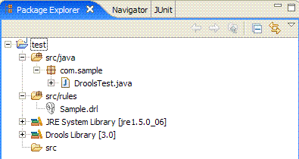
Rule project
The plugin adds a "Drools Builder" which validates and compiles the rules when rule’s files are updated.
(If the project contains a lot of rules, you may need to disable this feature)

Slide 37
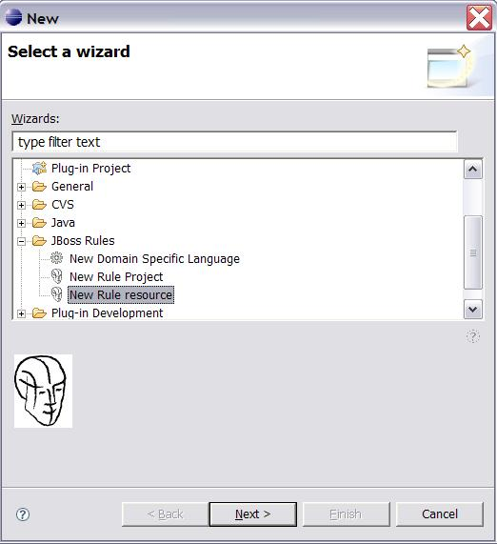
Wizards

Slide 38
Rule’s editors
Text editor
  Handles .drl or .rule files
  Support du dsl
  Completion : Control+Space
Guided Rule Editor
  Manages .brl files

Slide 39
Drool’s views
For debugging, the plugin offers several views to inspect the rules engine.
These views are available when the execution reaches a breakpoint
1. The Working Memory View allow to inspect the facts in memory
2. The Agenda View allow to see the activated ruels in the agenda. For each rule, the associated variables are displayed.
3. The Global Data View allow to see all the global variables available in the session.

Slide 40
The audit view
The audit view allow to display a log which can be generated with the following code :
KieRuntimeLogger logger =
KieServices.Factory.get().getLoggers().newFileLogger(ksession, "logdir/mylogfile");
ksession.insert(...);
ksession.fireAllRules();
// stop logging
logger.close();
Or which has been configured via kmodule.xml

Slide 41
Events of the logfile
1. Object inserted :
2. Object updated :
3.Object destroyed :
4. Activation created :
5. Activation canceled :
6. Activation executed :
7. Sequence of starting or ending of a rule :
8. Activation/desactivation of a rules’s group :
9. Add/remove a rule’s package :
10. Add/remove a rule :

Slide 42
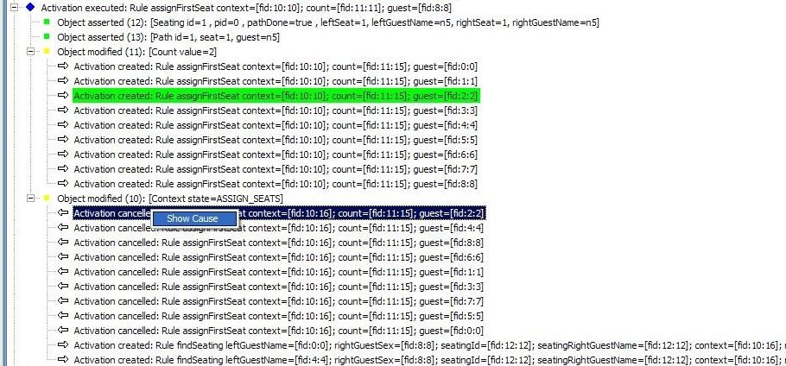
Example

Slide 43
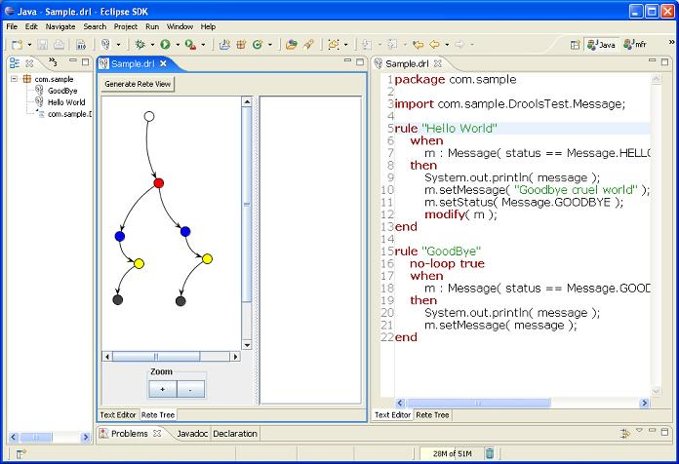
Rete view

Slide 44
Rete view legend
Green: Input point
Red : ObjectTypeNode
Blue : AlphaNode (Constraint)
Yellow: Adapter of the left input
Green : BetaNode
Black : Rule node
Selection update the properties view
Lab0 : IDE Setup

Slide 45
Getting started
Stateless Session
Stateful Session
Agenda and conflicts
Le plugin Eclipse

Slide 46
Main classes
KieServices : Singleton giving access to Kie services (Container, Loggers, persistence, Serializer, ...)
KieContainer : The container responsible for locating the configuration of knowledge bases and sessions, ...
KieModule : The configuration backed by a kmodule.xml
KieBase : A compiled knowledge base
KieSession : API with the working memory.

Slide 47
Types of sessions
Two types of Drools session are possible :
  stateless : StatelessKieSession. (Do not use inference)
  stateful : KieSession

Slide 48
Stateless session

Slide 49
Stateless Knowledge Session
Stateless sessions are the simplest case because they do not use the inference engine.
You can think about a function that we would pass arguments and that would cause a result.
Use cases of stateless sessions :
  Validation: Is a person eligible for a loan?
  The calculation: Calculate a reduction
  Routing or filtering: Filter emails, forward messages to destinations
  ...

Slide 50
Sample : The domain model (facts)
public class Applicant {
private String name;
private int age;
// getter and setter methods here
}
public class Application {
private Date dateApplied;
private boolean valid;
// getter and setter methods here
}

Slide 51
Sample - Rules
package com.company.license
rule "Is of valid age"
when
Applicant( age < 18 )
$a : Application()
then
$a.setValid( false );
end
rule "Application was made this year"
when
$a : Application( dateApplied > "01-jan-2014" )
then
$a.setValid( false );
end

Slide 52
Pattern matching (Rete)
When an instance of an Applicant is inserted in the engine, this fact is evaluated against the constraints of the rules.
  In this case, the 2 constraints of the first rule (constraint on the type and the age field).
  A constraint on an object type plus one or more constraints on its fields is called a pattern.
When an inserted instance matches the pattern, the consequence of the rule is executed.
The notation $a represents a variable to reference the object matched in the consequence. Its properties can be updated in the consequence part.
The ('$') character is optional but makes the expression of the rule more readable.

Slide 53
Configuration
In case of a classpath container, the file kmodule.xml must be located in;
ressources/META-INF/kmodule.xml
For the default configuration, this file is empty :
<?xml version="1.0" encoding="UTF-8"?>
<kmodule xmlns="http://jboss.org/kie/6.0.0/kmodule"/>

Slide 54
Container’s creation
// Get the Singleton
KieServices kieServices = KieServices.Factory.get();
// Load the module from the classpath
// Compile drl files found
// Set the compiled result
KieContainer kContainer = kieServices.getKieClasspathContainer();

Slide 55
Execution
// Statless session creation
StatelessKieSession ksession = kContainer.newStatelessKieSession();
Applicant applicant = new Applicant( "Mr John Smith", 16 );
Application application = new Application();
assertTrue( application.isValid() );
// Execution of the rules for this 2 facts
ksession.execute(
Arrays.asList( new Object[] { application, applicant } ) );
assertFalse( application.isValid() );

Slide 56
BatchExecutor and CommandFactory
The methods execute(Object object) and execute(Iterable objects) are shortcuts for : execute(Command command) of the BatchExecutor interface
For instance, the second method is equivalent to :
ksession.execute(
CommandFactory.newInsertIterable( new Object[] { application, applicant } ) ) ;

Slide 57
BatchExecutor and CommandFactory
BatchExecutor are CommandFactory are particulary useful for working with several commands and results avec plusieurs commandes et plusieurs identifiants de résultats :
List<Command> cmds = new ArrayList<Command>();
cmds.add(CommandFactory.newInsert( new Person( "Mr John Smith" ), "mrSmith" );
cmds.add(CommandFactory.newInsert( new Person( "Mr John Doe" ), "mrDoe" );
BatchExecutionResults results = ksession.execute( CommandFactory.newBatchExecution( cmds ) );
assertEquals( new Person( "Mr John Smith" ), results.getValue( "mrSmith" ) );
Lab1.1 : Stateless Session

Slide 58
Stateful session

Slide 59
Stateful Session
Stateful session have a longer life cycle and allow iterative update of the facts .
Use cases are :
  Monitoring : Stock market monitoring and semi-automatic purchasing
  Diagnosis: Discovery of fault, medical diagnosis
  Logistics: Delivery tracking, provisionning
  Compliance: Validation of legislation

Slide 60
Stateful versus stateless
Unlike a Stateless Session, the dispose () method must be called to avoid memory leaks (KieBase contains references to Stateful Sessions)
A Stateful Knowledge Session is simply called KieSession.
KieSession suppors also the interface BatchExecutor
  But, the method fireAllRules is not triggered automatically.

Slide 61
Sample – Domain model
public class Room {
private String name
// getter and setter methods here
}
public class Sprinkler {
private Room room;
private boolean on;
// getter and setter methods here
}
public class Fire {
private Room room;
// getter and setter methods here
}
public class Alarm { }

Slide 62
Sample – Rule
rule "When there is a fire turn on the sprinkler"
when
Fire($room : room)
$sprinkler : Sprinkler( room == $room, on == false )
then
modify( $sprinkler ) { setOn( true ) };
System.out.println( "Turn on the sprinkler for room " + $room.getName() );
end

Slide 63
Inference and modify
Unlike the StatelessSession example, which used the standard Java syntax to modify the attribute of a fact, using the modify statement can warn the engine of changes of the facts and thus allow it to make other pattern matching.
This is called inference

Slide 64
not operator
The not operator is used to match when no instance of the object exists in the working memory:
rule "When the fire is gone turn off the sprinkler"
when
$room : Room( )
$sprinkler : Sprinkler( room == $room, on == true )
not Fire( room == $room )
then
modify( $sprinkler ) { setOn( false ) };
System.out.println( "Turn off the sprinkler for room " + $room.getName() );
end

Slide 65
exists operator
The operator exist test the existence of a fact :
rule "Raise the alarm when we have one or more fires"
when
exists Fire()
then
insert( new Alarm() );
System.out.println( "Raise the alarm" );
end

Slide 66
retract instruction
The instruction retract allows to remove a fact from working memory
rule "Cancel the alarm when all the fires have gone"
when
not Fire()
$alarm : Alarm()
then
retract( $alarm );
System.out.println( "Cancel the alarm" );
end

Slide 67
Creation of a stateful session
// Compile the drl files found in the classpath
// Set the result in the container
KieServices kieServices = KieServices.Factory.get();
KieContainer kContainer = kieServices.getKieClasspathContainer();
// Creation of the stateful session
KieSession ksession = kContainer.newKieSession();

Slide 68
Execution
String[] names = new String[]{"kitchen", "bedroom", "office", "livingroom"};
Map<String,Room> name2room = new HashMap<String,Room>();
for( String name: names ){
Room room = new Room( name );
name2room.put( name, room );
ksession.insert( room );
Sprinkler sprinkler = new Sprinkler( room );
ksession.insert( sprinkler );
}
ksession.fireAllRules() ;
> Everything is ok

Slide 69
FactHandle
A FactHandle allow to obtain a reference to an inserted fact in the working memory.
  Fire kitchenFire = new Fire( name2room.get( "kitchen" ) );
  Fire officeFire = new Fire( name2room.get( "office" ) );
  FactHandle kitchenFireHandle = ksession.insert( kitchenFire );
  FactHandle officeFireHandle = ksession.insert( officeFire );
  ksession.fireAllRules() ;
  > Raise the alarm
  > Turn on the sprinkler for room kitchen
  > Turn on the sprinkler for room office
This reference allow to remove the fact later :
  ksession.retract( kitchenFireHandle );
  ksession.retract( officeFireHandle );
  ksession.fireAllRules() ;
  > Turn on the sprinkler for room office
  > Turn on the sprinkler for room kitchen
  > Cancel the alarm
  > Everything is ok

Slide 70
Agenda and conflicts

Slide 71
Methods versus Rules
Methods :
  They are explicitly called
  Specific instances are passed as arguments
  A call causes a single run
Rules :
  They are never explicitly called
  Specific instances can not be passed as an argument
  A rule can fire once, several times, or no time.

Slide 72
Activations, Agenda and conflicts (Drools6)
When calling fireAllRules(), the rules are evaluated independently of each other
The agenda chooses the first rule based on the active activation group and the salience attributes of the rule. If 2 rules have the same precedence, the declaration’s order is taken in account
If the conditions of a rule are met, it is triggered immediately.
  If the consequence of the rule updates the working memory, the inference occurs

Slide 73
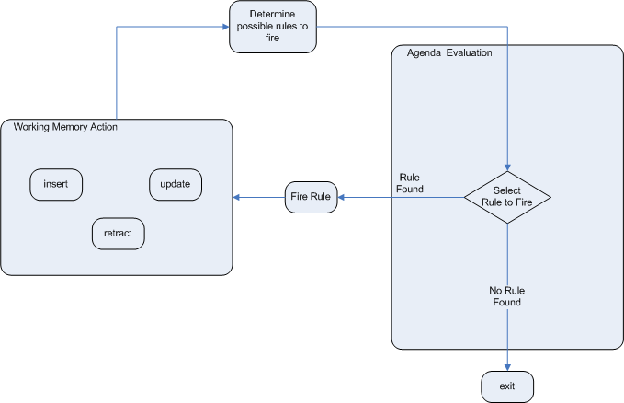
Life cycle of the Agenda

Slide 74
Résolution
Le mécanisme de base pour résoudre le conflit repose sur la grandeur de l'attribut salience des règles. (Valeur par défaut : 0)
  Cependant, il n'est pas recommandé de s'appuyer sur des séquences d'exécution !
Si nécessaire, il existe également d'autres possibilités :
  Les groupes d'agenda
  Les groupes « processus » (rule flow groups)
  Les groupes d'activation
  Et des instructions de contrôle ...

Slide 75
Agenda groups
Agenda groups allow to partition rules in groups that are themselves placed in an execution stack
The agenda executes the rules of the group placed on the top of the stack
When all the rules have been executed, the agenda pops aother group from the stack.

Slide 76
Inference and maintenabilty
The insertion of a new fact from a previous knowledge may lead to more maintenability
rule "Infer Adult"
when
$p : Person( age >= 18 )
then
insert( new IsAdult( $p ) )
end
The other rules can be based on being an adult rather than the value 18. Adaptation to other specification will be facilitated

Slide 77
logicalInsert
logicalInsert retract the fact as soon as the when clause becomes false again :
rule "Infer Child" when
$p : Person( age < 16 )
then
logicalInsert( new IsChild( $p ) )
end
The fact IsChild ($ p) is automatically retracted as soon as the person reaches 16

Slide 78
Engine’s listener

Slide 79
Event Model
Kie provides an event model that allows listeners to be aware of motor events such as triggering a rule, inserting a fact, and so on.
This allows separation of trace or audit activities
The KieRuntimeEventManager interface is implemented by KieRuntime which provides 2 interfaces:
  RuleRuntimeEventManager
  And ProcessEventManager.

Slide 80
Provided listeners of Drools
The RuleRuntimeEventManager interface allows the addition or removal of listeners who are then aware of the events concerning the working memory and the agenda
Drools provides 2 listeners DebugRuleRuntimeEventListener and DebugAgendaEventListener that displays debug messages

Slide 81
Example
ksession.addEventListener( new DefaultAgendaEventListener() {
public void afterMatchFired(AfterMatchFiredEvent event) {
super.afterMatchFired( event );
System.out.println( event );
}
});
ksession.addEventListener( new DebugRuleRuntimeEventListener() );

Slide 82
KieRuntimeLogger
KieRuntimeLogger also uses the event system to create a trace file that can be viewed with the Eclipse audit viewer
KieRuntimeLogger logger =
KieServices.Factory.get().getLoggers().newFileLogger(ksession, "logdir/mylogfile");
...
logger.close();

Slide 83
Channels
A channel is a standardized way to transmit data from within a session to the external world.
Alternative to globals.
Technically, Channel is a Java interface with a single method :
void send(Object object)
Channels can only be used in the RHS of our rules as a way to send data to outside

Slide 84
Registration
Channels must be registered :
ksession.registerChannel("audit-channel", auditChannel);
Then can be used in rules :
rule "Send Suspicious Operation to Audit Channel"
when
$so: SuspiciousOperation()
then
channels["audit-channel"].send($so);
end
Lab1.2 : Stateful Session

Slide 85
Rule syntax : DRL
Main elements
Rule’s attributes
LHS
RHS
Query
DSL
Decision tables

Slide 86
Main elements

Slide 87
.drl files
A rules file is a simple text file with the extension .drl
It has the following structure :
  package : Namespace
  imports : Java types used
  declare : Internal declaration of new types
  globals : Globals variables which can accessed from outside the session
  functions : Reuse of logic
  queries : Fact queries
  rules : Rules
It is also possible to distribute the rules over several files which then usually have the .rule extension

Slide 88
Structure of a rule
rule "name"
attributs
when
LHS
then
RHS
end
Punctuation ", line breaks are optional
Attributes are optional
LHS is the conditional part of the rule
RHS is a block that allows to specify in different dialects a code to execute.

Slide 89
Keyword
Keyword :
  Hard (true, false, accumulate, collect, from, null, over, then, when). Can not be used as object ID
  Soft : only recognized in their context (package, import, attributes, rule, ...)
The escape character is ` :
Holiday( `when` == "july" )
Comments :
  line : # ou //
  multi-lines : /* .... */

Slide 90

Error message
1st block : Error code
2nd block : Information on the column and the row.
3rd block : Description of the error.
4th block optional : First context of the error. Generally, the rule, the function, the query where the error occured.
5th bloc optional : Identify the pattern where the error occured.

Slide 91
Package
A package groups together a set of rules, imports, and globals that are related.
  A package represents a namespace and must be unique in the knowledge base. It follows the naming conventions of Java packages
  If the rules of the same package are distributed over several files. Only one file contains the package configuration.
  Items declared in a package can be in any order, except for the package statement.
  The ';' are optional.

Slide 92
Import
import instructions are similar to java imports
The full name of the Java types must be specified.
Drools automatically imports the Java classes from the package of the same name and the package java.lang.

Slide 93
Global
global defines global variables
  Global variables can be used in the consequences of the rules.
  They are not inserted into working memory and therefore should not be used as conditions in the rules except as a constant
  The engine is not warned when a value change of a global variable

Slide 94
Example
global java.util.List myGlobalList;
rule "Using a global"
when
eval( true )
then
myGlobalList.add( "Hello World" );
end
-----
List list = new ArrayList();
WorkingMemory wm = rulebase.newStatefulSession();
wm.setGlobal( "myGlobalList", list );

Slide 95
Functions
functions allow to insert code in rule’s files.
  They are just like Helper classes.
  With functions, the logic is centralized in one place.
  They are used to invoke actions in the consequence part of the rules.

Slide 96
Example
function String hello(String name) {
return "Hello "+name+"!";
}
rule "using a static function"
when
eval( true )
then
System.out.println( hello( "Bob" ) );
end

Slide 97
Declarations
2 kinds of declarations :
  Declaration of new types : Drools works directly with POJOs as facts. It is therefore possible to define the business model directly in the rules or to create model objects that are useful only in reasoning.
  Drools, at compile-time, generates the Java bytecode that implements the new type
  Declaration of meta-data or annotations: The facts or their attributes can be annotated. Annotations can be used in reasoning or fact finding.

Slide 98
Declaration of new types
declare Address
number : int
streetName : String
city : String
end
declare Person
name : String
dateOfBirth : java.util.Date
address : Address
end

Slide 99
Access to the declared types
We can access to the internal declaed types via the interface org.drools.definition.type.FactType
// Get the data type
FactType personType = kbase.getFactType( "org.drools.examples", "Person" );
// Instanciate it
Object bob = personType.newInstance();
// Set attributes
personType.set( bob, "name", "Bob" );
personType.set( bob, "age", 42 );

Slide 100
Meta-data declaration
The character @ is used
The metadata can concern a new or existing type or one of its attributes.
declare Person
@author( Bob )
@dateOfCreation( 01-Feb-2009 )
name : String @key @maxLength( 30 )
dateOfBirth : Date
address : Address
end
On a existing type
declare Person
@author( Bob )
@dateOfCreation( 01-Feb-2009 )
end

Slide 101
Use of meta-data
Drools allows the declaration of arbitrary meta-data.
Metadata can be used by queries.
Some meta-data are predefined and have a meaning for the engine. They are especially useful for Drools-CEP:
@role, @timestamp, @duration, ...

Slide 102
Example
StatefulKnowledgeSession ksession= createKSession();
ksession.fireAllRules(new AgendaFilter() {
public boolean accept(Activation activation) {
Map<String, Object> metaData = activation.getRule().getMetaData();
if (metaData.containsKey("LegalRequirement")) {
System.out.println(metaData.get("LegalRequirement"));
}
return true;
}
});

Slide 103
Rules and attributes

Slide 104
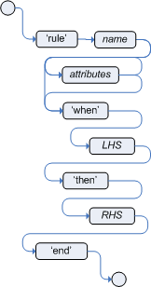
Rule

Slide 105
Rule, syntax
A rule must have a unique name inside the package.
The name can contain spaces if it is delimited by ".
The left side of the rule (Left Hand Side) or condition follows the keyword when
The Right Hand Side or Consequence follows the keyword then
The rule ends with the keyword end.
Rules can not be nested.

Slide 106
Attributes
no-loop (boolean, false): When the consequence of the rule changes a fact, it can cause the rule to be activated again. Recursion can be avoided with the no-loop attribute set to true.
salience (Integer, 0): Each rule has an integer salience attribute that determines the priority of the rule in the agenda.
dialect: (String, "java" or "mvel") The dialect is usually specified at the package level. This attribute overrides the package-level definition.

Slide 107
Attributes (2)
agenda-group (String, MAIN): This attribute allows you to partition the Agenda and control the execution. Only the rules of the agenda group that has the focus are allowed to fire.
activation-group (String): Rules belonging to the same activation group are exclusive. The first rule that fires cancels the others.
ruleflow-group (String): Group several rules. The rules in this group will only be enabled when the process is in a particular node of an associated jBPM process.

Slide 108
Attributes (3)
auto-focus (boolean, false): When a rule is enabled with the auto-focus attribute set, the group indicated by one of its attributes (agenda-group or activation-group) gains the focus.
lock-on-active (boolean, false): When a group (ruleflow or agenda) becomes active, all the rules in this group that have the lock-on-active attribute set will no longer be activated in the future whatever the origin of the update. They can be reactivated when their group is reactivated.
effective-date (String defining a date): A rule can only be activated if the current date is greater than the effective date.
date-expires (String defining a date): A rule can only be activated if the current date is greater than the expiration date.

Slide 109
Timer
Drools supports timers based on intervals or expressed by cron expressions.
timer ( int: <initial delay> <repeat interval>? )
timer ( cron: <cron expression> )
Example
rule "Send SMS every 15 minutes"
timer (cron:* 0/15 * * * ?)
when
$a : Alarm( on == true )
then
channels[ "sms" ].insert( new Sms( $a.mobileNumber, "The alarm is still on" );
end

Slide 110
fireUntilHalt()
In order for rules using timers to be triggered, the engine must be active.
In this case, do not call fireAllRules() but fireUntilHalt() which evaluates the rules until it receives a halt signal
In this case, stop the engine can be done:
  Via a rule: drools.halt ()
  Via Java: ksession.halt ()
In this case, the fireUntilHalt method is usually started in an independent thread so that the Java code can stop it.

Slide 111
LHS

Slide 112

LHS
The LHS part is the conditional part of the rule.
It consists of zero or more conditions elements
  If no condition element, the LHS is set to true and will be activated when the working memory is created
  Conditional elements consist of patterns that are implicitly connected by and

Slide 113
Pattern
A pattern consists of:
  A binding pattern to create a variable used in the rule (the $ character is optional but recommended)
  A restriction on the type (A fact, an interface, an abstract class)
  A set of constraints linked by operators
Ex: $ c: Cheese ()

Slide 114
Constraint’s syntax
2 types of syntax are available:
  Field’s constraints
    Concern only one attribute
    Combined with && , || and ()
  Group ‘s constraints
    Concern several attributes of the same fact
    Combined with ',' (which means && with a lower precedence)

Slide 115
Field’s constraints
A field constraint expresses a restriction on a property of the object accessible by getter / setter, it is possible to bind the field on a variable
3 types of restriction are possible:
  Unique value: the field is compared to a single value
  Multiple values: the field is compared to several values
  Multi-constraints: Several constraints are specified on the field
The value of the field can be String, numeric, date (format "dd-mmm-yyyy" by default), boolean or Enum tests on null can be carried out as well as on returns of method

Slide 116
Single value constraint
The operators that can be used are: <, <=, >, >=, ==, !=, contains, not contains, memberof, not memberof, matches (expr. régulière), not matches
Cheese( quantity == 5 )
Cheese( bestBefore < "27-Oct-2009" )
Cheese( type == "camembert" )
Cheese( from == Enum.COW)
Cheese( type matches "(Buffalo)?\S*Mozarella" )
CheeseCounter( cheeses contains "stilton" )
CheeseCounter( cheese memberOf $matureCheeses )
Person( likes : favouriteCheese ) Cheese( type == likes )
Person( girlAge : age, sex == "F" ) Person( age == ( girlAge + 2), sex == 'M' )

Slide 117
Multiple values constraint
Operators in and not in, allow to specify multiple values separated by ","
Person( $cheese : favouriteCheese )
Cheese( type in ( "stilton", "cheddar", $cheese ))

Slide 118
Multiples constraints
Multiple constraints allow you to specify several restrictions on the field related by the operators '&&' or '||' and parentheses
Person( age > 30 && < 40 )
Person( age ( (> 30 && < 40) ||
(> 20 && < 25) ) )
Person( age > 30 && < 40 || location == "london" )

Slide 119
Group’s constraint
The comma, allows to separate the constraints of groups and is equivalent to a less priority AND:
Person( age > 50, weight > 80, height > 2 )
The comma operator can not be nested in a composite expression:
Person( ( age > 50, weight > 80 ) || height > 2 )
// => compilation ERROR

Slide 120
Other operators
not: There is no fact in the working memory corresponding to these restrictions
exists: There is at least one fact in the working memory corresponding to these restrictions
forall: All the facts of the working memory corresponding to the first restriction satisfy the other restrictions
from: Used to compare data other than the entire working memory (For example a query, a channel)
collect: Lets reason on a collection of objects
accumulate: Allows you to perform an aggregate function on a collection of objects

Slide 121
Examples
#There is no red bus in the memory
not Bus(color == "red")
#There is at least one bus 42 of red color in the memory
exists ( Bus(color == "red", number == 42) )
#All English buses are red
forall( $bus : Bus( type == 'english') Bus( this == $bus, color = 'red' ) )
# Addresses with the correct postal code
# who are detained by Person from memory
Person( $personAddress : address )
Address( zipcode == "23920W") from $personAddress

Slide 122
Examples
# Build a mom list
# All females with children
$mothers : LinkedList()
from collect( Person( gender == 'F', children > 0 ) )
# All orders with total greater than 100
$order : Order()
$total : Number( doubleValue > 100 )
from accumulate( OrderItem( order == $order, $value : value ), sum( $value ) )

Slide 123
Query definition
A query can search for facts in the knowledge base
A request can be parameterized.
The names of the queries are global to the knowledge base
=> No identical name even in different packages
Its definition is identical to the left part of a rule:
query "people over the age of x" (int x)
person : Person( age > x )
end

Slide 124
Use
The result of a query is obtained by :
ksession.getQueryResults("name")
It is then possible to iterate on the returned lines
QueryResults results = ksession.getQueryResults( "people over the age of x" ,30 );
System.out.println( "we have " + results.size() + " people over the age of 30" );
System.out.println( "These people are are over 30:" );
for ( QueryResultsRow row : results ) {
Person person = ( Person ) row.get( "person" );
System.out.println( person.getName() + "\n" );
}

Slide 125
RHS

Slide 126
RHS
The right part contains a list of actions to perform.
In general, no conditional code because the rule must be "atomic" (if not separate into several rules)
The operations can act on the working memory and thus trigger the inference:
  Adding facts
  Deleting facts
  Update facts

Slide 127
Macro-methods
Drools proposes several macro-methods avoiding to recover the references of the facts which one wishes to update:
  update (object, handle): Notifies the engine that an object has been modified and rules must be reconsidered
  update (object): idem, but the equality test is used by the engine.
  insert (new Something ()): Inserts a new fact.
  insertLogical (new Something ()): Same as insert but the object is automatically removed from the working memory if the rule is no longer valid.
  retract (handle): Removes a fact from the working memory
  retract (object): idem with equality test

Slide 128
modify
The modify statement can call multiple setters on a model object
modify ( <fact-expression> ) {
<expression> [ , <expression> ]*
}
Exemple :
modify( $stilton ){
setPrice( 20 ),
setAge( "overripe" )
}

Slide 129
drools variable
The predefined variable drools of type KieHelper makes it possible to call other useful methods:
  drools.getWorkingMemory () returns the WorkingMemory or session object.
  drools.halt () stops execution of the rule
  drools.setFocus (String s) positions the focus on a group in the calendar.
  drools.getRule (). getName () returns the name of the rule
  drools.getTuple () returns the tuple of facts corresponding to the execution of the rule
  drools.getActivation () returns the activation.
  insert (Object o), update (Object o), and retract (Object o)

Slide 130
kcontext et KieRuntime API
The entire Knowledge Base API is exposed through the kcontext variable.
Its getKieRuntime () method returns an object of type KieRuntime that proposes other useful methods for the RHS part:
  getAgenda () returns a reference on the agenda of the session
  getQueryResults (String query) returns the result of a query
  addEventListener, removeEventListener: recording of listeners for working memory or calendar.
  getKnowledgeBase () returns the KnowledgeBase object.
  Management of global variables with setGlobal (...), getGlobal (...) and getGlobals ().
  getEnvironment (): the runtime environment and its properties
Lab2 : DRL

Slide 131
Complex Event Processing

Slide 132
Introduction
Complex event processing (CEP) allow to make decisions based on time relationships between facts.
The main focus of CEP is to correlate small units of time-based data within an ever-changing, ever-growing data cloud in order to react to hard-to-find special situations
Reasonning is made on events which are facts with a time of occurrence

Slide 133
Complex event
A complex event is simply an aggregation, composition, or abstraction of other events
Rules will be expressed via complex events using aggregation, composition or abstraction

Slide 134
Semantic of events
2 kinds of events are considered :
  Punctual event
  Interval event
All events are :
  Immutable
  A managed life cycle : when it is too old, it is removed from the session

Slide 135
Declaring time-based-events
In order to create the CEP rules, we must inform the engine which types of objects must be treated as events
It is done by adding meta-data :
  @Role : fact or event
  @Timestamp : The attribute which gives the time of occurrence. If not present, the timestamp is the time of insertion
  @Duration : The attribute which gives the duration of the event. Optional
  @Expires : The attribute which gives the life time in the session

Slide 136
Sample
@org.kie.api.definition.type.Role(Role.Type.EVENT)
@org.kie.api.definition.type.Duration("durationAttr")
@org.kie.api.definition.type.Timestamp("executionTime")
@org.kie.api.definition.type.Expires("2h30m")
public class TransactionEvent implements Serializable {
private Date executionTime;
private Long durationAttr;
/* class content skipped */
}

Slide 137
Sample (2)
declare PhoneCallEvent
@role(event)
@timestamp(whenDidWeReceiveTheCall)
@duration(howLongWasTheCall)
@expires(2h30m)
whenDidWeReceiveTheCall: Date
howLongWasTheCall: Long
callInfo: String
end

Slide 138
Temporal operators
There are 13 temporal operators available which allow to correlate events
For example :
declare MyEvent
@role(event)
@timestamp(executionTime)
End
rule "my first time operators example"
when
$e1: MyEvent()
$e2: MyEvent(this after[5m] $e1)
Then
System.out.println("We have two events" + " 5 minutes apart");
end

Slide 139
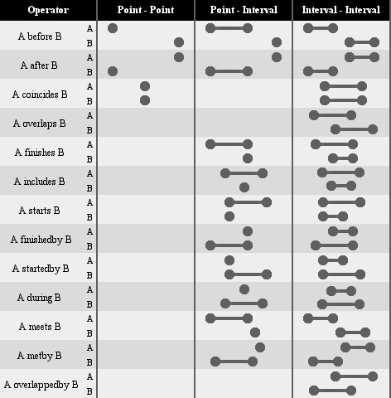

Slide 140
Another sample
rule "More than 10 transactions in an hour from one client"
when
$t1: TransactionEvent($cId: customerId)
Number(intValue >= 10) from accumulate(
$t2: TransactionEvent(this != $t1,
customerId == $cId, this meets[1h] $t1),
count($t2) )
not (SuspiciousCustomerEvent(customerId == $cId,
reason == "Many transactions"))
then
insert(new SuspiciousCustomerEvent($cId,
"Many transactions"));
end

Slide 141
Event-driven architecture
The idea of event-driven architecture (EDA) is to classify the components in the following four different categories:
  Event Producer : Creators of events, for example a sensor
  Event Consumer : Final output architecture which point the produced value. For example a dashboard
  Event Channels : Communication protocols between all the other components. For example JMS
  Event Processing Agents: Group the events to detect and process complex events. The Drools rules

Slide 142
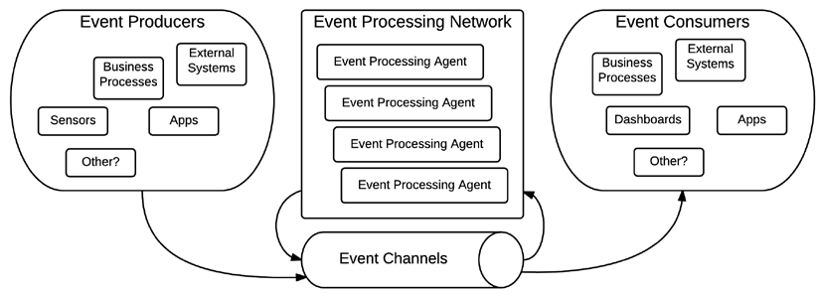
Event-driven architecture

Slide 143
Entry points
Entry points are a way to partition the working memory
Rules can express conditions about events from one particular source
Entry points are declared implicitly by using them in rules
At insertion, the entry point can be specified :
ksession.getEntryPoint("myEentryPoint").insert(new Object());

Slide 144
Sample
// Insert event from one entry-pont to another
rule "Routing transactions from small resellers"
when
$t: TransactionEvent() from
entry-point "small resellers"
then
entryPoints["Stream Y"].insert(t);
end

Slide 145
Sliding windows
Sliding windows allow to filter the events of the working memory or any entry point
2 kinds of sliding windows :
  Length-based : Number of elements
  Time-based sliding : Elements that happened within a specific time elapsed from now
Sliding windows can be defined
  inside a rule
  or outside for reuse

Slide 146
Length-based sample
rule "last 6 transactions are more than 100 dollars"
When
Number(doubleValue > 100.00) from accumulate(
TransactionEvent($amount: totalAmount)
over window:length(6),
sum($amount))
then
//... TBD
end

Slide 147
Time-based sample
rule "obtain last five hours of operations"
when
$n: Number() from accumulate(
TransactionEvent($a: totalAmount)
over window:time(5h),
sum($a)
)
Then
System.out.println("total = " + $n);
end

Slide 148
Declared sliding windows sample
declare window Beats
@doc("last 10 seconds heart beats")
HeartBeat() over window:time( 10s )
from entry-point "heart beat monitor"
end
rule "beats in the window"
when
accumulate(HeartBeat() from window Beats,
$cnt : count(1))
then
// there has been $cnt beats over the last 10s
end

Slide 149
Running CEP-scenarios
Both the Kie Base and Session that run the CEP cases need special management :
  Kie Base must be configured to support CEP
  Define the way to fire rules : discrete or continous
  The Kie Session internal clock used to evaluate temporal events must be set

Slide 150
KieBase
Kie Base must be configured to use the STREAM event processing mode.
This configuration informs the runtime that it should manage events and keep them internally ordered by their timestamp
In kmodule.xml
<kbase name="cepKbase" eventProcessingMode="stream"
packages="chapter06.cep">
<ksession name="cepKsession"/>
</kbase>

Slide 151
Discrete vs Continous
Firing rules can be done :
  At specific point of time.
  After inserting fact, we call fireAllRules
  Continously
  fireUntilHalt
If we have a scenario where the absence of events will trigger a rule, we have to use the continous way
If the only thing that could trigger new rules is the insertion of new events then discrete rule firing will be enough

Slide 152
Session clock
By default, Kie Sessions will use the clock of the machine on which is running
For testing scenarios, we can use pseu-clock
For complex distributed scenarios, we can configured in synchronized clock

Slide 153
Pseudo-clock sample
Configuration :
<kbase name="cepKbase" eventProcessingMode="stream"
packages="chapter06.cep">
<ksession name="cepKsession" clockType="pseudo"/>
</kbase>
Usage in test case for example :
SessionPseudoClock clock = ksession.
getSessionClock();
clock.advanceTime(2, TimeUnit.HOURS);
clock.advanceTime(5, TimeUnit.MINUTES);

Slide 154
DSL

Slide 155
Introduction
Domain Specific Languages (DSL) allow to extend the rules language by adapting it to the business language.
This is an abstraction layer dedicated to non-technical business experts that is translated into the rule language at compile time
They can also be used as templates of conditions or actions, allowing to share certain parts of rules

Slide 156
Syntax
The format of a DSL is simply a text file that translates "natural" language keys into drl expressions
Each line starts with a scope and then the extended language translation in the rule language
[when]This is "{something}"=Something(something=="{something})"
[then]Log "{message}"=System.out.println("{message}") ;

Slide 157
Syntax
It is also possible to use the scope [keyword] which makes it possible to redefine a keyword:
[keyword] quand = when
The defined sentences are actually regular expressions. Wildcards can therefore be used.

Slide 158
Examples
[when]There is a Person with name of "{name}"=Person(name=="{name}")
[when]Person is at least {age} years old and lives in "{location}"=Person(age > {age}, location=="{location}")
[then]Log "{message}"=System.out.println("{message}");
There is a Person with name of "kitty"
---> Person(name="kitty")
Person is at least 42 years old and lives in "atlanta"
---> Person(age > 42, location="atlanta")
Log "boo"
---> System.out.println("boo");

Slide 159
Example with regexp
[when][]is less than or equal to=<=
[when][]is less than=<
[when][]is greater than or equal to=>=
[when][]is greater than=>
[when][]is equal to===
[when][]equals===
[when][]There is a Cheese with=Cheese()
[when][]- {field:\w*} {operator} {value:\d*}={field} {operator} {value}
---------------------------------------------------------------------
There is a Cheese with
- age is less than 42
- rating is greater than 50
- type equals 'stilton'
---------------------------------------------------------------------
Cheese(age<42, type=='stilton', rating>50)

Slide 160
Steps
1. Name your DRL file with the .dslr extension
2. Refer to the DSL file in the rule file with the keyword expander
expander your-expander.dsl
3. Put resources in the KieContainer's classpath:
Lab3 : DSL

Slide 161
Decision tables

Slide 162
Presentation
Decision tables are an efficient and compact way to represent conditional logic, they are tailored to business experts
The data entered in a spreadsheet makes it possible to generate the rules.
=> the business expert then benefits from his favorite tool: Excel
For each line of the decision table, the data is combined with a template to generate a rule.
Decision tables allow you to encapsulate rules and isolate the object model. Only the parameters of the rules that can be modified are exposed.

Slide 163
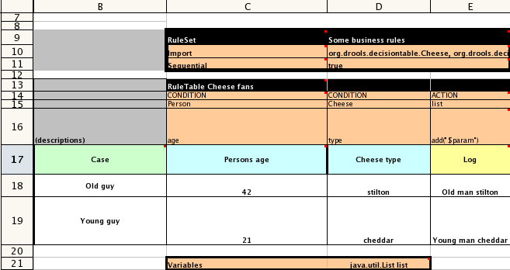
Example

Slide 164
Template syntax
Decision tables have 2 types of columns:
  Condition columns <=> LHS, the constraint syntax must be used
  Action columns <=> RHS, the code syntax must be used
$ param is used to indicate where cell data will be inserted ($ 1 can be used)
If the cell contains a value list separated by commas, the symbols $ 1, $ 2, and so on. can be used.
The forall (DELIMITER) {SNIPPET} function can be used to loop through all available values.

Slide 165
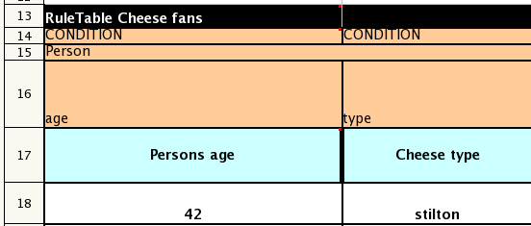
Condition columns
The rendering of a condition depends on the presence of a declaration of an object type in a line above.
If the type is specified, a type constraint is created.
If the cell contains just one attribute, the constraint will be an equality constraint, otherwise the cell will include an operator.

Slide 166
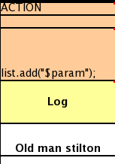
Consequences
The result of an action cell depends on the presence of an entry on the line immediately above.
  If there is nothing, the cell is interpreted as it is
  If there is a variable, the contents of the cell are added to the variable (Method Call)

Slide 167
Keywords
Before the keyword RuleTable, the following keywords may be present and condition their cell immediately to the right:
  RuleSet : Specifying the name of the rule group, if empty it is the default group
  Sequential : The cell on the right contains true or false. If true, the salience property is used to guarantee order
  Import : List of java classes to import
  Functions : Functions declaration
  Variables : Global variables declaration
  Queries : Queries declaration

Slide 168
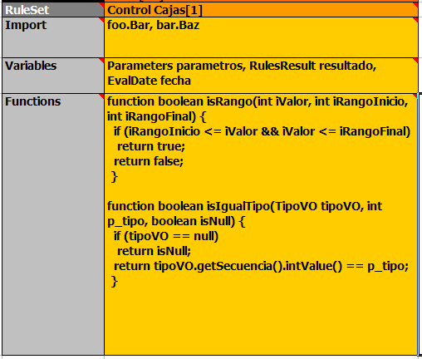
Example

Slide 169
RuleTable
A cell with RuleTable indicates the beginning of the definition of a rule table.
The table starts with the next line. It is read from left to right and from bottom to top to a white line.

Slide 170
Keywords in the rules table
CONDITION : Indicates a condition column
ACTION : Indicates an action column
PRIORITY : Indicates a column used for the salience attribute
DURATION : Indicates the duration attribute of the rule
NAME : The name of the rule (optional)
NO-LOOP : Attribute no-loop (true or false)
ACTIVATION-GROUP : Attribute activation-group
AGENDA-GROUP : Attribute agenda-group of the rule
RULEFLOW-GROUP : Attribute ruleflow-group of the rule

Slide 171
Integration
The integration of a decision table requires the library
drools-decisiontables.jar
The main class SpreadsheetCompiler takes as input a csv or excel file and generates the rules in DRL
The rules can then be manipulated independently

Slide 172
Steps
1. The business expert starts from a decision table template
2. It informs the parameters of the rules and actions with business descriptions
3. They enter the lines corresponding to the rules
4. The decision table is taken over by a technician who maps the business language to scripts
5. The business expert and the technician review together the changes made.
6. The business expert can edit the rules according to his needs.
7. The technician can write test cases that check the rules

Slide 173
Rules template
Rule templates use tabular data sources (Spreadsheets, CSV, or others) to generate many rules.
This is a technique that is ultimately more powerful than the decision tables:
  Data can be stored in a database
  Rule generation can be conditioned by data
  The data can be used in any part of the rules (operator, name of a class, name of a property)
  Several templates can be run on the same data

Slide 174
Structure of a template
The text file
  starts with a template header header.
  Then the list of columns of tabular data
  A blank line to mark the end of the column definitions
  The standard DRL headers (package, import, global, functions)
  The template keyword marks the beginning of a rule template ; several templates can be defined in the same file.
  The template uses the syntax @ {token_name} for substitutions (ex: @ {row.rowNumber})
  The keyword end template marks the end of the template.

Slide 175
Exemple
template header
age
type
Log
package org.drools.examples.templates;
global java.util.List list;
template "cheesefans"
rule "Cheese fans_@{row.rowNumber}"
when
Person(age == @{age})
Cheese(type == "@{type}")
then
list.add("@{log}");
end
end template

Slide 176
kmodule
The template must then be included with the associated data file in the kmodule definition
<?xml version="1.0" encoding="UTF-8"?>
<kmodule xmlns="http://drools.org/xsd/kmodule">
<kbase name="TemplatesKB" packages="org.drools.examples.templates">
<ruleTemplate dtable="org/drools/examples/templates/ExampleCheese.xls"
template="org/drools/examples/templates/Cheese.drt"
row="2" col="2"/>
<ksession name="TemplatesKS"/>
</kbase>
</kmodule>

Slide 177
Sample with database
// Get results from your DB query...
resultSet = preparedStmt.executeQuery();
// Generate the DRL...
resultSetGenerator = new ResultSetGenerator();
String drl = resultSetGenerator.compile(resultSet,
new FileInputStream("path/to/template.drt"));
Lab4 : Decision tables and templates

Slide 178
Build, deploy and run !
Construction / configuration
Deployment
Execution

Slide 179
Introduction
One of the primary goals when using a rule engine is to decorrelate the business rules from the application that uses it.
Drools relies on Maven to deploy business rules in a repository.
Applications can then:
  Either declare a Maven dependency to the artifact of the business rules finally load the rules via the classpath
  Either access a remote repository dynamically (http, Scanner)

Slide 180
Building rules with Maven
A "business rules" project is typically a Maven project plus a kmodule.xml file configuring the various knowledge bases
The build cycle is enriched with the Kie plugin that precompiles the rules and ensures their validity
<packaging>kjar</packaging>
...
<build>
<plugins>
<plugin>
<groupId>org.kie</groupId>
<artifactId>kie-maven-plugin</artifactId>
<version>${project.version}</version>
<extensions>true</extensions>
</plugin>
</plugins>
</build>

Slide 181
Default configuration
kmodule.xml defines knowledge bases and sessions that can be used in the project
An empty file gives a default configuration:
  A single knowledge base including all rules / processes / etc. found in the resources directory of jar
  A stateful session and a stateless session

Slide 182
Another kmodule.xml
<kmodule xmlns:xsi="http://www.w3.org/2001/XMLSchema-instance" xmlns="http://jboss.org/kie/6.0.0/kmodule">
<kbase name="KBase1" default="true" eventProcessingMode="cloud" equalsBehavior="equality">
<ksession name="KSession2_1" type="stateful" default="true/">
<ksession name="KSession2_1" type="stateless" default="false" beliefSystem="jtms"/>
</kbase>
<kbase name=""KBase2" default="false" eventProcessingMode="stream" equalsBehavior="equality" declarativeAgenda="enabled"
packages="org.domain.pkg2,org.domain.pkg3" includes="KBase1">
<ksession name="KSession2_1" type="stateful" default="false" clockType="realtime">
<fileLogger file="drools.log" threaded="true" interval="10"/>
<workItemHandlers>
<workItemHandler name="name" type="org.domain.WorkItemHandler"/>
</workItemHandlers>
<listeners>
<ruleRuntimeEventListener type="org.domain.RuleRuntimeListener"/>
<agendaEventListener type="org.domain.FirstAgendaListener"/>
<agendaEventListener type="org.domain.SecondAgendaListener"/>
<processEventListener type="org.domain.ProcessListener"/>
</listeners>
</ksession>
</kbase>
</kmodule>

Slide 183
Attributes of kbase
nom | défaut | autorisé | description
name | none |  | Mandatory. Used to retreive the base from the container
includes | none | Liste d'item séparés par des virgules | Knowledge bases to include
packages | all | Liste d'item séparés par des virgules | List the resources to compile
default | false | true/false | You do not have to specify the name for the default knowledge base
equalsBehaviour | identity | identity/equality | Test of presence of a fact in the knowledge base
eventProcessingMode | cloud | cloud/stream | Stream for drools-fusion
declarativeAgenda | disabled | disabled/enabled | Declarative agenda activated or not. experimental, the rules can act directly on the activations present in the agenda

Slide 184
Attributes of ksession
nom | défaut | autorisé | description
name | none |  | Mandatory. Name used to retrieve a container session
type | stateful | stateless/ stateful
default | false | true/false | It is not necessary to specify the name for the default session
clockType | realtime | realtime/ pseudo | Indicates whether the timestamp of events is provided by the system or by the application
beliefSystem | simple | simple/jtms/ defeasible | System of fact management

Slide 185
Elements of ksession
A <ksession> element can also define different sub-elements:
  A logger is used to define a trace file that will record all Drools events in a file
  WorkItemHandlers allows you to define task managers that are associated with specific Drools-flow nodes (ex: Human task)
  Drools event listeners: ruleRuntimeEventListener, agendaEventListener, or processEventListener

Slide 186
Classpath Container
Once the application has access to kmodule.xml, it can retreive the knowledge bases and create sessions via their name.
KieServices kieServices = KieServices.Factory.get();
KieContainer kContainer = kieServices.getKieClasspathContainer();
KieBase kBase1 = kContainer.getKieBase("KBase1");
KieSession kieSession1 = kContainer.newKieSession("KSession2_1");
StatelessKieSession kieSession2 = kContainer.newStatelessKieSession("KSession2_2");

Slide 187
Maven and Release ID
If the KIE project is a Maven project, it is possible to use the Maven coordinates to instantiate the container.
KieServices kieServices = KieServices.Factory.get();
ReleaseId releaseId = kieServices.newReleaseId( "org.acme", "project", "1.0" );
KieContainer kieContainer = kieServices.newKieContainer( releaseId ) ;

Slide 188
Deployment

Slide 189
KieScanner
KieScanner allows to constantly scan the Maven repository to check if a new release of the project is available
In this case, the new release is deployed in the KieContainer and the new rules are taken into account
The use of KieScanner requires the presence of kie-ci.jar in the classpath

Slide 190
Scanner registration
KieServices kieServices = KieServices.Factory.get();
ReleaseId releaseId = kieServices.newReleaseId( "org.acme", "myartifact", "1.0-SNAPSHOT" );
KieContainer kContainer = kieServices.newKieContainer( releaseId );
KieScanner kScanner = kieServices.newKieScanner( kContainer );
// Start KieScanner
// which scans the repository every 10 seconds
kScanner.start( 10000L );

Slide 191
Upgrade
Automatic update is effective if:
  the version of the artifact is suffixed with SNAPSHOT, LATEST RELEASE, or a version interval
  KieScanner finds an update in the Maven repository
The update consists of downloading the new version and performing an incremental build. KieBases and KieSessions controlled by KieContainer are automatically updated and all new KieBases or KieSessions use the new version of the project.

Slide 192
Programmatic build of
kModule

Slide 193
Classes
KieFileSystem is a memory file system used to programmatically define the resources of a KieModule
KieBuilder is a compiler for the resources contained in a KieModule
KieRepository: Singleton representing a Maven repository allowing access to kieModules via their coordinates

Slide 194
Steps
Get a KieFileSystem from the singleton KieServices
Optionally, write in the KieFileSystem the kmodule.xml
Optionally, write in the KieFileSystem the pom.xml (defining the Maven coordinates of the module)
Add one by one the resources (.drl, .bpmn, ...)
Use the builder to compile resources and check for errors
Get a container from the KieFileSystem

Slide 195
Creation of kModule
KieServices kieServices = KieServices.Factory.get();
KieModuleModel kieModuleModel = kieServices.newKieModuleModel();
KieBaseModel kieBaseModel1 = kieModuleModel.newKieBaseModel( "KBase1 ")
.setDefault( true )
.setEqualsBehavior( EqualityBehaviorOption.EQUALITY )
.setEventProcessingMode( EventProcessingOption.STREAM );
KieSessionModel ksessionModel1 = kieBaseModel1.newKieSessionModel( "KSession1" )
.setDefault( true )
.setType( KieSessionModel.KieSessionType.STATEFUL )
.setClockType( ClockTypeOption.get("realtime") );
KieFileSystem kfs = kieServices.newKieFileSystem();
kfs.writeKModuleXML(kieModuleModel.toXML());

Slide 196
Adding resources
Resources can be added:
  By indicating a path location
  Using the Drools resource class
KieFileSystem kfs = ...
kfs.write( "src/main/resources/KBase1/ruleSet1.drl", stringContainingAValidDRL )
.write( "src/main/resources/dtable.xls",
kieServices.getResources().newInputStreamResource( dtableFileStream ) );

Slide 197
Build
The build of the kieModule consists of providing the KieFileSystem to a KieBuilder.
If the compilation is done correctly a kModule is stored in the KieRepository with its Maven credentials:
  Those of the pom.xml
  Or default identifier if no pom.xml

Slide 198
Example
KieServices kieServices = KieServices.Factory.get();
KieFileSystem kfs = ...
kieServices.newKieBuilder( kfs ).buildAll();
ssertEquals( 0, kieBuilder.getResults().getMessages( Message.Level.ERROR ).size() );
KieContainer kieContainer = kieServices.newKieContainer(kieServices.getRepository().getDefaultReleasId()) ;

Slide 199
Internal KieHelper
KieHelper kieHelper = new KieHelper();
kieHelper.addResource(ResourceFactory.newClassPathResource("some/file.drl"), ResourceType.DRL);
//add more resources if needed
Results results = kieHelper.verify();
if (results.hasMessages(Message.Level.WARNING, Message.Level.ERROR)){
//fail
}
KieBase kieBase = kieHelper.build()

Slide 200
Execution

Slide 201
KieRuntime
The KieRuntime interface provides methods for rules and processes
As for example, set global variables
A session implements the KieRuntime interface

Slide 202
API KieRuntime
Calendars getCalendars()
Map<String,Channel> getChannels()
Environment getEnvironment()
Object getGlobal(String identifier)
Globals getGlobals()
KieBase getKieBase()
<T extends SessionClock> T getSessionClock()
KieSessionConfiguration getSessionConfiguration()
void registerChannel(String name, Channel channel)
void setGlobal(String identifier, Object value)
void unregisterChannel(String name)

Slide 203
Event Model
Drools provides an event model that allows listeners to be aware of motor events such as triggering a rule, inserting a fact, and so on.
This allows separation of trace or audit activities
The KieRuntimeEventManager interface is implemented by KieRuntime which provides 2 interfaces:
  RuleRuntimeEventManager
  And ProcessEventManager.
The RuleRuntimeEventManager interface allows the addition or removal of listeners who are then aware of the events concerning the working memory and the agenda
Drools provides 2 listeners DebugRuleRuntimeEventListener and DebugAgendaEventListener that displays debug messages

Slide 204
Example
ksession.addEventListener( new DefaultAgendaEventListener() {
public void afterMatchFired(AfterMatchFiredEvent event) {
super.afterMatchFired( event );
System.out.println( event );
}
});
ksession.addEventListener( new DebugRuleRuntimeEventListener() );

Slide 205
KieRuntimeLogger
KieRuntimeLogger also uses the event system to create a trace file that can be viewed with the Eclipse audit viewer
KieRuntimeLogger logger =
KieServices.Factory.get().getLoggers().newFileLogger(ksession, "logdir/mylogfile");
...
logger.close();

Slide 206
KieMarshallers
KieMarshallers are used to serialize / deserialize KieSessions.
ByteArrayOutputStream baos = new ByteArrayOutputStream();
Marshaller marshaller = KieServices.Factory.get().getMarshallers().newMarshaller( kbase );
marshaller.marshall( baos, ksession );
baos.close();

Slide 207
Persistence and transactions
Persistence with Drools is implemented via JPA.
It is however necessary to have an implementation of Java Transaction API (JTA)
For test classes and development Bitronix Transaction Manager implementation is suggested for a JBoss Transactions production environment is recommended.

Slide 208
Example
KieServices kieServices = KieServices.Factory.get();
Environment env = kieServices.newEnvironment();
env.set( EnvironmentName.ENTITY_MANAGER_FACTORY,
Persistence.createEntityManagerFactory( "emf-name" ) );
env.set( EnvironmentName.TRANSACTION_MANAGER, TransactionManagerServices.getTransactionManager() );
KieSession ksession =
kieServices.getStoreServices().newKieSession( kbase, null, env );
int sessionId = ksession.getId();
UserTransaction ut =
(UserTransaction) new InitialContext().lookup( "java:comp/UserTransaction" );
ut.begin();
ksession.insert( data1 );
ksession.insert( data2 );
ksession.startProcess( "process1" );
ut.commit();

Slide 209
Loading a session
To retreive a session stored in database:
KieSession ksession =
kieServices.getStoreServices().loadKieSession( sessionId, kbase, null, env );

Slide 210
persistence.xml
<persistence-unit name="org.drools.persistence.jpa" transaction-type="JTA">
<provider>org.hibernate.ejb.HibernatePersistence</provider>
<jta-data-source>jdbc/BitronixJTADataSource</jta-data-source>
<class>org.drools.persistence.info.SessionInfo</class>
<class>org.drools.persistence.info.WorkItemInfo</class>
<properties>
<property name="hibernate.dialect" value="org.hibernate.dialect.H2Dialect"/>
<property name="hibernate.max_fetch_depth" value="3"/>
<property name="hibernate.hbm2ddl.auto" value="update" />
<property name="hibernate.show_sql" value="true" />
<property name="hibernate.transaction.manager_lookup_class"
value="org.hibernate.transaction.BTMTransactionManagerLookup" />
</properties>
</persistence-unit>

Slide 211
JTA Datasource with Bitronix
PoolingDataSource ds = new PoolingDataSource();
ds.setUniqueName( "jdbc/BitronixJTADataSource" );
ds.setClassName( "org.h2.jdbcx.JdbcDataSource" );
ds.setMaxPoolSize( 3 );
ds.setAllowLocalTransactions(
ds.getDriverProperties().setProperty("driverClassName", "org.h2.Driver");
ds.getDriverProperties().setProperty("url", "jdbc:h2:tcp://localhost/JPADroolsFlow");
d1.getDriverProperties().setProperty("user", "sa");
ds.getDriverProperties().setProperty("password", "");
ds1.init();
jndi.properties
java.naming.factory.initial=bitronix.tm.jndi.BitronixInitialContextFactory
Lab5 : Deployment and KieScanner

Slide 212
Drools and jBPM

Slide 213
Introduction
Drools and jBPM complement each other, allowing end users to describe business knowledge using different paradigms : Rules and processes
They shared :
  The same API
  The same integration patterns with a business application
  The same mechanisms for building and deploying

Slide 214
Accessing processes from rules
In the action side, a rule has access to kcontext and kcontext.getKieRuntime()
With this object reference, it is possible to :
  create, abort, and signal processes
  Access the WorkItemManager to complete WorkItems

Slide 215
Sample
rule "Validate OrderLine Item's cost"
when
$ol: OrderLine()
then
Map<String, Object> params = new HashMap<String, Oject>();
params.put("requested_amount", $ol.getItem().getCost());
kcontext.getKieRuntime().startProcess("simple", params);
end

Slide 216
Process instances as facts
Insertion of Process Instances as facts in the Rule Engine allow to write rules about our processes or groups of processes
The listener RuleAwareProcessEventLister, provided by jBPM, automatically insert our ProcessInstances and update them whenever a variable is changed
The processes need to include Async activities

Slide 217
Sample
rule "Too many orders for just our Managers"
when
List($managersCount:size > 0) from collect(Manager())
List(size > ($managersCount * 3)) from
collect(WorkflowProcessInstance(processId == "process-
order"))
then
//There are more than 3 Process Order Flows per manager.
// Please hire more people :)
end

Slide 218
BPMN2 Business Rule Tasks
BPMN2 specification proposes a specific type of task called a Business Rule Task.
It is used in conjunction with the Rule Property called ruleflow-group .
This property allows to specify which rules can be fired when the Business Rule Task is executed as part of a process instance

Slide 219
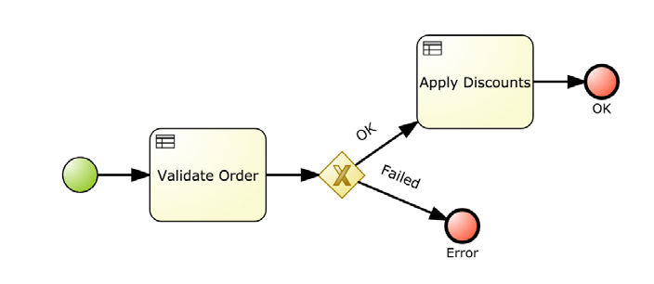
Sample
Lab4 : Business Rule Task

Slide 220
Rules and processes
La modélisation workflow est très adaptée pour décrire les séquences normales d'un processus mais il devient de difficile de modéliser des logiques complexes et de prendre en compte tous les cas d'exceptions
=> Le graphe devient rapidement illisible
Depuis ses premières versions, Drools a eu pour objectif de fournir un moyen d'intégrer facilement les règles dans les processus :
  Les décisions complexes sont plus faciles à spécifier via des règles (plutôt que par un graphe)
  Les règles et les processus peuvent avoir des cycles de vie différents
  Les règles peuvent être utilisées dans plusieurs processus ou en dehors de processus
  Avec les DSLs, les éditeurs GUI, les tables décisionnelles; la logique métier peut être comprise et manipulée directement par les experts métier

Slide 221
RuleFlow
Un RuleFlow est un processus modélisé via un graphe qui décrit la séquence d'exécution d'une série d'étapes
Le graphe est constitué d'un ensemble de nœuds liés entre eux par des connections ou transitions.
RuleFlow fournit des types de nœuds prédéfinis implémentant une exécution particulière
La définition d'un RuleFlow peut se faire :
  Via l'éditeur graphique du plug-in Eclipse
  En éditant directement, le fichier source XML (associé à son schéma)
  En utilisant la Process API fournie par Drools
  En utilisant les applications Workbench (Drools, jBPM, KIE)

Slide 222
Utilisation
1) La définition du processus doit être ajoutée à la base de connaissance Drools. Le fichier .bpmn est ajouté dans les resssources projet
2) Pour démarrer le processus, il faut d'abord créer une session permettant de communiquer avec le moteur de workflow :
StatefulKnowledgeSession ksession = kbase.newKieSession();
ProcessInstance processInstance = ksession.startProcess("com.sample.MyProcess", parametersMap) ;
3) Ou le démarrer à partir d'une conséquence d'une règle ou de l'action d'un processus
kcontext.getKnowledgeRuntime().startProcess("com.sample.MyProcess");

Slide 223
Integration Kie with applications
Considerations
Architectures
Kie Server and Kie Workbench

Slide 224
Some mechanisms to communicate between Drools and the rest of the application :
  Global variables may contain domain objects
  Entry points : Stream of facts and event
  Channels to send information to the outside world
  Listeners or marshallers

Slide 225
Synchronous
If we need to execute our business rules in a synchronous manner
  Using stateless Kie Sessions and create as many sessions as requests
  Use global variables to store specific rule execution information

Slide 226
Asynchronous
Kie Sessions may be shared between different threads, because some of them may insert new information and others might take care of firing rules
Register special listeners that take care of notifying other components about special situations detected by the rules
Entry points become a very useful component when multiple sources will be inserting information into a single Kie Session

Slide 227
Patterns of integration

Slide 228
Scenarios of integration
Different ways of integration can be considered :
  Embed Drools runtime in your application
  Externalize rules in a separate repository
  Knowledge as a service
For these scenariis, Drools offers supports for CDI, Spring and Camel

Slide 229
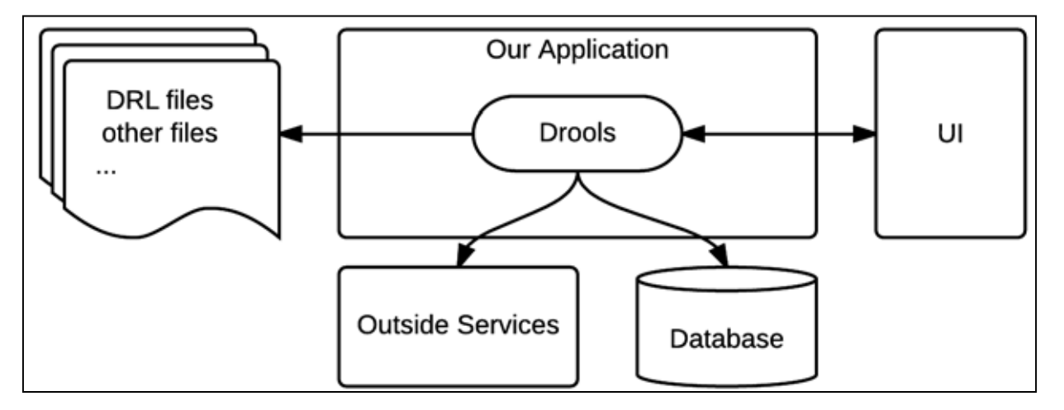
Architecture

Slide 230
Drools an interact with any and all layers of our application, depending on what we expect to accomplish with it
  It could interact with the UI to provide complex form validations
  It could interact with data sources to load persisted data when a rule evaluation determines it is needed
  It could interact with outside services, to either load complex information into the rules or send messages to outside services about the outcome of the rules execution

Slide 231
Maven Repo
Another approach is to separate the rules from the rest of the application by using a Maven repository :
  business rules are deployed in the Maven repository as a KJAR
  Components Drools runtime can dynamically load the rules
=> The rules can be developed, deployed, and managed as many times as needed without having to redeploy the applications.

Slide 232
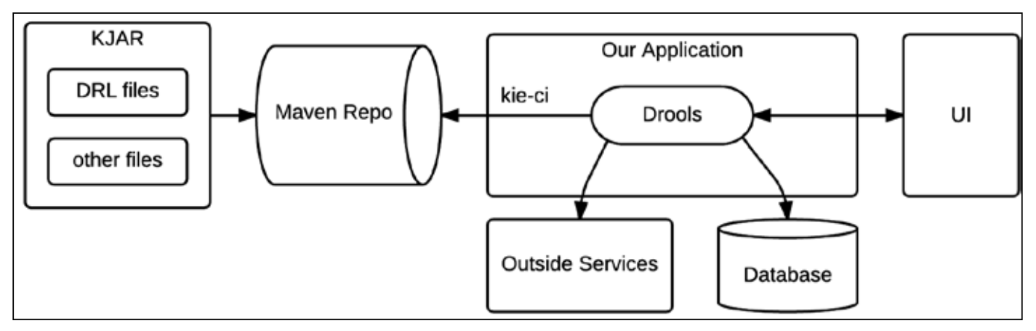
Architecture

Slide 233
Loading the rules
With CDI
@Inject @KSession
@KReleaseId(groupId = "org.drools.devguide",artifactId = "chapter-11-kjar",
version = "0.1-SNAPSHOT")
KieSession kSession;
With a scanner
KieServices ks = KieServices.Factory.get();
KieContainer kContainer = ks.newKieContainer(
ks.newReleaseId("org.drools.devguide",
"chapter-11-kjar", "0.1-SNAPSHOT"));
KieScanner kScanner = ks.newKieScanner(kContainer);
kScanner.start(10_000);
KieSession kSession = kContainer.newKieSession();

Slide 234
Knowledge as a service
The last approach is to externalize the Drools runtime in an external services.
  This service expose une API (REST or other)
  Multiple-applications can access the service
  The service may be replicated if needed
  Life cycle of rules are completely independent

Slide 235
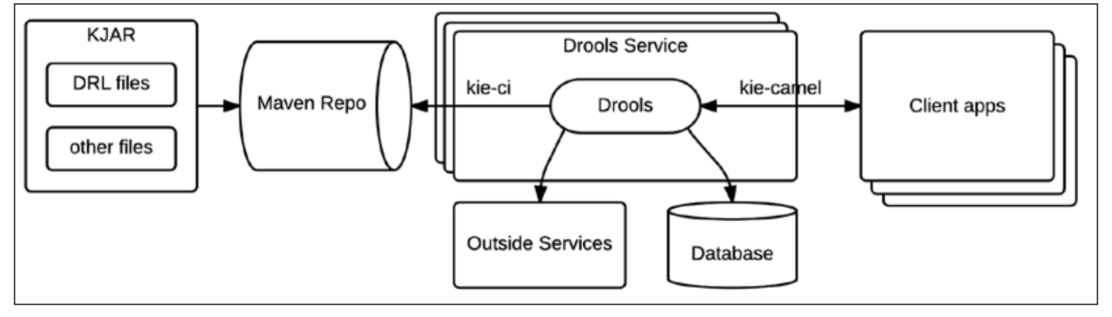
Architecture

Slide 236
Kie Server and Kie Workbench

Slide 237
Introduction
KIE provides a module called kie-server , which can be used to configure similar environments that are only responsible for running Drools rules and processes, taking the kJAR from outside sources
It provides also kie-workbench which can manage rules and processes : edit, build deploy

Slide 238
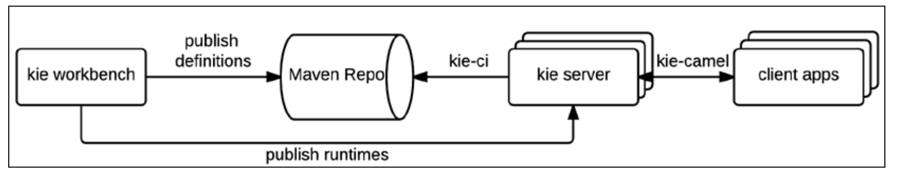
Architecture

Slide 239
Kie Server
It is a modular, standalone server component that can be used to execute rules and processes, configured as a WAR file
It is available for web containers and JEE6 and JEE7 application containers
It can be easily deployed in cloud environments
Each instance of the Kie Server can manage many Kie Containers
Its functionality can be extended through Kie Server Extensions

Slide 240
Configuration
The distributions of Kie Server : archive zip or Docker image use a jBoss wildfly server in the full configuration.
Once a user with the role kie-server configured
The REST API is available at :
http://localhost:8080/kie-server/services/rest/server/
La documentation est disponible en ligne
https://docs.jboss.org/drools/release/6.3.0.Final/drools-docs/html/ch22.html#d0e22326

Slide 241
Sample Response
<?xml version="1.0" encoding="UTF-8" standalone="yes"?>
<response type="SUCCESS" msg="Kie Server info">
<kie-server-info>
<capabilities>KieServer</capabilities>
<capabilities>BRM</capabilities>
<capabilities>BPM</capabilities>
<capabilities>CaseMgmt</capabilities>
<capabilities>BPM-UI</capabilities>
<capabilities>BRP</capabilities>
<capabilities>DMN</capabilities>
<capabilities>Swagger</capabilities>
<location>http://localhost:8230/kie-server/services/rest/server</location>
...
</kie-server-info>
</response>

Slide 242
Workbenches
Kie projects provide a set of usable workbench tools that allow to create, build, and deploy rule and process definitions in any Kie Server
These workbenches are build with the framework UberFire .
They are web application deployed in a application server (Jboss wildfly)

Slide 243
Installation
Download the distribution which is a war kie-wb-*.war
Deploy it in the application server
  Drools 7 is only available for Wildfly 14
Workbench is available at :
http://<server>:<port>/

Slide 244
Données du workbench
Les données internes du workbench sont stockées dans :
$WORKING_DIRECTORY/.niogit ,
par exemple wildfly-8.0.0.Final/bin/.niogit
C'est le répertoire à sauvegarder en production

Slide 245
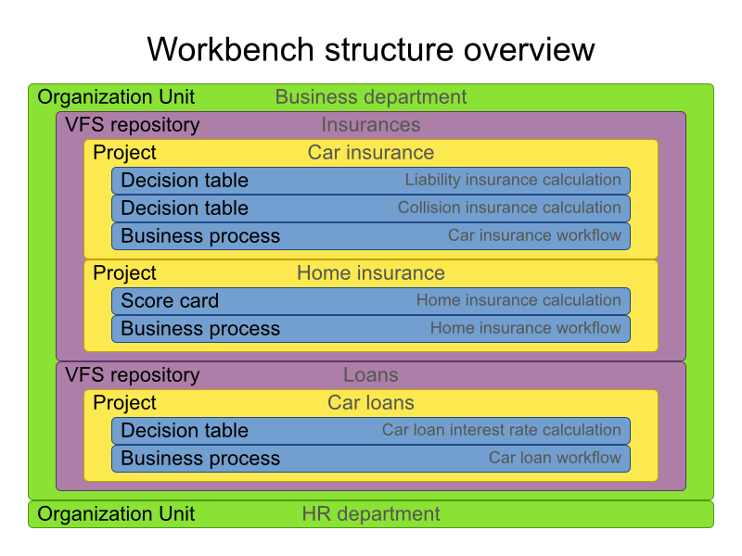
Organisation
Un workbench est structuré avec des unités organisationnelles, des dépôts et des projets

Slide 246
Roles and users
A WB use the following roles:
  admin : Administrator, manages users, repositories, ...
  developer : Manage assets (rules, models, processes, forms. Create build and deploy projects
  analyst : Idem developer with restricted right (no deployment for example)
  user : Participate in business processes and perform tasks
  manager : Access to reporting

Slide 247
Getting started
Typical actions to start:
Create a user with the admin rôle
Add a repository
Add a project
Provide the business model
Create the rules
Build and deploy
These actions can be done through the web interface, an online command tool (kie-config-cli.sh) or via a REST interface

Slide 248
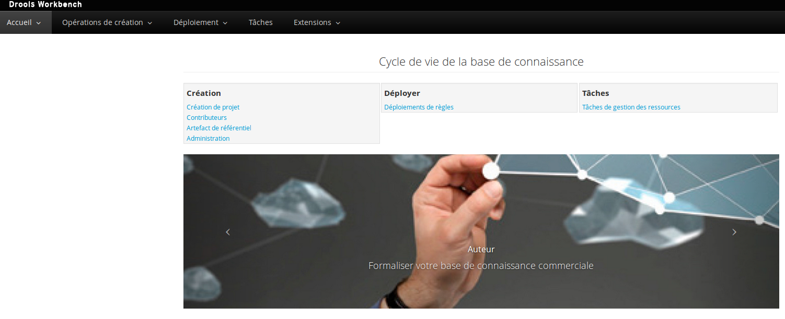
Interface

Slide 249
Création : unité organisationnelle, dépôt, projet
Création → Administration
Unité organisationnelle → Nouveau
Référentiel → Nouveau
Page d'accueil :
Création de projet

Slide 250
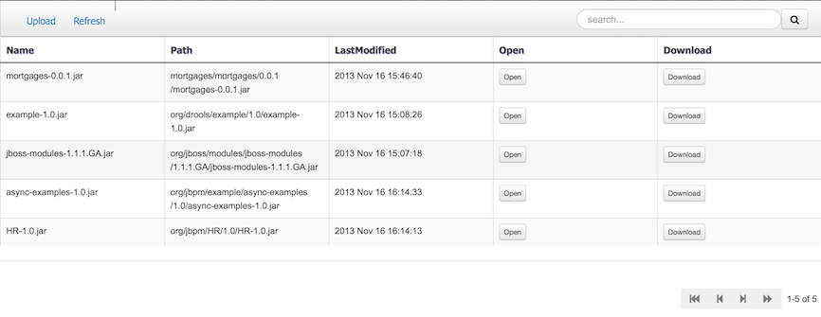
Dépôt d'artefact et gestion de dépendances
Les projets nécessitent généralement des artefacts externes dans leur classpath (par exemple les classes du modèle)
Ces artefacts sont stockés dans un dépôt Maven en général local

Slide 251
Asset
Drools-WB regroupe les différents formats de règles sous le terme d'asset.
En fait, un asset est une ressource stockée et versionnée dans le repository
  Assets métier : Tables décisionnelles, Règles métier en DSL
  Assets techniques : Règles DRL, Énumérations, Processus.
  Fonctions :
  DSL: Domain Specific Languages
  Modèle : Les classes ou les types de faits du modèle métier
  WorkingSets : Sous-ensemble du modèle sur lequel des contraintes peuvent s'appliquer globalement.
  Des cas de test
Les assets peuvent être taggés.

Slide 252
Editeur d'asset
L'éditeur d'asset est le principal composant de l'interface Guvnor. Il est constitué de 2 vues :
  Edition : Dépend du type d'asset. Possibilité de voir sa correspondance drl. D'avoir une vue « import »
  Méta-données : Titre, catégories (déprécié), Date de modification, dernier auteur, note, date de création, créateur, historique des versions, discussions, ...

Slide 253
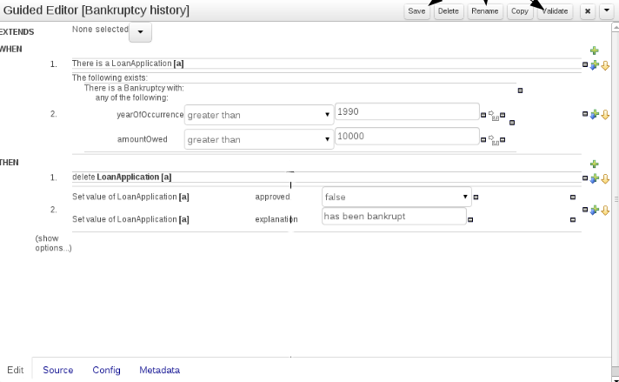
Editeur

Slide 254
Explorateur projet
L'explorateur projet permet de parcourir les différentes unités organisationnelles, les repositories, les projets et les ressources d'un projet
L'utilisateur, après avoir sélectionné un projet, peut accéder à ses packages et voir leur contenu
2 vues sont disponibles :
  Vue projet : certains fichiers sont cachés
  Vu repository : tous les fichiers sont affichés

Slide 255
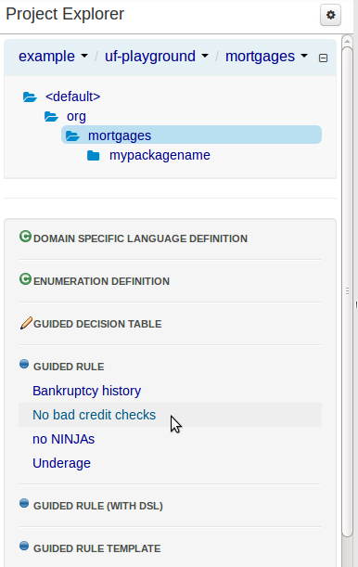
Exemple

Slide 256
Éditeur projet
L'éditeur projet centralise toutes les configurations projet disséminés dans différents fichiers
  Projet : pom.xml
    Général : Coordonnées Maven
    Dépendances
    Méta-données
  Base de connaissance : kmodule.xml
    Bases de connaissance et sessions
    Méta-données
  Imports : project.imports
    Suggestions : les imports suggérés dans l'éditeur d'assets
    Méta-données
Le bouton Build & Depoy construit le projet et déploie le KJAR dans le repository Maven interne du workbench

Slide 257
Validation
Drools-WB permet de valider les règles créées
Le panneau Problem affiche les validations en temps réel des différents assets
Tous les éditeurs permettent une validation avant l'enregistrement du fichier

Slide 258
Modèle de donnée
Il est possible de définir son modèle de donnée via Drools-WB
Un modèle de données est toujours associé à un projet
La vue Data Modeller tool permet de définir de nouvelles entités
Une entité contient :
  Des attributs modeleur : identifiant, label, description, package
  Des attributs applicatifs : types de base Java ou autre entité

Slide 259
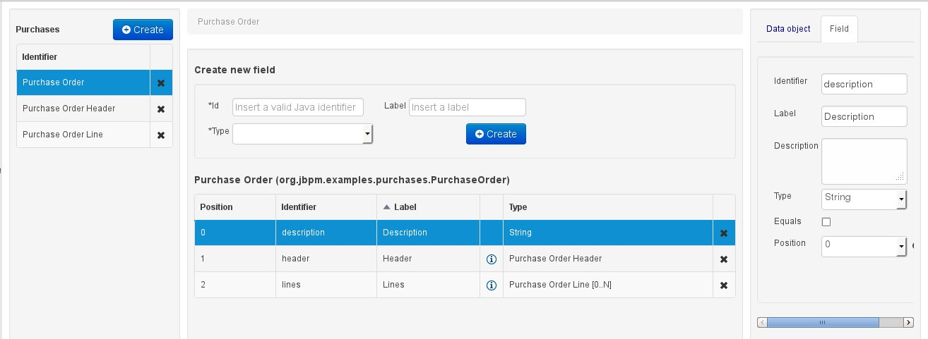
Data Modeller

Slide 260
Génération de code
Le modeleur est un outil visuel qui lorsque le bouton « Save » est actionné, génère une classe Java POJO (Plain Old Java Object).
La classe contient un constructeur sans argument, des getters/setters pour ses attributs applicatifs, des constantes annotées pour les attributs modeleur, les méthodes equals() et hashCode()

Slide 261
Modèle externe
Les projets peuvent utiliser des modèles définies dans des classes Java créées à l'extérieur du workbench.
La dépendance vers le jar contenant les classes est indiquée :
  Soit par rapport au repository Maven local (Bouton Add)
  Soit par rapport au repository Guvnor M2 du workbench (Bouton Add from repository)

Slide 262
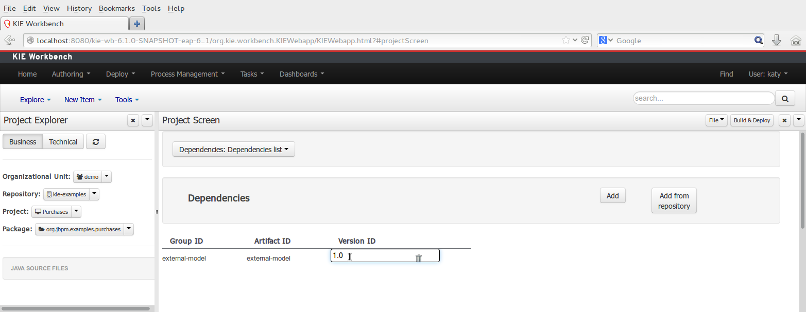
Repository Maven local

Slide 263
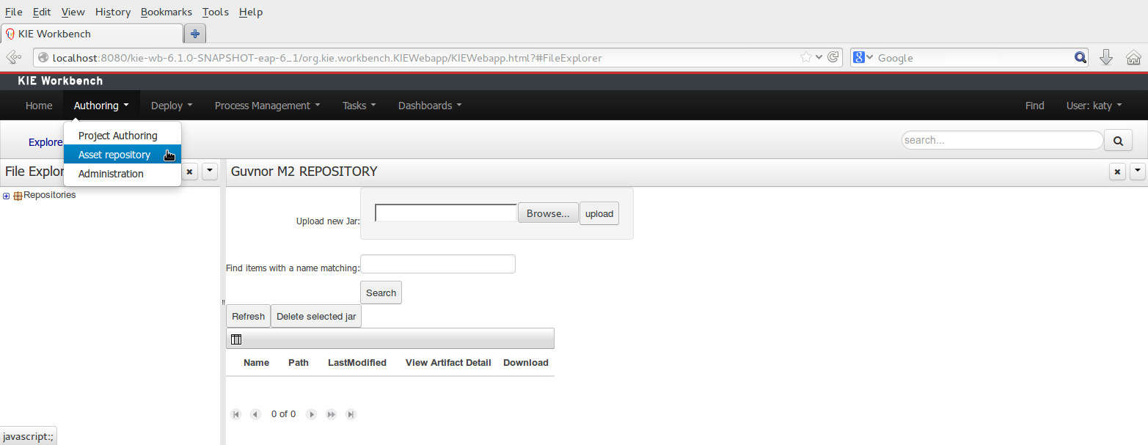
Guvnor repository

Slide 264
Asset creation

Slide 265
Packages
Package configuration is usually done only once by someone with expertise with rules and templates
All assets belong to a single package that acts as a namespace
A package is created by specifying its name

Slide 266
Formats of rules
The workbench supports multiple rule formats and editors:
  BRL Format with BRL Editor (also present in Eclipse)
  DSL
  Decision tables in file to upload
  Decision tables edited directly in the web interface
  Rule Flow process to upload
  DRL
  functions
  Configuring lists of values (Enum)
  Rules template powered by data tables
New Rule → name, category and format
=> A wizard starts
It is always possible to consult the source in drl

Slide 267
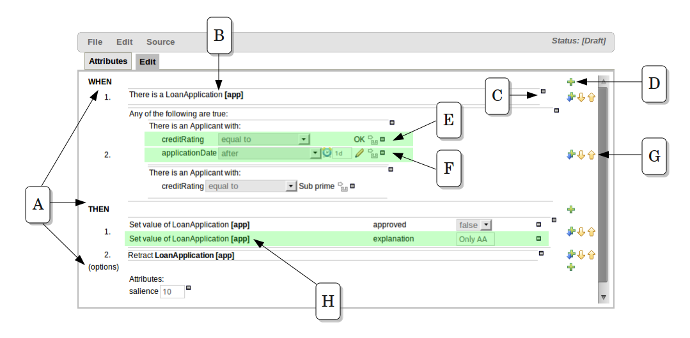
Guided Business Rules Editor

Slide 268
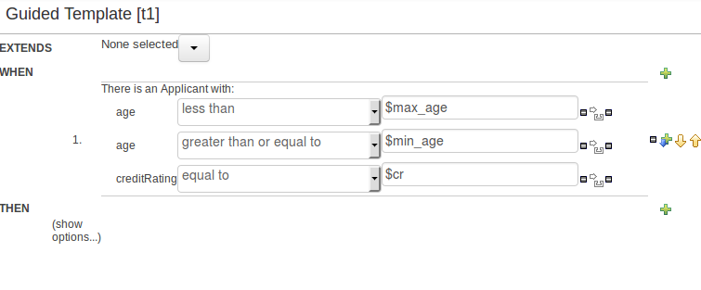
Guided Template Editor

Slide 269
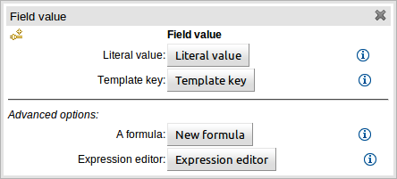
Keys of templates

Slide 270
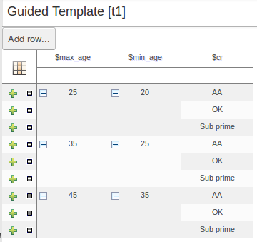
Template data

Slide 271
Decision Table Editor
Drools-WB offers an editor for decision tables.
The editor proposes facts and fields available in the context of the project
2 types of tables can be created:
  Extended Entries: Column definitions do not specify a value. The values are then indicated in the body of the table. However, they can be restricted by an interval.
  Limited Entries: The column definitions specify a value. The body of the table contains checkboxes

Slide 272
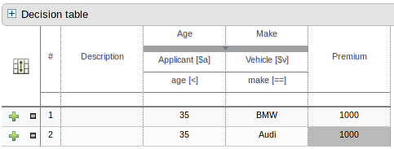
Extended table

Slide 273
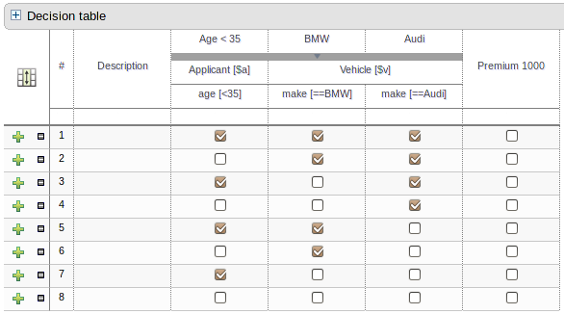
Limited table

Slide 274
Test scenario
The test scenarios validate the operation of the rules and avoid regression bugs.
A test case defines several sections:
  Given list the test facts
  Expected lists the expected changes and actions

Slide 275
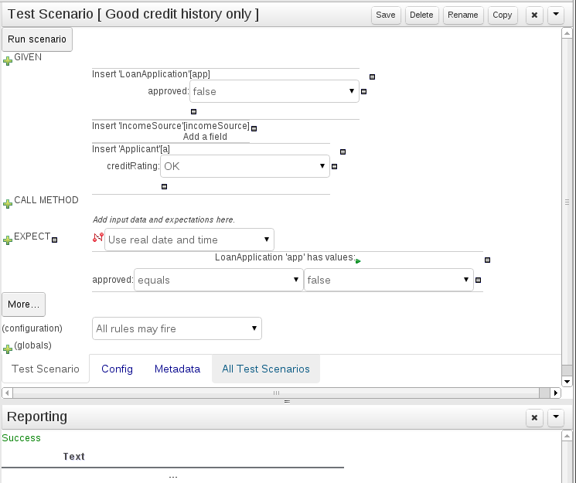
Test scenario

Slide 276
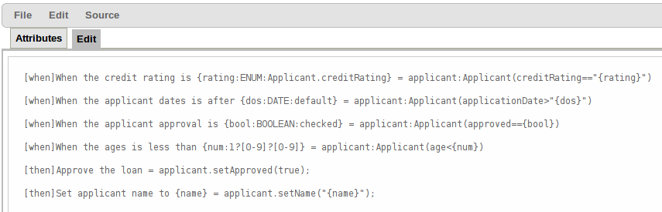
DSL editor

Slide 277
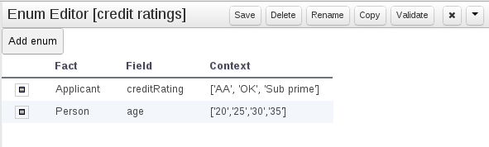
List of values

Slide 278
Access to the Workbench database
public class MainKieTest {
public static void main(String[] args) {
// works even without -SNAPSHOT versions
String url = "http://localhost:8080/kie-drools/maven2/de/test/Test/1.2.3/Test-1.2.3.jar";
// make sure you use "LATEST" here!
ReleaseIdImpl releaseId = new ReleaseIdImpl("de.test", "Test", "LATEST");
KieServices ks = KieServices.Factory.get();
ks.getResources().newUrlResource(url);
KieContainer kieContainer = ks.newKieContainer(releaseId);
// check every 5 seconds if there is a new version at the URL
KieScanner kieScanner = ks.newKieScanner(kieContainer);
kieScanner.start(5000L);
// alternatively:
// kieScanner.scanNow();
Scanner scanner = new Scanner(System.in);
while (true) {
runRule(kieContainer);
System.out.println("Press enter in order to run the test again....");
scanner.nextLine();
}
}
private static void runRule(KieContainer kieKontainer) {
StatelessKieSession kSession = kieKontainer.newStatelessKieSession("testSession");
kSession.setGlobal("out", System.out);
kSession.execute("testRuleAgain");
}
}
Lab6 : Drools workbench

Slide 279
Thank U!!!
THANK YOU FOR YOUR ATTENTION

Slide 280
Annexes

Slide 281
Syntaxe

Slide 282
Élément conditionnel and
Les éléments conditionnels peuvent être combinés avec les opérateurs and (opérateur implicite)
L'opérateur and peut-être utilisé en préfixe ou en infixe
Implicite
Cheese( cheeseType : type )
Person( favouriteCheese == cheeseType)
Préfixe
(and Cheese( cheeseType : type )
Person( favouriteCheese == cheeseType ) )
Infixe
(Cheese( cheeseType : type ) and
Person( favouriteCheese == cheeseType ) )

Slide 283
Élément conditionnel or
L'élément conditionnel or a pour effet de créer plusieurs sous-règles distinctes qui deviennent complètement indépendantes. Il peut s'employer en préfixe ou en infixe.
(or Person( sex == "f", age > 60 )
Person( sex == "m", age > 65 )

Slide 284
Construction programmatique

Slide 285
Alternative programmatique
Il est possible de définir les bases de connaissance et les sessions programmatiquement (comme avec Drools 5)
Il est alors nécessaire de créer un KieFileSystem et d'y ajouter les ressources

Slide 286
Exemple
KieServices kieServices = KieServices.Factory.get();
KieModuleModel kieModuleModel = kieServices.newKieModuleModel();
KieBaseModel kieBaseModel1 = kieModuleModel.newKieBaseModel( "KBase1 ")
.setDefault( true )
.setEqualsBehavior( EqualityBehaviorOption.EQUALITY )
.setEventProcessingMode( EventProcessingOption.STREAM );
KieSessionModel ksessionModel1 = kieBaseModel1.newKieSessionModel( "KSession1" )
.setDefault( true )
.setType( KieSessionModel.KieSessionType.STATEFUL )
.setClockType( ClockTypeOption.get("realtime") );
KieFileSystem kfs = kieServices.newKieFileSystem();
….
kfs.write("src/main/resources/KBase1/ruleSet1.drl", stringContainingAValidDRL )
.write( "src/main/resources/dtable.xls",
kieServices.getResources().newInputStreamResource( dtableFileStream ) );

Slide 287
Phase de build
KieServices kieServices = KieServices.Factory.get();
KieFileSystem kfs = ...
kieServices.newKieBuilder( kfs ).buildAll();
// Vérification qu'il n'y a pas d'erreur
assertEquals( 0, kieBuilder.getResults().getMessages( Message.Level.ERROR ).size() );
// Récupération du conteneur
KieContainer kieContainer = kieServices.newKieContainer(kieServices.getRepository().getDefaultRepository()) ;

Slide 288
Drools 5 versus Drools 6

Slide 289
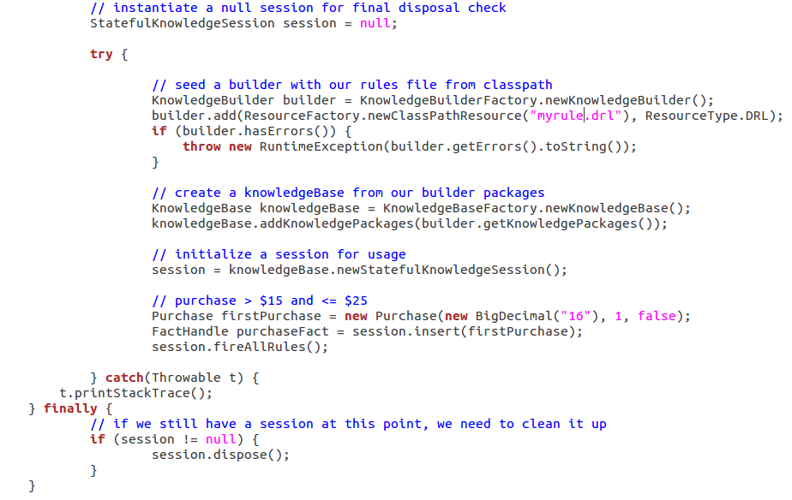
Drools 6 vs Drools 5

Slide 290
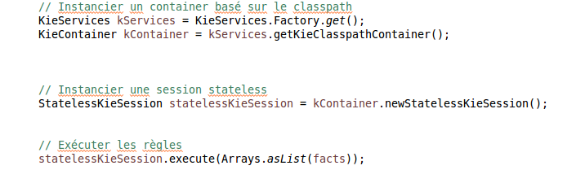
Drools 6 vs Drools 5

Slide 291
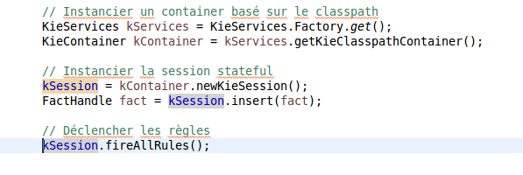
Drools 6 vs Drools 5

Slide 292
Drools 6, ce qui a changé
KnowledgeBase -> KieBase
StatefulKnowledgeSession -> KieSession
KnowledgeAgent -> KieScanner
kjar : Un jar qui contient:
resources (drl, dsl, csv, ...), Java classes
kmodule.xml
pom.xml (maven)
KieContainer kContainer = ks.newKieContainer(
ks.newReleaseId("org.mygroup", "myartifact", "1.0"));
Knowledge API replaced by KIE API
Integration with CDI

Slide 293
Kie Serveur

Slide 294
Introduction
Le KIE serveur est une application stand-alone permettant d’exécuter des règles ou démarrer des processus
Ces fonctionnalités sont accessibles via REST, JMS ou l’API Java
Il propose également une intégration avec le Weorkbench
Il est packagé sous forme de war

Slide 295
Configuration
Le serveur est configurable via des propriétés système
Par exemple :
-Dorg.jbpm.server.ext.disabled=true

Slide 296
TP
Installation
Chargement des règles dans Guvnor
Création de snapshot

Slide 297
Drools Fusion
Problématique du CEP
Fonctionnalités Drools Fusion

Slide 298
Complex Event Processing
Le traitement d'évènements , Complex event processing (CEP) consiste à traiter de nombreux évènements survenant à différents niveaux d'organisation afin d'identifier les plus significatifs, analyser leurs impacts et prendre les actions en conséquence. Tout cela en temps-réel.
Wikipedia

Slide 299
Caractéristiques
• En général, il faut traiter de nombreux événements mais seulement un petit pourcentage a un réel intérêt.
• Les événements sont généralement immuables, (on ne peut pas changer le passé ! ).
• Les règles et les requêtes travaillent sur des pattern d’événements
• Il y a de fortes relations temporelles entre les événements
. Les événements pris isolément n'ont en général peu d'importance. Le système doit détecter des patterns d’événements reliés
• Le système doit composer et agréger les événements

Slide 300
Objectifs de Drool Fusion
Drools Fusion s'adresse plusieurs objectifs :
• Permettre la détection, corrélation, agrégation et composition d’événements
• Support pour le traitement de flux d’événements
• Support de contraintes temporelles pour modéliser les relations temporelles entre les événements
• Support des fenêtres glissantes
• Support d'une horloge unifiée à l'intérieur d'une session.
• Support d'un important volume d’événements relatif aux cas d'utilisation du CEP.
• Support de règles réactives, inférence.
• Support de différents adaptateurs pour l'insertion des événements dans le moteur.

Slide 301
Typologie des événements
Les événements pour Drools et sa base de connaissance sont des faits particuliers :
  Immuable (même si ces attributs peuvent être enrichis)
  Ayant des contraintes temporelles
  Ayant un cycle de vie géré : A cause des contraintes temporelles, le moteur peut déduire qu'un événement ne pourra plus correspondre à d'autre faits et donc de le retirer de la base de connaissance
  Fenêtre de temps : Tout événement est attaché à un timestamp, il est donc possible de spécifier des règles d’agrégation sur une période
Drools distingue 2 types d’événements : ponctuel (point-in-time), à durée (interval-based)

Slide 302
Déclaration d’événement
Pour déclarer un fait comme un événement, il suffit de l'annoter avec @role(event)
import some.package.StockTick
declare StockTick
@role( event )
end
Ou
declare StockTick
@role( event )
datetime : java.util.Date
symbol : String
price : double
end

Slide 303
Autres annotations
Dés sa déclaration, un événement a un ensemble de méta-données avec des valeurs par défaut, elles peuvent être surchargées par les annotations :
  @timestamp(attributeName) : L'attribut à utiliser pour déterminer le timestamp
  @duration(attributeName) : la durée
  @expires(attributeName) : Expiration de l’événement

Slide 304
Horloge de la session
Le traitement des événements nécessite une horloge de référence.
Drools implémente le pattern « strategy » afin de pouvoir plugger différents types d'horloges adaptées à différents environnements :
  Environnement de test ou de simulation le temps doit être contrôlé
  Environnement de production, horloge classique
  Environnement JEE : L'horloge du serveur
  Environnement cluster : Horloges synchronisées

Slide 305
Implémentation
Drools fournit 2 implémentations d'horloges :
  Horloge temps-réel utilisant l'horloge système
  KnowledgeSessionConfiguration config =
  KnowledgeBaseFactory.newKnowledgeSessionConfiguration();
  config.setOption( ClockTypeOption.get("realtime") ) ;
  Une pseudo-horloge qui est avancée par l'application et qui est très utile pour les tests

Slide 306
Pseudo-Horloge
Configuration
KnowledgeSessionConfiguration config = KnowledgeBaseFactory.newKnowledgeSessionConfiguration();
config.setOption( ClockTypeOption.get("pseudo") );
Utilisation
SessionPseudoClock clock = session.getSessionClock();
// then, while inserting facts, advance the clock as necessary:
FactHandle handle1 = session.insert( tick1 );
clock.advanceTime( 10, TimeUnit.SECONDS );
FactHandle handle2 = session.insert( tick2 );
clock.advanceTime( 30, TimeUnit.SECONDS );

Slide 307
Points d'entrée
Pour supporter différents flux d’événements, Drools Fusion introduit la notion de point d'entrée.
Les événements proviennent d'un point d'entrée et la mémoire de travail est donc partitionnée selon les différentes provenances des faits.
Les points d'entrée peuvent alors être spécifiés dans les règles.
rule "authorize withdraw"
when
WithdrawRequest( $ai : accountId, $am : amount ) from entry-point "ATM Stream"
CheckingAccount( accountId == $ai, balance > $am )
then
// authorize withdraw
end

Slide 308
Opérateurs temporels
Drools Fusion ajoute 13 opérateurs temporels permettant de corréler des événements :
after, before, coincides, during, finishes, finished by, includes, meets, met by, overlaps, overlapped by, starts, started by

Slide 309
Exemples
$eventA : EventA( this after[ 3m30s, 4m ] $eventB )
L'évènement A démarre entre 3 minutes 30s et 4 minutes après la fin de l'évènement B
$eventA : EventA( this coincides $eventB )
Les évènements A et B ont la même date de démarrage et de fin
$eventA : EventA( this during $eventB )
L'évènement A démarre après B et se termine avant B
$eventA : EventA( this includes $eventB )
A démarre avant B et se termine après
$eventA : EventA( this finishes $eventB )
A démarre après B et se termine en même temps que B
$eventA : EventA( this finishedby $eventB )
A démarre avant B et se termine en même temps que B

Slide 310
Exemples
$eventA : EventA( this meets $eventB )
A se termine lorsque B démarre
$eventA : EventA( this metby $eventB )
A démarre lorsque B se termine
$eventA : EventA( this overlaps $eventB )
A démarre avant B et se termine avant B
$eventA : EventA( this overlappedby $eventB )
B démarre avant A et se termine avant A
$eventA : EventA( this starts $eventB )
A démarre en même temps que B et se termine avant
$eventA : EventA( this startedby $eventB )
A démarre en même temps que B et se termine après

Slide 311
Mode stream
Par défaut, le moteur de règles travaille en mode CLOUD, c'est à dire que tous les faits de la mémoire de travail sont pris en compte de suite, il n'y a pas de notion de temps.
Pour traiter des flux d’événements, il faut changer le mode en STREAM. Dés lors, le moteur est capable de gérer :
  Des fenêtres de temps
  Le cycle de vie des événements (expiration)
  Des délais d'exécution dans les règles
KnowledgeBaseConfiguration config = KnowledgeBaseFactory.newKnowledgeBaseConfiguration();
config.setOption( EventProcessingOption.STREAM ) ;
Dans ce cas :
  Les évènements de chaque flux doivent être ordonnés.
  Les différents streams doivent également être synchronisés

Slide 312
Exemple : délai d'activation
rule "Sound the alarm"
when
$f : FireDetected( )
not( SprinklerActivated( this after[0s,10s] $f ) )
then
// sound the alarm
end

Slide 313
Fenêtres glissantes
Les fenêtres glissantes permettent de grouper des événements dans une fenêtre temporelle glissante.
Les fenêtres peuvent être exprimées via :
  Un temps : Prise en compte des événements survenus lors des x dernières unités de temps
  StockTick() over window:time( 2m )
  Une longueur : Prise en compte des x derniers événements
  StockTick( company == "IBM" ) over window:length( 10 )

Slide 314
Exemple d'agrégation
rule "Sound the alarm in case temperature rises above threshold"
when
TemperatureThreshold( $max : max )
Number( doubleValue > $max ) from accumulate(
SensorReading( $temp : temperature ) over window:time( 10m ),
average( $temp ) )
then
// sound the alarm
end

Slide 315
Cycle de vie des événements
L'exécution en mode STREAM permet au moteur de détecter les événements qui ne peuvent plus matcher aucune règle et donc de les supprimer de la mémoire de travail
L'identification des événements à supprimer se fait :
  En se basant sur leur attribut d'expiration
  En analysant les contraintes temporelles des règles

