Slide 1

Simple Classifier Using
Random Forest Classifier

Slide 2


Dataset
The dataset that to be used in this slide is "Titanic - Machine Learning from Disaster" from Kaggle.

Slide 3
Data Cleaning and Preprocessing
Raw data often requires cleaning and preprocessing to make it suitable for machine learning algorithms.
1
Missing Values
Handle missing data by imputing values using techniques like mean, median, or mode, or by removing rows or columns with missing data. What i have done to handle the missing values are:
Fill missing values from "Age" column by its mean
Fill missing values from "Embarked" column by its mode
Remove "Cabin" column
2
Data Encoding
Convert categorical features into numerical values using Label Encoder to make them suitable for machine learning algorithms. The Label Encoder converts
In "Sex" column: converts 'female' → 0 and 'male' → 1
In "Embarked" column: converts 'C' → 0, 'Q' → 1, and 'S' → 2

Slide 4
Feature Selection
Feature selection is done in order to check the wheter that column importance to be trained or not. Reducing the features can be used in order to improve the training speed of model. I just drop "Survived", "Ticket", and "Name" columns, and let the rest of features to be trained.

Slide 5

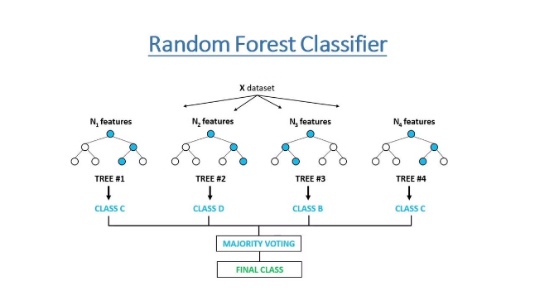
Modeling
The "Random Forest Clasifier" is used in this task, it's good to classifying task. Since the label of this dataset is categorical (survived or not), so better to use classification algorithm instead of regression.
The number of estimator for this model is 500. By experiment the number estimatorss from 300 through 1000, it was found that 500 get the highest accuracy.

Slide 6

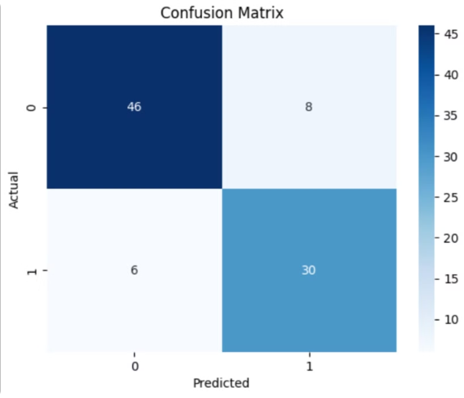
Model Evaluation
Evaluate the trained model's performance using various metrics to assess its accuracy, precision, recall, and other relevant measures.
Metric
Value
Score Accuracy
0.840 or 86%
Confusion Matrix
0.844 or 84.4%
F1-Score
0.844 or 84.4%

Slide 7


Conclusion
This presentation has provided basic and simple steps to make model to predict on classification task. Random Forest Classifier is one of many classification algorithms, so it's widely open to improve the prediction from other methods and algorithms.
Success
Insights
Optimization
Effective models that solve real-world problems.
Data-driven decision making based on model predictions.
Continuously improving models through evaluation and refinement.

