Slide 1

Microsoft Student Partner Workshop
Construct 2
by: Dylan Thiemann

Slide 2
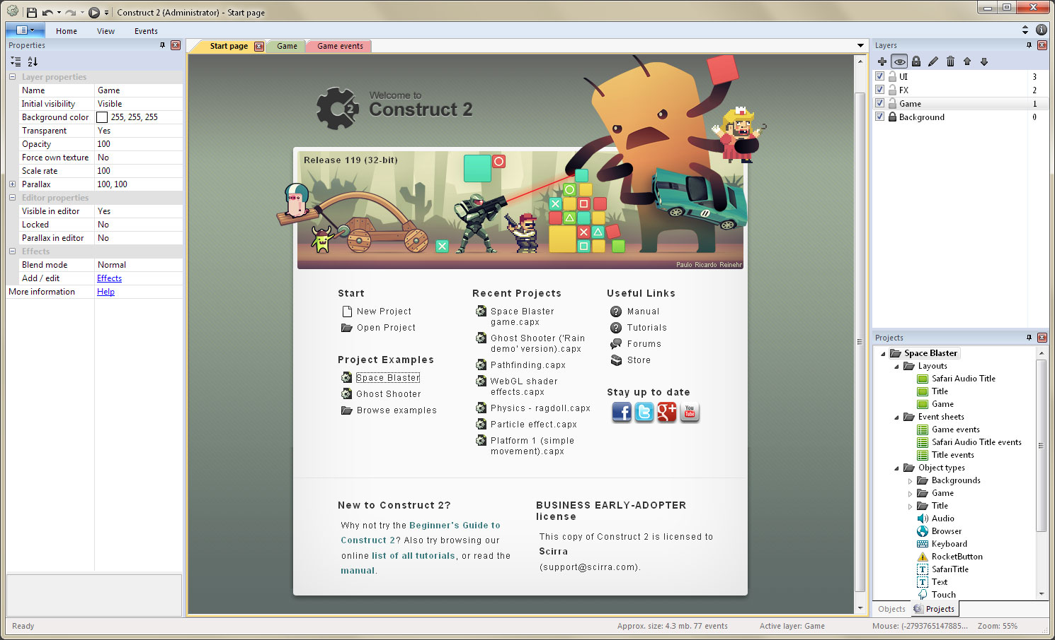
What is Construct 2
Construct 2 is a powerful ground breaking HTML5 game creator designed specifically for 2D games. It allows anyone to build games — no coding required!

Slide 3
What are we doing today?
Building a Windows 8 Store game!
A Sci-Fi shooter game!
What will the final product look like?

