Slide 1



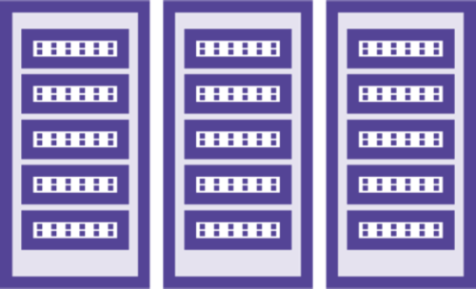




The Globomantics Network
R2
S2
W1 W2 W3
L1
Internet
H2
F1
H1
R1
S1
M1

Slide 2
Detailed Switching Diagram
E0/2.10 --- 10.1.10.1
0000.0000.AAAA
R1
S1
VLAN 10
E0/2
E0/1
E0/0
10.1.10.11
10.1.10.12
H1
H2
0000.0000.1111
0000.0000.2222

Slide 3
Detailed Routing Diagram
R2
S2
E0/2 --- 10.2.5.2
0000.0000.BBBB
L1
10.2.5.9
0000.0000.EEEE
E0/1
10.1.2.2
E0/1
10.1.2.1
10.1.10.11
H1
E0/2.10 --- 10.1.10.1
0000.0000.AAAA
0000.0000.1111
R1
S1

