Slide 1
Safer Streets NI
Road Traffic Collision Analysis 2017
Team Barchart
Dylan Thomas • James Troy • Darragh Counihan
Presentation for DfI NI & PSNI Road Policing

Slide 2
Problem & Stakeholders
The Challenge
In 2017, Northern Ireland experienced over 6,000 road traffic collisions resulting in casualties. Understanding collision patterns is critical for targeted interventions to reduce fatalities and serious injuries.
Key Stakeholders
DfI NI
PSNI Road Policing
Infrastructure planning & road safety policy
Enforcement & collision response
Success Metrics
Identify high-risk locations, times, and conditions to enable data-driven resource allocation and targeted safety interventions.
Data Source: PSNI Road Traffic Collision Data 2017

Slide 3
Data Sources & Quality
Dataset Overview
Data Quality
Source: PSNI Official Records
Period: January - December 2017
Official PSNI records with standardized coding for collisions, vehicles, and casualties.
Records: 6,000+ collisions
Data Components
Limitations
Collision locations, times, severity levels, vehicle types, casualty demographics
Missing data in some fields, single year (2017), excludes non-injury collisions
Integrated collision, vehicle, and casualty datasets with Irish Grid to WGS84 mapping

Slide 4
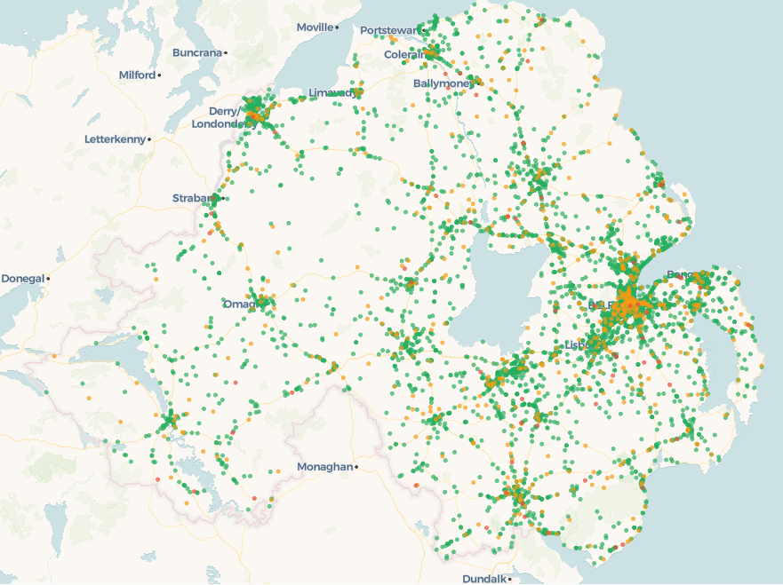
Key Findings: Geographic Patterns
GEOGRAPHIC HEATMAP
Belfast shows highest concentration with 1,478 collisions forming a dense cluster in the city center. Urban arterial routes display elevated collision frequencies. Rural areas show dispersed, lower-density patterns.
1,478
Belfast collisions
Highest in Northern Ireland
Severity by District
Belfast: 1,352 slight, 123 serious
Newry & Mourne: 13 fatal
Urban Concentration
Major urban centers show highest collision density, particularly Belfast city center and arterial routes.
Map displays 6,000+ collision locations with severity-based color coding

Slide 5
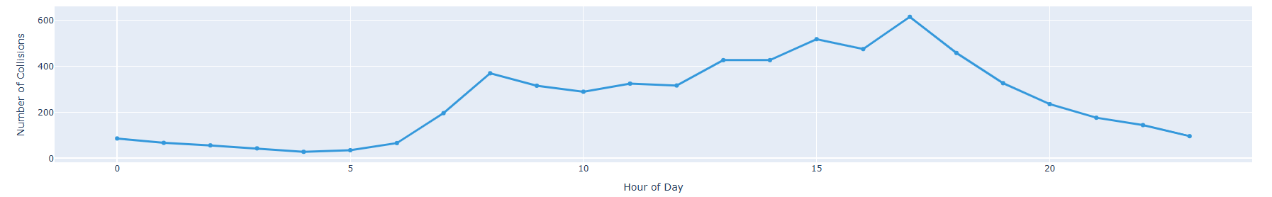
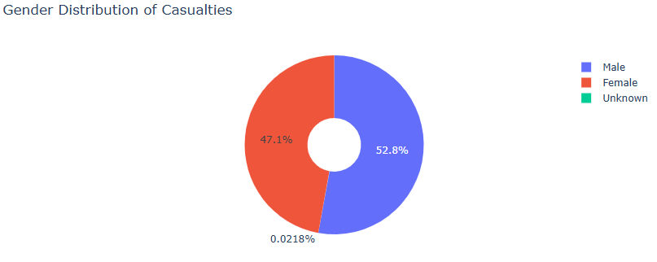
Key Findings: Temporal & Demographic
5pm Peak
Evening rush hour
Friday High
Most collisions by day
September
Highest monthly total
Additional Insights
83% of collisions involved cars
50% occurred on 30mph roads
25-34 age group highest casualties
Temporal patterns indicate predictable high-risk periods for targeted interventions

Slide 6
Recommendations
1
Enhanced Rush Hour Enforcement
Deploy additional PSNI traffic units during 4-6pm weekdays, particularly on Fridays in Belfast and major urban centers. Focus on accident-prone junctions identified in geographic analysis.
2
30mph Zone Infrastructure Review
Given 50% of collisions occur in 30mph zones, DfI NI should conduct infrastructure audits of high collision urban roads. Consider traffic calming measures, improved signage, and pedestrian crossing enhancements.
3
Targeted Youth Driver Campaigns
With 25-34 age group showing highest casualty rates, develop focused road safety campaigns for young drivers. Partner with employers and universities for workplace/campus awareness programs.
4
September Safety Initiative
Launch annual September road safety awareness campaign targeting the back-to-school period. Increase enforcement presence and public messaging during this high-risk month.

Slide 7
Limitations & Next Steps
Study Limitations
Future Work
Data Quality
Multi-Year Analysis
Missing values in some fields may affect specific analyses. Weather and lighting records incomplete for subset of collisions.
Integrate 2016-2020 data to identify long-term trends and validate 2017 patterns.
Temporal Scope
Predictive Modeling
Single year (2017) limits trend analysis and seasonal validation across multiple years.
Develop machine learning models to predict high-risk locations and enable proactive deployment.
Real-Time Dashboard
Build operational dashboard for PSNI with live data integration for dynamic decision-making.

Slide 8
Questions?
Thank you for your attention
Team Barchart
Dylan Thomas • James Troy • Darragh Counihan
Safer Streets NI - 2017 Analysis
Dashboard available for interactive exploration

