Slide 1
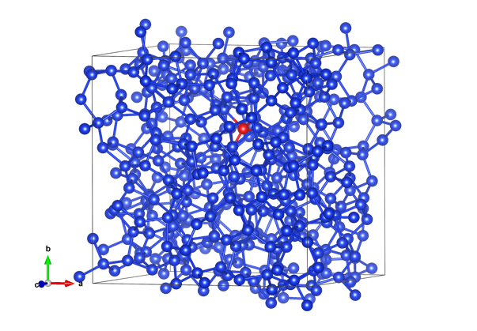
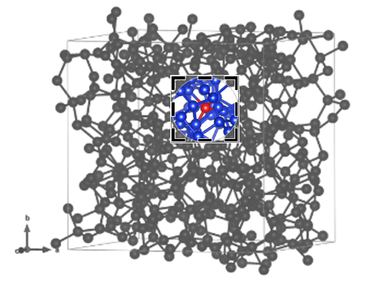
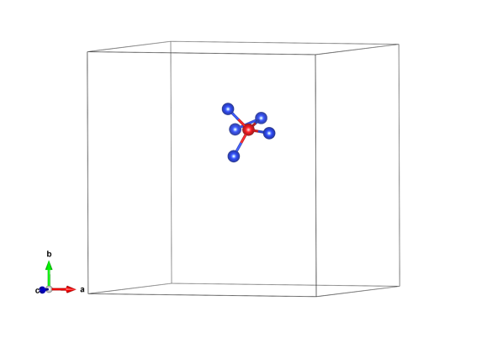
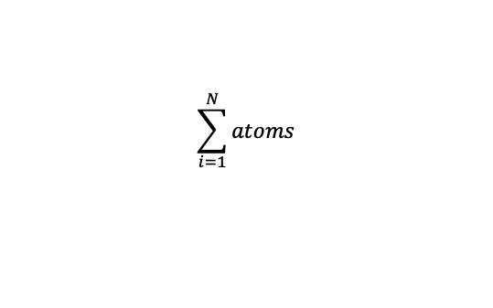




Data
Define Neighbor Atoms
Local Descriptors
(Bispectrum)
$$B^{i}$$
.
.
.
.
.
.
.
$k$Neighbor atoms around a central atom $i$
$$\sum_{i=1}^{N}{atoms}$$
.
.
.
$$B^{N}$$
$$N$$

Slide 2





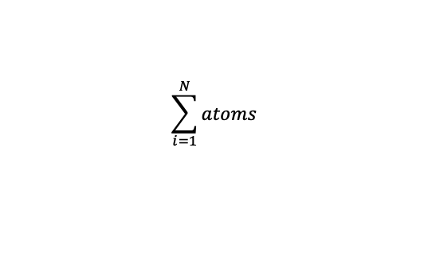


Data
Define Neighbor Atoms
Local Descriptors
(Bispectrum)
$$R_{cut}$$
$$X_{1}$$
$$B^{1}$$
$$B^{i}$$
$$X_{i}$$
$k n$eighbor atoms
around a central atom $i$
Input for neural network training
.
.
.
.
.
.
$$X_{N}$$
$$B^{N}$$
$$\sum_{i=1}^{N}{atoms}$$

Slide 3





$x^{q}$ ={$x_{1},x_{2},…,x_{d}$}
$$y$$
Example
$$i$$
ID17
$1 × N$ matrix
$N × d$ matrix

Slide 4
ML Model
(mathematics functions)
Input
Guess
(model predictions)

