Slide 1
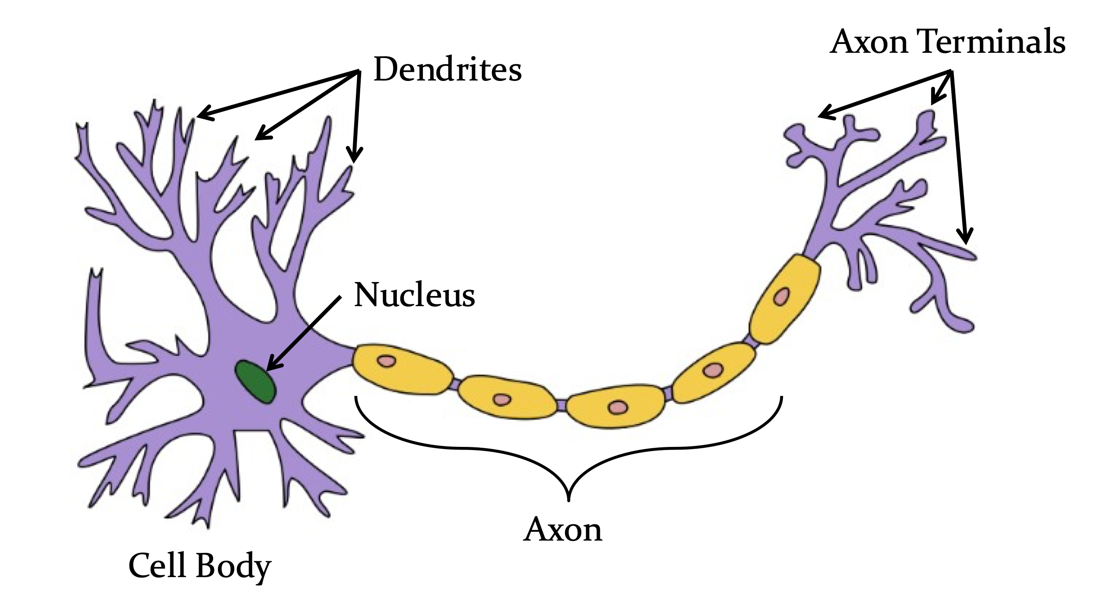
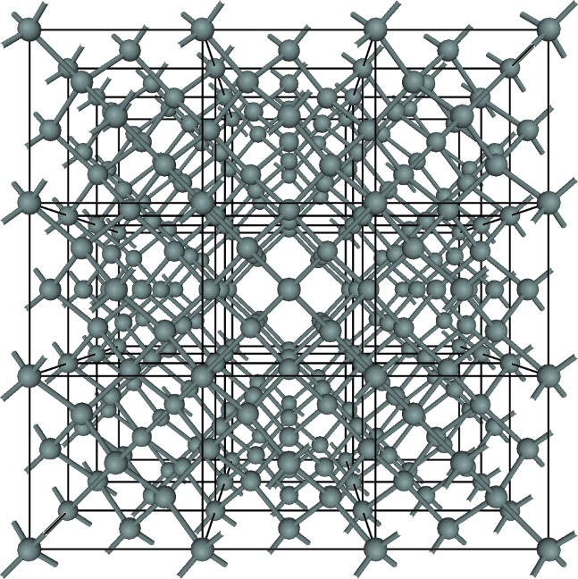
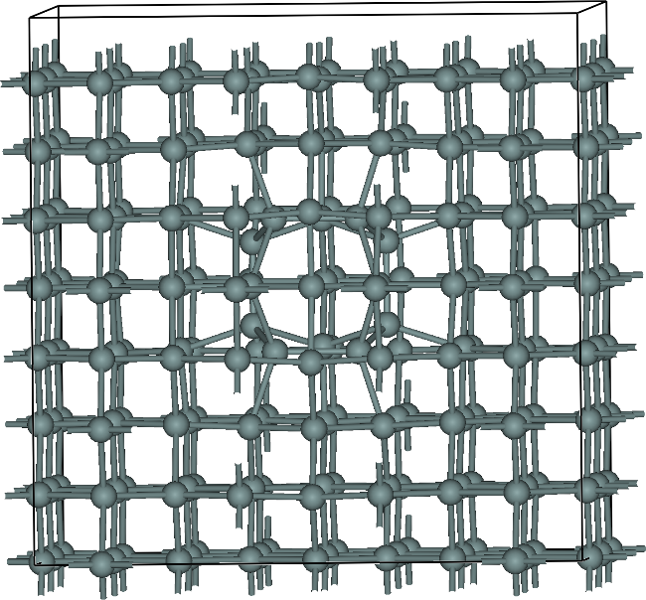
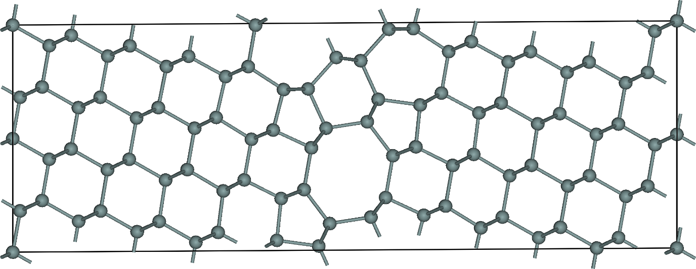
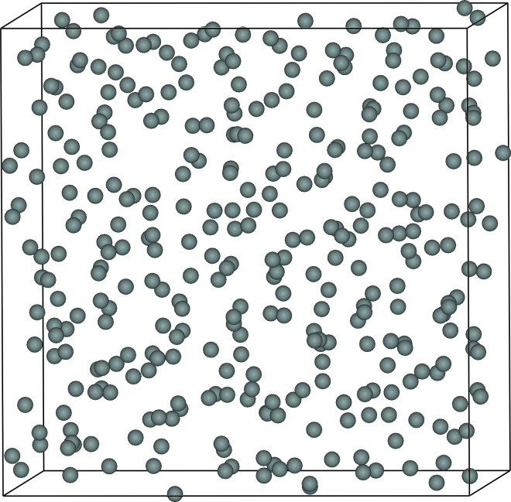
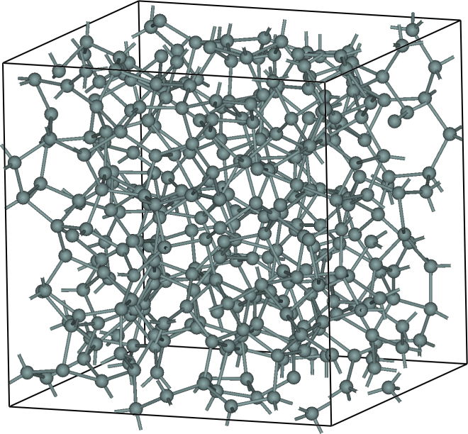
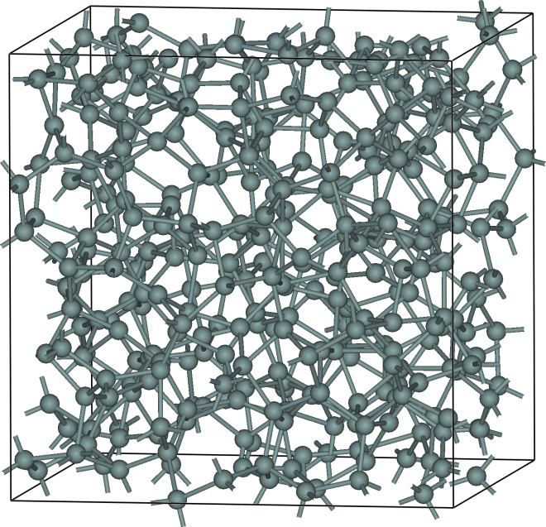
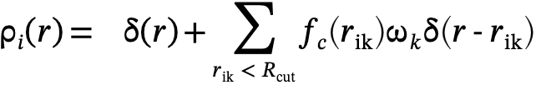
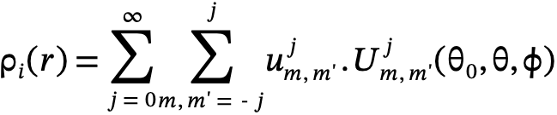
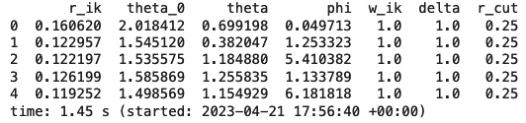
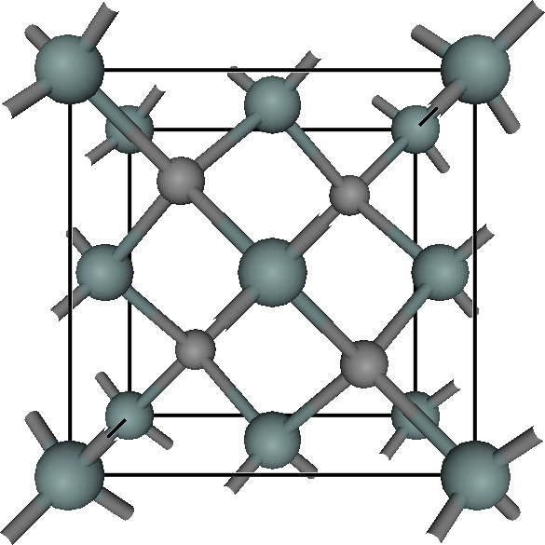
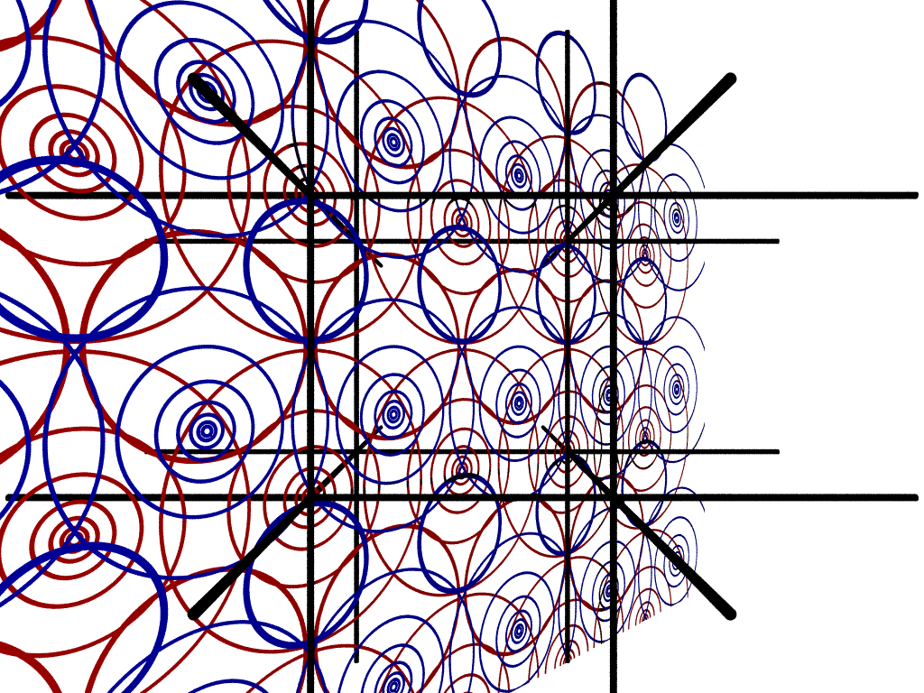
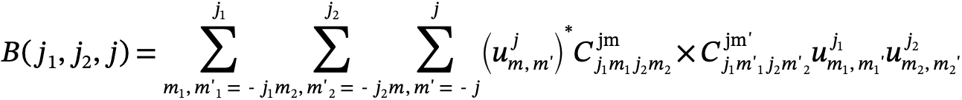




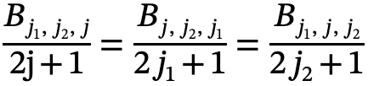
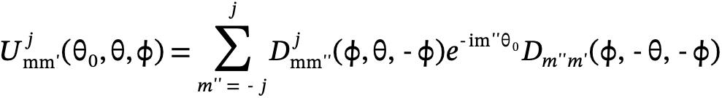
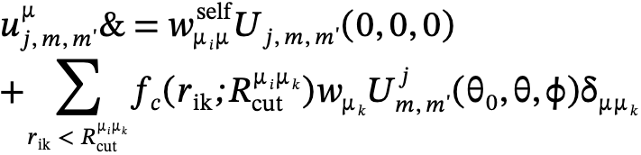
Understanding the relationship between quantum numbers and the density coefficient function is crucial for accurately describing particle behavior in higher-dimensional space. The expansion density function (u) is particularly essential for calculating the bispectrum component since it relates to the probability density of atoms' orientations in the material. However, interpreting the expansion density function accurately can be challenging due to our incomplete understanding of hyper-spherical harmonics. This lack of understanding can limit the development of methods to predict the material's behavior based on the bispectrum, underscoring the urgent need for further research in this area to realize the full potential of the hyper-spherical harmonic expansion of density function.​
​
One challenge in this research is defining a suitable cut-off radius for the cut-off function to avoid neglecting the interaction between the center atom and its defined neighbor. The bispectrum also depends on the (j,j1,j2) values for the expansion, and it is crucial to understand this band limit and undertake further study. By doing so, we can gain a better understanding of the behavior of materials in higher-dimensional space and develop more accurate predictive models.​
​
Machine Learning Potential Function Generation for ab initio Electronic Structure Calculations
Duong Hoang and Paul Rulis
Division of Energy, Matter, and Systems at the University of Missouri – Kansas City
Introduction
Artificial Neural Network
Systems
First-principles electronic structure calculations play a vital role in condensed matter materials physics research and its many related fields, but they are well-known for being computationally demanding because of their typical O(N³) scaling rate. In recent years a range of methods—including machine learning based approaches—have been developed to try to overcome the tremendous roadblock of the algorithmic complexity scaling problem [1].
In this poster we present progress toward the implementation of a machine learning based method to predict the electronic potential function of amorphous silicon in the form used by the orthogonalized linear combination of atomic orbitals (OLCAO) method [2]. The OLCAO potential function is expressed as a linear combination of atom-centered Gaussian functions. The local environment of each atom is characterized using the bispectrum components. The bispectrum components and potential function coefficients are used as the input/output training pairs for an artificial neural network (ANN) based machine learning scheme.
The conceptual idea behind an artificial neural network (ANN)
A collection of different pure silicon models are used for computing bispectrum compoenty and used them as training input feature for ANN model training
X₃
w₃
X₂
w₂
Output
Inputs
X₁
w₁
z
X₀
w₀
Bias Node
Figure 3: (Left) Cartoon sketch of a biological neuron; (Upper Right) Abstract schematic of a single artificial neuron with a hyperbolic tangent based transfer function; (Right) Abstract schematic of an ANN.
Bispectrum Components
OLCAO Potential Function
Local density neighbor function in 3D/ 4D dimensional space
Figure 4: Six different models of pure silicon. (A) Crystalline silicon; (B) Crystalline silicon with an I4 set of self interstitial silicon; (C) A model of silicon with a passive defect; (D – F) Identically structured models of pure Si with uniform scaling of bond lengths from largest (Bottom Left) to the standard bond length (Bottom Middle) to compressed bond lengths (Bottom Right).
The total electronic potential function of the crystal, V_{cry}, is expressed as a sum of atom-centered potential functions, V_{B}. Each atom-centered potential function is expressed as a sum of spherical Gaussian functions. Each Gaussian function, i, in the set of all Gaussian functions has a fixed (α_{i}) coefficient but a variable (A_{i}) coefficient in its functional form: A_{i} exp(-α_{i} r²). The crystal potential function can be visualized as in Figure 1 and the potential function for an individual atom can be evaluated and plotted as in Figure 2. Project goal: Predict the A_{i} coefficients using an ANN.
3D | 4D
Cons: - missing all “phase” information (the relative phases of the different plane waves), | Pros: - one-to-one representation of the atomic neighborhood, include phase angels
Preliminary Results
Bispectrum calculation for a center atom in amorphous silicon cell
Bispectrum - S(O)4
The atomic environment descriptor proposed by Bartok et al [3], that have real value and remain invariant under translation, rotation, and permutation of atoms:
B =2.58542539253139 - 9.71445146547012e-17*I
Equation | Definition
 | Exapansion density coefficient function relates to the probability density of atoms' orientations in the material
 | Clebsch Gordan coefficient, represent the probability amplitude that j1 and j2 are coupled into a resultant angular momentum j with projection m.
 | Coupling coefficients in four-dimensional spherical harmonic, analogous to the Clebsch-Gordan coefficients for rotations in two dimensions.
Other Computed Python Functions ​
Clebsch- Gordan Coefficients ​, Wigner-D functions​, Rotational Matrix U​, Expansion coefficient density (function​ with optimized running times that do not require the use of third-party libraries such as SymPy. Our custom functions exhibits faster running times than SymPy implementation​).
Figure 1: (Left) Ball and stick model of crystalline Silicon Carbide with large balls for the Si and small balls for the C. (Right) A cross sectional slice of the potential function for Silicon Carbide showing the atom centered spherical Gaussians at each atomic site.
Discussion
The effectiveness of machine learning frameworks relies on several factors, including the quality of the input feature training data, the choice of algorithm, and the specific problem being addressed. Therefore, it is necessary to study deeper into the underlying physics of descriptors used in training models.
In our case, the expansion density function plays a crucial role in calculating the bispectrum component. However, due to an incomplete understanding of hyper-spherical harmonics, it becomes challenging to comprehend the relationship between expansion of the density function and quantum numbers.
Coefficients (A_{i}) Exp Coeffs (α_{i})
---------------------------------------------------------
#1 -0.60672619E+00 0.15000000E+00
#2 -0.12407671E+01 0.42758111E+00
#3 -0.36166706E+01 0.12188374E+01
#4 -0.91724811E+01 0.34743455E+01
#5 -0.16959754E+02 0.99037634E+01
#6 0.40745139E+02 0.28231081E+02
#7 0.12733590E+02 0.80473846E+02
#8 0.10442423E+02 0.22939397E+03
#9 -0.19109966E-01 0.65389686E+03
#10 0.54010939E+01 0.18639596E+04
#11 -0.42032006E+01 0.53132928E+04
#12 0.66156017E+01 0.15145758E+05
#13 -0.74064920E+01 0.43173599E+05
#14 0.91870114E+01 0.12306810E+06
#15 -0.92689314E+01 0.35081063E+06
#16 0.63220401E+01 0.10000000E+07
Table 1: Mathematical equations definition for bispectrum calculation
Data Preparation
Input Parameters
Coupling Coefficients
Test Accuracy
Rotational Matrix U via Wigner D function
Future Work
Study the expansion density function in hyper-spherical harmonic.
Visualize the relationship between the bispectrum component and input parameters, such as the band limit.
Define a neural network architecture that is suitable for our purposes.
Compare the bispectrum to other descriptors for input training, such as Atom-centered Symmetry Functions (ACSFs), Coulomb matrix eigenvalues (CMEs), and Bag of bond.
Figure 2: (Left) Table of the numerical values of the A_{i} and α_{i} exponential coefficients for the Si potential function; (Middle) The first four potential functions are plotted (black lines) and summed together (red line); (Right) All Gaussian functions for one Si atomic site are summed together.
Generation of Bispectrum
Coefficients
Expansion Coefficients
References
[1] Kulik, H. J., Welborn, M., Marom, N., Tkatchenko, A., Hennig, R. G., Kästner, J., Lilienfeld, O. A. v., & Yang, T. (2022). Roadmap on Machine learning in electronic structure. Electronic Structure, 4, 023004. https://doi.org/10.1088/2516-1075/ac572f
[2] Ching, W.-Y., & Rulis, P. (2012). Basic Theory and Techniques of the OLCAO Method. In A. Zunger (Ed.), Modern Methods of Crystal Structure Prediction (pp. 61-83). Oxford University Press. https://doi.org/10.1093/acprof:oso/9780199575800.003.0003
Figure 4: Bispectrum calculation framework for a chosen center atom
Copyright © 2023 UMKC
Work supported by the Computational Physics Group and
The UMKC Physics and Astronomy Program
Contact us at: rulisp@umkc.edu , dtht2d@umsystem.edu

