Slide 1
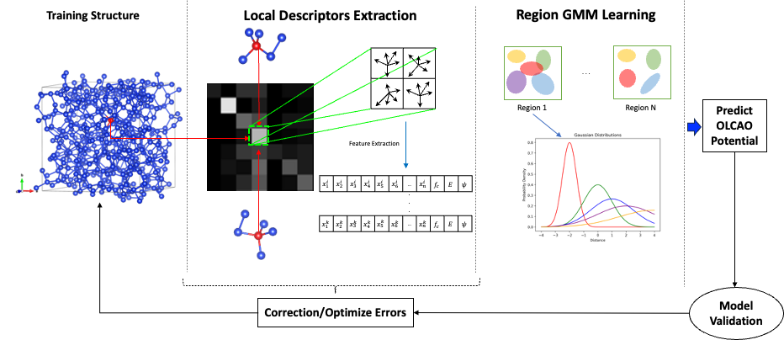
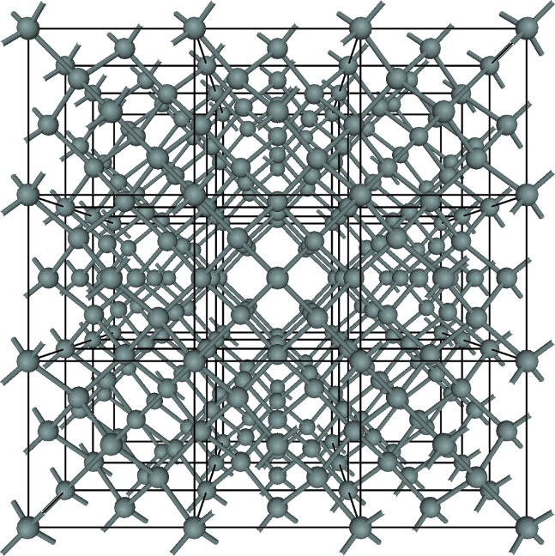
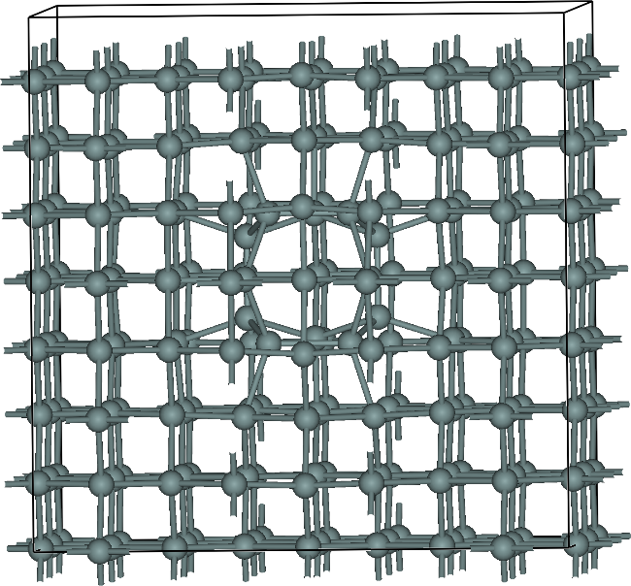
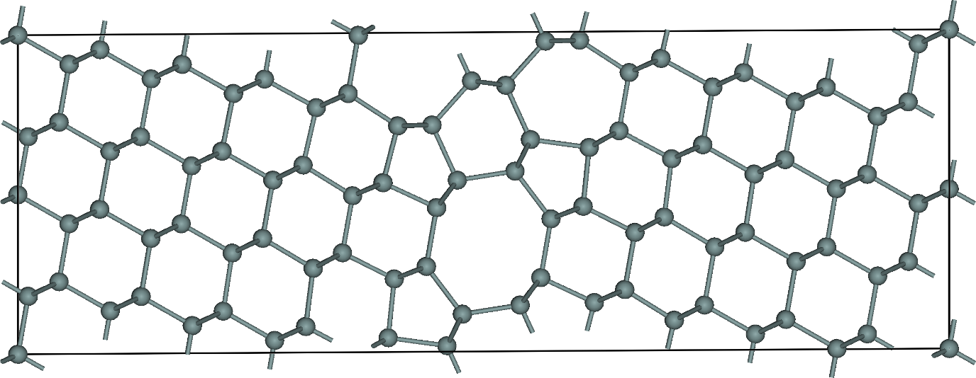
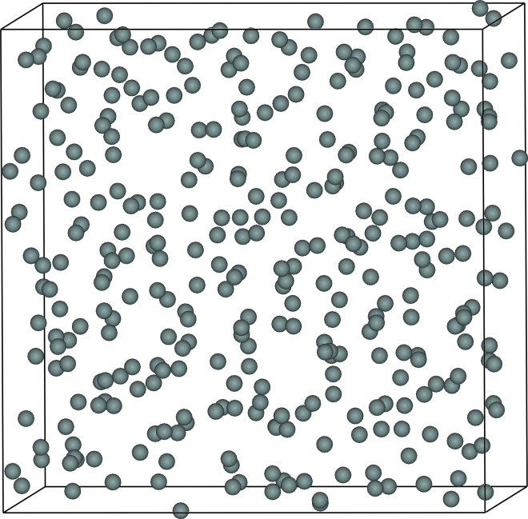
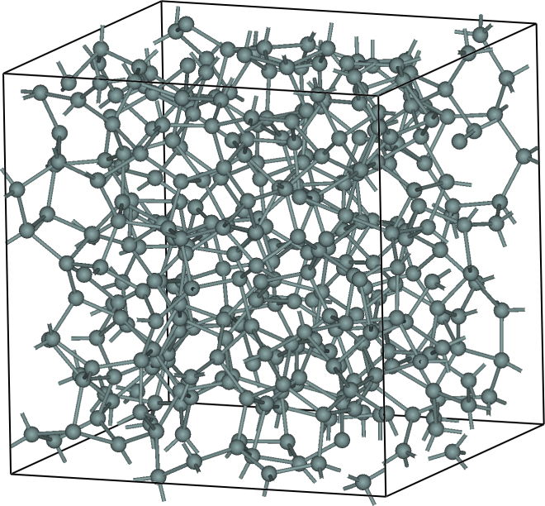
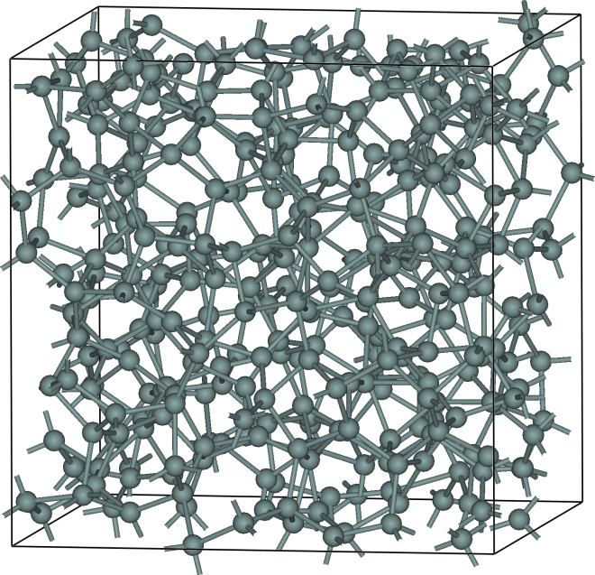
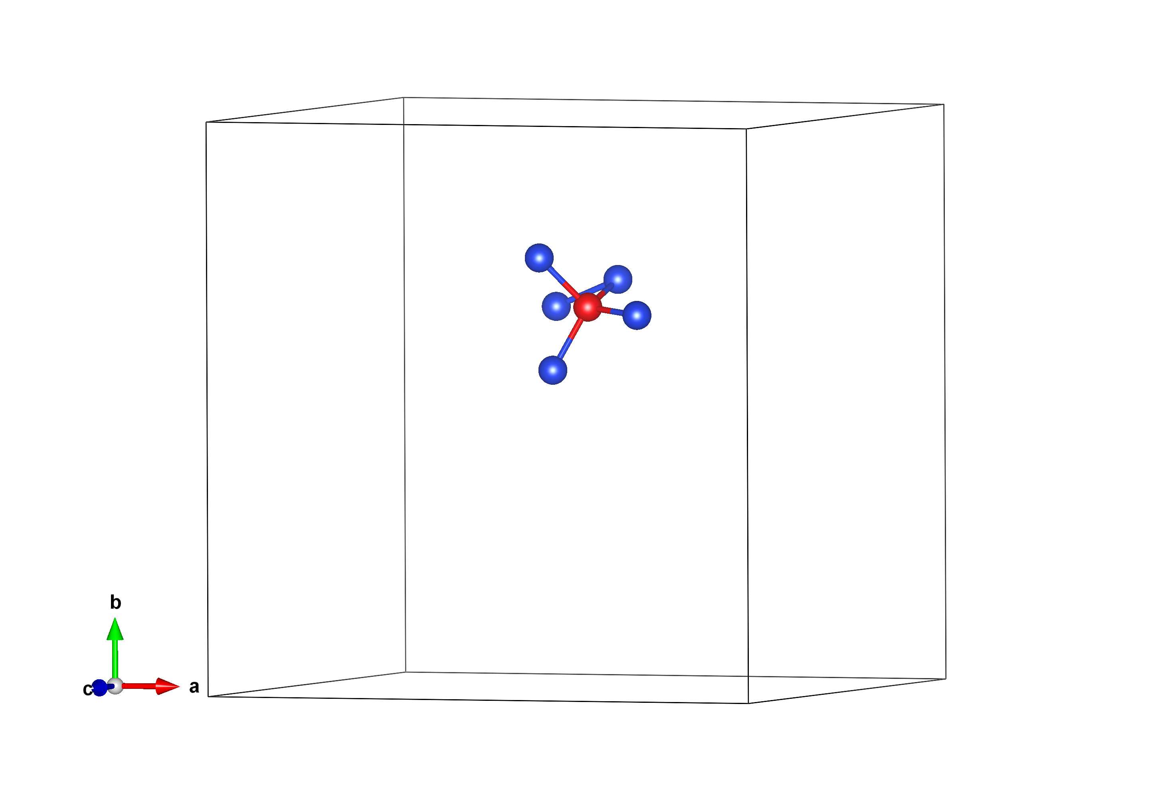
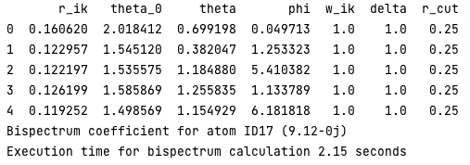
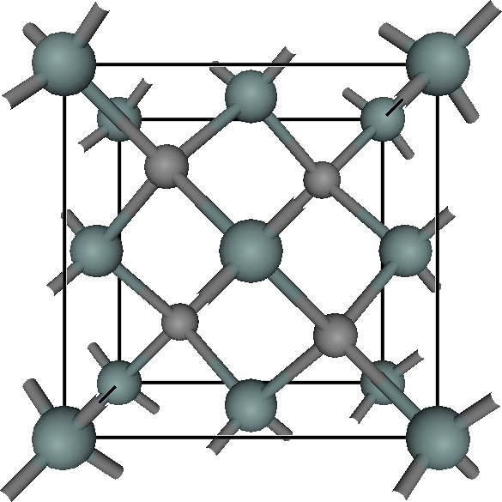
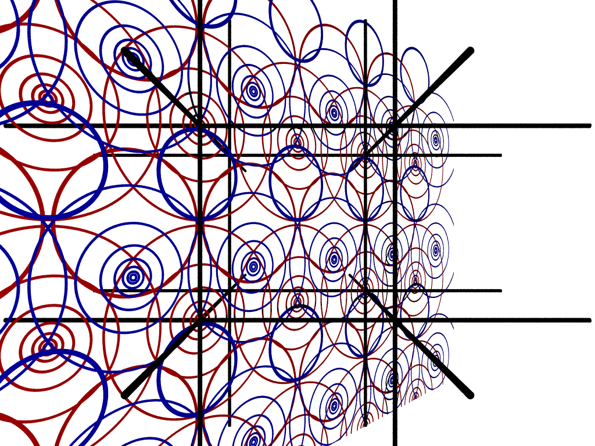
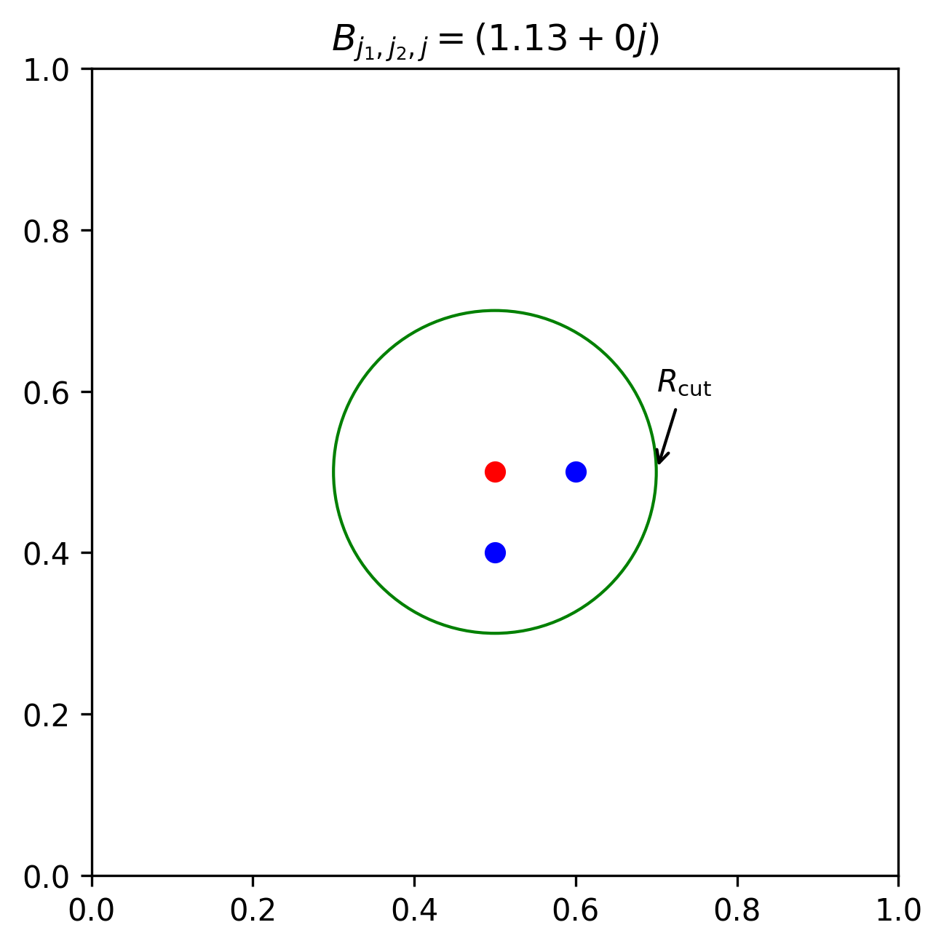
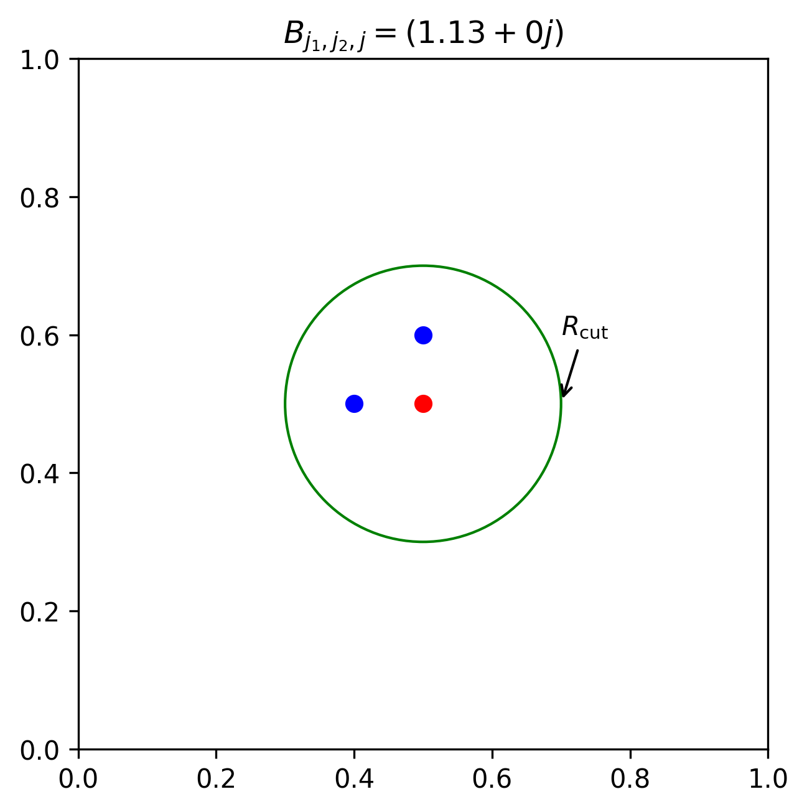
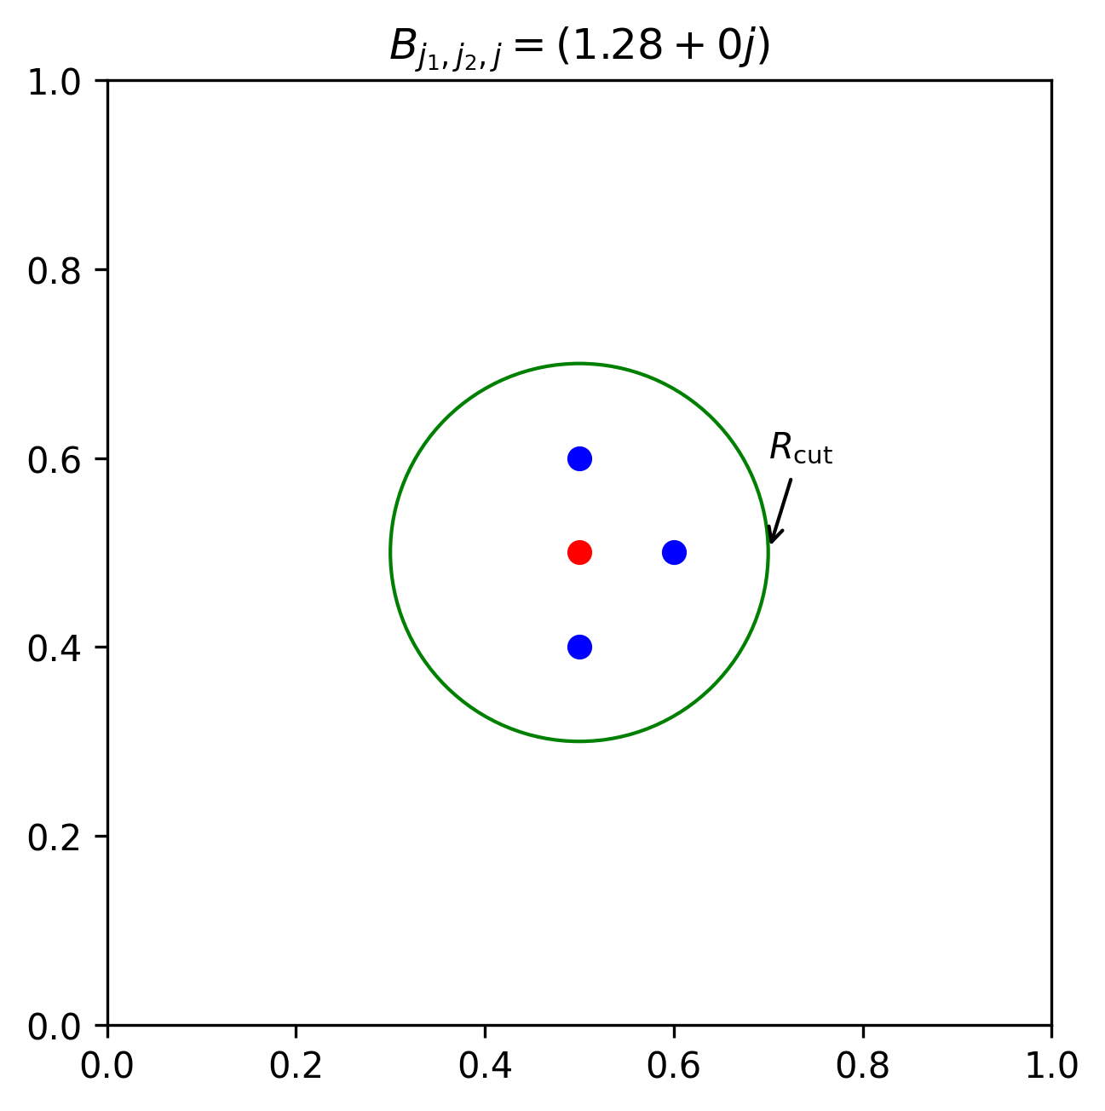
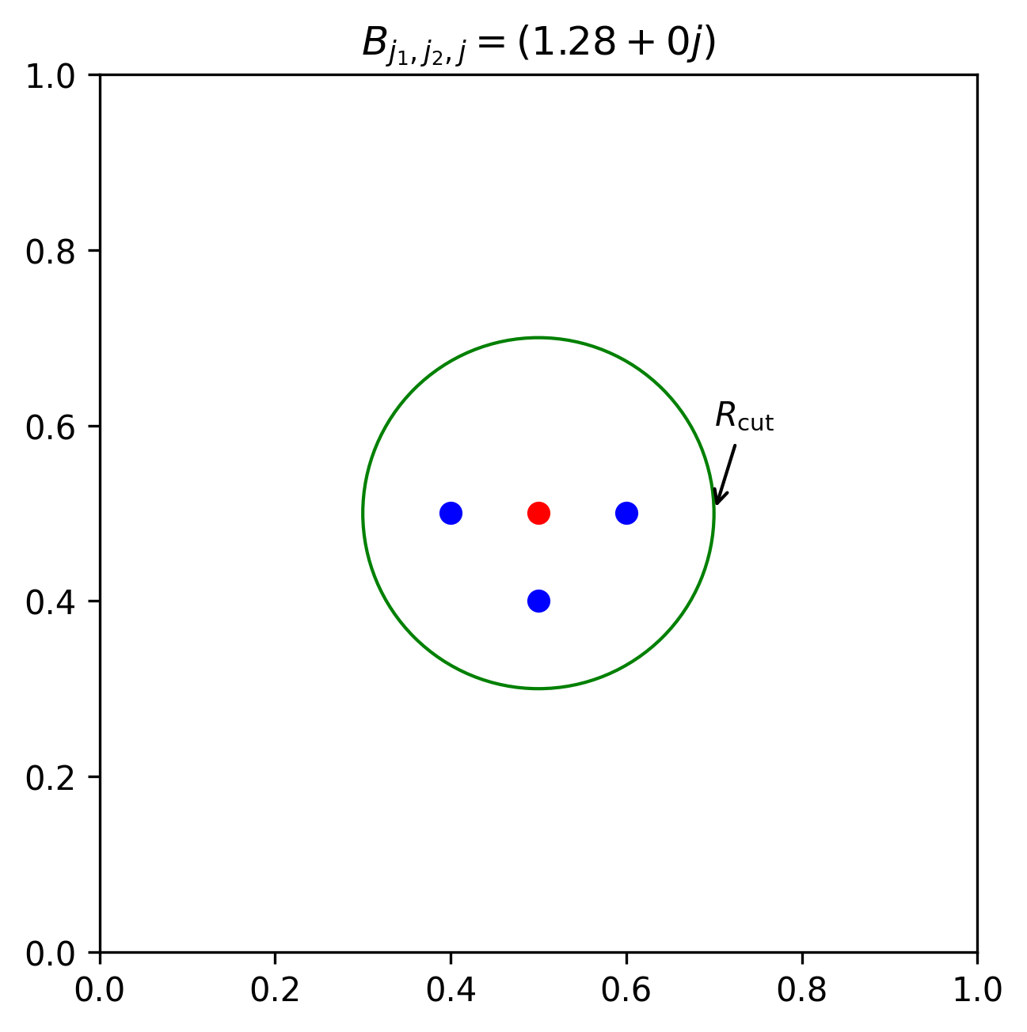
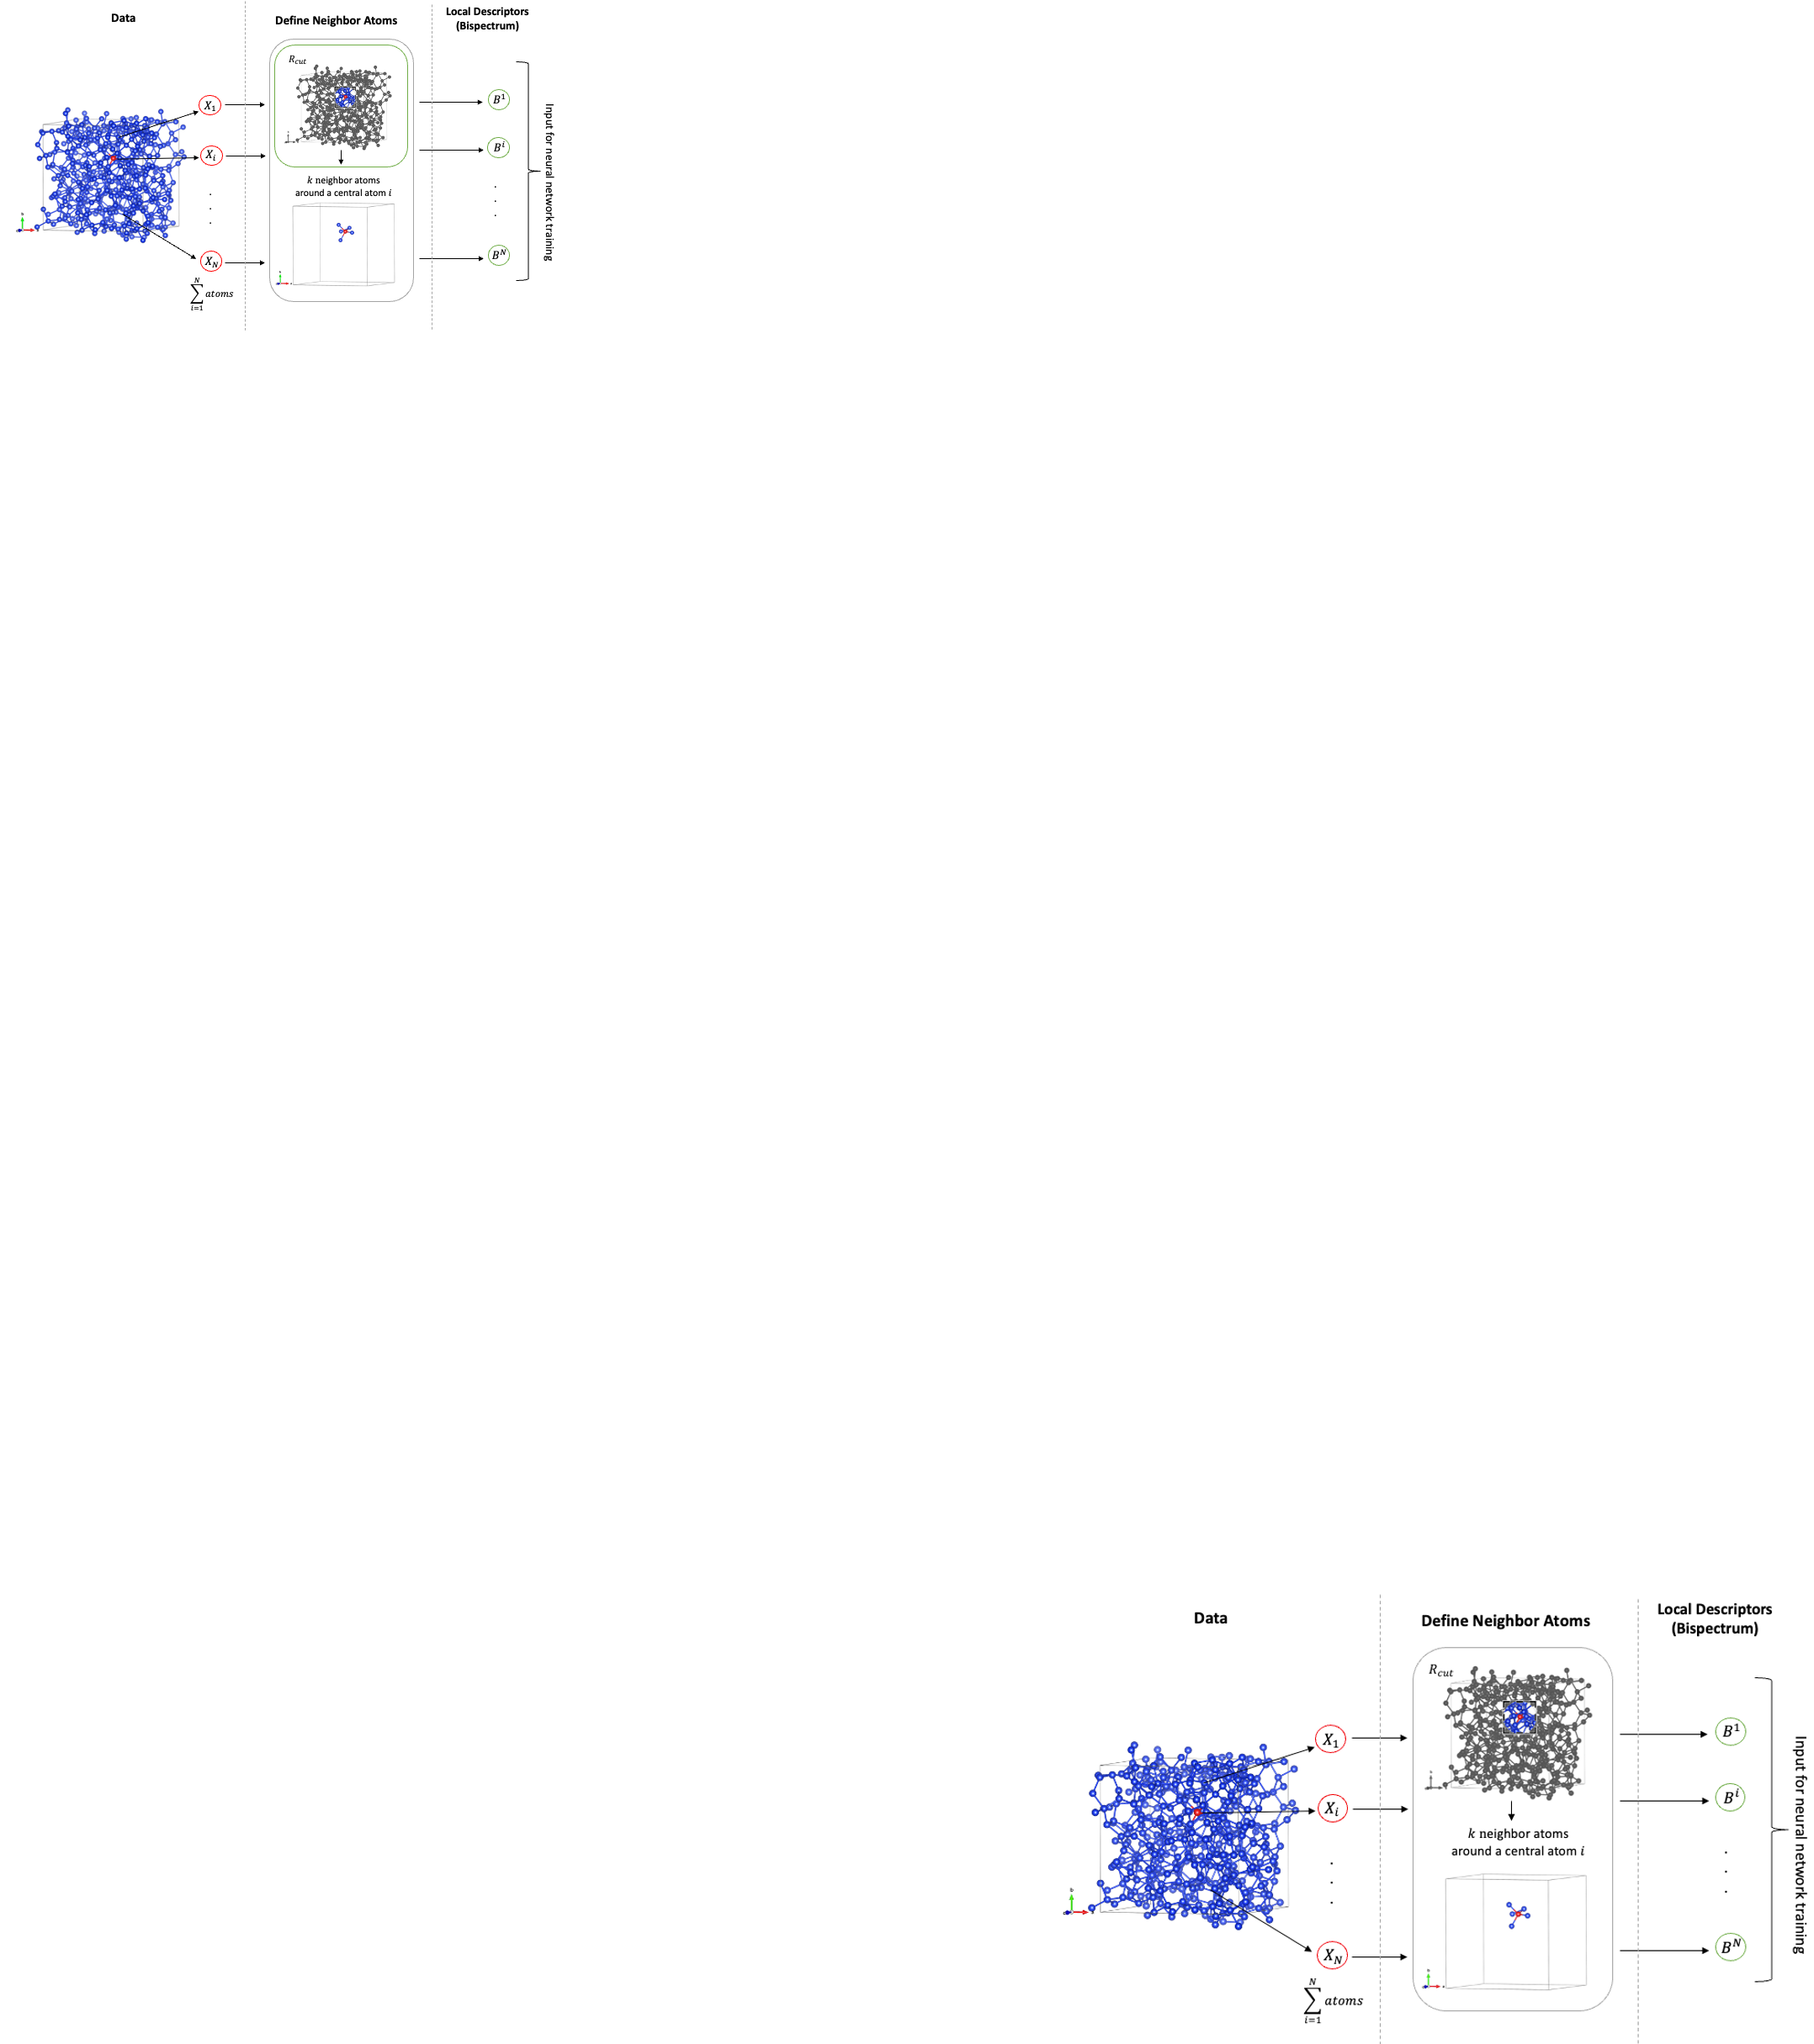
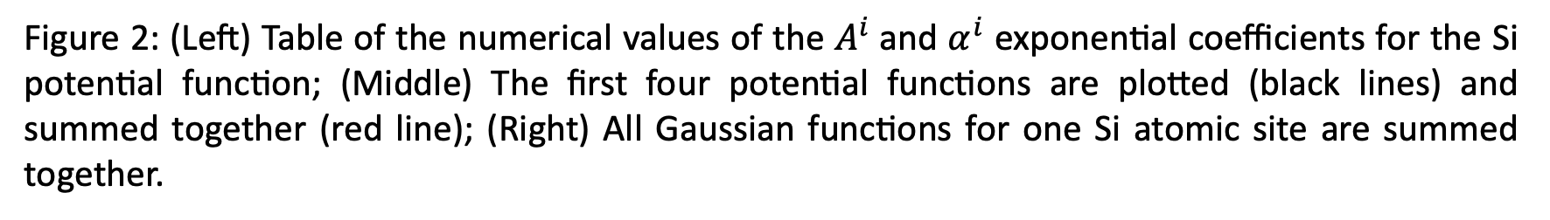


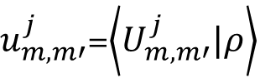
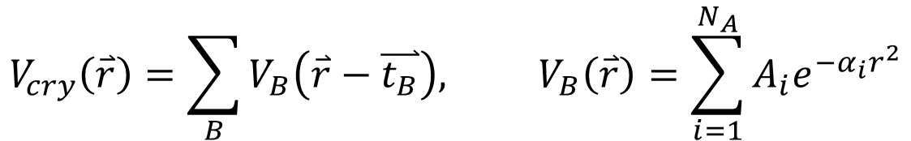
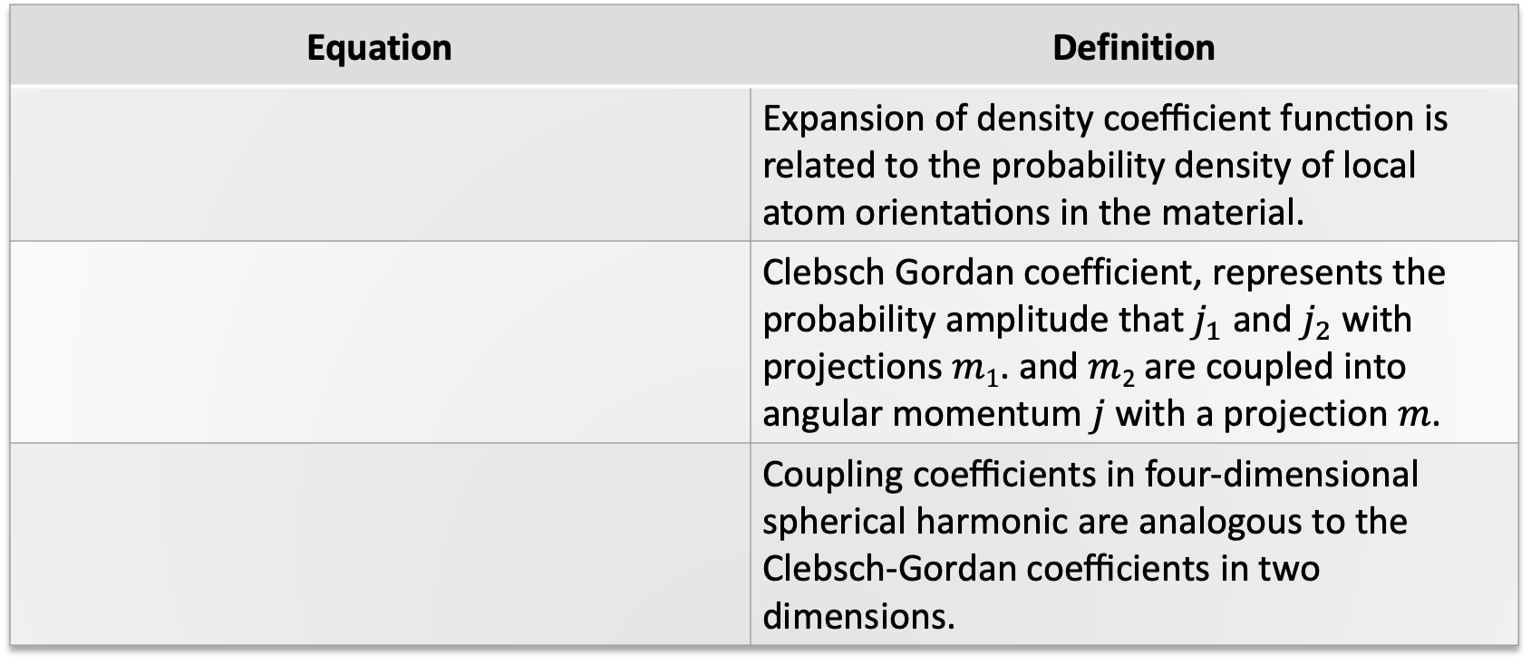
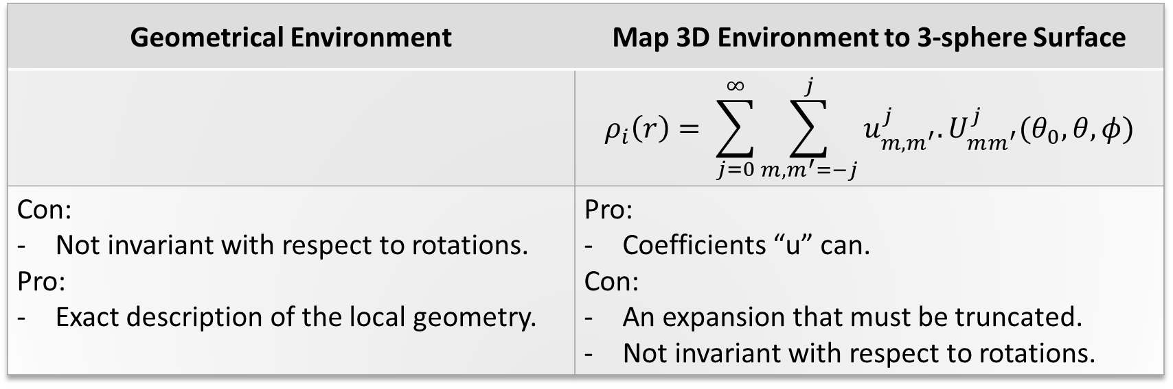
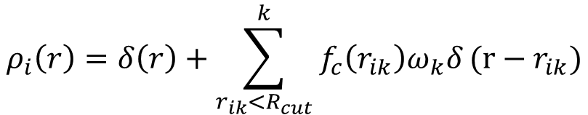
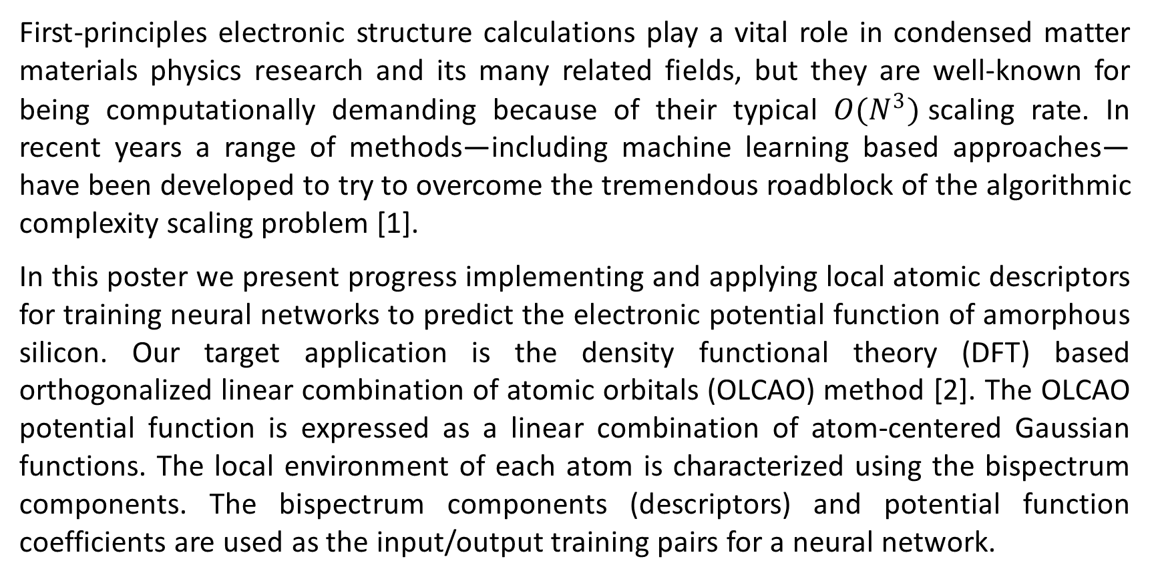
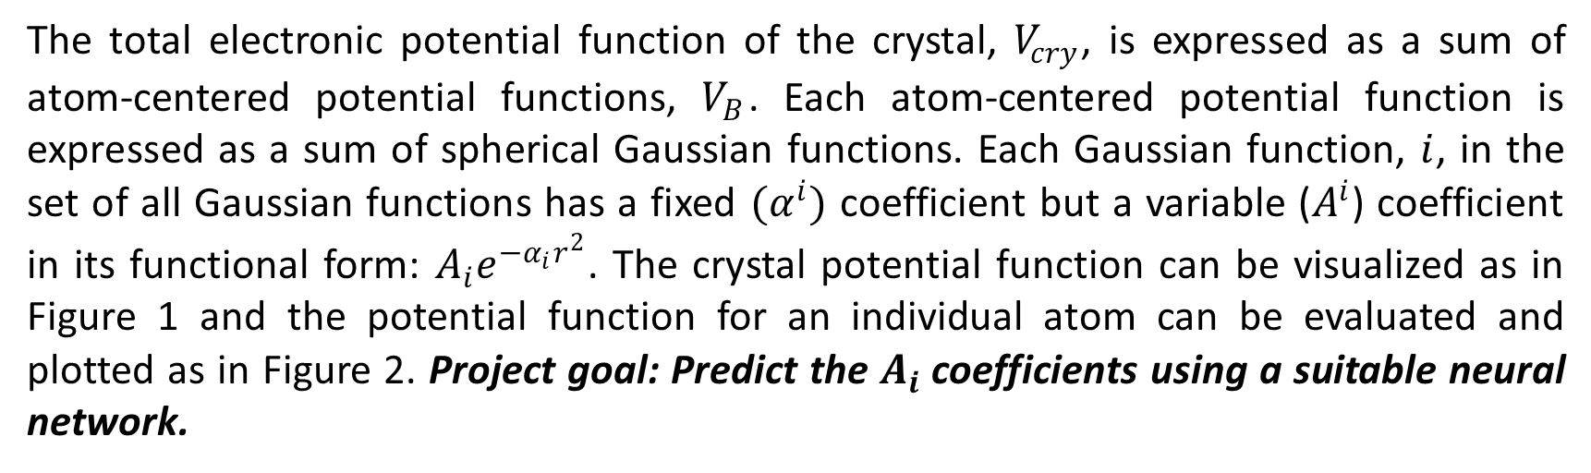

Machine Learning Potential Function Generation for ab initio Electronic Structure Calculations
Duong Hoang and Paul Rulis
Division of Energy, Matter, and Systems at the University of Missouri – Kansas City
Introduction
Proposed Neural Network Framework
Systems
First-principles electronic structure calculations play a vital role in condensed matter materials physics research and its many related fields, but they are well-known for being computationally demanding because of their typical ${O(N}^{3})$scaling rate. In recent years a range of methods—including machine learning based approaches—have been developed to try to overcome the tremendous roadblock of the algorithmic complexity scaling problem [1].
In this poster we present progress implementing and applying local atomic descriptors for training neural networks to predict the electronic potential function of amorphous silicon. Our target application is the density functional theory (DFT) based orthogonalized linear combination of atomic orbitals (OLCAO) method [2]. The OLCAO potential function is expressed as a linear combination of atom-centered Gaussian functions. The local environment of each atom is characterized using the bispectrum components. The bispectrum components (descriptors) and potential function coefficients are used as the input/output training pairs for a neural network.
A collection of different pure silicon models are used for computing bispectrum components and used them as training input feature for ML model training.
(A)
(B)
(C)
Figure 3: Conceptual framework for a proposed neural network
Bispectrum Components
OLCAO Potential Function
Local density neighbor function
(D)
(E)
(F)
The total electronic potential function of the crystal, $V_{cry}$, is expressed as a sum of atom-centered potential functions, $V_{B}$. Each atom-centered potential function is expressed as a sum of spherical Gaussian functions. Each Gaussian function, $i$, in the set of all Gaussian functions has a fixed ${(α}^{i})$ coefficient but a variable ($A^{i}$) coefficient in its functional form: $A_{i}e^{−α_{i}r^{2}}$. The crystal potential function can be visualized as in Figure 1 and the potential function for an individual atom can be evaluated and plotted as in Figure 2. Project goal: Predict the $A_{i}$coefficients using a suitable neural network.
Geometrical Environment | Map 3D Environment to 3-sphere Surface
 | $$ρ_{i}\left(r\right)= \sum_{j=0}^{∞}{\sum_{m,m^{′}=−j}^{j}{u_{m,m^{′}}^{j}.U_{mm^{′}}^{j}(θ_{0},θ,φ)}}$$
Con: Not invariant with respect to rotations. Pro: Exact description of the local geometry. | Pro: Coefficients “u” can. Con: An expansion that must be truncated. Not invariant with respect to rotations.
Figure 4: Six different models of pure silicon. (A) Crystalline silicon; (B) Crystalline silicon I4 model with four self-interstitials; (C) A model of silicon with a passive defect; (D – F) Identically structured models of pure silicon with uniform scaling of bond lengths from largest (D) to the standard bond length (E) to compressed bond lengths (F).
$$ρ_{i}\left(r\right)=δ\left(r\right)+\sum_{r_{ik}<R_{cut}}^{k}{f_{c}\left(r_{ik}\right)ω_{k}δ}(r−r_{ik})$$
Preliminary Results
$$V_{cry}\left(\overset{⃑}{r}\right)=\sum_{B}{V_{B}\left(\overset{⃑}{r}−\overset{⃑}{t_{B}}\right), V_{B}\left(\overset{⃑}{r}\right)=\sum_{i=1}^{N_{A}}{A_{i}e^{{−α}_{i}r^{2}}}}$$
Bispectrum SO(4)
$B_{j_{1, }j_{2}, j}=\sum_{m_{1},m_{1}^{′}}^{j_{1}}{\sum_{m_{2},m_{2}^{′}={−j}_{2}}^{j_{2}}{\sum_{m,m^{′} =−j}^{j}{{(u_{mm^{′}}^{j})}^{∗}H_{j_{1}m_{1}m_{1}^{′},j_{2}m_{2}m_{2}^{′}}^{jm}}u_{m_{1}m_{1}^{′}}^{j_{1}}}}$ $u_{m_{2}m_{2}^{′}}^{j_{2}}$
$$B_{j_{1}=2, {j_{2}=}_{2}^{1},j=5/2}^{i}≈9.12$$
Equation | Definition
 | Expansion of density coefficient function is related to the probability density of local atom orientations in the material.
 | Clebsch Gordan coefficient, represents the probability amplitude that $j_{1}$ and $j_{2}$ with projections $m1$. and $m$₂ are coupled into angular momentum $j$ with a projection $m$.
 | Coupling coefficients in four-dimensional spherical harmonic are analogous to the Clebsch-Gordan coefficients in two dimensions.
Figure 6: Bispectrum calculation for a center atom $i, k=5$neighbor atoms in amorphous silicon cell
$u_{m,m′}^{j}$=$\left\langle U_{m,m′}^{j}|ρ\right\rangle$
$$C_{j_{1}m_{1}j_{2}m_{2}}^{jm}≡\left\langle j_{1}m_{1}j_{2}m_{2}|jm\right\rangle$$
$$C_{j_{1}m_{1}j_{2}m_{2}}^{jm}×C_{j_{1}m_{1}^{′}j_{2}m_{2}^{′}}^{jm^{′}}≡H_{j_{1}m_{1}m_{1}^{′},j_{2}m_{2}m_{2}^{′}}^{jm}$$
Figure 6: Bispectrum calculation with modified neighbor atom positions
Figure 1: (Left) Ball and stick model of crystalline Silicon Carbide with large balls for the Silicon (Si) and small balls for the C. (Right) A cross sectional slice of the potential function for Silicon Carbide showing the atom centered spherical Gaussians at each atomic site.
Conclusions and Future Work
Table 1: Mathematical equations definition for bispectrum calculation
In this work, we developed a computer program to automatically generate bispectrum components for a single-element system in a periodic unit cell. We investigated the symmetric properties of the bispectrum components, which align with the proof established in Ref. [4]. However, further development and testing of the program are necessary before it can be applied to multiple-element systems. A key challenge lies in extending the expansion density function to include proper weighting for different elements.
Now that the bispectrum component has been computed for single element systems, the next step will be to develop an appropriate ML model to link the bispectrum component and the OLCAO potential function coefficients. Without careful and detailed understanding of the ML model, the accuracy of the ML potential for OLCAO will be limited. The proposed framework is based on techniques developed for computer vision whereby the local, medium-range, and long-range (global) properties are encoded as input descriptors for each atom. While in most cases, electrons are “short-sighted”, the proposed method could address novel long range electronic structure properties.
Coefficients (A_{i}) Exp Coeffs (α_{i})
---------------------------------------------------------
#1 -0.60672619E+00 0.15000000E+00
#2 -0.12407671E+01 0.42758111E+00
#3 -0.36166706E+01 0.12188374E+01
#4 -0.91724811E+01 0.34743455E+01
#5 -0.16959754E+02 0.99037634E+01
#6 0.40745139E+02 0.28231081E+02
#7 0.12733590E+02 0.80473846E+02
#8 0.10442423E+02 0.22939397E+03
#9 -0.19109966E-01 0.65389686E+03
#10 0.54010939E+01 0.18639596E+04
#11 -0.42032006E+01 0.53132928E+04
#12 0.66156017E+01 0.15145758E+05
#13 -0.74064920E+01 0.43173599E+05
#14 0.91870114E+01 0.12306810E+06
#15 -0.92689314E+01 0.35081063E+06
#16 0.63220401E+01 0.10000000E+07
References
Figure 2: (Left) Table of the numerical values of the $A^{i}$and $α^{i}$ exponential coefficients for the Si potential function; (Middle) The first four potential functions are plotted (black lines) and summed together (red line); (Right) All Gaussian functions for one Si atomic site are summed together.
[1]Fiedler L, Modine NA, Schmerler S, Vogel DJ, Popoola GA, Scale with Machine Learning. arXiv;. Available from: http://arxiv.org/abs/2210.11343.
[2] Ching, W.-Y., & Rulis, P. (2012). Basic Theory and Techniques of the OLCAO Method. In A. Zunger (Ed.), Modern Methods of Crystal Structure Prediction (pp. 61-83). Oxford University Press. https://doi.org/10.1093/acprof:oso/9780199575800.003.0003
3] Bart ́ok AP, Payne MC, Kondor R, Cs ́anyi G. Gaussian Approximation Potentials: The Accuracy of Quantum Mechanics, Without the Electrons;104(13):136403. Available from: http://arxiv.org/abs/0910.1019
[4] Thompson AP, Swiler LP, Trott CR, Foiles SM, Tucker GJ. A Spectral Analysis Method for Automated Generation of Quantum-Accurate Interatomic Potentials;285:316-30. Available from: http://arxiv.org/abs/1409.3880.
Figure 4: Bispectrum calculation framework
Copyright © 2023 UMKC
Work supported by the Computational Physics Group and
The UMKC Physics and Astronomy Program
Contact us at: rulisp@umkc.edu , dtht2d@umsystem.edu

