Slide 1
Advance Medical Robotics
Team 5
Dang The Hung

Slide 2
Introduction

Slide 3
Introduction
Aim
Building a haptic device using 3 DOF planar robot
Objectives
Real time haptic rendering from a virtual environment
Scalable and modifiable virtual environment: with at least three types of obstacles:
Spring
Walls
Damping areas
Real-time UI visualization

Slide 4
Methodology

Slide 5
Methodology
Friction modeling
PID controller
Jacobian based controller
Torque-current calibration
Haptics devices
Environment simulation

Slide 6
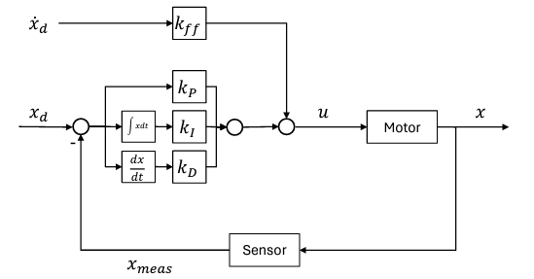
Methodology – PID controller
Friction Modeling:
PID controller:
Moving robot at constant velocity
Find relationship of current ~ velocity
Model: Current = a*velocity + b*sign(velocity)
Optimizing: Minimizing sum of square error of current

Slide 7
Methodology – PID controller
Jacobian based controller with pathway generation
Target
Pathway generation
Jacobian based controller: dθ = J⁺(q).dx
PID velocity controller
Hardware interface
ROS NODE
ROS NODE
ROS NODE
ROS NODE
ROS NODE

Slide 8
Methodology – haptics
Force controller: t = J^{T}.F
Torque-current calibration
Load cell calibration: known weight + gravity
Robot calibration: applying an arbitrary force to the load cell -> measure
Friction compensation: previously mentioned
Dynamic compensation: solving using Lagrangian method

Slide 9
Methodology – haptics
Environment simulation:
Generating and exporting from a computer -> flexibility
Storing as python list/numpy.ndarray -> accessing complexity O(1)
Simulation of different objects: spring, wall, damping area
UI:
Remote Desktop Connection
Matplotlib

Slide 10
Results

Slide 11
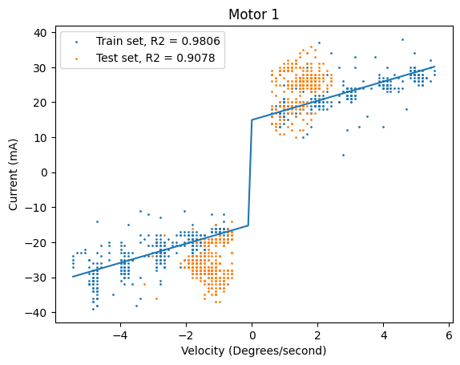
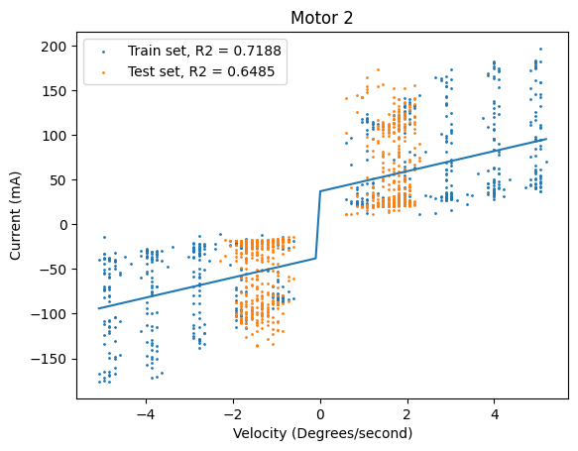
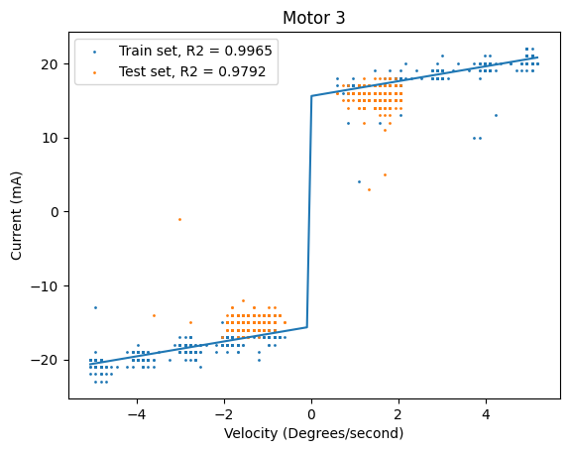
Friction model
Current = a*velocity + b*sign(velocity)

Slide 12
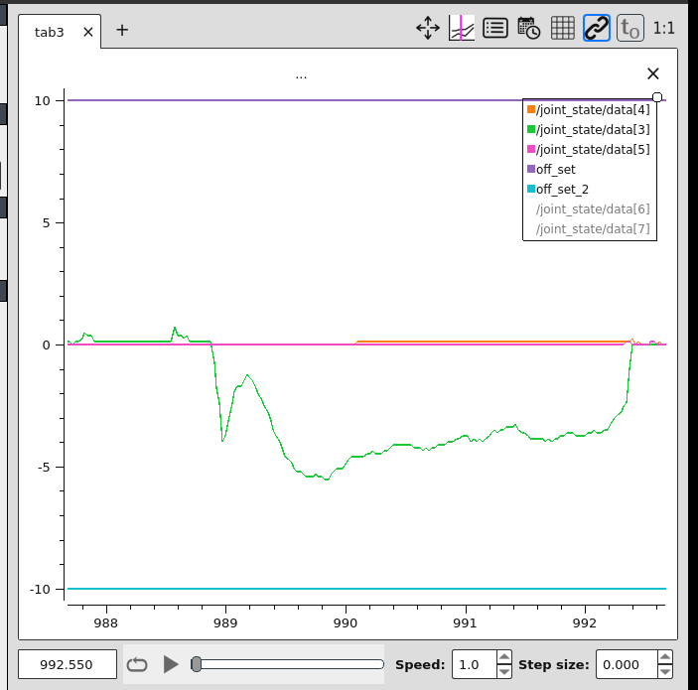
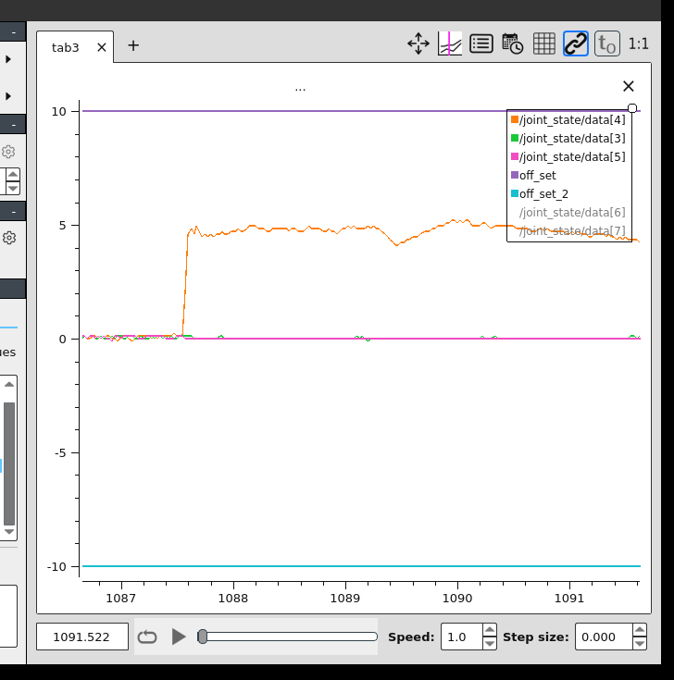
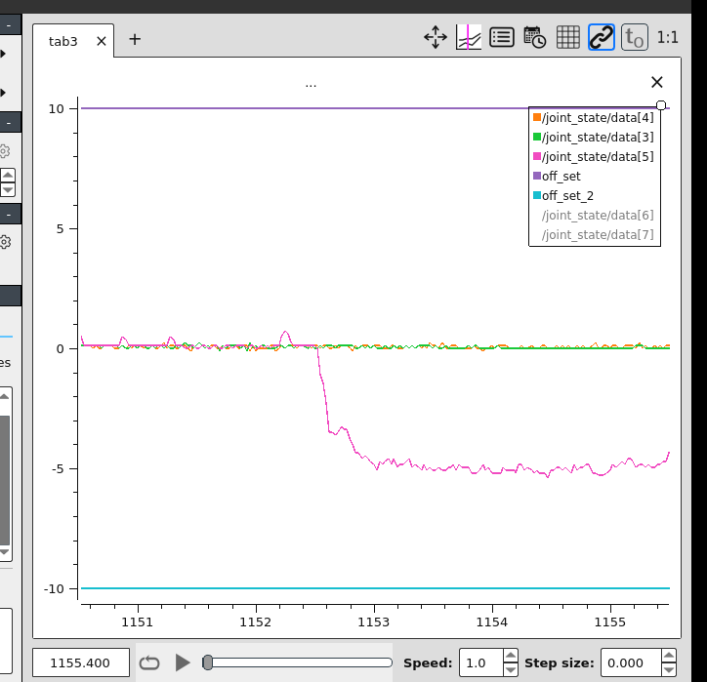
PID for velocity control

Slide 13
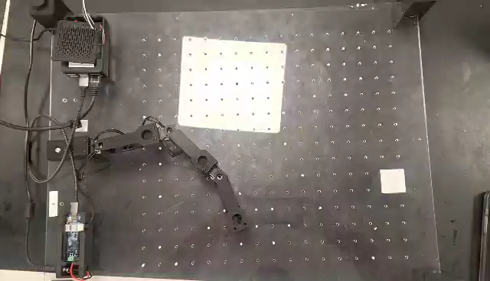
Jacobian-based controller with linear path planning

Slide 14
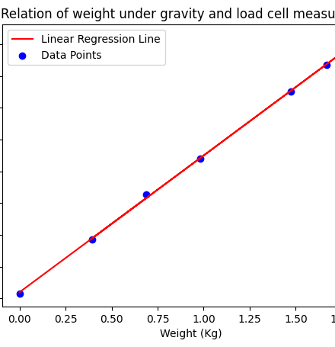
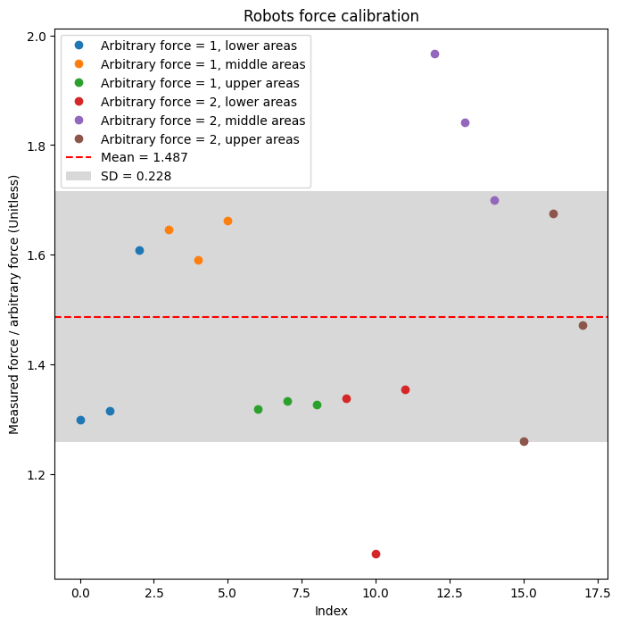
Force calibration

Slide 15

Haptics device

Slide 16
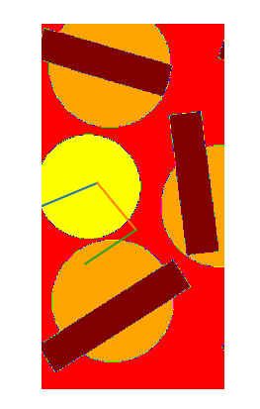

UI – Environment
Data accessed as python list
Scalability
Modifiability
Real-time plotting
Comparison of np.ndarray and python list access time

Slide 17
User experience
Four springs test
Four damping areas test

Slide 18
Discussion
Force limit
Open loop force control
The method is not suit for simulating dynamic environment
Visualization greatly increase haptic feeling

