Slide 1
Advance Medical Robotics
Team 5
Dang The Hung
Zhenguan Tu
Rui Han
Notes:
Hello everyone, we are Team 5.

Slide 2
Introduction
Notes:
Firstly, I will introduce our aim and objectives.

Slide 3
Introduction
Aim
Building a haptic device using 3 DOF planar robot
Objectives
Real time force-control for rendering haptics
Scalable and modifiable virtual environment: with at least three types of obstacles:
Spring
Walls
Damping areas
Real-time UI visualization
Notes:
Our aim is to build a haptic device by using a 3 DOF planar robot.
And we have three objectives:
Real time force-control,
three types of obstacles: Spring, Walls, and Damping areas,
And the Real-time UI visualization.

Slide 4
Methodology
Notes:
The second part is our methodologies.

Slide 5
Methodology
Friction modeling
PID controller
Jacobian based controller
Torque-current calibration
Haptics devices
Environment simulation
Notes:
These are our methodologies:

Slide 6
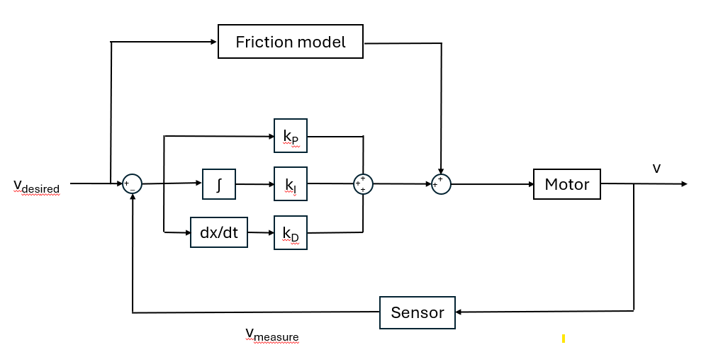
Methodology – PID controller
Friction Modeling:
PID controller:
Moving robot at constant velocity
Find relationship of current ~ velocity
Model: Current = a*velocity + b*sign(velocity)
Optimizing: Minimizing sum of square error of current
Notes:
We added a Friction Model by this formula, which can be regarded as friction compensation and used to optimize our model.
And this is our PID controller block diagram.
Based on general PID control, we added the Friction Model here.

Slide 7
Friction model
k_{P}
v
v_{desired}
∫
k_{I}
+
+
Motor
+
_
+
+
+
dx/dt
k_{D}
Sensor
v_{measure}

Slide 8
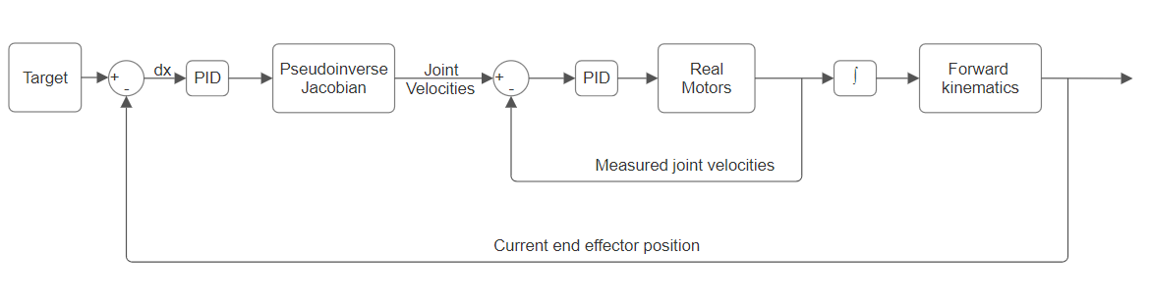
Methodology – PID controller
Jacobian based cascade PID controller
Notes:
Then we added another PID controller here for the position control,
whose function is to reduce the difference between the target position and the current position in the task space.

Slide 9
Methodology – PID controller
ROS2 architecture
Target
Pathway generation
Jacobian based controller: dθ = J⁺(q).dx
PID velocity controller
Hardware interface
ROS NODE
ROS NODE
ROS NODE
ROS NODE
ROS NODE
Notes:
This is our final flowchart. The first ROS node is to get the target from the user;
the second node is to plan the pathway of our robot;
the third node is to calculate the desired velocity by using the Jacobian;
the fourth node is to implement the PID velocity controller;
and the last node is the hardware interface.

Slide 10
Methodology – haptics
Force controller: t = J^{T}.F
Torque-current calibration
Load cell calibration: known weight + gravity
Robot calibration: applying an arbitrary force to the load cell -> measure
Friction compensation: previously mentioned
Dynamic compensation: solving using Lagrangian method
Notes:
The way to achieve haptics is that the machine can respond to a real-world force. For the robot, it is necessary to convert the force into a moment and control the current by the moment. First we calibrate the force sensor. Then we input a value to F such as 1 2 3 and use force sensor to test robotic force. Compare the values on the force sensor with the value input to the robot to find the relationship between the two type values. Friction compensation actually regards the activated current at different speeds as the force used to overcome friction. After that, add friction matrix, inertia matrix and Coriolis matrix to improve our robotic to be more smooth.

Slide 11
Methodology – haptics
Environment simulation:
Generating and exporting from a computer -> flexibility
Storing as python list/numpy.ndarray -> accessing complexity O(1)
Simulation of different objects: spring, wall, damping area
UI:
Remote Desktop Connection
Matplotlib
Notes:
We created a matrix of 300,300,10 to store the information of the force and generate the virtual environment. This environment can be export and add different obstacles, by setting different forces in the matrix. For UI, read the 3 motor position and use Remote Desktop Connection to plot image.

Slide 12
Results

Slide 13
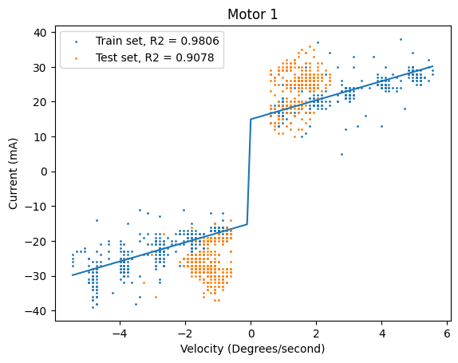
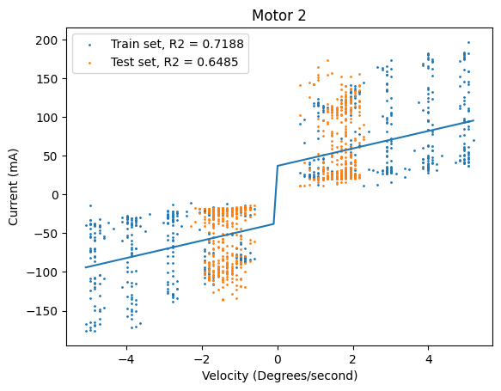
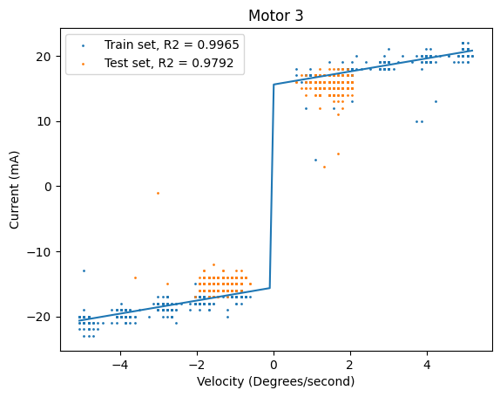
Friction model
Current = a*velocity + b*sign(velocity)

Slide 14
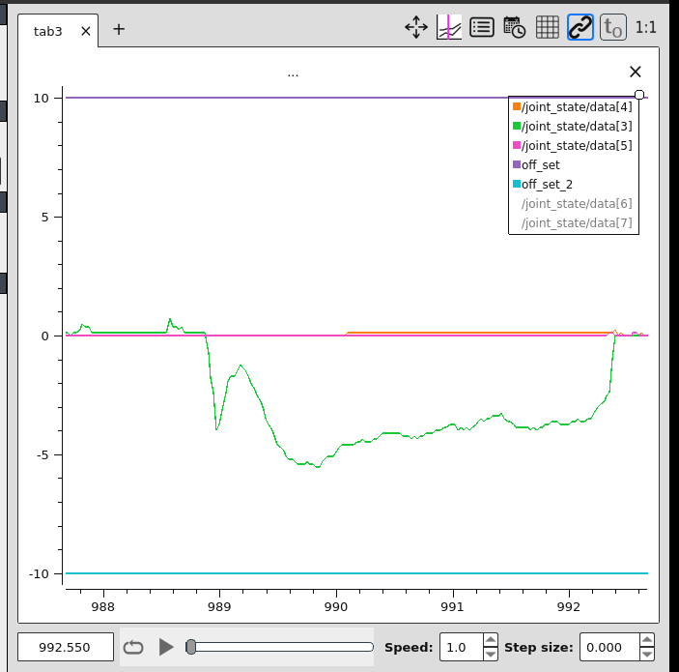
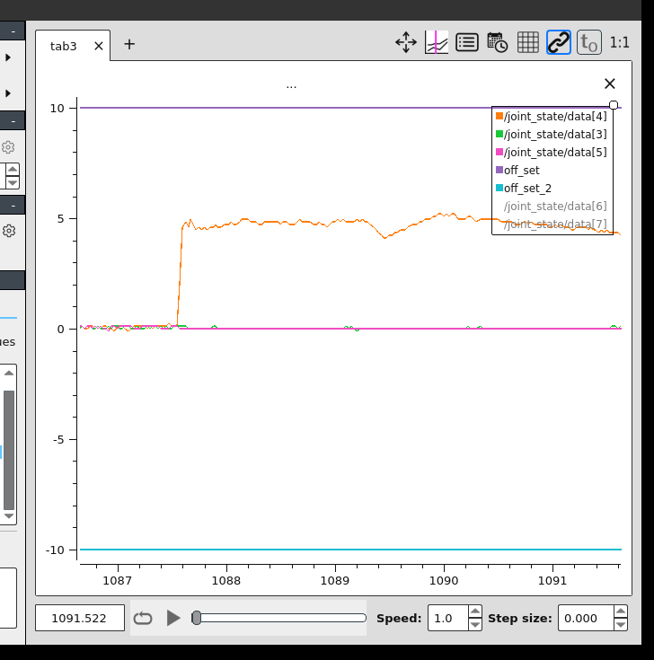
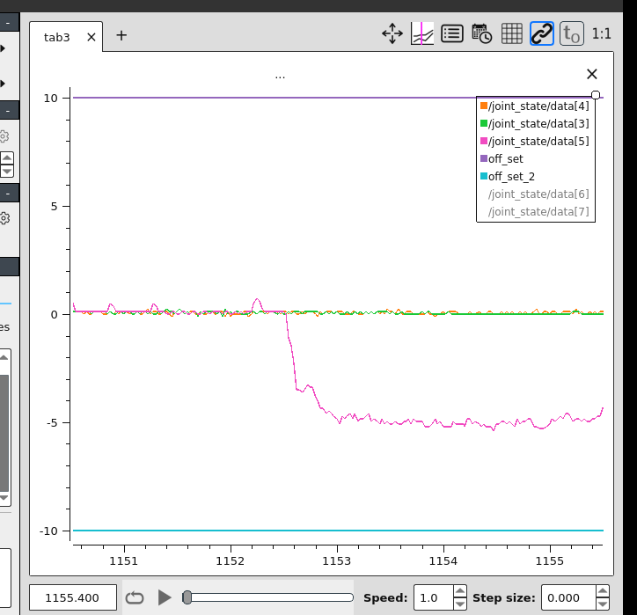
PID for velocity control

Slide 15
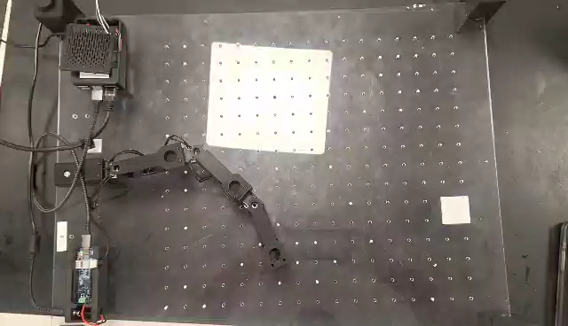
Jacobian-based controller with linear path planning

Slide 16
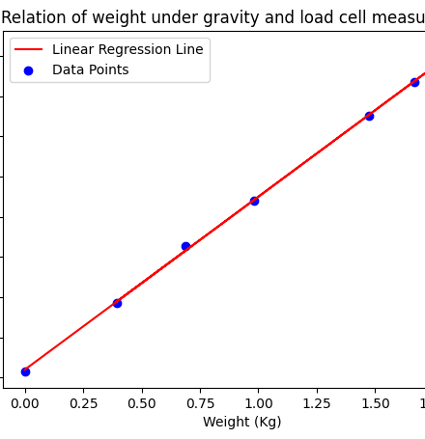
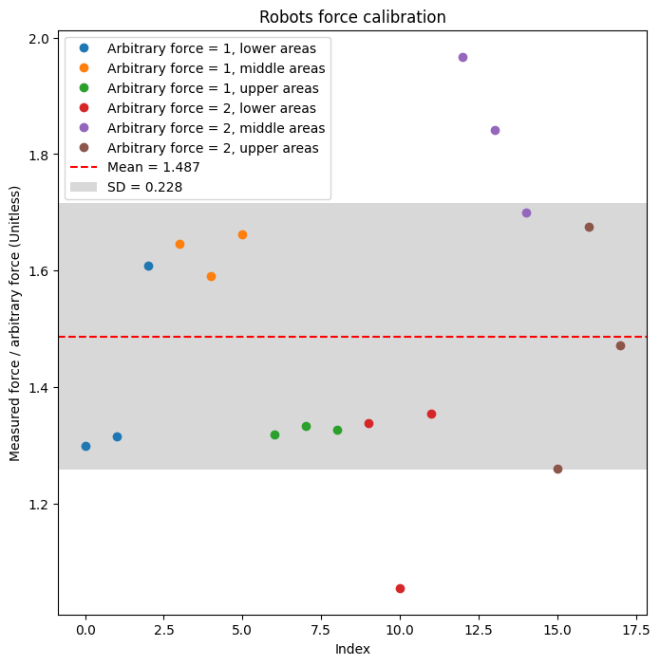
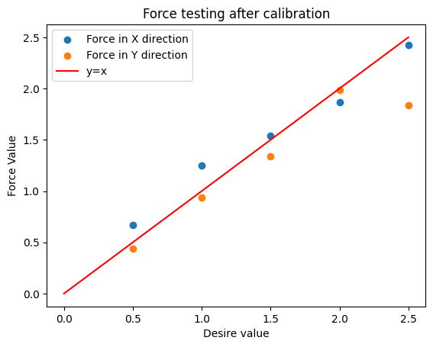
Force calibration

Slide 17
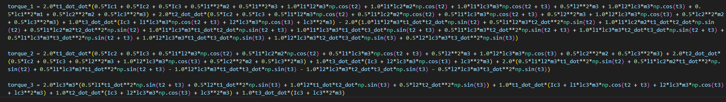
Free space compensation
Compensation in both friction and dynamic model

Slide 18
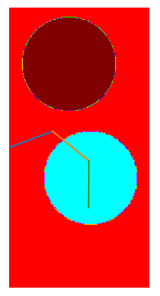
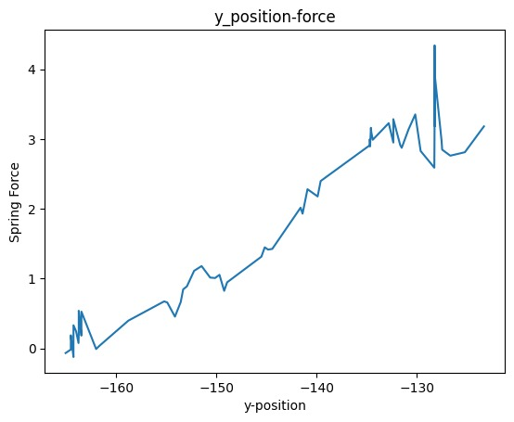
Haptics device
Spring

Slide 19
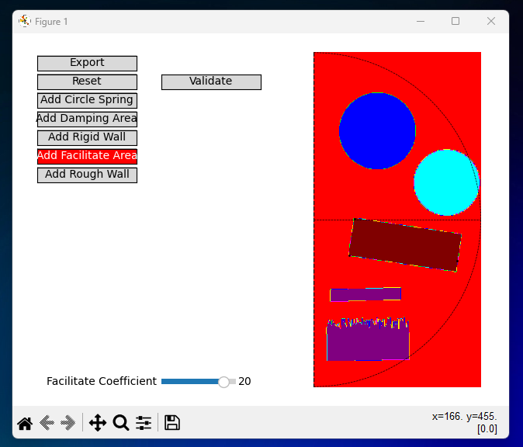
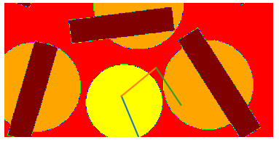

UI – Environment
Python list faster numpy array
Environment
Scalability
Modifiability
Real-time plotting
5 types of environment

Slide 20
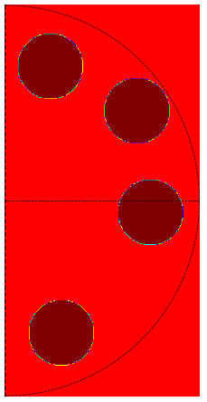
User experience
Four springs test: 3 members to guess number of spring, and order their strength
2/3 wrongly detected ¾ without visualisation
2/3 misclassified 1st and 2nd strongest springs
=> Visualization impact haptics performance
=> Performance is bad at upper force limit

Slide 21
Discussion – good points
Real time implementation (all codes run >40Hz)
Scalable method for static environment simulation
Haptics resolution for environment is 1mm
Good feedback from user

Slide 22
Discussion – limitation
Our method is not suit for simulating dynamic environment
Open loop force control -> faulty force rendering
Force limit for our system is around 2N. Higher result in instability
40Hz is the microcontroller limit -> feeling

Slide 23
Discussion – future
Method for creating dynamic environment?
Try close loop force control
Better hardware
Simulation collision for whole arm instead of end effector

