Slide 1
File structure
Authentication
Main layout
Login
Logout
Register
Public
Personal
community
about
Profile
api
private-encryption
error
Individual post

Slide 2
Layout
NavBar (Not following scrolling)
Community | Private Encryption | About | API | Account
(Login/Register – Profile/Logout)
Guide
(Collapsiable)
Footer
(Only appear at the end)

Slide 3
Individual post
NavBar (Not following scrolling)
Community | Private Encryption | About | API | Account
(Login/Register – Profile/Logout)
Guide
(Collapsiable)
Date
Author
Title
Description
| | Key Copy Key
Explain about key
Copy path to post with key | Copy path to post without key
Decrypt |
Content
Footer
(Only appear at the end)

Slide 4
Individual post
NavBar (Not following scrolling)
Community | Private Encryption | About | API | Account
(Login/Register – Profile/Logout)
Guide
(Collapsiable)
Username: |…| |Update|
Email: |…| |Change password|
Your saved keys
Your posts
Delete
Upload key and make it public
Footer
(Only appear at the end)

Slide 5
Title
Key Icon
Enter Icon
By
Date post
Description

Slide 6
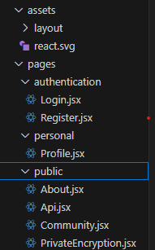

Slide 7
Authentication
Main layout
Login
Logout
Register
Public
Personal
Home (Repo)
Login
Profile
Logout
Register
Register
Home

Slide 8
/profile - A general personal profile page.
/dashboard - A personalized dashboard with user-specific information.
/settings - A page for customizing account settings.
/my-account - A centralized account management page.
/portfolio - A page showcasing personal projects or work.
/activity - A log of user activities or interactions.
/messages - A personal inbox for messages or notifications.
/favorites - A collection of saved items or favorites.
/friends - A list of connections or friends.
/preferences - A page for managing user preferences.

