Slide 1
Mastering Java OOP: Four Core Principles
Siris Duong | Argon

Slide 3
Table Of Contents
OOP
Four Main Principle
Common Mistakes
Best Practices
Demo
Conclusion

Slide 4
Object-Oriented Programming (OOP)
What is OOP?
Paradigm that models real-world entities.
Emphasizes objects rather than procedures.
Components in OOP
Class
Object
Interface
Notes:
Class: A blueprint for creating objects. It defines the properties (attributes) and behaviors (methods) that the objects created from the class can have.
Object: An instance of a class. Objects have state (data) and behavior (methods).
An interface defines a contract or a set of methods that a class must implement. An interface specifies what a class must do but not how it does it.

Slide 5
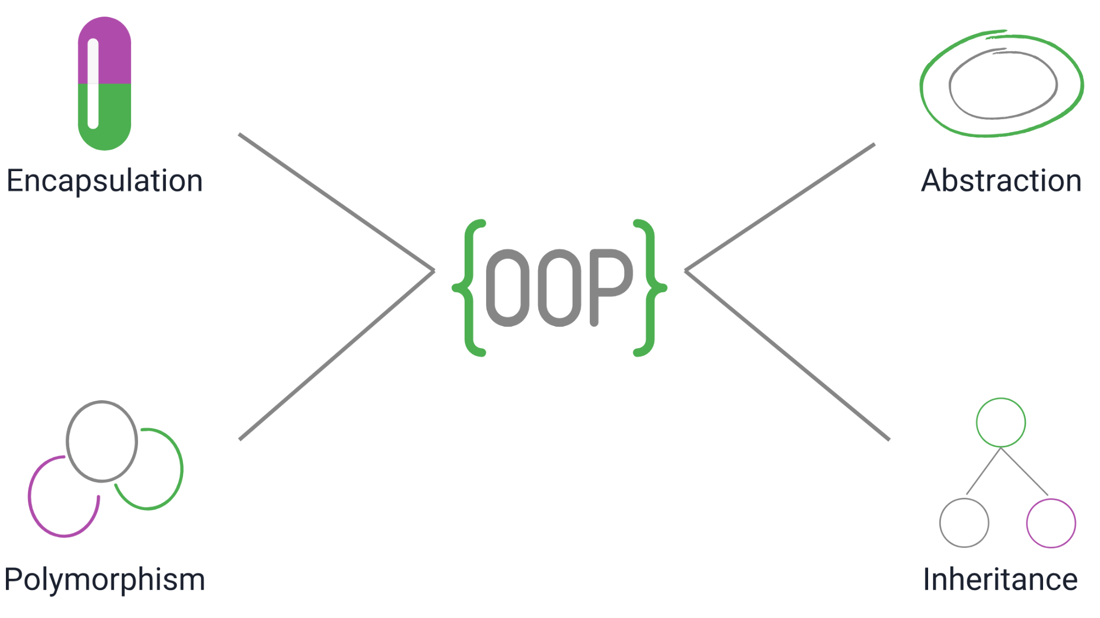
Four Main Principles in OOP

Slide 6
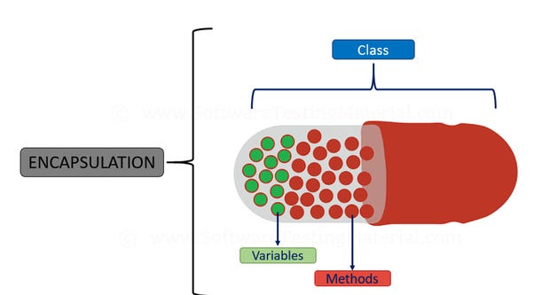
Principle 1: Encapsulation – What Is It?
Encapsulation is the bundling of data (variables) and methods (functions) that operate on that data into a single unit or class. It restricts direct access to some of the object's components to protect the integrity of the data.

Slide 7
Encapsulation in Java – How It Works
By declaring class variables as private and providing public getter and setter methods to access and modify the data. This ensures that any changes to the data happen in a controlled manner.
class BankAccount {
private double balance;
public void deposit(double amount) { ... }
public void withdraw(double amount) { ... }
public double getBalance() { return balance; }
}
Notes:
Key Points:
- Protects object integrity.
- Promotes controlled access.

Slide 8
Encapsulation – Why It Matters
Controlled Data Access
Data Protection
Easy Code Maintenance and Changes
Hiding Complex Internal Logic
Improved Flexibility for Future Changes
Preventing Invalid States
Notes:
Data Protection:
Encapsulation prevents direct access to an object’s internal data, safeguarding it from accidental or malicious modifications.
Controlled Data Access:
Encapsulation allows controlled access to object properties via getter and setter methods, ensuring data is modified in a consistent and predictable way.
Improves Code Maintainability:
Since implementation details are hidden, changes to the internal structure of a class do not affect other parts of the code, making systems easier to maintain and update.
Reduces Complexity:
By exposing only the necessary functionality to the outside world, encapsulation hides complex details, making the code easier to understand and use.
Increases Modularity:
Encapsulation helps in breaking down large systems into smaller, self-contained objects, each responsible for a specific functionality.
Enhances Flexibility:
Internal implementation can be modified without changing the external interface, allowing developers to improve or optimize the code while maintaining compatibility.
Improves Security:
Sensitive data is kept private and inaccessible from outside the class, reducing the risk of unintended exposure or security vulnerabilities.
Encourages the Use of Invariants:
By using setter methods to validate data, encapsulation ensures that objects remain in valid states and maintain class invariants.

Slide 9
Encapsulation – Why It Matters
class BankAccount {
private double balance; // Private access
public BankAccount(double initialBalance) { this.balance = initialBalance; }
public double getBalance() { return balance; }
public void deposit(double amount) {
if (amount > 0) {
balance += amount;
}
}
public void withdraw(double amount) {
if (amount > 0 && amount <= balance) {
balance -= amount;
}
}
}
Notes:
With encapsulation, balance is private, so it can’t be directly accessed or modified from outside.
Controlled access through getBalance(), deposit(), and withdraw() ensures balance is only modified in valid ways, improving security.

Slide 10
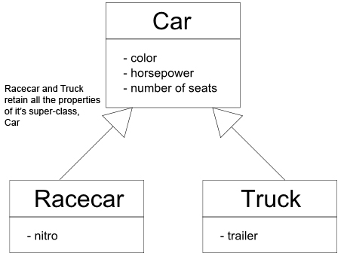
Principle 2: Inheritance – What Is It?
Inheritance allows a class (subclass) to acquire properties and behaviors (fields and methods) from another class (superclass). This establishes a parent-child relationship between classes.

Slide 11
Inheritance in Java – How It Works
The subclass can reuse the methods and fields of the superclass and even add new behaviors or override existing ones. It establishes an "is-a" relationship
class Vehicle {
protected String brand = "Ford"; // Vehicle attribute
public void honk() { System.out.println("Tuut, tuut!"); } // Vehicle method
}
class Car extends Vehicle {
public String modelName = "Mustang"; // Car attribute
}
public static void main(String[] args) {
Car myCar = new Car();
myCar.honk(); // Call the honk() method (from the Vehicle class) on the myCar object
// Display the value of the brand attribute (from the Vehicle class) and the value of the modelName (from the Car class)
System.out.println(myCar.brand + " " + myCar.modelName);
}

Slide 12
Inheritance – Why It Matters
Code Reusability
Creating a Class Hierarchy
Polymorphism
Improves Modularity
Notes:
Code Reusability: Share common logic among related classes.
Improved Organization: Structure code in logical hierarchies.
Polymorphism: Enable different behaviors for inherited methods in subclasses.
Reduced Redundancy: Avoid duplicating code by moving common functionality to a superclass.

Slide 13
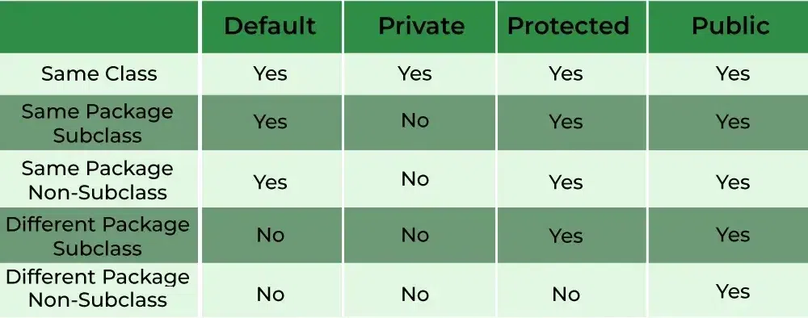
Inheritance – Access Modifier

Slide 14
Composition
Composition is a design principle where one class contains a reference to another class (a "has-a" relationship).
Allows building complex objects by combining simpler, reusable components.

Slide 15
Composition - Example
class Engine {
void start() { System.out.println("Engine starts"); }
}
class Car {
private Engine engine;
Car(Engine engine) { this.engine = engine; }
void startCar() {
engine.start(); // Delegates the start action to the Engine instance
System.out.println("Car is starting");
}
}

Slide 16
Composition - Why It Matters
Reusability: Easily reuse components across different classes.
Flexibility: Swap components at runtime (e.g., different engine types for a Car).
Loose Coupling: Reduces dependencies between classes, making code more maintainable.
Avoids Complex Hierarchies: Prevents deep inheritance chains and tight coupling.

Slide 17
Composition vs. Inheritance
Composition: "Has-a" relationship (e.g., a Car has an Engine).
Inheritance: "Is-a" relationship (e.g., a Dog is an Animal).
-> Composition is often more flexible and easier to maintain than inheritance.

Slide 18
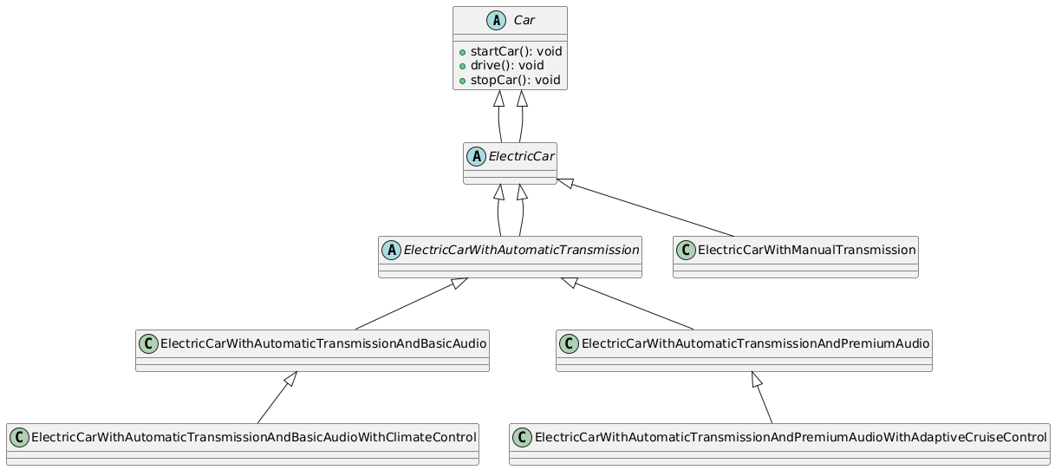
Inheritance Only

Slide 19
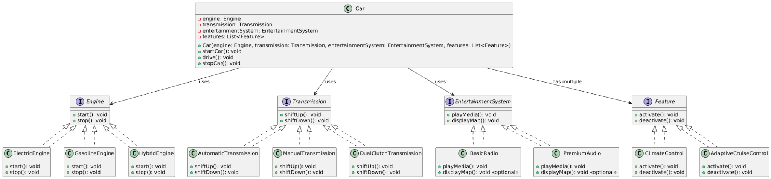
Improve with composition

Slide 20
Principle 3: Polymorphism – What Is It?
Polymorphism allows one interface to be used for a general class of actions, where a single method can perform different behaviors depending on the object that invokes it.

Slide 21
Polymorphism in Java – How It Works
Method Overloading: Multiple methods with the same name but different parameter lists within the same class.
Method Overriding: A subclass provides a specific implementation of a method that is already defined in its superclass.

Slide 22
Polymorphism in Java – Method Overriding
class Animal {
void sound() { System.out.println("Animal makes a sound"); }
}
class Dog extends Animal {
void sound() { System.out.println("Dog barks"); } // Overriding the sound method
}
class Cat extends Animal {
void sound() { System.out.println("Cat meows"); } // Overriding the sound method
}
public class Main {
public static void main(String[] args) {
Animal myDog = new Dog();
Animal myCat = new Cat();
myDog.sound(); // Outputs: Dog barks
myCat.sound(); // Outputs: Cat meows
}
}

Slide 23
Polymorphism in Java – Method Overloading
class MathOperations {
int add(int a, int b) { return a + b; }
int add(int a, int b, int c) { return a + b + c; }
double add(double a, double b) { return a + b; }
}
public class Main {
public static void main(String[] args) {
MathOperations math = new MathOperations();
System.out.println(math.add(5, 10)); // Calls the first add method
System.out.println(math.add(5, 10, 15)); // Calls the second add method
System.out.println(math.add(5.5, 10.5)); // Calls the third add method
}
}

Slide 24
Polymorphism – Why It Matters
Code Reusability
Dynamic Method Resolution
Simplified Code
Extensibility
Notes:
Code Reusability: Polymorphism allows for the reuse of code by enabling a single interface to represent different data types. This leads to more flexible and maintainable code.
Dynamic Method Resolution: It enables dynamic binding or late binding, where the method to be executed is determined at runtime based on the object type, allowing for more flexible and dynamic interactions.
Simplified Code: Polymorphism can reduce the complexity of the code by allowing the same method to operate on different objects, reducing the need for multiple conditionals or type checks.
Extensibility: It makes it easier to add new classes or functionalities without modifying existing code, as new classes can implement existing interfaces or extend base classes.
Improved Maintenance: With polymorphism, changes in code (like adding new classes) often require minimal changes to existing code, making maintenance easier and less error-prone.
Interface Implementation: Polymorphism facilitates the use of interfaces, allowing for multiple implementations and making it easier to switch implementations without changing the code that uses the interface.

Slide 25
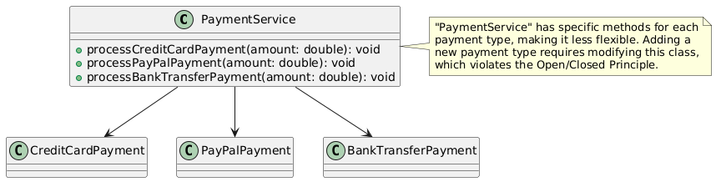
Without Polymorphism
Notes:
The note next to PaymentService highlights that having separate methods for each payment type reduces flexibility and violates the Open/Closed Principle. Adding new payment types requires modifying PaymentService, which makes maintenance more challenging as the code grows.

Slide 26
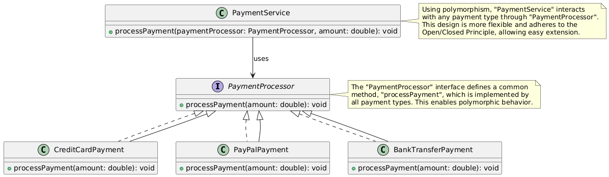
With Polymorphism
Notes:
The note next to PaymentService highlights that this approach is flexible and adheres to the Open/Closed Principle. Adding new payment types doesn’t require modifying PaymentService, as long as they implement PaymentProcessor.
The note next to PaymentProcessor explains that the interface defines a common processPayment method, enabling polymorphic behavior across different payment types.

Slide 27
Principle 4: Abstraction – What Is It?
Abstraction is the concept of hiding the complex implementation details of a system and exposing only the essential features. In Java, abstraction is achieved through abstract classes and interfaces.

Slide 28
Abstraction in Java – How It Works
Abstract Class: A class that cannot be instantiated directly and may contain abstract methods that must be implemented by subclasses.
Interface: A contract that defines a set of methods a class must implement without providing the implementation itself. A class can implement multiple interfaces

Slide 29
Abstraction in Java – Abstract Class Example
abstract class Shape {
// Abstract method (does not have a body)
abstract void draw();
// Concrete method
void display() { System.out.println("This is a shape"); }
}
class Circle extends Shape {
// Implementing the abstract method
void draw() {
System.out.println("Drawing a circle");
}
}

Slide 30
Abstraction in Java – Interface Example
interface Drawable {
void draw(); // Abstract method
}
class Circle implements Drawable {
public void draw() { System.out.println("Drawing a circle"); }
}
public class Main {
public static void main(String[] args) {
Drawable myCircle = new Circle();
myCircle.draw(); // Outputs: Drawing a circle
}
}

Slide 31
Abstraction – Why It Matters
Simplifies Code
Enhances Flexibility
Promotes Code Reusability
Improves Maintainability
Encourages Encapsulation
Notes:
Simplifies Code by hiding complexities.
Enhances Flexibility by allowing new implementations without modification.
Promotes Reusability through shared behaviors in abstract classes.
Improves Maintainability by isolating changes.
Encourages Encapsulation and supports design principles like the Open/Closed Principle.

Slide 32
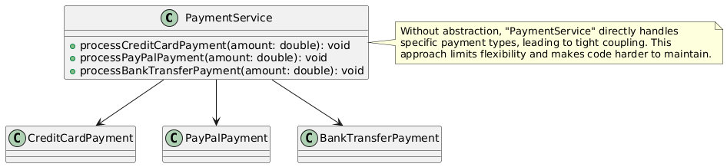
Without Abstraction

Slide 33
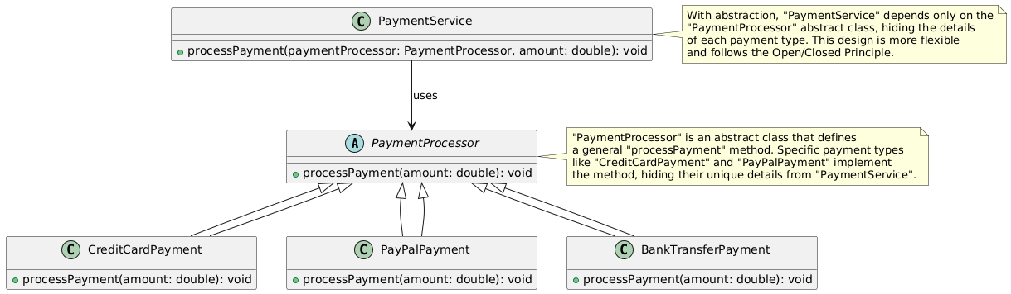
With Abstraction

Slide 34
OOP – Common Mistakes
Overusing Inheritance
Poor Encapsulation
Creating Large, Monolithic Classes
Tight Coupling Between Classes
Not Using Polymorphism Effectively
Notes:
1. Overusing Inheritance
Issue: Inheritance is often misused as the default way to share code, leading to deep inheritance hierarchies that are hard to understand and maintain.
Solution: Prefer composition over inheritance when possible. Use inheritance only when there’s a true “is-a” relationship.
2. Violating Encapsulation
Issue: Directly exposing internal data (public fields) or using too many getters and setters can break encapsulation, making classes hard to change without breaking dependent code.
Solution: Keep fields private and limit getters and setters. If a class’s internal state needs to change, provide methods that perform operations on that data rather than exposing it.
3. Creating Large, Monolithic Classes (God Objects)
Issue: Classes that try to do too much (often called "God objects") are difficult to maintain, test, and reuse.
Solution: Apply the Single Responsibility Principle (SRP). Split large classes into smaller, focused ones with a single purpose.
5. Ignoring Polymorphism
Issue: Relying on type-checking conditions (like if-else or switch statements for type checks) instead of polymorphism makes code less flexible and harder to maintain.
Solution: Use polymorphism to allow objects of different classes to be treated as objects of a common superclass. This lets you add new behaviors without modifying existing code.
6. Poor Understanding of SOLID Principles
Issue: Ignoring SOLID principles (Single Responsibility, Open/Closed, Liskov Substitution, Interface Segregation, Dependency Inversion) can lead to rigid, unscalable code.
Solution: Learn and apply SOLID principles to design classes that are more flexible, reusable, and easier to modify.
7. Tight Coupling
Issue: High dependency between classes means changes in one class may require changes in many others, reducing flexibility.
Solution: Use interfaces and dependency injection to promote loose coupling between classes.
9. Overloading Classes with Responsibilities (Lack of Separation of Concerns)
Issue: Mixing responsibilities (e.g., combining data access, business logic, and UI in a single class) makes code harder to maintain.
Solution: Separate concerns by breaking up responsibilities into different classes or layers, like MVC (Model-View-Controller) patterns.

Slide 35
OOP - Best Practices
Favor composition over inheritance
Use Interfaces and Dependency Injection
Encapsulation all fields
SOLID principles
Design Patterns
Notes:
Use Interfaces or Abstract Classes:
Define a common interface or abstract class for related classes. This promotes a consistent API and allows for flexibility in code implementation.
Favor Composition Over Inheritance:
Use polymorphism with composition to enhance flexibility and maintainability. This allows for behaviors to be composed rather than inherited.
Keep Methods Meaningful:
Ensure that polymorphic methods are logically similar and serve a related purpose. This makes the code easier to understand and maintain.

Slide 36
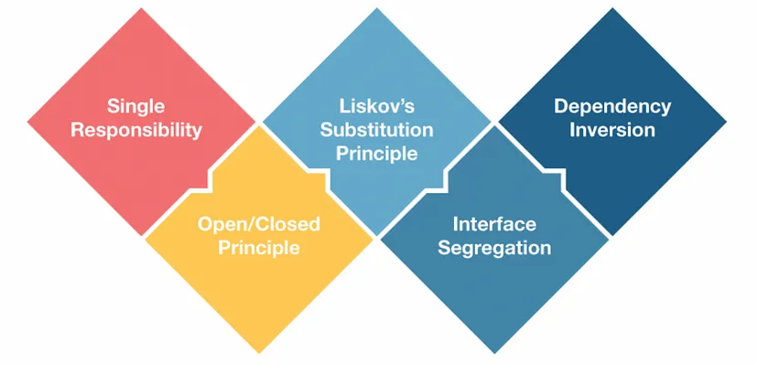
OOP - SOLID
Notes:
Use Interfaces or Abstract Classes:
Define a common interface or abstract class for related classes. This promotes a consistent API and allows for flexibility in code implementation.
Favor Composition Over Inheritance:
Use polymorphism with composition to enhance flexibility and maintainability. This allows for behaviors to be composed rather than inherited.
Keep Methods Meaningful:
Ensure that polymorphic methods are logically similar and serve a related purpose. This makes the code easier to understand and maintain.

Slide 37
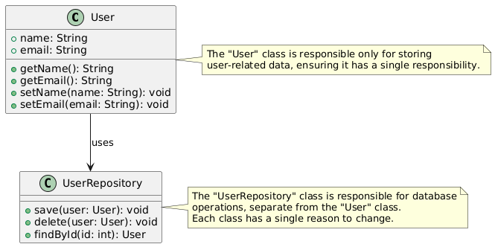
S - Single Responsibility Principle (SRP)
A class should have only one reason to change, meaning it should have only one responsibility.
Notes:
Explanation: A class should focus on one task or responsibility. If a class has multiple responsibilities, changes in one part of the code can lead to unexpected side effects in others, making the code harder to understand, maintain, and test.
Example: Suppose you have a User class that handles both user data and database operations. According to SRP, it would be better to separate these into User for the data and UserRepository for database operations.

Slide 38
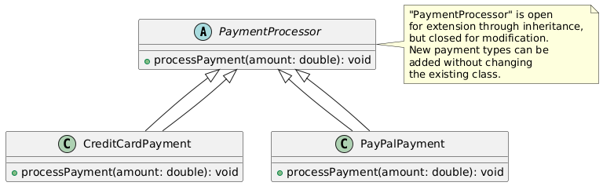
O - Open/Closed Principle (OCP)
Software entities (like classes, modules, and functions) should be open for extension but closed for modification.
Notes:
Explanation: This principle means you should be able to add new functionality to a class without changing its existing code. This helps prevent bugs and makes it easier to extend code without altering its core.
Example: Consider a PaymentProcessor class that processes payments for different payment methods (e.g., credit card, PayPal). Instead of modifying the PaymentProcessor class every time a new payment method is added, you can create new classes for each method that extend the PaymentProcessor.

Slide 39
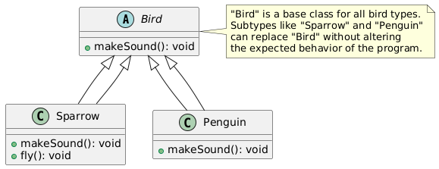
L - Liskov Substitution Principle (LSP)
Subtypes should be substitutable for their base types.
Notes:
Explanation: If a class B is a subclass of class A, it should be replaceable for A without the program failing or behaving unexpectedly. This ensures that the derived class enhances or maintains the behavior expected by its base class.
Example: If you have a Bird class with a fly() method and then create a Penguin class that inherits from Bird but cannot fly, this would violate LSP. Instead, you might use an interface for FlyingBird and apply it only to birds that can actually fly.

Slide 40
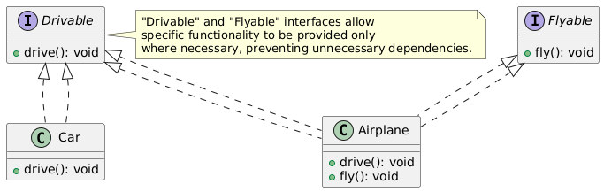
I - Interface Segregation Principle (ISP)
A client should not be forced to depend on methods it does not use.
Notes:
Explanation: This principle suggests creating smaller, specific interfaces rather than large, general-purpose ones. Classes should only implement methods that are relevant to them, preventing unnecessary dependencies.
Example: If you have a Vehicle interface with drive() and fly() methods, classes that don’t fly (e.g., Car) should not be forced to implement fly(). Instead, separate interfaces like Drivable and Flyable can be created and implemented only by relevant classes.

Slide 41
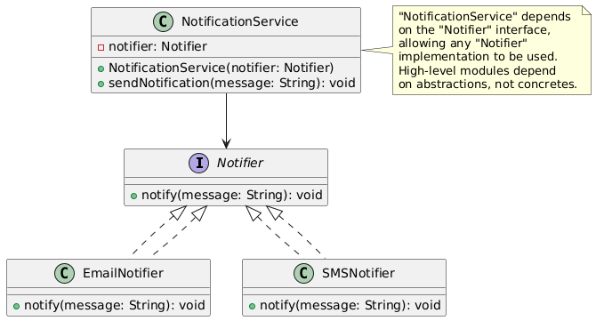
D - Dependency Inversion Principle (DIP)
High-level modules should depend on abstractions, not concrete implementations.
Notes:
Explanation: This principle emphasizes the importance of depending on abstractions (interfaces) rather than concrete implementations. This approach reduces tight coupling and makes code more modular and testable.
Example: If you have a NotificationService that sends notifications via email, you can create an interface Notifier with an notify() method, and then create different implementations like EmailNotifier or SMSNotifier. The NotificationService can use Notifier as an abstraction, making it easy to switch between different notification types.

Slide 42
Benefits of Applying SOLID Principles
Improved readability and maintainability
Easier to test individual components
Increased flexibility for future changes
Enhanced code reusability
Notes:
Improved Readability: By structuring code around single responsibilities, abstraction, and proper modularization, the resulting code becomes easier to read and understand.
Ease of Maintenance: With clearly defined responsibilities and dependencies, changes and bug fixes are easier to implement without affecting unrelated parts of the codebase.
Enhanced Testability: Independent and focused classes are easier to isolate for unit testing.
Reusability: By creating classes and methods that serve single purposes, you make them reusable across different parts of your application.

Slide 43
Demo

Slide 44
OOP – Conclusion
While Java OOP offers many powerful tools for building scalable, maintainable software, it’s not a universal solution. The choice of programming paradigm (OOP, procedural, functional, etc.) should be based on the specific problem, team expertise, and project requirements. In many cases, combining multiple paradigms may yield the best results.

Slide 45
Q&A

