Slide 1
US Housing Market Trends and Amenities
Team Members: Anand Sharan, Alanna Javier, Donna Tigrett, and Elizabeth Koehler

Slide 2

The Goal
We wanted to create a database that would provide information on the housing market trends in a particular area, as well as provide information about the nearby businesses and amenities.

Slide 3
Data Sources
Zillow Home Value Index (ZHVI) Timeseries Datasets
Yelp Business Search API
Yelp Business JSON API

Slide 4

Zillow Dataset
We downloaded seven .csv files directly from Zillow’s website.
There was a separate file for each type of home:
Single-family residences
Condo/Co-Op
1 Bedroom
2 Bedroom
3 Bedroom
4 Bedroom
5+ Bedroom

Slide 5

Yelp Business Search API
The Yelp Business Search API returns up to 1000 businesses base on search criteria and basic information about the business
Option filters can also be applied, and the user has the option to sort the responses in a particular way
The following parameters can be searched on:
Term
Location
Latitude
Longitude
Radius
Categories
Locale
Price
Whether or not it is currently open
What time it opens

Slide 6
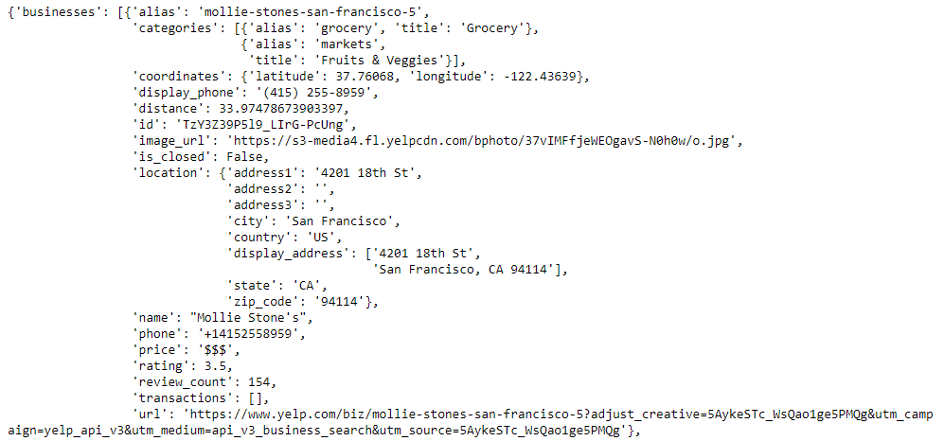
Sample API Response

Slide 7

The Yelp Academic Business JSON Dataset
This dataset provides comprehensive view of a subset of businesses in the Yelp database

Slide 8
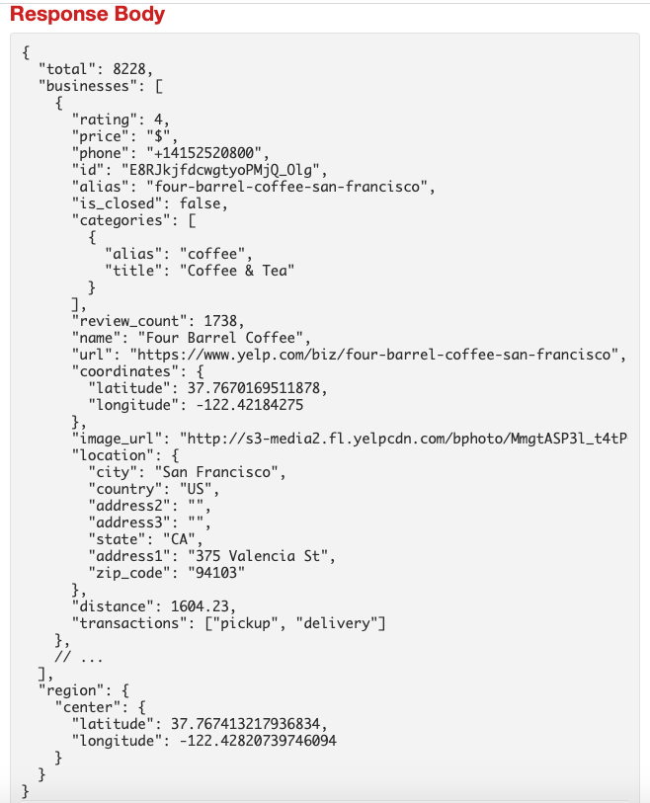
Sample JSON Data

Slide 9

Extract Transform and Load Process
Python and Pandas
Mongo DB
Data Sources
ETL with Pandas
data_etl_db
Zillow .csv Files
homes Collection
Yelp business search API
yelp Collection
Yelp business JSON File
yelp_business Collection

Slide 10
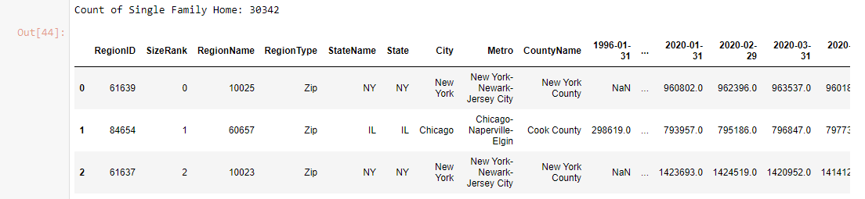
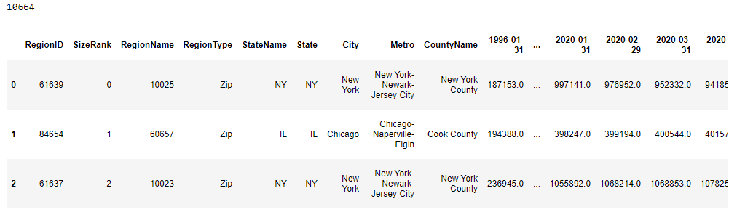
ETL process to load Zillow .csv Files
Extract
Store each of the 7 Zillow .CSV into Pandas Data Frames using pd.read_csv( filepath/filename) function
Add Home-Type Column in each of the 7 Zillow Data Frames ( e.g. “Single Family Home” )
Output 2
Validate number of homes in each of the 7 Zillow Data Frames ( Count(Single Family Home))
Output 1
Combine each of the 7 Zillow Data Frames into One Combined Pandas Data Frames ( combined_zip_zhvi_homes_time_series_df )
Validate the total number of homes in each of the 7 Zillow Data Frames is same as the total of homes in individual dataset

Slide 11
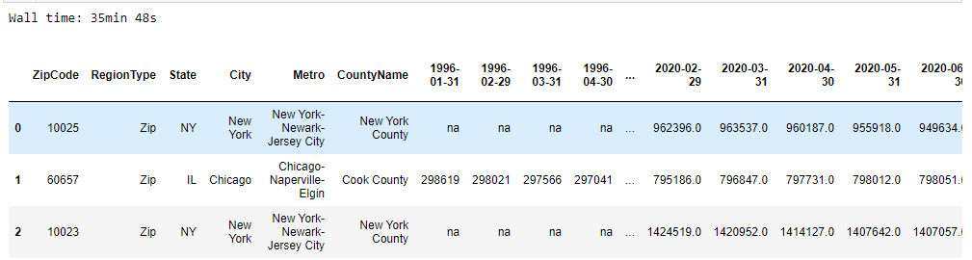
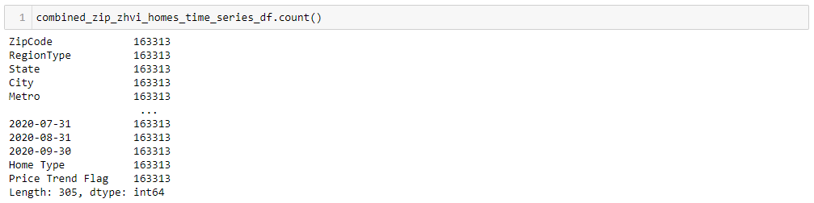
ETL process to load Zillow .csv Files
Transform
Clean Combined Data Frame: Drop columns Region ID, Sizerank, StateName
Output 2
Output 1
Rename columns: RegionName to ZipCode
Clean NaN Values by replacing NaN with 'na'
Add Price Trend Flag
Validate the total number of homes in each of the 7 Zillow Data Frames is same as the total of homes in individual dataset

Slide 12
ETL process to load Zillow .csv Files
Load
Connect to local database
Validate the pymongo results object was created in jupyter notebook
Output
Define data_etl_db database and homes collection
Load the combined dictionary into Mongo DB using insert_many()
Validate the total number of homes in each Combined Zillow with the data count in Mongo DB
Delete all existing records from homes collection
Convert the Combined Zillow Pandas Data Frames ( combined_zip_zhvi_homes_time_series_df ) to a dictionary ( combined_zip_zhvi_homes_time_series_dict )

Slide 13
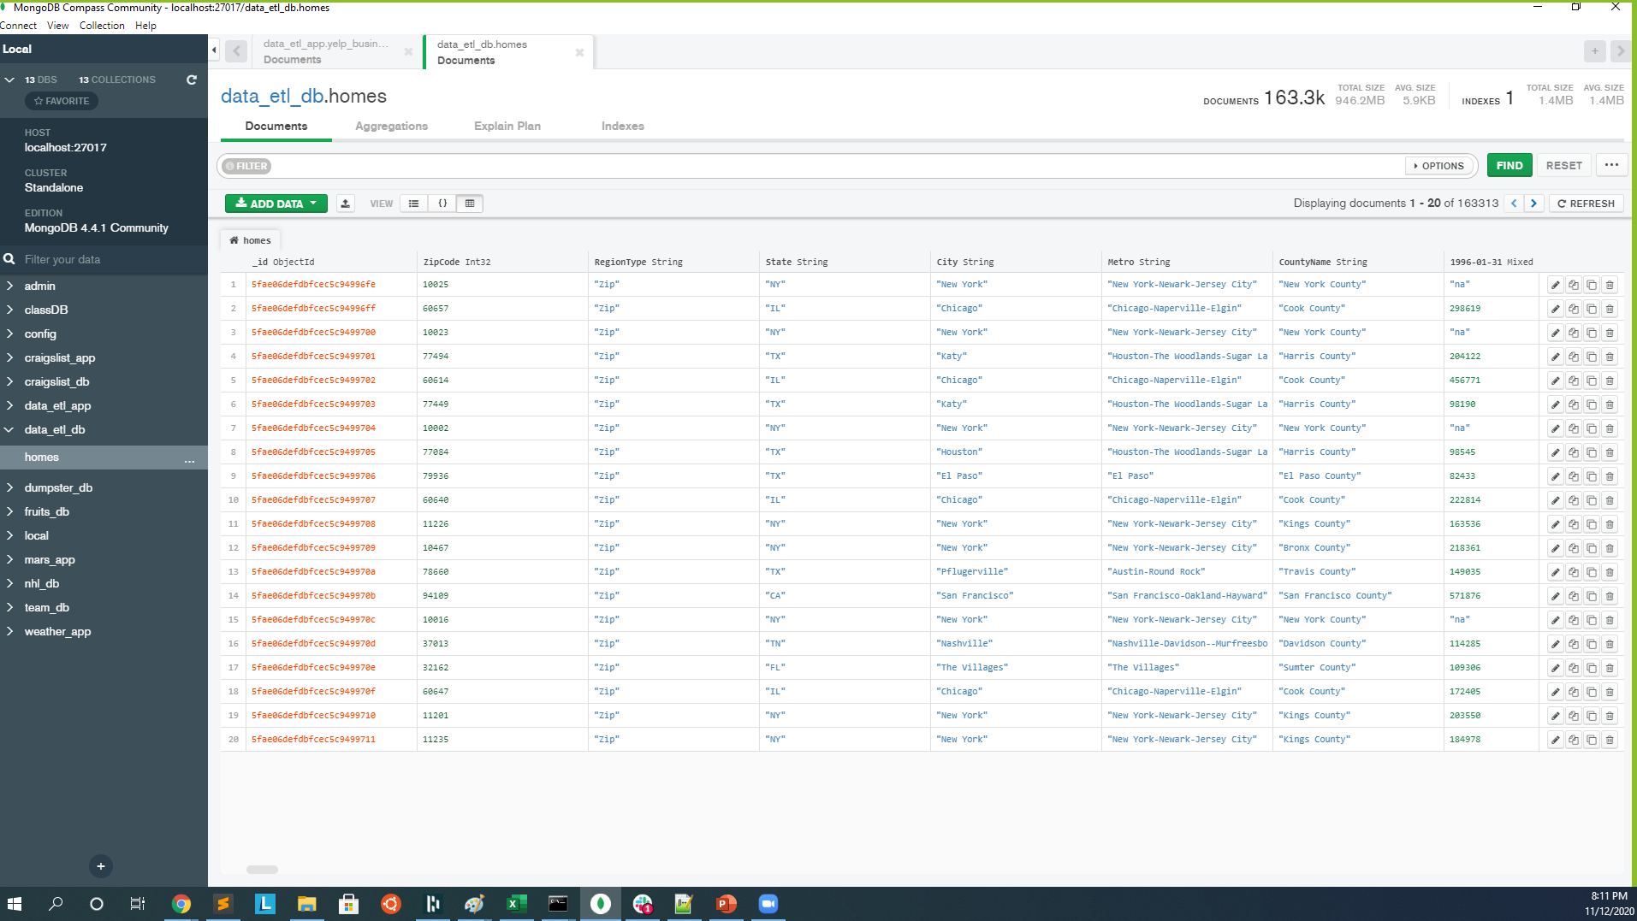

Zillow .csv Files Data output in Mongo DB
Query Homes Collection

Slide 14
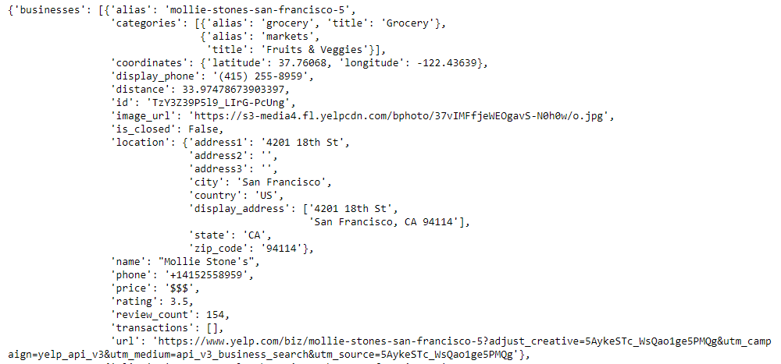
ETL process to load Yelp Fusion API
Extract
Create a yelp Fusion API instance and import the API key
Fill in parameters for term, location, search_limit and category
Output
Validate python dict object is created in jupyter notebook, and pretty print output of response object and check total number of results returned.

Slide 15
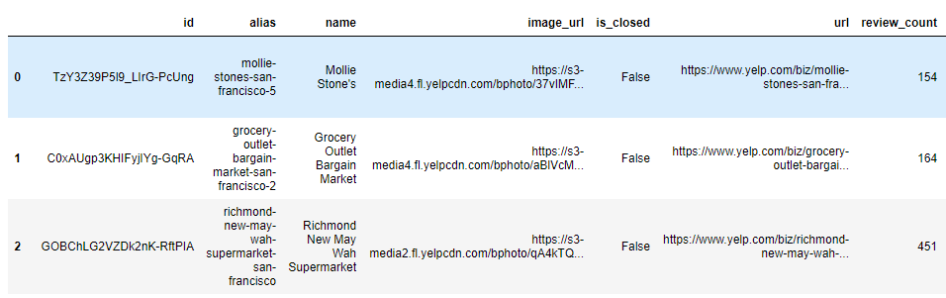
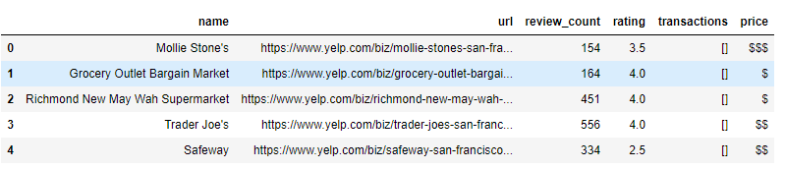
ETL process to load Yelp Fusion API
Transform
Check key of response dictionary ( dict_keys(['businesses', 'total', 'region’]) )
Output 2
Output 1
Set list of keys as column names
Create a Data Frame and loop through each businesses in the response and append to the dataframe
Create new dataframe with [id, name, url, review_count, rating, transactions and price]

Slide 16
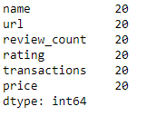
ETL process to load Yelp Fusion API
Load
Connect to local database
Validate the pymongo results object was created in jupyter notebook
Output 2
Define data_etl_db database and yelp_api collection
Load the combined dictionary into Mongo DB using insert_many()
Validate the total number of business in the data frame with the data count in Mongo DB
Delete all existing records from yelp_api collection
Convert the yelp new data frame to dictionary object
Output 1
Validate count of records in the Yelp api data frame

Slide 17
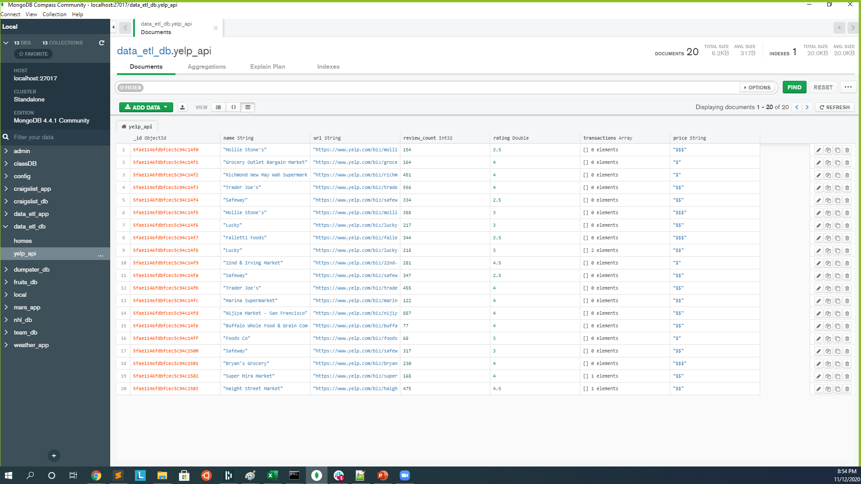
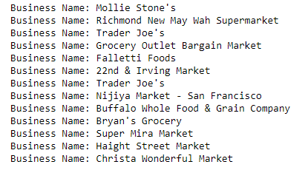
Yelp Fusion API Data output in Mongo DB
Query yelp_api Collection
Rating between 3.0 and 5.0

Slide 18
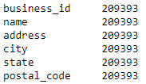
ETL process to load Yelp json file
Extract
Download Yelp academic dataset from Yelp
Output
Tar the file to uncompress Yelp academic dataset
Use read_json() to load only the Yelp academic dataset business dataset
Validate the count of businesses in the Yelp academic dataset business dataset

Slide 19
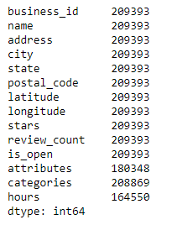
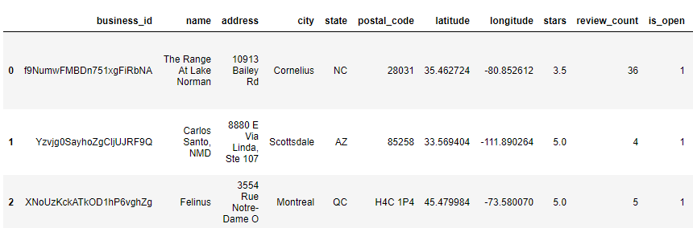
ETL process to load Yelp Fusion API
Transform
Open the Yelp academic data set using format Codepage 437 is the original DOS encoding and read each line.
Output
Remove the trailing "\n" from each line and create a combined string of the json dataset
Load the combined json string dataset into pandas dataframe

Slide 20
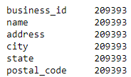
ETL process to load Yelp Fusion API
Load
Connect to local database
Validate the pymongo results object was created in jupyter notebook
Output 2
Define data_etl_db database and yelp_business collection
Load the combined dictionary into Mongo DB using insert_many()
Validate the total number of business in the data frame with the data count in Mongo DB
Delete all existing records from yelp_business collection
Convert the yelp business data frame to dictionary object
Output 1
Validate count of records in the Yelp business data frame

Slide 21
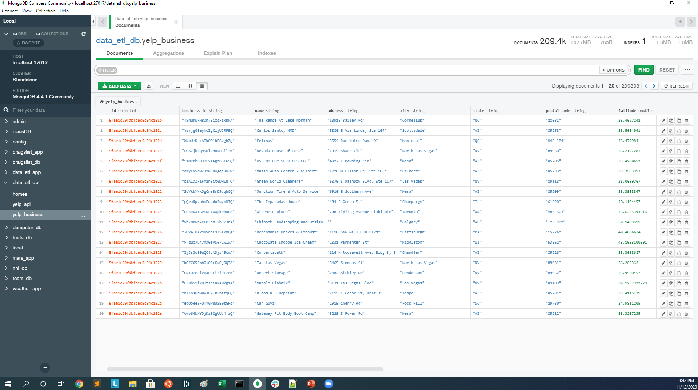
Yelp JSON Data output in Mongo DB
Query yelp_business Collection

Slide 22
Why Mongo DB?
Agility
In MongoDB, the structure of the data doesn’t have to be planned up front in the database and it is much easier to change.
MongoDB is adept at handling data structures generated by modern applications and APIs.
The structure of many different forms of data is more easily handled and evolved with a NoSQL database.
High performance both for ingesting data and for delivery in a timely manner.
Notes:
For this project Mongo was utilized due to its agility since the data was generated from a Yelp API, Yelp Json files, and Zillow US housing market time series data sets. Mongo was also used since we wanted to see if prices were trending up or down so the data needed to be taken in and delivered in a timely manner. Another reason was that we could define the structure of a JSON document, do some development, see how it goes, add new fields at any time and reshape data at will. Another reason we used Mongo was that the structure of the data didn’t have to be planned up front in the database and it is much easier to change. MongoDB is also better at handling data structures generated by modern applications and APIs

Slide 23
Why Mongo DB?
Mongo DB supports widely used data formats
Big Data of all kinds -- text data as well as time-series data
JSON files. This format can capture highly complex parent-child hierarchical structures, which can be efficiently stored in document databases
Big Data needs to be ingested into a repository where it can be stored and easily accessed. Most Big Data is unstructured, it ill-suited for traditional relational databases, which require data in tables-and-rows format.
Transforming unstructured data to conform to relational-type tables and rows would require massive effort.
Notes:
We had very large data sets: Zillow US housing market as well as Yelp information for businesses. Mongo was a better suited DB for this task otherwise transforming the data to conform to relational type tables and rows would have been much more effort and time.

Slide 24
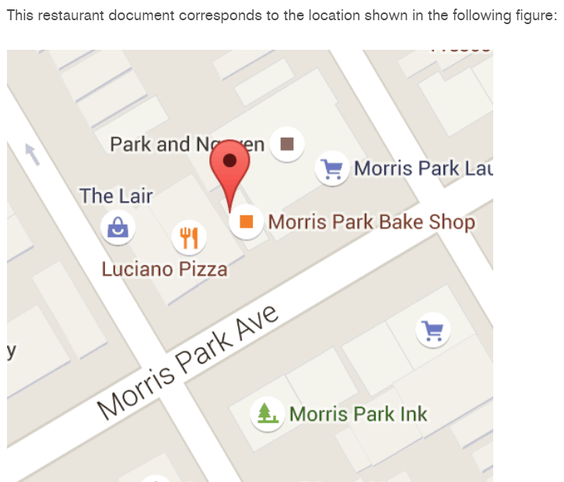
Potential Next steps to use Data Base
Develop a mobile app to enable users to make a geospatial query from the Database for restaurants.
MongoDB’s geospatial indexing would allow to efficiently execute spatial queries on a collection that contains geospatial shapes and points.

Slide 25
Thank you
Notes:
We had very large data sets: Zillow US housing market as well as Yelp information for businesses. Mongo was a better suited DB for this task otherwise transforming the data to conform to relational type tables and rows would have been much more effort and time.

