Slide 1
Lightning Talk
By Dianna Tingg

Slide 2
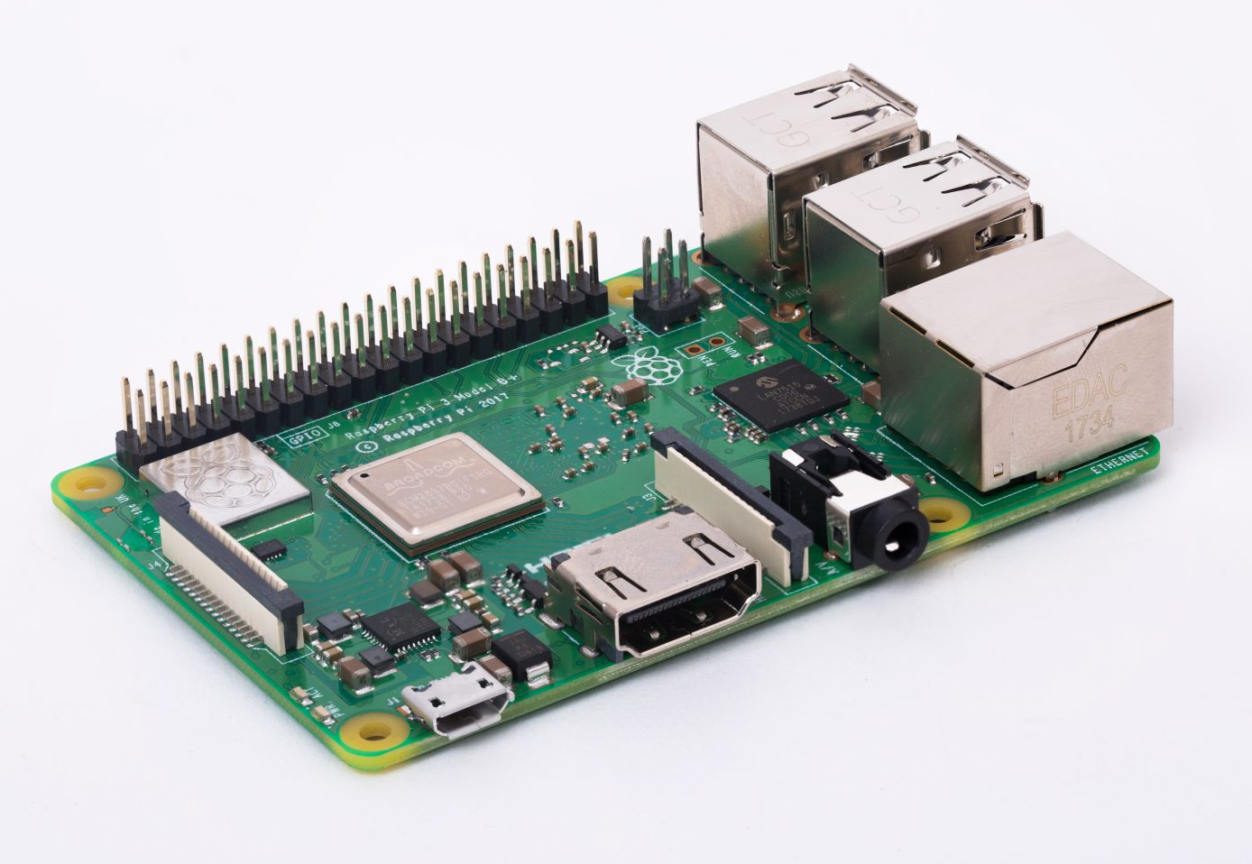

Raspberry Pi
Model 3 B+

Slide 3
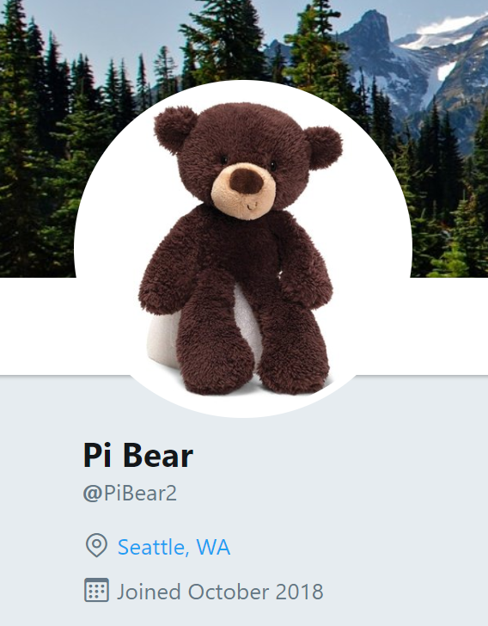
twitter.com/PiBear2

Slide 4
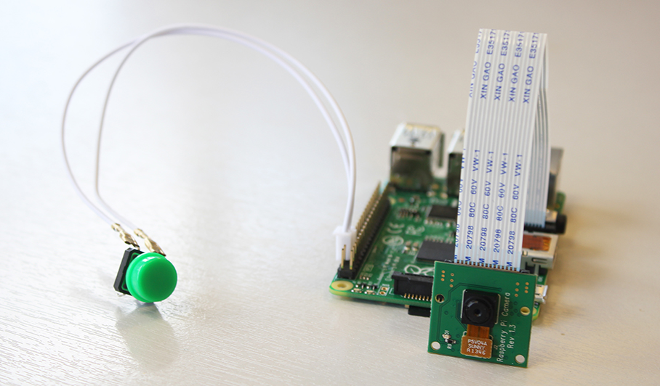

Slide 5

Twitter Setup
Create a Twitter account
Apply for a Twitter Developer Account (developer.twitter.com)
Register your App
Receive Consumer API keys and Access Tokens

Slide 6
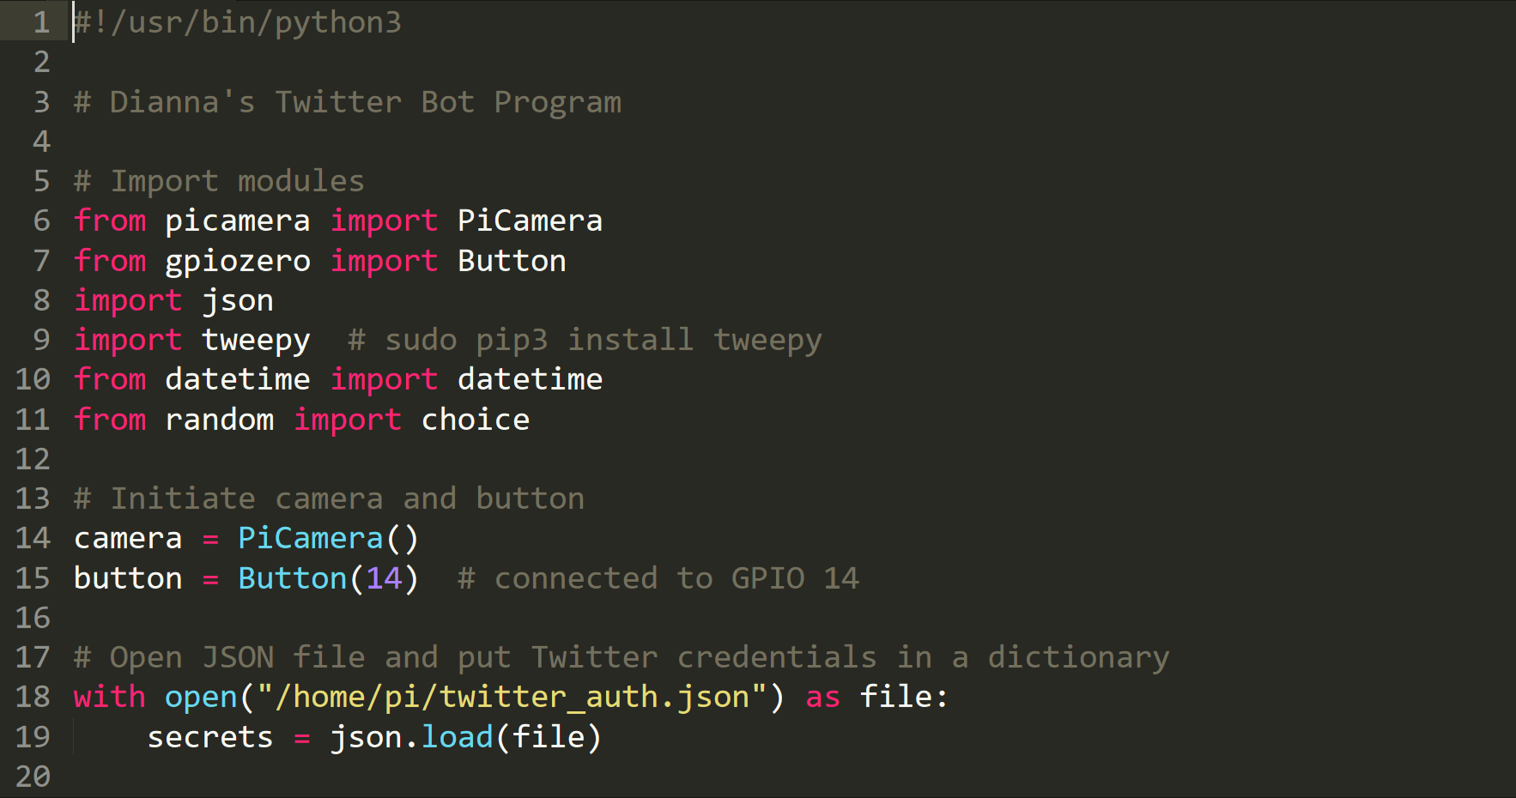

Slide 7
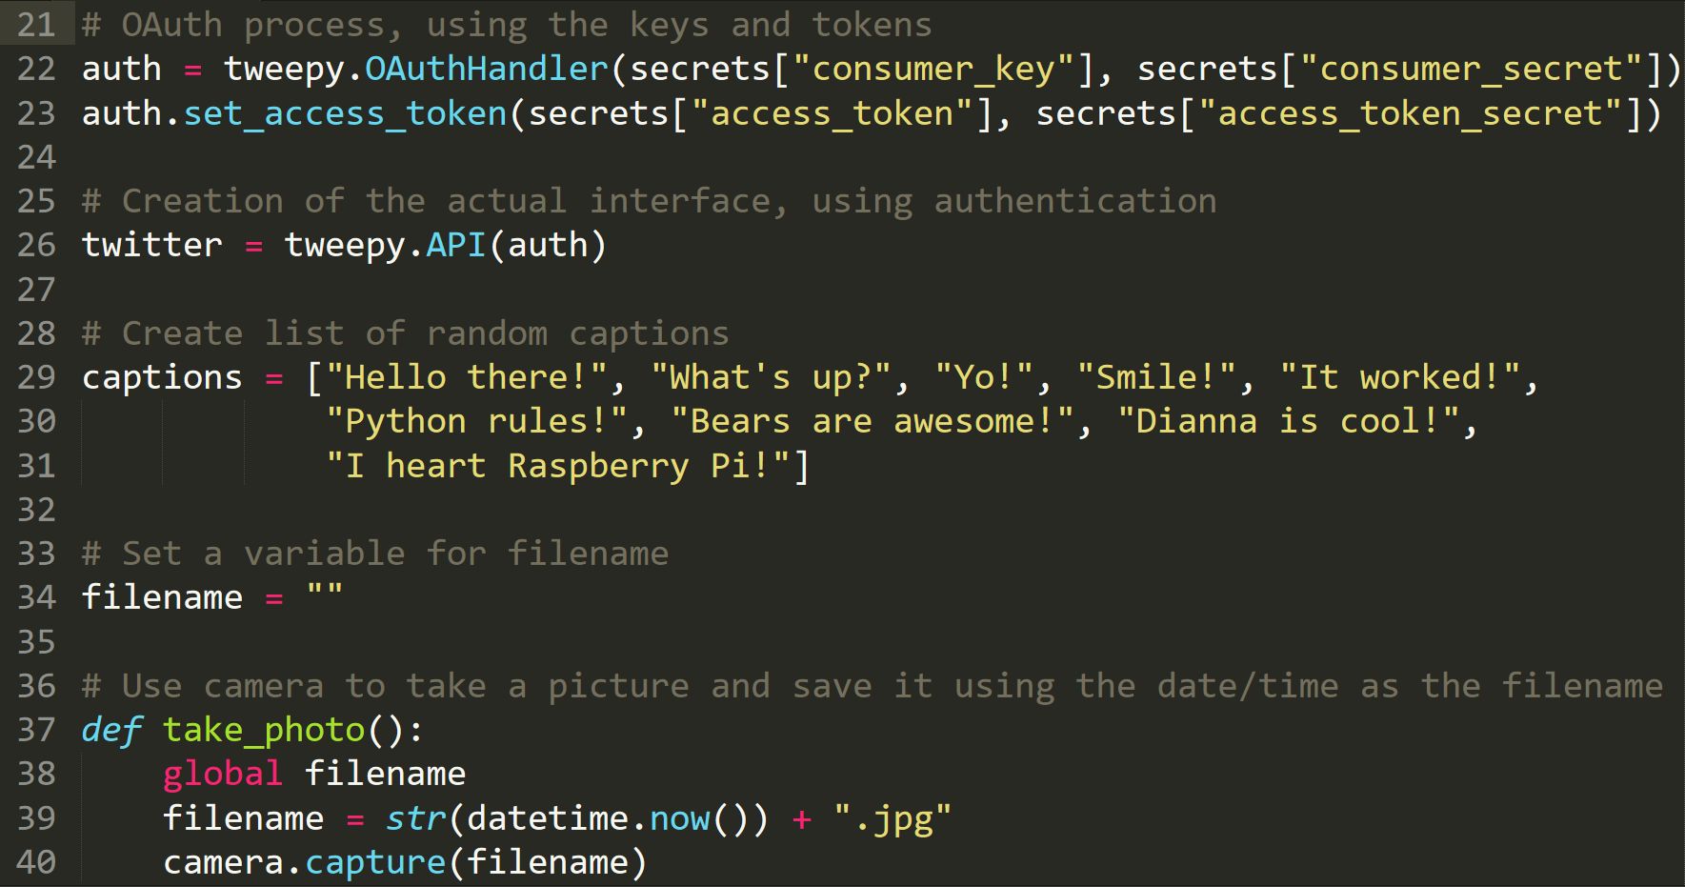

Slide 8
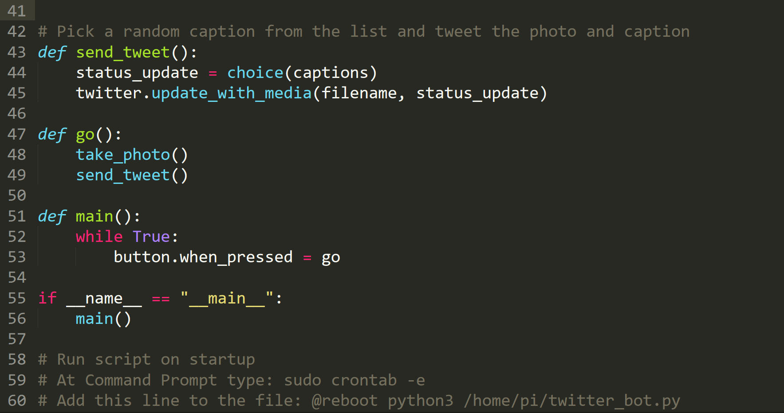

Slide 9
Resources
Raspberry Pi Foundation Official Site
www.raspberrypi.org
The MagPi Official Magazine
www.raspberrypi.org/magpi-issues/MagPi75.pdf

