Slide 1



Analysis of the energy sustainability of Machine Learning algorithms
Students:
Yin Jun
Tutors:
Prof. Meo Michela
Prof. Vallero Greta
First presentation
23/10/2023

Slide 2
Agenda
Last time
Simulation results
Next step

Slide 3
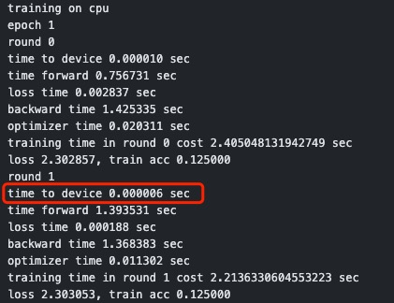
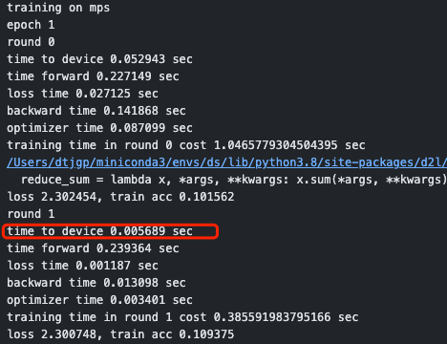
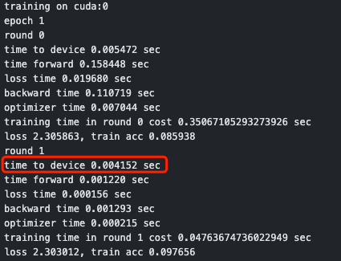
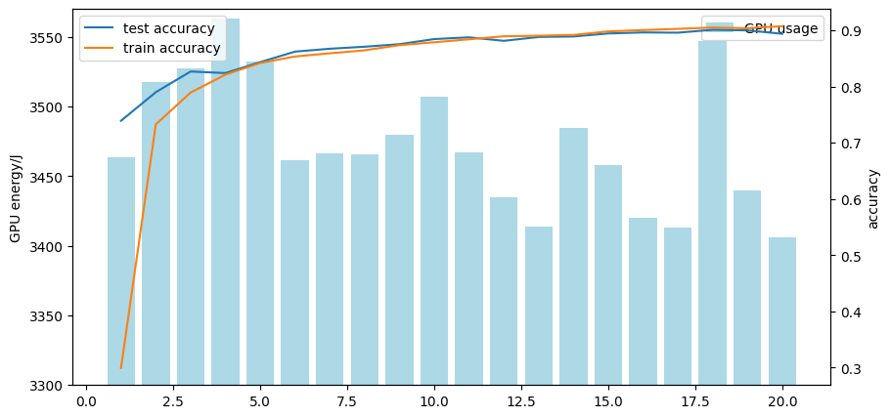
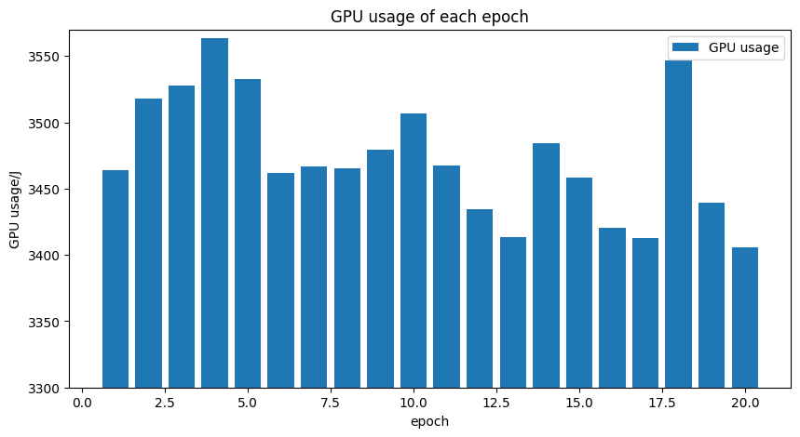
Last time
1.to_device() time
Training on cpu
Training on mps
Training on gpu
GPU energy consumption, train acc and test acc of each epoch
GPU energy consumption of epoch(total 20 epochs)
Multi epoch result

Slide 4
Agenda
Last time
Simulation results
Next step

Slide 5
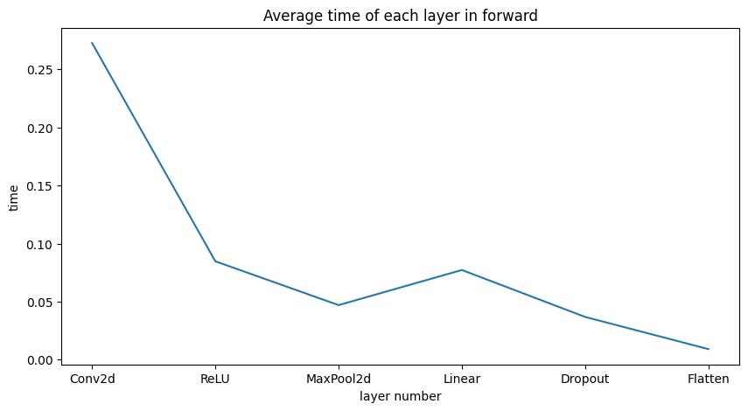
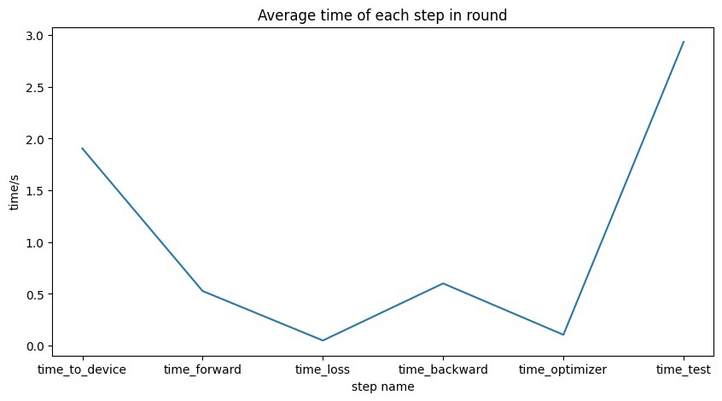
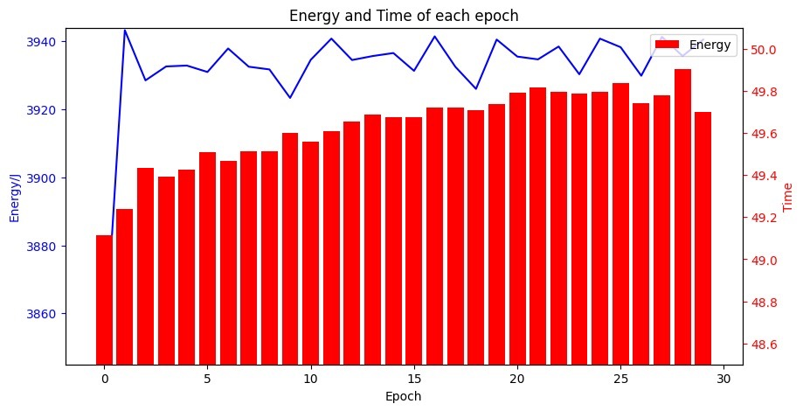
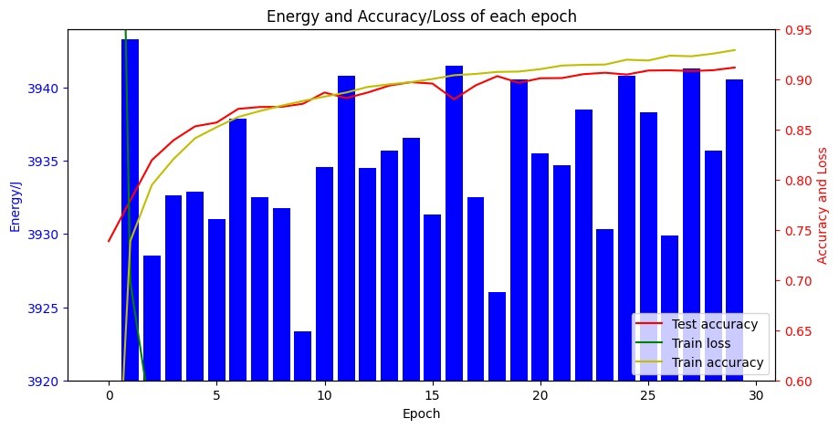
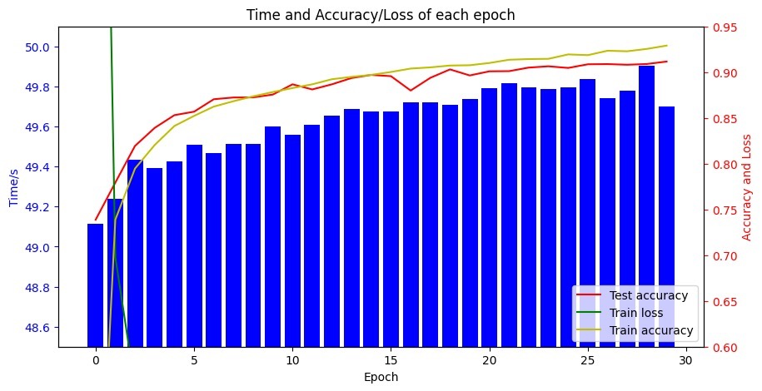
Simulation results
Optimizer: SGD
Mean energy: 3932J/epoch
nvidia-smi --query-gpu=power.draw --format=csv --loop-ms=1000 > gpu_power_usage.csv

Slide 6
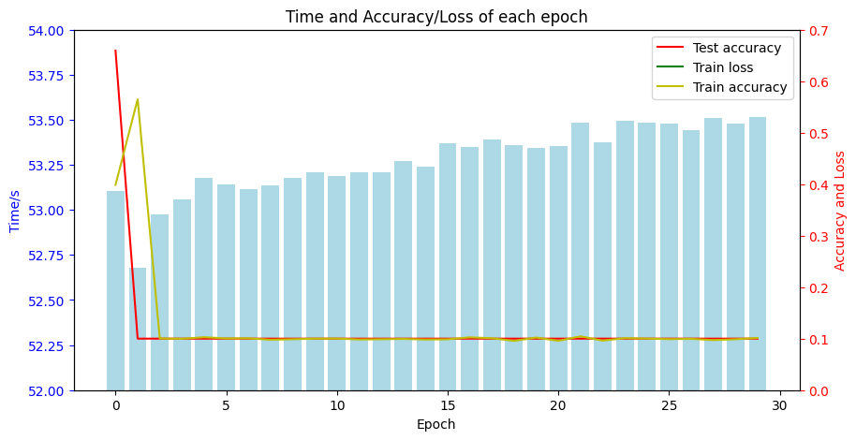
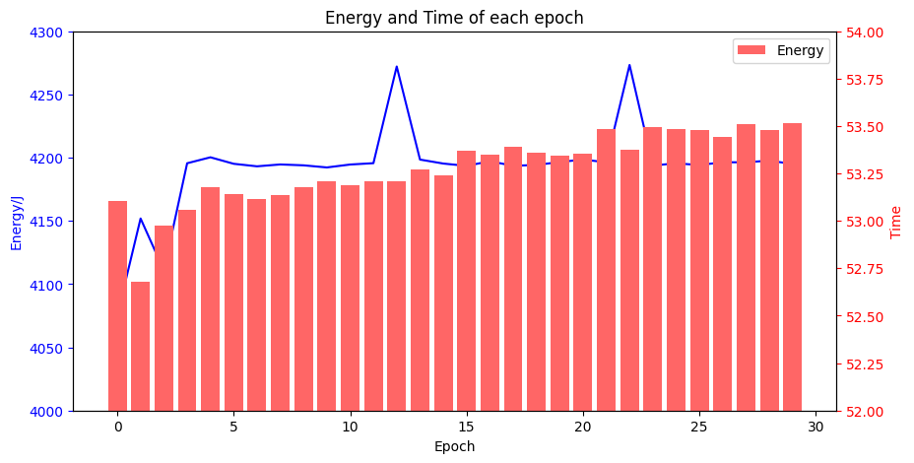
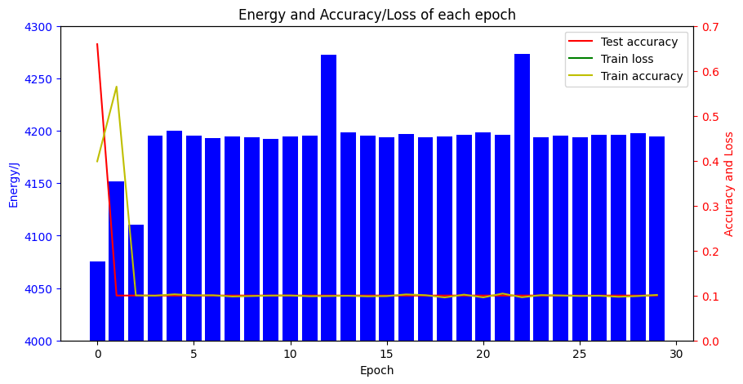
Simulation results
Optimizer: Adam
Mean energy: 4192J/epoch

Slide 7
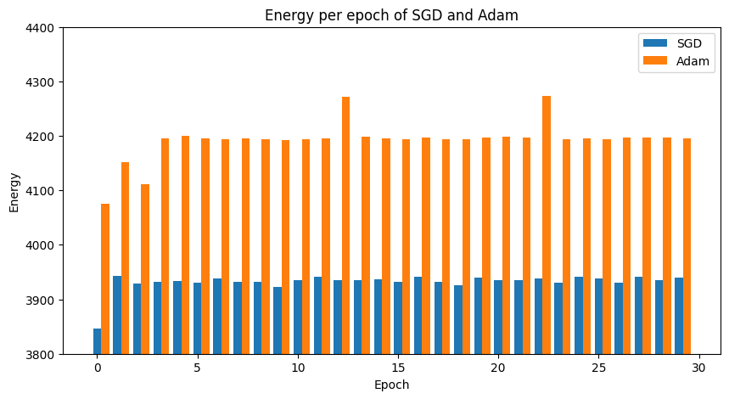
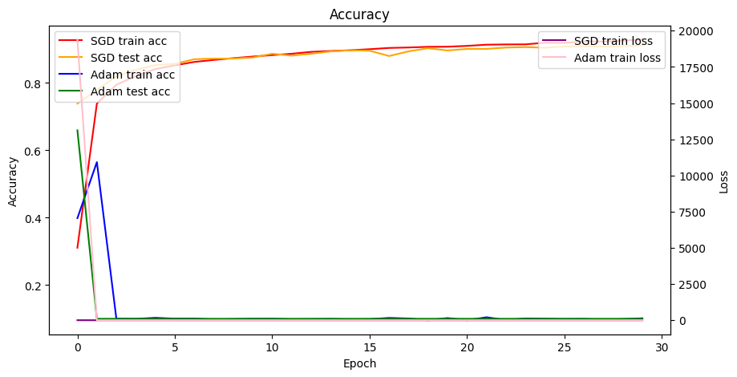
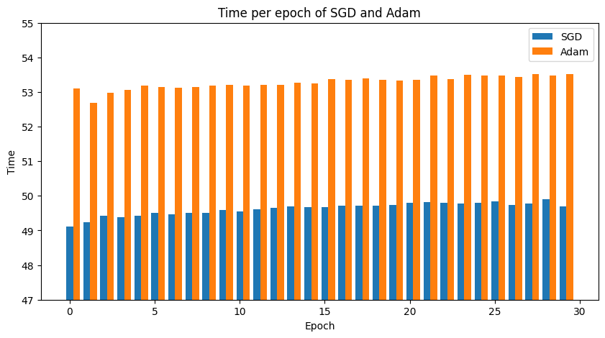
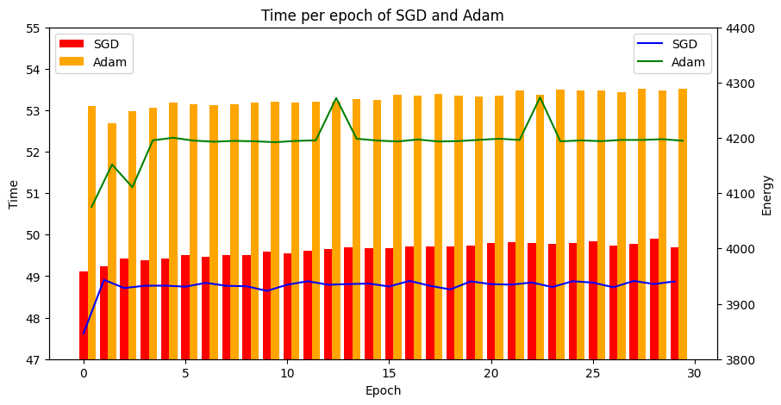
Simulation results
Optimizer: comparison between SGD & Adam
GPU energy consumption
train acc, test acc, train loss of SGD and Adam
Time consumption of each epoch between SGD and Adam
Energy consumption and time cost between SGD and Adam

Slide 8
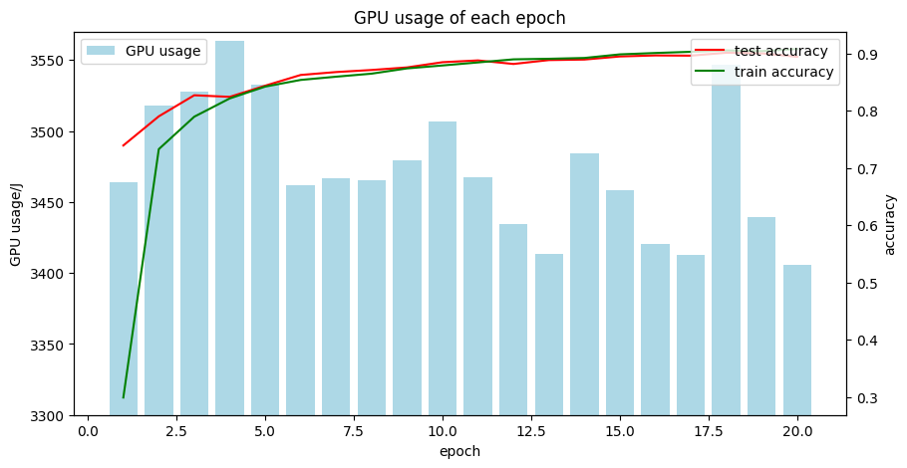
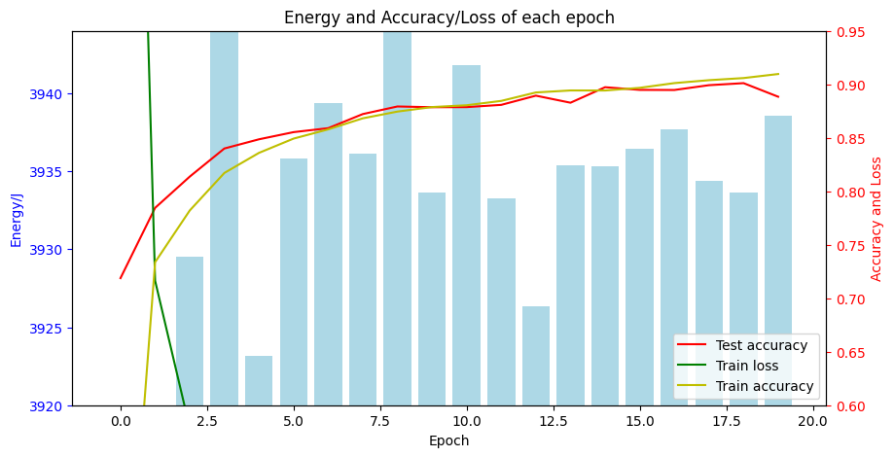
Simulation results
Energy consumption between mps and GPU
MPS energy consumption in M1
GPU energy consumption in Linux(with RTX 3060)

Slide 9
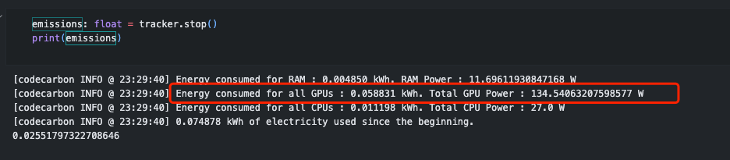
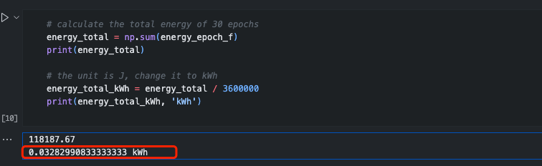
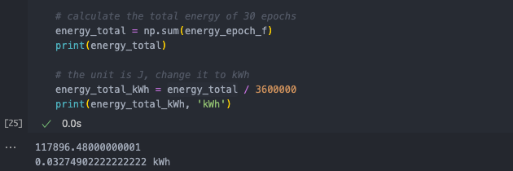
Simulation results
Energy record between codecarbon and nvidia-smi
Codecarbon result
Nvidia-smi result

Slide 10
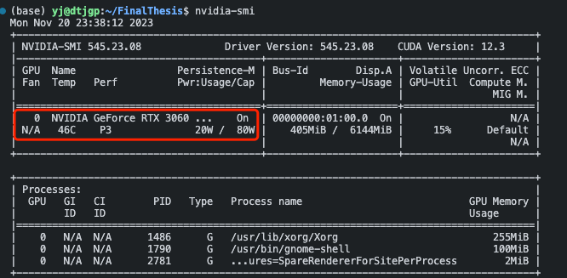
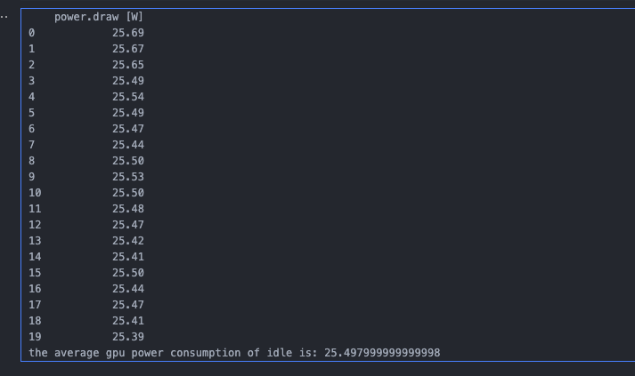
Simulation results
The avg GPU power of all epochs is 78.65W, the codecarbon result is 120.88W
The GPU energy consumption calculated by nvidia-smi is 0.03275kWh, and 0.05915kWh by codecarbon
Ratio between power result is 78.65/130 = 0.6506
Ratio between energy consumption result is 0.03275/0.05915 = 0.5537
Idle consumption
For GPU energy consumption, concerning the current device that using, codecarbon might not be the best choice

Slide 11
Agenda
Last time
Simulation results
Next step

Slide 12
Next step
1. Validate CPU energy consumption
2. Federated Learning

Slide 13
Thanks

