Slide 1



Analysis of the energy sustainability of Machine Learning algorithms
Students:
Yin Jun
Tutors:
Prof. Meo Michela
Prof. Vallero Greta
First presentation
23/10/2023

Slide 2
Agenda
Last time
Simulation results

Slide 3
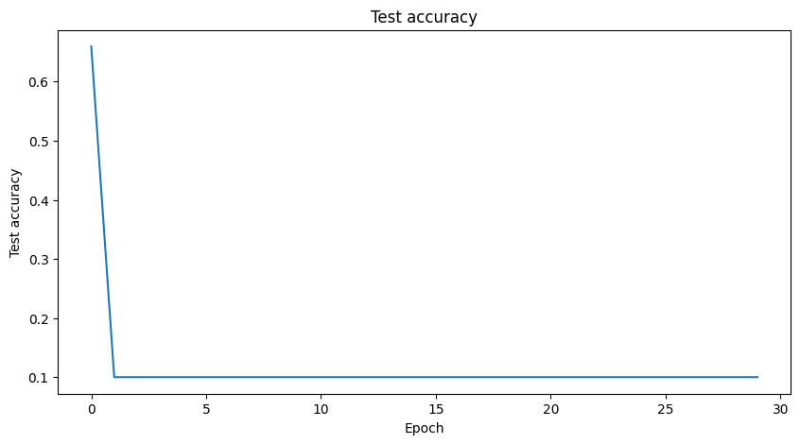
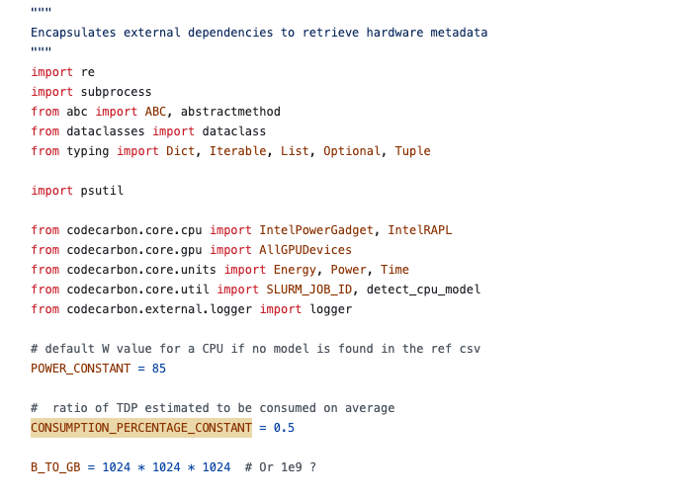
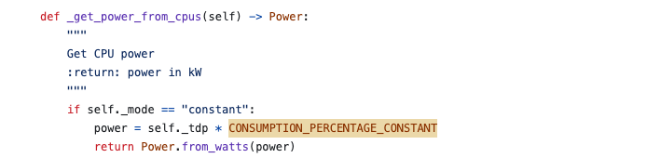
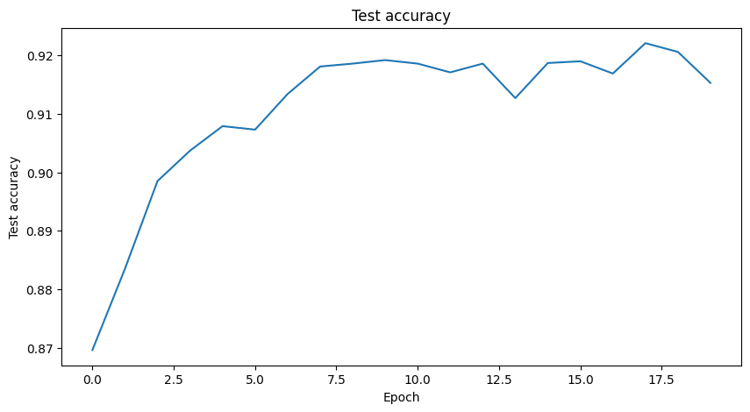
Last time
1. CPU power validation
2. Accuracy in Adam optimizer
Learning rate = 0.01
Learning rate = 0.001

Slide 4
Agenda
Last time
Simulation results

Slide 5
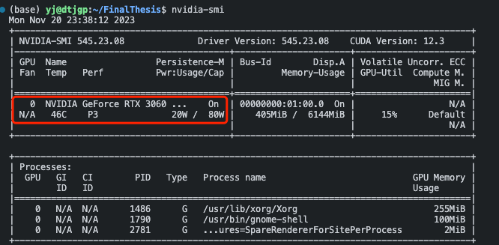
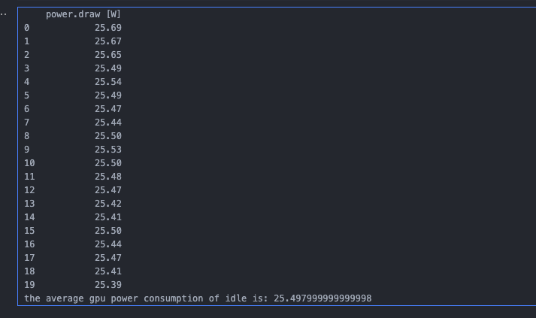
Simulation results
The avg GPU power of all epochs is 78.65W, the codecarbon result is 120.88W
The GPU energy consumption calculated by nvidia-smi is 0.03275kWh, and 0.05915kWh by codecarbon
Ratio between power result is 78.65/130 = 0.6506
Ratio between energy consumption result is 0.03275/0.05915 = 0.5537
Idle consumption
For GPU energy consumption, concerning the current device that using, codecarbon might not be the best choice

Slide 6
Thanks

