Slide 1



Analysis of the energy sustainability of Machine Learning algorithms
Students:
Yin Jun
Tutors:
Prof. Meo Michela
Prof. Vallero Greta
First presentation
23/10/2023

Slide 2
Agenda
Last time question
Simulation results

Slide 3
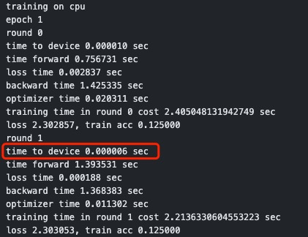
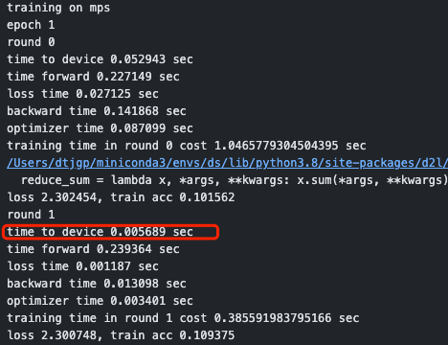
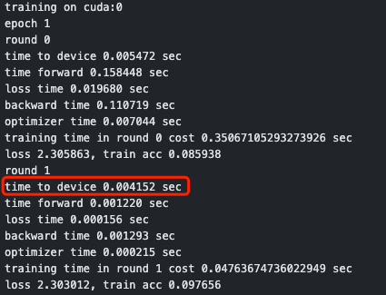
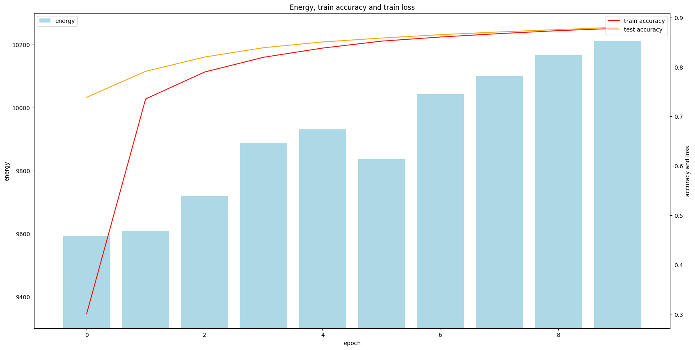
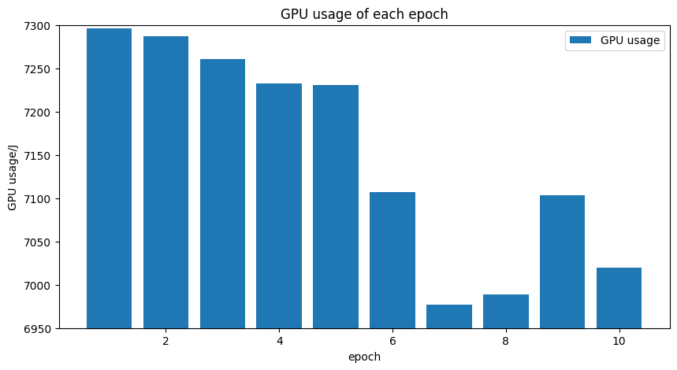
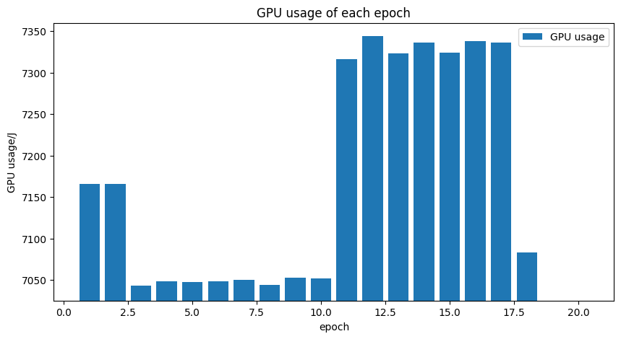
Last time question
1.to_device() time
Training on cpu
Training on mps
Training on gpu
Total energy consumption, train acc and test acc of each epoch
GPU energy consumption of epoch(total 10 epochs)
GPU energy consumption of epoch(total 20 epochs)
Multi epoch result

Slide 4
Agenda
Last time question
Simulation results

Slide 5
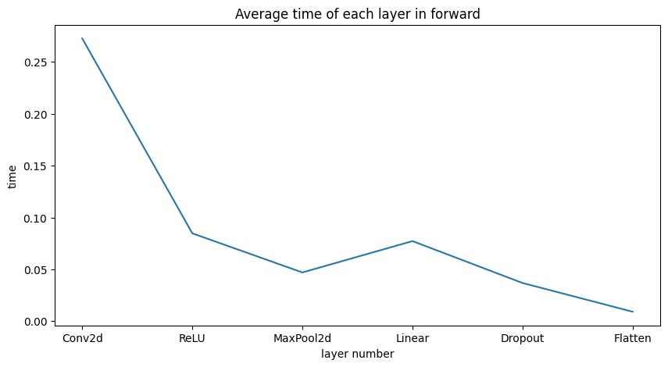
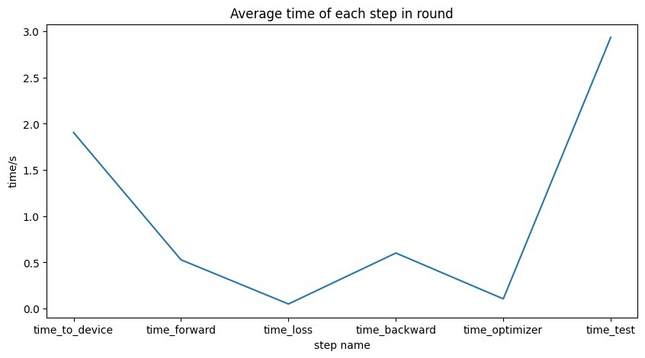
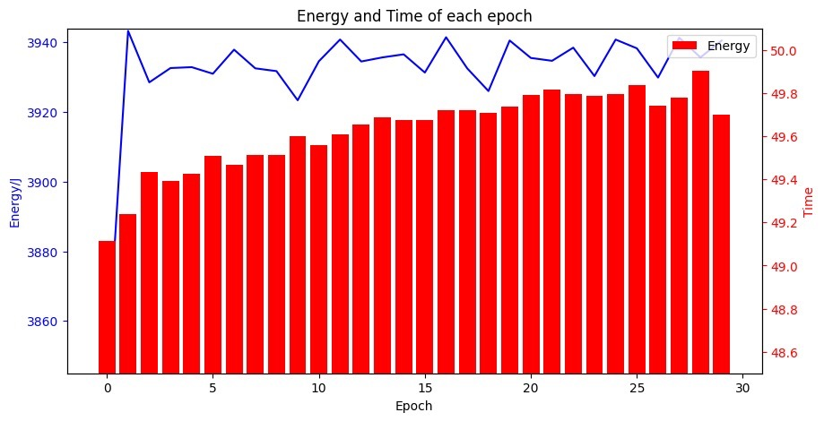
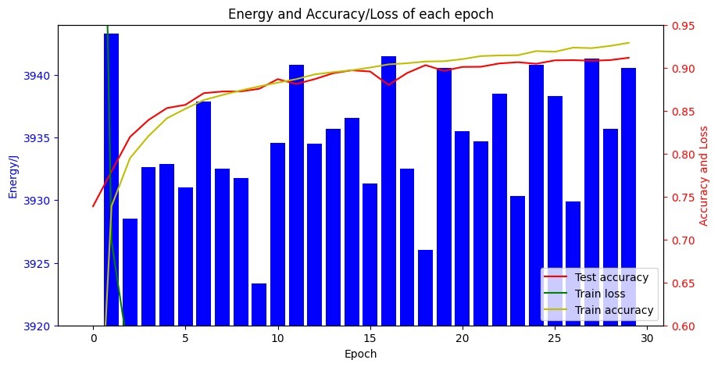
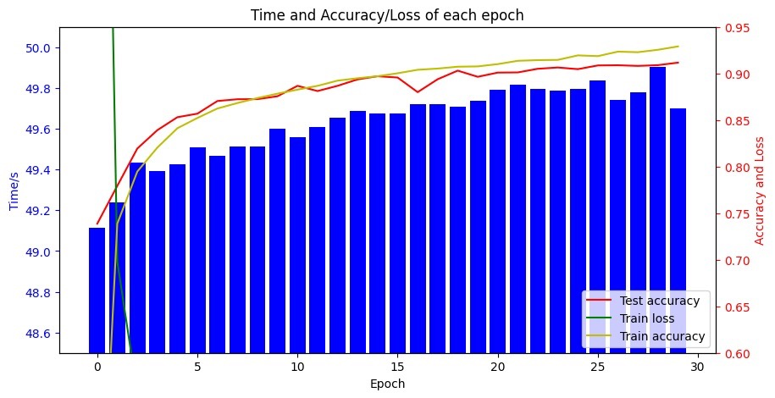
Simulation results
Optimizer: SGD
Mean energy: 3932J/epoch
nvidia-smi --query-gpu=power.draw --format=csv --loop-ms=1000 > gpu_power_usage.csv

Slide 6
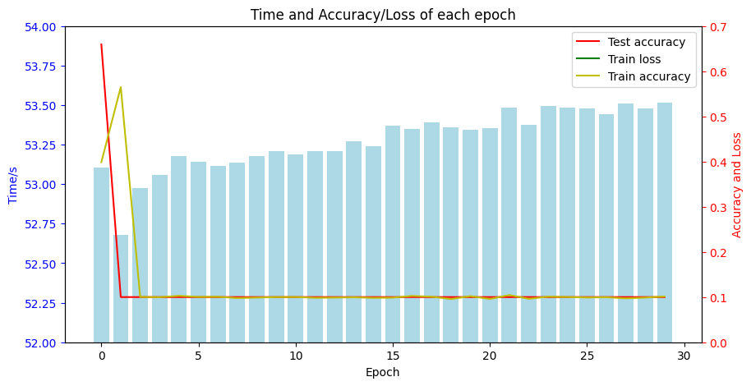
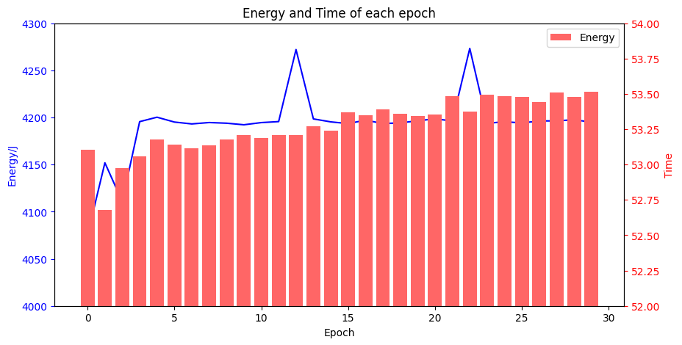
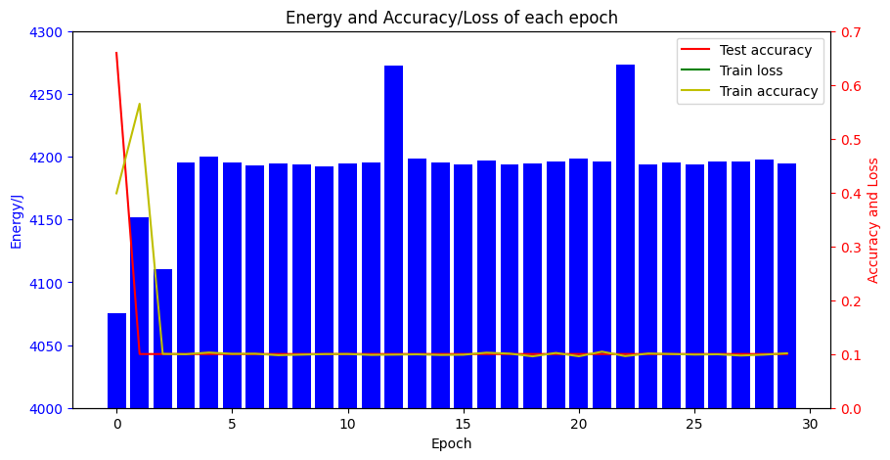
Simulation results
Optimizer: Adam
Mean energy: 4192J/epoch

Slide 7
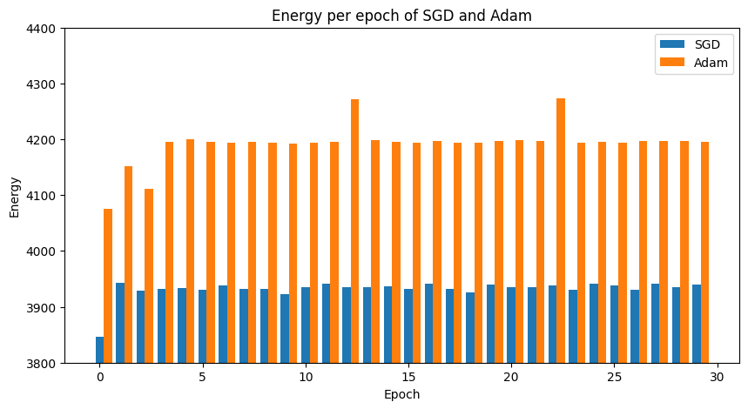
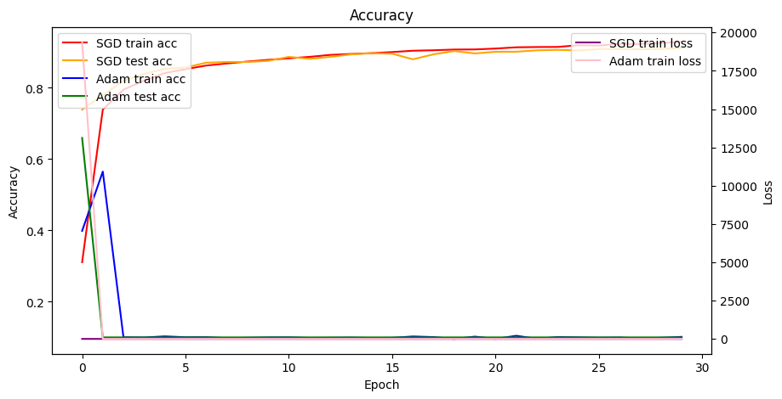
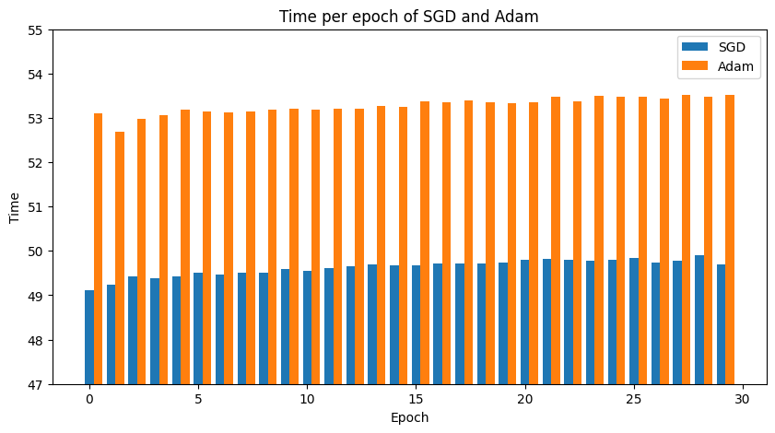
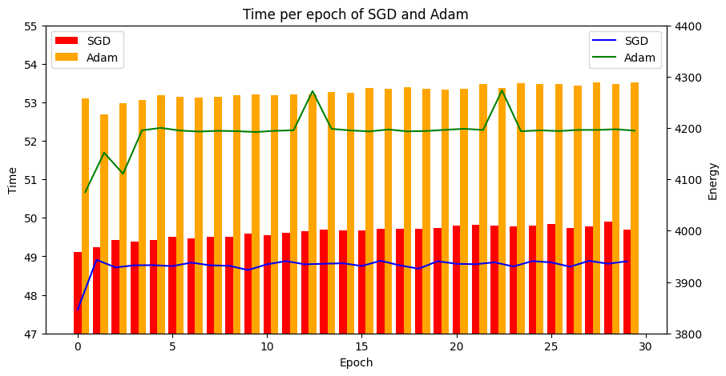
Simulation results
Optimizer: comparison between SGD & Adam
GPU energy consumption
train acc, test acc, train loss of SGD and Adam
Time consumption of each epoch between SGD and Adam
Energy consumption and time cost between SGD and Adam

Slide 8
Thanks

