Slide 1



Analysis of the energy sustainability of Machine Learning algorithms
Students:
Yin Jun
Tutors:
Prof. Meo Michela
Prof. Vallero Greta
First presentation
23/10/2023

Slide 2
Analytical model to calculate the power consumption
Get data through various simulations to build model for calculate power consumption
Dataset: FashionMnist
Original size: 1*28*28 pixels
Deep Learning Models:
Alexnet | VGG-11 | Resnet-18 | GoogLeNet
940.95 M | 7.58 G | 1.75 G | 278.62 M
46.76 M | 128.81 M | 11.18 M | 5.98 M
34430.087 J | 113015.843 J | 112909.394 J | 124845.577 J
437.3 s | 1419.5 s | 1417.9 s | 1567.8 s
87.92% | 97.42% | 97.43% | 81.73%
87.99% | 89.31% | 89.85% | 81.88%
MACs
Number of Parameters
Energy of 10 epochs
Time of 10 epochs
Final reached train acc
Final reached test acc
The energy, time, final reached train acc and test acc results are the averaged valued of 10 rounds simulation
MACs(Multiply-Accumulate Operations)
The unit for measuring the computational complexity of a deep learning model
https://github.com/sovrasov/flops-counter.pytorch

Slide 3
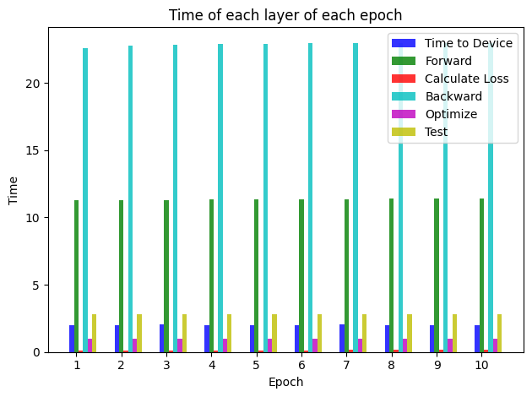
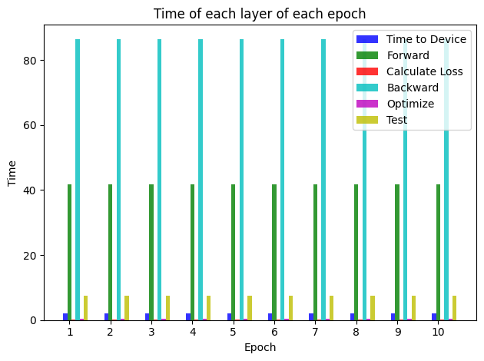
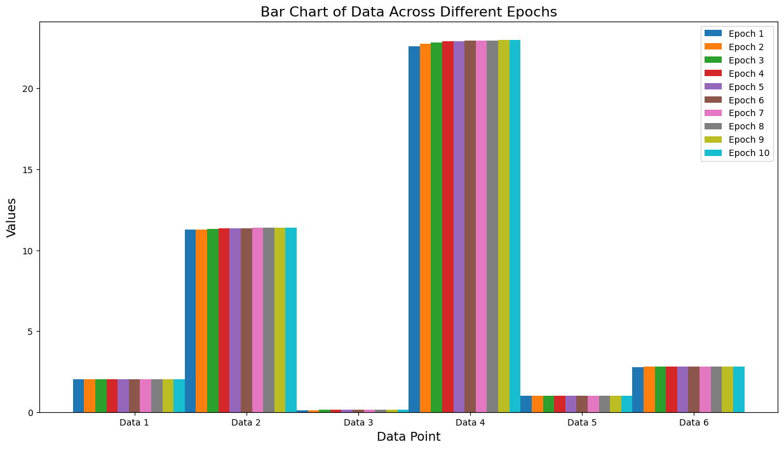
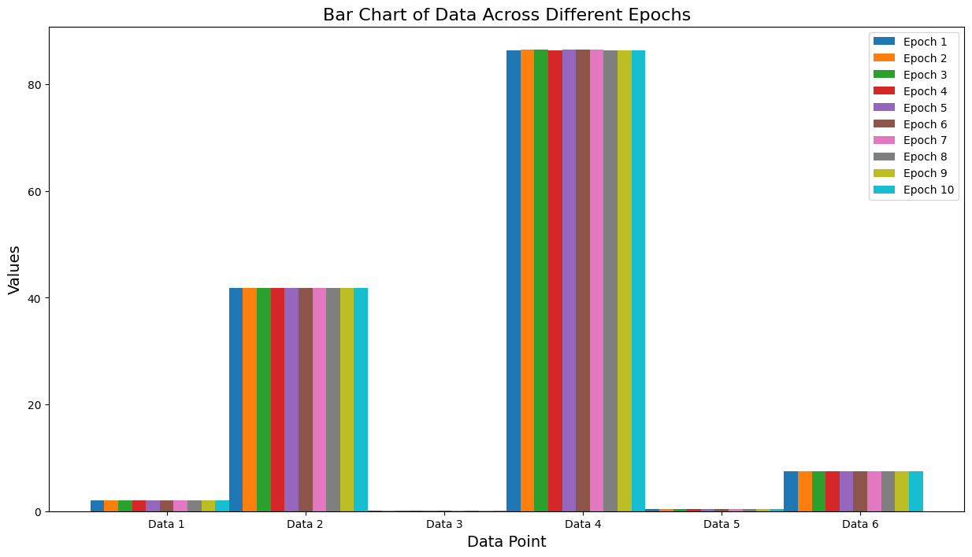

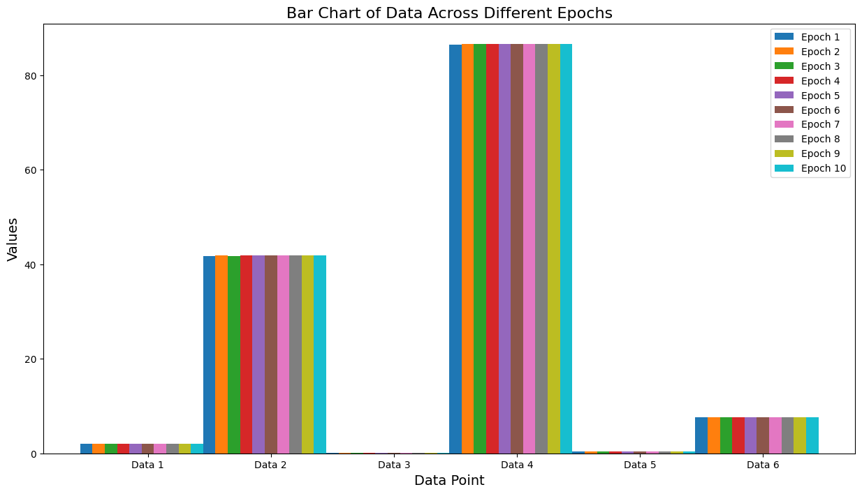
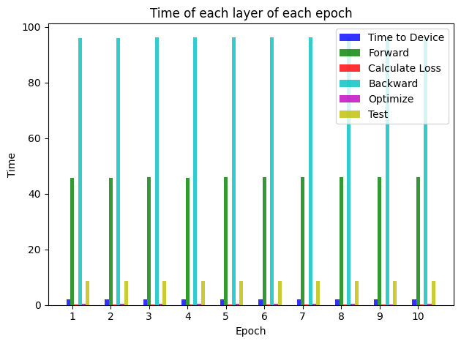
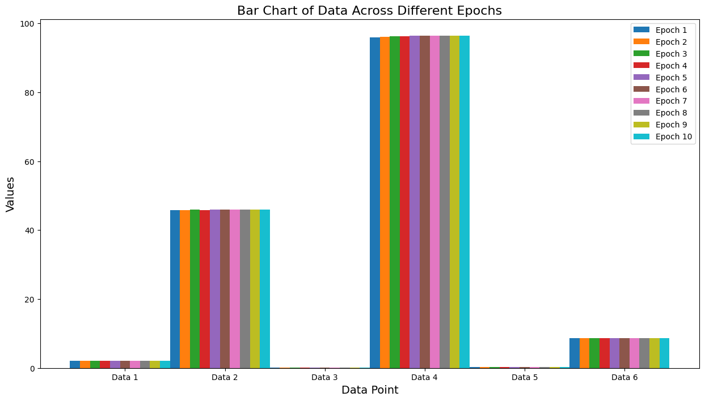
Time consumption of each part of simulation
Alexnet
Resnet-18
VGG-11
GoogLeNet

Slide 4
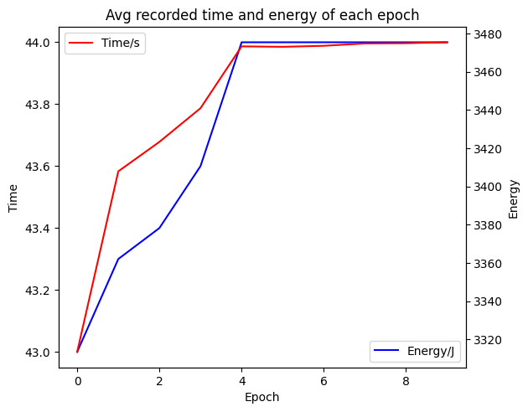
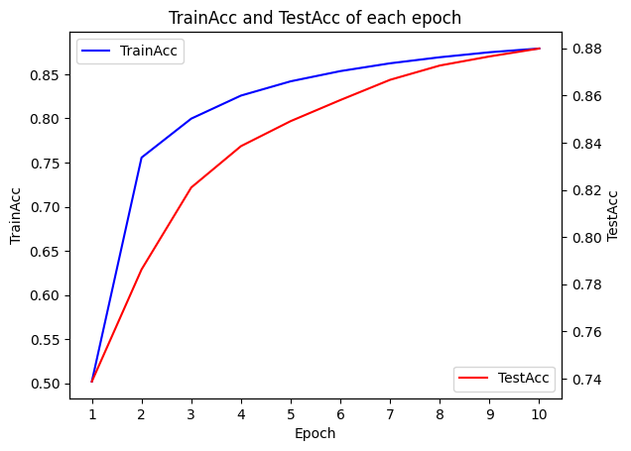
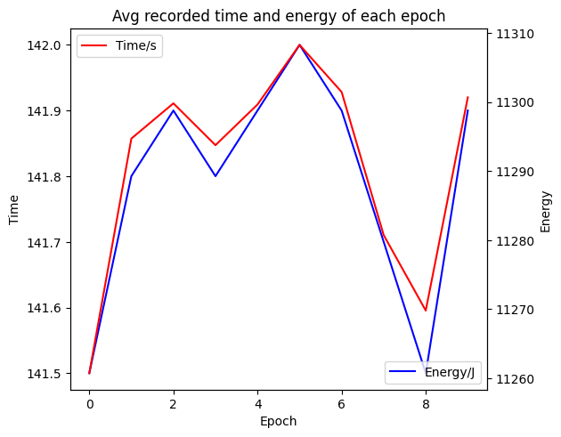
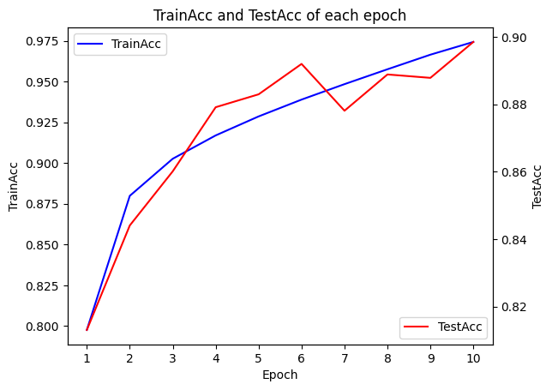
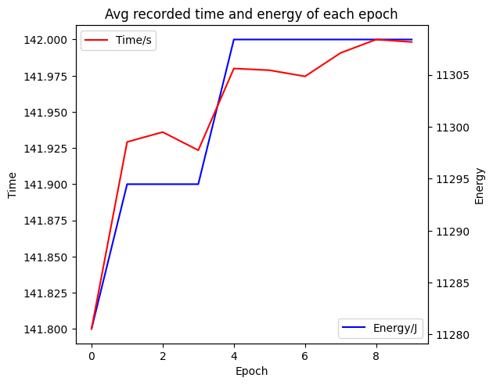
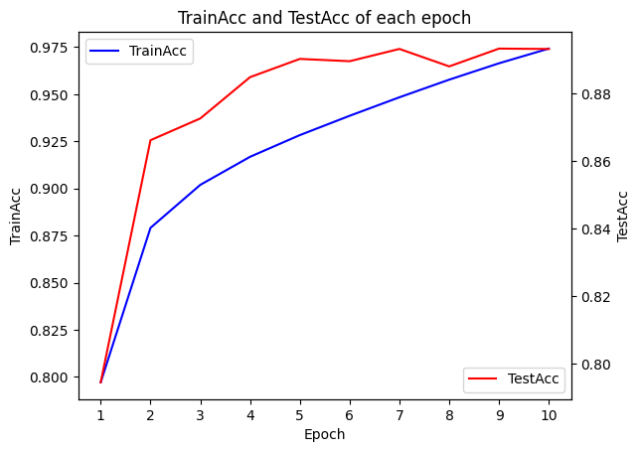
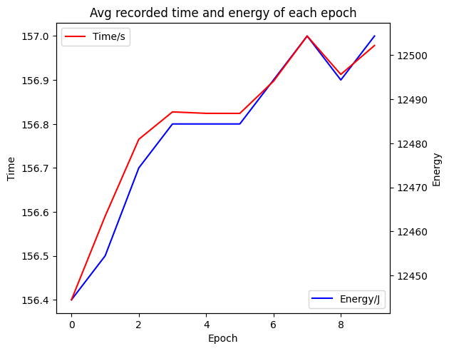
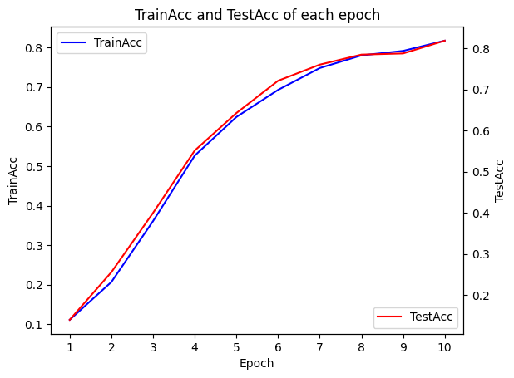
Average time & energy consumption, train & test acc
Alexnet
Resnet-18
VGG-11
GoogLeNet

Slide 5
Simulation result
For deep learning models, using synchronize can perfectly measure time consumption of each step during the training part.
All the data are using average values of 10 rounds simulation, with each round contains 10 epochs. And the average time consumption results of each epoch in different deep learning models are almost the same with a variation less than 1 second.
During the training part, the two most time-consuming parts are the backward and the forward.
The MACs(Multiply-Accumulate Operations) can be used as a parameter to do the energy consumption prediction of given deep learning model.
In the table presented in the first slide, the Resnet and VGG have better test accuracy than Alexnet about 2% but consuming over 3 times energy, might be due to the dataset.
Next step:
Try to find different dataset to test the result.

Slide 6
Thanks

