Slide 1
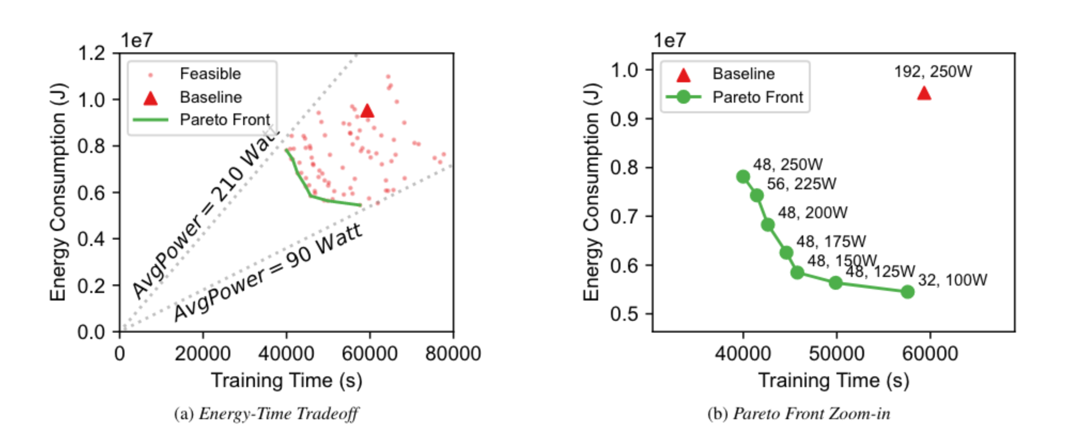
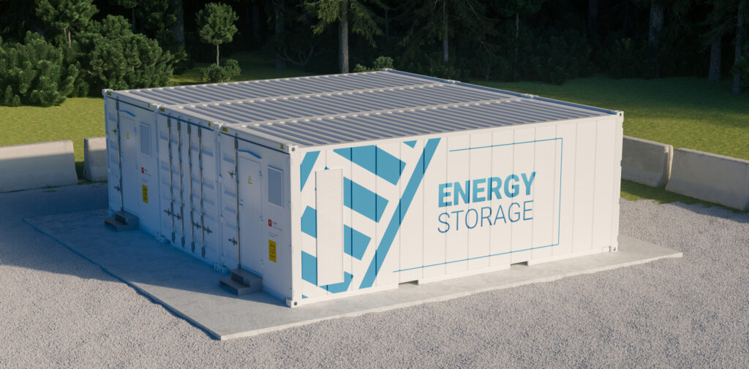
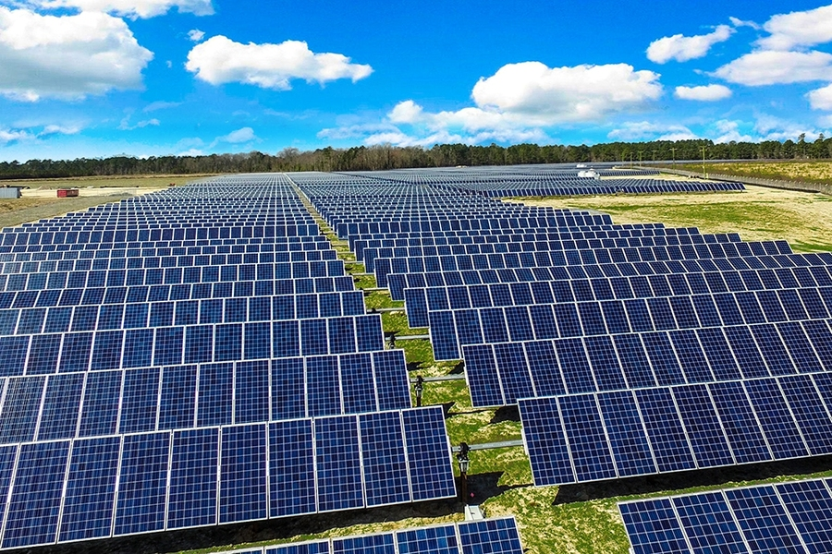
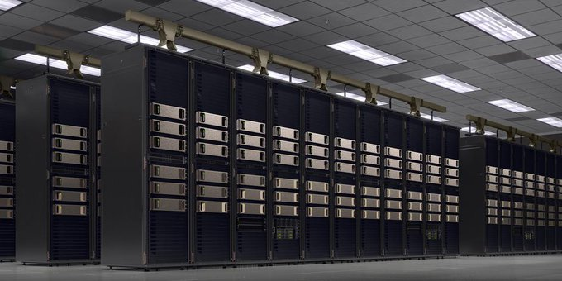
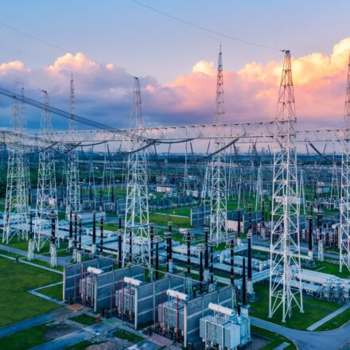






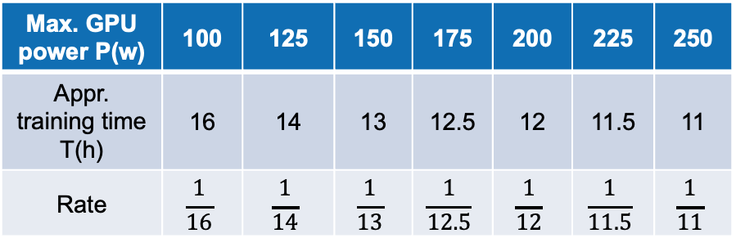

$${βD}_{t}^{dc}$$
$$R_{t}^{solar}$$
$$P_{t}^{solar}$$
+
Data Center
$$W_{t}^{solar}$$
Max. GPU power P(w) | 100 | 125 | 150 | 175 | 200 | 225 | 250
Appr. training time T(h) | 16 | 14 | 13 | 12.5 | 12 | 11.5 | 11
Rate | $$\frac{1}{16}$$ | $$\frac{1}{14}$$ | $$\frac{1}{13}$$ | $$\frac{1}{12.5}$$ | $$\frac{1}{12}$$ | $$\frac{1}{11.5}$$ | $$\frac{1}{11}$$
$$P_{t}^{grid}$$
$$R_{t}^{grid}$$
$${βD}_{t}^{grid}$$
Model training request [1]
Power supply

