Slide 1



Analysis of the energy sustainability of Machine Learning algorithms
Students:
Yin Jun
Tutors:
Prof. Meo Michela
Prof. Vallero Greta
First presentation
23/10/2023

Slide 2
Analytical model to calculate the power consumption
Get data through various simulations to build model for calculate power consumption
Dataset: FashionMnist
Original size: 1*28*28 pixels
Deep Learning Models:
Alexnet | VGG-11 | Resnet-18 | GoogLeNet
940.95 M | 7.58 G | 1.75 G | 278.62 M
46.76 M | 128.81 M | 11.18 M | 5.98 M
34430.087 J | 113015.843 J | 112909.394 J
437.3 s | 1419.5 s | 1417.9 s
87.92% | 97.42% | 97.43%
87.99% | 89.31% | 89.85%
MACs
Number of Parameters
Energy of 10 epochs
Time of 10 epochs
Final reached train acc
Final reached test acc
The energy, time, final reached train acc and test acc results are the averaged valued of 10 rounds simulation
MACs(Multiply-Accumulate Operations)
The unit for measuring the computational complexity of a deep learning model
https://github.com/sovrasov/flops-counter.pytorch

Slide 3
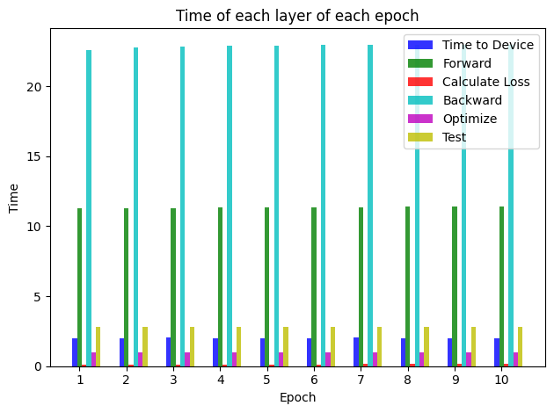
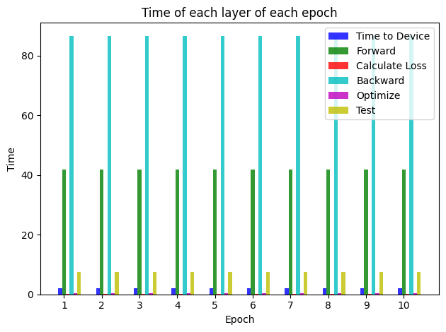

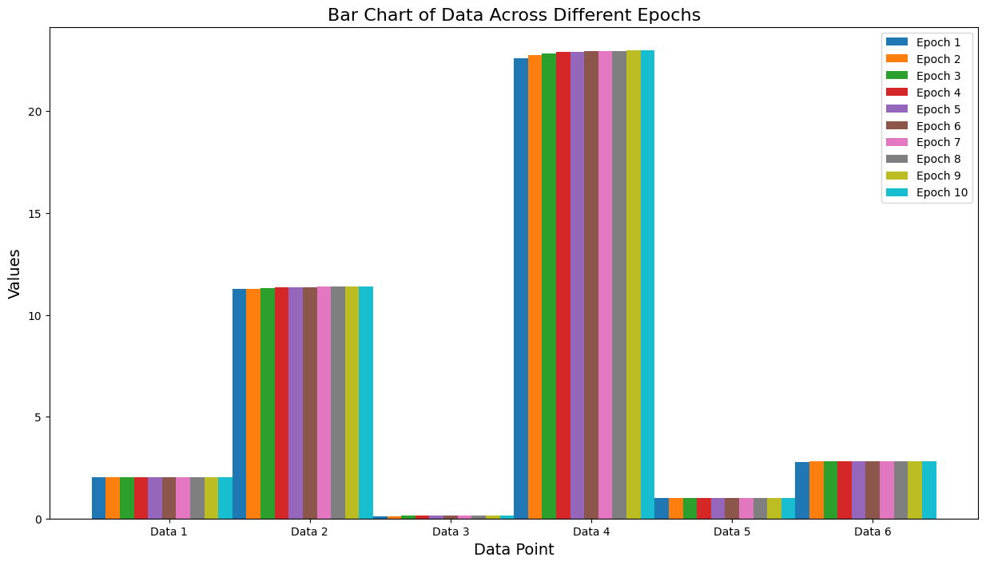
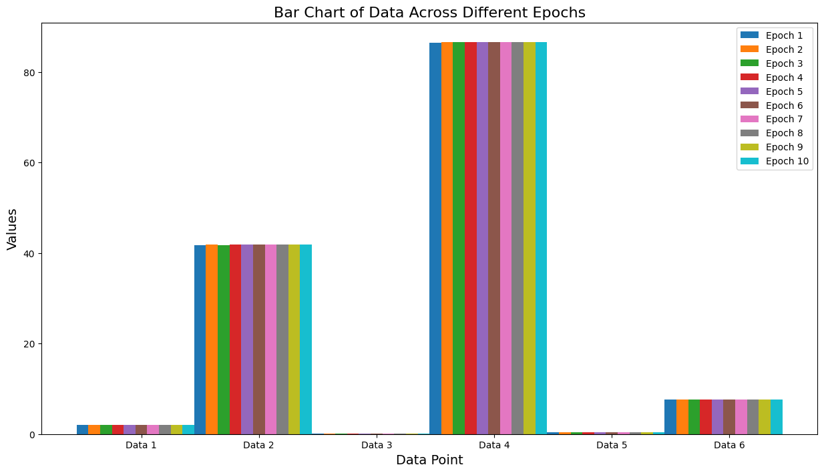
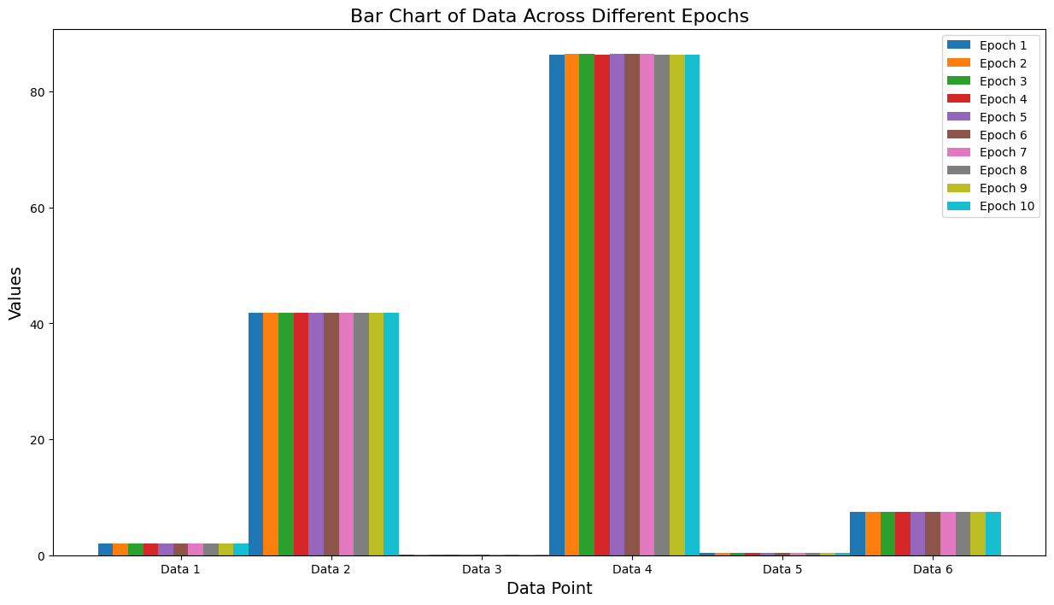
Time consumption of each part of simulation
Alexnet
VGG-11
Resnet-18

Slide 4
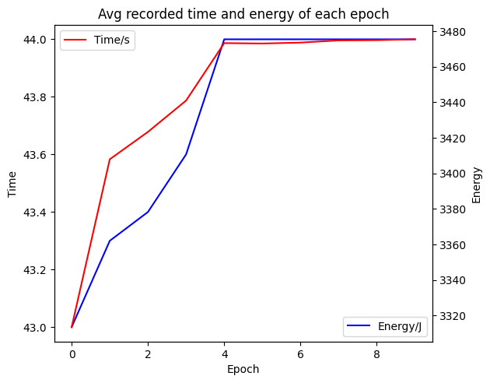
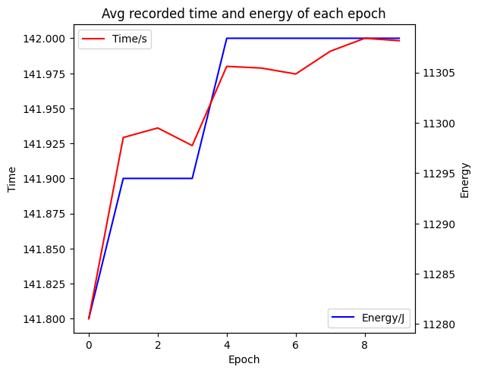
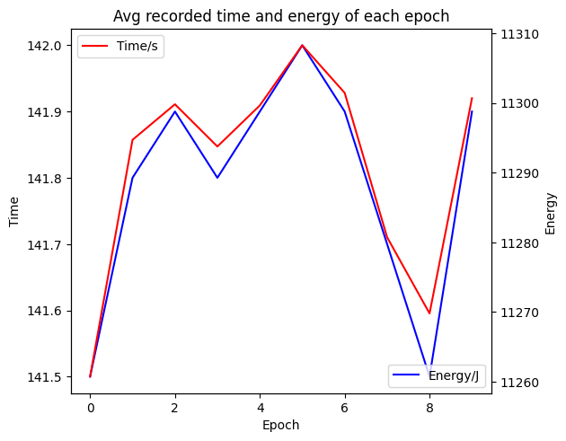
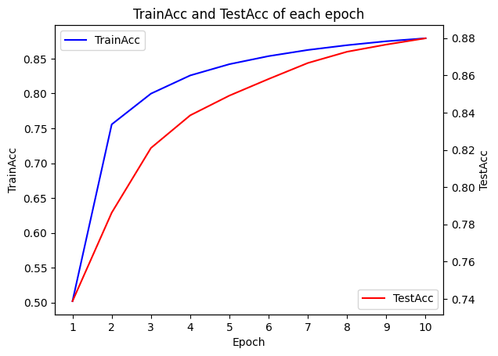
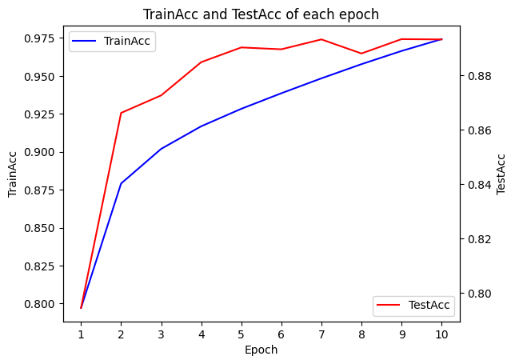
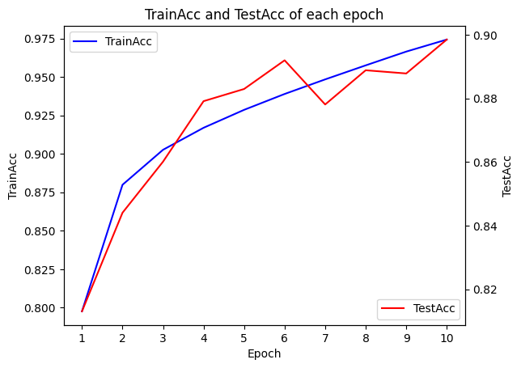
Time consumption of each part of simulation
Alexnet
VGG-11
Resnet-18

Slide 5
Next step
More dataset to test
More epoch to test

Slide 6
Thanks

