Slide 1



Analysis of the energy sustainability of Machine Learning algorithms
Students:
Yin Jun
Tutors:
Prof. Meo Michela
Prof. Vallero Greta
First presentation
23/10/2023

Slide 2
Agenda
Last time
Simulation results

Slide 3
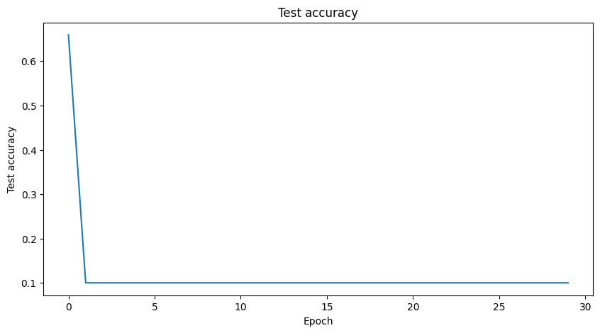
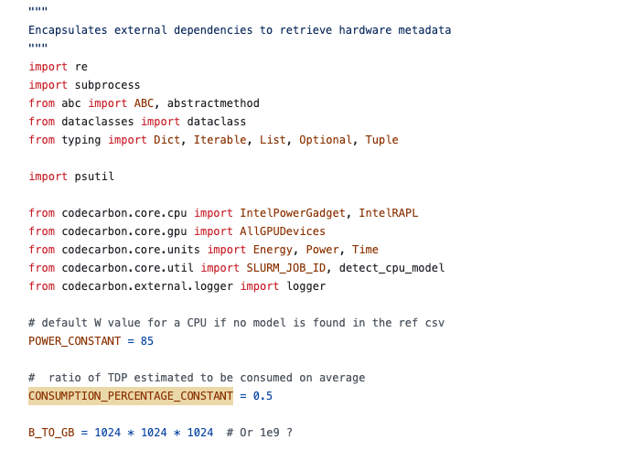
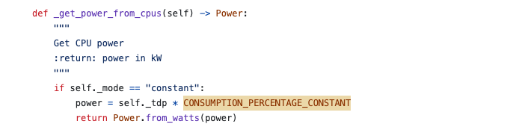
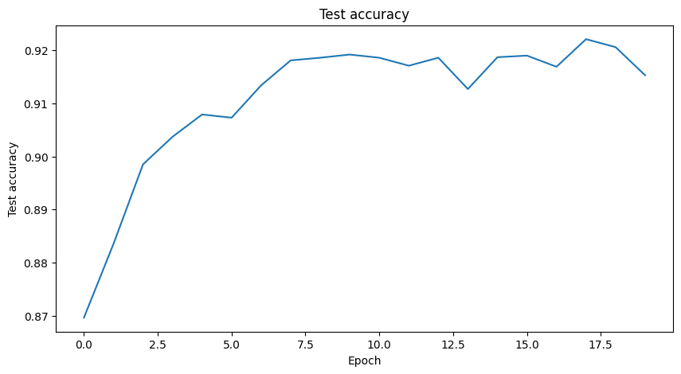
Last time
1. CPU power validation
2. Accuracy in Adam optimizer
Learning rate = 0.01
Learning rate = 0.001

Slide 4
Agenda
Last time
Simulation results

Slide 5
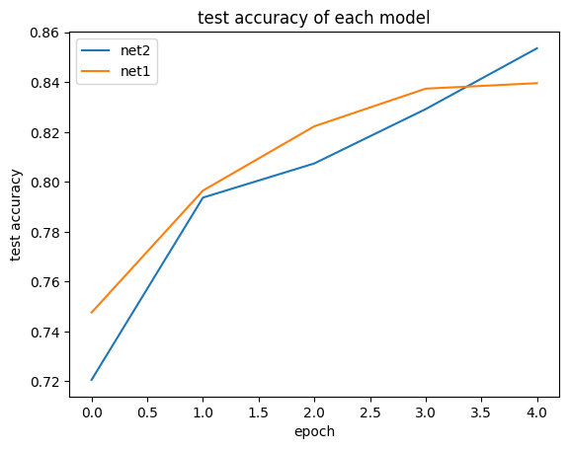
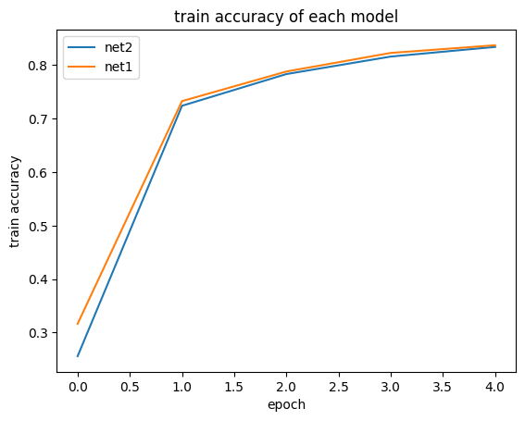
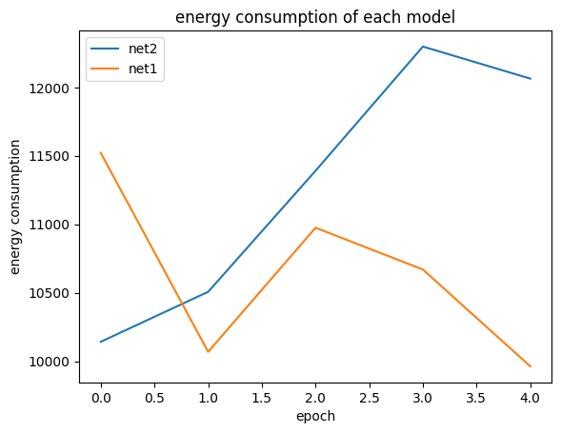
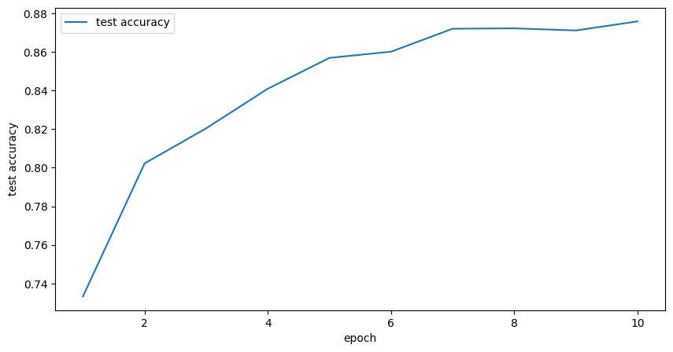
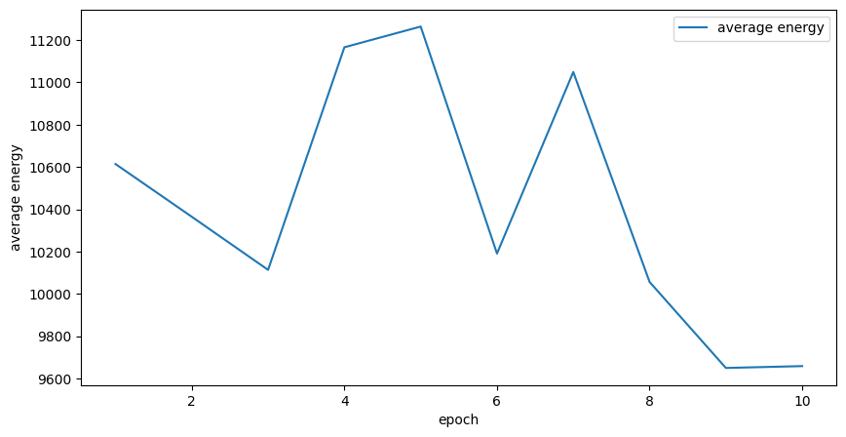
Simulation results
Model: Alexnet
Dataset: FashionMNIST
1. Simulated 5 epochs on each of the two devices
2. Simulated 10 epochs on 1 devices
total energy consumption(FL) | total energy consumption(centralize)
39857938J | 41632904

Slide 6
Questions
Update the parameters in the final model, using averaging causing problems
weight | test acc
0.8,0.2 | 0.8321
0.5,0.5 | 0.2759

Slide 7
Thanks

