Slide 1



Analysis of the energy sustainability of Machine Learning algorithms
Students:
Yin Jun
Tutors:
Prof. Meo Michela
Prof. Vallero Greta
First presentation
23/10/2023

Slide 2
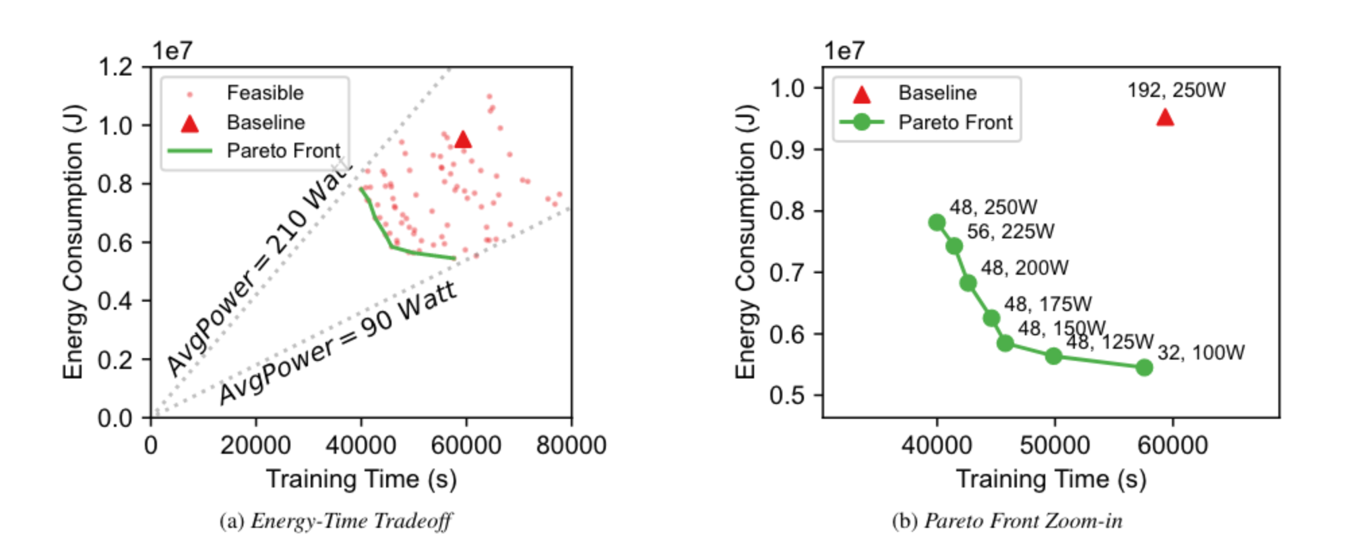
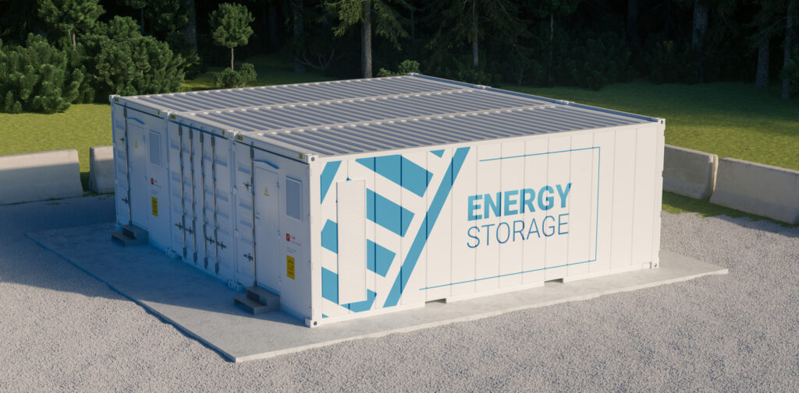
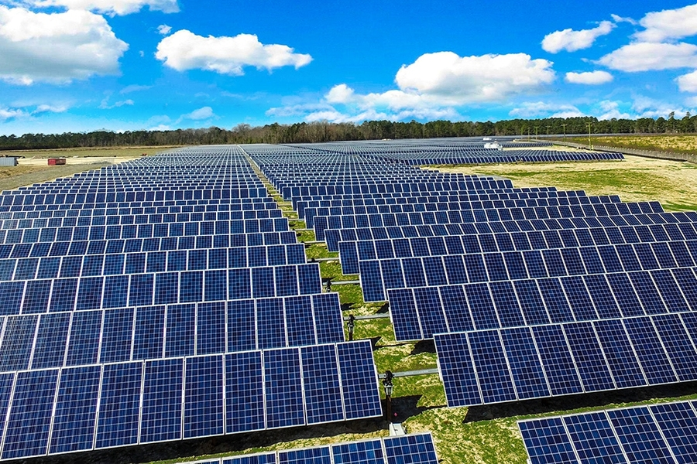
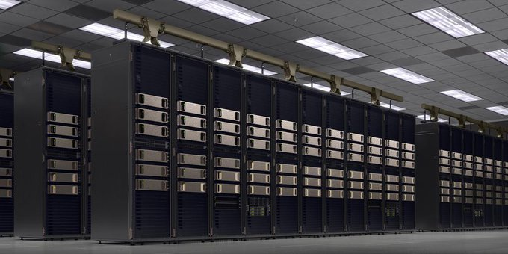
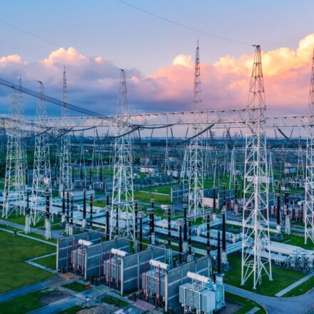






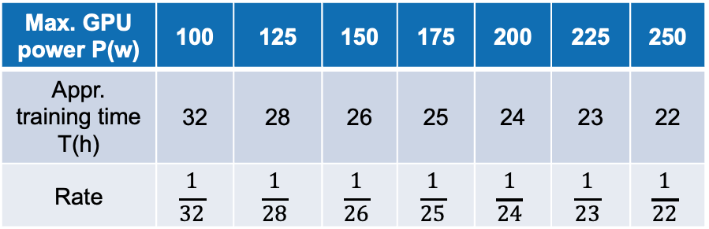

$${βD}_{t}^{dc}$$
$$R_{t}^{solar}$$
$$P_{t}^{solar}$$
+
Data Center
$$W_{t}^{solar}$$
Max. GPU power P(w) | 100 | 125 | 150 | 175 | 200 | 225 | 250
Appr. training time T(h) | 32 | 28 | 26 | 25 | 24 | 23 | 22
Rate | $$\frac{1}{32}$$ | $$\frac{1}{28}$$ | $$\frac{1}{26}$$ | $$\frac{1}{25}$$ | $$\frac{1}{24}$$ | $$\frac{1}{23}$$ | $$\frac{1}{22}$$
$$P_{t}^{grid}$$
$$R_{t}^{grid}$$
$${βD}_{t}^{grid}$$
Model training request [1]
Power supply

Slide 3
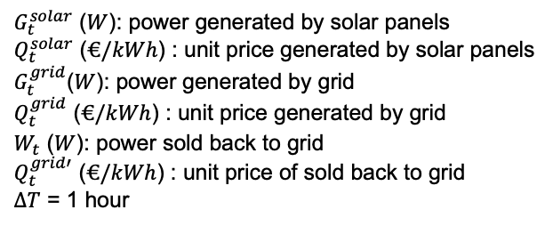
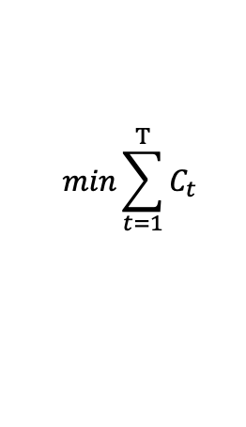
Energy dispatch
Objective function
$$min\sum_{t=1}^{T}{C_{t}}$$
$C_{t}$ ($€$): electricity cost of each time slot by data center
Cost function
$$C_{t}=G_{t}^{solar}∙∆T∙Q_{t}^{solar}+G_{t}^{grid}∙∆T∙Q_{t}^{grid}−W_{t}∙∆T∙Q_{t}^{grid′}$$
$G_{t}^{solar}$ ($W$): power generated by solar panels
$Q_{t}^{solar}$ ($€/kWh$) : unit price generated by solar panels
$G_{t}^{grid}$($W$): power generated by grid
$Q_{t}^{grid}$ ($€/kWh$) : unit price generated by grid
$W_{t}$ ($W$): power sold back to grid
$Q_{t}^{grid′}$ ($€/kWh$) : unit price of sold back to grid
$∆T$ = 1 hour
Notes:
暂时先不考虑太阳能的部分
用最优的方案，看看能剩多少钱，比较两种极端情况，计算最终能够节省下来的钱有多少能够用到安装太阳能电池板上
注意一下如果按照这个数据来进行计算的话要考虑开始时间，早上的话太阳能多，晚上的话太阳能少但是电价便宜

Slide 4
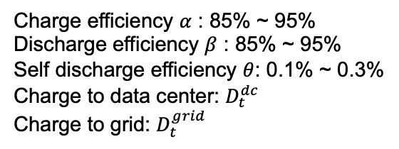

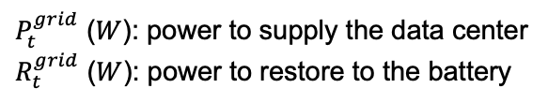

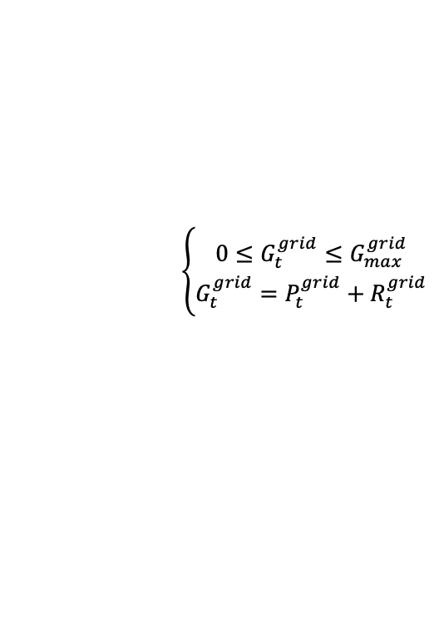

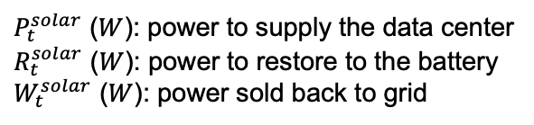
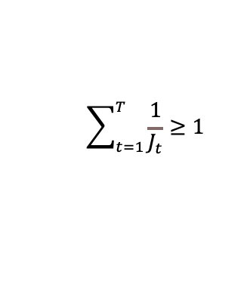

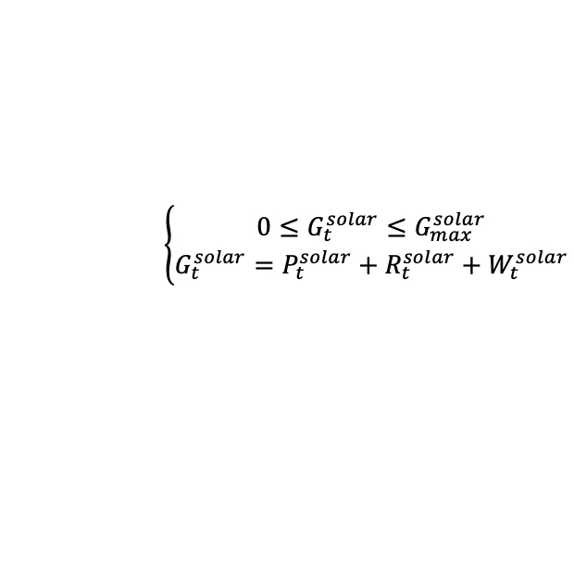

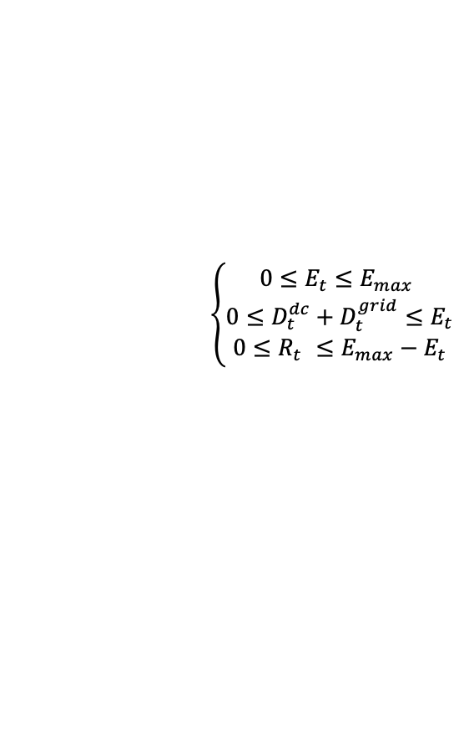
Energy dispatch
s.t. :
Solar panels
Data center
$$\left\{\begin{aligned}0≤G_{t}^{solar}≤G_{max}^{solar} \\ G_{t}^{solar}=P_{t}^{solar}+R_{t}^{solar}+W_{t}^{solar}\end{aligned}\right.$$
$P_{t}=P_{t}^{solar}+P_{t}^{grid}$ + ${βD}_{t}^{dc}$
$$\sum_{t=1}^{T}{\frac{1}{J_{t}}}≥1$$
$P_{t}^{solar}$ ($W$): power to supply the data center
$R_{t}^{solar}$ ($W$): power to restore to the battery
$W_{t}^{solar}$ ($W$): power sold back to grid
$P_{t}$ ($W$): supplied power to data center [100, 125, 150, 175, 200, 225, 250]
$J_{t}$ ($h$): training time [16, 14, 13, 12.5, 12, 11.5, 11]
Grid
$$\left\{\begin{aligned}0≤G_{t}^{grid}≤G_{max}^{grid} \\ G_{t}^{grid}=P_{t}^{grid}+R_{t}^{grid}\end{aligned}\right.$$
Charge ESD
$$R_{t}=R_{t}^{solar}+R_{t}^{grid}$$
$P_{t}^{grid}$ ($W$): power to supply the data center
$R_{t}^{grid}$ ($W$): power to restore to the battery
Back to grid
$$W_{t}=W_{t}^{solar}+{βD}_{t}^{grid}$$
ESD (energy storage device)
ESD power in each time slot
Charge efficiency $α$ : 85% ~ 95%
Discharge efficiency $β$ : 85% ~ 95%
Self discharge efficiency $θ$: 0.1% ~ 0.3%
Charge to data center: $D_{t}^{dc}$
Charge to grid: $D_{t}^{grid}$
$$E_{t}=(1−θ)∙\left[E_{t−1}−D_{t−1}^{dc}−D_{t−1}^{grid}+αR_{t−1}\right]$$
$E_{1}=0,D_{1}^{dc}=0,D_{1}^{grid}$=0
$$\left\{\begin{aligned}0≤E_{t}≤E_{max} \\ {0≤D}_{t}^{dc}+D_{t}^{grid}≤E_{t} \\ {0≤R}_{t} ≤E_{max}−E_{t}\end{aligned}\right.$$

Slide 5
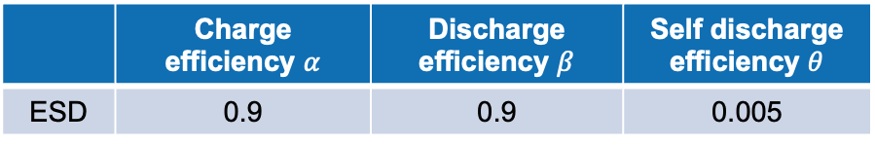

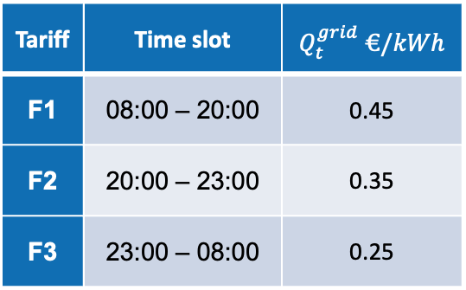
Energy dispatch – case study
1. Parameters setting
Tariff | Time slot | $Q_{t}^{grid}$ $€/kWh$
F1 | 08:00 – 20:00 | 0.45
F2 | 20:00 – 23:00 | 0.35
F3 | 23:00 – 08:00 | 0.25
Max. GPU power P(w) | 100 | 125 | 150 | 175 | 200 | 225 | 250
Appr. training time T(h) | 32 | 28 | 26 | 25 | 24 | 23 | 22
 | Charge efficiency $α$ | Discharge efficiency $β$ | Self discharge efficiency $θ$
ESD | 0.9 | 0.9 | 0.005
$$Q_{t}^{grid^{′}}=0.3€/kWh$$
2. Simulations setting
Set the start time of the training process from 0 to 143 hours.
Set the duration of the training process from 23 to 32 hours.
Notes:
暂时先不考虑太阳能的部分
用最优的方案，看看能剩多少钱，比较两种极端情况，计算最终能够节省下来的钱有多少能够用到安装太阳能电池板上
注意一下如果按照这个数据来进行计算的话要考虑开始时间，早上的话太阳能多，晚上的话太阳能少但是电价便宜

Slide 6
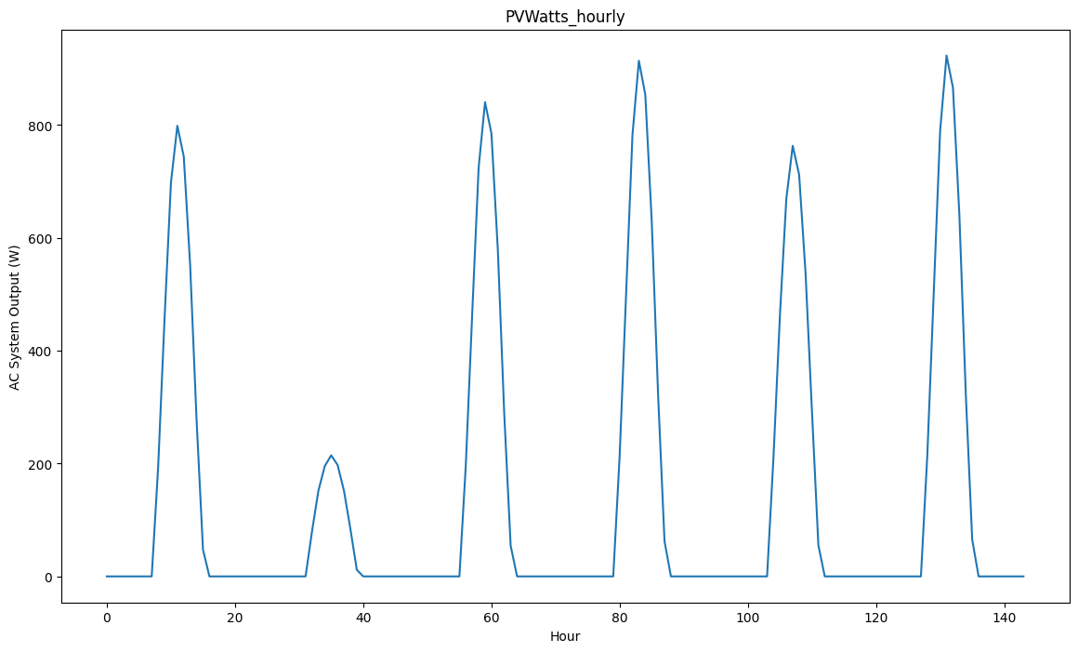
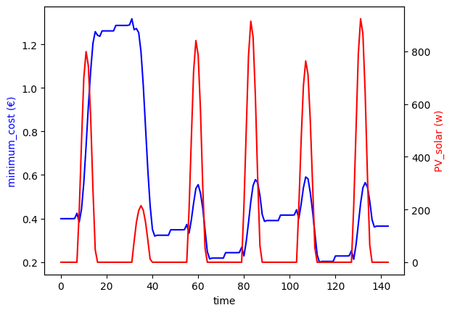
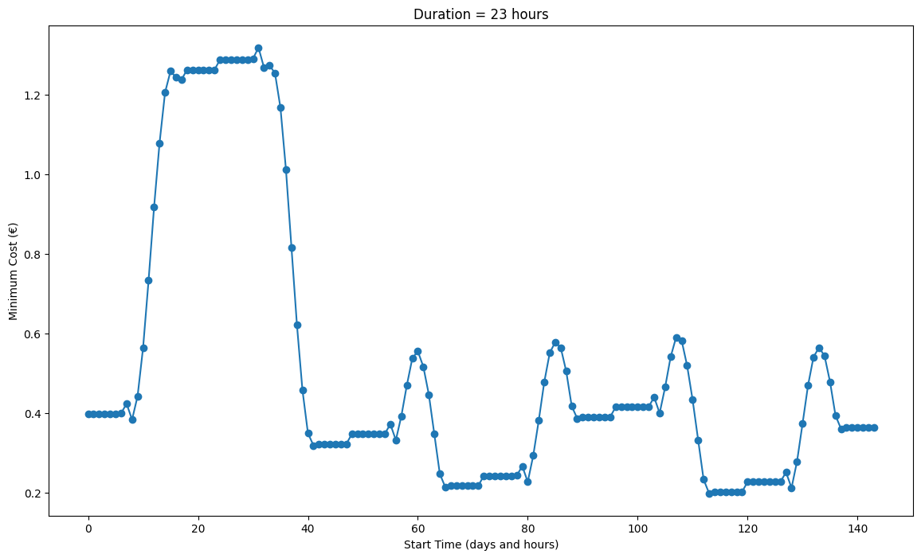
Energy dispatch – case study
PV_solar power at different time
If start training the model when the PV panels are just starting to generate electricity, the electricity cost will be the lowest.
Minimum cost under different start time
Notes:
暂时先不考虑太阳能的部分
用最优的方案，看看能剩多少钱，比较两种极端情况，计算最终能够节省下来的钱有多少能够用到安装太阳能电池板上
注意一下如果按照这个数据来进行计算的话要考虑开始时间，早上的话太阳能多，晚上的话太阳能少但是电价便宜

Slide 7
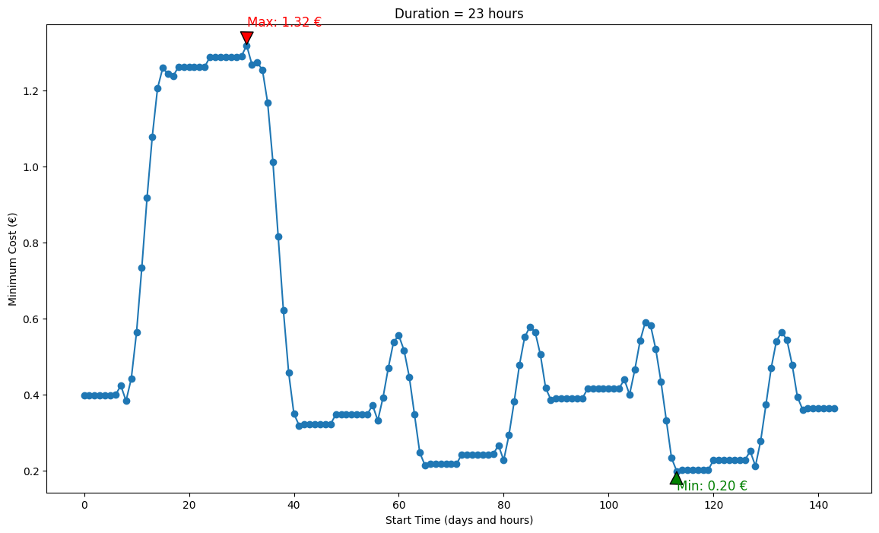
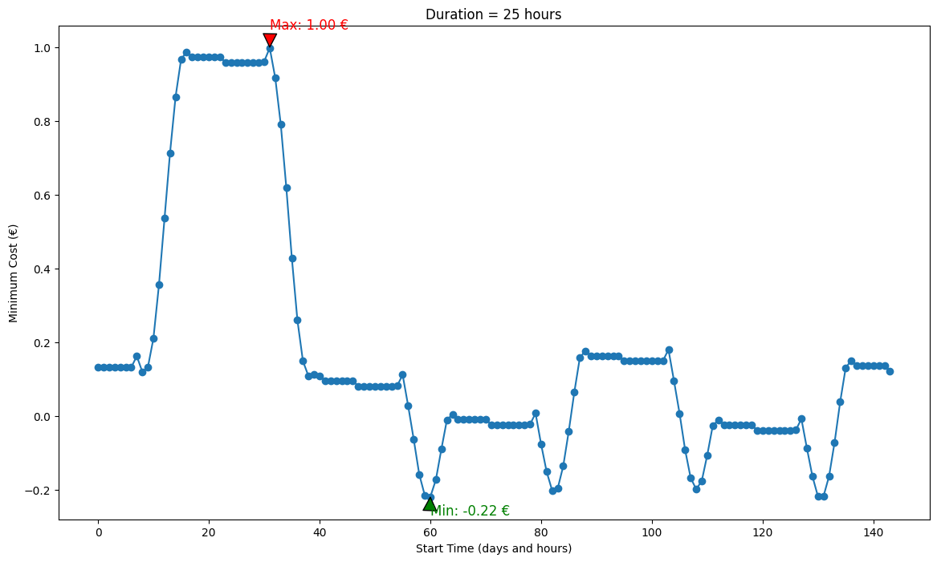
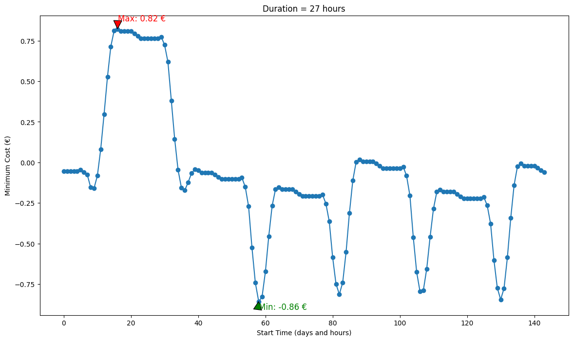
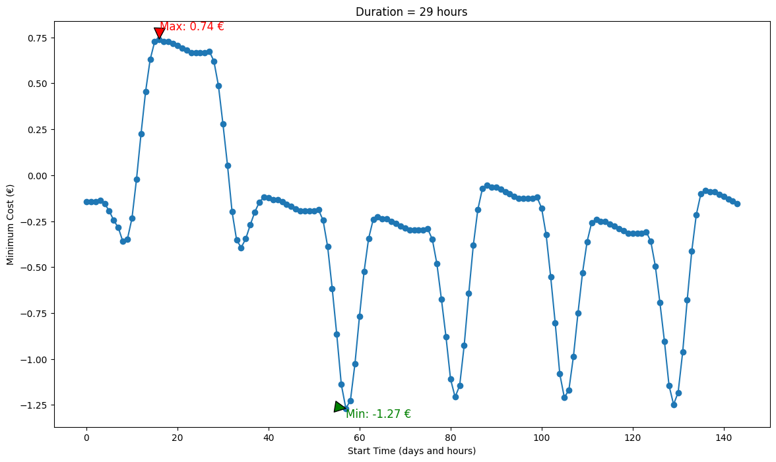
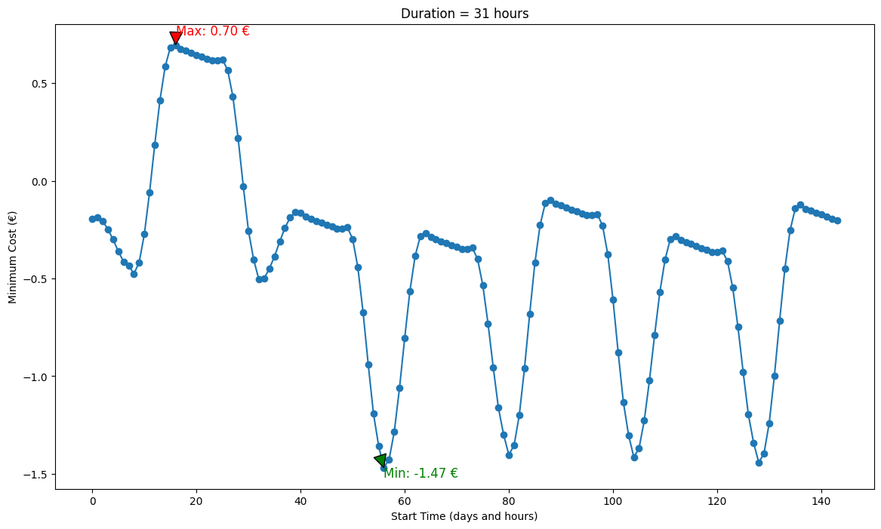
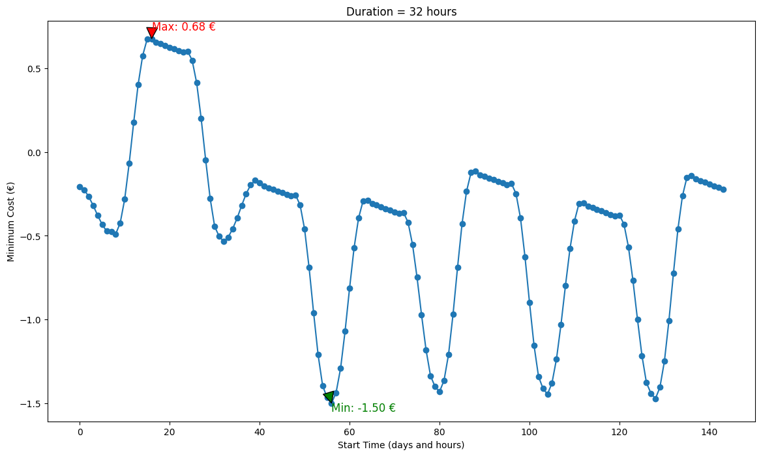
Energy dispatch – case study
Set the duration of the training process from 23 to 32 hours. The shorter the training time, the higher the cost.
Notes:
暂时先不考虑太阳能的部分
用最优的方案，看看能剩多少钱，比较两种极端情况，计算最终能够节省下来的钱有多少能够用到安装太阳能电池板上
注意一下如果按照这个数据来进行计算的话要考虑开始时间，早上的话太阳能多，晚上的话太阳能少但是电价便宜

Slide 8
Thanks

