Slide 1



Analysis of the energy sustainability of Machine Learning algorithms
Students:
Yin Jun
Tutors:
Prof. Meo Michela
Prof. Vallero Greta
First presentation
23/10/2023

Slide 2
Agenda
Codecarbon & Powerstat
Powermetrics

Slide 3


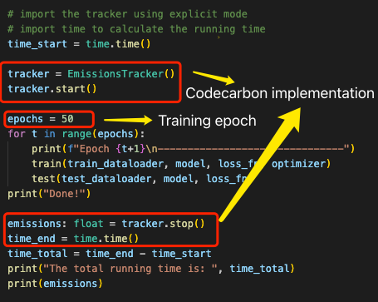
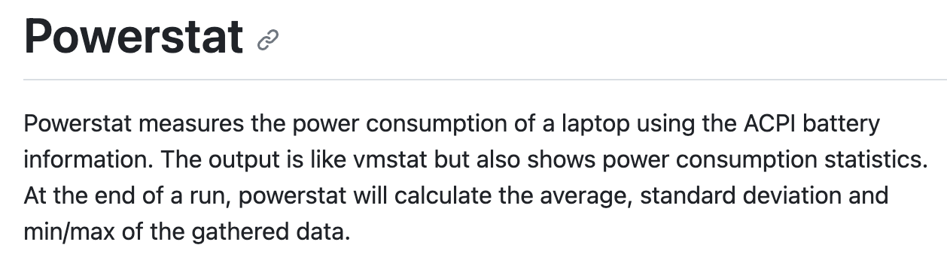
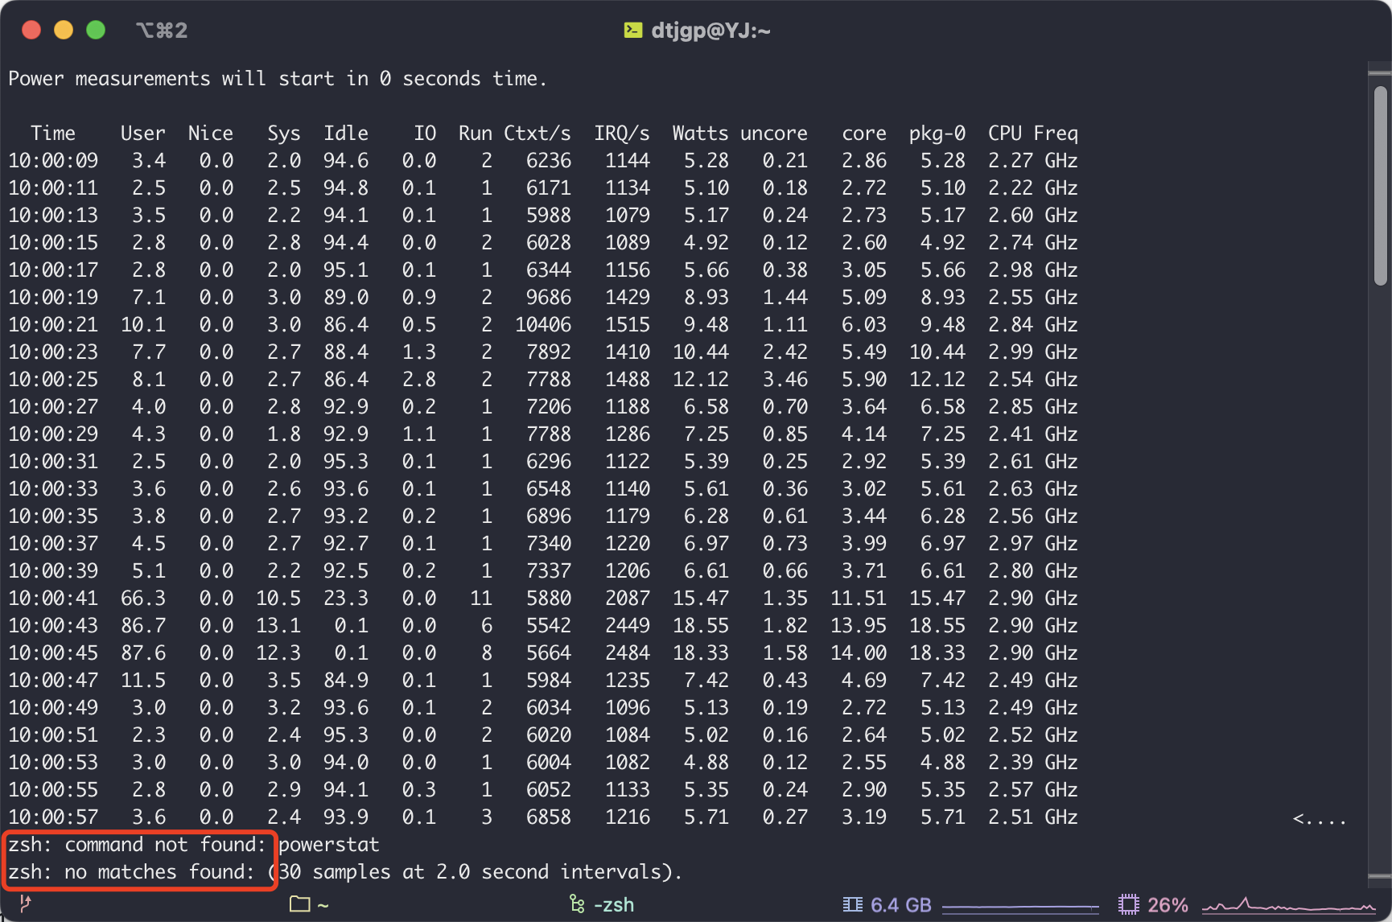
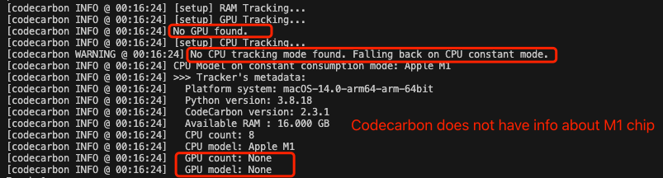
Codecarbon & Powerstat
Codecarbon final result
Code implement
Issue(considering M1 chip):
No GPU info
No accurate CPU info
RAM info is based on How much power does memory use? | Crucial.com
Codecarbon info

Slide 4
Agenda
Codecarbon & Powerstat
Powermetrics

Slide 5
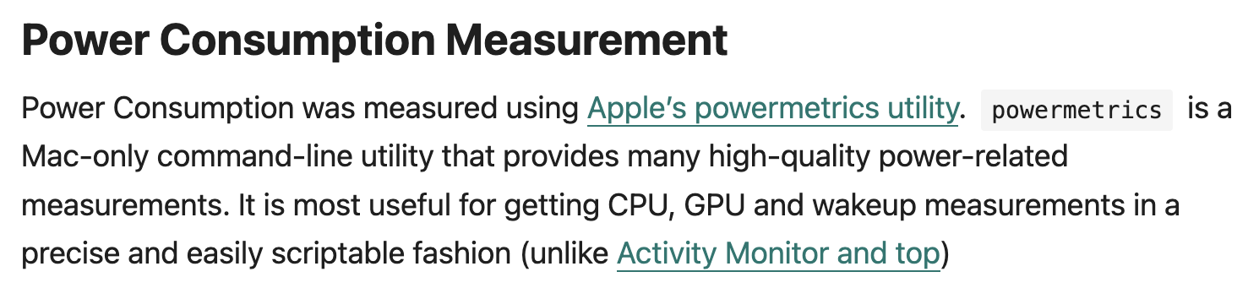
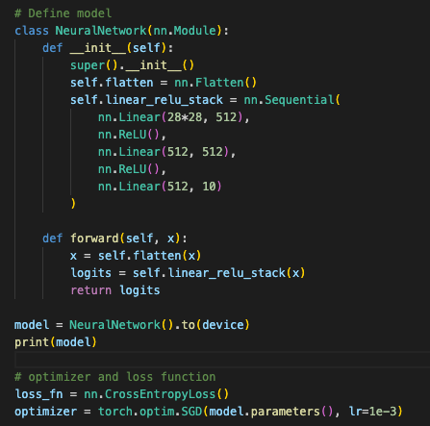
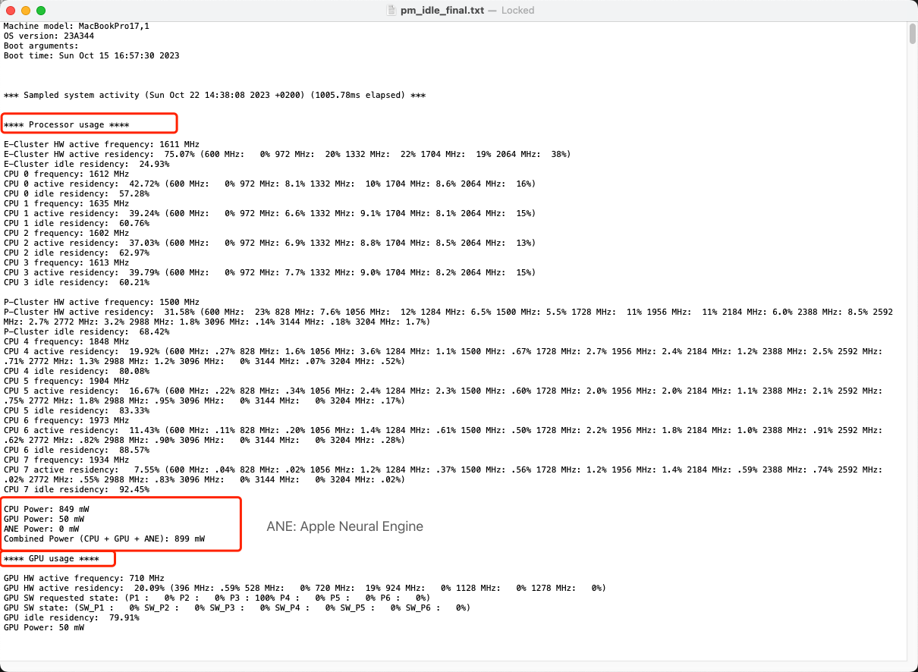
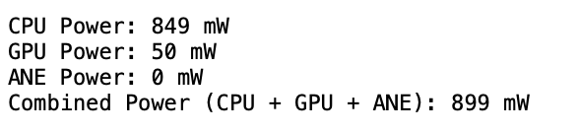
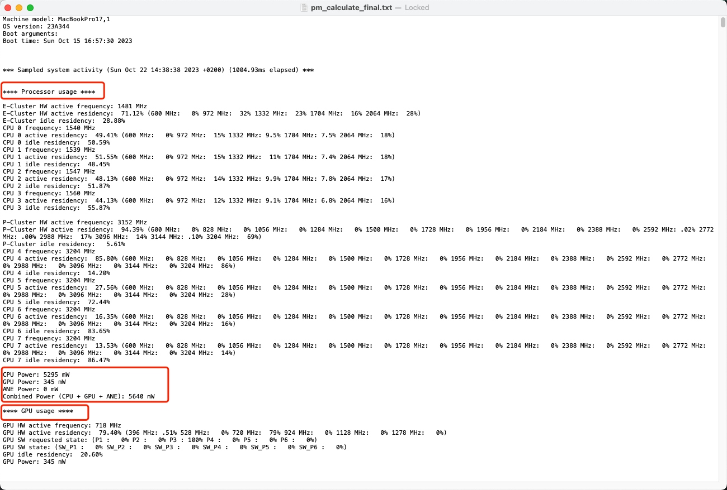
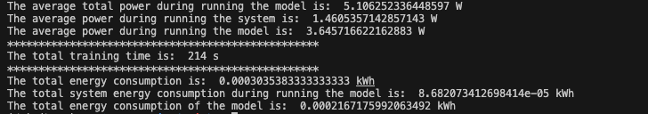
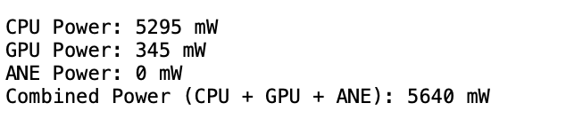

Powermetrics
Data: MNIST
Model:
Command Line:
Power consumption in idle status (1 cycle)
Powermetrics result
Power consumption in running models (1 cycle)
$Energy_consumption_of_the_model$= $total_energy_consumption$ – $idel_energy_consumption$

Slide 6
Verification
Data: Fashion_MNIST
Model | Alexnet | Resnet | GoogLenet
Codecarbon | RAM energy consumed: 0.005205 kWh RAM Power : 6.0 W CPU energy consumed: 0.004339 kWh Total CPU Power : 5.0 W Electricity consumption: 0.009544 kWh Emission: 0.003252617 kg Running time: 3124s | RAM energy consumed: 0.00247 kWh RAM Power : 6.0 W CPU energy consumed: 0.00206 kWh Total CPU Power : 5.0 W Electricity consumption: 0.00453 kWh Emission: 0.00154 kg Running time: 1482s | RAM energy consumed: 0.00283 kWh RAM Power : 6.0 W CPU energy consumed: 0.00236 kWh Total CPU Power : 5.0 W Electricity consumption: 0.00518 kWh Emission: 0.00177 kg Running time: 1697s
Powermetrics | CPU+GPU Power(running): 11.202 W CPU+GPU Power(idle): 1.395 W CPU+GPU Power(model): 9.807 W Electricity consumption: 0.00959 kWh CPU+GPU energy consumed(idle): 0.00120 kWh CPU+GPU energy consumed(model): 0.00840 kWh Running time: 3084s RAM(prediction): 0.00514 W Final consumption: 0.01473 kWh | CPU+GPU Power(running): 10.347 W CPU+GPU Power(idle): 1.547 W CPU+GPU Power(model): 8.800 W Electricity consumption: 0.00431 kWh CPU+GPU energy consumed(idle): 0.000645 kWh CPU+GPU energy consumed(model): 0.00367 kWh Running time: 1469s RAM(prediction): 0.00245 W Final consumption: 0.00755 kWh | CPU+GPU Power(running): 9.655 W CPU+GPU Power(idle): 1.470 W CPU+GPU Power(model): 8.185 W Electricity consumption: 0.00441 kWh CPU+GPU energy consumed(idle): 0.000671 kWh CPU+GPU energy consumed(model): 0.00374 kWh Running time: 1644s RAM(prediction): 0.00274 W Final consumption: 0.00715 kWh
Note: the samples result of powermetrics does not include RAM info, but based on public information about RAM, considering 3W per 8G RAM, the results are shown as above.
The Electricity consumption results measured by powermetrics is higher than by codecarbon.

Slide 7
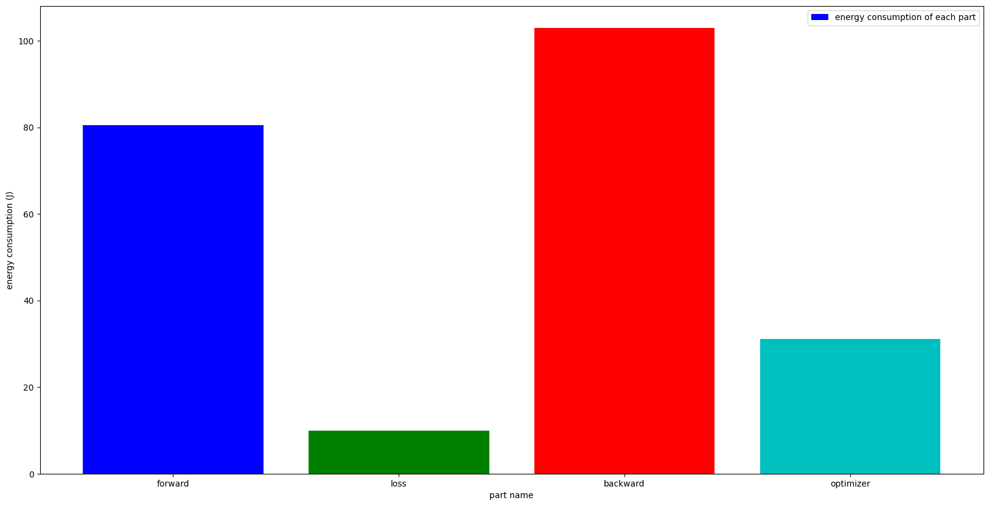
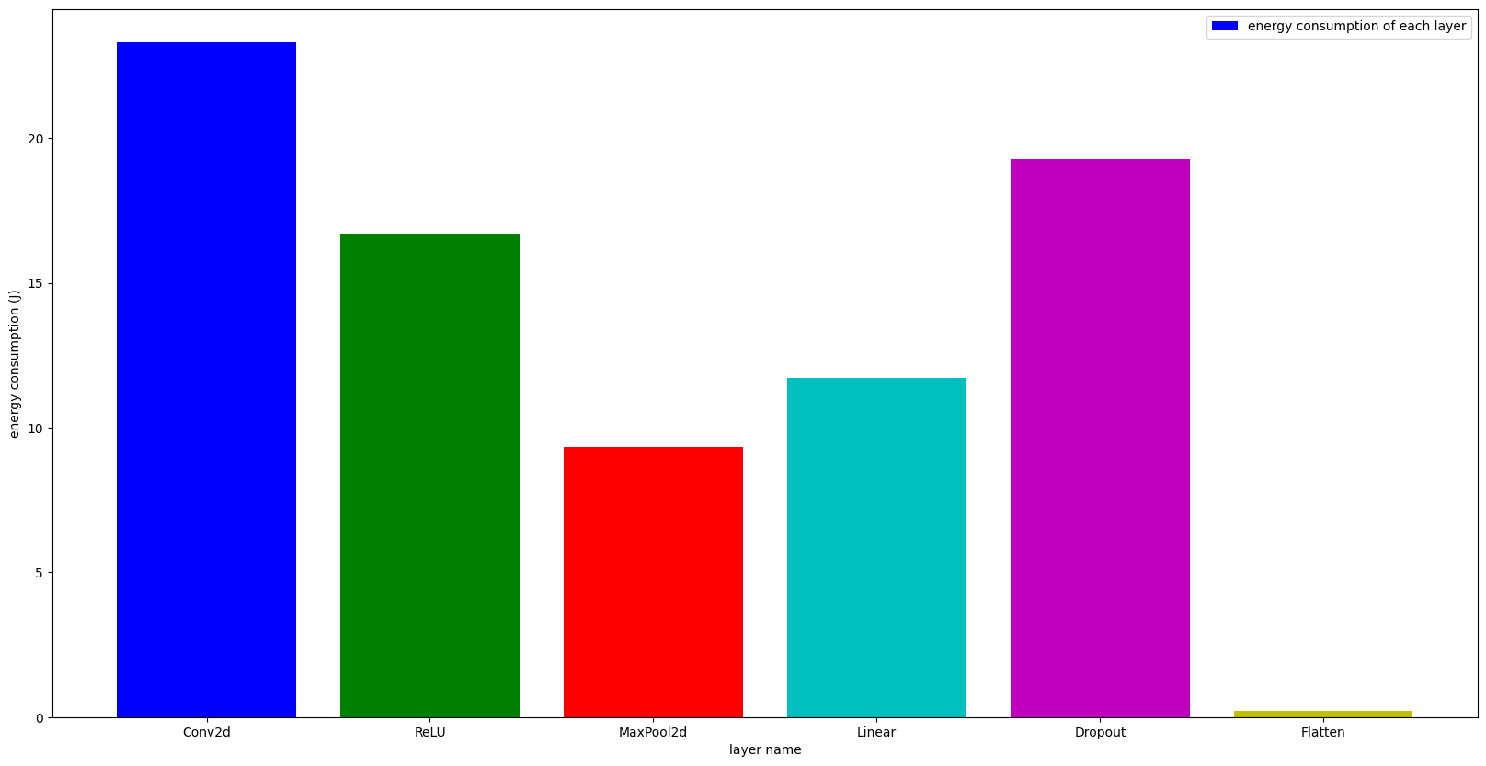
Energy_consumption in Alexnet-powermetrics
Data: Fashion-MNIST, batch_size = 128
batch_size | time(s) | forward | loss | backward | optimizer
64 | 182 | 72.309 | 10.249 | 94.480 | 29.469
128 | 329 | 82.780 | 15.411 | 103.444 | 26.234
256 | 320 | 62.145 | 12.179 | 82.063 | 62.145
512 | 288 | 58.808 | 10.630 | 43.317 | 11.070
1024 | 346 | 100.927 | 15.385 | 71.189 | 46.927
Relationship between energy consumption and batch_size

Slide 8
Next step
Is it the right direction?
The to_device consume way much more time than model training and test.
HW difference
Code problem, multi threads can solve this.
Transfer to linux
Apply codecarbon in devices which in databases

Slide 9
Thanks

