Slide 1



Analysis of the energy sustainability of Machine Learning algorithms
Students:
Yin Jun
Tutors:
Prof. Meo Michela
Prof. Vallero Greta
First presentation
23/10/2023

Slide 2
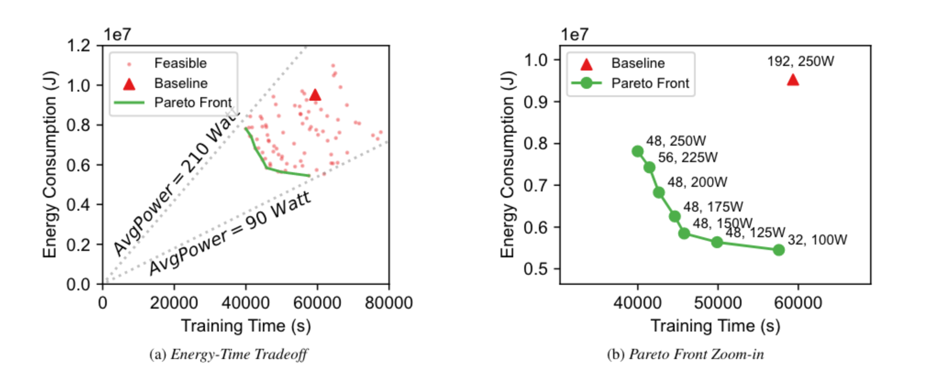
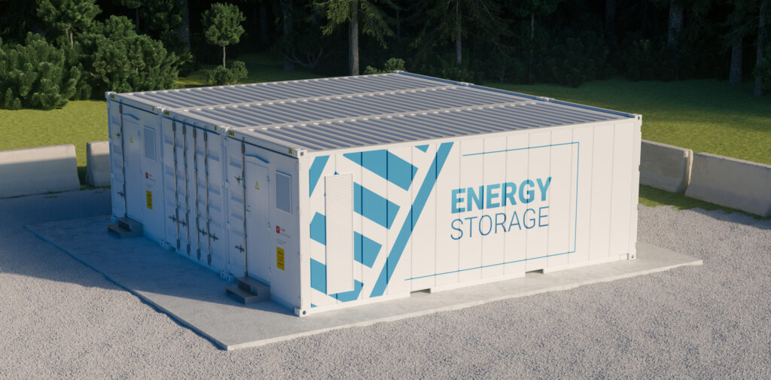
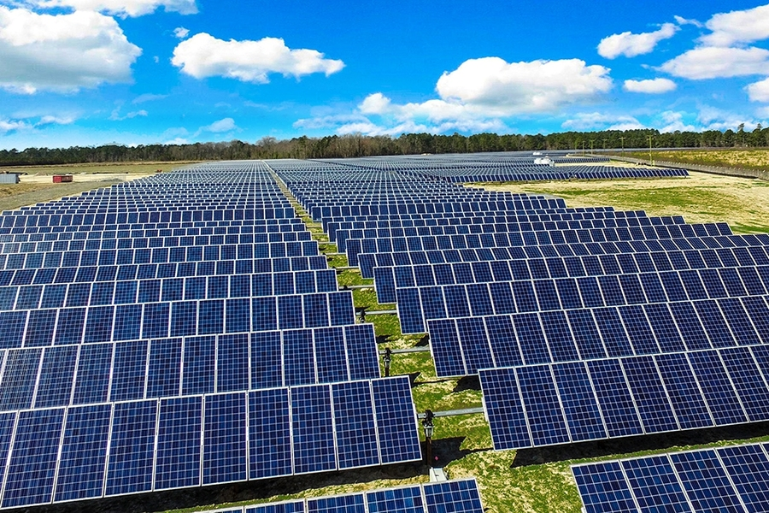
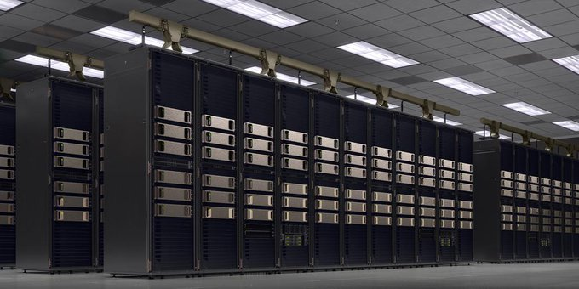
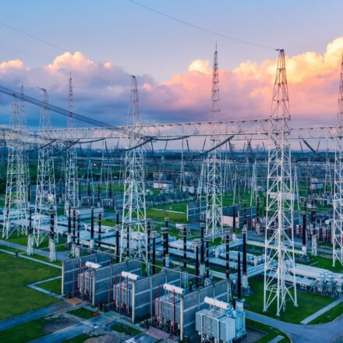






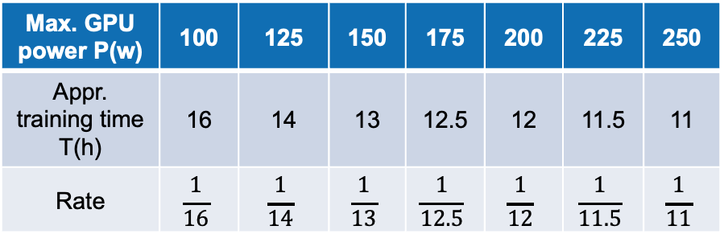

$${βD}_{t}^{dc}$$
$$R_{t}^{solar}$$
$$P_{t}^{solar}$$
+
Data Center
$$W_{t}^{solar}$$
Max. GPU power P(w) | 100 | 125 | 150 | 175 | 200 | 225 | 250
Appr. training time T(h) | 16 | 14 | 13 | 12.5 | 12 | 11.5 | 11
Rate | $$\frac{1}{16}$$ | $$\frac{1}{14}$$ | $$\frac{1}{13}$$ | $$\frac{1}{12.5}$$ | $$\frac{1}{12}$$ | $$\frac{1}{11.5}$$ | $$\frac{1}{11}$$
$$P_{t}^{grid}$$
$$R_{t}^{grid}$$
$${βD}_{t}^{grid}$$
Model training request [1]
Power supply

Slide 3
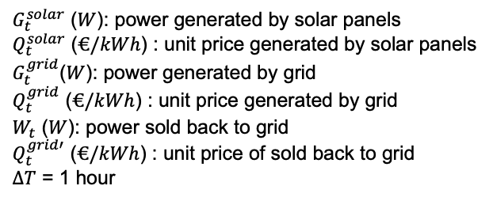
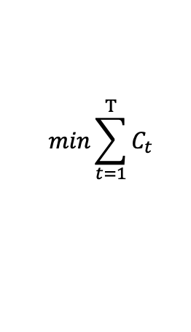
Energy dispatch
Objective function
$$min\sum_{t=1}^{T}{C_{t}}$$
$C_{t}$ ($€$): electricity cost of each time slot by data center
Cost function
$$C_{t}=G_{t}^{solar}∙∆T∙Q_{t}^{solar}+G_{t}^{grid}∙∆T∙Q_{t}^{grid}−W_{t}∙∆T∙Q_{t}^{grid′}$$
$G_{t}^{solar}$ ($W$): power generated by solar panels
$Q_{t}^{solar}$ ($€/kWh$) : unit price generated by solar panels
$G_{t}^{grid}$($W$): power generated by grid
$Q_{t}^{grid}$ ($€/kWh$) : unit price generated by grid
$W_{t}$ ($W$): power sold back to grid
$Q_{t}^{grid′}$ ($€/kWh$) : unit price of sold back to grid
$∆T$ = 1 hour
Notes:
暂时先不考虑太阳能的部分
用最优的方案，看看能剩多少钱，比较两种极端情况，计算最终能够节省下来的钱有多少能够用到安装太阳能电池板上
注意一下如果按照这个数据来进行计算的话要考虑开始时间，早上的话太阳能多，晚上的话太阳能少但是电价便宜

Slide 4
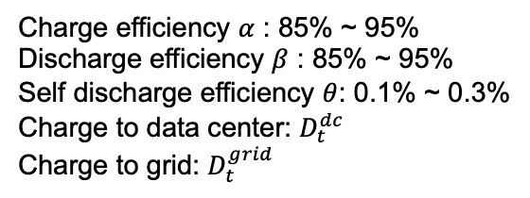

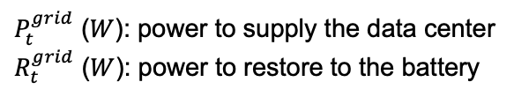

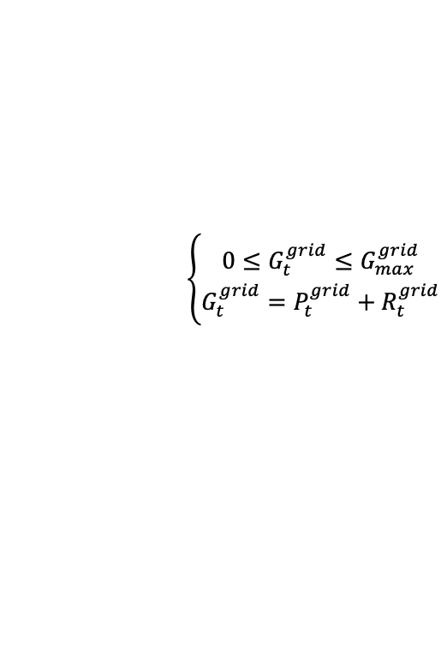

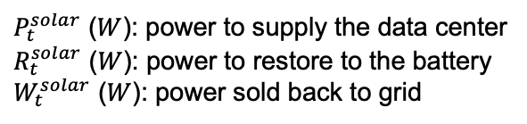
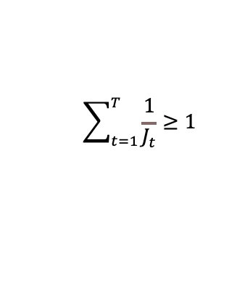

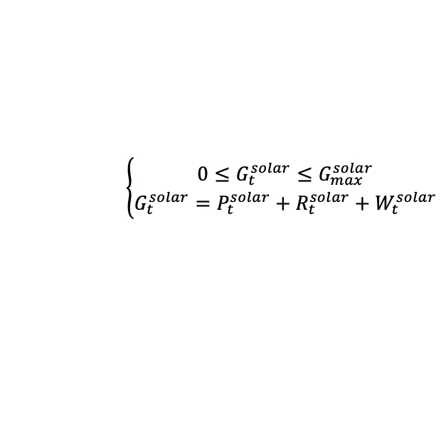

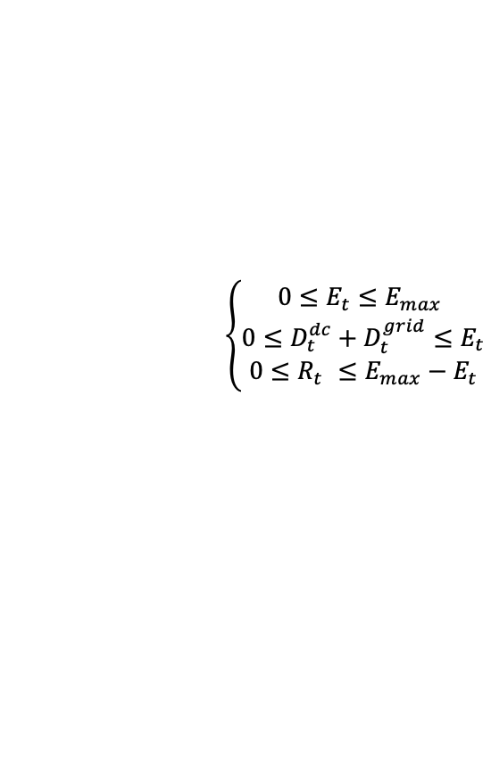
Energy dispatch
s.t. :
Solar panels
Data center
$$\left\{\begin{aligned}0≤G_{t}^{solar}≤G_{max}^{solar} \\ G_{t}^{solar}=P_{t}^{solar}+R_{t}^{solar}+W_{t}^{solar}\end{aligned}\right.$$
$P_{t}=P_{t}^{solar}+P_{t}^{grid}$ + ${βD}_{t}^{dc}$
$$\sum_{t=1}^{T}{\frac{1}{J_{t}}}≥1$$
$P_{t}^{solar}$ ($W$): power to supply the data center
$R_{t}^{solar}$ ($W$): power to restore to the battery
$W_{t}^{solar}$ ($W$): power sold back to grid
$P_{t}$ ($W$): supplied power to data center [100, 125, 150, 175, 200, 225, 250]
$J_{t}$ ($h$): training time [16, 14, 13, 12.5, 12, 11.5, 11]
Grid
$$\left\{\begin{aligned}0≤G_{t}^{grid}≤G_{max}^{grid} \\ G_{t}^{grid}=P_{t}^{grid}+R_{t}^{grid}\end{aligned}\right.$$
Charge ESD
$$R_{t}=R_{t}^{solar}+R_{t}^{grid}$$
$P_{t}^{grid}$ ($W$): power to supply the data center
$R_{t}^{grid}$ ($W$): power to restore to the battery
Back to grid
$$W_{t}=W_{t}^{solar}+{βD}_{t}^{grid}$$
ESD (energy storage device)
ESD power in each time slot
Charge efficiency $α$ : 85% ~ 95%
Discharge efficiency $β$ : 85% ~ 95%
Self discharge efficiency $θ$: 0.1% ~ 0.3%
Charge to data center: $D_{t}^{dc}$
Charge to grid: $D_{t}^{grid}$
$$E_{t}=(1−θ)∙\left[E_{t−1}−D_{t−1}^{dc}−D_{t−1}^{grid}+αR_{t−1}\right]$$
$E_{1}=0,D_{1}^{dc}=0,D_{1}^{grid}$=0
$$\left\{\begin{aligned}0≤E_{t}≤E_{max} \\ {0≤D}_{t}^{dc}+D_{t}^{grid}≤E_{t} \\ {0≤R}_{t} ≤E_{max}−E_{t}\end{aligned}\right.$$

Slide 5
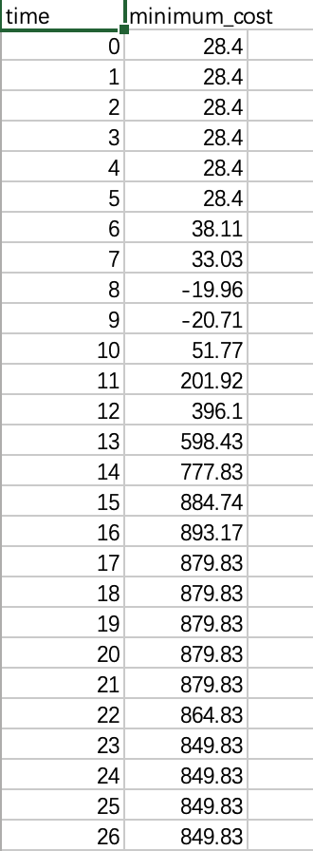
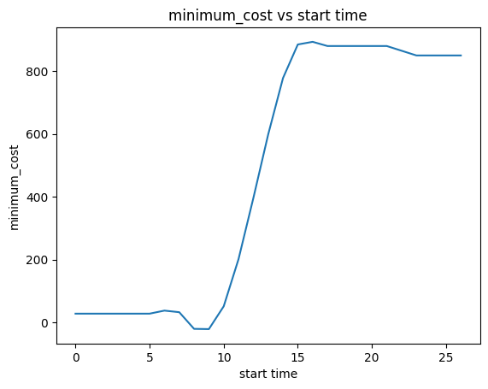
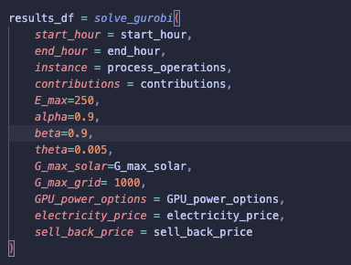
Energy dispatch – case study
Notes:
暂时先不考虑太阳能的部分
用最优的方案，看看能剩多少钱，比较两种极端情况，计算最终能够节省下来的钱有多少能够用到安装太阳能电池板上
注意一下如果按照这个数据来进行计算的话要考虑开始时间，早上的话太阳能多，晚上的话太阳能少但是电价便宜

Slide 6
Thanks

