Slide 1



Analysis of the energy sustainability of Machine Learning algorithms
Students:
Yin Jun
Tutors:
Prof. Meo Michela
Prof. Vallero Greta
First presentation
23/10/2023

Slide 2
Agenda
Last time question
Simulation results

Slide 3
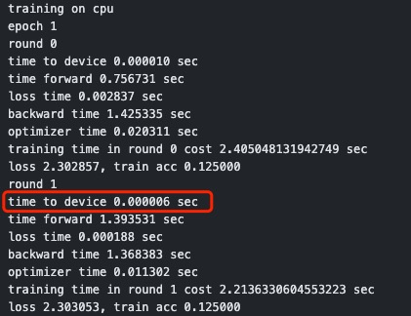
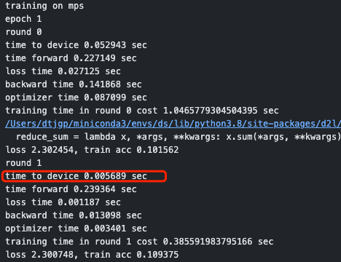
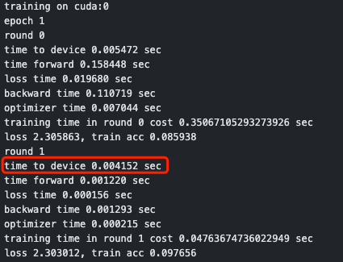
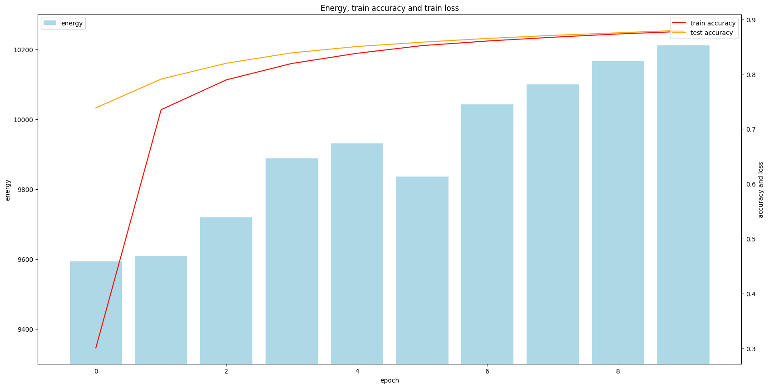
Last time question
1.to_device() time
Training on cpu
Training on mps
Training on gpu
Multi epoch result

Slide 4
Agenda
Last time question
Simulation results

Slide 5
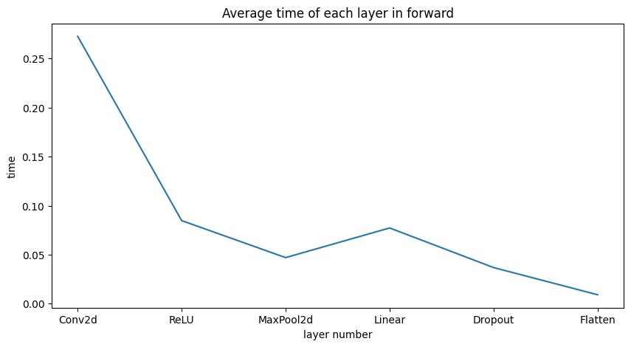
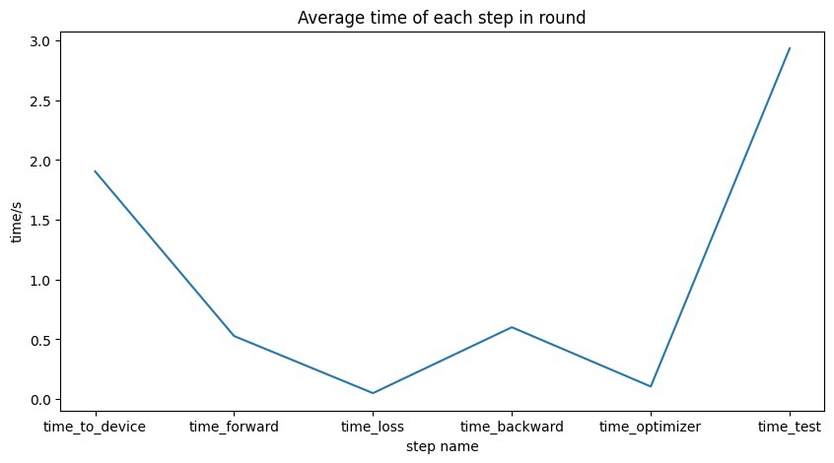
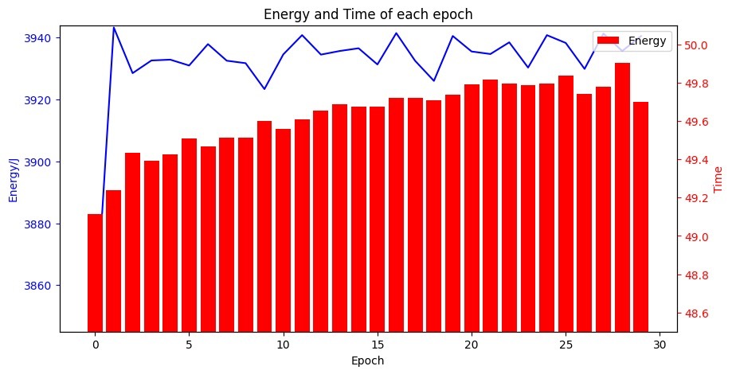
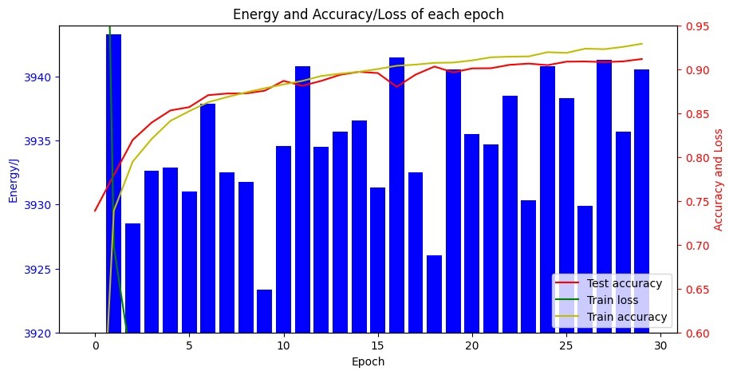
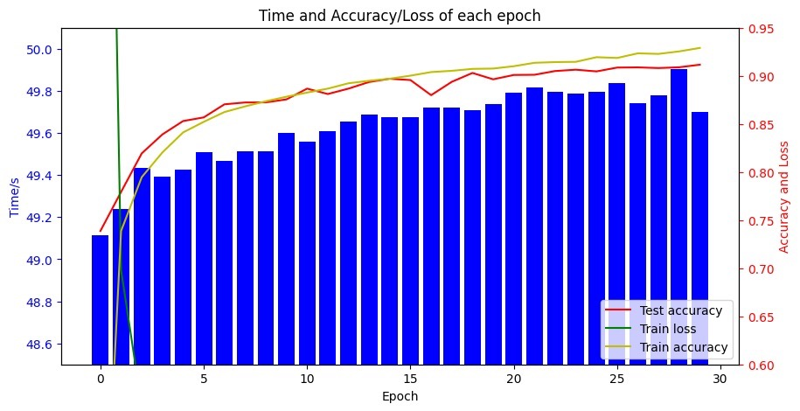
Simulation results
Optimizer: SGD
Mean energy: 3932J/epoch
nvidia-smi --query-gpu=power.draw --format=csv --loop-ms=1000 > gpu_power_usage.csv

Slide 6
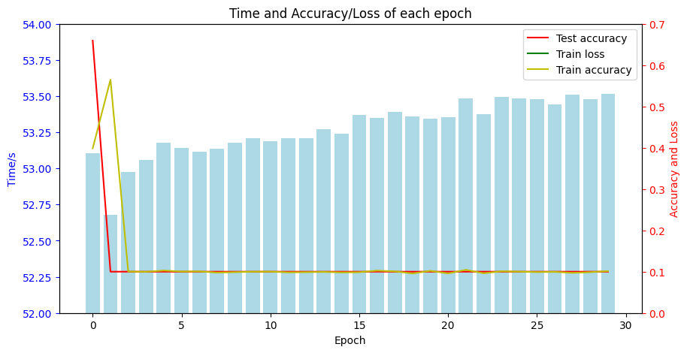
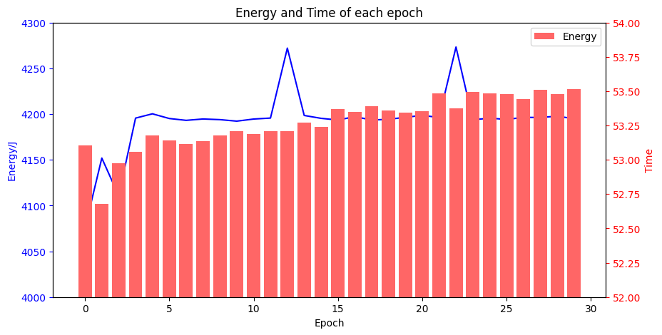
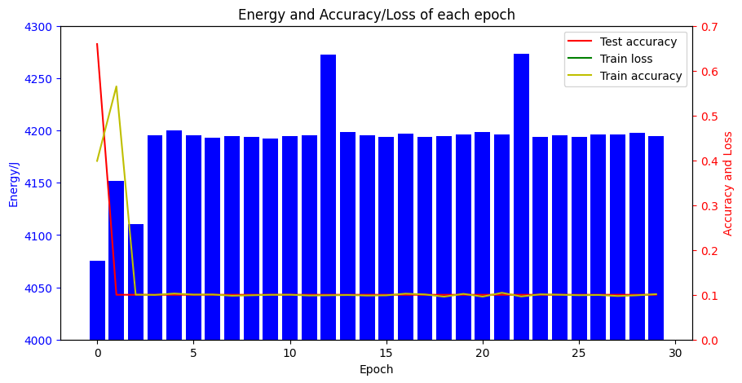
Simulation results
Optimizer: Adam
Mean energy: 4192J/epoch

Slide 7
Question
How to make compromise between acc and energy consumption?
Is time sufficient to be the measurement?

Slide 8
Thanks

