Slide 1
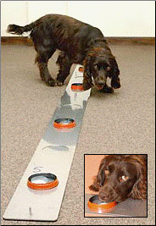
New York Times, September 28, 2004 D.G. McNeil
Moist Nose Shows Promise in Tracking Down Cancers
British researchers have trained dogs to detect bladder cancer by sniffing human urine, opening up the possibility that dogs - or electronic noses modeled on their snouts - may one day be used to detect the disease.
The study, published in the British medical journal BMJ on Saturday, is the first to demonstrate scientifically that dogs can detect cancer through smell, its authors said.
The study, done at Amersham Hospital in Buckinghamshire, England, was small; six dogs sniffed at 54 urine samples after weeks of training.
As a group, they were only about 41 percent accurate. That is far below what is considered acceptable on most medical tests, but the idea is in its infancy.
Dog tests might eventually be cheap and work early, and they also might be useful in poor countries, scientists said.
A dog named Tangle works his way along a line of urine samples during his search for one from a patient with bladder cancer. Tangle has been taught to lie down by a positive sample.

Slide 2
Suppose another research group announced a test that was 95 percent accurate? Compare the new test to the dog test (which was 41% accurate).
The new test would be much better.
The new test would be somewhat better.
The new test might be better or worse.
The new test would be somewhat worse.
The new test would be much worse.

Slide 3
Terror no-fly list singled out Kennedy
Senator was stopped 5 times at airports
Sara Kehaulani Goo, Washington Post Friday, August 20, 2004
Washington -- Sen. Edward "Ted" Kennedy said Thursday that he was stopped and questioned at airports on the East Coast five times in March because his name appeared on the government's secret "no-fly" list.
Federal air security officials said the initial error that led to scrutiny of the Massachusetts Democrat should not have happened even though they recognize that the no-fly list is imperfect. But privately they acknowledged being embarrassed that it took the senator and his staff more than three weeks to get his name removed.
A senior administration official, who spoke on condition he not be identified, said Kennedy was stopped because the name "T. Kennedy" has been used as an alias by someone on the list of terrorist suspects.
While he worked to clear himself, Kennedy kept having to wait in the terminal at Washington's Reagan National, Boston's Logan International and at least one other airport, his staff said. All the flights were on US Airways.
When the senator checked in at the counter, airline employees told him they could not issue him a boarding pass because he appeared on the list. Kennedy was delayed until a supervisor could be summoned to identify him and give approval for him.
Kennedy's description of his air travel troubles -- mentioned during a Senate Judiciary Committee hearing Thursday on the 9/11 panel's recommendations -- gave new life to questions about the quality and effectiveness of the no-fly list. Security, intelligence and law enforcement agencies established the list after the 2001 terrorist attacks. Critics said the senator's experience served as the latest example of how a system designed to improve security is instead targeting innocent travelers.
The government does not make public the names or total number of people on the list, which officials say is constantly updated. According to FBI documents obtained by the American Civil Liberties Union under a Freedom of Information Act request, more than 350 Americans have been delayed or denied boarding since the list's inception. The list hasn't led to any arrests, officials said.
The American Civil Liberties Union has filed a lawsuit on behalf of six Americans who have had experiences similar to Kennedy's.
"That a clerical error could lend one of the most powerful people in Washington to the list -- it makes one wonder just how many others who are not terrorists are on the list," said Reggie Shuford, a senior ACLU counsel. "Someone of Sen. Kennedy's stature can simply call a friend to have his name removed, but a regular American citizen does not have that ability. He had to call three times himself."
A Kennedy aide said the senator nearly missed a couple of flights because of the delays. After the first few incidents, his staff called the Transportation Security Administration, which maintains the no-fly list. But even after those discussions about getting his name removed, the senator was stopped again, according to Kennedy spokesman David Smith.
Homeland Security Secretary Tom Ridge finally called to personally apologize about the mix-up, and the delays stopped in early April, Smith said.
TSA spokesman Mark Hatfield said the no-fly system occasionally causes problems because the airlines are responsible for flagging passengers who show up on the list.
"Administration of the list clearly needs to be changed and consolidated to be government-managed," Hatfield said. "This points out the weakness in having the names checked against passengers at hundreds of different airlines at thousands of different airline counters across the country."

Slide 4
Imagine that the Travel Security Administration developed an ID-card reading system that is 99.9% accurate for detecting terrorists.
Impossible, but I would support it.
Impossible, and I would not support it.
Might be possible, but I would support it.
Might be possible, but I would not support it.

Slide 5
Immigrants applying for permanent residency status are required to take a blood test, including an HIV test.
Testing positive for HIV disqualifies the applicant.
The test is not perfect.
Assuming for the moment that HIV is a good reason to disqualify an applicant for a green card, how reliable should the test be before we take it seriously?
QUESTION: The test should be good enough so that a person who tests positively has a
10% 20% 30% 40% 50% 60% 70% 80% 90%
probability of actually having HIV.

Slide 6
BSE/Mad Cow Disease
In some countries, e.g., UK, Japan, Switzerland, all slaughtered cattle are tested for BSE.
The US tests about 1% of cattle, and these are mostly the “downers.”
As the test improves, how accurate does it have to before you would encourage the US government to use it more widely?
1 2 3 4 5 6 7 8
50% 75% 90% 95% 99% 99.9% 99.999% 99.9999%

Slide 7
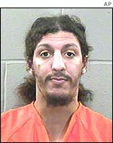
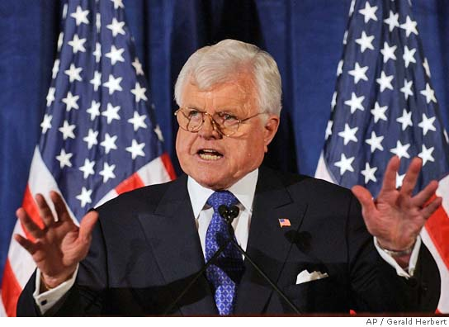
Tests Involve Two Kinds of Possible Errors
False Positive:
Test was positive but wrong.
False Negative:
Test was negative but wrong.
Senator Kennedy
Shoe bomber Richard Reid
Notes:
Ted Kennedy (top) and Richard Reid (a.k.a. the shoe bomber

Slide 8
Dog Sniffing Cancer Test: 41% accurate
Population
1000
Cancer
100
No Cancer
900
Test Pos
100
Test Neg
0
Test Pos
610
Test Neg
290

Slide 9
Dog Sniffing Cancer Test: 95% accurate, but worse than the 41% test
Population
1000
Cancer
25
No Cancer
975
Test Pos
0
Test Neg
25
Test Pos
25
Test Neg
950

Slide 10
Transportation Security Administration
A secret no-fly list established after 9/11 by security, intelligence, and law-enforcement agencies contains the names of known or suspected terrorists.
How does it work? Ticket agents compare the name on the ID card to the list. The government does not make public the names or total number of people on the list, which officials say is constantly updated.
This system is more than 99% accurate.

Slide 11
Travel Security Administration: No-Fly List, 99.9% accurate
Population
10,000,000
Terrorist
10
Not a Terrorist
9,999,990
Test Pos
0
Test Neg
10
Test Pos
350
Test Neg
9,999,640

Slide 12
This is a good test, since it is 99.9% accurate.
1 2 3 4 5
Strongly agree Agree Neutral Disagree Strongly
Agree Disagree

Slide 13
Mammography
The probability that a woman of age 40 has breast cancer is about 1%.
The accuracy of a screening mammograms is about 93%
If a woman of age 40 has a mammogram that is positive, the probability that she has cancer is about
10% 20% 30% 40% 50% 60% 70% 80% 90%
Notes:
Numbers from Gigerenzer, p.45

Slide 14
Mammography
Population
1000
Cancer
8
No Cancer
992
Test Pos
7
Test Neg
1
Test Pos
70
Test Neg
922

Slide 15
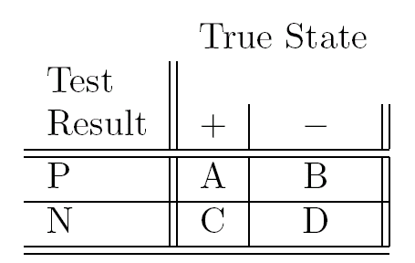
A Canonical Summary
Sensitivity: A/(A+C)
For the + objects, what is the probability of a correct test result.
Specificity: D/(B+D)
For the – objects, what is the probability of a correct test result.
Prevalence: (A+C)/n
What fraction of the objects are +.
Total count: n=A+B+C+D

Slide 16
A Canonical Summary
Population
N
Sensitivity: A/(A+C)
For the + objects, what is the probability of a correct test result.
Specificity: D/(B+D)
For the – objects, what is the probability of a correct test result.
Prevalence: (A+C)/n
What fraction of the objects are +.
Total count: n=A+B+C+D
Diseased
N*prevalence
Healthy
N*(1-prev)
Pos
Test
A
Neg
Test
C
Pos
Test
B
Neg
Test
D

Slide 17
Some other terms
Accuracy: (A+D)/n
How often is the test right in either way?
Pos. Predictivity: A/(A+B)
For the P objects, what’s the probability of +?
Neg. Predictivity: D/(C+D)
For the N objects, what’s the probability of -?

Slide 18
Some other terms
Population
N
Accuracy: (A+D)/n
How often is the test right in either way?
Pos. Predictivity: A/(A+B)
For the P objects, what’s the probability of +?
Neg. Predictivity: D/(C+D)
For the N objects, what’s the probability of -?
Diseased
N*prevalence
Healthy
N*(1-prev)
Pos
Test
A
Neg
Test
C
Pos
Test
B
Neg
Test
D

Slide 19
Designing a Test
Generally a test involves a threshold or parameter, e.g., dial on metal detector, “normal” range on medical tests, # of repeat tests …
This parameter can be set to increase sensitivity at the cost of specificity, or vice versa.
We can always make a perfectly sensitive test, or a perfectly specific test.
The “Receiver Operating Curve”

Slide 20
Receiver Operating Curve
100%
Useful test
Specificity
Dumb Luck
0
100%
Sensitivity

Slide 21
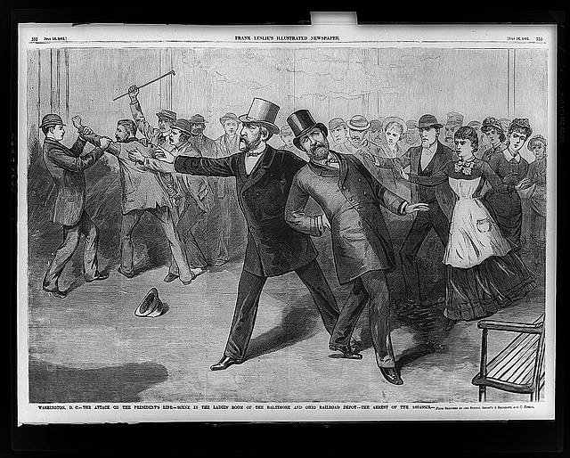
Pres. Garfield shot: July 2, 1880

Slide 22
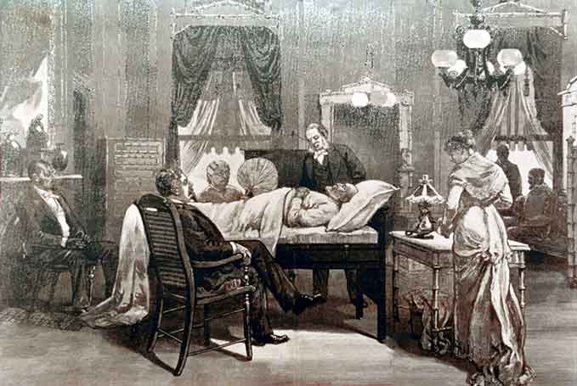
President taken to the White House with a bullet near his spine.

Slide 23
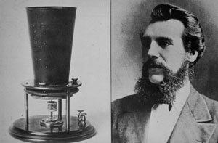
Invention of The Metal Detector by Alexander Graham Bell
Consulting doctors ask Bell to invent metal detector. He does so in two weeks.
Examined Garfield on July 26. Bell: “We found it difficult to adjust the balance to obtain silence.”
Refined device. Try again on Aug 1. Failed on Garfield, but were able to locate bullets in test material. Garfield too weak now for operation.
Aug 2. Startling discovery in White House
Sept 19. Garfield dies

Slide 24
Sensitivity and Specificity
In initial tests, metal detector is insensitive to bullets.
Bell is able to increase sensitivity of his device in order to find deep bullets.
Increased sensitivity comes at the expense of decreased specificity: False positives.
Device swamped by false positives from Garfield’s metal box spring (unusual type of bed for the time).

Slide 25
Mad-Cow Disease
Expert Warned that Mad Cow Was Imminent
New York Times, Dec.25, 2003
Ever since he identified the bizarre brain-destroying proteins that cause mad cow disease, Dr. Stanley Prusiner, a neurologist at the Univ. of California at San Francisco, has worried about whether the meat supply in America is safe.
He spoke over the years of the need to increase testing and safety measures. Then in May, a case of mad cow disease appeared in Canada, and he quickly sought a meeting with Ann M . Veneman, the secretary of agriculture. He was rebuffed, he said in an interview yesterday, until he ran into Karl Rove, senior advisor to President Bush.
So, six weeks ago, Dr. Prusiner, who won the 1997 Nobel Prize in Medicine for his work on prions, entered Ms. Veneman’s office with a message. “I went to tell her that what happened in Canada was going to happen in the United States,” Dr. Prusiner said. “I told her it was just a matter of time.”

Slide 26
This nation should immediately start testing every cow that shows signs of illness and eventually every single cow upon slaughter, he said he told Ms. Veneman. Japan has such a program and is finding the disease in young asymptomatic animals.
Fast, accurate and inexpensive tests are available, Dr. Prusiner said, including one that he has patented through his university.
Ms. Veneman’s response (he said she did not share his sense of urgency) left him frustrated. That frustration soared this week after a cow in Washington State was tentatively found to have the disease. If the nation had increased testing and inspections, meat from that cow might never have entered the food chain, he said.
Animals that eat infected tissues can contract the disease, setting off an epidemic as animals eat each other via rendered meats. But misfolded proteins can also arise spontaneously in cattle and other animals, Dr. Pusiner said. It is not known whether meat from animals with that form of the disease could pass the diesase to humans, he said, but it is a risk that greatly worries him.
Cattle with sporadic disease are probably entering the food chain in the United States in small numbers, Dr. Prusiner and other experts say.
“The problem is we just don’t know the size of the problem,” he said. “We don’t know the prevalence or incidence of the disease.”

Slide 27
Plan for Sharp Rise in Mad Cow Testing Gets Mixed Reaction
New York Times, March 17, 2004
The Agriculture Department’s plan for a tenfold increase in testing for mad cow disease was greeted yesterday with a mixture of optimism and skepticism.
The plan, announced Monday, involves testing half the nation’s 446,000 “downer” cows– animals deemed at higher risk of having mad cow diesase because they cannot walk or because they show signs of nervous system disorders. It will also test 20,000 older, apparently healthy cows at slaughter.
Agriculture Secretary Ann M. Veneman said that the goal was to reassure consumers, trading partners and the industry that cows were being properly tested.
Some experts in risk analysis said that the plan was an excellent way to assess the problem, but consumer groups and trading partners were not convinced. Japan, until December one of the largest importers of American beef, said the ban would continue until the cattle industry tested every cow slaughtered.

Slide 28
Plan for Sharp Rise … continued
Testing laboratories will be established around the country and are expected to process 250,000 to 400,000 snippets of brain tissue taken from the specified cattle.
By the laws of probability, the department said, that many tests should detect mad cow disease even if it is present in only 5 cows of the 45 million in the nation.
“We have been quite convinced that the disease is on its way out,” Dr. Gray said. “If they find one, two, or three cases, it will be a signal that we had a bigger challenge than we thought. If they find no cases, it will suggest that the prevalence is extremely low. That would mean there’s a good chance the disease is not here at all.”

Slide 29
Should we test all cows? Why test just the “downer” cows?
US 100 million cattle. Japan 4 million
US 35 million slaughtered each year. Japan 1.2 million
Japan tests all cows. Found 3 cases in 3 years.
Testing all cattle would raise price of beef by 2-3 cents per pound.
Mad cow transmitted by eating nervous-system tissue. Can also occur spontaneously.
Disease more likely in older cows. Cows with severe disease display strong symptoms: downers.

Slide 30
Editorial in the Los Angeles Times (Feb. 26, 2004):
The recent outbreak of mad cow disease led to immediate, soothing reassurances from the U.S. Department of Agriculture, resting on what sounded like hard, scientific facts. Don't worry, the official story went, we have a rigorous inspection program designed to ensure with 95 percent certainty that fewer than one in a million cattle have the disease. Doing more than that would be unnecessarily expensive because we are already, it seems, safe enough.
Instead of resolving to find every case of mad cow disease and eradicate it from the United States, the USDA engaged in a how-much-is-too-much conversation in which it balanced the safety of our meat supply with the beef industry's bottom line.
That cost-benefit approach is how regulatory Washington makes decisions these days, and the mad cow fiasco is the perfect example of the moral bankruptcy of the method. With 36 million cattle slaughtered annually in the United States, the 'one-in-a-million' threshold would actually allow more than one case of mad cow disease every two weeks."

Slide 31
Comprehensive BSE testing in US, test is 99.9999% accurate
Cattle Slaughtered
35,000,000
BSE
10
No BSE
34,999,990
Test Pos
10
Test Neg
0
Test Pos
35
Test Neg
34,999,955

Slide 32
Restricted BSE testing in US, test is 99.9999% accurate. High risk population with 80% of cases
Cattle Slaughtered
200,000
BSE
8
No BSE
199,992
Test Pos
8
Test Neg
0
Test Pos
0.5
Test Neg
199,992

Slide 33
US to take fingerprints of visiting Muslims
By David Rennie in Washington
(Filed: 06/06/2002)
[telegraph.co.uk]
America announced last night that tens of thousands of visitors from Islamic countries must register with the government and submit to fingerprinting.
New arrivals and more than 100,000 visa-holders from up to 35 countries already in America will be affected by the regulation, which revives long-dormant powers from a 1952 immigration law.
The move, which was condemned by Arab-American rights groups, was announced on television by John Ashcroft, the attorney-general. It has been the subject of fierce debate in the Bush administration, officials told the New York Times yesterday.
One official said White House and Justice Department officials backed the move, which would affect "individuals from countries who pose the highest risk to our security".

Slide 34
The Associated Press State & Local Wire
The materials in the AP file were compiled by The Associated Press.
November 11, 2003, Tuesday,
Groups file suit to overturn immigrant drivers' license law
BYLINE: By ANNA OBERTHUR, Associated Press Writer
DATELINE: SACRAMENTO
A small Hispanic organization and a conservative legal group have teamed up to block a new law granting drivers' licenses to California's undocumented immigrants from taking effect in January.
The Pacific Legal Foundation filed a lawsuit Monday on behalf of Latino Americans for Immigration Reform, a 55-member association based in Salinas and Santa Ana. The suit claims the law is not only unconstitutional, but a slap to legal immigrants, said Lupe Moreno, spokeswoman for the Hispanic group.
An attorney for the Sacramento-based legal foundation that conceived and filed the lawsuit said the court challenge was the surer and speedier course to reverse the law signed by Gov. Gray Davis as he fought in vain to save his job during the recall election.

Slide 35
Groups file suit to overturn immigrant drivers' license law (cont.)
"This new scheme undermines the rule of law and rewards people who violate the law," said Pacific Legal Foundation attorney Harold Johnson.
Johnson said it provides a "flashing green light for those who come here with hostile intentions."
Davis was criticized for pandering to Hispanics when he signed Senate Bill 60 in September, reversing a 1993 law by allowing undocumented immigrants a chance to earn California drivers' licenses. New Mexico has a similar law.
The lawsuit is the latest in a series of efforts to undo the bill. A private organization called the California Republican Assembly launched a referendum last month aimed at bringing the matter to voters in the March election, and Gov.-elect Arnold Schwarzenegger has said he plans to call a special legislative session to try to repeal the legislation.

Slide 36
Groups file suit to overturn immigrant drivers' license law (cont.)
Francisco Estrada, spokesman for the Mexican American Legal Defense and Education Fund, said the legal challenge was ridiculous.
"These people are just using this rhetoric to stir up the same kind of wedge politics and divisiveness that is threatening to tear our state apart," Estrada said. "And that, as far as I can see, is their only motivation."
The lawsuit claims that offering licenses to undocumented immigrants intrudes on the federal government's authority over immigration. It also charges the law will encourage voter fraud and that it illegally restricts information sharing with federal law enforcement, Johnson said.
Supporters of the bill said it would offer essential workers a legal way to get to their jobs and it would improve safety by requiring drivers to pass tests and get insurance.

Slide 37
Copyright 2002 Star Tribune
Star Tribune (Minneapolis, MN)
St. Paul Star Tribune, December 13, 2002, Friday, Pg. 2B
Court hears appeal of immigrant driver rules;
The restrictions aimed to stop terrorism have been a problem to visitors and Muslim women
Conrad deFiebre; Staff Writer
New driver's license rules intended to check terrorism are unconstitutionally unfair to temporary foreign visitors and veiled Muslim women, attorneys for immigrant groups told a Minnesota Court of Appeals panel Thursday.
But a state lawyer defending the rules said they are a legal and necessary measure to safeguard all Minnesotans from serious and imminent threats of more attacks like those of Sept. 11.
The rules took effect in July and were planned to last for up to two years after secret emergency proceedings before state administrative law judges. Since then, 3,088 foreigners have been issued licenses with their visa expiration dates printed in red, and veiled women have been denied the former option of getting licenses without identification photos.
In addition, all first-time applicants for Minnesota driver's licenses have been required to produce two forms of identification, not including a license from another state.
The rules figured prominently in the 2002 legislative session, when Senate DFLers blocked their passage, and in the gubernatorial campaign, when Republican Tim Pawlenty vowed on his way to victory in the Nov. 5 election to put them into permanent law.
Critics, including all of Pawlenty's major-party opponents, said the rules unfairly single out a few segments of Minnesota's diverse society, even though, as the immigrants' attorney Todd Noteboom argued Thursday, most acts of terror have been committed by "our very own United States citizens."
Although most of Thursday's one-hour hearing in St. Paul focused on legal and procedural technicalities, the dispute has become a flashpoint for wider immigration concerns.
Marilyn Larson of Minneapolis, founder and president of Minnesotans for Immigration Reform, issued a statement calling the rules "a shining example of what state governments must do to help the federal government regain control of America's borders."
She said that the Sept. 11 hijackers had dozens of U.S. driver's licenses and that some licenses have even been found in caves in Afghanistan, "proof that those who wish to do us harm understand the importance of obtaining a state ID," she added.
No applicant uproar
Kevin Smith, spokesman for the Department of Public Safety, said Thursday that the rules have caused little apparent concern among license applicants. "It's been relatively well received," he said. "No one that we know of has left in a huff."
That's at least partly due to meetings with immigrant groups and some modifications in procedures for photographing veiled women, he said. That is being done in a private room rather than at a public counter and, although the rules call for a full-face photo, women are being asked to lift the veil only above their eyebrows, he said.
And although the rules allow veiled women to seek a variance from the photo requirement, none has done so, Smith said.
Assistant Attorney General Melissa Eberhart said in court Thursday that the rules impose no unfair burden because obtaining a driver's license is "not a right, but a privilege" and because "there is no requirement to get a driver's license." She also argued that the judges should strike down the rules only if they find them "arbitrary and capricious."
Noteboom said that because the rules were imposed without public hearings and with the support of a secret FBI bulletin on terror threats, which is still being withheld from the appellants but not the judges, they should be subject to a tougher standard.
Although it wasn't discussed in court Thursday, the immigrant groups also are appealing the new identification requirements for license applicants. In an interview, Noteboom said the rules exclude many legal-immigration documents and are inconsistent with federal law.
Appeals Court Judges Jill Flaskamp Halbrooks, David Minge and Gordon Shumaker have 90 days to issue a ruling.
_ Conrad deFiebre is at cdefiebre@startribune.com.

Slide 38
St. Paul Star Tribune, December 13, 2002, Friday, Pg. 2B
Court hears appeal of immigrant driver rules;
The restrictions aimed to stop terrorism have been a problem to visitors and Muslim women
Conrad deFiebre; Staff Writer
New driver's license rules intended to check terrorism are unconstitutionally unfair to temporary foreign visitors and veiled Muslim women, attorneys for immigrant groups told a Minnesota Court of Appeals panel Thursday.
But a state lawyer defending the rules said they are a legal and necessary measure to safeguard all Minnesotans from serious and imminent threats of more attacks like those of Sept. 11.
The rules took effect in July and were planned to last for up to two years after secret emergency proceedings before state administrative law judges. Since then, 3,088 foreigners have been issued licenses with their visa expiration dates printed in red, and veiled women have been denied the former option of getting licenses without identification photos.
In addition, all first-time applicants for Minnesota driver's licenses have been required to produce two forms of identification, not including a license from another state.
The rules figured prominently in the 2002 legislative session, when Senate DFLers blocked their passage, and in the gubernatorial campaign, when Republican Tim Pawlenty vowed on his way to victory in the Nov. 5 election to put them into permanent law.
Critics, including all of Pawlenty's major-party opponents, said the rules unfairly single out a few segments of Minnesota's diverse society, even though, as the immigrants' attorney Todd Noteboom argued Thursday, most acts of terror have been committed by "our very own United States citizens."
Although most of Thursday's one-hour hearing in St. Paul focused on legal and procedural technicalities, the dispute has become a flashpoint for wider immigration concerns.
Marilyn Larson of Minneapolis, founder and president of Minnesotans for Immigration Reform, issued a statement calling the rules "a shining example of what state governments must do to help the federal government regain control of America's borders."
She said that the Sept. 11 hijackers had dozens of U.S. driver's licenses and that some licenses have even been found in caves in Afghanistan, "proof that those who wish to do us harm understand the importance of obtaining a state ID," she added.
No applicant uproar
Kevin Smith, spokesman for the Department of Public Safety, said Thursday that the rules have caused little apparent concern among license applicants. "It's been relatively well received," he said. "No one that we know of has left in a huff."
That's at least partly due to meetings with immigrant groups and some modifications in procedures for photographing veiled women, he said. That is being done in a private room rather than at a public counter and, although the rules call for a full-face photo, women are being asked to lift the veil only above their eyebrows, he said.
And although the rules allow veiled women to seek a variance from the photo requirement, none has done so, Smith said.
Assistant Attorney General Melissa Eberhart said in court Thursday that the rules impose no unfair burden because obtaining a driver's license is "not a right, but a privilege" and because "there is no requirement to get a driver's license." She also argued that the judges should strike down the rules only if they find them "arbitrary and capricious."
Noteboom said that because the rules were imposed without public hearings and with the support of a secret FBI bulletin on terror threats, which is still being withheld from the appellants but not the judges, they should be subject to a tougher standard.
Although it wasn't discussed in court Thursday, the immigrant groups also are appealing the new identification requirements for license applicants. In an interview, Noteboom said the rules exclude many legal-immigration documents and are inconsistent with federal law.
Appeals Court Judges Jill Flaskamp Halbrooks, David Minge and Gordon Shumaker have 90 days to issue a ruling.
_ Conrad deFiebre is at cdefiebre@startribune.com.

Slide 39
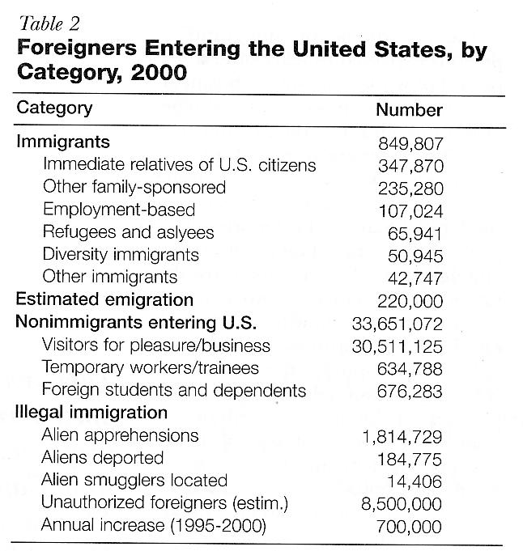
Notes:
David Lanegran wants something said about the 1.8 million alien apprehensions compared to the 184,000 deported. Why are only 10% of apprehended immigrants deported? Ask him for the answer.

Slide 40
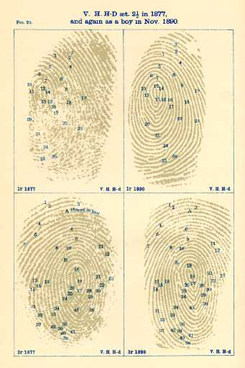
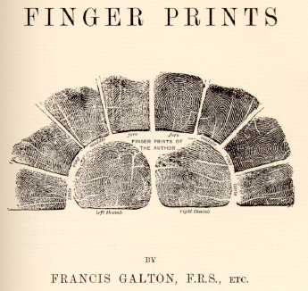
Finger Prints, Francis Galton
(London: Macmillan and Co., 1892)
Notes:
Cousin of Charles Darwin,

Slide 41
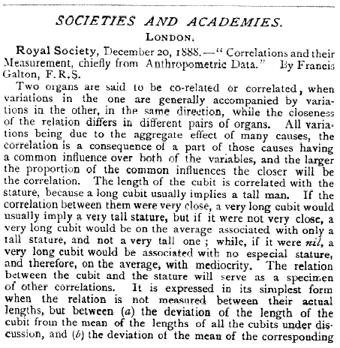
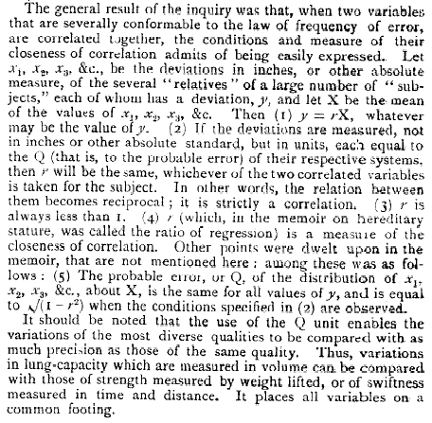
The Correlation Coefficient

Slide 42
Fingerprint testing
Assertions in court
Senior FBI fingerprint supervisor testifies in US Fed. Court that no FBI examiner had ever made an erroneous identification in court. “Its error rate is zero.” - Stephen Meagher
Tested in the courts for decades.
Subject to peer review.
Techniques based on research on the origins of fingerprints during fetal development.
Empirical Tests: send known latent prints and a set of 10-finger cards to crime labs. Check the results.
In IAI crime-lab proficiency tests from 1995 to 2001, 4% of labs made one or more false Ids, 40% missed ID.
2% of cases (including multiple examiners) resulted in false Ids.
No independent experiments have ever been published.
From L. Haber and R.N. Haber, “Error Rates for Human Latent Fingerprint Examiners”

Slide 43
Lawyer Linked to Bombings Is Released
New York Times, May 21, 2004
An Oregon lawyer arrested May 6 and held as a material witness in connection with the deadly Madrid bombings in March was released from custody on Thursday.
The lawyer, Brandon Mayfield, 37, was freed from a detention center … as Spanish authorities said that fingerprints on a plastic bag near the scene of the bombings that killed 191 people belonged to an Algerian national, according to AP.
Beth Anne Steele, a spokeswoman for the FBI in Portland, said she could not comment on the case or on Mr. Mayfield’s release because it was “a pending grand jury matter.”

Slide 44
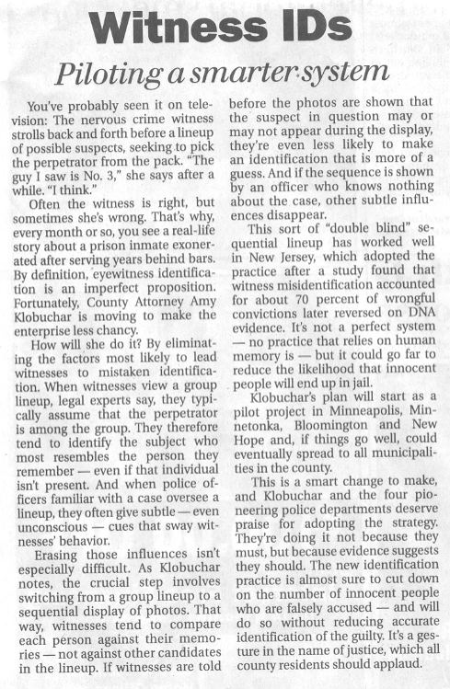
Minneapolis
Star Tribune
Editorial
Mon 10 Nov
page A14

Slide 45
Experiments on Eyewitness Accuracy
Stage a fake crime 200 times in front of 200 different witnesses. Ask witness to pick out the offender from a 6-person line-up. From G.L. Wells, “Mistaken Eyewitness Identification” notes of testimony to a subcommittee of the Senate Judiciary Committee
 | Picked Offender | Picked similar-looking person | Picked another person | No choice made
Offender in Lineup | 54 | 13 | 12 | 21
Offender not in lineup | -- | 38 | 30 | 32
Notes:
Say that there is no correlation between the witnesses self-appraisal of confidence
And the accuracy of the identification.

Slide 46
Example: How good is ELISA testing for HIV
Sensitivity: 99.9%
Specificity: 99.8%
Prevalence in low-risk population: roughly 2 in 10,000
Is this a good test?
What question to ask?

Slide 47
Is this a good test?
Red-cross perspective:
Keep HIV out of blood supply.
Only negative-testing blood is used
Want a high negative predictivity.
Individual’s perspective: Avoid false positives (anxiety, job discrimination)
If I have a positive result, what is the probability I have HIV?
Positive predictivity

Slide 48
Filling in the Table
 | + | -
P | 20 | 200
N | 0 | 99780
 | 20 | 99980 | 100,000

Slide 49
HIV ELISA Test in Normal-risk population
Population
100,000
HIV positive
20
Free of HIV
99,980
Test Pos
20
Test Neg
0
Test Pos
200
Test Neg
99,780

Slide 50
HIV/ELISA
Negative Predictivity:
99780/(99780+0) = 100%
A negative ELISA test is definitive
Positive Predictivity:
20/(200+20) = 9%
A positive ELISA test is in no way definitive

Slide 51
All 3 numbers are important
Repeat HIV test evaluation for a high-risk population: e.g. prevalence of 5%
 | + | -
P | 4995 | 190
N | 5 | 94,810
 | 5000 | 95,000 | 100,000

Slide 52
HIV ELISA Test in High-Risk Population (prevalence 5%)
Population
100,000
HIV positive
5000
Free of HIV
95,000
Test Pos
4995
Test Neg
5
Test Pos
190
Test Neg
94,810

Slide 53
Typical Medical Screening Tests
Sensitivity: 30-95%
If you have the disease, this is the chance it will be caught.
Positive Predictivity: 1-20%
If you get a positive test, this is the chance you have the disease. If the number is much lower than this, people don’t believe the test.
There is a real cost to a low positive predictivity. Screening for breast and prostate cancer has come under criticism; more harm is done by the false positives than good by the true positives.

Slide 54
Medical Post June 24, 2003
SECTION: v.39(25) Je 24'03; ISSN: 0025-7435
MRI more sensitive for breast CA: three studies find imaging finds more, but specificity levels unclear
CHICAGO - Magnetic resonance imaging is significantly more sensitive than
mammography in screening women at high risk for breast cancer, according
to several studies presented here.
Dutch, German and U.S. researchers unveiled their findings at a press
conference. However, the researchers also offered contrasting findings
about the specificity of MRI in women they diagnosed with suspected or
hereditary breast cancer.
Both the Dutch and U.S. studies found MRI's increased sensitivity resulted in a lower diagnostic specificity, so MRI was likely to produce
false-positive results. The German study found MRI specificity not to be
compromised. ''The improved sensitivity of MRI screening is very encouraging,'' said Dr. Mark Robson of the Memorial Sloan-Kettering Cancer Centre in New York City. ''MRI can clearly detect breast abnormalities that are not seen by mammography. Unfortunately, we are finding many of these abnormalities are not cancer.''
U.S. study
Dr. Robson led a study of 54 women with BRCA gene mutations who underwent
contrast-enhanced MRI of the breast between 1998 and 2002. Women with BRCA
mutations are at risk for interval breast cancer developing between
mammographic screening examinations.
Findings showed MRI was 100% sensitive for detecting breast cancer,
including one case not visible on mammography, but that specificity with
the screening modality was only 83%.
Biopsies were recommended after 21 (16.3%) of the 129 MRIs performed in the
study, but only three biopsies resulted in a cancer diagnosis. Two women
were found to have ductal carcinoma in situ, a precancerous condition, and
another developed invasive breast cancer. All three women had reportedly
normal mammograms within six months of their MRI. No woman in the study
has yet to develop breast cancer within 12 months of MRI.
Dutch study
A team of Dutch researchers, led by Dr. Jan Klijn of the Erasmus Medical
Centre in Rotterdam came to a similar conclusion: MRI has a greater
sensitivity than mammography, but has a lower specificity.
As part of the multi-institution Dutch MRI Screening Study, these
researchers evaluated twice-yearly clinical breast examinations, yearly
mammography and yearly MRI in 1,905 women at high risk of breast cancer
due to BRCA mutations or a strong family history of the disease. During a
mean followup period of two years, 40 breast cancers were found. Many
(46%) of the tumours were small (1 cm or less in size), and 77% of
patients had lymph nodes free of cancer cells, indicating cancer had
remained in the breast.
Sensitivity for detecting tumours was 16% for clinical breast examination, 36% for mammography and 71% for MRI. The differences in sensitivity were even greater for invasive cancers: 20%, 26% and 83%, respectively.
However, specificity for the three modalities showed an opposite trend.
Clinical breast examination had a specificity of 97%, followed by
mammography at 95% and MRI at 88%.
''We recommend the routine use of MRI in addition to mammography especially in women with the proven mutations in the BRCA 1/2 genes because these women generally develop rapidly growing tumours and show the lowest sensitivity to mammography because of their young age and dense breast tissue,'' said Dr. Klijn.
German study
In contrast to the U.S. and Dutch studies, a German clinical trial
comparing several different screening methods in women at high risk for
breast cancer found MRI offered the highest sensitivity but did not
compromise specificity.
For these women diagnosed with suspected familial or hereditary breast
cancer, MRI has the highest sensitivity and the lowest rate of unnecessary
biopsies, said lead study author Dr. Christiane Kuhl of the University of
Bonn. ''MRI's increased sensitivity is not achieved at the expense of
specificity, i.e., the power to identify women who are healthy,'' she
said.
At the meeting, Dr. Kuhl and colleagues reported the results of the first
five years of their prospective study of 462 women with BRCA mutations or
a strong family history of breast cancer. All women in the study were
screened each year with MRI, mammography, clinical breast examination and
ultrasound.
Over the five-year period, 51 breast cancers were detected in 45 patients.
MRI had the highest sensitivity for diagnosing breast cancer (96%)
compared to ultrasound (47%) and mammography (43%). Clinical breast
examination detected 13 breast cancers (25%).
Moreover, MRI was associated with the lowest rate of unnecessary biopsies.
It had a negative predictive value (a measure of the likelihood a negative
result is correct) of 99.7%, compared to 96.9% with ultrasound and 95.1%
with mammography.
[Graph Not Transcribed]
Based on their findings, Dr. Kuhl and colleagues concluded MRI of the
breast should replace mammography to screen woman at risk for familial
breast cancer.
Similarly to Dr. Klijn, Dr. Kuhl noted the lower sensitivity of mammography
in younger women due to the density of their breasts. As well, women with
BRCA mutations have an increased sensitivity to the effects of the
radiation used in mammography, which can cause genetics mutations that may
lead to cancer.
''In view of the limited diagnostic utility of ultrasound and mammography,
and the possibly increased radiosensitivity of patients with a BRCA
mutation, it appears justifiable to use MRI alone for screening mutation
carriers,'' Dr. Kuhl said.
JOURNAL-CODE: 0945
LOAD-DATE: August 5, 2003
Document 3 of 125.
Terms & Conditions
Privacy C

Slide 55
SECTION: v.39(25) Je 24'03; ISSN: 0025-7435
MRI more sensitive for breast CA: three studies find imaging finds more, but specificity levels unclear
CHICAGO - Magnetic resonance imaging is significantly more sensitive than
mammography in screening women at high risk for breast cancer, according
to several studies presented here.
Dutch, German and U.S. researchers unveiled their findings at a press
conference. However, the researchers also offered contrasting findings
about the specificity of MRI in women they diagnosed with suspected or
hereditary breast cancer.
Both the Dutch and U.S. studies found MRI's increased sensitivity resulted in a lower diagnostic specificity, so MRI was likely to produce
false-positive results. The German study found MRI specificity not to be
compromised. ''The improved sensitivity of MRI screening is very encouraging,'' said Dr. Mark Robson of the Memorial Sloan-Kettering Cancer Centre in New York City. ''MRI can clearly detect breast abnormalities that are not seen by mammography. Unfortunately, we are finding many of these abnormalities are not cancer.''
U.S. study
Dr. Robson led a study of 54 women with BRCA gene mutations who underwent
contrast-enhanced MRI of the breast between 1998 and 2002. Women with BRCA
mutations are at risk for interval breast cancer developing between
mammographic screening examinations.
Findings showed MRI was 100% sensitive for detecting breast cancer,
including one case not visible on mammography, but that specificity with
the screening modality was only 83%.
Biopsies were recommended after 21 (16.3%) of the 129 MRIs performed in the
study, but only three biopsies resulted in a cancer diagnosis. Two women
were found to have ductal carcinoma in situ, a precancerous condition, and
another developed invasive breast cancer. All three women had reportedly
normal mammograms within six months of their MRI. No woman in the study
has yet to develop breast cancer within 12 months of MRI.
Dutch study
A team of Dutch researchers, led by Dr. Jan Klijn of the Erasmus Medical
Centre in Rotterdam came to a similar conclusion: MRI has a greater
sensitivity than mammography, but has a lower specificity.
As part of the multi-institution Dutch MRI Screening Study, these
researchers evaluated twice-yearly clinical breast examinations, yearly
mammography and yearly MRI in 1,905 women at high risk of breast cancer
due to BRCA mutations or a strong family history of the disease. During a
mean followup period of two years, 40 breast cancers were found. Many
(46%) of the tumours were small (1 cm or less in size), and 77% of
patients had lymph nodes free of cancer cells, indicating cancer had
remained in the breast.
Sensitivity for detecting tumours was 16% for clinical breast examination, 36% for mammography and 71% for MRI. The differences in sensitivity were even greater for invasive cancers: 20%, 26% and 83%, respectively.
However, specificity for the three modalities showed an opposite trend.
Clinical breast examination had a specificity of 97%, followed by
mammography at 95% and MRI at 88%.
''We recommend the routine use of MRI in addition to mammography especially in women with the proven mutations in the BRCA 1/2 genes because these women generally develop rapidly growing tumours and show the lowest sensitivity to mammography because of their young age and dense breast tissue,'' said Dr. Klijn.
German study
In contrast to the U.S. and Dutch studies, a German clinical trial
comparing several different screening methods in women at high risk for
breast cancer found MRI offered the highest sensitivity but did not
compromise specificity.
For these women diagnosed with suspected familial or hereditary breast
cancer, MRI has the highest sensitivity and the lowest rate of unnecessary
biopsies, said lead study author Dr. Christiane Kuhl of the University of
Bonn. ''MRI's increased sensitivity is not achieved at the expense of
specificity, i.e., the power to identify women who are healthy,'' she
said.
At the meeting, Dr. Kuhl and colleagues reported the results of the first
five years of their prospective study of 462 women with BRCA mutations or
a strong family history of breast cancer. All women in the study were
screened each year with MRI, mammography, clinical breast examination and
ultrasound.
Over the five-year period, 51 breast cancers were detected in 45 patients.
MRI had the highest sensitivity for diagnosing breast cancer (96%)
compared to ultrasound (47%) and mammography (43%). Clinical breast
examination detected 13 breast cancers (25%).
Moreover, MRI was associated with the lowest rate of unnecessary biopsies.
It had a negative predictive value (a measure of the likelihood a negative
result is correct) of 99.7%, compared to 96.9% with ultrasound and 95.1%
with mammography.
[Graph Not Transcribed]
Based on their findings, Dr. Kuhl and colleagues concluded MRI of the
breast should replace mammography to screen woman at risk for familial
breast cancer.
Similarly to Dr. Klijn, Dr. Kuhl noted the lower sensitivity of mammography
in younger women due to the density of their breasts. As well, women with
BRCA mutations have an increased sensitivity to the effects of the
radiation used in mammography, which can cause genetics mutations that may
lead to cancer.
''In view of the limited diagnostic utility of ultrasound and mammography,
and the possibly increased radiosensitivity of patients with a BRCA
mutation, it appears justifiable to use MRI alone for screening mutation
carriers,'' Dr. Kuhl said.
JOURNAL-CODE: 0945
LOAD-DATE: August 5, 2003
Notes:
Note their recommendation. They recommend MRI in women with mutations in BRCA gene because this increases the prevalence of the group, so the poor specificity is not such a problem.

Slide 56
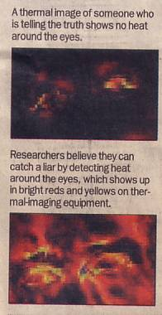
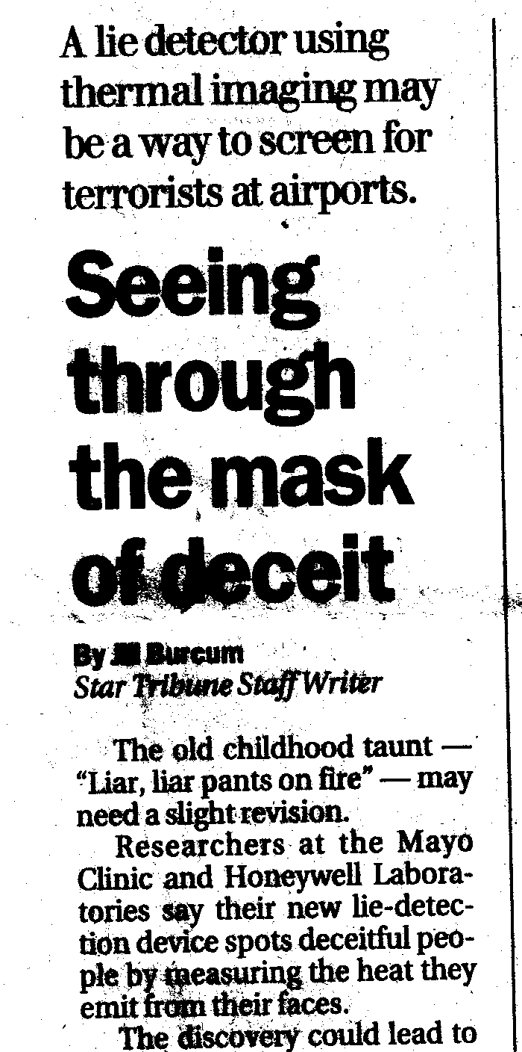
Lie Detection
Minneapolis Star Tribune, 3 Jan 2002, p. A1

Slide 57
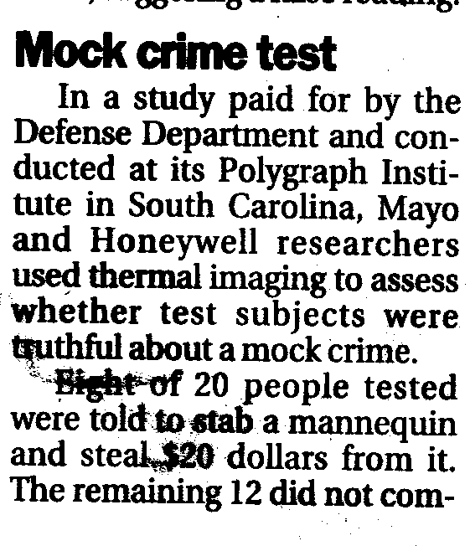
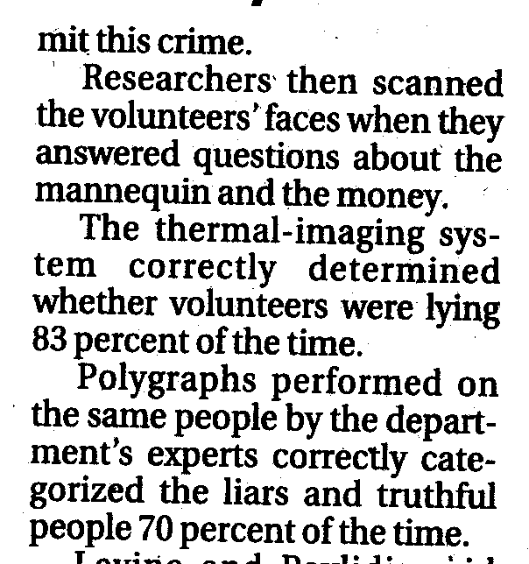
Lie Detection Continued

Slide 58
Star Tribune Report Incomplete
Report gives 3 quantities: accuracy (83%?), n=20, prevalence (8/20). We need all 4.
Three quite different performances are consistent with this.
 | + | -
P | 8 | 4
N | 0 | 8
 | 8 | 12 | 20
 | + | -
P | 4 | 0
N | 4 | 12
 | 8 | 12 | 20
 | + | -
P | 5 | 1
N | 3 | 11
 | 8 | 12 | 20
High False Positive
High False Negative
In between case

Slide 59
Why terrorist detection will not work
Real prevalence is not 40%, it is roughly 0.0001% or less.
For high false positive test: Pos. Pred. is 0.0003%; one-third of honest passengers would be stopped. This is useless; the screening would not be taken seriously.
For in-between test: Pos. Pred. Is 0.005%; one-twelfth of honest passengers would be stopped.

Slide 60
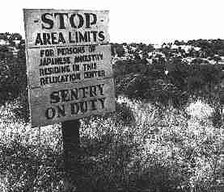
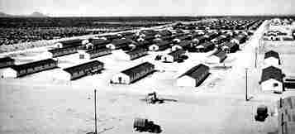
Civilian Exclusion Order # 34,
Detention of Japanese-Americans starting May 9, 1942
Notes:
Gila River, AZ
Canal Camp.³
Opened July 20, 1942. Closed November 10, 1945. Peak population 13,348. Origin of prisoners: Sacramento Delta, Fresno County, Los Angeles area. Divided into Canal Camp and Butte Camp. Over 1100 citizens from both camps served in the U.S. Armed Services.

Slide 61
KOREMATSU v. UNITED STATES
Supreme Court of the United States
323 U.S. 214; 65 S. Ct. 193; 89 L. Ed. 194; 1944 U.S. (1944)
MR. JUSTICE BLACK delivered the opinion of the Court.
The petitioner, an American citizen of Japanese descent, was convicted in a federal district court for remaining in San Leandro, California, a "Military Area," contrary to Civilian Exclusion Order No. 34 of the Commanding General of the Western Command, U.S. Army, which directed that after May 9, 1942, all persons of Japanese ancestry should be excluded from that area. No question was raised as to petitioner's loyalty to the United States. The Circuit Court of Appeals affirmed, and the importance of the constitutional question involved caused us to grant certiorari.
It should be noted, to begin with, that all legal restrictions which curtail the civil rights of a single racial group are immediately suspect. That is not to say that all such restrictions are unconstitutional. It is to say that courts must subject them to the most rigid scrutiny. Pressing public necessity may sometimes justify the existence of such restrictions; racial antagonism never can.

Slide 62
Korematsu Decision (cont.)
Like curfew, exclusion of those of Japanese origin was deemed necessary because of the presence of an unascertained number of disloyal members of the group, most of whom we have no doubt were loyal to this country. It was because we could not reject the finding of the military authorities that it was impossible to bring about an immediate segregation of the disloyal from the loyal that we sustained the validity of the curfew order as applying to the whole group.
That there were members of the group who retained loyalties to Japan has been confirmed by investigations made subsequent to the exclusion. Approximately five thousand American citizens of Japanese ancestry refused to swear unqualified allegiance to the United States and to renounce allegiance to the Japanese Emperor, and several thousand evacuees requested repatriation to Japan

Slide 63
Korematsu Decision (cont.)
Korematsu was not excluded from the Military Area because of hostility to him or his race. He was excluded because we are at war with the Japanese Empire, because the properly constituted military authorities feared an invasion of our West Coast and felt constrained to take proper security measures, because they decided that the military urgency of the situation demanded that all citizens of Japanese ancestry be segregated from the West Coast temporarily, and finally, because Congress, reposing its confidence in this time of war in our military leaders -- as inevitably it must -- determined that they should have the power to do just this. There was evidence of disloyalty on the part of some, the military authorities considered that the need for action was great, and time was short. We cannot – by availing ourselves of the calm perspective of hindsight -- now say that at that time these actions were unjustified.
Affirmed.

Slide 64
Korematsu Dissenting Option
MR. JUSTICE MURPHY, dissenting.
This exclusion of "all persons of Japanese ancestry, both alien and non-alien," from the Pacific Coast area on a plea of military necessity in the absence of martial law ought not to be approved. Such exclusion goes over "the very brink of constitutional power" and falls into the ugly abyss of racism.

Slide 65
Korematsu Dissenting Option (cont.)
It must be conceded that the military and naval situation in the spring of 1942 was such as to generate a very real fear of invasion of the Pacific Coast, accompanied by fears of sabotage and espionage in that area. The military command was therefore justified in adopting all reasonable means necessary to combat these dangers. In adjudging the military action taken in light of the then apparent dangers, we must not erect too high or too meticulous standards; it is necessary only that the action have some reasonable relation to the removal of the dangers of invasion, sabotage and espionage. But the exclusion, either temporarily or permanently, of all persons with Japanese blood in their veins has no such reasonable relation. And that relation is lacking because the exclusion order necessarily must rely for its reasonableness upon the assumption that all persons of Japanese ancestry may have a dangerous tendency to commit sabotage and espionage and to aid our Japanese enemy in other ways. It is difficult to believe that reason, logic or experience could be marshalled in support of such an assumption.

Slide 66
A Canonical Summary
Sensitivity: A/(A+C)
For the + objects, what is the probability of a correct test result.
Specificity: D/(B+D)
For the – objects, what is the probability of a correct test result.
Prevalence: (A+C)/n
What fraction of the objects are +.
Total count: n=A+B+C+D

