Slide 1
A “Typical” Algebra Problem
A canoe and a duck are moving toward one another from opposite ends of a 2 mile long lake. The canoe moves at 3mph, the duck at 2 mph. Where do they meet?
Used to demonstrate general principles of solution, not because we are interested in canoes and ducks.
Has a unique, definitive answer.

Slide 2
“Typical” Trade-off Problem: A Dilemma
You are alone at an isolated beach with your two children, Anna and Bob, ages 5 and 1. Anna goes swimming and is caught in an undertow. You cannot swim well; you have a 50:50 chance of rescuing Anna or drowning yourself.
What should you do?

Slide 3
Save Anna (age 5) and leave Bob (age 1) on deserted beach risking drowning yourself (50% chance).
Stay with Bob and hope for the best with Anna.
Take Bob with you to try to rescue Anna.

Slide 4
The Mathematics of this Problem
You might think that mathematics has nothing to say here.
Most people are taught that in math every problem has a right and wrong answer, and this problem has no right answer. This is a problem of intuition and morality, not logical deduction. Two reasonable people may well reach different conclusions about the right course of action.

Slide 5
There’s no good answer
There is a trade-off between two goods: rescuing Anna and caring for Bob.
Although there is no unique “right” answer, there is something to consider. If I change the problem a bit, your answer may change:
Is there another parent to take care of the surviving child? Is there anyone else on the beach?
Is there any hope of rescue from someone else?
Your chances of successful rescue are 99:1 instead of 50:50.

Slide 6
Save Anna (age 5) and leave Bob (age 1) on deserted beach risking drowning yourself (1% chance).
Stay with Bob and hope for the best with Anna.
Take Bob with you to try to rescue Anna.

Slide 7
Individual vs Social Decisions
In an decision made by an individual, you are entitled to use intuition.
Social decisions, if made by groups, must involve discussion and debate.
Mathematics provides a framework for discussing dilemmas and evaluating trade-offs.
It doesn’t provide the answer, just a way of making comparisons explicit.
Notes:
Think how unsatisfactory it is when a “moral” decision is forced on a group. Examples: therapeutic cloning of human cells; genetic engineering of plants in the face of uncertainty; abortion.

Slide 8
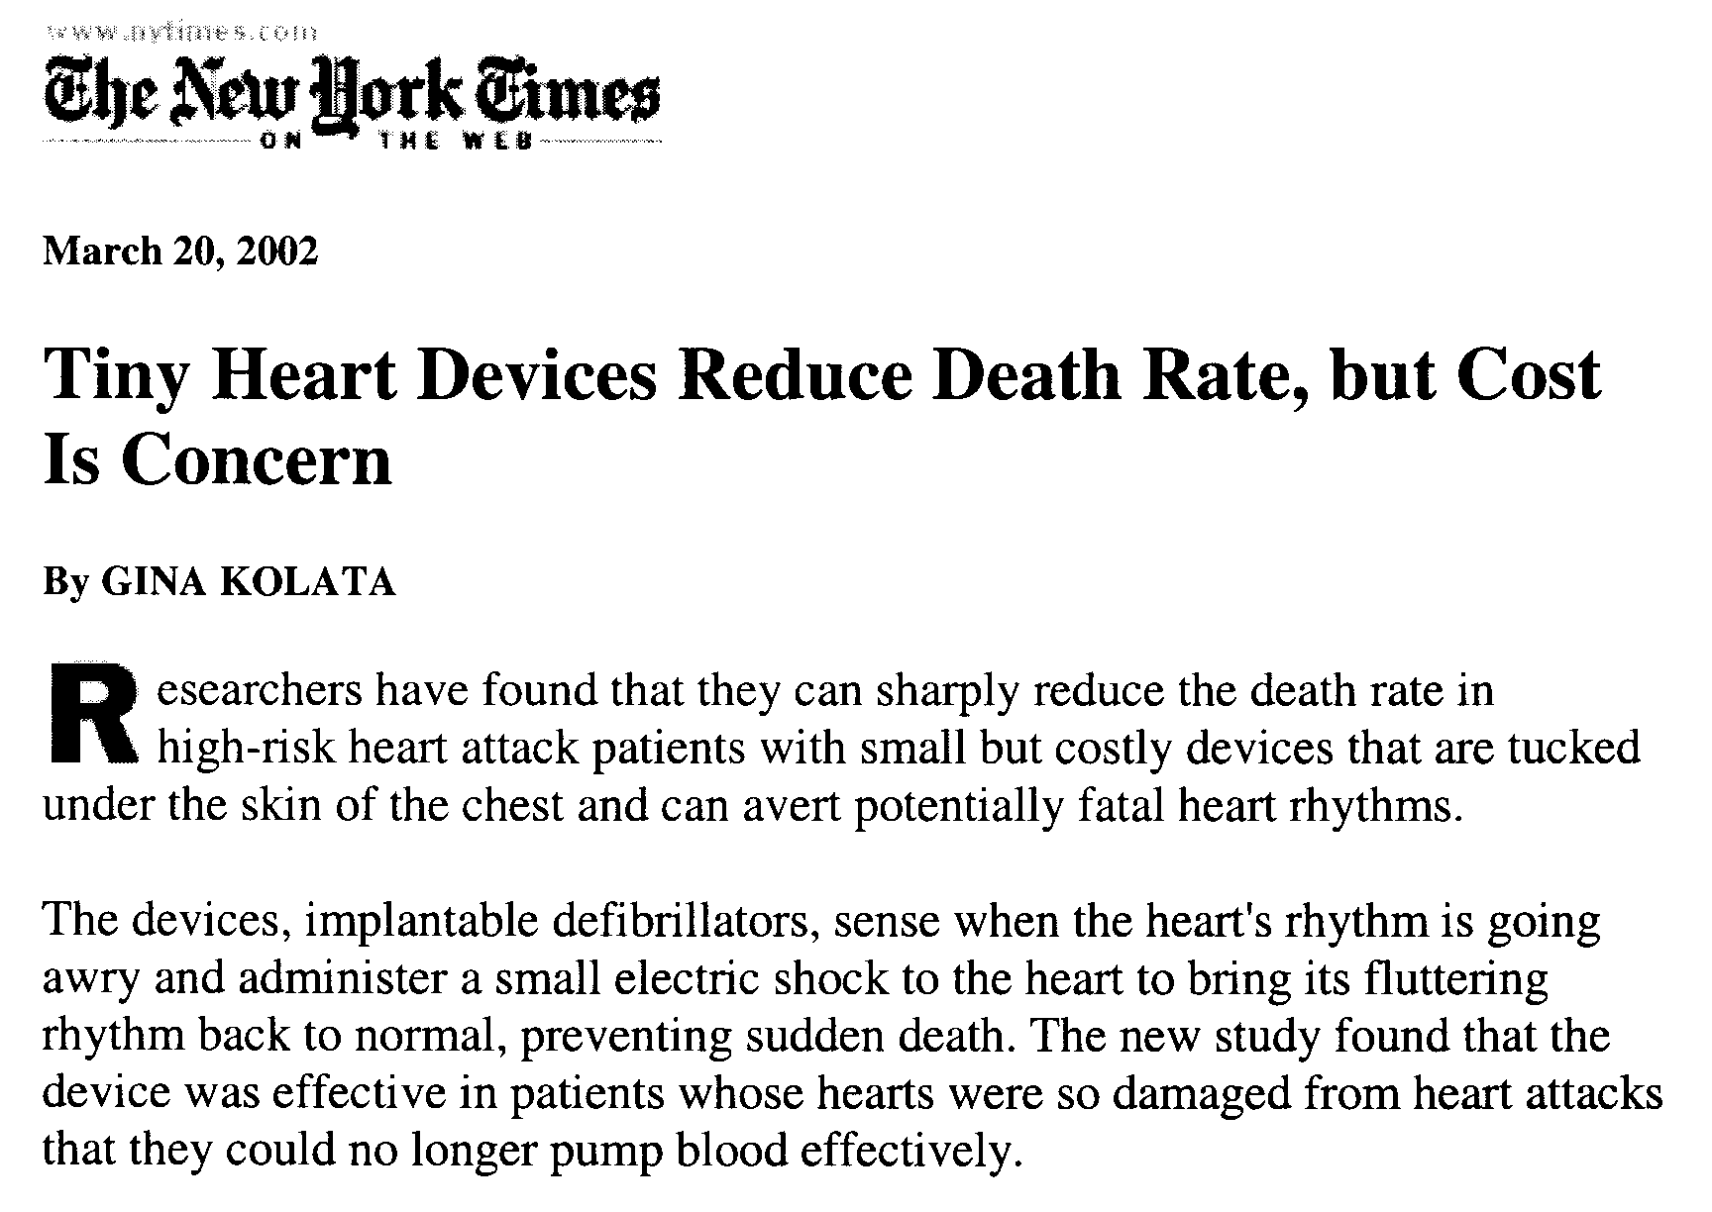
A Social Dilemma

Slide 9
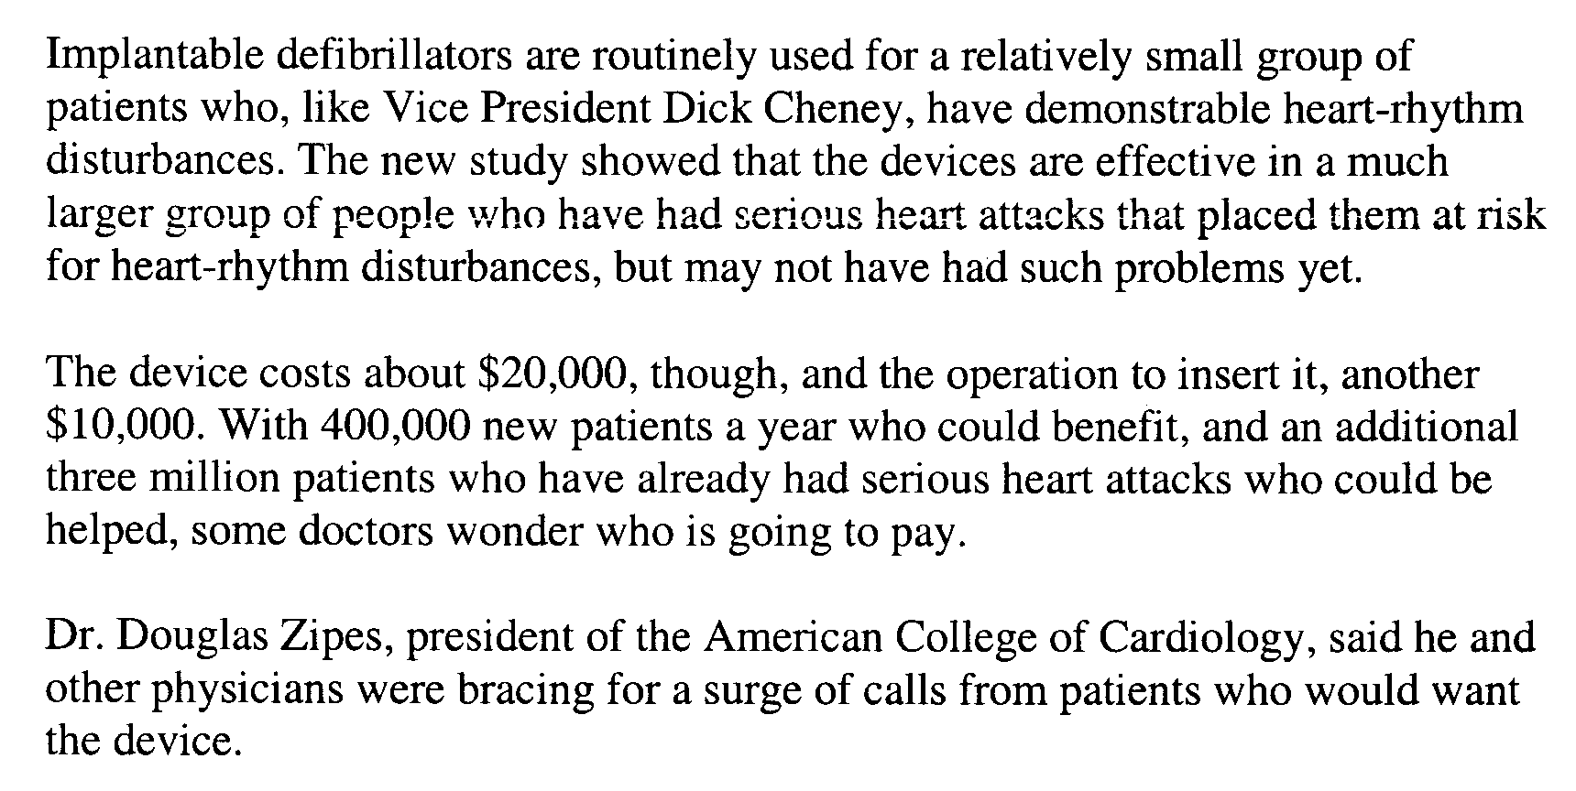
ICDs (continued 2)

Slide 10
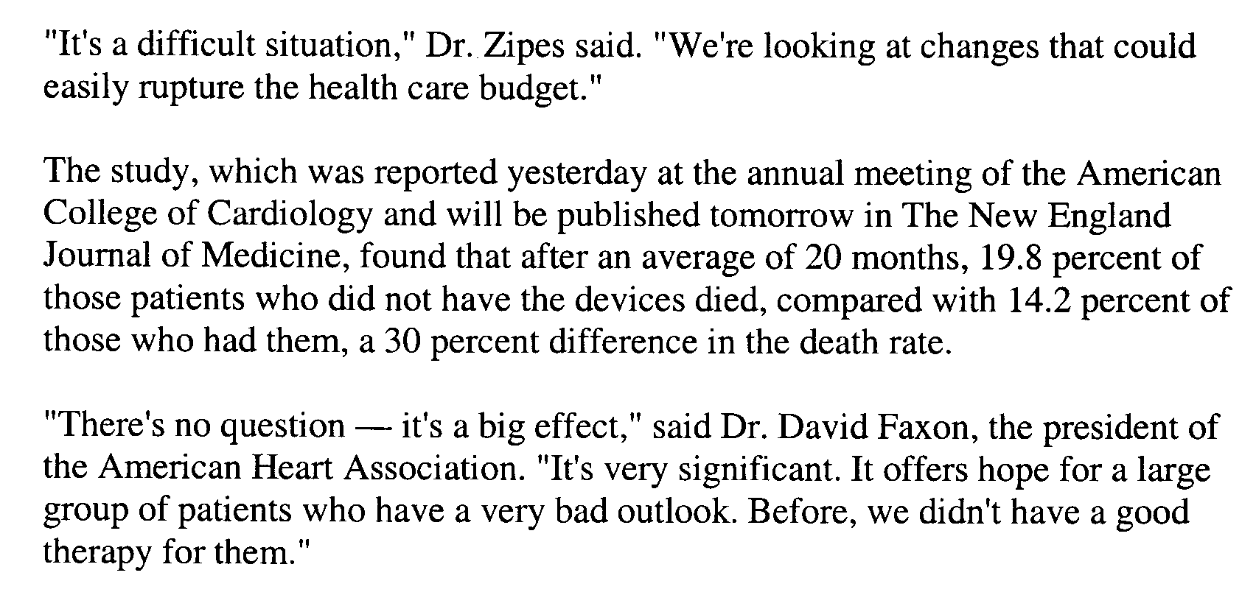
ICDs (continued 3)

Slide 11
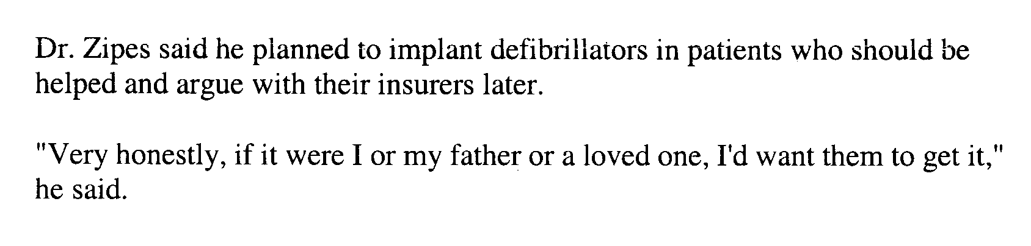
ICDs: the Trade-off
For every 20 such patients given an ICD, on average one life will be saved.
Cost: $30,000 x 20 = $600,000 per life
What else could we do with $600,000? Drug treatment programs, head start, highway safety, pre-natal care.
What is the added survival time?
Personal versus societal decisions:

Slide 12
Question: How much should the government be willing to spend to provide implantable cardioverters-defibrillators?
$50,000 per saved life
$200,000 per saved life
$400,000 per saved life
$600,000 per saved life
$800,000 per saved life
$1,000,000 per saved life
Don’t be crass, Kaplan. You shouldn’t put a dollar value on life.

Slide 13
Question: Would your answer to the previous question have changed if you took into account the age of the ICD recipient?
No. The value of a life doesn’t depend on age.
No. We told you not to be crass, Kaplan. Now stop it.
Yes. It’s reasonable to spend less on an older person.
Yes. It’s reasonable to spend more on an older person.

Slide 14
Terminology
Policy variables --- the inputs that we can set. Examples: quotas, employment certificates, border patrols, visa regulations, …
Policy --- a setting of all the relevant policy variables.
Outputs --- the quantities that we are interested in obtaining. Example: wages.
Mechanisms --- how the policy variables influence the outputs. Example: supply elasticity of wages, relocation of natives and immigrants

Slide 15
Optimization
When there is a single output, we can adjust the policy variables to optimize the output.
Optimization lets you make the best out of your resources. But it requires a quantitative scale of output, which isn’t always possible.

Slide 16
Discrete Policy Variables
. Choose the policy that gives the best value of the output.
Policy D
Policy A
Policy C
Policy B
Better
Worse
The Winner!

Slide 17
Continuous Policy Variables
Example: Immigration quota as input, GDP per capita as output.
Mechanisms:
Higher quota leads to more GDP
But there are more people so per capita GDP might be lower.
Although the mechanisms conflict, there is a single output so optimization is possible.

Slide 18
Continuous Policy Variables
GDP per capita
Immigration Quota 10,000s

Slide 19
Quick Quiz
Consider 4 policies, labeled A,B,C, & D
Each policy is evaluated on two outputs: black and green.
Next slide shows a plot of the values of the black and green outputs for each of the 4 policies.
Which is the best policy?
Which policies are better than others?

Slide 20
Which is the best policy?
Worse
Policy A
Policy B
Better
Worse
Policy D
Policy C
Better
A – 1 ; B – 2 ; C – 3; D – 4;

Slide 21
Answer to Quiz
A is clearly worse than B or D.
A might be better or worse than C.
C might be better or worse than B or D.
B might be better or worse than D.
Worse
B
A
Better
Worse
D
C
Better

Slide 22
Multiple Outputs have no Optimium (in general)
The word “best” has no mathematical meaning when there is more than one output.

Slide 23
But Not All Situations Are Hard
Worse
Policy A
Policy C
Better
Policy D
Worse
Policy B
Better
Policy B is the best; it dominates the others.

Slide 24
More Terminology
Incommensurate. Two quantities are incommensurate when they cannot be directed compared. Example: Inches and Liters. Example: Human rights & GDP. CO₂ & GDP.
Domination. One policy dominates another when all the outputs are better than the outputs for another policy.

Slide 25
Some Policy Choices in Global Warming
CO2 production
US
Better
Nuclear/Hydro
problems
Wind/Hydrogen
Storage
France
Better
A – 1 ; B – 2 ; C – 3; D – 4;

Slide 26
Situations with Trade-Offs
Design trade-offs:
In detection: Sensitivity v. Specificity
In hypothesis testing: significance v. power
Design generally
Mine versus yours / zero-sum situation:
Allocation of resources to competing parties or goals: more low-income workers may benefit high-income families.

Slide 27
Design Trade-Offs
Fuel economy/performance versus comfort/safety.
Weight v. security in aircraft. As values change, the configuration changes. Cockpit doors are heavier post 9/11.
U.S. vs German Tanks in WWII

Slide 28
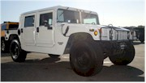

Car Design
v
Which is the better vehicle?
Outputs: Expense, comfort, speed, off-road capability, capacity, …

Slide 29
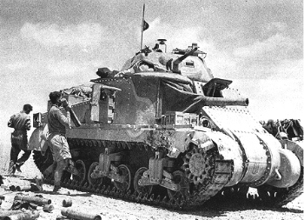
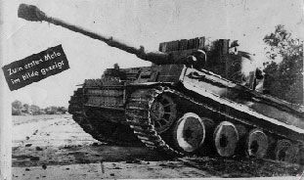
Tank Design
Sherman
Tiger

Slide 30
Tank Design in World War II
…Overall, however, Americans in Normandy gladly would have traded weapons with the Germans. Especially the tankers. There was a barely suppressed fury among American tankers about the inferiority of the Sherman tank (thirty-two tons) to the latest German models, the Panther (forty-three tons) and the Tiger (fifty-six tons). German tanks had heavier armor, too heavy for the Sherman’s 75mm cannon to penetrate, while the Panther and Tiger, armed with 88s, easily penetrated the Sherman. The discrepancy was so great it has led military historian Max Hastings to wonder how in the world “could American and British industries produce a host of superb aircraft, an astonishing variety of radar equipment, the proximity fuse, the DUKW [amphibious vehicle], the jeep [not to mention the atomic bomb and Ultra] yet still ask their armies to join battle against the Wehrmacht equipped with a range of tanks utterly inferior in armor and killing power.”
Stephen Ambrose, “Citizen Soldiers” p. 63

Slide 31
Tank Design: Trade-Offs
“The Sherman was universally denounced by anyone who had to fight in one against a Panzer or Tiger. But one thing about the Shermans --- there were a lot more of them than there were Panthers or Tigers. Quantity over quality and size was General Marshall’s deliberate choice. He wanted more, faster (and thus lighter) tanks, in accord with American doctrine, which held that tanks should exploit a breakthrough, not fight other tanks.
“Marshall’s first problem was that American tanks had to cross the Atlantic to get to the battle, and the number one strategic shortage of the Allies was shipping. Experiment showed that you could get two Shermans into the space required by one larger tank on an LST.”
ibid

Slide 32
Mine vs Yours / Zero-Sum Situation
Air travel safety versus highway safety
Mainstreaming special education: special ed students versus regular ed students
Pro-life versus pro-choice
Tax cuts versus welfare state
Native workers versus immigrants
Retirees versus workers

Slide 33
Multiple Outputs Lead to Suboptimal Policies
When there is a single output we can optimize the policy.
When there are multiple (conflicting) outputs the selected policy will not be optimal for all outputs.
We tend to compromise, making each output somewhat sub-optimal.
In comparing two systems (e.g., public v. private schools), it’s important to look at all the outputs and not just a single one.
Race cars and bicycles compare differently when evaluated on different scales. I prefer a bicycle for my purposes but that doesn’t mean a bicycle is better for all purposes.

Slide 34
Dealing with Trade-Offs
Make trade-offs explicit; acknowledging them
Look for dominating policy
Talk in other people’s terms
Ignore the trade-off
Reduction to a single goal: bottom line, loss function, present value
Conversion via a market price
Conversion via shadow prices

Slide 35
Acknowledging Multiple Outputs
per capita GDP
total GDP (buying our way out of debt)
Wages (employees want them high, employers low)
Finding labor for jobs not desired by US citizens
Providing refuge or asylum
Increasing population diversity
Providing support for domestic retirees
Avoiding environmental effects/congestion
Attracting “desirable” people to the US
Keeping out undesirables
ESL teaching load in schools

Slide 36
Multiple outputs for global warming
Avoiding climate change
Keeping high GDP
Allowing developing countries to develop.
Non-CO2 environmental issues
Nuclear proliferation, accidents
Damage due to hydro-electric projects
Security implications of reliance on oil.

Slide 37
Look for Dominating Policy
Best solution by all measures. But there may not be such a policy.
Simplify: Ignore policies that are dominated by others.
Pareto optimality: accept only policies that dominate the status quo. Unfortunately, this gives the status quo a privileged status.

Slide 38
Pareto Optimality in Global Warming
Kyoto puts CO2 constraints on many countries including US, but not including China and India.
This isn’t a pareto optimal change, since the change effectively transfers wealth from the Kyoto countries to China and India.

Slide 39
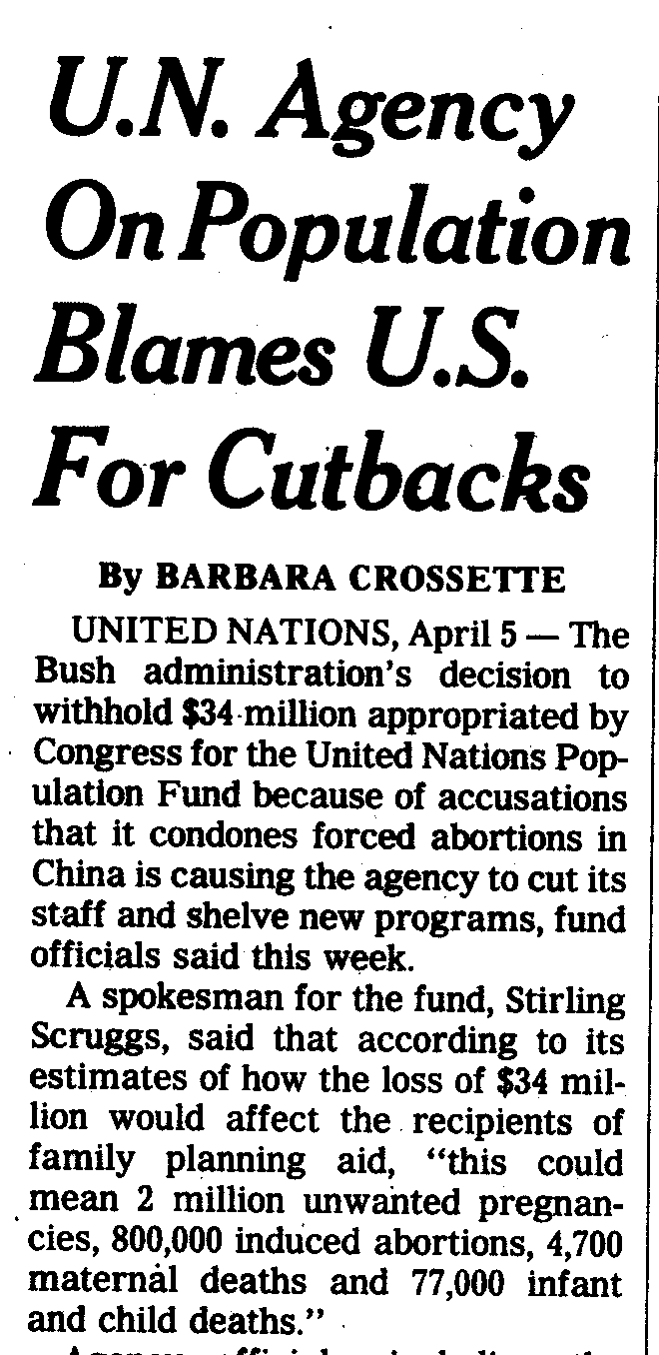
Speaking in the Other Side’s Terms
New York Times, Sunday 7 April 2002, International p. 11

Slide 40
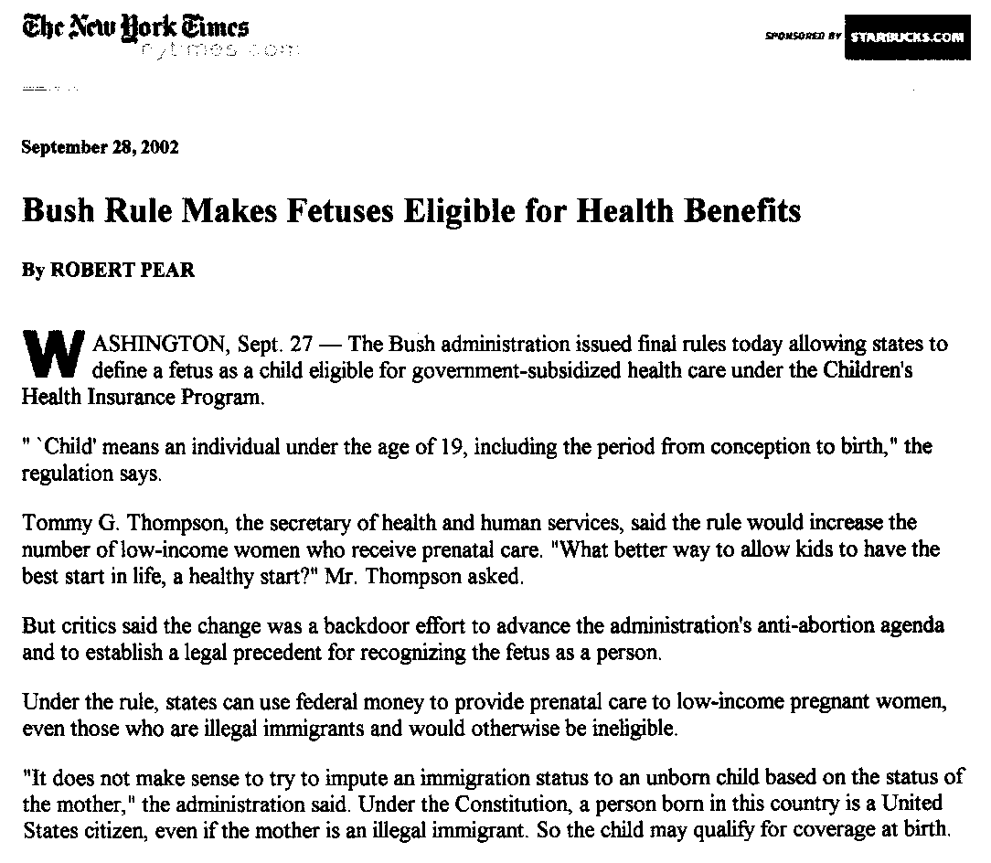

Slide 41
Ignore the Trade-Off
Choose one output. Optimize policies for that.
Example: majority rule. Effective, but crude.
Example: split the difference. Give something to everyone.

Slide 42
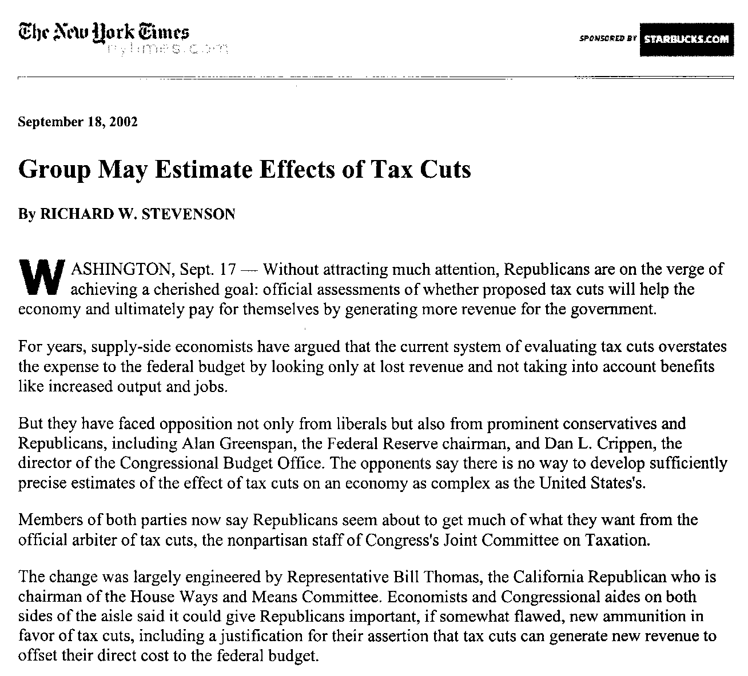

Slide 43
Reduction to a Single Output
“Bottom Line” in business, or stock price
Present Value when comparing today with the future. (Covered in cost/benefit class session.)
Value of a human life when evaluating safety policies.
Reduction of immigration policy to issues of race.
Reduction of immigration policy to labor availability.
Reduction of immigration policy to asylum issues or to social security issues or to …

Slide 44
Reduction to a single output in Global Warming
President Bush: Emphasize uncertainties in the projections. Maybe global warming isn’t happening or isn’t caused by CO₂.
Some environmentalists: Ignore GDP-related issues.
Hollywood: Amplify risks of global warming to make it a simple matter of survival.

Slide 45
Reduction (cont.)
Such reductions may distort evaluations.
Tendency to rely on anything that can be quantified. (e.g., Student-faculty ratios rather than educational outcomes.)
Manipulation of stock prices by CEOs.
Foolishness of standardized tests such as SATs.
Stock analysts would have done better if they looked at many outputs of a company rather than the single output, stock price. Lesson: Don’t be lazy.
But don’t ignore situations where reduction works!

Slide 46
Need-blind Admissions
Trade-off between “access” and “quality.”
RPC perspective: trying to balance these two goods.
Attempts to reduce to a single good.
Immoral to deny access to anyone (because of inability to pay)
Rebuttal: So why is it moral for transfer and foreign students?
Our financial aid doesn’t include opportunity costs.
Denying access will lessen quality
Access is meaningless except in the context of quality
Attempts to deny the trade-off:
We’ll raise more money for financial aid

Slide 47
Child seats on Airplanes from St. Paul Pioneer Press, Sun. 1 Feb, 2004, Travel Section p. 106
Q: We are flying to Europe with our 1½-year-old and have purchased a seat for her. We are confused about the rules regarding car seat use on planes.
A: You don’t need a child restraint seat for children under age 2 on airplanes. Alison Duquett, a spokeswoman for the Federal Aviation Administration, said, “The FAA does not require parents to use a child restraint seat. However, we strongly encourage it.”

Slide 48
Airline Child Safety (cont.) Lives vs Money or Lives vs Lives
“The issue of whether children under 2 should be permitted to sit on parents’ laps while flying has been debated for years. The American Academy of Pediatrics and the government’s National Transportation Safety Board are among the groups that have been lobbying the FAA to mandate child-safety restraints aboard airliners. The FAA has responded by strongly recommending that parents use child-restraint systems but has not adopted the rule, citing arguments, including the results of a recent study, that conclude that such a law may cause an increase in deaths if parents switch from air to car travel to avoid paying for the extra plane ticket. Most airlines offer discounts of up to 50 percent on seats for children younger than 2. Children in laps travel free.”
Notes:
From the St. Paul, Pioneer Press, Sunday Feb 1, 2004, Travel Section, page 106

Slide 49
Emissions Trading
NPR.org, February 16, 2005 · Under the Kyoto Protocol, many developed nations have agreed to roll back their emissions of carbon dioxide and other gases that contribute to global warming. One way they hope to achieve the cuts is through "emissions trading."
Under [the Kyoto] rules, each country or region is allowed to assign a cap on emissions of carbon dioxide, which is typically created by the burning of fossil fuels such as coal. Countries or companies that are over their assigned caps can buy permits from countries or companies that are under their caps.
Russia, for instance, is expected to have extra credits available for sale for at least the next five years. Europe has chosen this method to reach the reduction targets it agreed to under the Kyoto Protocol.
The protocol also provides another way for countries to exceed their carbon caps. They can fund projects in developing nations that either capture and store carbon, or promote the development of less polluting energy sources. For instance, a country can earn more credits by reducing emissions at power plants in the developing world.

Slide 50
Shadow Prices
Optimum with
relaxed constraint.

Slide 51
Trading Constraints
China sells CO₂ to US

Slide 52
MENA = Middle East, North Africa

Slide 53
Trade and Pareto-Optimality
Trading allows you to achieve a Pareto-optimal result: each party considers themselves to be better off as a result of the trade.

Slide 54
Shadow Prices
Need a lot of detailed information to compute these.
Probably not feasible in most immigration issues.
Widely used in energy, pollution, etc. where good production data are available.
When there are multiple constraints, some will be inactive. These aren’t worth anything and expect skilled negotiators to know which constraints these are and be willing to “trade” them for better terms on active constraints.

Slide 55
Value of a Human Life (non-crass version)
Lives saved from auto safety
Lives saved from ICDs

Slide 56
Question: Given these (hypothetical) data on lives saved in auto safety or from ICDs, would you reduce the ICD budget in favor of auto safety?
Yes, reduce the budget a lot, until the shadow prices balance.
Yes, reduce the budget a little, but not too much.
No, keep things they way they are. That’s Pareto optimal
No, don’t keep trying to put a $ value on life, Kaplan. You are soooo crass.

Slide 57
A Social Dilemma Game
Each of us can choose to play either strategy C or D. Our payoff depends both on which strategy we choose as an individual, and what strategy others choose.
D-players get $1 for every C player.
C-players get $1 for every C player - $20
Example: If 15 of 30 choose D, then each D player gets $15. Each C player pays $5.
1 --- C player
5 --- D player

Slide 58
What should we do to get people to cooperate?
Play the game again, but two students get to address the class beforehand.
1 => C player
5 => D player

Slide 59
Peer-pressure
Play the game again, but with a show of hands for C and D, not the anonymous clickers.

Slide 60
Real situations in which this dilemma arises.
Origin of the dilemma:
The individual benefits are different and conflicting with the group benefits, even though both are denominated in dollars.
Vaccination
Driving at the speed limit
Goods held in common: clean air, clean water, space, quiet. “The Tragedy of the Commons.”
Paying taxes honestly
Financial aid at Macalester

Slide 61
Summary on why we study tradeoffs
“As a practical matter, we probably won’t be able to change our constitutional system in any truly significant way. But we can, as Dahl suggests, change the way we think about it. If we worshipped the framers a little less, we might respect ourselves a little more. If we kept in mind the ways in which our constitutional arrangements distort our democracy and hobble our politic, we might gain a deeper, more useful understanding of the sources of our various national discontents. If we didn’t assume that the system was perfect, we wouldn’t assume that everything we don’t like is the fault of bad people. We’d judge our politicians more shrewdly, and more charitably, if we reminded ourselves regularly of the constraints that the system imposes on them. We’d be less tempted by lazy moralism.”
Hendrik Hertzberg, The New Yorker July 29, 2002, p.90, in a review of R.A. Dahl, “How Democratic is the American Constitution?”

