Slide 1
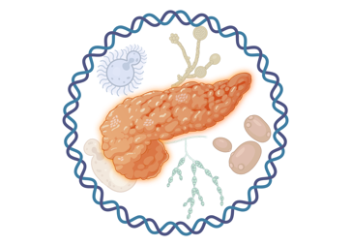

Distangling contaminants from true intratumoural microbial signals in pancreatic ductal
adenocarcinoma – A benchmarking approach
Linh Dang, xxx, xxx, Volker Ellenrieder, Albrecht Neesse ‍
AG Neeße - Clinic for Gastroenterology, Gastrointestinal Oncology and Endocrinology
University Medical Center Göttingen

Slide 2

Intratumoral Microbiome
Background
Malignant tumors harbor their own bacteria community
New biomarkers for diagnoses, prognoses and therapy
Challenges!!
Low bio-mass samples, prone to contamination
Prone to batch effect
Need a systematic study

Slide 3
Section 1
Negative Control Survey in the Lab
Unpublished Data

Slide 4
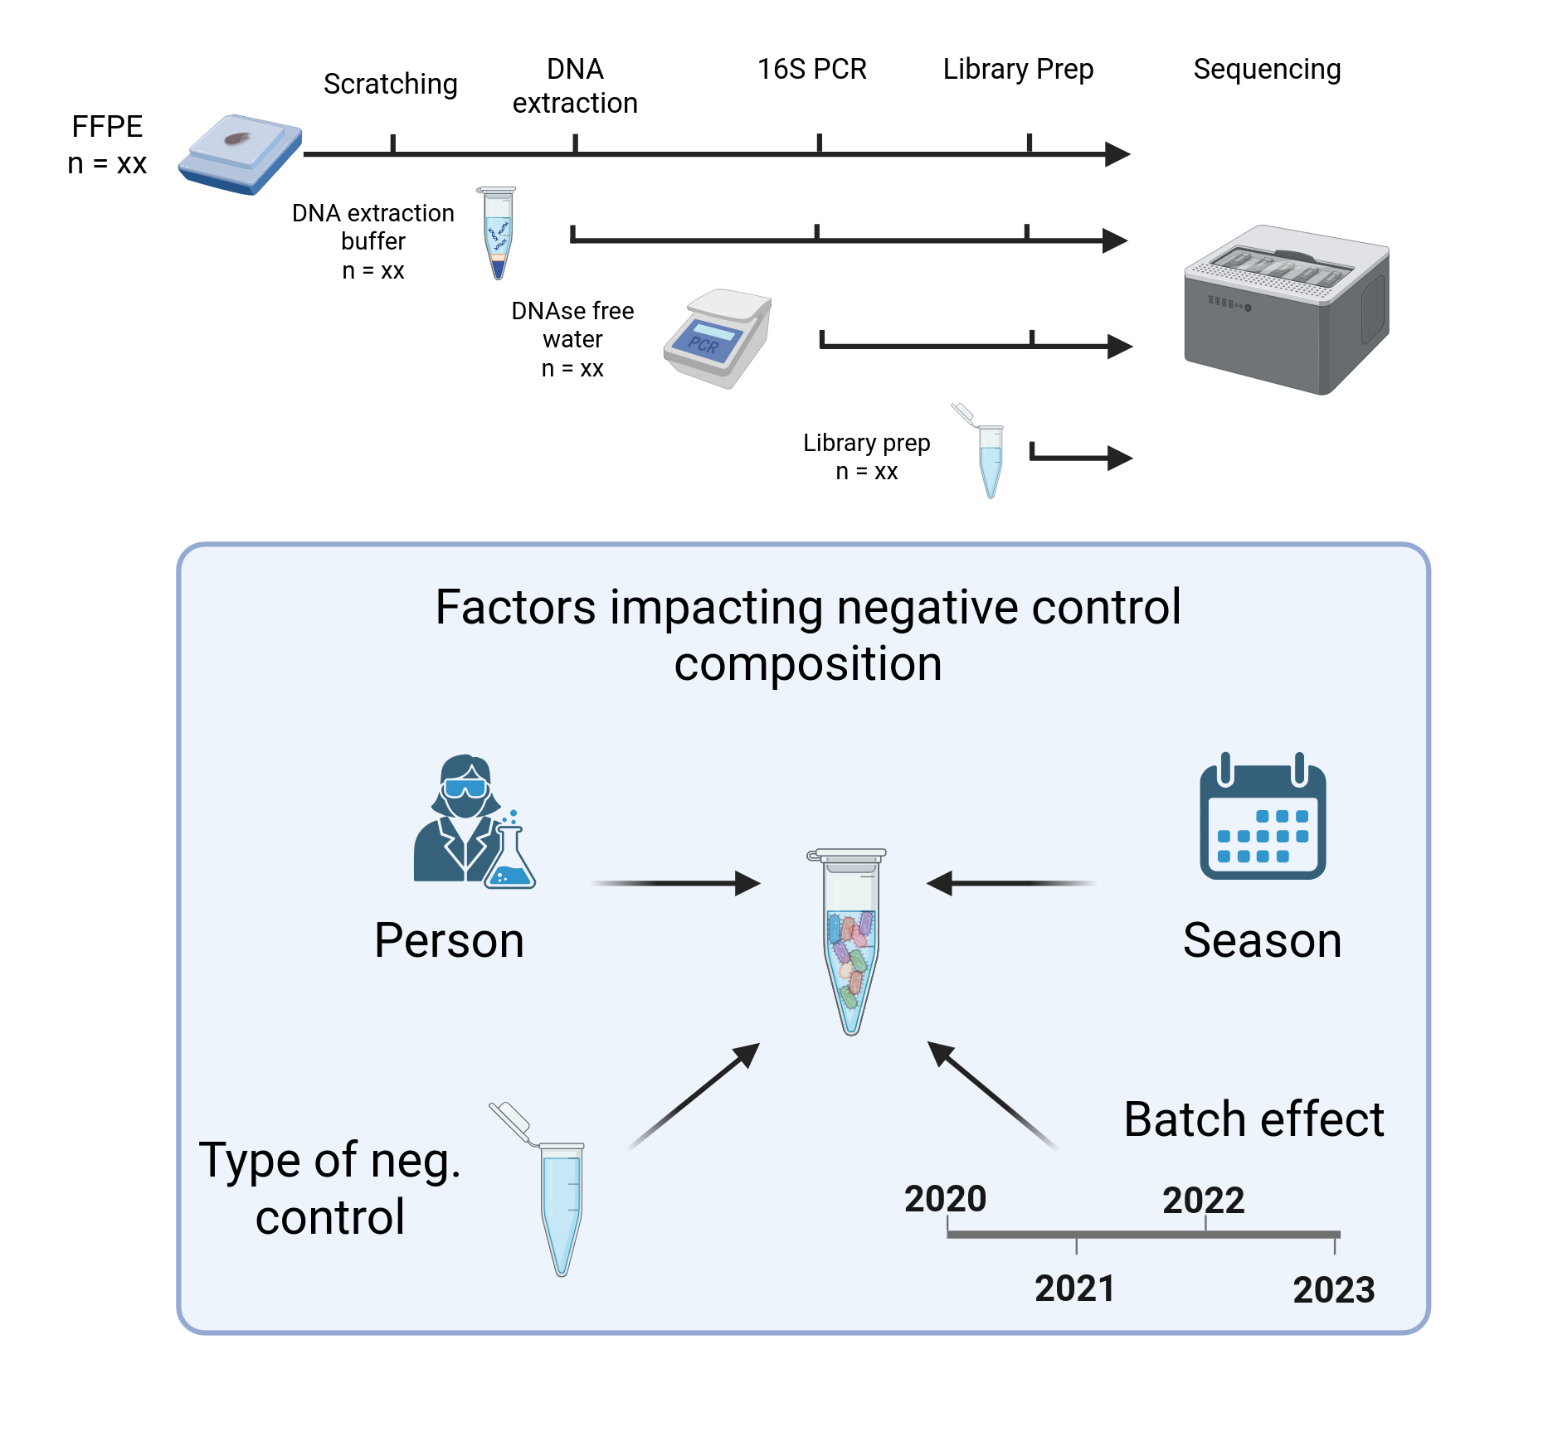
Negative Sample Collection
203 negative control samples were collected over 4 years:
113 buffer controls,
84 paraﬀin controls,
6 PCR controls.
Unpublished Data

Slide 5
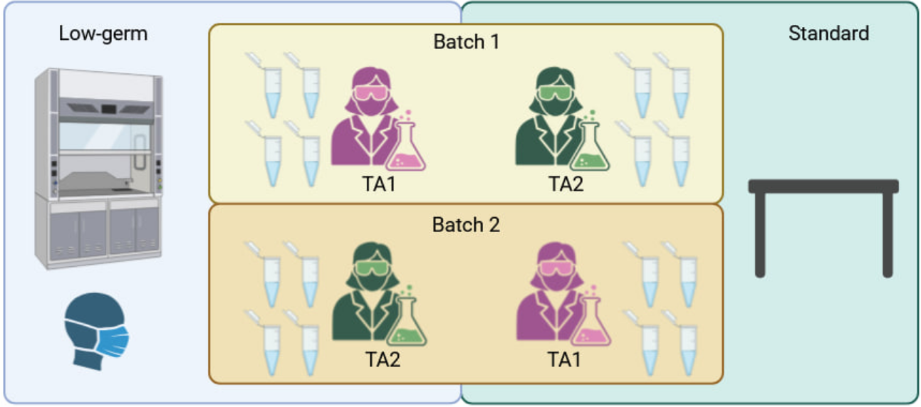
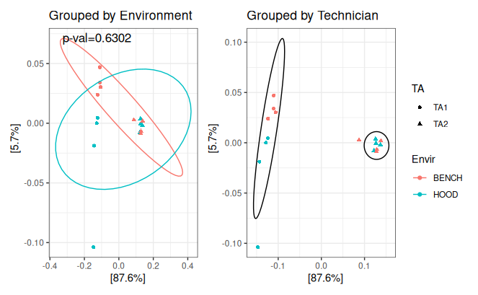
Low bio-mass microbiome data are prone to batch effect
Unpublished Data

Slide 6
Section 2
Assessment of Decontamination Methods and Intratumoral Microbiome in PDAC
Unpublished Data

Slide 7
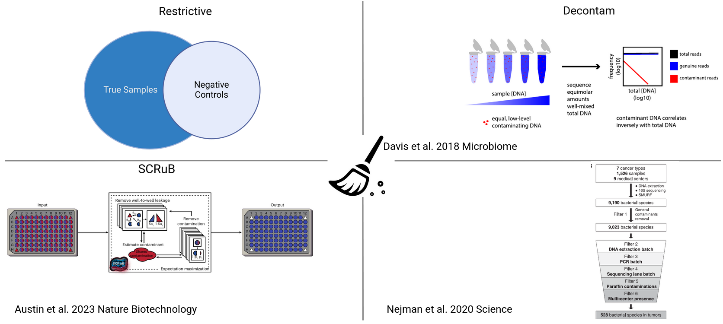
Decontamination Strategies
Unpublished Data

Slide 8
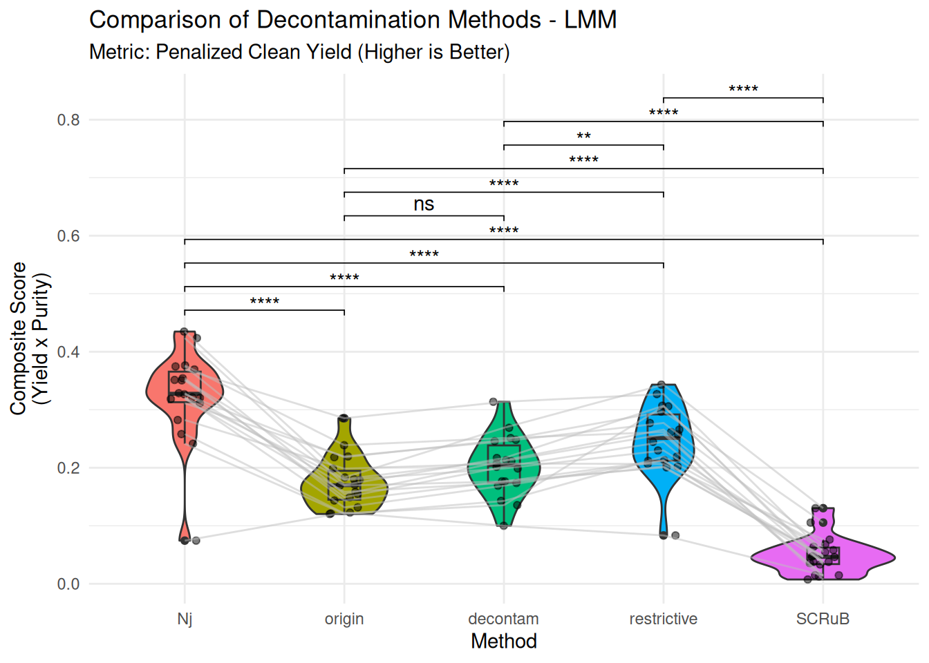
Assessment of Decontamination Approach
Composite Score:
Bacterial profile before/after decontaminated
longitudinal collection of NCT samples
Higher is better
Unpublished Data

Slide 9
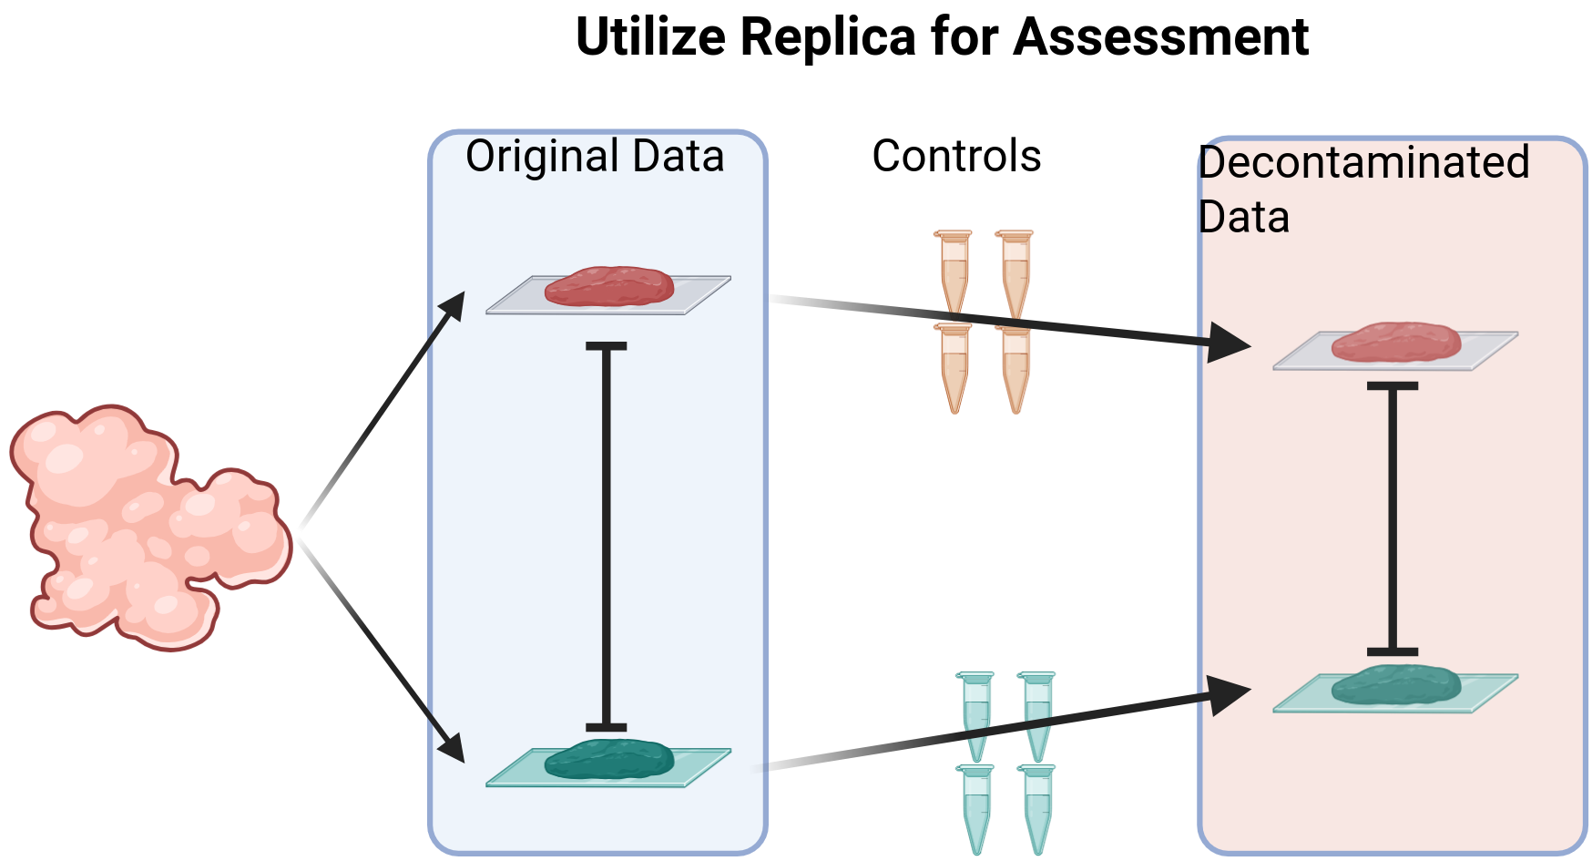
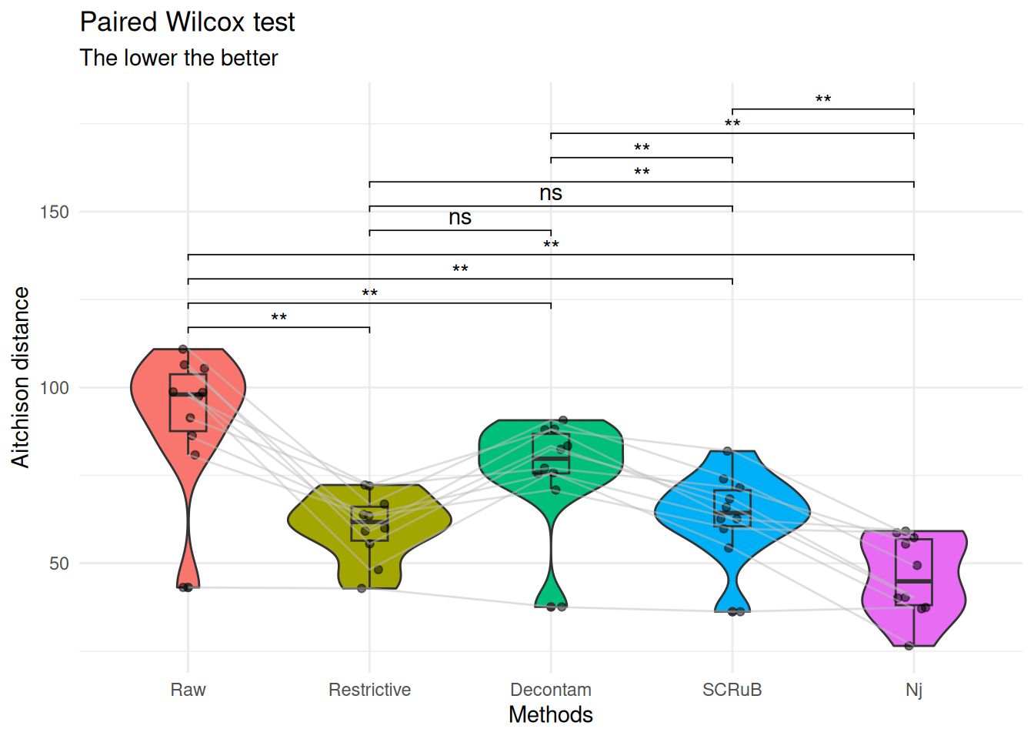
Assessment of Decontamination Approach with Technical Replica
From 10 PDAC samples:
Each has 2 replica
Distance between 2 replica before/after decontamination
Lower is better
Unpublished Data

Slide 10

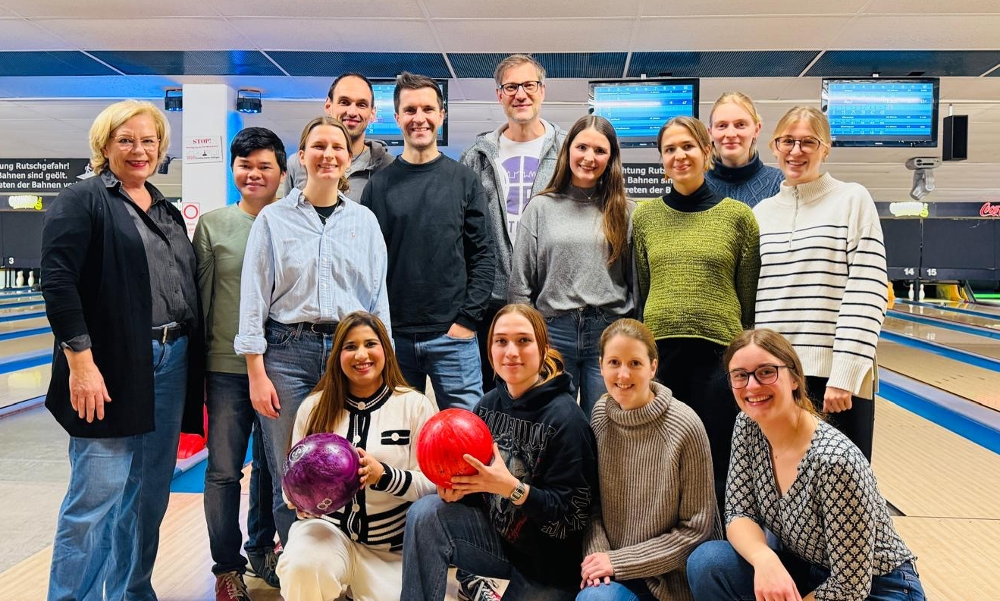





Thank you for your attention!
AG Neesse
Christoph Ammer-Herrmenau
Jacob Hamm
Jutta Blumberg
Ulrike Wegener
Sören Buchholz
Catharina Lingens
Cathleen Heuer
Areej Shahbaz
Richard Meier
Rahel Scholz
Louisa Eskelson
Helena Lescow
Charlotte Vogel
Linh Dang
Isabel Toussaint
Johannes Richter
Annemarie Dresbach
Leoni Florschütz
UMG
AG Beissbarth (Bioinformatik)
AG Ströbel (Pathologie)
AG Schneider (Chirurgie)
AG Papantonis (Pathologie)
AG Sax (Medizinische Informatik)
Externe Kooperationspartner
Johannes Zimmermann, Jena
Gabriel Nussbaum, Jerusalem
Bernd Heinrich, Hannover
Magdalena Huber, Marburg
Matthias Gaida, Mainz
Paco Real, CNIO Madrid
Nuria Malats, CNIO Madrid
Evgenij Shumilov, Münster
Ulrike Bacher, Bern
Notes:
<number>

