Slide 1
Drug Repositioning for Diabetes Based on 'Omics' Data Mining
Ming Zhang, Heng Luo, Zhenrui Xi, Ekaterina Rogaeva
SLiDE SHOW Created BY Dylan Lehrer

Slide 2
Diabetes Mellitus
Affects approximately 382 million people worldwide
Over $548 billion in treatment costs
Previous diabetes treatments had associated health risks.
Traditional drug development process is both lengthy ( 10-17 years) and costly, with a low success rate (< 10%) and a high safety risk.
Need for developing diabetic drugs in a more efficient way with reduced safety risks.

Slide 3
Drug Repositioning
Reusing marketed (safe/approved) drugs for a new indication/disease.
Faster – reduces development time (no need for approval)
10 to 17 yrs → 3 to 12 years
Cheaper – fewer clinical trials and usage of expensive materials
Safer – toxicity information is more likely to be available.

Slide 4
‘Omics’ Data
Experimental data related to diseases
Technological advancement → more biomedical data available
Genomics - concerned with an organism’s genome, the DNA content that is present within one cell of an organism
Genome Wide Association Studies (GWAS) – useful data for drug repositioning
Proteomics - deals with the entire proteome, networks of proteins that can be expressed by organisms
Metabolomics - involves studies of metabolic processes and metabolites, which are low molecular weight biochemicals

Slide 5
Materials and Methods
1. Literature Search and Data Extraction
2. Mining Diabetics Metabolites Related Proteins
3. Constructing the Diabetic Metabolites-Proteins Network
4. Mapping Diabetes Risk Proteins to Proteins with Drug Projects
5. Application of Pathogenesis Information into Anti-Diabetic Drug Repositioning
6. Connectivity Map (CMap) Analysis

Slide 6
1. Literature Search and Data Extraction
PubMed database was searched for recent articles that included diabetes and ‘omics’ linked keywords
Using search results… extracted data from GWAS, proteomics, and metabolomics studies on diabetes.

Slide 7
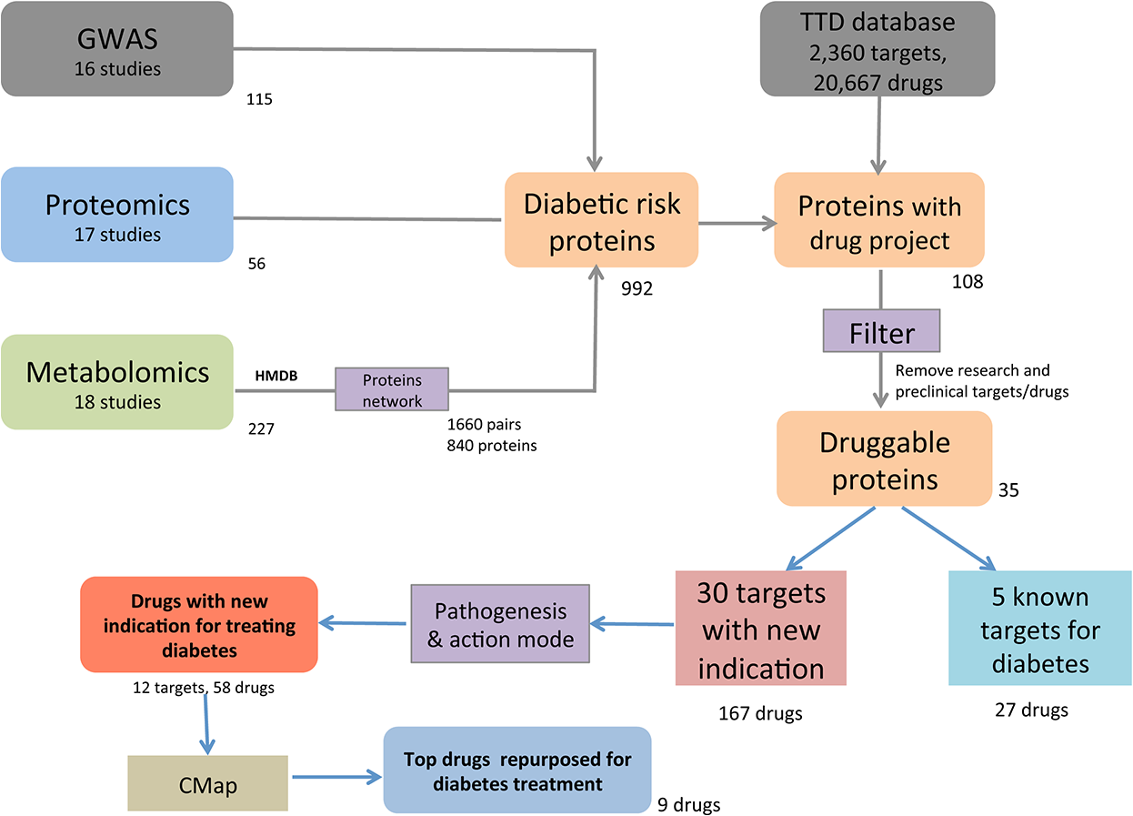
REsults
OMICS STUDIES REVEALED DIABETES RELATED GENES, PROTEINS, AND METABOLITES
PubMed Search – genes, proteins, and metabolites that were reported to be significantly associated with diabetes were selected for further research.
16 GWAS Studies → 115 genes
17 Proteomics Studies → 56 proteins
18 Metabolomics Studies → 227 metabolites

Slide 8
2. Mining Diabetic Metabolites Related Proteins
Searched the Human Metabolome Database (HMDB) to obtain the names of any proteins (enzymes or transporters) that could be associated with the diabetes related metabolites that were discovered from the previous metabolomics studies found from the literature search.
Literature Search → Previous Metabolomics Studies
Previous Metabolomics Studies → Discovered Diabetes Related Metabolites
Diabetes Related Metabolites → Names of Associated Proteins (Enzymes or Transporters)

Slide 9
REsults
Using the HMDB, the 227 diabetes associated metabolites found from the metabolomics studies in the literature search were linked to 840 enzymes or transporters (proteins), making 1660 metabolite-protein pairs.

Slide 10
3. Constructing the Diabetic Metabolites-Proteins Network
Diabetic Metabolites and their Associated Enzymes/Transporters were visually linked through a metabolites-proteins network.
Cytoscape (www.cytoscape.org) was used to construct the metabolites-proteins network.

Slide 11
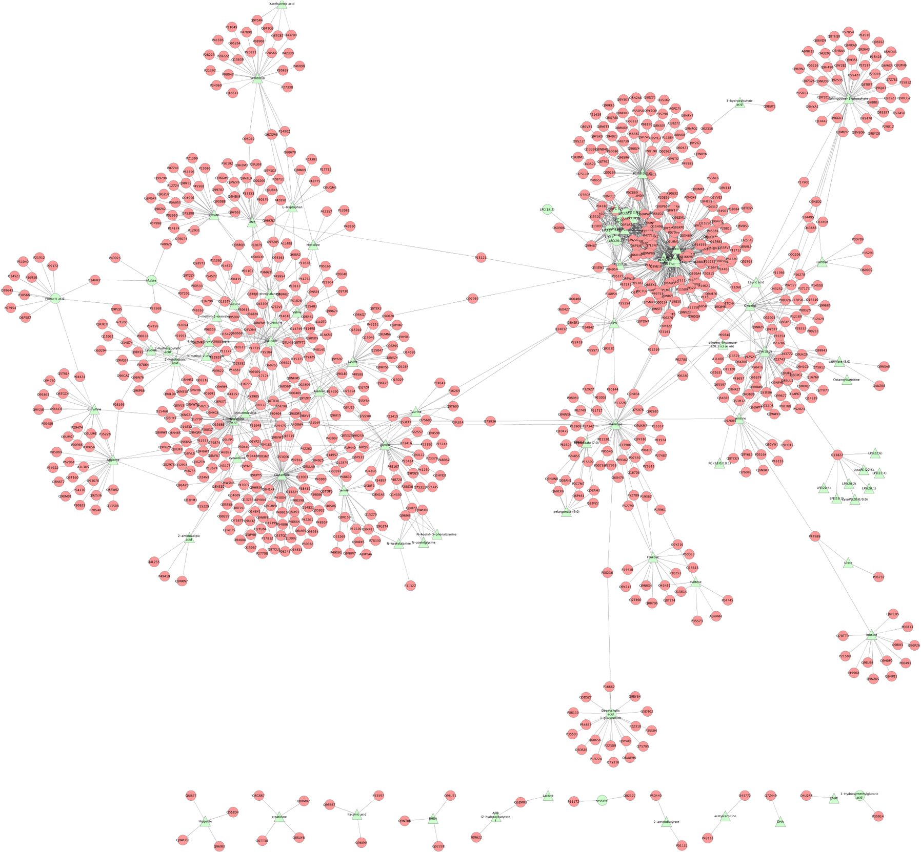
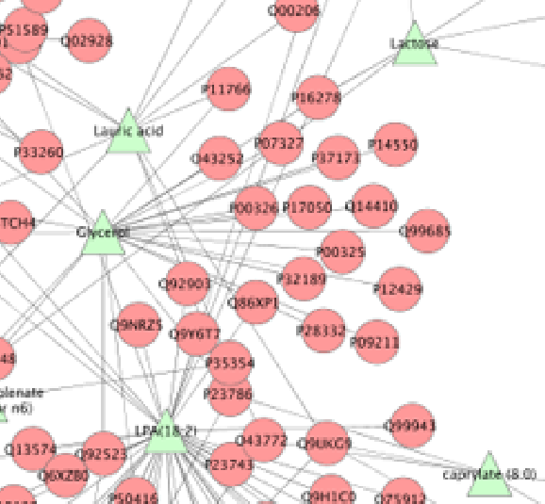
Visualization of Metabolite-Protein Network Associated With Diabetes
The metabolite-protein network was generated using Cytoscape.
Shows the highly connected metabolic pathways of various metabolites.
Diabetes Associated Metabolites
Proteins associated with metabolites
(based on the HMDB database)

Slide 12
4. Mapping Diabetes Risk Proteins to Proteins With Drug Projects
Literature Search → Genomics and Proteomics Studies → Diabetes Related Genes or Proteins
Diabetes Related Genes or Proteins + Diabetes Related Proteins from Step 2 → Set of Diabetic Risk Proteins
Uniprot IDs were retrieved to map the corresponding proteins.

Slide 13
840 metabolic proteins associated with diabetic metabolites + 115 genes + 56 proteins → 992 unique diabetic risk proteins.

Slide 14
4. Mapping Diabetes Risk Proteins to Proteins With Drug Projects
Therapeutic Target Database (TTD)
Contains information on 236 targets of 20,667 drugs at the stages of approved, clinical trial and experimental.
Used to find the diabetes risk proteins that had drug projects available.

Slide 15
Using the TTD database, it was found that 108 of the 992 diabetic risk proteins had information on at least one existing drug project.

Slide 16
4. Mapping Diabetes Risk Proteins to Proteins With Drug Projects
Diabetic risk proteins that had existing drug projects were selected and further filtered.
Information on the drug target, current disease indication, drug name, drug development stage, and drug mode of action was collected.
Only the targets/drugs at the approved stage or in clinical trials were selected and studied.

Slide 17
Using the TTD database, it was found that 108 of the 992 diabetic risk proteins had information on at least one existing drug project.
Drug projects at the research or preclinical stage were filtered out (since they had no toxicity information in humans) to focus on the most promising drug candidates.
35 “druggable” proteins were selected

Slide 18
5 of the 35 “druggable” protein targets were known anti-diabetic drug targets from 27 drug projects (S5 Table).
Indicates that the current repositioning strategy works and has the potential to reveal new indications/protein targets.
30 of the 35 proteins targets were unknown anti-diabetic drug targets from 167 drug projects (S6 Table).
The new indications can potentially be repurposed to treat diabetes.

Slide 19
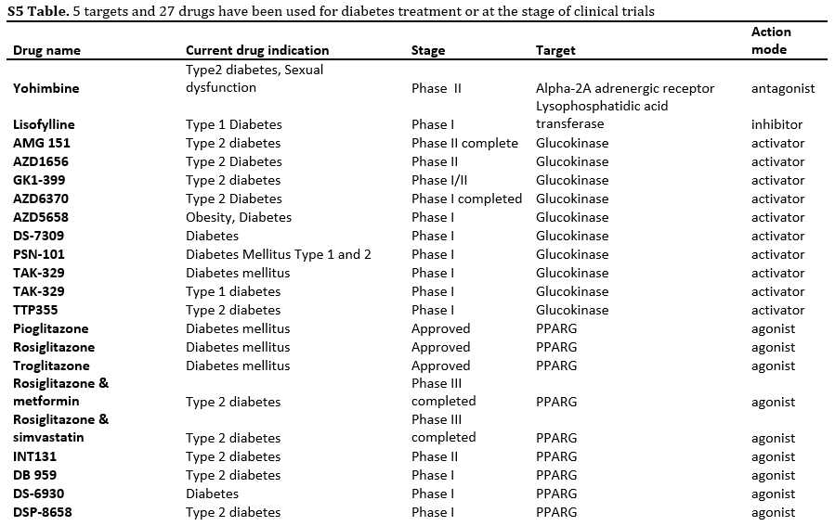

Slide 20
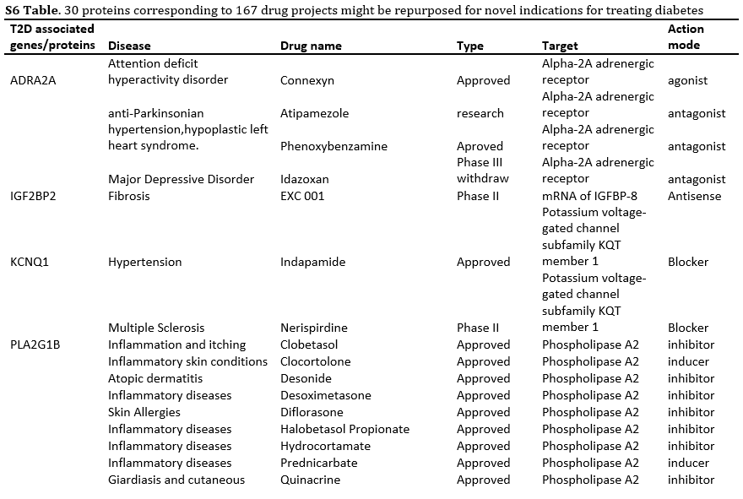
(Full Table Available Online)

Slide 21
5. Application of Pathogenesis Information from Anti-Diabetic Drug Repositioning
‘Omics’ results only suggest associations between proteins and risk of diabetes.
Don’t indicate the cause-effect mechanism.
Need to understand the pathogenesis (manner of development) of a specific target protein to predict whether the associated drug might improve or worsen the disease phenotype.

Slide 22
5. Application of Pathogenesis Information from Anti-Diabetic Drug Repositioning
The Online Mendelian Inheritance in Man (OMIM) database (http://www.omim.org) and a PubMed literature search were used to find information on the pathogenesis (manner of development) of the reduced set of anti-diabetic target proteins.
Gain of function (GOF) and loss of function (LOF) roles were gathered.
Drugs that were shown to aggravate diabetic symptoms based on GOF and LOF studies in human/animal models were excluded from further analysis.
Ex. If drug D activates target T, and GOF of target T was known to increase diabetes risk, then drug D is more likely to cause diabetes instead of treating it.

Slide 23
OMIM and a literature search were used to gather GOF and LOF knowledge for the 30 protein targets that had unknown anti-diabetic effects.
Drug action mode information was gathered from TTD.
Exclusions: 3 of the 35 targets had no direct pathogenesis link to diabetes, 6 targets were associated with diabetic complications, 14 targets could possibly aggravate diabetic symptoms according to TTD.
12 unique protein targets and 58 drugs had pathogenesis information that supported their therapeutic potential for diabetes treatment. One target was already repurposed for diabetes treatment, and one target had a drug project under phase II clinical trial for diabetes treatment.

Slide 24
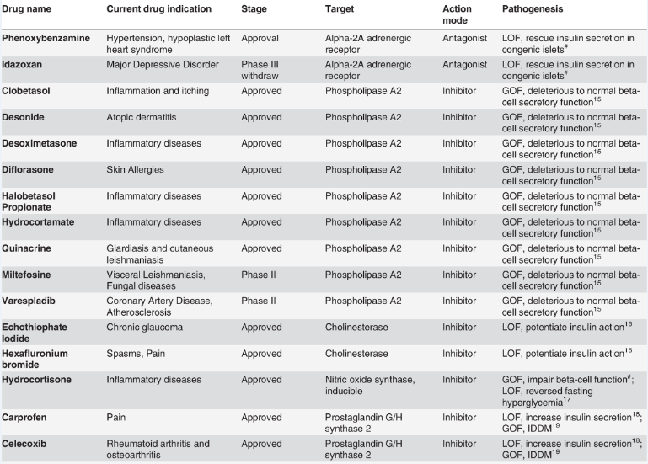
Information of the 12 targets and 58 drugs repurposed for treating diabetes based on “omics” data mining.
(Full Table Available Online)

Slide 25
6. Connectivity Map (CMaP) Analysis
CMap – a collection of genome-wide transcriptional expression data from cultured human cells treated with compounds, and simple pattern-matching algorithms.
Candidate drugs gathered from the previously outlined analysis were input into CMap.
Evaluated whether they were positively associated with known anti-diabetic drugs or acted in an aggravating manner with known diabetes risk compounds from existing studies.

Slide 26
Connectivity Map (CMaP) Analysis
The 58 drugs with novel indications for treating diabetes were analyzed by CMap.
9 of 58 drugs had CMap Information relating to anti-diabetic drugs or diabetic risk compounds.
11 of 58 drugs had CMap data, but didn’t have links to anti-diabetic drugs or diabetic risk compounds.
38 of 58 drugs had no CMap data.

Slide 27
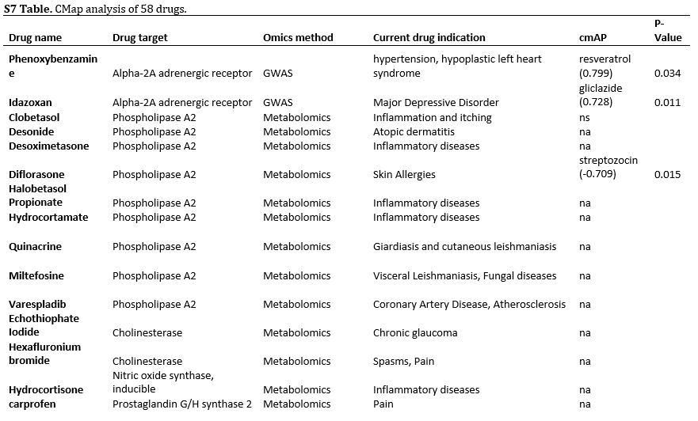
(Full Table Available Online)

Slide 28
CMap analysis indicated 9 repurposed drugs
for potential diabetes treatment!

Slide 29
Notes
The Therapeutic Target Database (TTD) was used to map diabetes risk proteins to drug projects in this study, but other databases such as DrugBank (http://www.drugbank.ca) may also be useful in finding additional information for disease related proteins and to validate initial findings.

