Slide 1
MAV’s Ice Cream Emporium
Presenter: Duy Nguyen

Slide 2

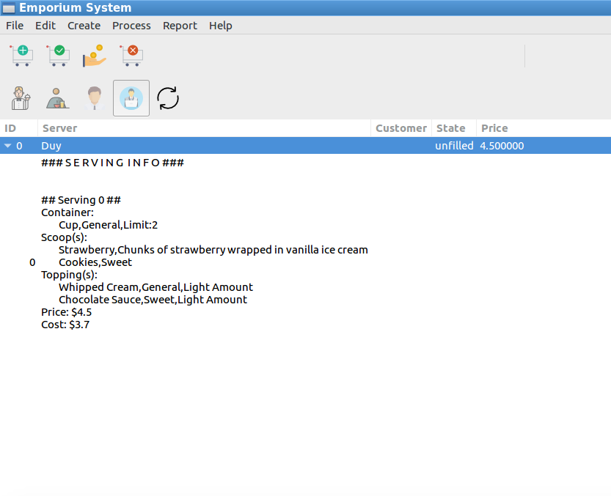
Completed Requirements
Create new items
Create a new order with servings in seconds
Create new persons
Change state of order easily with simple clicks
Show serving info

Slide 3



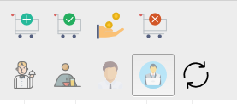

User-friendly App
Create new order, change between state: cancel, fill, pay by only a click
Switch between users constantly .
Provide image while choosing servings

Slide 4
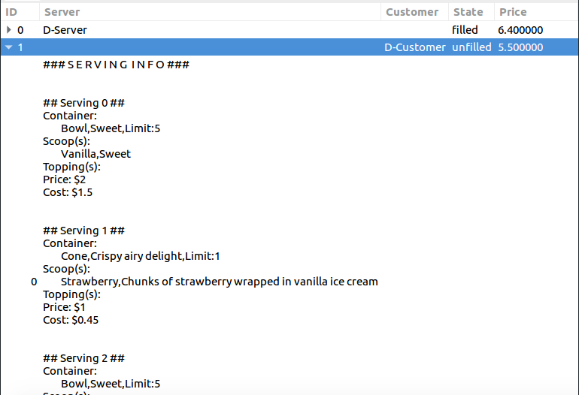
Organized
Show orders and servings as table view
Benefits:
Owners: Can Have a overlook of how their emporiums look like
Managers: Manage servers easily, know who is working hard
Customers: Confirm servings again by table, keep track of their order histories
Servers: Easy to know which order unfilled and fill it immediately with serving details

Slide 5
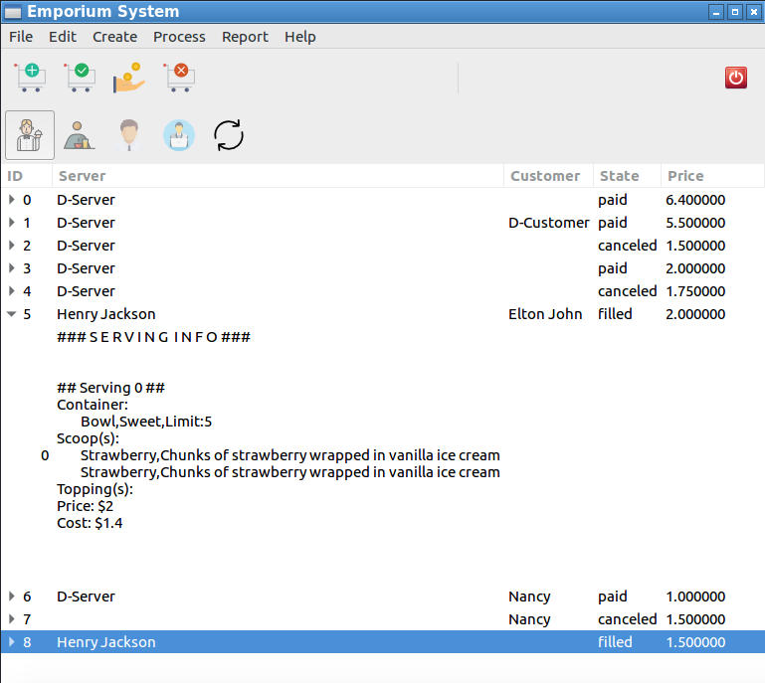
Manageable
Customer Elton complain about the product?
Not A Problem, can see who filled the order and what is supposed to be in the order.(5)
At the end of the date, lost some money?
Look up a list of order to see which one is unpaid.(5,8)
Save permernanly

Slide 6
Improvable
Can see which serving is order the most
Server can prepare items early

Slide 7
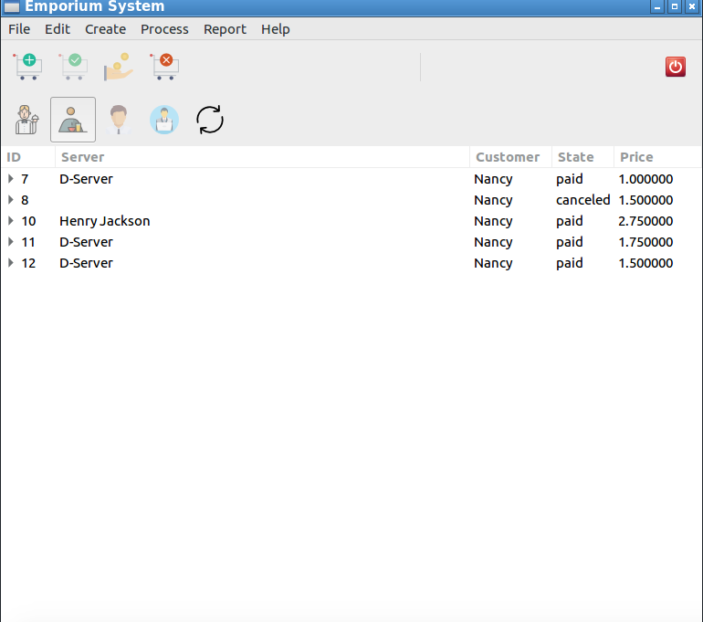
Gain Profit
Yes, Of course!

Slide 8
Future Features
Show image when clicking on a serving , make sure new server know what to put in
Encrypt a password when changing users
Export profit and loss statement to an excel file for accounting purpose.

