Slide 1
Vision
Optimization under uncertainty toolkit:
test bench for development of new algorithms;
reference implementation of the algorithms;
library of limited-rationality-based optimization algorithms for use in real-world applications.

Slide 2
Roles
AI Scientist: develops core optimization algorithms for the toolkit;
Researcher: a colleague of the AI scientist, uses the toolkit as a part of an experiment;
Application Engineer: employs the algorithms as black boxes, components in an industrial environment.

Slide 3
Author's Viewpoint

Slide 4
User's Viewpoint

Slide 5
Tool Approach
Set of self-contained tools:
easy to implement;
supports exploratory development of search solutions;
provides flexible tools for experiments and data analysis;
allows easy packaging of the algorithms for industrial use.

Slide 6
Solver — Environment

Slide 7
Solver — Algorithm

Slide 8
Pairwise Comparison

Slide 9
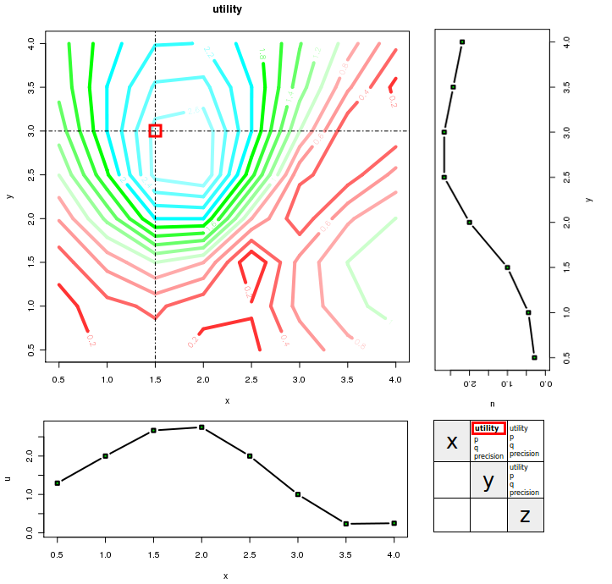
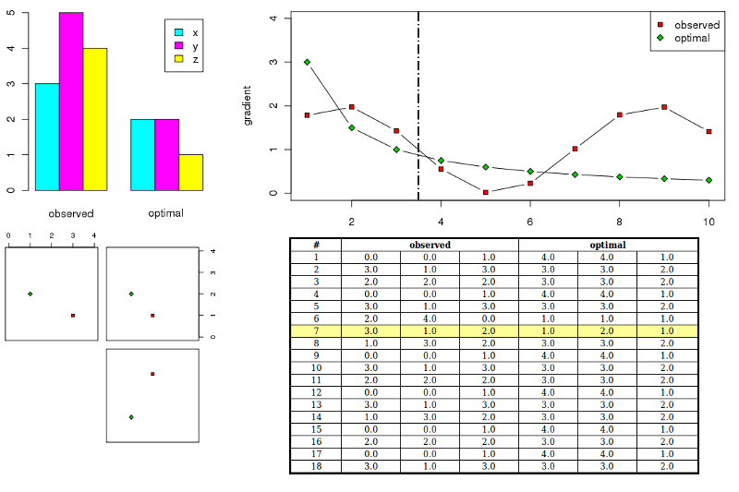
GUI Tools
Monitoring
Results Analysis

Slide 10
Problem — SVM RBF
problem svm {
space (C, gamma) {
C = [-8, -6 .. 8] / 0.0;
gamma = [ -12, -9 .. 12 ] / 0.0;
}
observe acc {
1=> acc = 0.5 / 0.10;
}
find max util[C,gamma] = acc;
model grid(C, gamma) {
acc = (0.0, 100.0) / (2.0, 2.0) ;
}
}
Find best C,  for SVM RBF
Maximize classification accuracy
Use uniform 2-dimensional grid dependency model

Slide 11
Problem — Wafer Setup
problem wafer {
space (site, focus, color, angle) {
site = [1, 2 .. 5] / 60;
focus = [1, 2 .. 31 ] / 60;
color = [1, 2 .. 5 ] / 60;
angle = [0, 180] / 300;
}
observe (x, y, px, py) {
1 => (x, y, px, py) = (1.0, 1.0, 100.0, 100.0) / 30;
}
find max merit[focus, color] =
1/2-1/12*(tanh((xprec-a_prec)/c_prec)‏
+tanh((yprec-a_prec)/c_prec)‏
+tanh((xtis-a_tis)/c_tis)‏
+tanh((ytis-a_tis)/c_tis)‏
+tanh((xtsv-a_tsv)/c_tsv)‏
+tanh((ytsv-a_tsv)/c_tsv)) {
xprec = mean(px);
yprec = mean(py);
xtis = mean(x[angle=1]-x[angle=0]);
ytis = mean(y[angle=1]-y[angle=0]);
xtsv = sd(x[angle=1]-x[angle=0]);
ytsv = sd(y[angle=1]-y[angle=0]);
a_prec = 1.0;
c_prec = 1.0;
a_tis = 1.0;
c_tis = 1.0;
a_tsv = 1.0;
c_tsv = 1.0;
}
model bif “wafer.bif”;
}
Find best focus and color for wafer measurement
Observe four features (x, y, px, py) in 4-dimensional space (site, focus, color, angle)‏
Maximize utility function of 6 arguments
Use dependency model in Bayes Interchange Format, stored in external file

Slide 12
Monitoring

Slide 13
Results Analysis

Slide 14
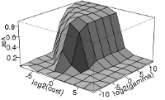
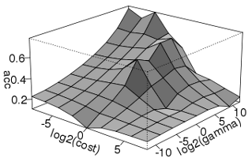
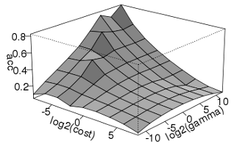
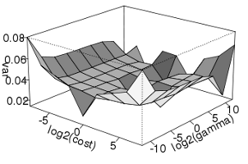
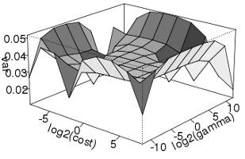
SVM parameter search
Myopic (13)‏
Blinkered (19)‏
Accuracy
Variance

Slide 15
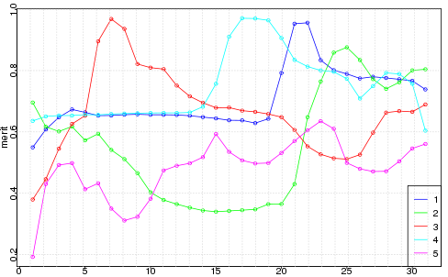
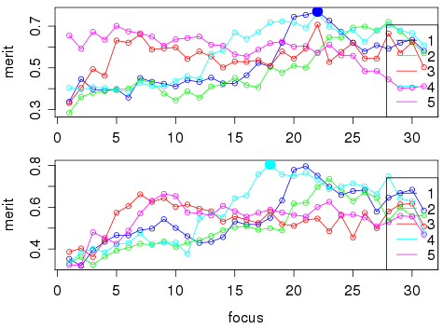
KLA metrology
Actual data
10% of measurements

